Slide 1
Nikopol Medical College
English lesson 2
Theme: Things for nursing. Medicine as a science
Teacher-Syrotina Y.G.
Group – 1 NB-18

Slide 2
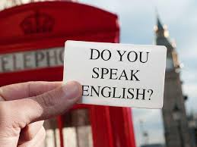
Believe in yourself.
And always remember, we believe in you, too.

Slide 3
Today we have a joint lesson for two subgroups of one group. This lesson allows everybody of you to learn from each other and improve your communication skills in English. The topic is closely related to your future profession and discipline Fundamentals of Nursing.

Slide 4

1.Checking Homework
Translate into Ukrainian

Slide 5
headache
e.g. I have a bad headache.
toothache
e.g. His toothache was so bad.
stomachache
e.g. He is suffering from a stomachache.
earache
e.g. The child cries because of his earache.
Heartache
e.g. He has a heartache.
sore throat
e.g. The baby has a sore throat and a high temperature.
bleeding
e.g. You must stop bleeding as soon as possible.

Slide 6
Cough
e.g. He asked me to cough.
cold in the head
e.g. Influenza is not a cold in the head.
fracture
e.g. There are open and closed fractures.
sunstroke
e.g. He can get a sunstroke. It's very hot today.
fever
e.g. She had a bad fever.
temperature
e.g. Her son a high temperature in the evening.

Slide 7
Translate into English

Slide 8
сильний головний біль (біль у серці, у вусі, у животі, зубний)
прийняти таблетку від...
- полоскати рот
- дотримуватись дієти
- покласти теплий компрес на...
- прослухати серце
- слабке серце
- полоскати горло
- сухий (сильний) кашель
- сильний нежить
- нежить
- накладати шини
- накласти гіпс
- охолодити тіло
- залишатися в ліжку
- застудитися

Slide 9
Act out the dialogues.
Theme: Admitting to the hospital. Medical history
Memorize the plan of questioning a patient.
Introduction (вступ)
Passport Data (паспортні дані)
Complaints (скарги)
Present History (анамнез захворювання)
Past History (анамнез життя)
Physical Examination (фізичні обстеження)

Slide 10
2 Theme: Things for nursing. Medicine as a science

Slide 11


Slide 12
https://dictionary.cambridge. org/
We suggest to study new lexical material and to guess about the meaning of new terms.
Pay attention to the correct pronunciation
https://www.merriam-webster.com/dictionary/

Slide 13
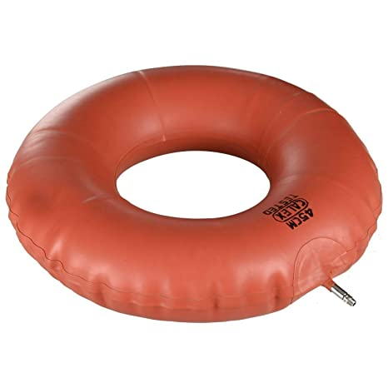
air ring
[eə(r) rɪŋ] an inflatable rubber ring used as a cushion to relieve pressure on body points

Slide 14
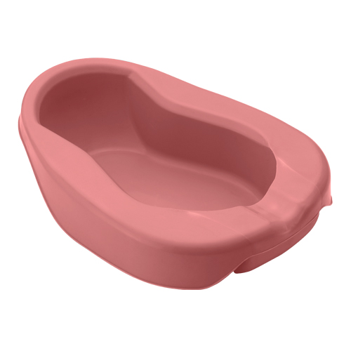
bedpan
/ˈbed.pæn/ a flat dish used as a toilet by people who are too ill to get out of bed

Slide 15
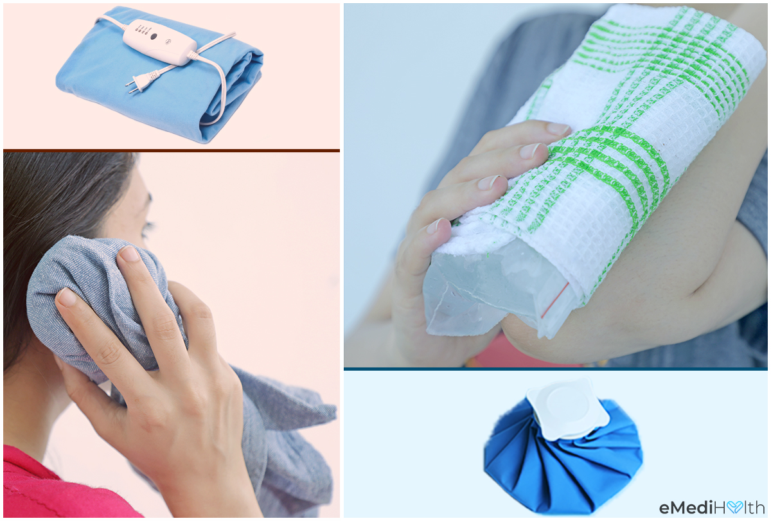
compress
[kəmˈpres]
Cloth or another material applied under pressure to an area of the skin and held in place for a period of time. Most compresses are used to relieve inflammation.

Slide 16
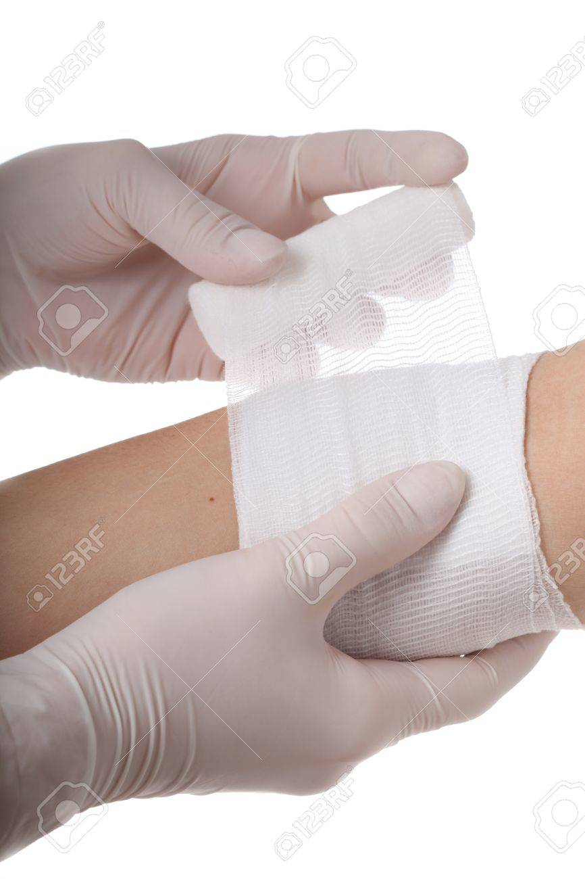
dressing
/ˈdres.ɪŋ/ a covering that is put on a cut or an area of damaged skin to protect it

Slide 17
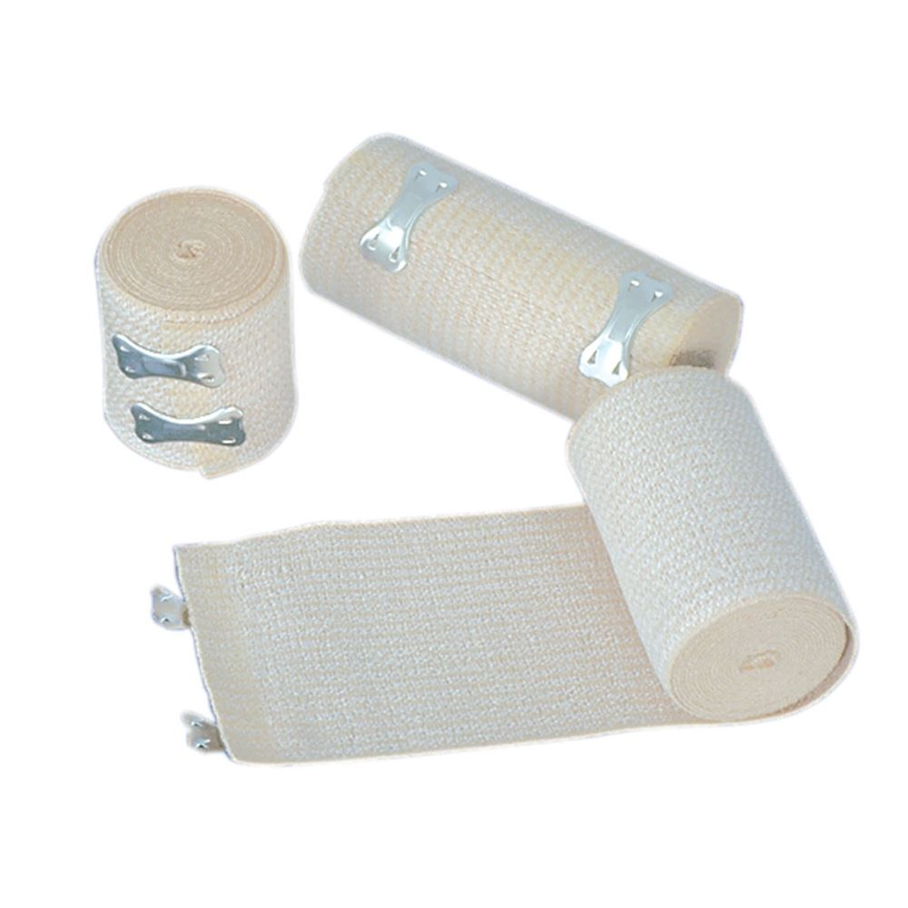
bandage
/ˈbæn.dɪdʒ/
(US also gauze) a long, narrow piece of cloth that is tied around an injury or a part of someone's body that has been hurt

Slide 18
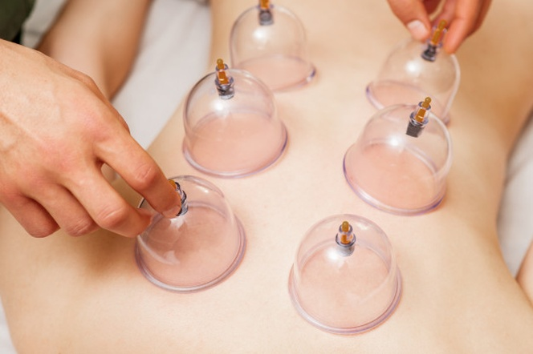
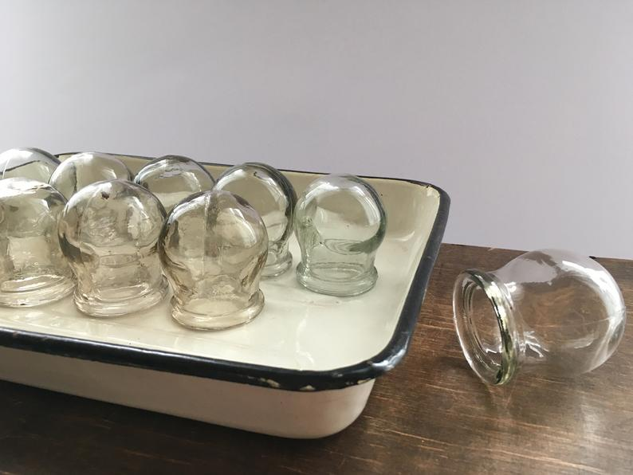
cups
[kʌps]

Slide 19
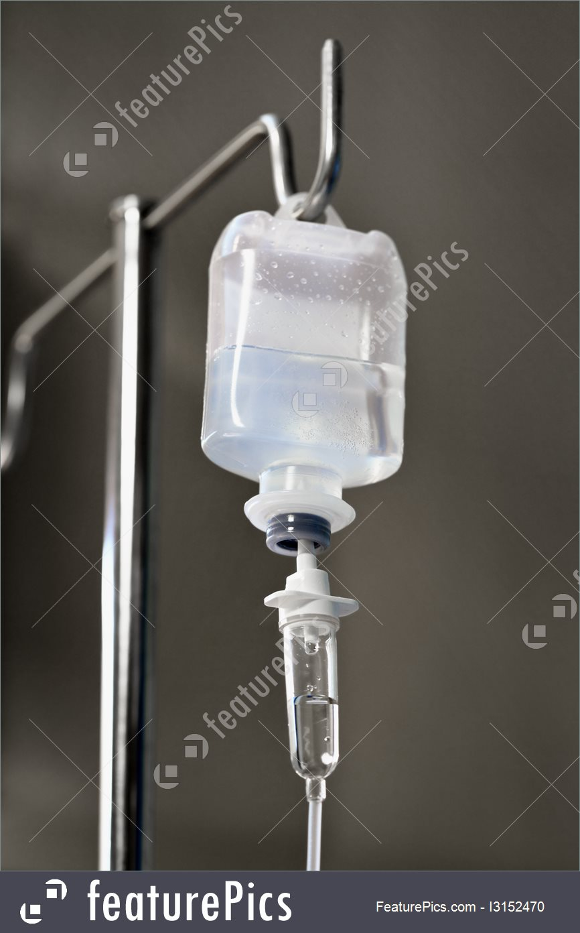
dropping bottle
[ˈdrɒpɪŋ ˈbɒtl]
1: a small pitcher-shaped bottle with a curved or tapered neck used to supply liquids in small amounts (as to test tubes)
2a: a small bottle with a grooved glass stopper and neck permitting the contents to be poured out in drops b: a bottle furnished with a dropper or a glass rod applicator

Slide 20
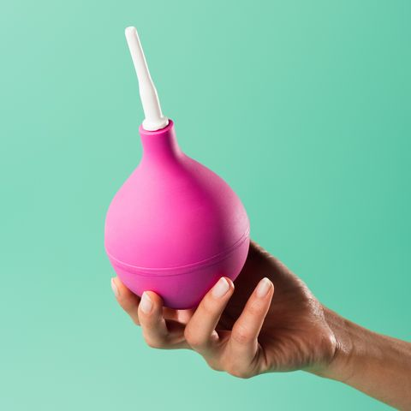
enema
/ˈen.ə.mə/ a treatment for cleaning the bowels by filling them with a liquid through the anus
.

Slide 21
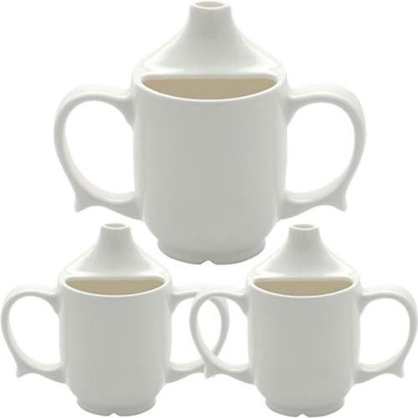
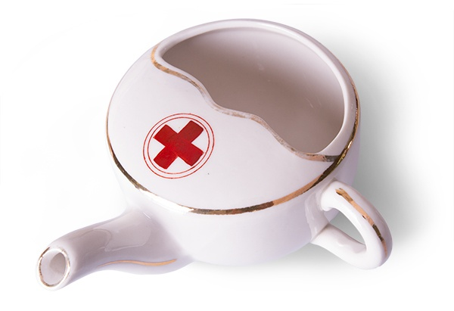
Feeding cup
/ˈfid·ɪŋ kʌp/
Drinking aids that can help disabled individuals to hold straws, drink beverages, or provide liquids assist in making daily independence more possible.

Slide 22
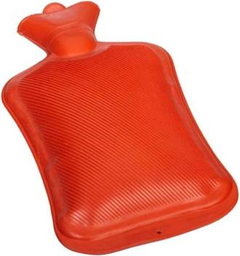
hot-water bottle
/ˌhɒtˈwɔː.tə ˌbɒt.l/ a rubber container that you fill with very hot water and use to warm a bed or a part of your body

Slide 23
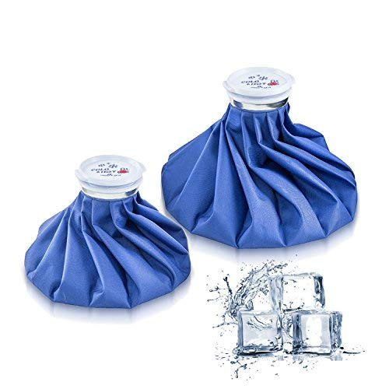
ice bag
[aɪs bæɡ] a waterproof bag to hold ice for local application of cold to the body

Slide 24
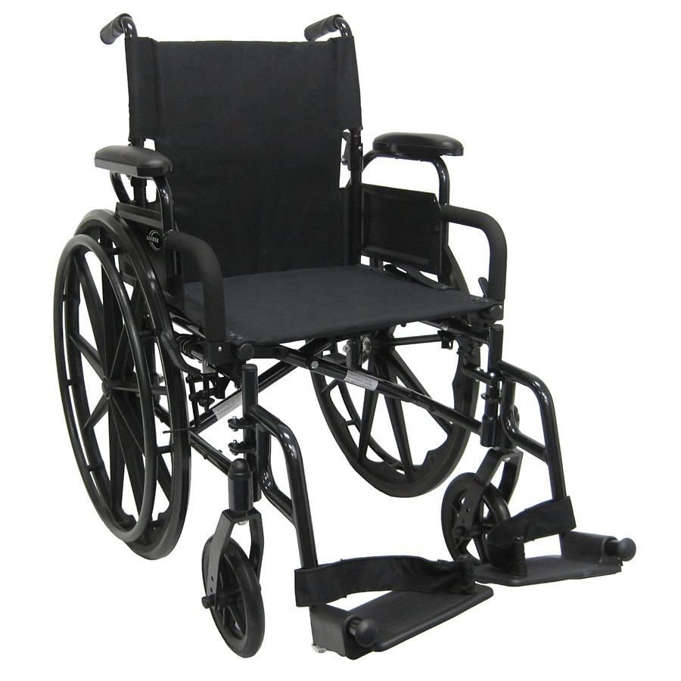
wheelchair
/ˈwiːl.tʃeər/ a chair on wheels that people who are unable to walk use for moving around

Slide 25
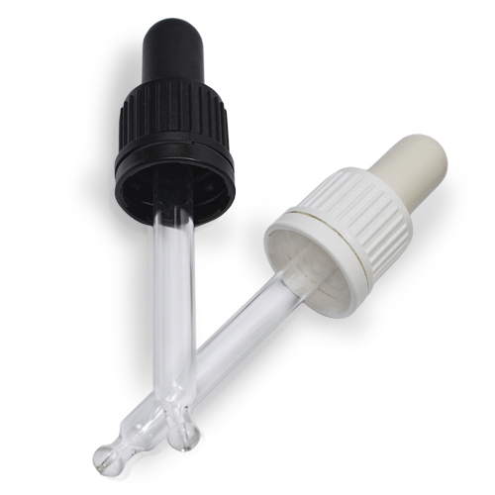
pipette
/pɪˈpet/ a thin glass tube used especially in biology and chemistry for measuring or moving a small amount of liquid

Slide 26
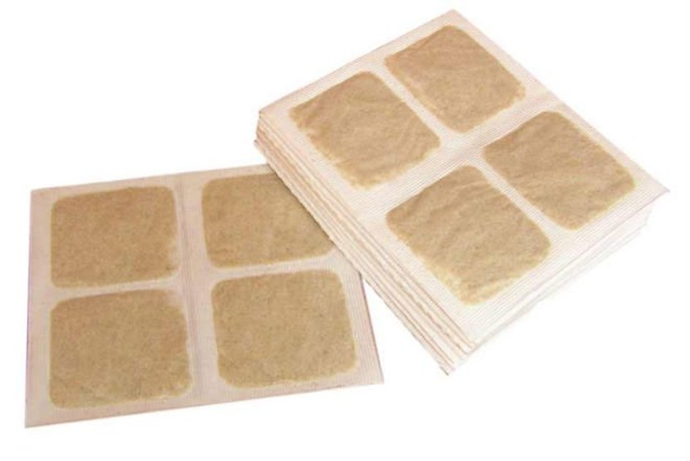
mustard plaster
[ˈmʌs.təd ˈplɑː.stər] a counterirritant and rubefacient plaster containing powdered mustard

Slide 27
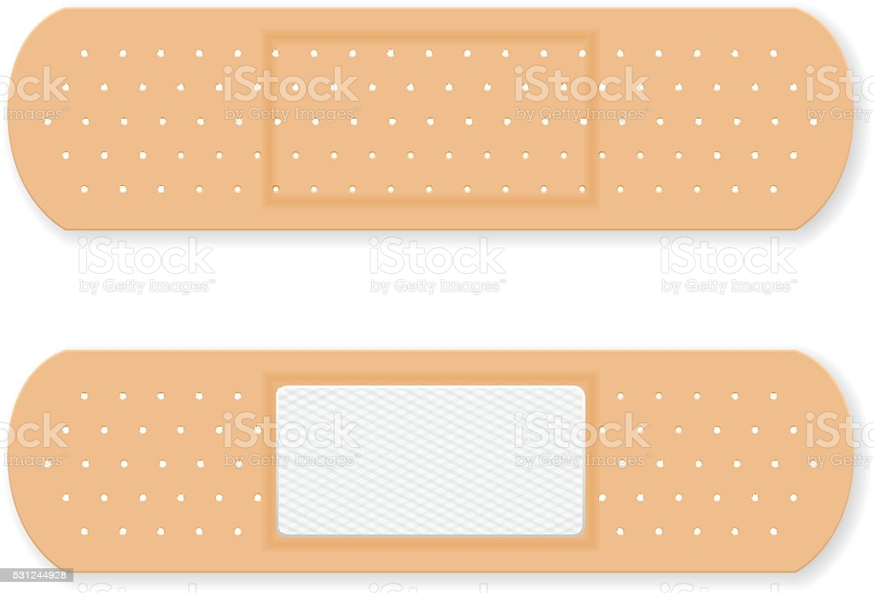
sticking plaster
/ˈstɪk.ɪŋ ˌplɑː.stər/ a piece of material that you can put over a small cut in the skin in order to protect it and keep it clean

Slide 28

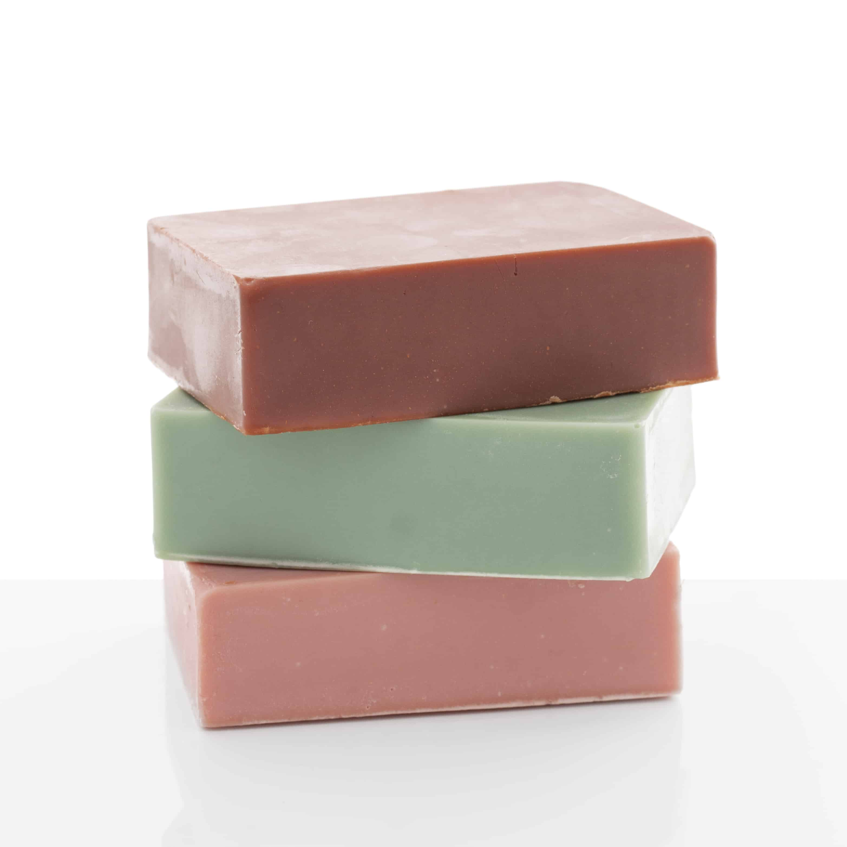
soap
/səʊp/ a substance used for washing the body or other things

Slide 29
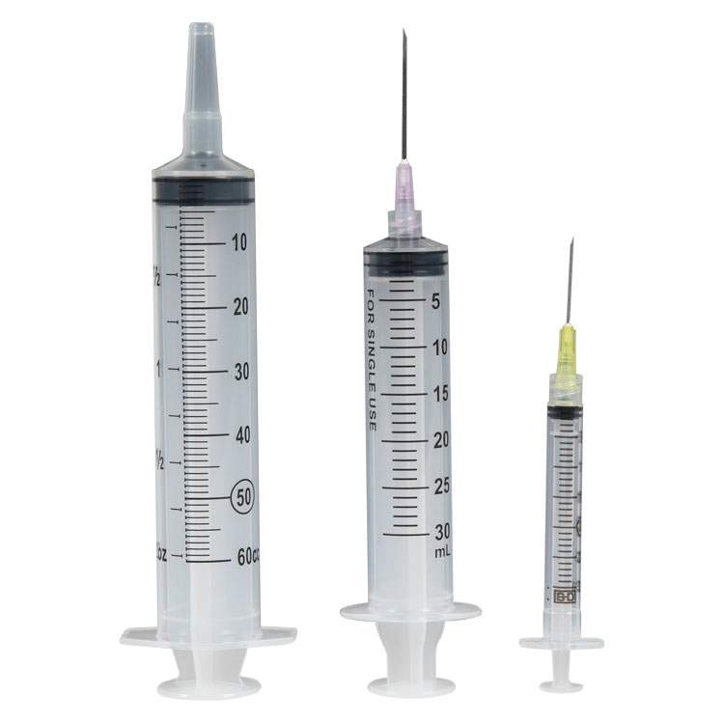
syringe
/sɪˈrɪndʒ/ a hollow, cylinder-shaped piece of equipment used for sucking liquid out of something or pushing liquid into something, especially one with a needle that can be put under the skin and used to inject drugs, remove small amounts of blood, etc.

Slide 30
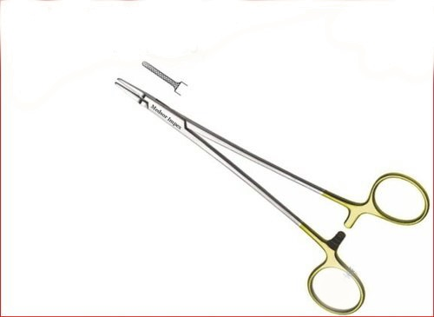
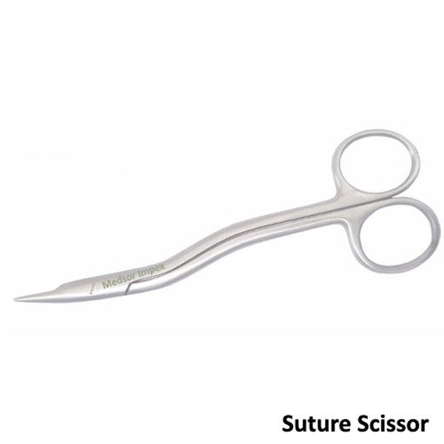
scissors
/ˈsɪz.əz/ / a device used for cutting materials such as paper, cloth, and hair, consisting of two sharp blades that are joined in the middle, and two handles with holes to put your fingers through

Slide 31
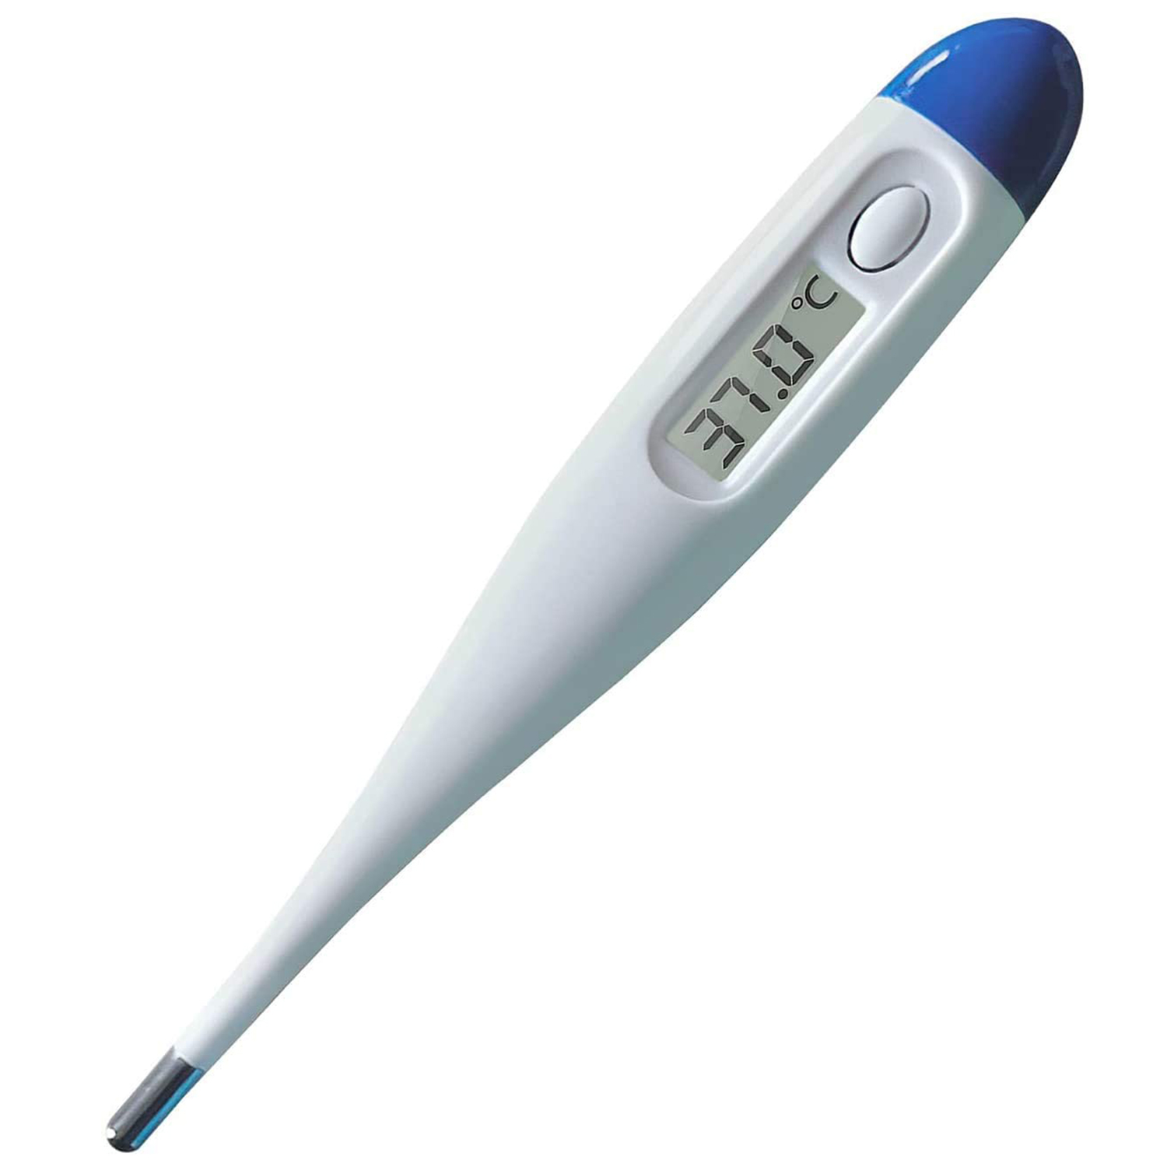
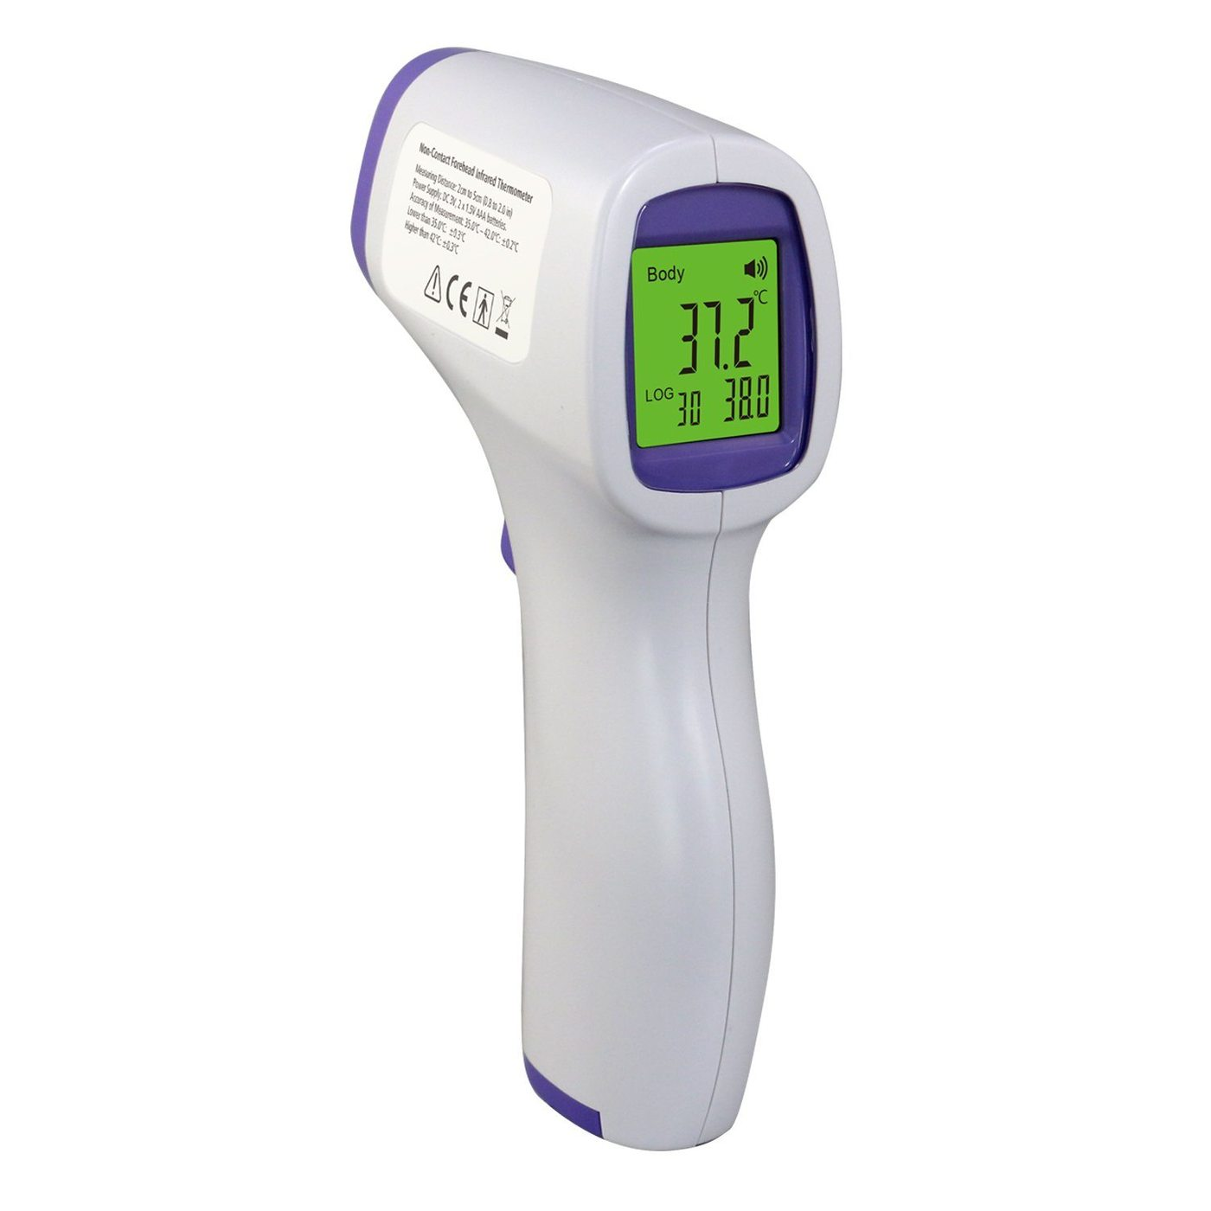
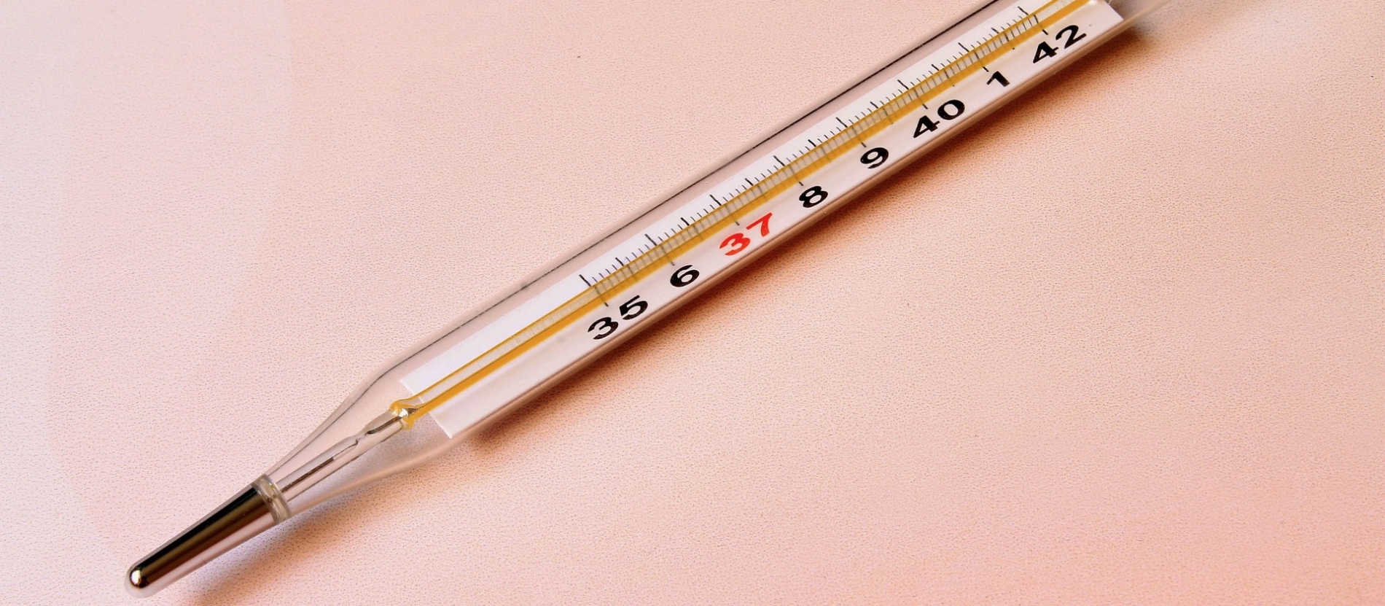
thermometer
/θəˈmɒm.ɪ.tər/ a device used for measuring temperature, especially of the air or in a person's body

Slide 32
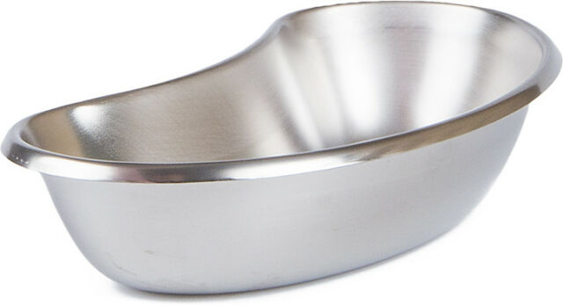
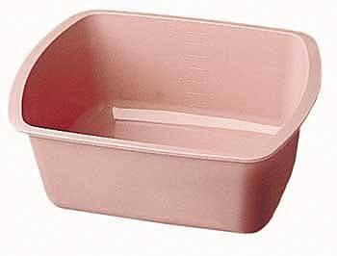
Basin
/ˈbeɪ.sən/
- an open, round container shaped like a bowl with sloping sides, used for holding food or liquid

Slide 33
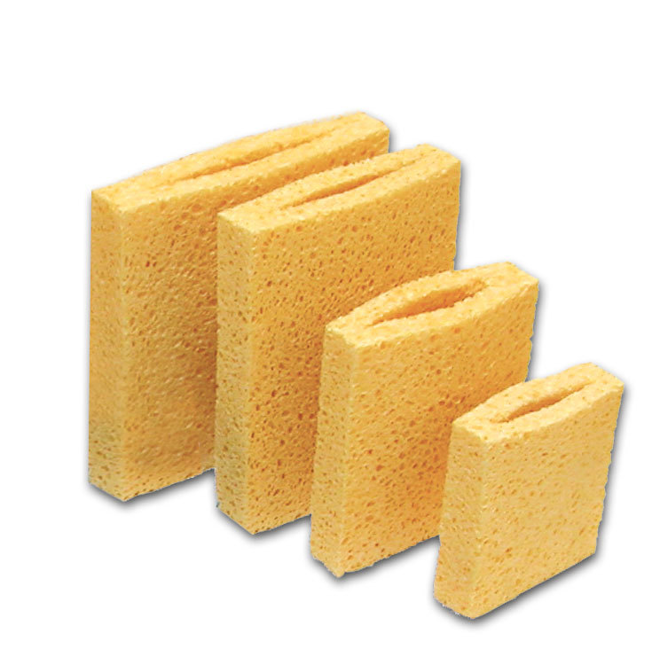
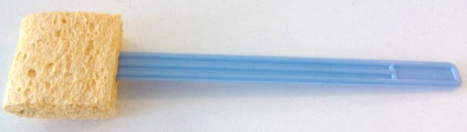
sponge
/spʌndʒ/ - a soft substance that is full of small holes and can absorb a lot of liquid, and is used for washing and cleaning

Slide 34
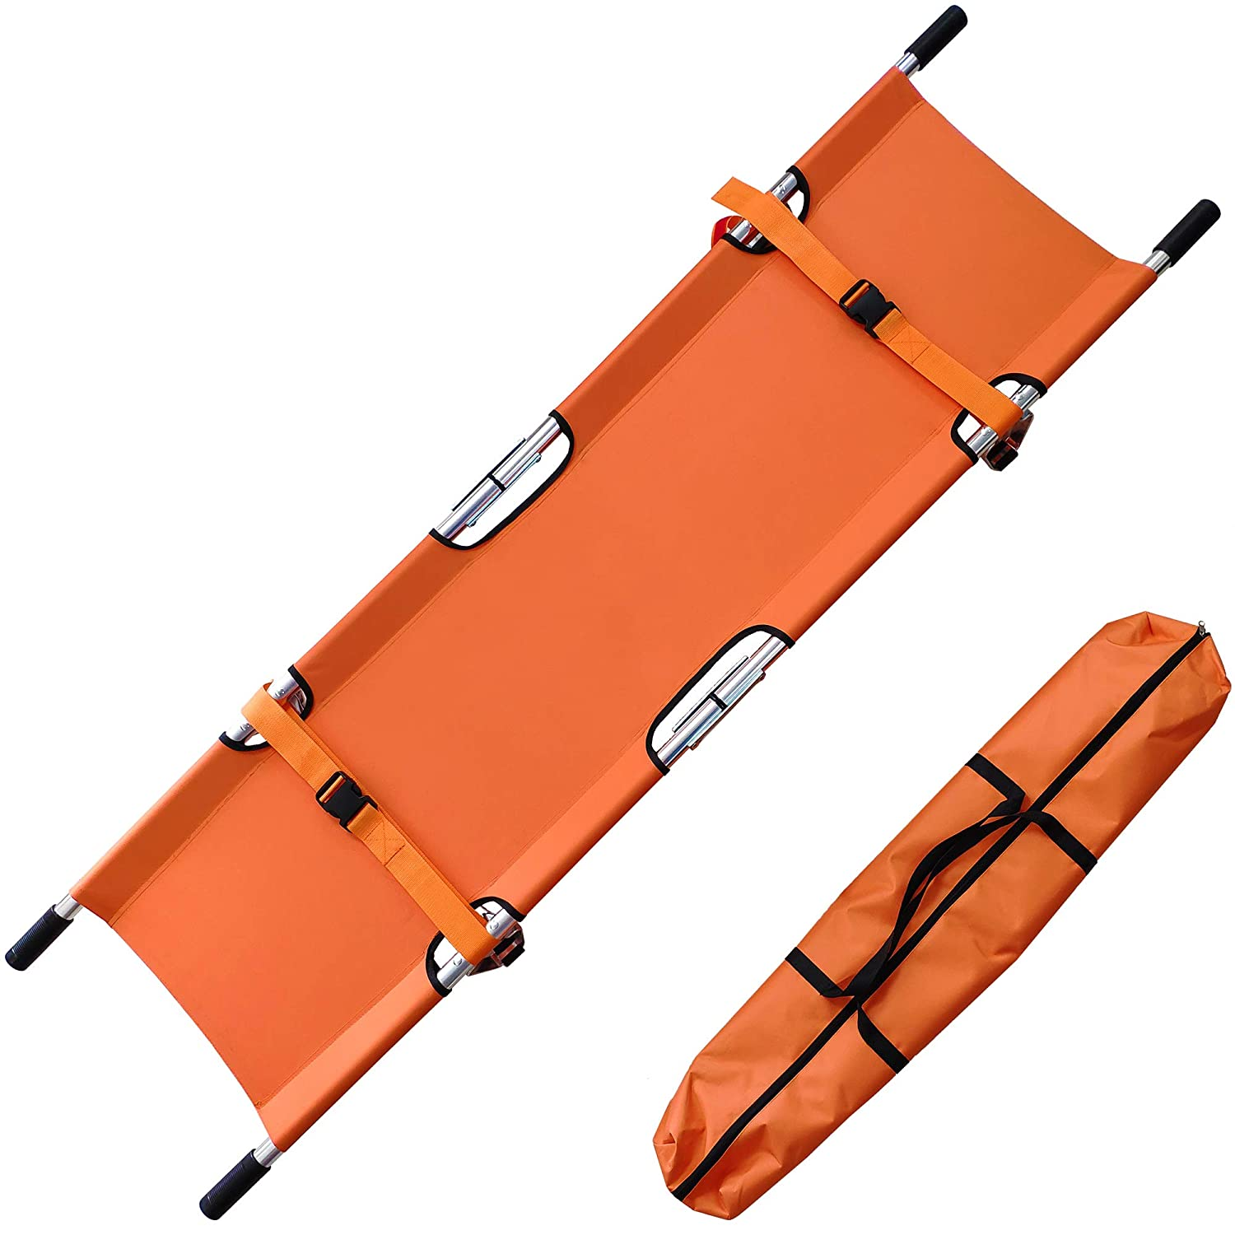
Stretcher
/ˈstretʃər/ a light frame made from two long poles with a cover of soft material stretched between them, used for carrying people who are ill, injured, or dead

Slide 35
Learn the following word combinations
bed patient - лежачий хворий
to give smth to smb - дати щось комусь
to take smth away from smb - забрати щось у когось
to apply a cold (warm, hot) compress on - покласти холодний (теплий, гарячий) компрес на
to put drops (in) - крапати краплі
to give a warm (cleansing, medicinal) enema - зробити теплу (очисну, лікувальну) клізму
to fill an ice bag with ice - наповнити міхур льодом
to change ice in the ice bag - замінити лід у міхурі

Slide 36
to take a patient in a wheelchair to the ward - відвезти хворого у кріслі-каталці в палату
a bar of soap - брусок мила
to put (read, shake) a thermometer - поставити (подивитись показники, збити) термометр
to take a thermometer out - забрати термометр
to bring a basin for washing - принести миску для вмивання
to wash with a sponge - обмити губкою
to be on a stretcher - бути на ношах
to carry a patient on a stretcher - нести хворого на ношах

Slide 37
Choose the correct sentence
1. The nurse gives injections.
The nurse makes injections.
The nurse does injections.
2. I apply cups and mustard plasters on the back.
I give cups and mustard plasters on the back.
I take cups and mustard plasters on the back.
3.They carry a patient on a wheeled bed.
They bring a patient on a wheeled bed.
They take a patient on a wheeled bed.
4. She puts a thermometer and reads it.
She takes a thermometer out and reads it.
She shakes a thermometer and reads it.

Slide 38
Make up correct sentences as much as possible in 5 minutes using the table
You | apply | the patient 10 drops .
I | applies | the patient on a stretcher.
The nurse | give | cups and mustard plasters.
The doctor | gives | him in a wheelchair.
The patient | take | an injection with a syringe.
 | takes | an ice bag with ice.
 | drops | her a medicinal enema.
 | fills | a bandage with scissors.
 | cuts | the thermometer.
 | shakes | his face and hands.
 | carry | water in a hot-water bag.
 | change | a thermometer out.
 | washes | a cold compress on the bruise.
 | make | on a stretcher.
 | is | a single syringe.

Slide 39
Read and act out the dialogues (work in pairs)
N.: Good morning!
P.: Good morning!
N.: It's time to take your temperature. Put the thermometer under your armpit.
P.: Left or right?
N.: It doesn't matter. (In 3 minutes.) Give me your thermometer, please. I want to read it.
P.: What's the temperature today?
N.: It's normal. Thirty-six point six. That' all right.
P.: Thank you.
N.: Please, let me take the hot-water bag.
P.: Don't change water in it, please.
N.: But the doctor said that water had to be cold all the time.
P.: But my liver hurts me very much.
N.: I'll put an ice bag on your right side, the ice will relieve the pain.
P.: Thank you.

Slide 40
Complete the text. Translate the endings of the sentences into English ( individual work)
1.The work of a nurse в лікарні дуже важка. 2.The nurse must виконувати всі вказівки лікаря. 3.She must доглядати хворих удень і вночі. 4. In the morning the nurse міряє температуру пацієнтам, дає необхідні ліки, робить ін'єкції. 5. She takes special care of лежачих хворих. 6. She helps to wash їхнє обличчя і руки губкою. 7.She changes their простирадла і shakes the pillows. 8.When doctors come, the nurse розповідає їм про стан пацієнтів. 9.She helps the doctors to оглядати пацієнтів і записує нові призначення лікаря. 10.During all day the nurse is busy, she змінює пов'язки, робить ін'єкції, закапує очі (вуха) пацієнтів піпеткою, робить бинтові пов'язки, ставить банки, компреси і гірчичники, робить клізми, ставить міхури з льодом і грілки, приносить і забирає судна у лежачих хворих, допомагає годувати лежачих хворих напувальником.
11.In the evening the nurse знову міряє температуру пацієнтів і записує її в їх температурні листи, виконує всі вказівки лікарів.
12.At work the nurse watches over her patients' health with great attention. 13.She is responsible for їх життя.

Slide 42
Look at the text and make a plan of it.

Slide 43
3. Communicative situations (work in small groups)
You are a ward nurse. What are your duties in the morning?
Name all the things for nursing. Explain what they are used for. Next slide is to repeat the terms.

Slide 45
Homework: to learn new words and word combinations to the theme: Things for nursing (textbook Sabluk A.H. p.147-148,Google class,link: https://classroom.google.com/c/NTM3ODIyOTg5Mzha/m/NTYxODA1MDMzODda/details)
To make a report about Alternative medicine (10-15 sentences)
Your marks are…

Slide 46

We wish you success in learning English and we hope that our joint lesson will help you master English communication skills.
thank you all for your cooperation.
The lesson is over.

