Slide 1
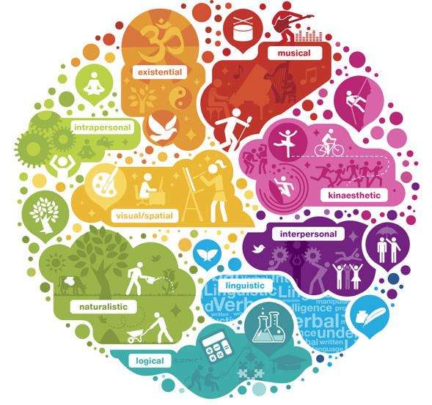
Types of intelligence in the English classroom
Державний навчальний заклад
«Бердичівське вище професійне училище»
Засідання методичної секції викладачів предметів гуманітарної підготовки Житомирської області на тему
«Професійна компетентність педагога як одна з умов його успішної діяльності та запорука підвищення якості освіти»
Доповідач:
викладач іноземної мови
Лесько І.В.
2021

Slide 2

Dr. Howard Gardner,
American psychologist (inspired by
Jean Piaget to study developmental psychology), developed a theory of Multiple Intelligences (1983) which can go some way towards explaining different learner styles.
Gardner describes how humans can be intellectually smart in a variety of different ways.

Slide 3
According to Gardner there are eight different types of intelligences:
Linguistic / Verbal
Logical / Mathematical
Visual / Spatial
Musical
Bodily / Kinaesthetic
Interpersonal
Intrapersonal
Naturalistic

Slide 4
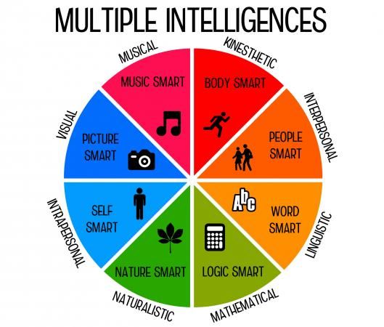

Slide 5
Learner Type:
Linguistic
Logical / mathematical
Visual / Spatial
Musical
Bodily / Kinaesthetic
Interpersonal
Intrapersonal
Naturalistic
Existential
Learns best by:
Saying, hearing and seeing words
Asking questions, categorising and working with patterns
Visualising, using the mind's eye
Using rhythm, with music on
Moving, touching and doing
Cooperating, working in groups and sharing
Working alone
Working outside and observing nature
Capacity to tackle deep questions about human existence

Slide 6
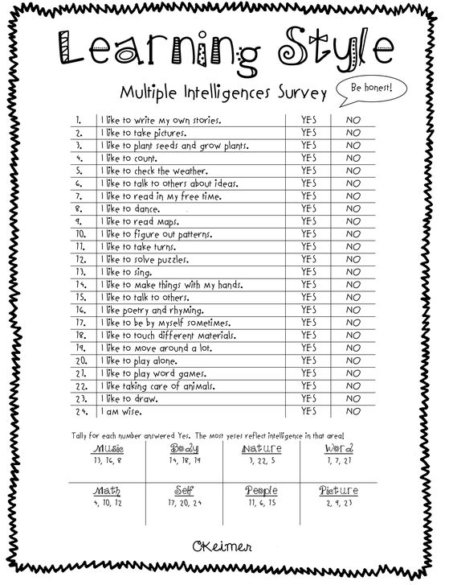

Slide 7
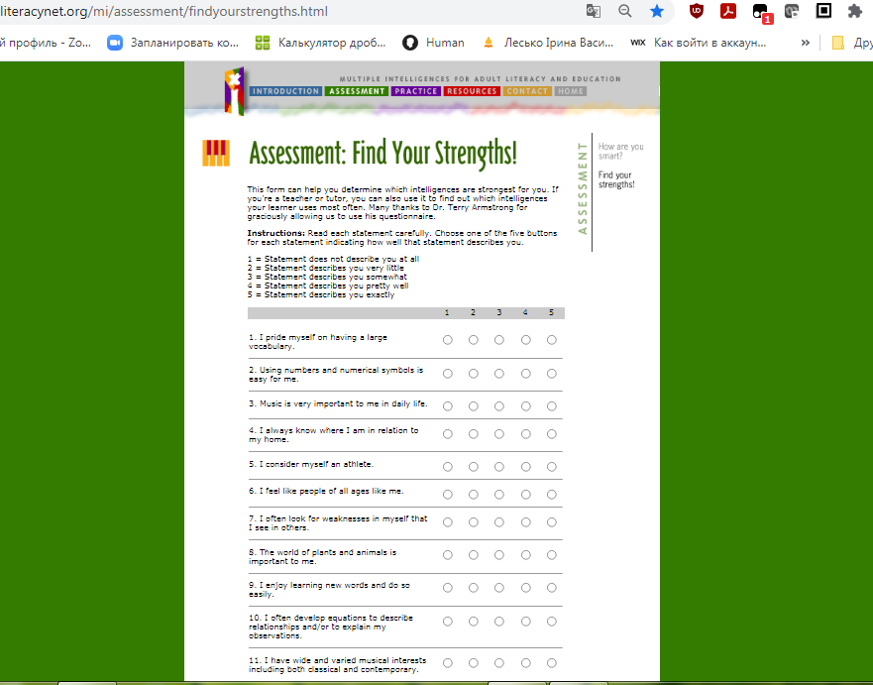
http://www.literacynet.org/mi/assessment/findyourstrengths.html

Slide 8
Linguistic / Verbal
Teacher-centered explanations
Memory games
Quizzes
Essays and written reports
Reading selections
Book based grammar and language function explanations
Crosswords and gap-fill exercises

Slide 9

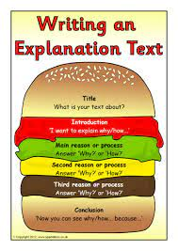
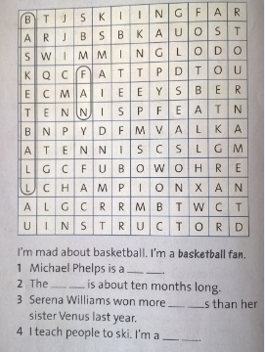
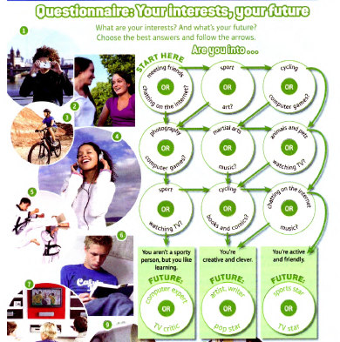

Slide 10
Logical / mathematical
Grammar and vocabulary categorizing activities
Grammar rules study and inductive explanations
Error recognition
Correcting work based on teacher indications
Develop mind-maps and other vocabulary charts

Slide 11
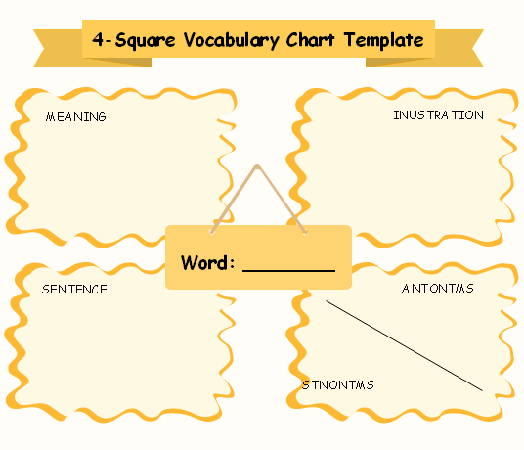
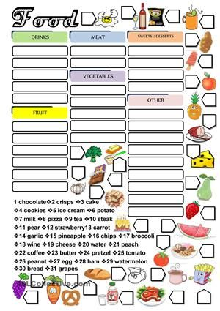
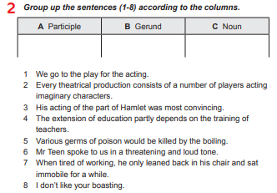

Slide 12
Visual / Spatial
Mind maps
Using flash cards, photos, paintings, etc. to encourage discourse
Graphs used to initiate explanations of statistics
Videos
Creating multimedia projects
Highlighting texts in different colors to indicate tense, or function
Games such as Pictionary

Slide 13
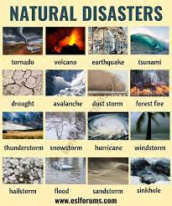
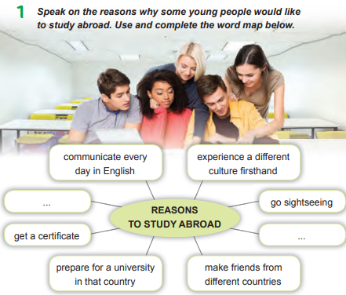
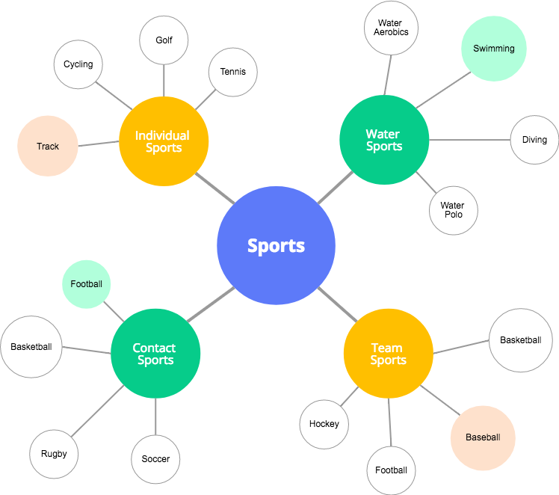
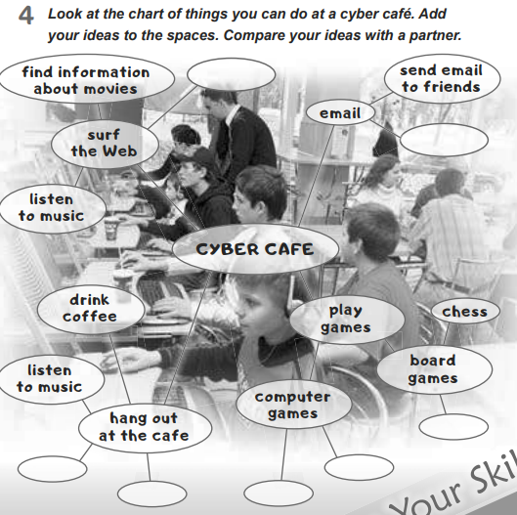

Slide 14
Musical
Using songs, chants, drills
Creating songs, rhymes
Making connections between sound/music and the information you are teaching

Slide 15
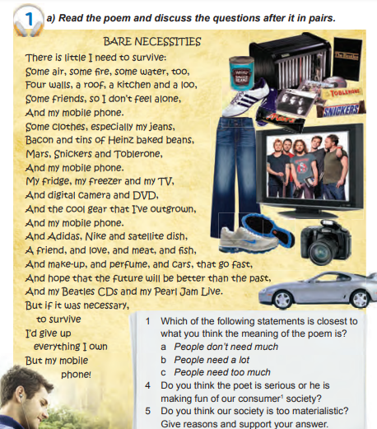


Slide 16
Bodily / Kinaesthetic
Movement games
Role plays / drama
Pantomime vocabulary activities
Facial expression games

Slide 17
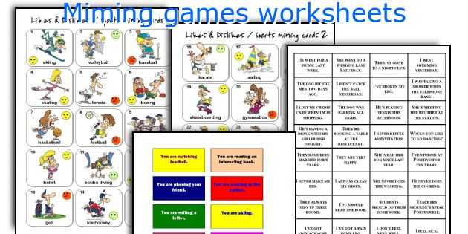
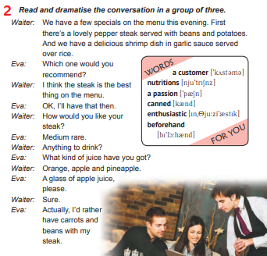


Slide 18

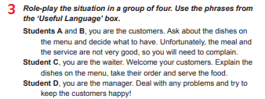
Interpersonal
Small group work
Team competitions
Role plays using dialogues
Peer teaching
Work in groups.
Discuss Ukrainian cities and places of interest. Explain which of them foreign tourists should visit and why.

Slide 19
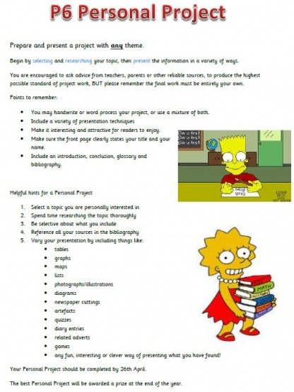
Intrapersonal
Writing diaries
Working individually
Creating personalized projects

Slide 20
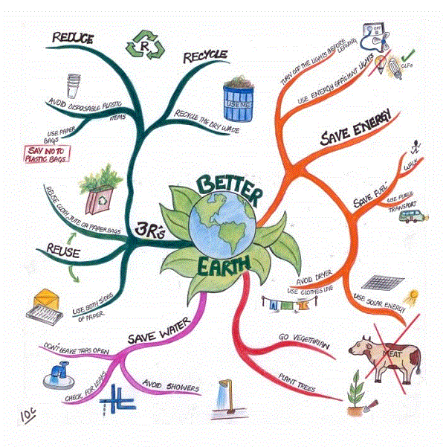
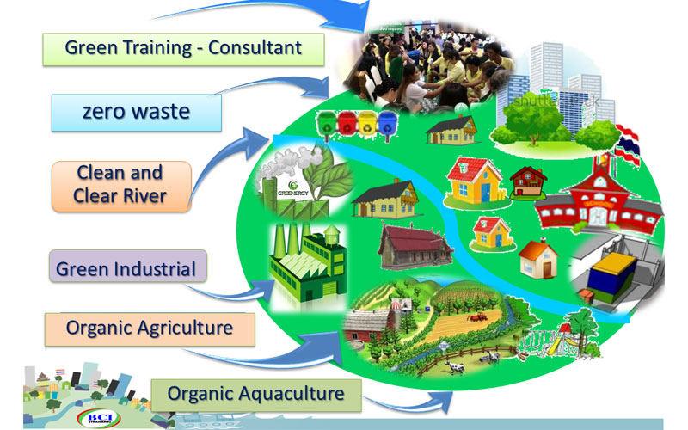
Naturalistic
Exploring outdoors but in English
Creating environment projects

Slide 21
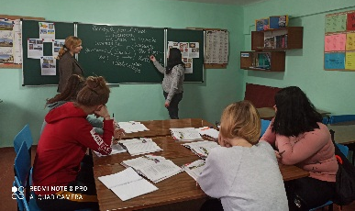
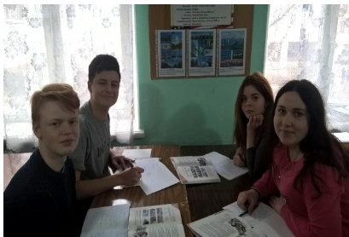
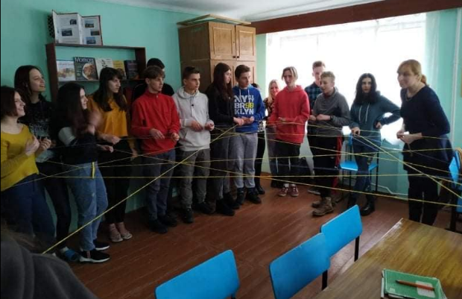
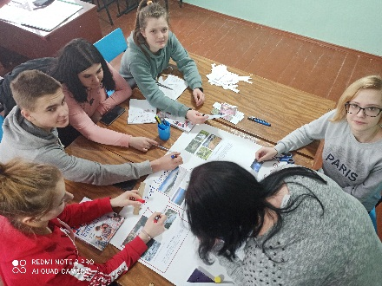
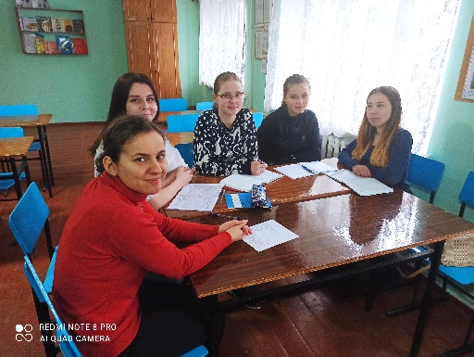
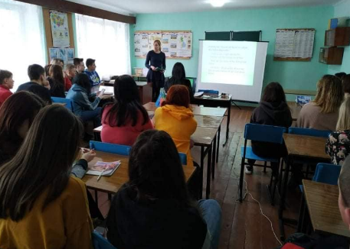
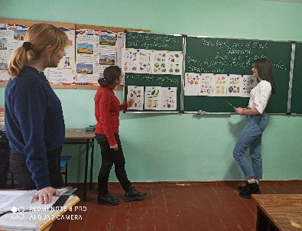
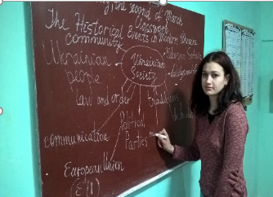
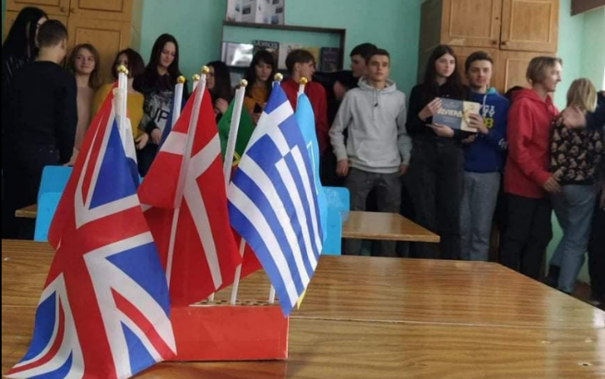
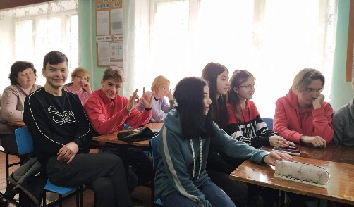
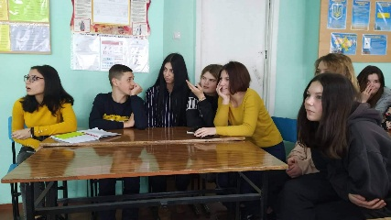
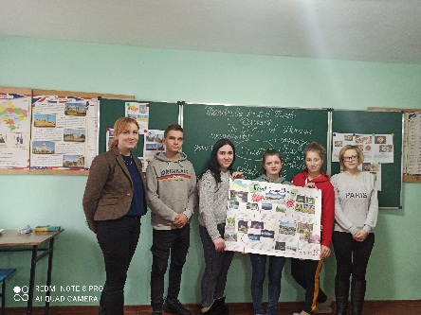

Slide 22


