Slide 1
Урок з англійської мови для 6 класу
Тема: Одяг . Пори року
Підготувала:
Вчитель англійської мови
ХСШ №134
І категорії
Шликова катерина Олександрівна

Slide 2
Phonetic exercise
ai [ ei ]: trainers, rain, raincoat.
a [ a: ]: scarf, glasses, pyjamas.
ou (ow) [ au ]: trousers, bow, out.
ir [ ə: ]: third, skirt, shirt.
ear [ ɛə ]: wear.

Slide 3
Proverbs
1.Good clothes open all doors.
По одягу людину зустрічають, а по розуму проводжають.
2.It is not the gay coat that makes the gentleman.
Не одяг прикрашає людину.
3.It’s not the clothes that count, but the things the clothes cover.
Судять не по одягу, а по тому що під ним.

Slide 4
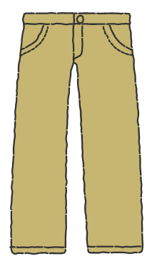
Task 1
Look at the picture and choose the right variant.
T-SHIRT
DRESS
SKIRT
TROUSERS

Slide 5
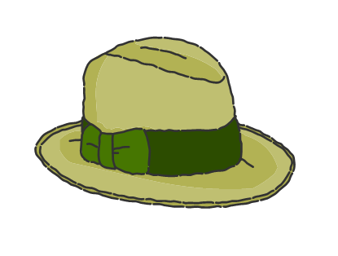
TRAINERS
HAT
TIE
SCARF

Slide 6
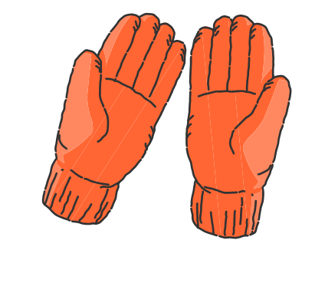
SOCKS
BLOUSE
GLOVES
BOOTS

Slide 7
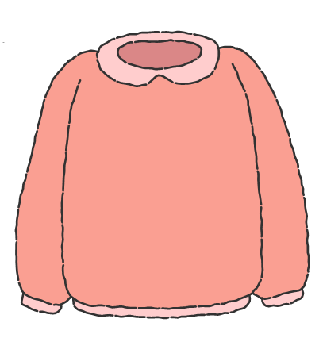
JUMPER
BELT
BANDANA
SUIT

Slide 8
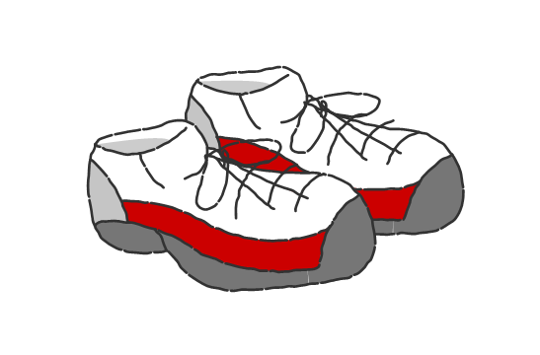
SANDALS
SNEAKERS
TIGHTS
GLASSES

Slide 9
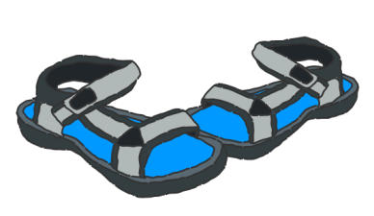
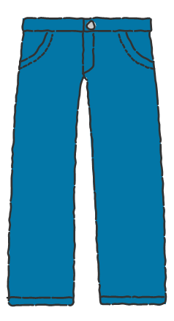
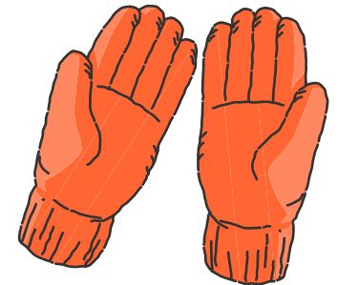
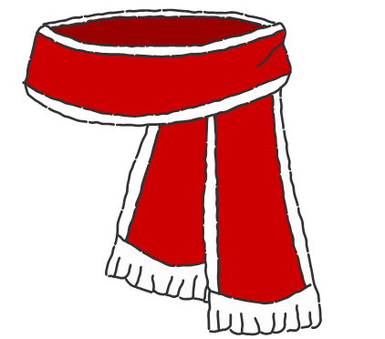
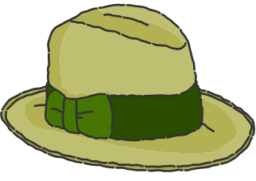
Task 2
Match the names of clothes to the parts of the body.
Hand
Legs
Head
Feet
Neck

Slide 10
Grammar
affirmative form Present Simple
I | V
You
We
They
He | Vs(-es)
She
It
The verb “to be” in Present Simple
I | Am
He | Is
She
It
We | Are
You
They

Slide 11

Listening

Slide 12
Watch the cartoon and mark sentences as T(True) or F(False).
In summer you can ski and slide on a sled.
When the weather is rainy, you can make a snowman.
In autumn, sometimes the weather is cloudy.
When it`s winter, you put on your sweater.
The Earth spins around the Moon.
When the weather is snowy , you can go to the beach.
In winter, leaves are green and the weather is warm.
In spring, you can have a snowball fight with your friends.
In autumn, leaves are red and brown.
In winter, you can sail on a sailboat.

Slide 13
Thank you for attention!

