Slide 1
УКРАЇНА
ШКОЛА І–ІІІ СТУПЕНІВ № 119
ДЕСНЯНСЬКОГО РАЙОНУ МІСТА КИЄВА вул. Закревського, 15-Б, м. Київ, 02217, тел./факс: (044) 515-88-86
E-mail: sh119@ukr.net Код ЄДРПОУ 03598707
План – конспект
( медіа – презентація)
Підсумкового уроку
З англійської мови
У 6-Б класі на тему “Sport”
Учитель: Руденко І.Г.

Slide 2
Subject: Sport
Objectives:
to systematize lexical materials on the topic;
to practice the active vocabulary of the topic;
to develop speaking, reading, writing skills through various activities;
to present new grammar material;
to develop students’ thinking, memory, imagination, attention and creativeness.
Equipment : a computer, a multimedia projector, multimedia presentation, copy-book.

Slide 3
Тема: Спорт. Види спорту.
Цілі:
Практична: практикувати активний словник теми уроку, вчити правильно артикулювати слова, розвивати вміння учнів логічно та послідовно викладати думки англійською мовою.
Освітня: практикувати учнів у вживанні л.о в усному мовленні та у вивчених граматичних структурах, поглибити знання учнів про види спорту і формувати навички читання та аудіювання.
Розвиваюча: розвивати комунікативні навички, мовну здогадку, пам’ять, увагу, розвивати пізнавальний інтерес до англійської мови.
Виховна: виховувати культуру спілкування, зацікавленість у розширенні своїх знань, виховувати любов до занять спортом.
Обладнання: мультимедійний проектор, презентація до уроку, підручник для 6 класу, робочий зошит.

Slide 4
Procedure
Lead in part
Greeting and aim
Warming up
The basic part of the lesson
Vocabulary revision
Lexical training
Grammar material
Speaking
The final part of the lesson
Homework
Summarizing
Saying “ Good-bye”

Slide 5

Sport
Notes:
1.Greeting and Aim
T: Good morning, students. Nice to see, you. Today we continue our work at the topic “ Sport”.

Slide 6
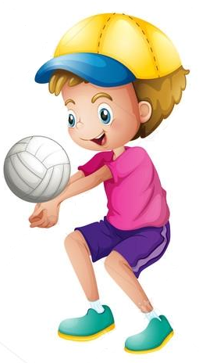
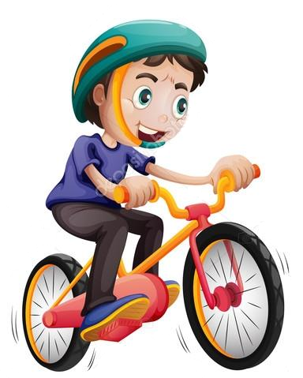
The motto of the lesson is:
Warming up
“We’ll be good,
We’ll be fine,
We’ll be clever every time”.
Notes:
2. Warming up

Slide 7
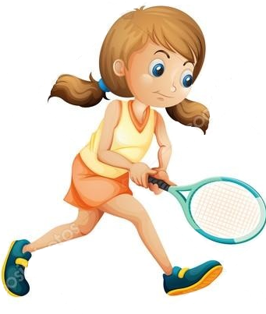
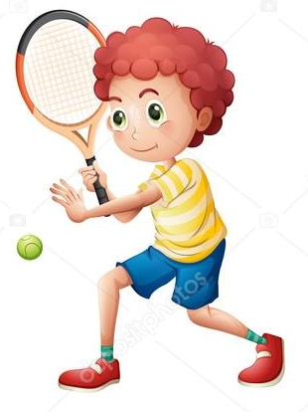
Proverbs
A sound mind…
Health is better…
One apple a day…
in a sound body
than wealth
keeps doctor away
Notes:
T:Students, there are a lot of proverbs about sport. Let us remember some of them. I’ll tell you the beginning and you’ll tell me the end. Look at the board, please.

Slide 8

Vocabulary revision
Notes:
T: Now look at the board, please. Let’s remember the kinds of sport, we’ve already learnt. Be attentive, repeat after the video. And then we’ll do some exercises.

Slide 9

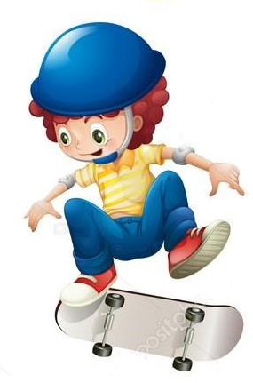
T: Pupils listen some sentences and guess what is the kind of sport?
Lexical training
Notes:
T: Right now, we’ll do some lexical and grammatical exercises.
You’ll see the sentences on the board, your task is to guess the kind of sport.
Are you ready? Let’s start.

Slide 10
A game for two teams that you play with a ball and a basket.
A game that you play on board.
A game for two teams that you play with the sticks on the ice-ground.
A game for two people that you play with a small ball on the table.
An English popular game.
This kind of sport includes things like running, jumping, etc.
Canada’s national sport is…
You can swim there in winter
A place where boys and girls go in for sports…
A person that trains sportsmen in this or that kind of sport…
basketball
chess
ice- hockey
table -tennis
football
athletics
hockey
swimming- pool
gymnasium
trainer

Slide 11
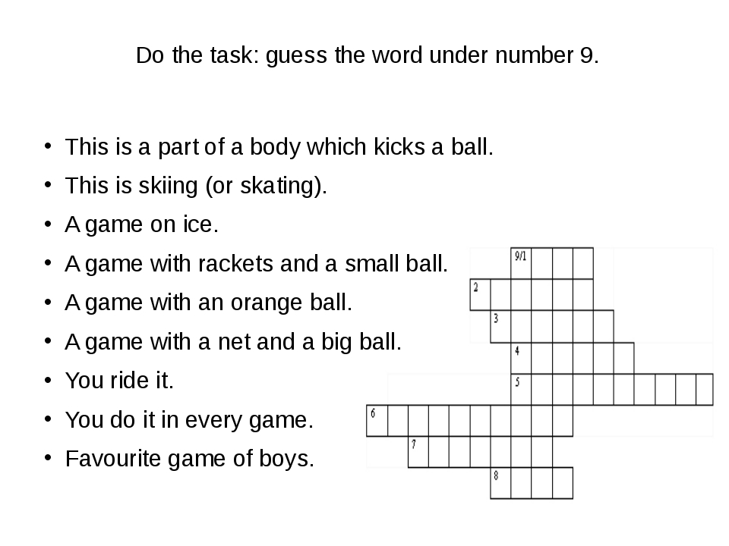
Crossword
F o o t
s p o r t s
h o c k e y
t e n n i s
b a s k e t b a l l
v o l l e y b a l l
b i c y c l e
p l a y
Notes:
T: And now, let’s do a crossword. Your task is to guess the word number № 9.

Slide 12

Grammar material
Remember, do we ”play football ”, “go football” or ”do football”?
play with ball games
We use go with sports ending – ing
do with other sports
Notes:
T: It’s time to revise a grammar material.
Remember this rule and be attentive while using the appropriate verb.
Look at the board and answer my questions.

Slide 13
I like to(play,go,do)
My friend likes to( play,go,do)
play | go | do
Tennis | Swimming | Aerobics
Football | Cycling | Karate
Basketball | Skateboarding | Judo
Volleyball | Windsurfing | Athletics
Notes:
T: Let us practice. Please, open your copy- books, make up sentences and write them down. You have two minutes.

Slide 14

Grammar training
T: Write down using the verbs Do / Play/ Go
1. Every morning I ______ jogging.
2. On Saturday mornings my brothers _____ football.
3. I ______ gymnastics on Saturdays.
4. My mother and I ______ aerobics every week.
5. My father and mother _____ golf at the weekend.
6. In winter we _____ skiing.
7. In summer we _____ tennis and _____ swimming.
go
play
do
do
play
go
play
go
Notes:
T: Next exercise is using play, do, go.

Slide 15
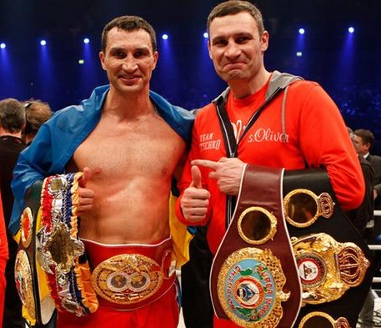
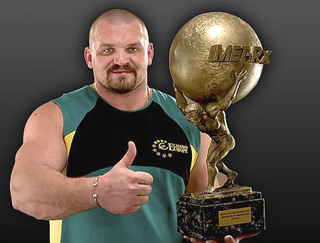
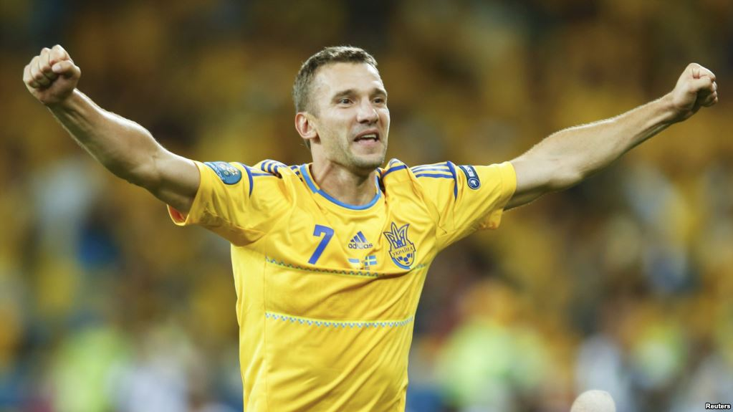
Speaking
Say” Who is this? “ Using This is…..
He is famous…
Notes:
T: Now, I’ll show you some photos of famous Ukrainian sportsmen. Your task is to say:” Who is this?”

Slide 16

The final part
Home work
To make a project “My favorite kind of sport”
Summarizing
Did you enjoy the lesson?.
It’s time to estimate you.
Saying “ good-bye”
The lesson is over, good- bye.

