Slide 1

INTEGRATED SEMANTIC LINES
AT THE ENGLISH LESSONS

Slide 2

The defining priorities of the content of modern school foreign language education shall be its focus on competent, communicative, active, personally oriented, and culturological learning paradigms.
They shall be ensured by the unity of subject, procedural and emotional-value components and be based on the foreign language mastering ideas in the intercultural education context, which implies the interconnected mastering the language and culture of the people it communicates.

Slide 3

The teacher’s task shall lie in the students’ key competences development, which means a set of knowledge and skills necessary for the students’ self-determination, general development as well as their self-realization.
Their formation shall be in line with the across lines:
«Environmental Security and Sustainable Development»;
«Civic Responsibility»;
«Health and Safety»;
«Entrepreneurship and Financial Literacy».

Slide 4
"ENVIRONMENTAL SECURITY
AND SUSTAINABLE DEVELOPMENT"
The «Environmental Security and Sustainable Development» across line implementation shall be aimed at the formation of students' social activity, responsibility and environmental consciousness, awareness of the sustainable development importance for the environment preservation and the society development, the willingness to take care of the environment.

Slide 5
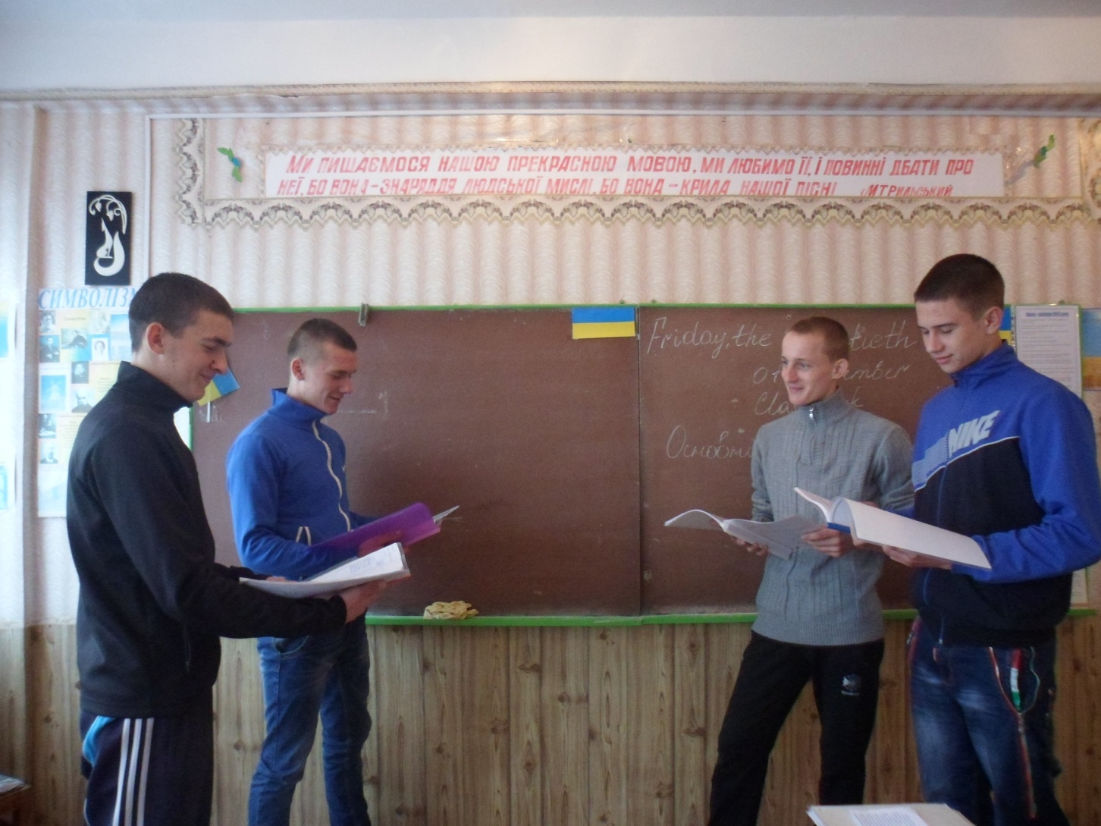
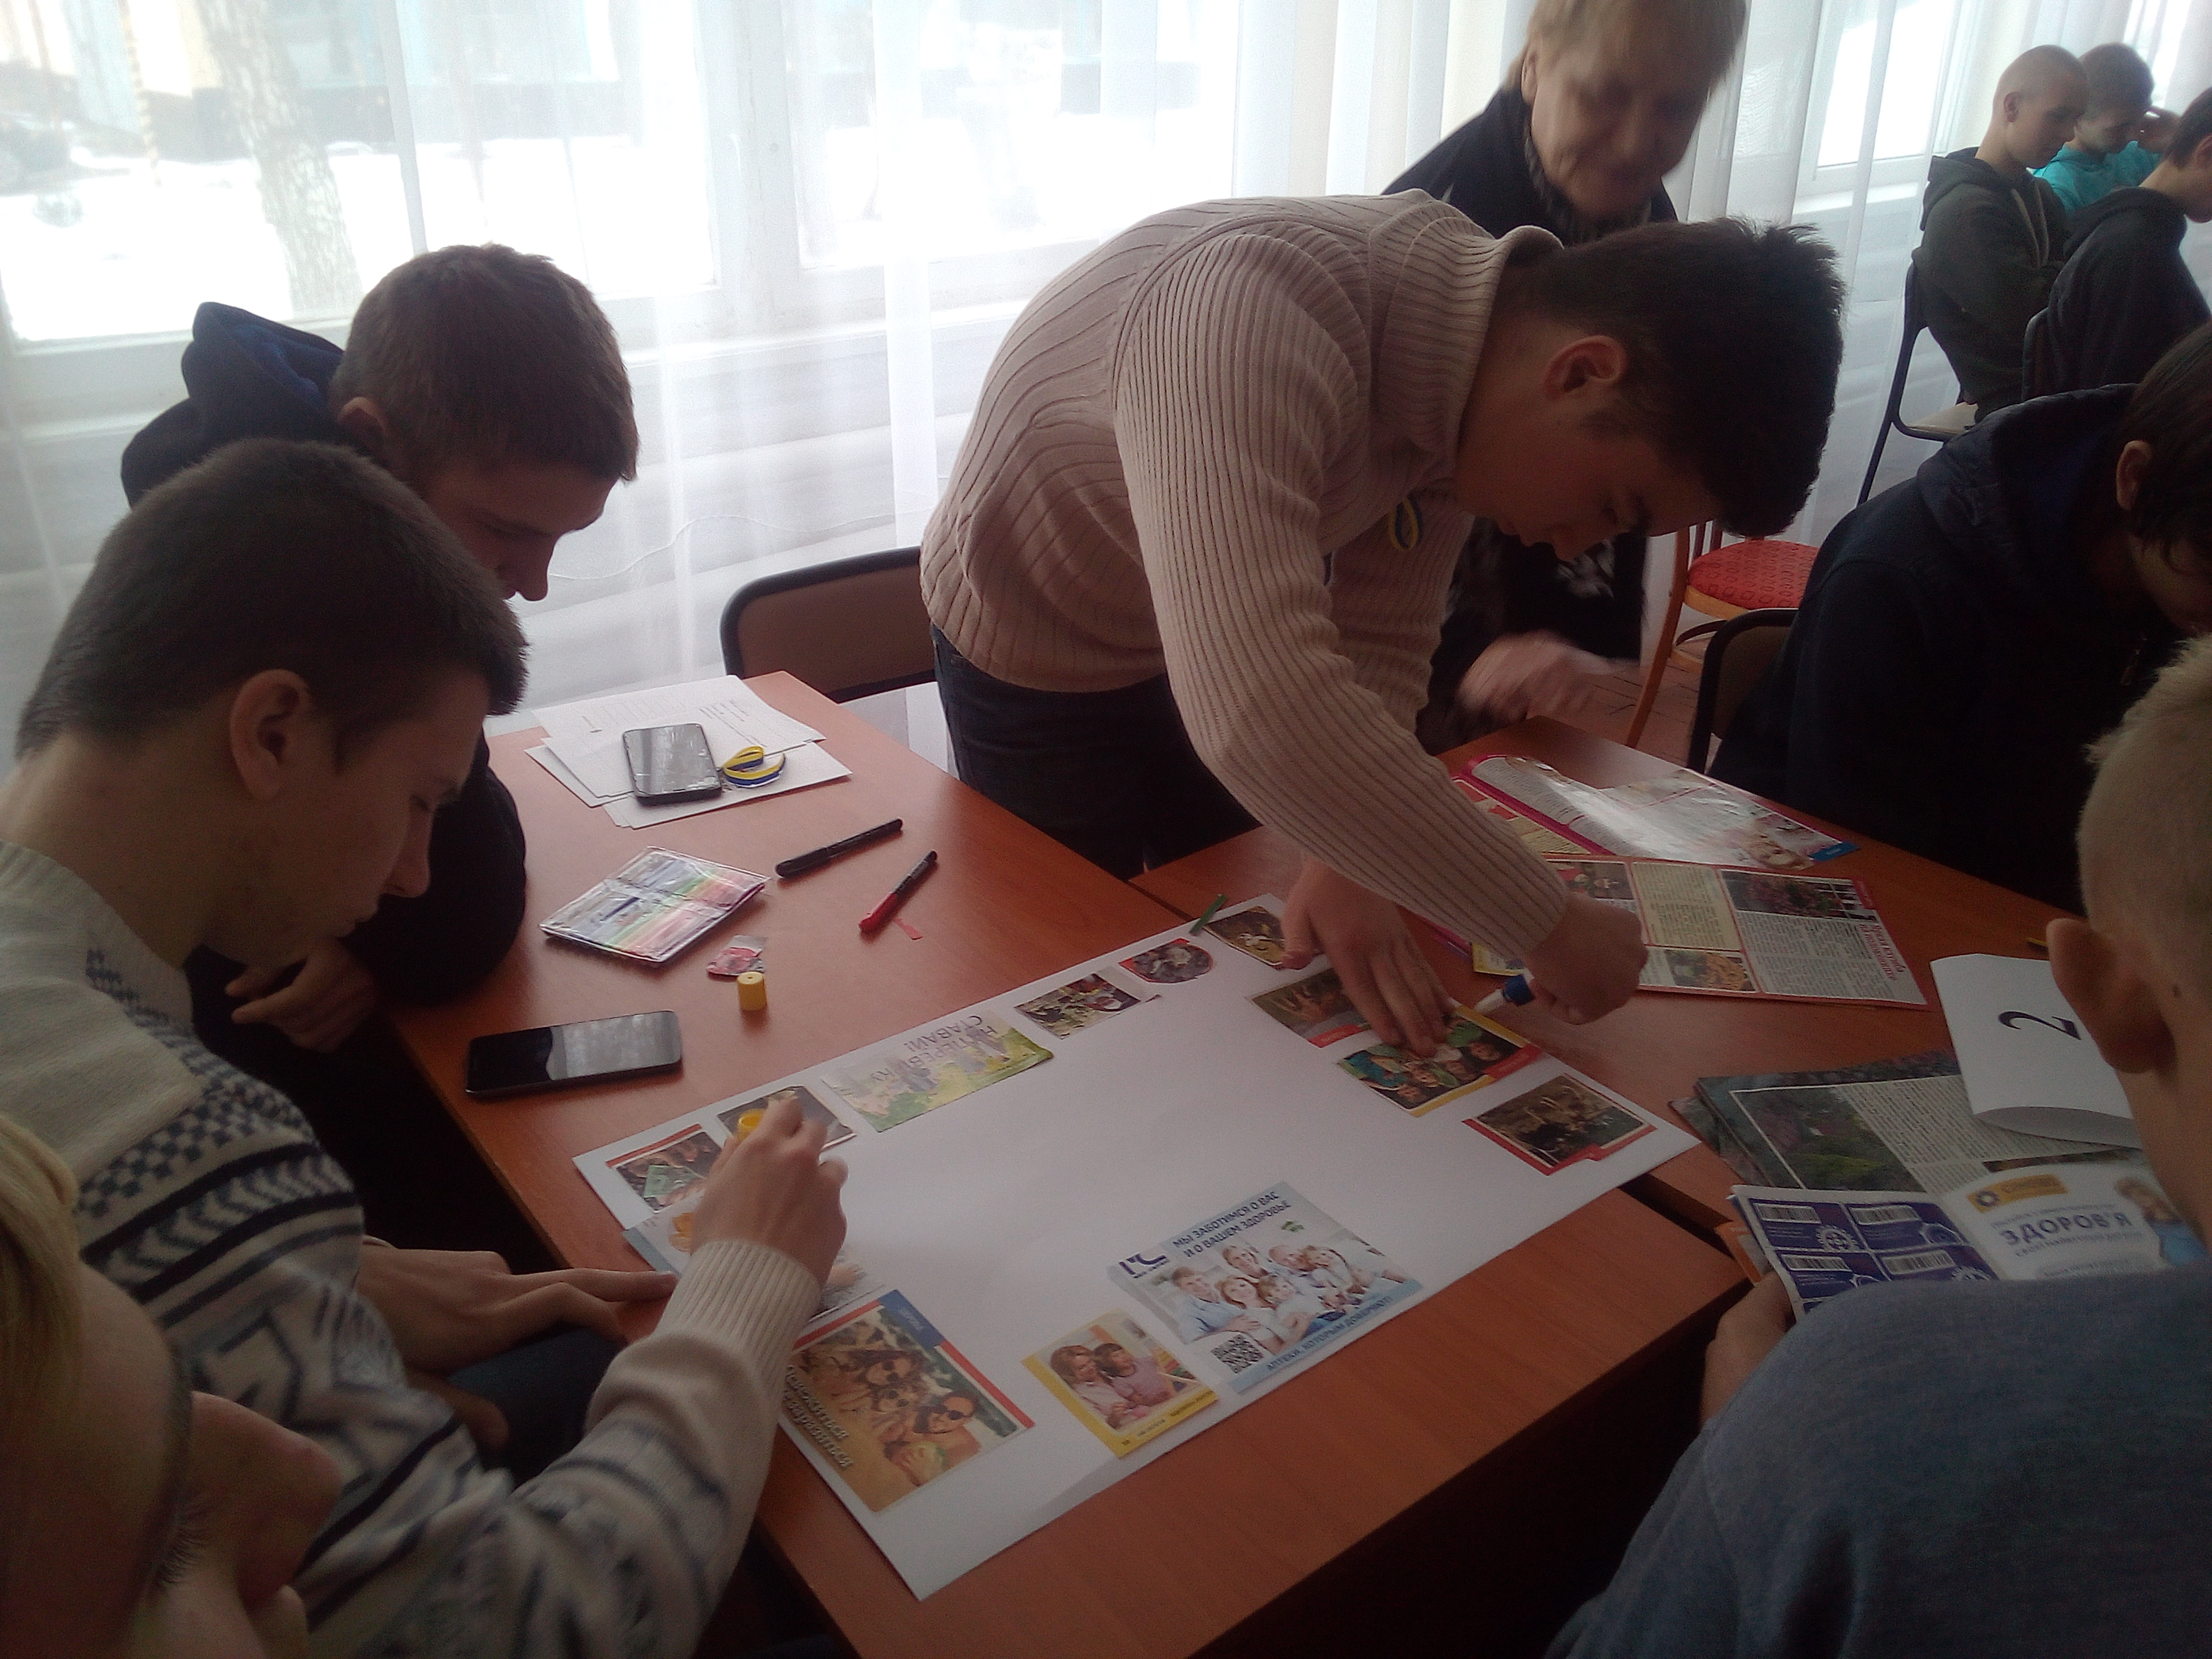
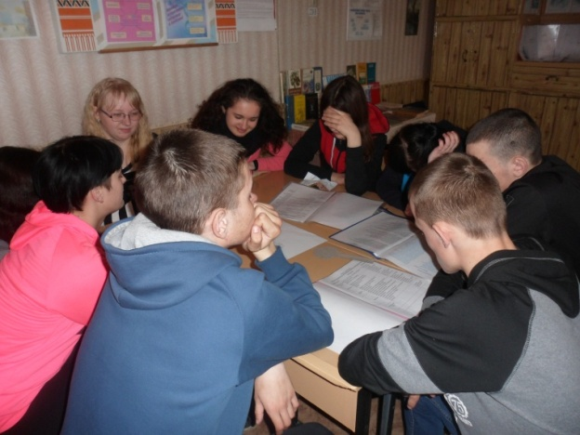
"ENVIRONMENTAL SECURITY
AND SUSTAINABLE DEVELOPMENT"
When working on the topics "Nature and Weather", "Climate", "Environment", "Transport", "Traveling" and "Health", it shall be necessary to form in students the notion that Man is part of Nature, and its existence depends on the natural environment.

Slide 6

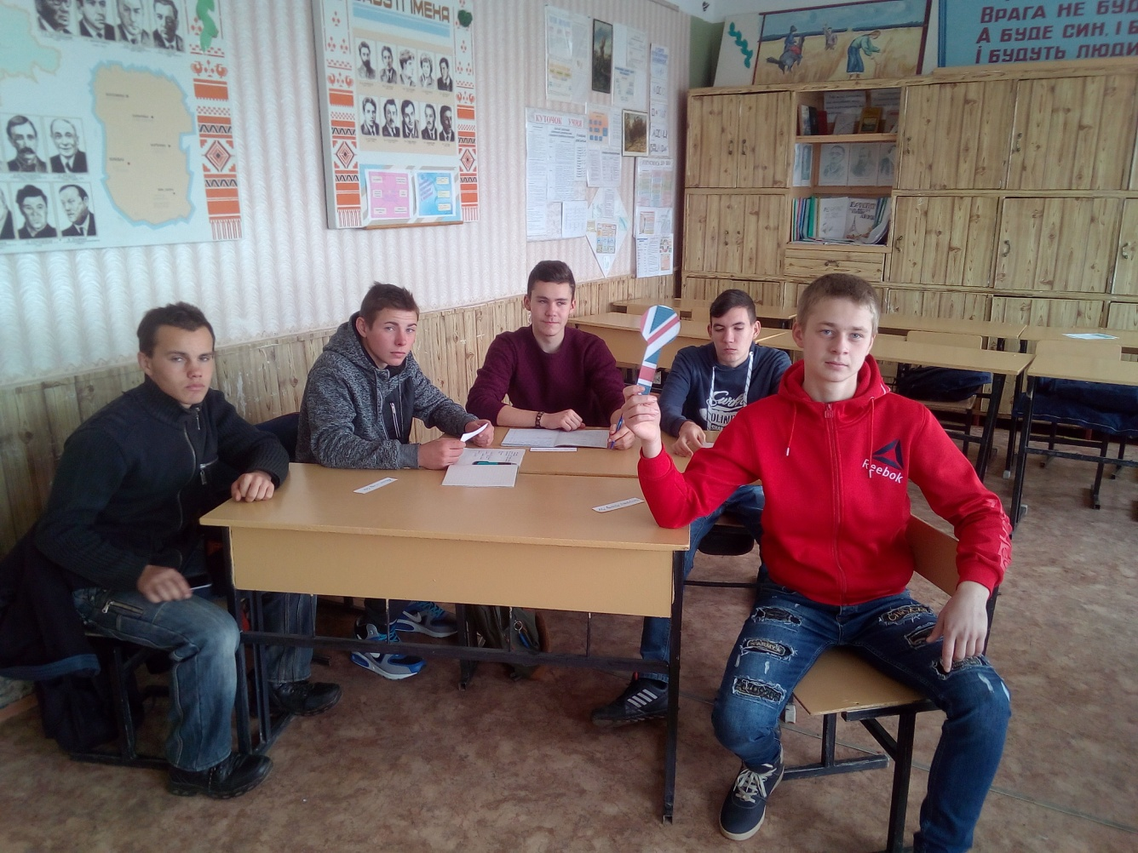
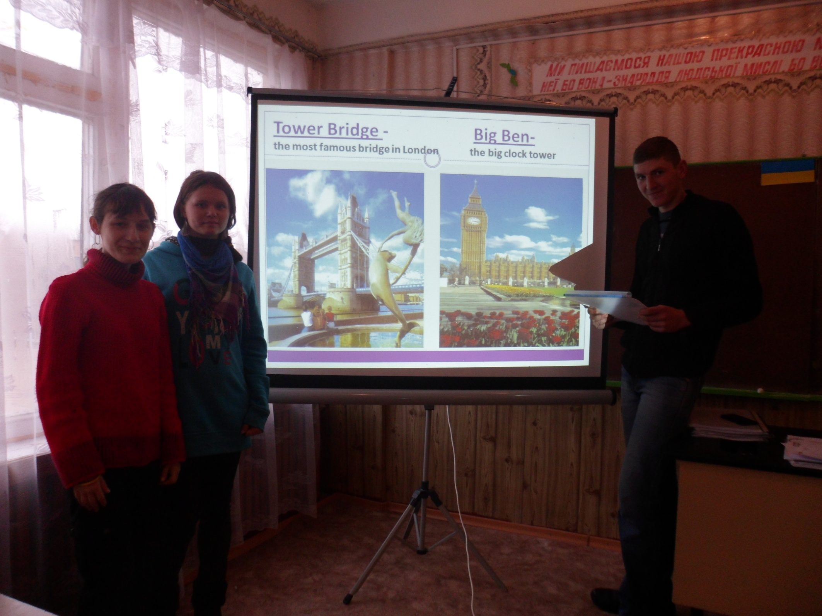
"CIVIC RESPONSIBILITY"
The "Civic Responsibility" semantic line implementation shall be aimed at forming a responsible citizen of our society, capable of intercultural communication and interaction. It shall be implemented through collective activities, developing students' willingness to cooperate, as well as tolerance in various ways of activities and thoughts (Research Work, Group Work or Projects).

Slide 7
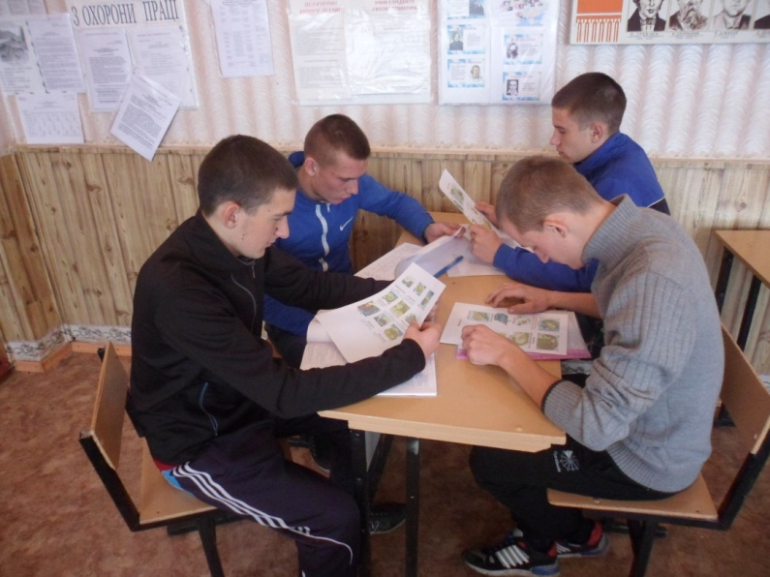
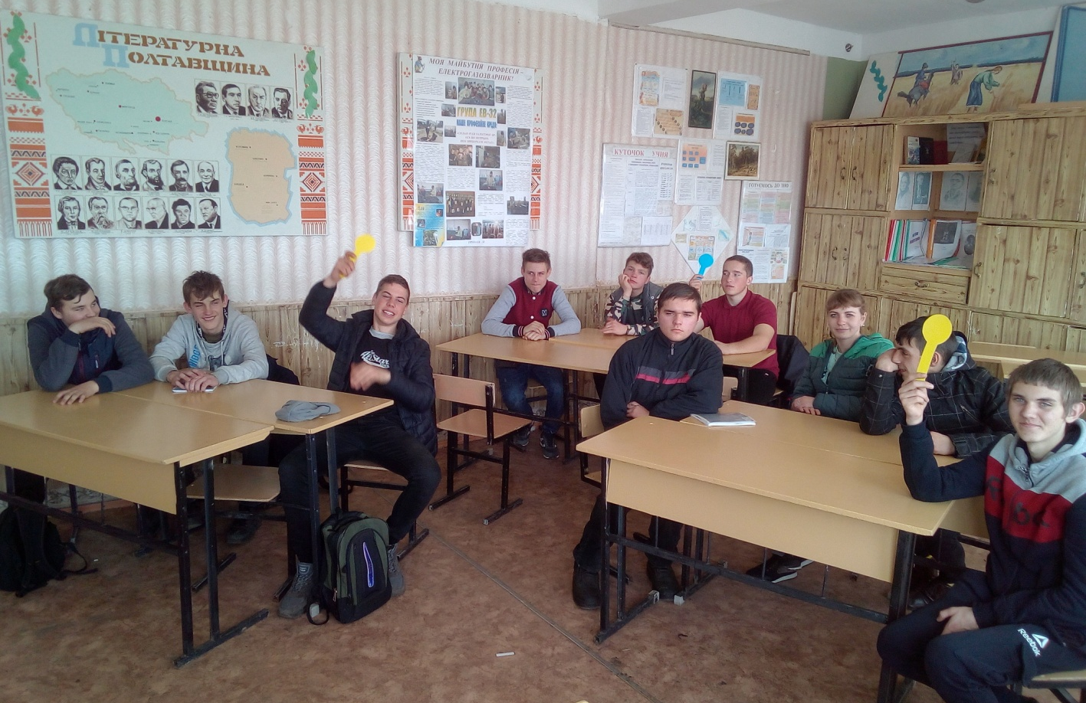
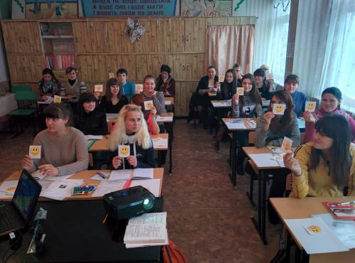
The "Health and Safety" across semantic line implementation shall be aimed at adolescents’ health maintenance. It shall mean a rational, healthy nutrition, healthy lifestyle and safe behavior.
The topics "Food", "Sport", "Health", "Internet" and "Leisure", in the study of which I practice interesting forms of work, active methods and relaxation minutes, can be used to implement this semantic line.
"HEALTH AND SAFETY"

Slide 8
"ENTREPRENEURSHIP
AND FINANCIAL LITERACY"
The "Entrepreneurship and Financial Literacy" across semantic line implementation will provide students with the ability to plan and develop different tasks, present their achievements, take decisions, and make calculations. For example, when studying the topic "Clothes", students shall discuss the clothing cost and learn to distribute funds properly.

Slide 9
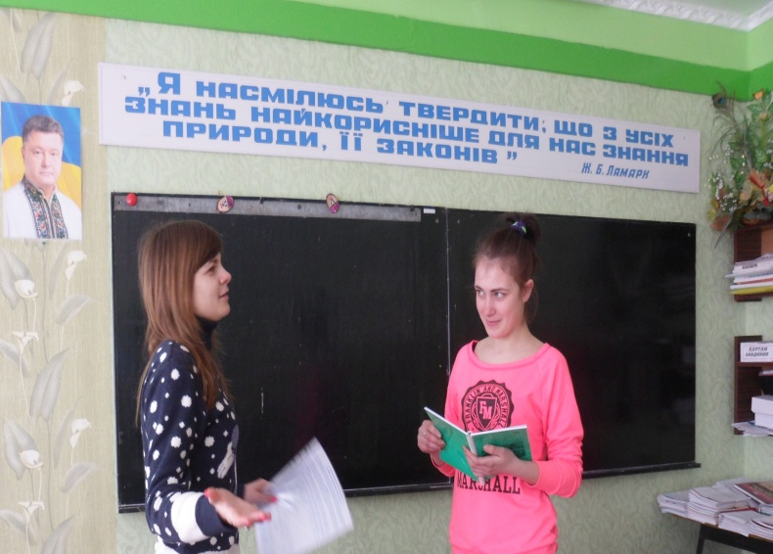
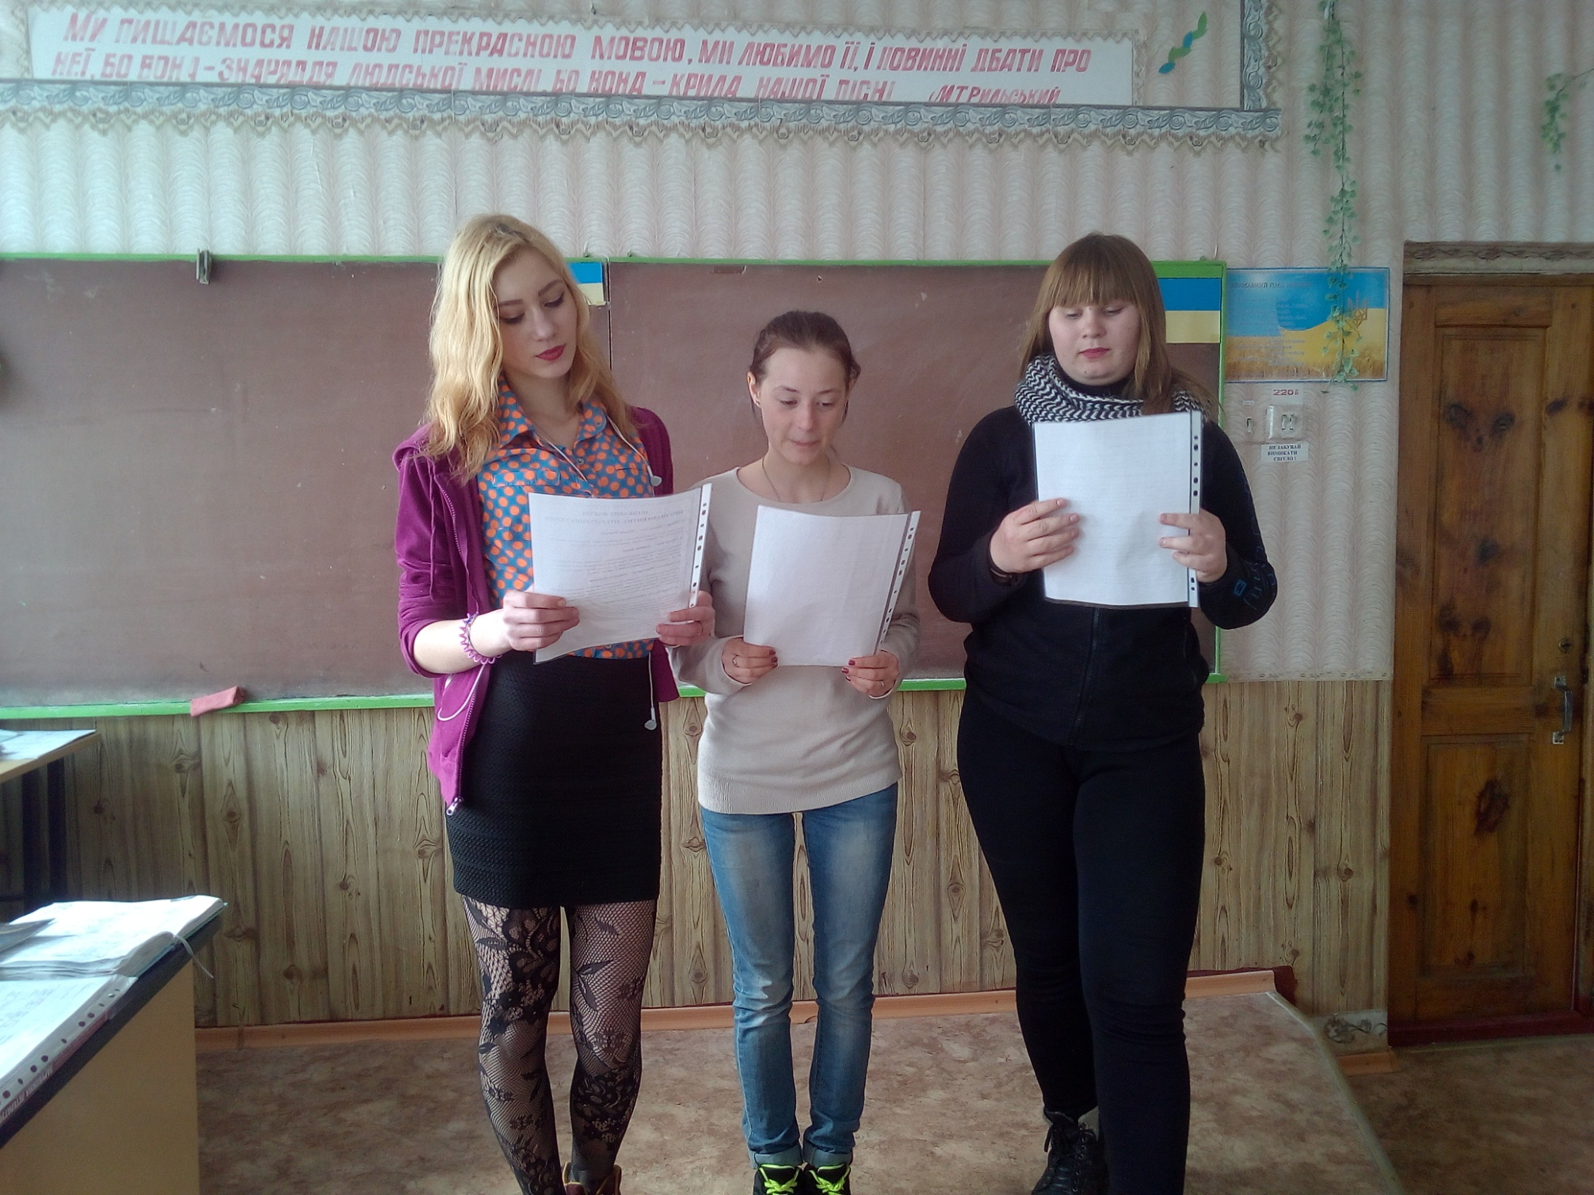
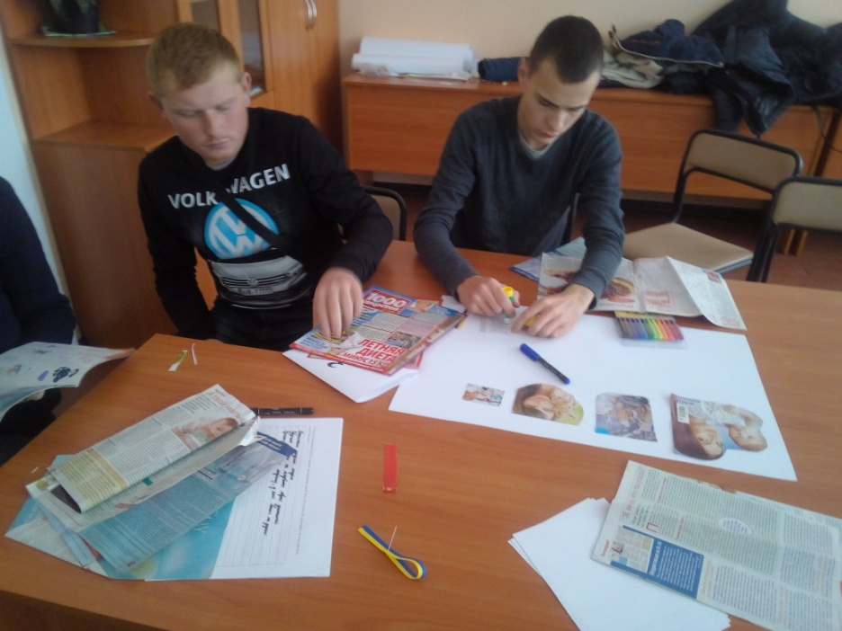
"ENTREPRENEURSHIP
AND FINANCIAL LITERACY"
When studying the topics "Shops and Shopping", "Health", "My Family", "In the Restaurant", it shall be necessary to acquaint students with vocabulary concerning goods purchase and consumption, the international size standards, types of sales and payment of goods as well as with other special terms.

Slide 10
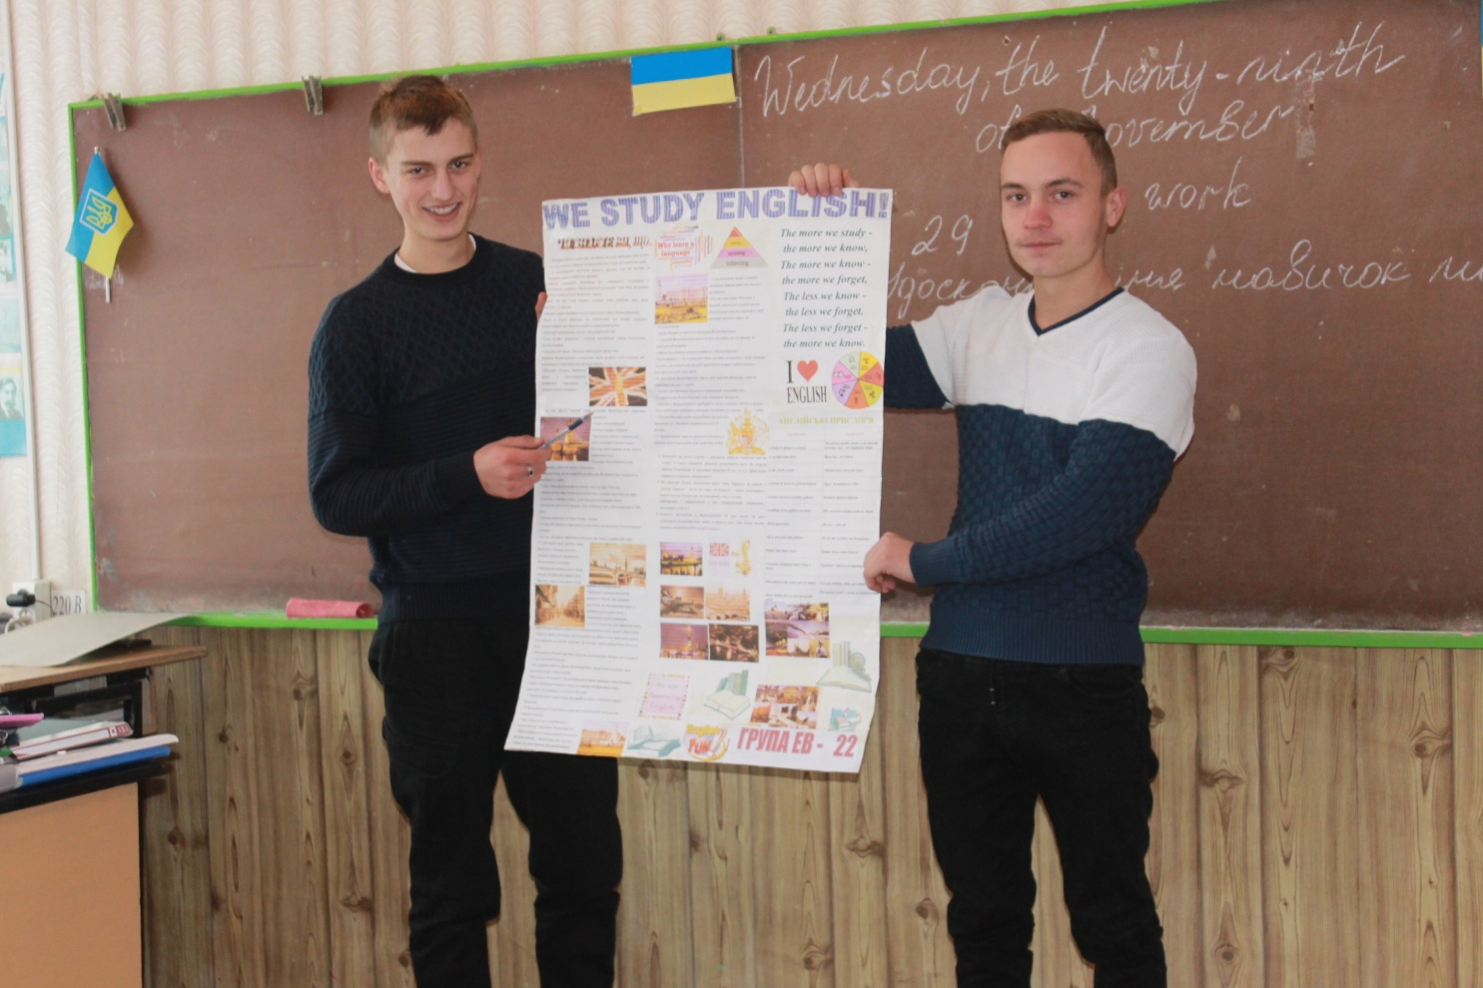
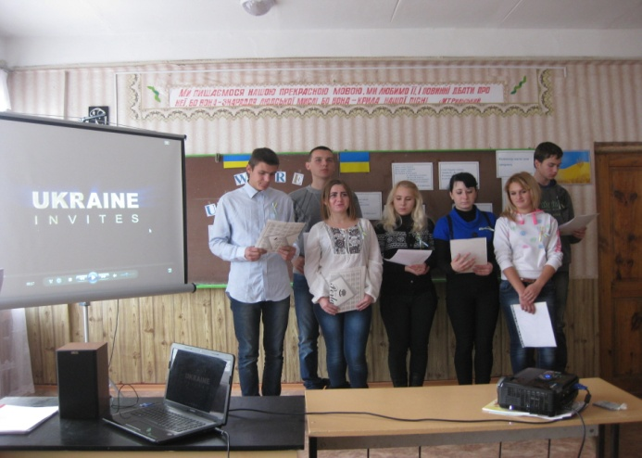
THE ACROSS SEMANTIC LINES
SHALL BE IMPLEMENTED THROUGH THE FORMS OF WORK AS FOLLOWS:
Integration methods shall help to understand that everything in life is interconnected, and knowledge gained at other lessons may be needed at any time;
Cooperative learning shall form leadership qualities, social and teamwork skills;

Slide 11
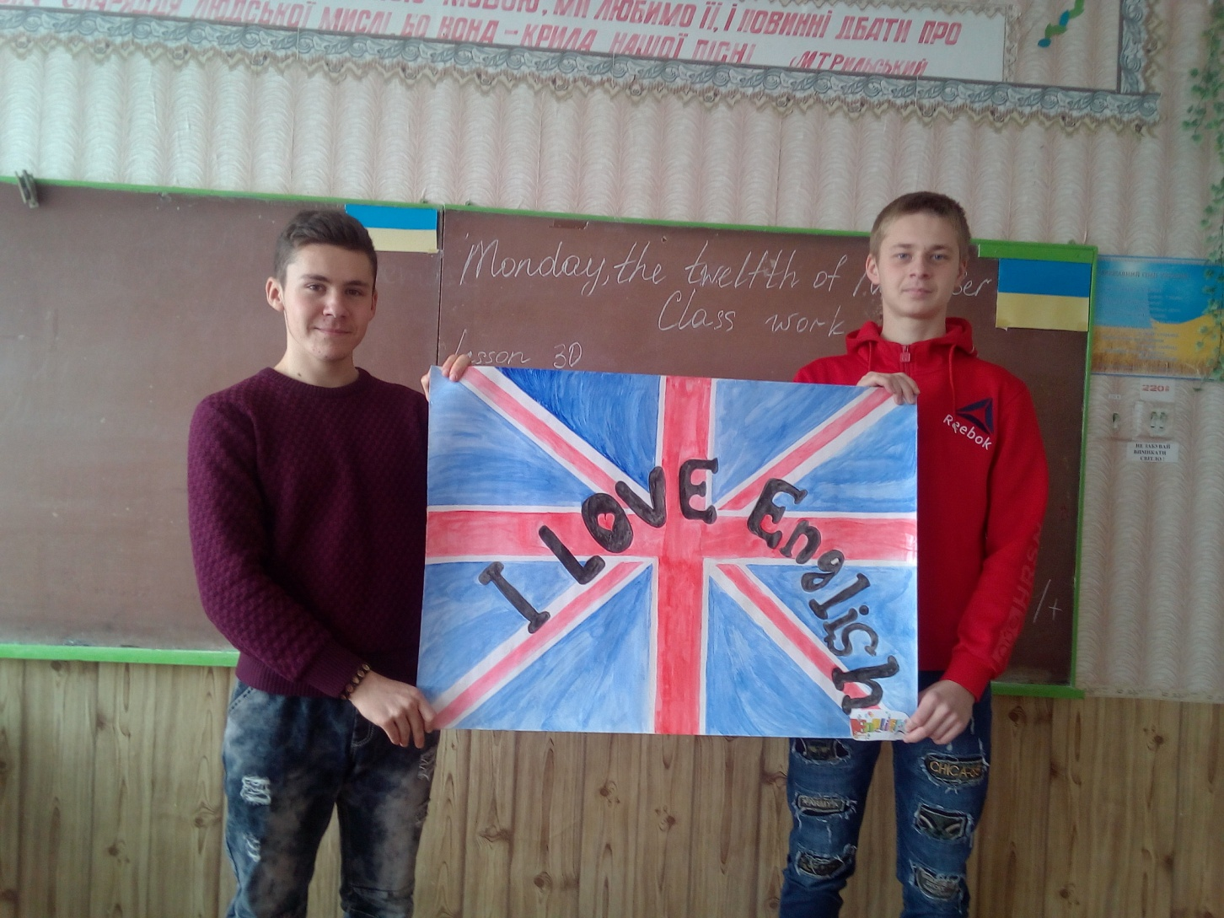
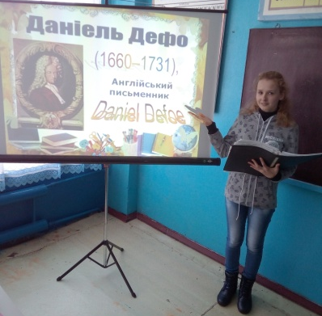
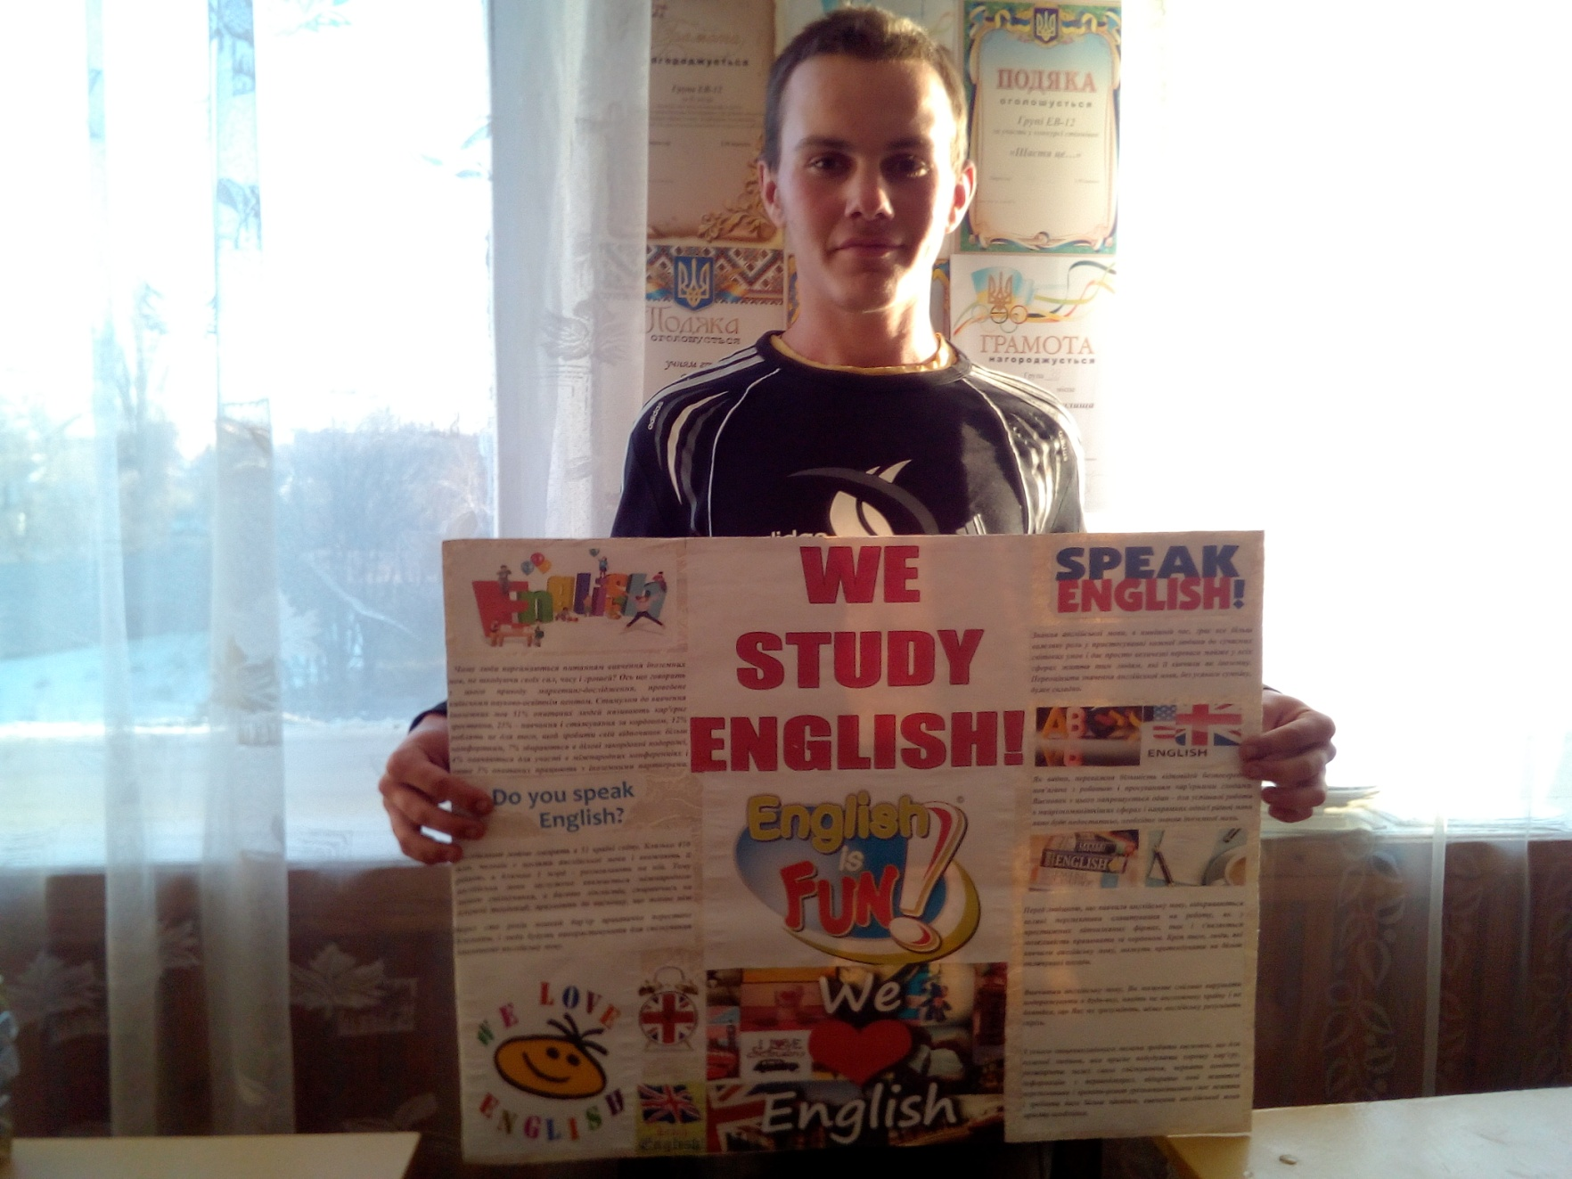
THE ACROSS SEMANTIC LINES
SHALL BE IMPLEMENTED THROUGH
THE FORMS OF WORK AS FOLLOWS:
Role-plays and Business games shall bring the situation closer to real life;
Project technologies shall form creative thinking, sense of responsibility, teamwork skills, as well as ability to present the results of one’s own work;

Slide 12
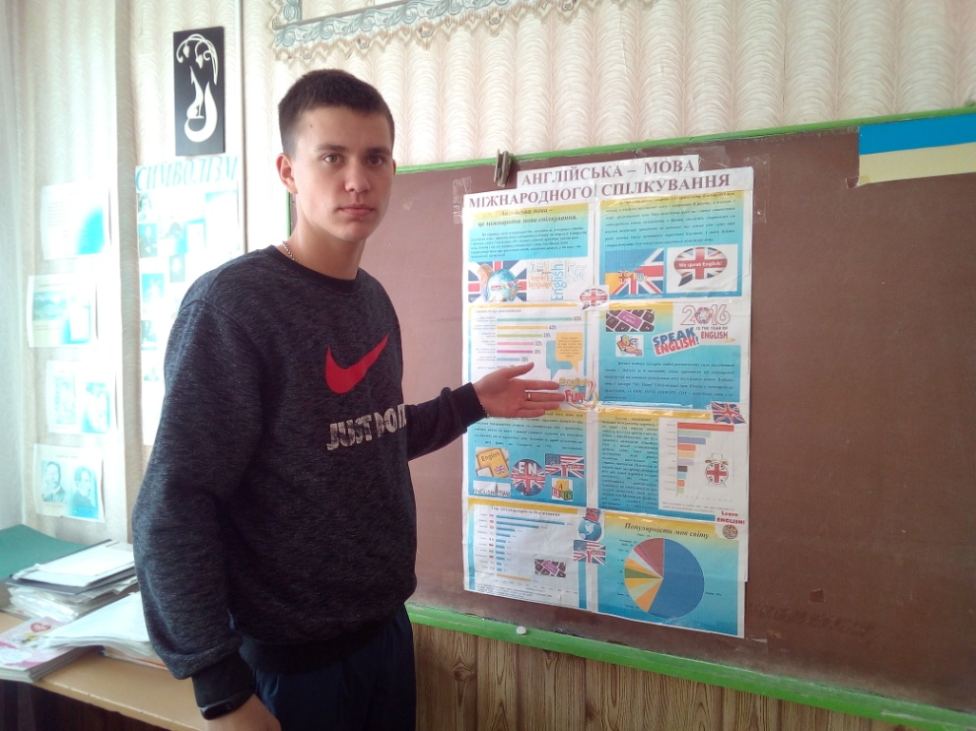
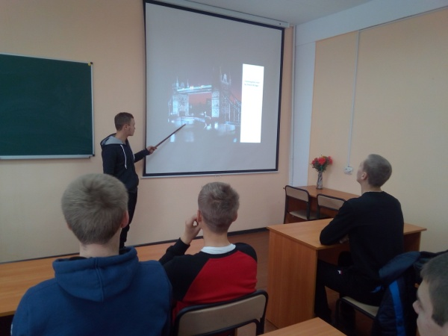
THE ACROSS SEMANTIC LINES
SHALL BE IMPLEMENTED THROUGH
THE FORMS OF WORK AS FOLLOWS:
Interactive methods shall provide the students’ vigorous activity;
Appealing to students' experiences shall transform them into the educational process active participants and link learning to life;
Self-evaluation shall form the ability to self-analyze (self-reflection), as well as the ability to see one’s own mistakes;
Mutual evaluation shall nurture the ability to compare, analyze, and criticize.

Slide 13
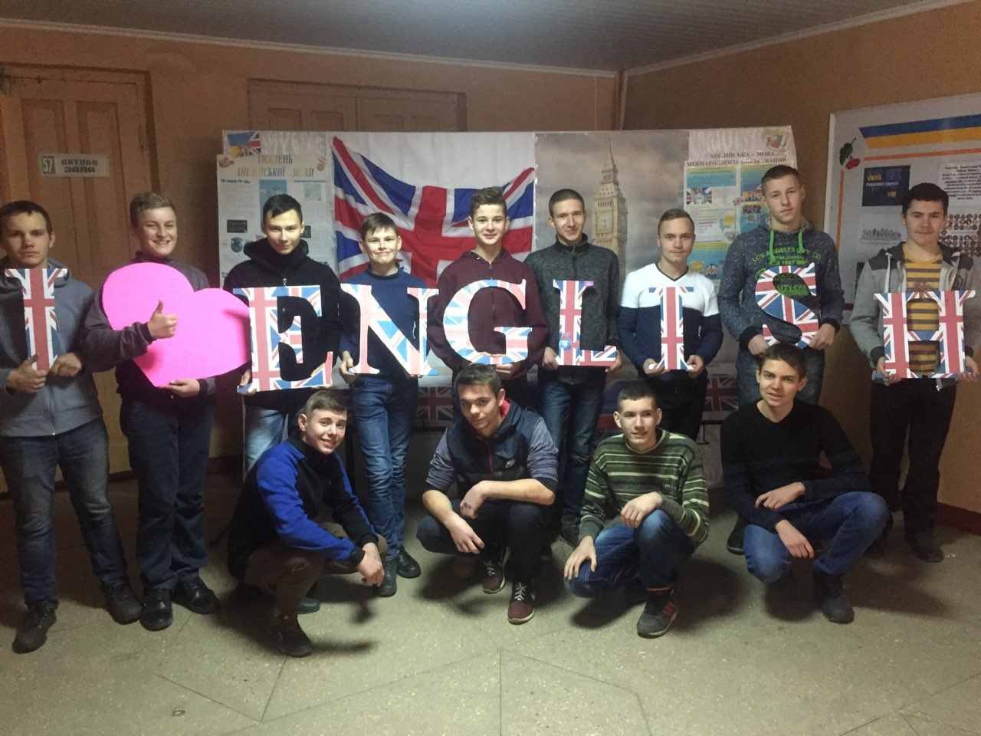
Across lines shall represent means of integrating key and subject specific competencies, their purpose shall be to "focus" the teachers’ attention and efforts on achieving a vital for a student and the community goal, to express key competences.

Slide 14
REFERENCES:
https://mon.gov.ua/ua/osvita/zagalna-serednya-osvita/navchalni-programi/naskrizni-zmistovi-liniyi
http://ukr.theewc.org/Content/What-we-do/Demokratichna-shkola/Gromadyans-ka-vidpovidal-nist
https://www.coe.int/en/web/edc/publications
https://www.coe.int/en/web/no-hate-campaign
www.libra-terra.com.ua
http://journal.osnova.com.ua/article/69394

