Slide 1
Eugenia Gapchinska
Ukrainian artist

Slide 2
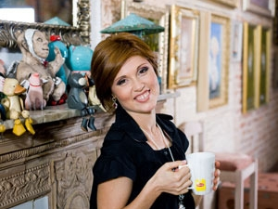
Biography
Eugenia Gapchinska was born in Kharkiv, Ukraine in 1974. She is the fifth child of the family. At the age of five, she went to school.

Slide 3
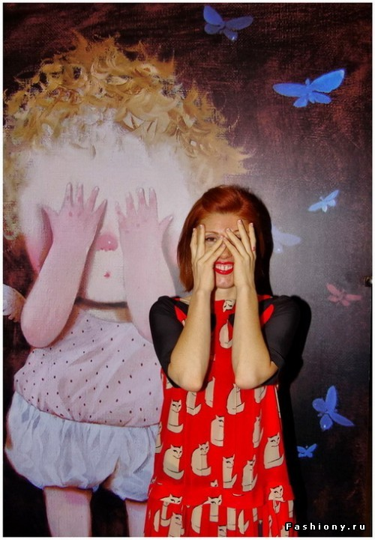
Biography
At the age of 13, she became a student of Kharkiv Art College.
Graduated from The Institute of Industrial Arts in Kharkiv, Eugenia Gapchinska made her internship at the Academy of Fine Arts in Nuremberg (Germany).

Slide 4
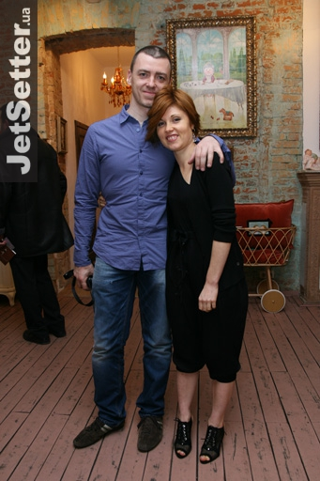
Biography
In 2000, Eugenia with her husband moved to Kiev.

Slide 5
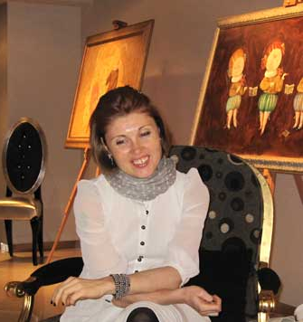
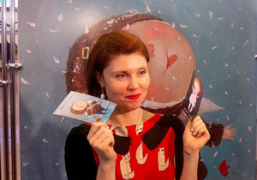
Biography
In 2001, Eugenia started painting in the style that has made her famous today. She started to organize exhibitions of her works in 2002.

Slide 6
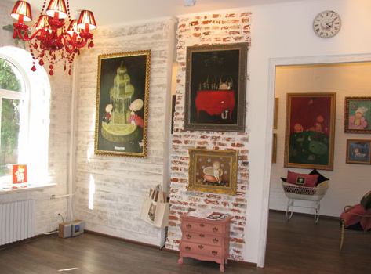
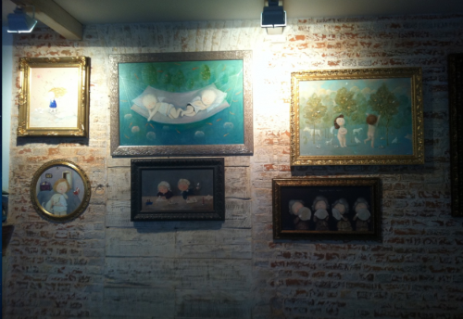
Biography
At first these exhibitions were in ordinary places like local restaurants.
Since then her paintings have been exhibited in Ukraine, Russia, France, Belgium, England, the Netherlands, etc.

Slide 7
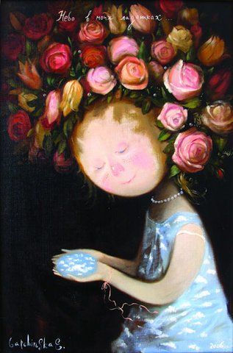
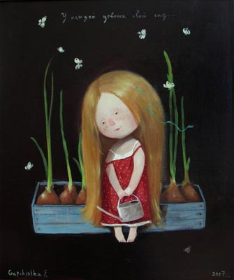
Style
With unique and distinctive style her art-works are full of light and kindness. In her paintings, Eugenia tries to express joy, a good sense of humor, and optimism about the future.

Slide 8
Angels

Slide 9
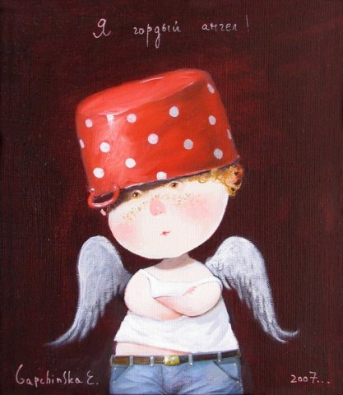
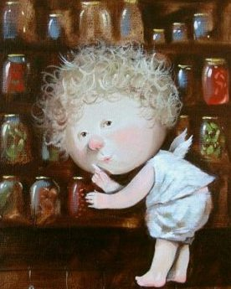

Slide 10
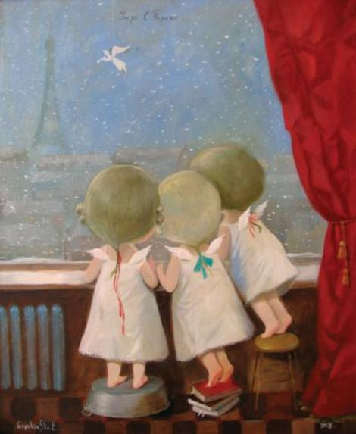
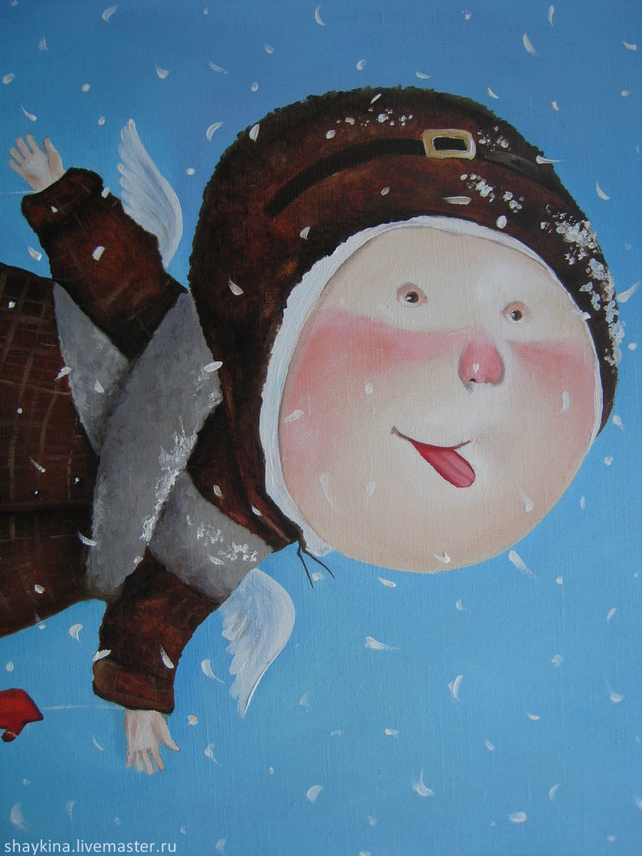
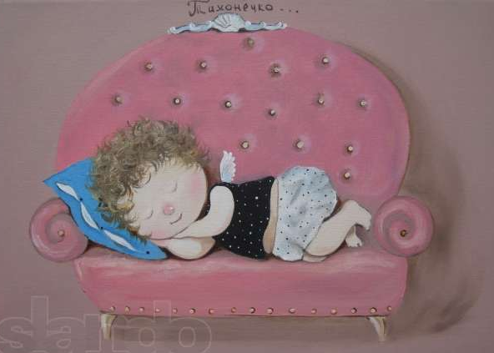

Slide 11
Famous characters

Slide 12
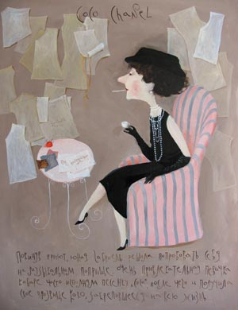
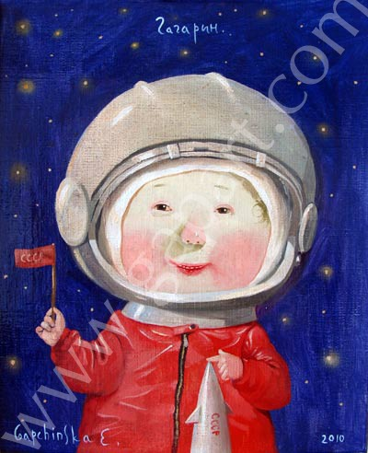
Coco Chanel
Yuriy Gagarin

Slide 13
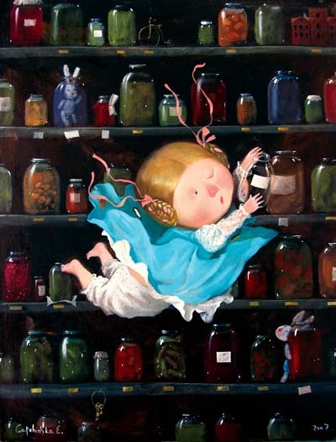
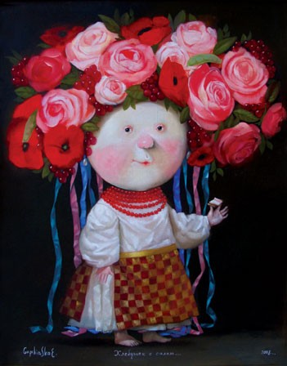
Alice
Nina Matvienko

Slide 14
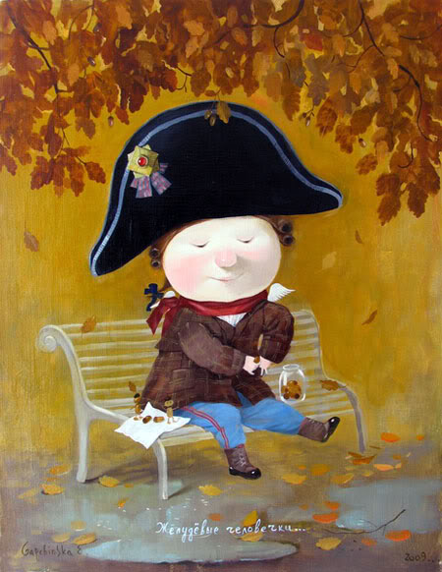
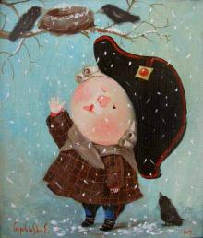
Napoleon Bonaparte

Slide 15
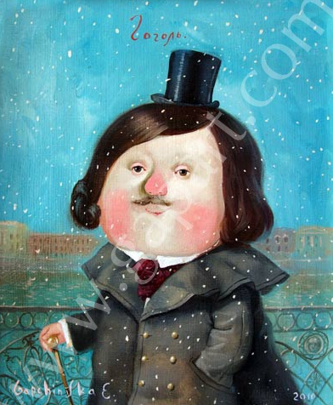
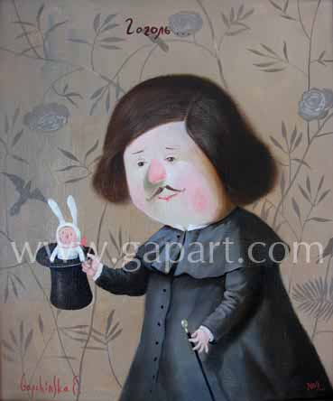
Nikolai Gogol

Slide 16
Covers of books

Slide 17



Slide 18

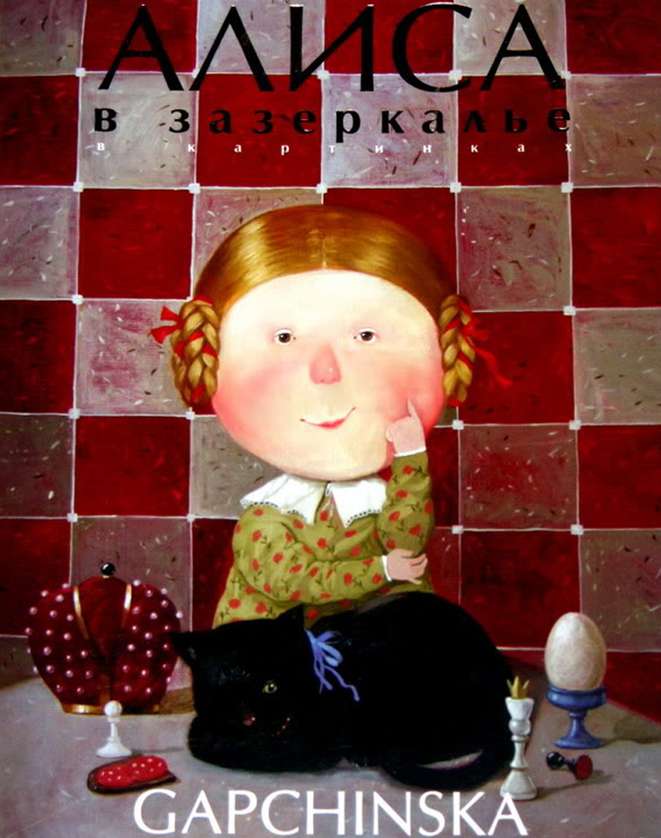

Slide 19
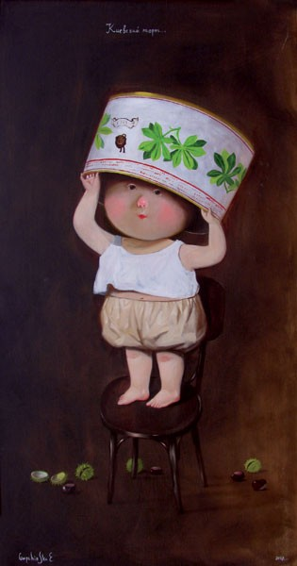
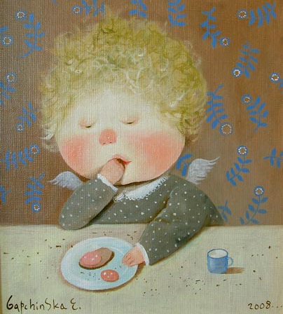
I fell in love with her characters – funny little children-angels who savor chocolate and sausage and like posing in nice clothes!

Slide 20
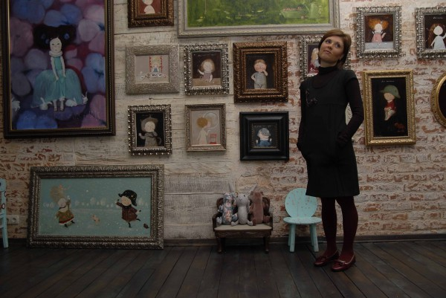
Eugenia Gapchinska is now one of the most popular Ukrainian artists!

