Slide 1

1. Introduction
Adjective – це слово, яке описує або уточнює іменник. Відповідає на питання "Який?
Adverb – це слово, яке описує або уточнює дієслово , прикметник (adjective) або інший прислівник. Відповідає на питання "Як?""

Slide 2



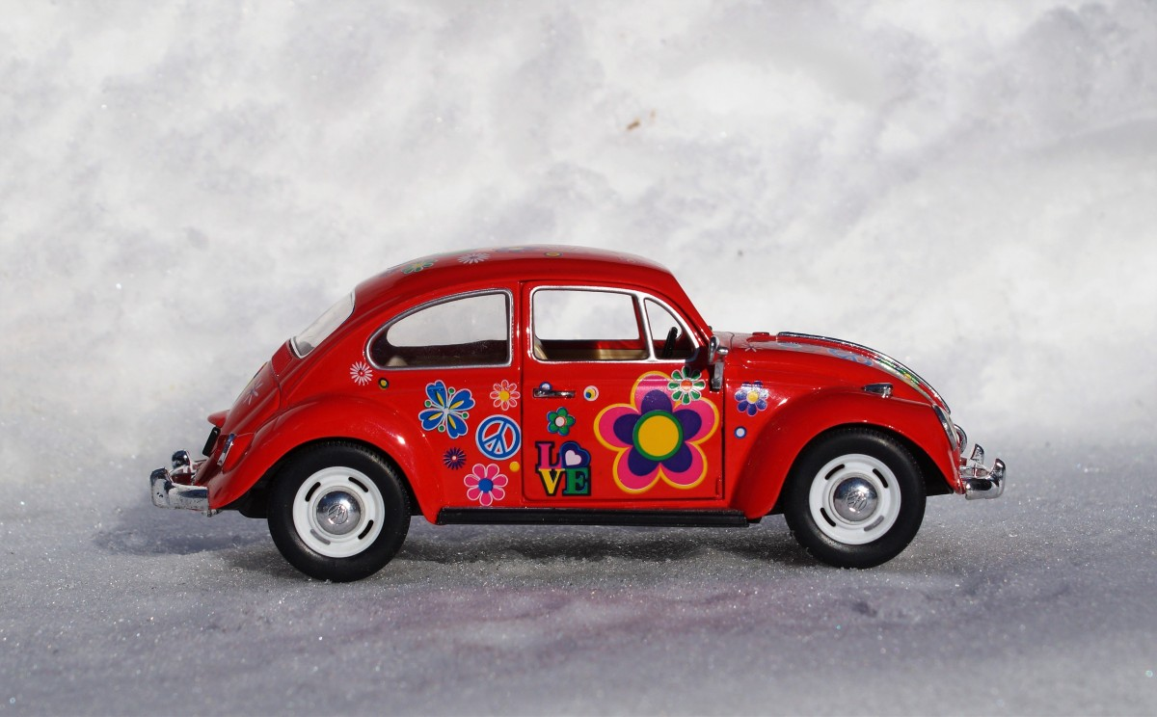
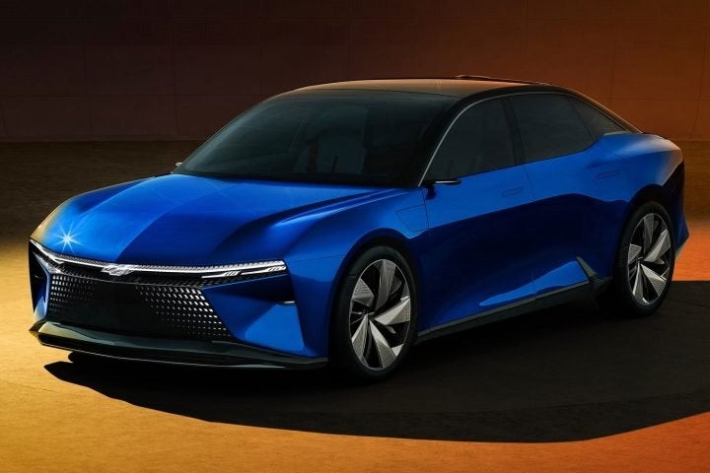
2. Прикметники
Definition
Adjectives describe nouns or pronouns, giving more information about them.
Examples:
The big house.
A happy child.
She is smart.
Types of Adjectives
Descriptive: Describes a quality (e.g., beautiful, old).
Quantitative: Refers to quantity (e.g., some, few).
Demonstrative: Points out specific items (e.g., this, those).
Possessive: Shows ownership (e.g., my, his).
Position of Adjectives
Before the noun: "She has a small car."
After the verb "to be": "The car is small."

Slide 3
3. Прислівники
Adverbs modify verbs, adjectives, or other adverbs, describing how, when, where, or to what extent something happens.
She runs quickly. (Modifies verb "runs"), It’s very hot. (Modifies adjective "hot"), He spoke quite clearly. (Modifies adverb "clearly")
Adverbs of Manner: Describe how something happens (e.g., quickly, slowly).
Adverbs of Time: Indicate when something happens (e.g., yesterday, now).
Adverbs of Place: Indicate where something happens (e.g., here, there).
Adverbs of Frequency: Indicate how often something happens (e.g., always, never).
Adverbs of Degree: Indicate the intensity of an action or adjective (e.g., very, too).
Forming Adverbs Quick → Quickly Happy → Happily

Slide 4
4. Difference between Adjectives and Adverbs
Adjective Adverb
Describes nouns or pronouns Modifies verbs, adjectives, adverbs
Example: She is beautiful.
Example: She sings beautifully.

Slide 5
5. Common Mistakes
Using an adjective instead of an adverb:
Incorrect: She runs quick.
Correct: She runs quickly.
Confusing adjectives and adverbs in comparative forms.

Slide 6
6. Practice Exercise
  She walks __ (slow/slowly).
  The movie was __ (good/well).
  He speaks __ (clear/clearly).

Slide 7
7. Conclusion
Importance of knowing the difference between adjectives and adverbs for clear and accurate communication.

