Slide 1

Young people and society

Slide 2

Every generation and every group brings the door into other things

Slide 3
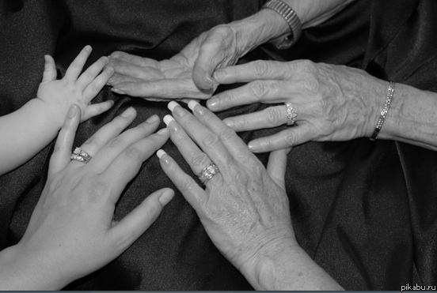
Every new generation must rewrite history in its own way.

Slide 4
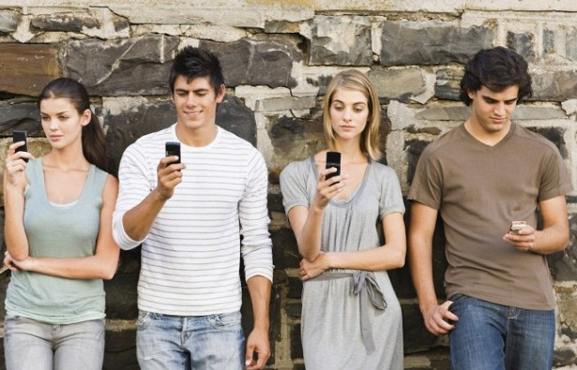
Every generation is more influenced by technology, which is always changing faster

Slide 5


Slide 6
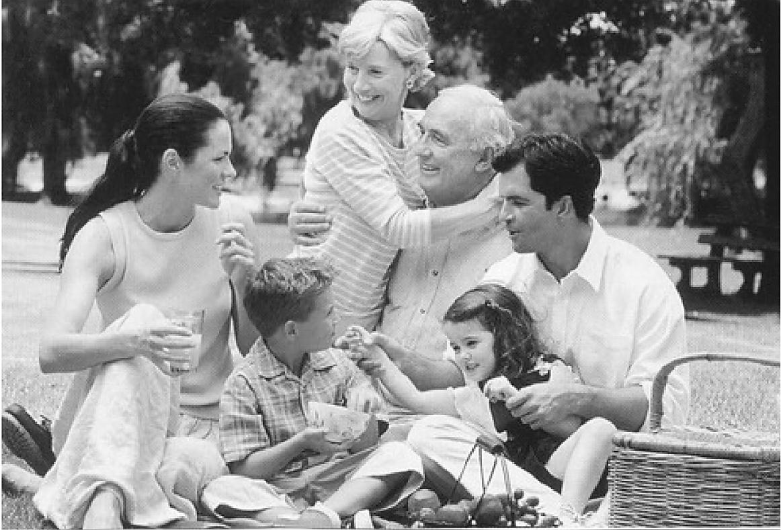
What do you know about life in 2000?

Slide 7

How do you think what was different from today?

Slide 8

What do you think was the same?

Slide 9

What things do you think were important to students like yourself in 2000?

Slide 10
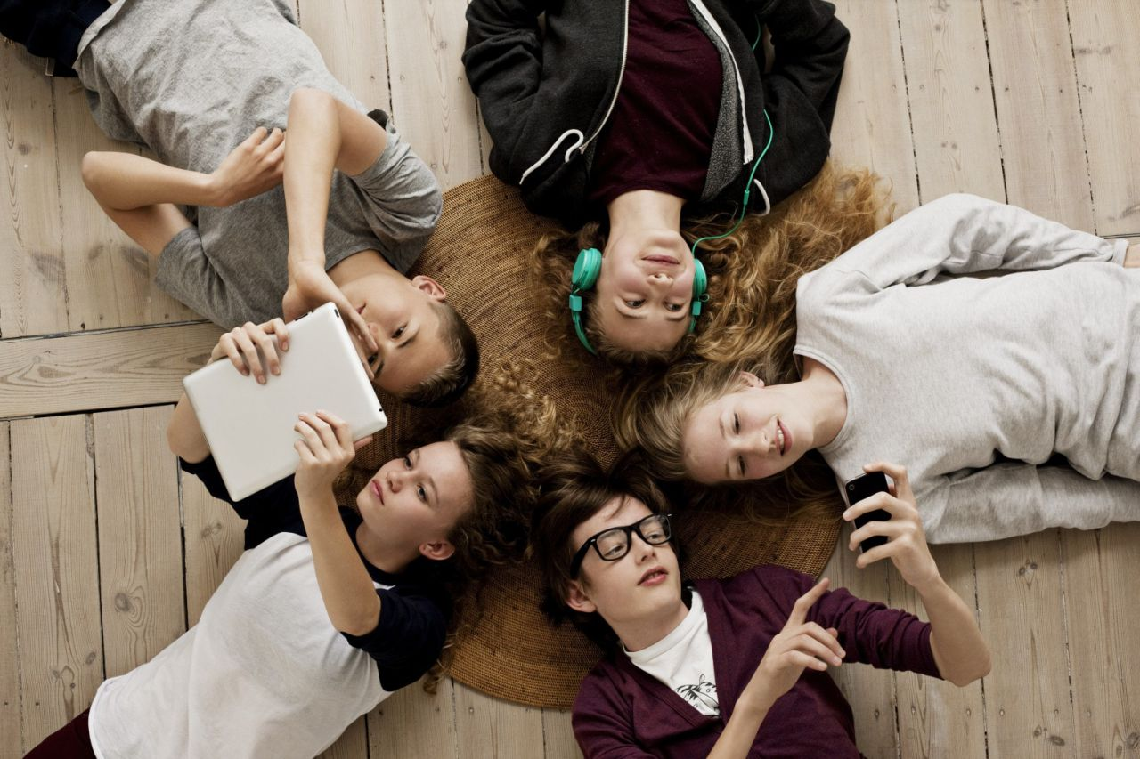
What has changed?

Slide 11

What has stayed the same?

Slide 12

What three things are most important in your life today?

Slide 13
By the end of the lesson:
I can talk about different generations,
I can compare different times,
I can make up a dialogue concerning this theme,
I can answer the questions what has changed and what is the same.

Slide 14
Homework:
- Find the information about youth subcultures of 2000 and be ready to talk about them.

Slide 15


