Slide 1
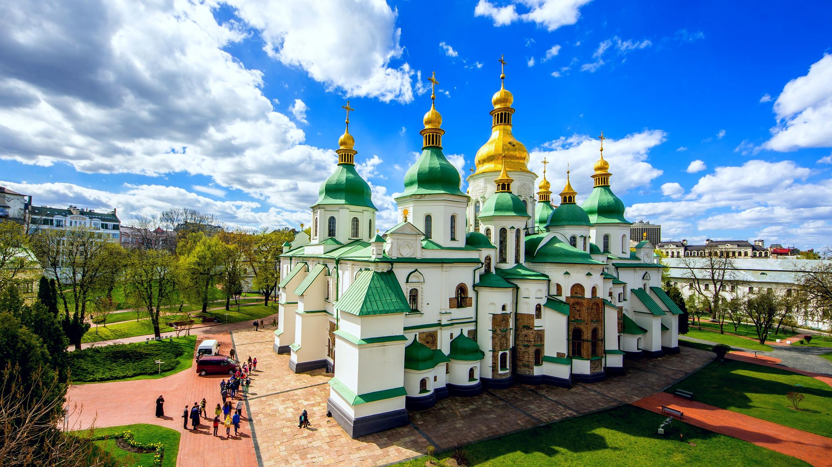
St. Sophia’s Cathedral

Slide 2
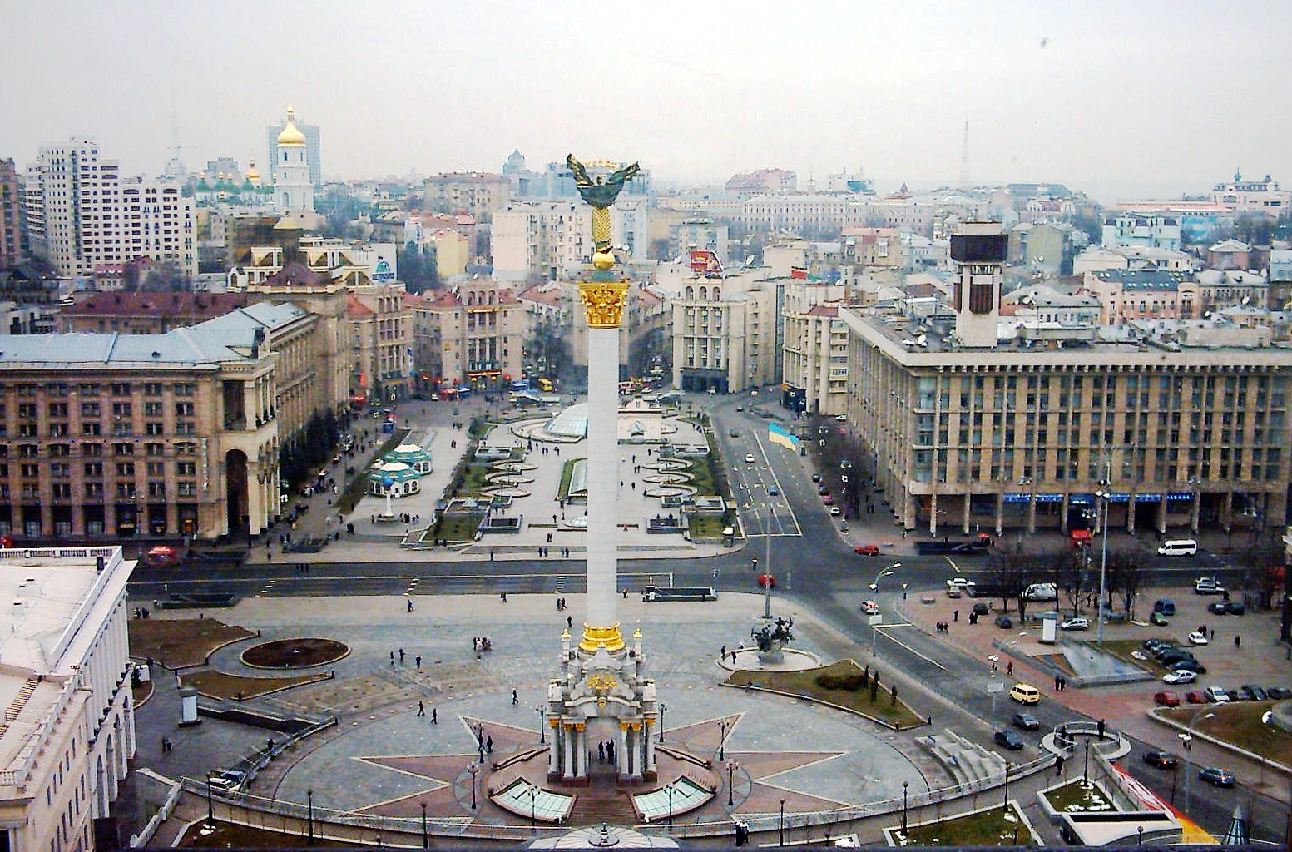
Independence Square

Slide 3
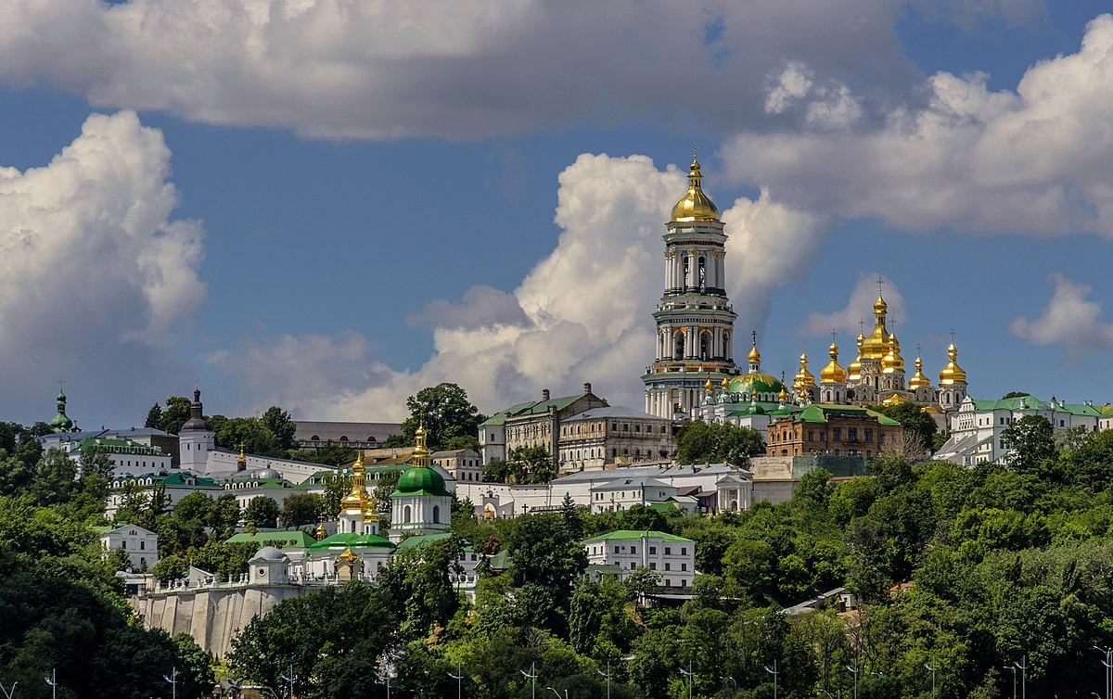
the Kyiv-Pecherska Lavra

Slide 4
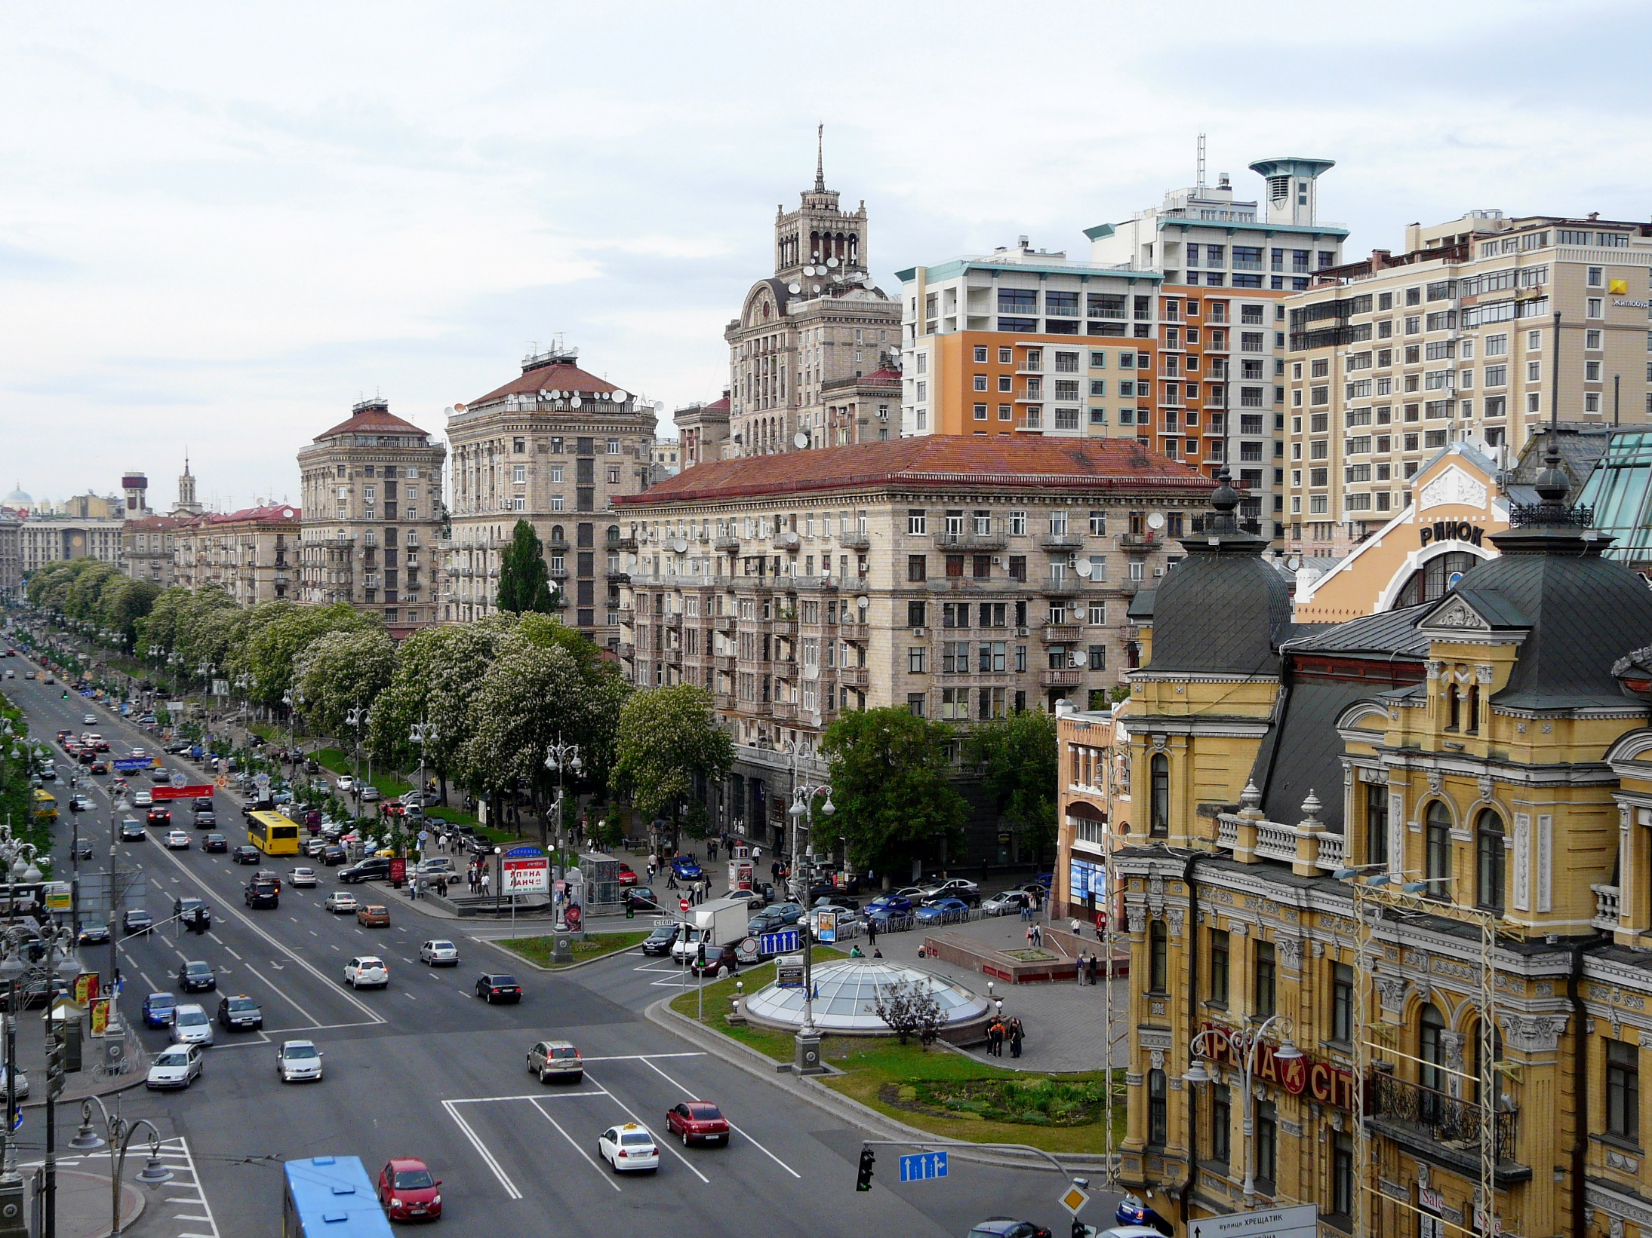
Khreshchatyk Street

Slide 5
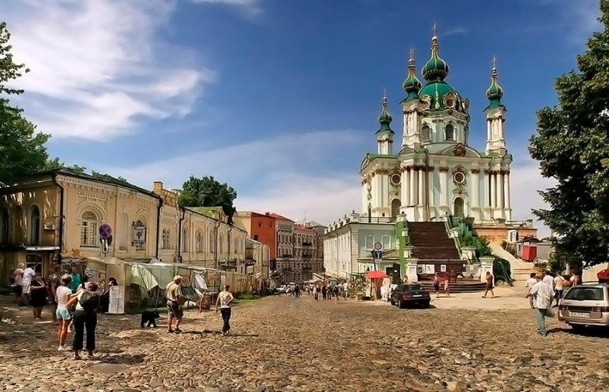
Andriyivskiy Uzviz (Descent)

Slide 6
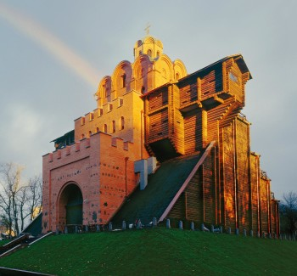
the Golden Gate

Slide 7
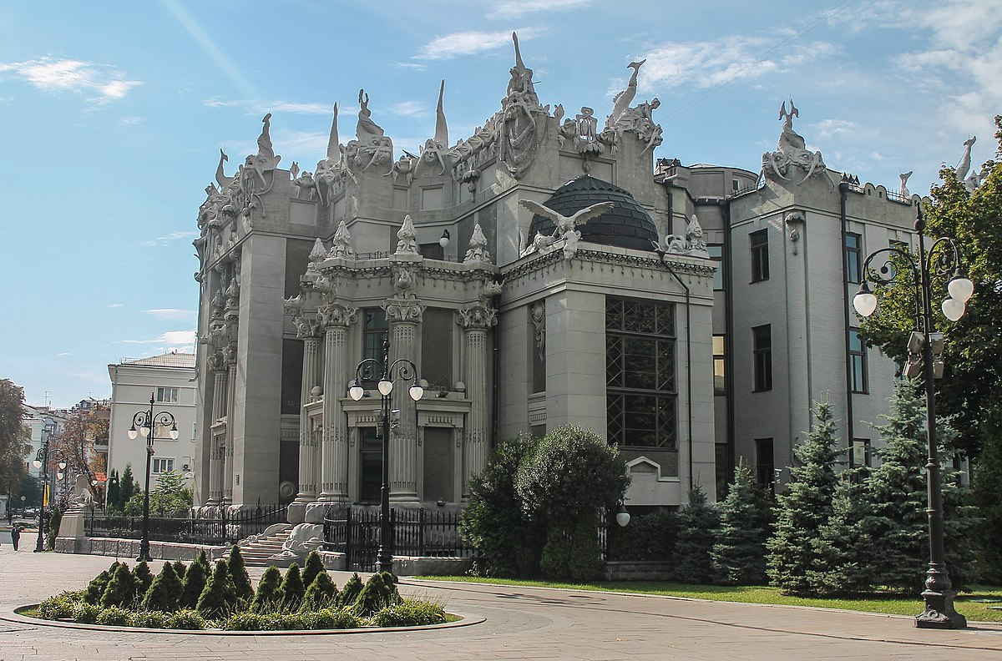
the House with Chimeras

Slide 8
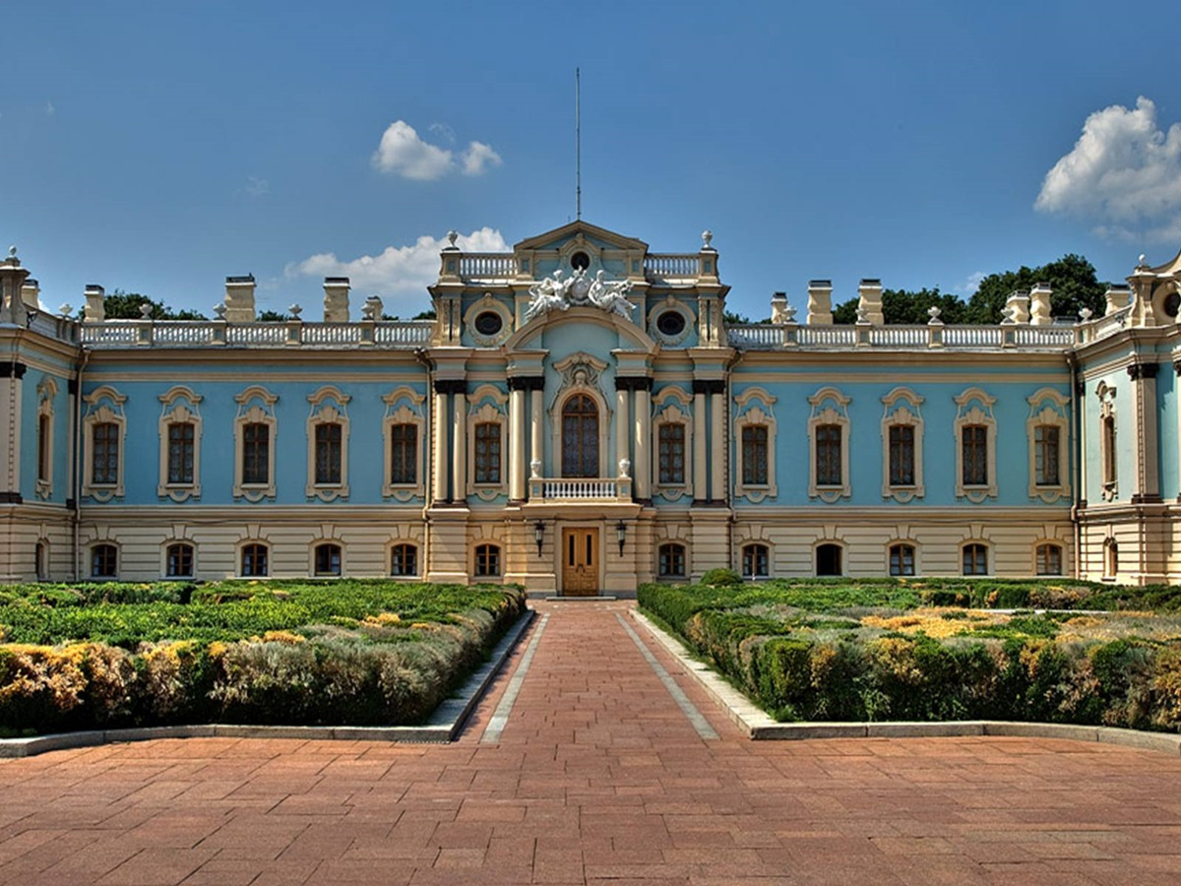
Mariyinskiy Palace

Slide 9
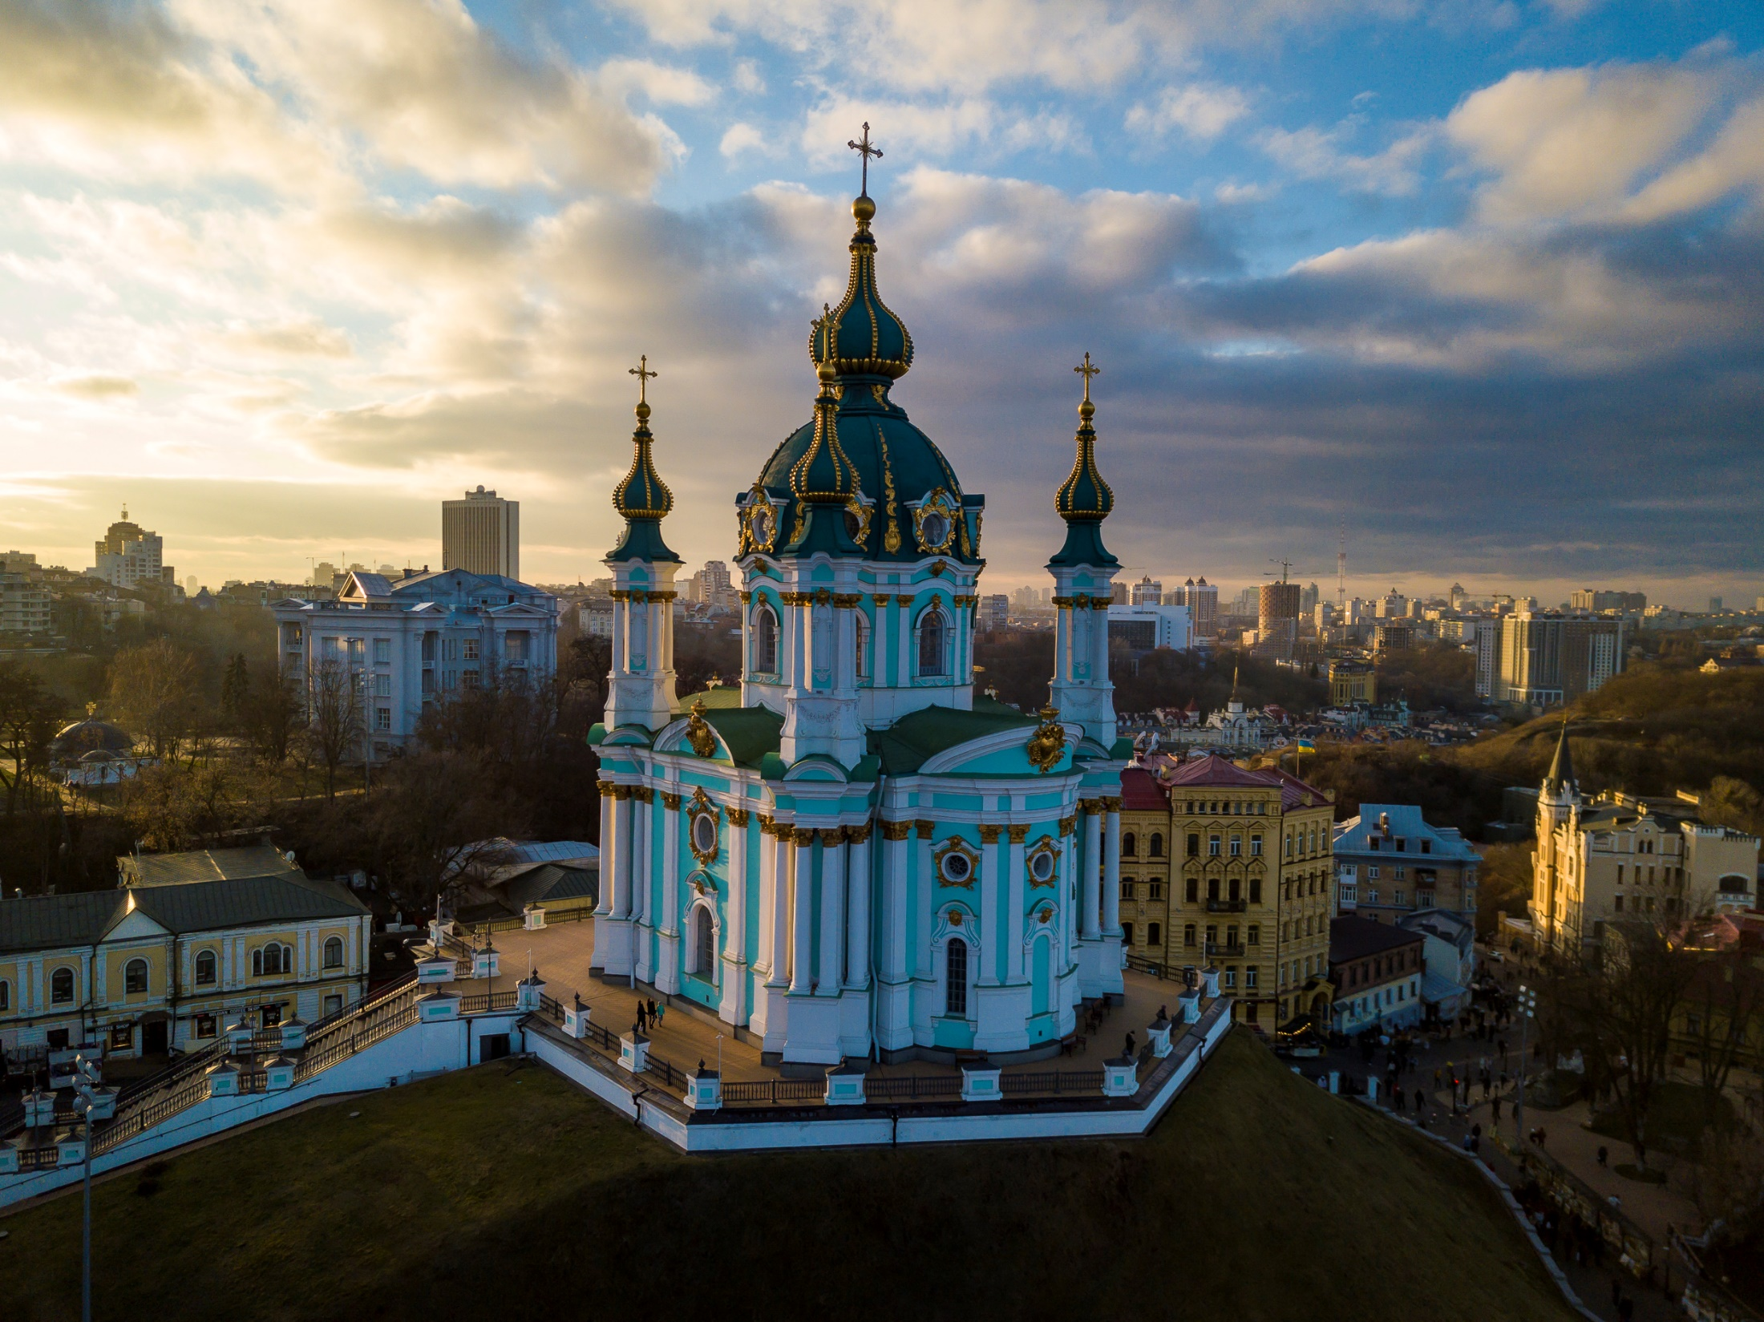
St. Andrew’s Church

