Slide 1
Ask you friends if they do the following (Do you go to a sports centre?)
- go to a sports centre
- go to P.E. lessons
- play basketball
- do karate
- go cycling
- watch sports programmes
- go swimmimg
- play ice hockey

Slide 2
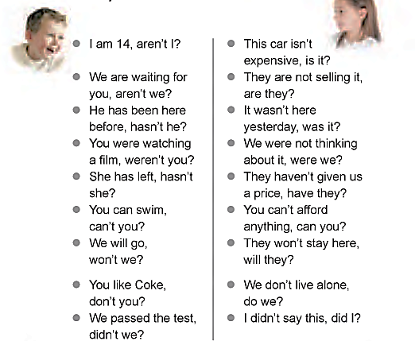
Question tags / tag questions
aren’t I
is it
have they чи не так?
weren’t you
can you

Slide 3
Question tag : ДОПОМІЖНЕ СЛОВО + ХТО учні самостійно добирають заперечні форми поданих допоміжних слів
is – isn’t
are –
am –
have – will –
has – can -
was – would -
were – should -
did – must -
do –
does -

Slide 4
Question tag : ДОПОМІЖНЕ СЛОВО + ХТО
is – isn’t
are – aren’t
am – aren’t will – won’t
have – haven’t can – can’t
has – hasn’t would – wouldn’t
was – wasn’t should –shouldn’t
were – weren’t must – mustn’t
did – didn’t worked – didn’t
do – don’t work – don’t
does – doesn’t works – doesn’t

Slide 5
Question tag : ДОПОМІЖНЕ СЛОВО + ХТО
You can swim, can’t you?
+ -
Tom isn’t your brother, is he?
- +

Slide 6


