Slide 1

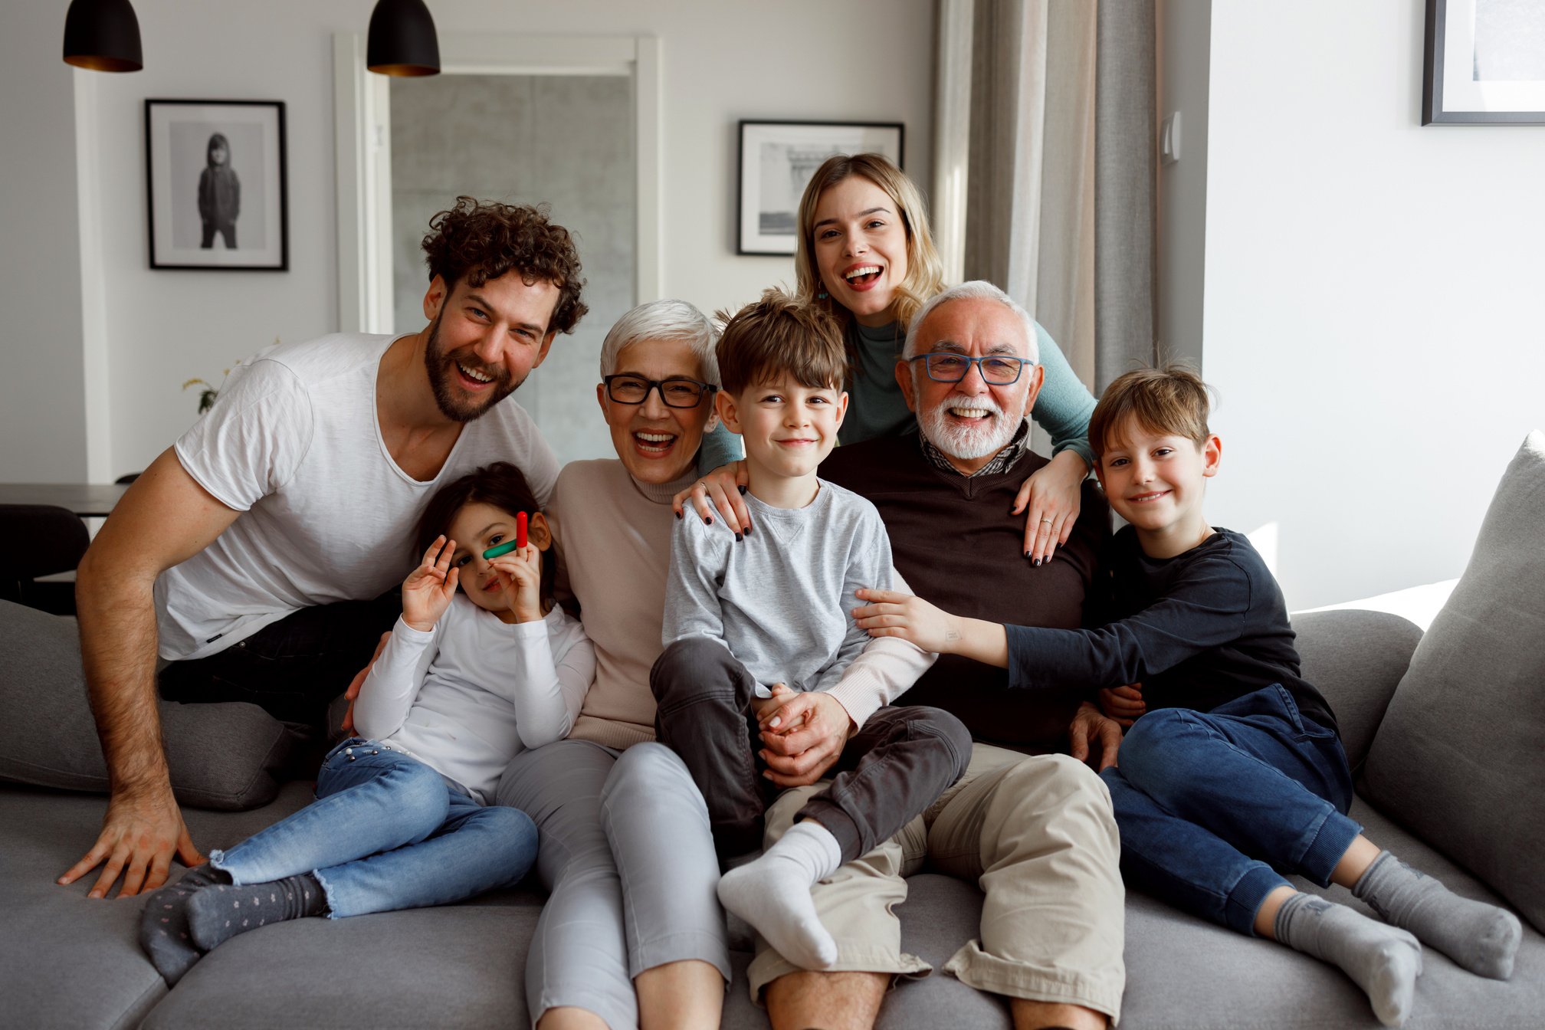
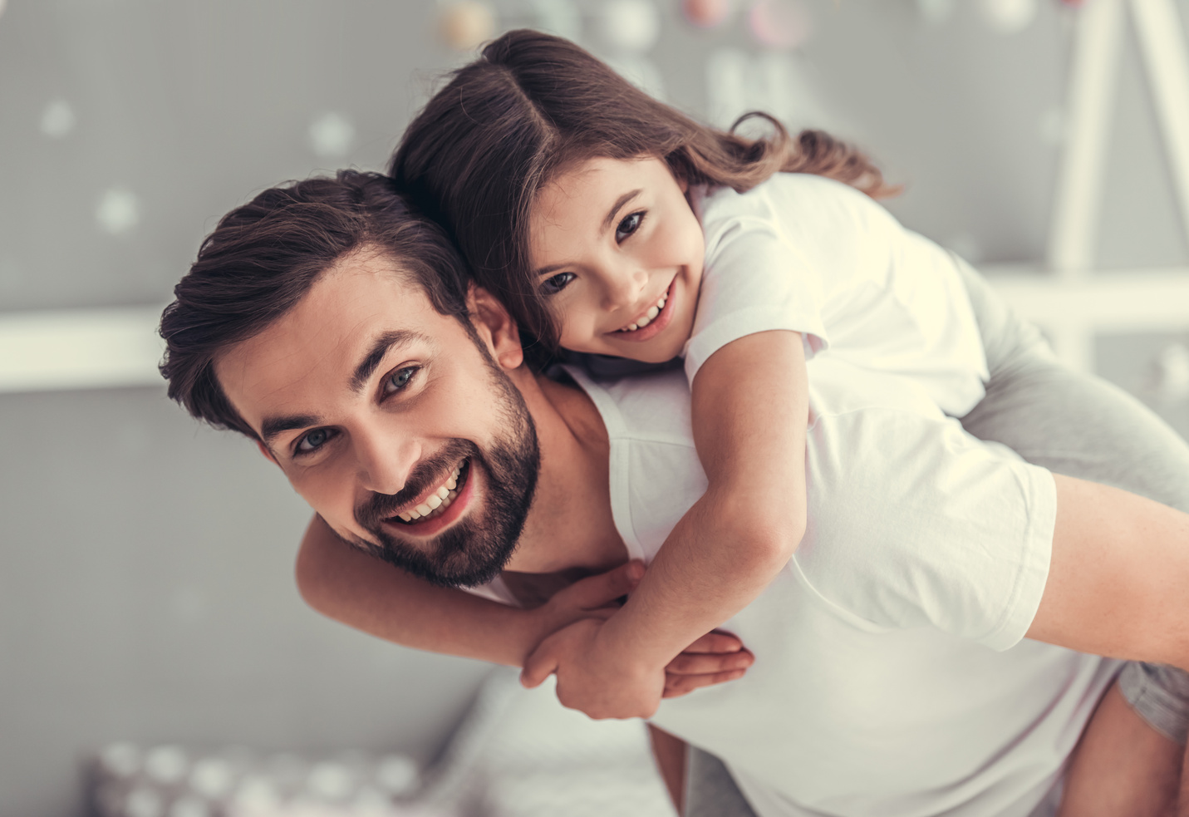

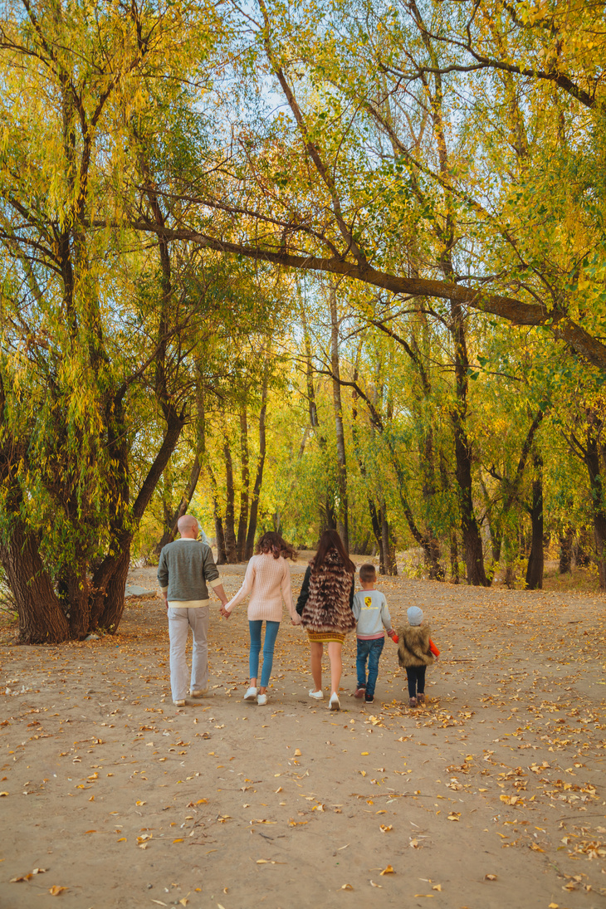
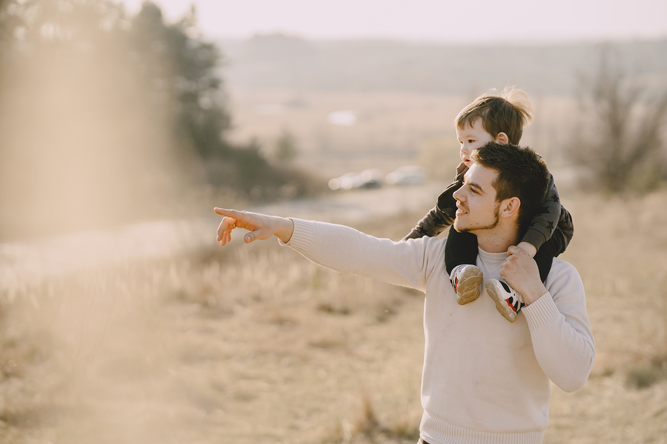
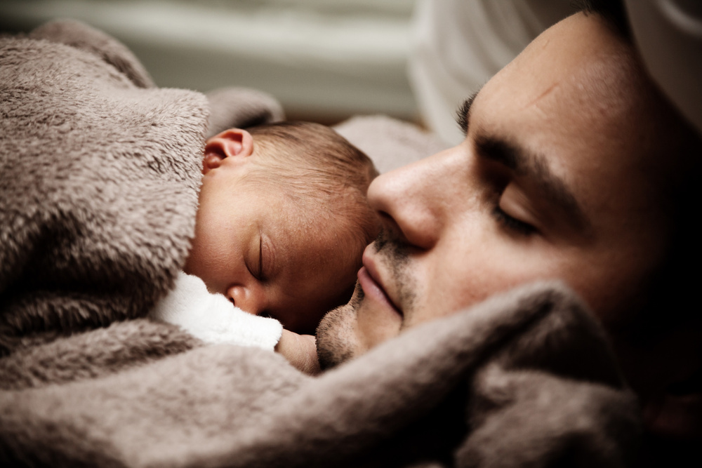
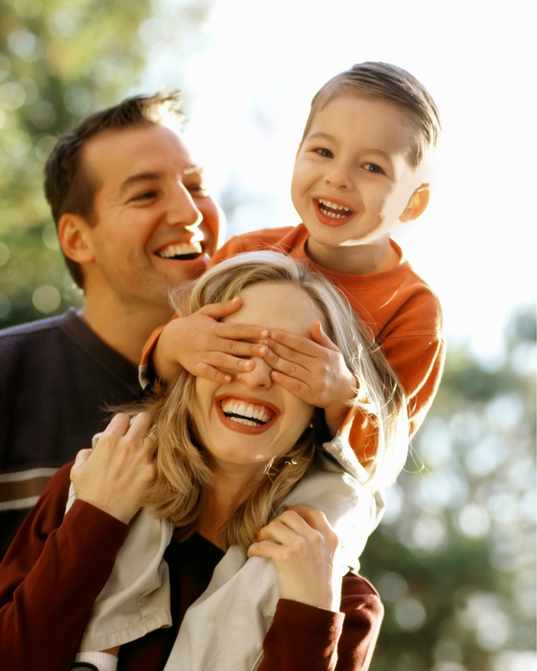
Unit 2
What About Your Family?

Slide 2



What words do you associate with the word “FAMILY”
Unscramble the words
tanu
aunt
elunc
uncle
Family
tduagerh
daughter
nos
son

Slide 3
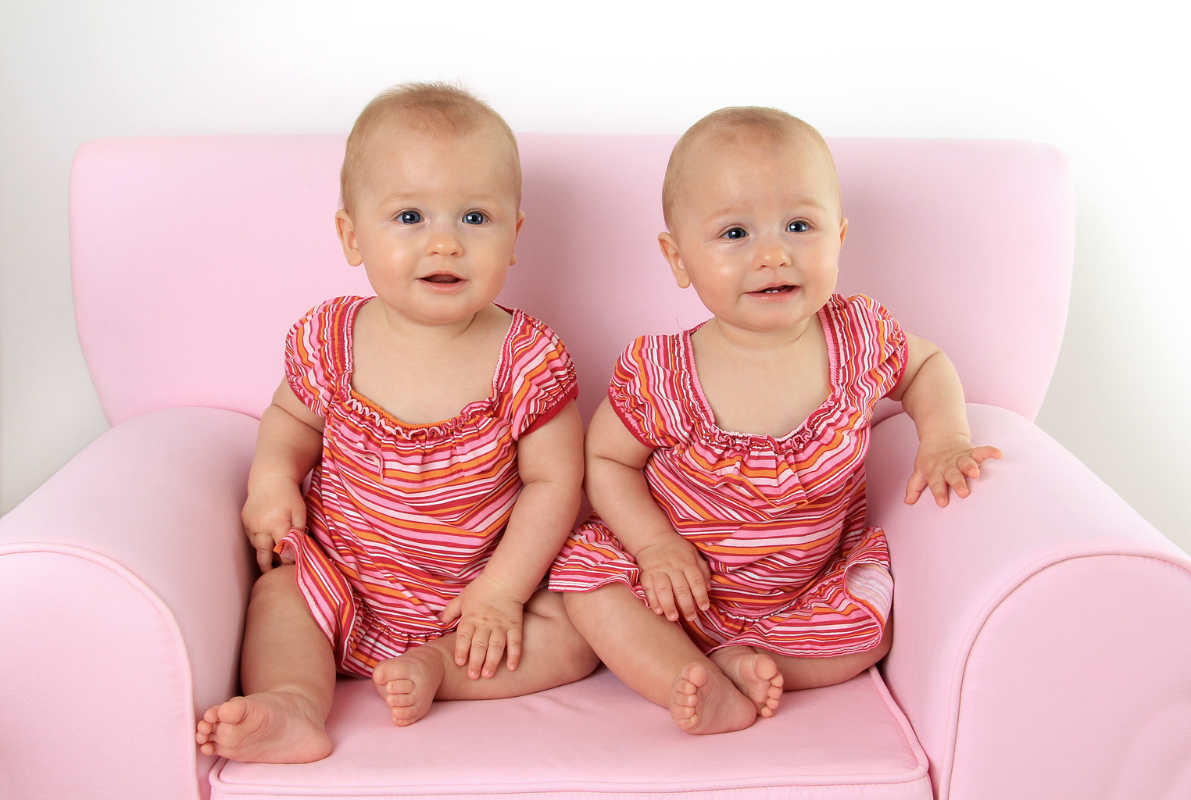
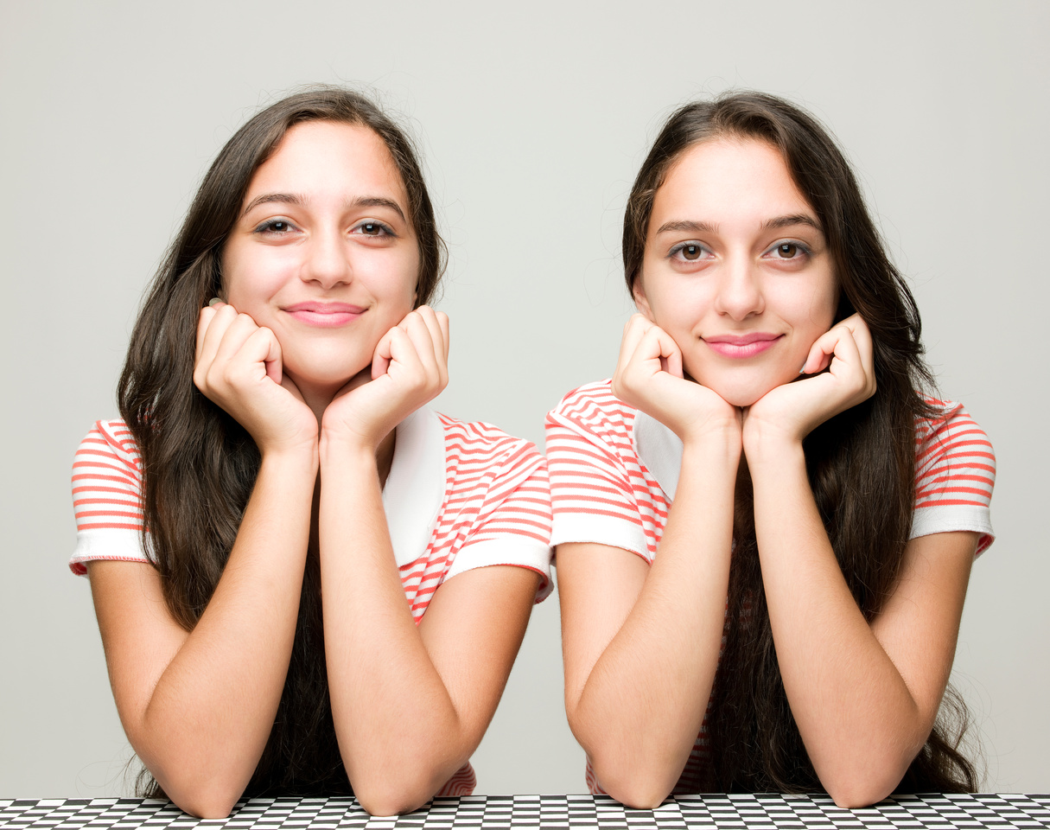
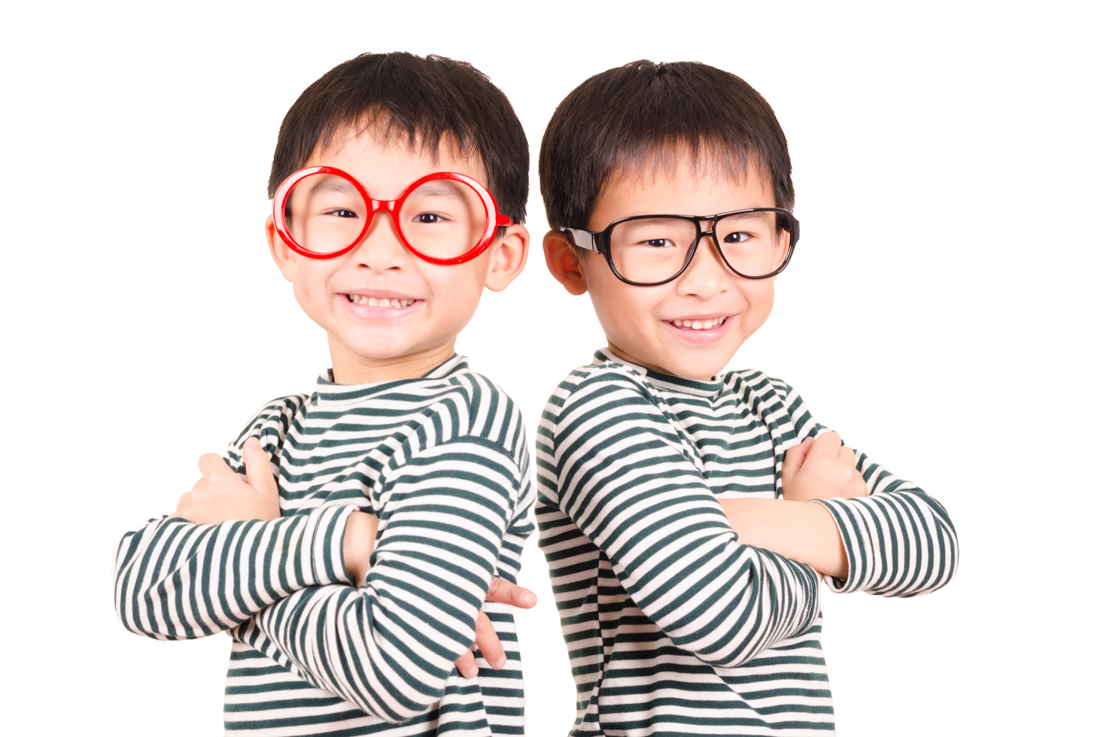
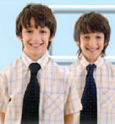


Have you got a twin brother or a twin sister?
Do you think it is fun to be twins or it is a problem?

Slide 4






to enjoy
/ɪnˈdʒɔɪ/
насолоджуватись
power /paʊər/
сила
twin
/twɪn/
близнюк
to compete
/kəmˈpiːt/
змагатися
to grow up
/ɡrəʊ ʌp /
дорослішати
together
/təˈɡeðər/
разом
each other
/ˌiːtʃ ˈʌðər/
один одного

Slide 5



What do you know about twins?
Take a look at these comments
Sue,6
Taras, 12
Ira, 9
Twins always compete
with each other.
Twins look alike and no one
can say who is who.
Twins should always be in different
classes so they can learn to live
without each other.
Ahmet, 10
Santiego,11
Twins have special
powers.
Twins are always
best friends.
look alike - схожі один на одного

Slide 6

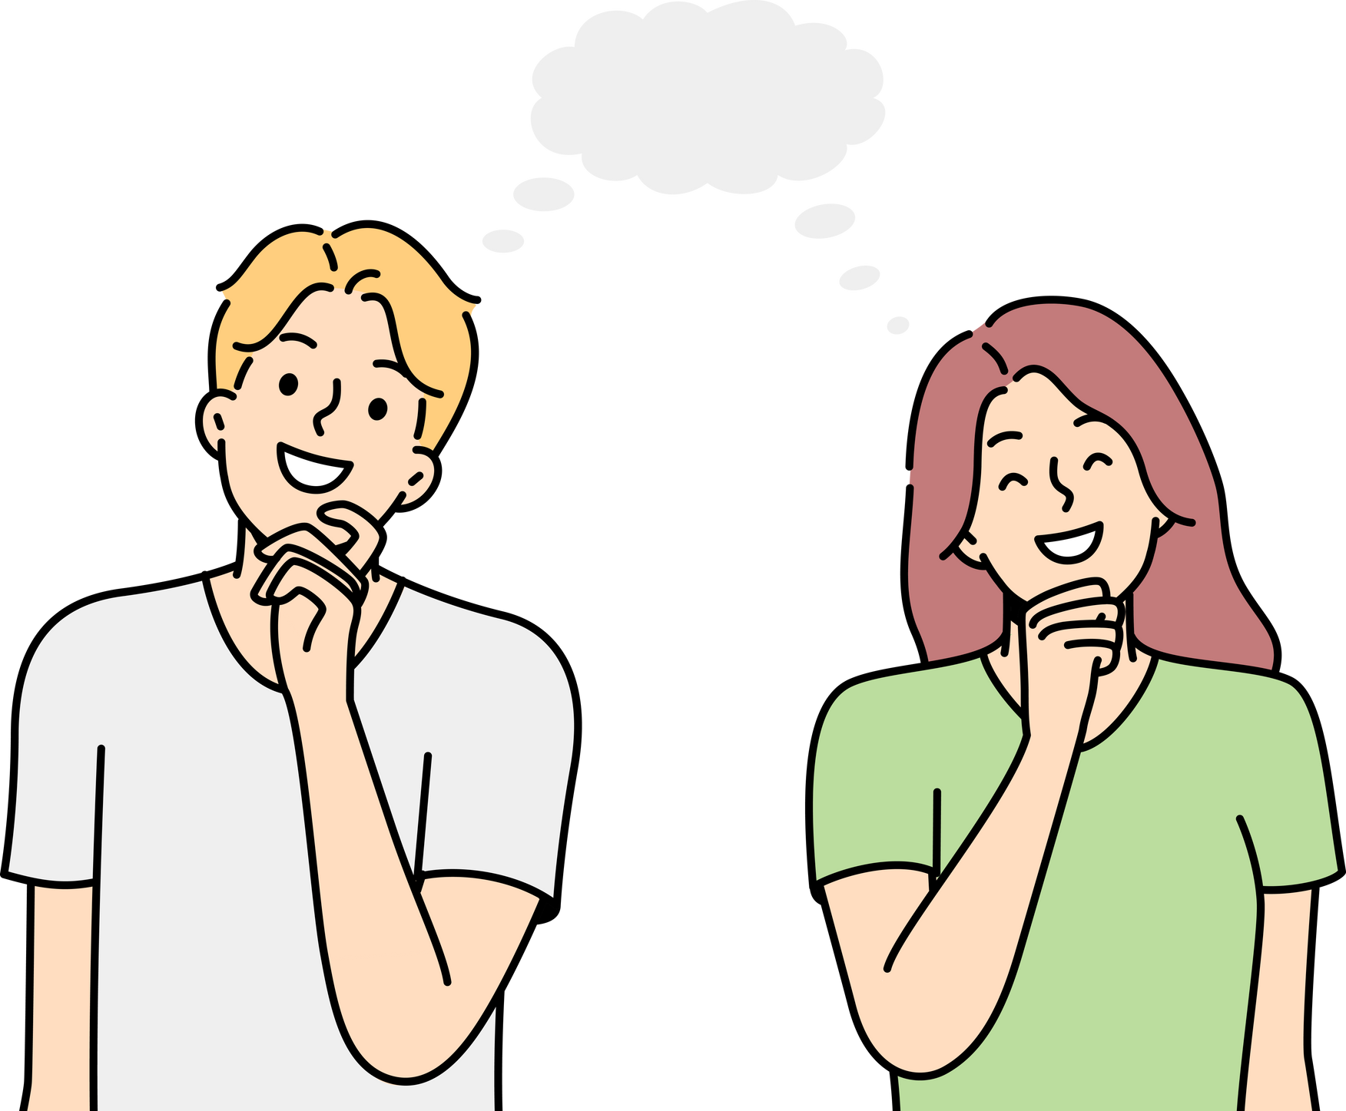

Read, guess and match the words with their meanings.
1 to compete
2 an only child
3 a twin
4 to look alike
5 similar
a) a child who has got no brothers or sisters
b) somebody who was born at the same time as his or her brother or sister
c) to look like somebody else
d) to try to do everything better than somebody else
e) almost the same

Slide 7
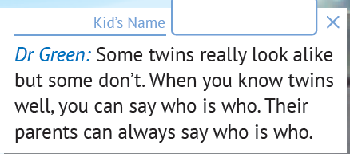
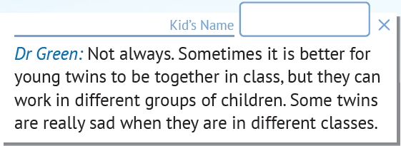
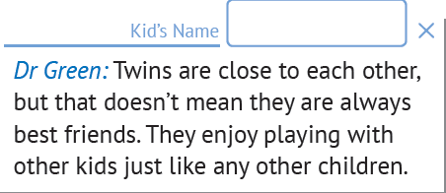
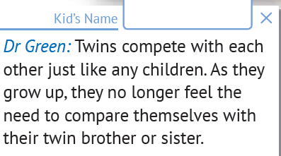
Listen and read the article. Compare the kids’ answers with Dr Green’s words.
Match Dr Green’s answers with the kids’ comments.

Slide 8



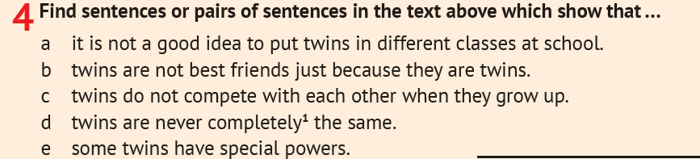
Записати у словник та вивчити слова с.27 (слайд 4)
Виконати усно Впр.4, с.27

