Slide 1
Interesting hobbies

Slide 2
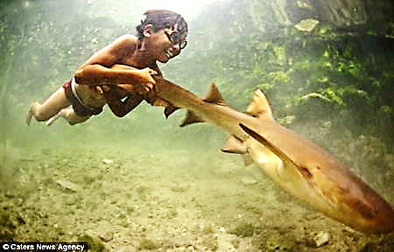
Swimming with sharks
67-years-old Wolgan Linder has such unusual hobbies. Linder of shark and submarine world attract from babyhood, when in 6 years he first knew about "submarine monsters" from books.

Slide 3
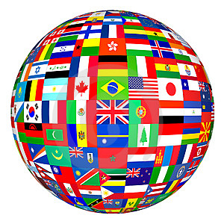
Vexillology
Study of flags, in collection of advocate from Portland more than 200 flags of countries of the whole world. Devero Canon deserved a nickname Flagman for the hobby.

Slide 4
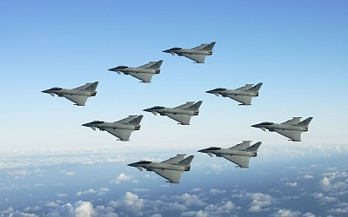
Here are 100 jet-fighters in collection of Michel Pona! In addition, he collected 500 motor cycles and series of cars “Ebart".

Slide 5
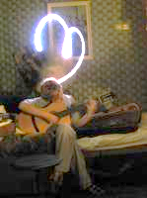
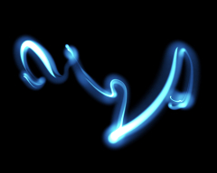
Frizlait
wonderful art of drawing light.

Slide 6
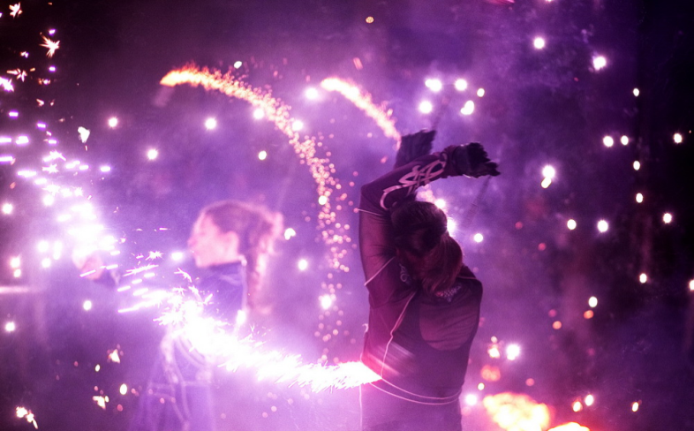
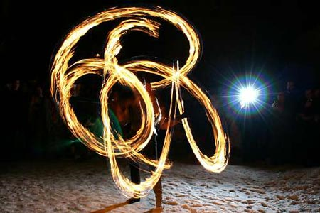
Fire
Fiery shows is a show in that people do different acrobatic tricks with the special conflagrant projectiles in hands.

Slide 7
Friendship bracelet
A friendship bracelet is a bracelet given by one person to another as a symbol of friendship. Friendship bracelets are handmade and usually made out of embroidery floss or thread. There are various styles and patterns, but most are based on the same simple half-hitch knot. The making of friendship bracelets is a version of macrame.

Slide 8
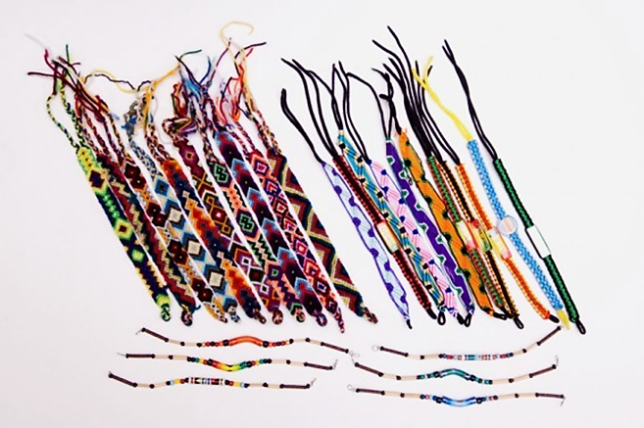

Slide 9
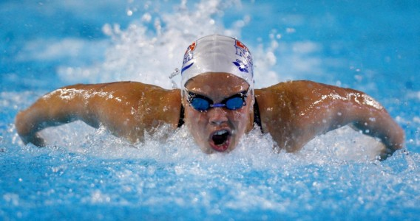
Swimming
Swimming is a type of sport, consisting in overcoming swimming for the least time of different distances.

Slide 10
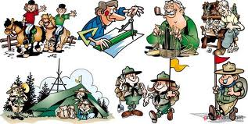
Everybody must have even one cognitive type of hobby.

