Slide 1
Live and learn
Speaking skill builder

Slide 2
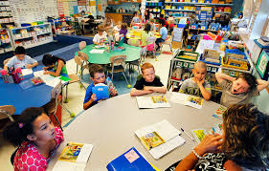
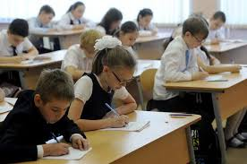
Look at the pictures and find at least five differences between the way children study

Slide 3
Work with your partner to make up sentences about education in the previous century and modern schools
Model: In the previous century, students/pupils ….,while nowadays …

Slide 4
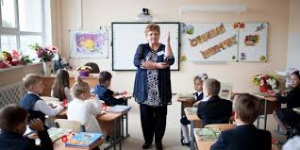
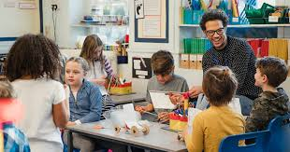
Match the statements below with the pictures
1. Children should be quit and keep still while they are learning and they should do what the teachers tell them.
2. Children need to talk and discuss together while they are learning.
3. Pictures and boors help children to learn.
4. Education means to read and write and do maths.
5. Education means learning about the world and about how to find out information for yourself.
6. Teachers should set a good example to their students both in and out of the classroom.
7. Teachers should tech children to co-operate and to research each other

Slide 5
Work with your partner. Discuss the questions below.
1. Where do we learn the skills necessary to become a good student – in elementary, middle or high school?
2. What are the skills that separate good students from bad students?
3. Are there any subjects you wanted to study but they weren’t available at your school?
4. Do you think it is easier to learn as a child or as an adult?
5. Is it difficult for people without college education to get good jobs in Ukraine? Does education guarantee a good job?

Slide 6
Read the information about International education programs and say which program you would like to take. Reason your choice.
1. NORTHERN ARIZONA UNIVERSITY (USA): Our degree program prepares candidates for a career as an English as a second language (ESL) classroom teacher, ESL resource teacher, or a teacher responsible for providing ESL instruction and support in the regular classroom or special settings.
2. UNIVERSITY OF OULU (FINLAND): MA in Education and Globalisation is a full-time two-year international Master’s programme. Students major in educational sciences. The central aim of the programme is to develop quality in education and to equip students to exercise socially responsible leadership in complex and diverse societies. The programme emphasises North-South-EastWest dialogue and includes studies in international education, interculturalism, globalisation and their effects on various sectors of education.
3. VANDERBILT PEABODY COLLEGE (USA): Through a multifaceted approach to education led by faculty with expertise in human capital development, international organizations, and education policy reform, IEPM equips students with the skills and knowledge to become changemakers in the field of international education and human and economic development around the world.

Slide 7
4. RAYS ONLINE COLLEGE CREDITS, JOHN ZEPP ACADEMY FOUNDATION INC (the Philippines): A Two-year course (including thesis) for international educators. Contains basic courses in research methods, as well as specialized courses such as e-learning, cross-cultural psychology, language issues, comparative education systems.
5. INSTITUTO FRANKLIN – UNIVERSIDAD ALCALA DE HENARES (SPAIN): he Master in International Education is part of the Teach & Learn in Spain Master Program, and it is designed for future professionals, teachers and administrators who pursue a career in an international environment in all educational levels (from kindergarten to high school).

