Slide 1

FILMS

Slide 2

[ˈkɑmədi] [ˈsaɪ fai] [ˈθrɪlə ] [ˈfæntəsi] [kɑ:ˈtu:n] [ˈmju:zɪkl] [ˈækʃn] [ˌdɑkjuˈmɛntəri] [ˈfeəri teil] [‘horə]
[ hɪsˈtɔrɪkəl] [ˈwestən] [reuˈmæntɪk]
[dɪˈtektɪv]

Slide 3

Vocabulary practice

Slide 4

The words and their definitions

Slide 5
Listening practice
Choose the sentence that is NOT true.
1. Sci-fi films
a. He chooses this kind of film most often.
b. He finds them interesting.
c. He has never watched a terrible sci-fi movie.
d. He finds some sci-fi movies funny.
2. Romantic comedies (romcoms)
a. He does not like romcoms.
b. His girlfriend loves romcoms.
c. Romcoms are predictable.
d. They are often funny.

Slide 6
Listening practice
Choose the sentence that is NOT true.
3. Horror films
a. He usually knows what is going to happen.
b. He prefers to watch them when he is alone.
c. He is interested in the special effects and make-up.
d. He doesn’t find them scary now.
4. Animated films
a. Children’s cartoons are his favourite kind of animated films.
b. He finds Japanese films beautiful and imaginative.
c. He watches cartoons with a young family member.
d. Children’s cartoons can be fun for both adults and children.

Slide 7
Listening practice
Choose the sentence that is NOT true.
5. Action films
a. He thinks action films are better now than in the past.
b. He likes big-budget films.
c. He likes movies with real stunts.
d. He dislikes films with lots of computer graphics.
6. Documentaries
a. He rarely watches documentaries.
b. He finds them depressing.
c. He thinks they talk about things that are not important
d. He doesn’t find them enjoyable or relaxing.

Slide 8
Listening practice
Choose the sentence that is NOT true.
7. Musicals
a. He feels that the characters aren’t realistic.
b. He doesn’t understand the stories.
c. He is glad that they are unpopular.
d. He doesn’t watch them with his girlfriend.

Slide 9
LEONARDO DICAPRIO
Leonardo DiCaprio________(be) born in 1974 and_________(grow up) in Los Angeles. DiCaprio________(begin) his career in the late 1980s. Leonardo DiCaprio always _______ (want) to be an actor. But he _______ (not study) acting, and he nearly ________ (not enter) the profession. As a teenager, his first agent _______ (not like) his name or his haircut! Leonardo ________ (decide) to try again and finally he _______ (play) some small parts on American TV. In 1993, he ________ (receive) his first big break in the film “This Boy’s Life”. People soon _______ (call) him the new “teenage star” and he ________ (act) in films with superstars like Sharon Stone and Gene Hackman. After the Film “Titanic” , he _______ ( change) overnight into a superstar himself.
Grammar practice
was
grew up
began
wanted
did not study
did not enter
did not like
decided
played
received
called
acted
changed

Slide 10
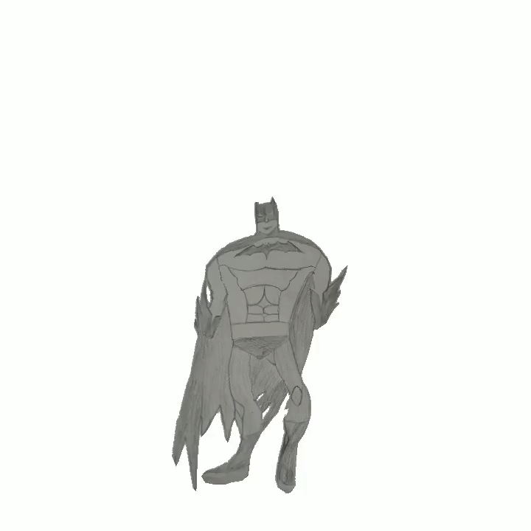
Speaking practice

Slide 11
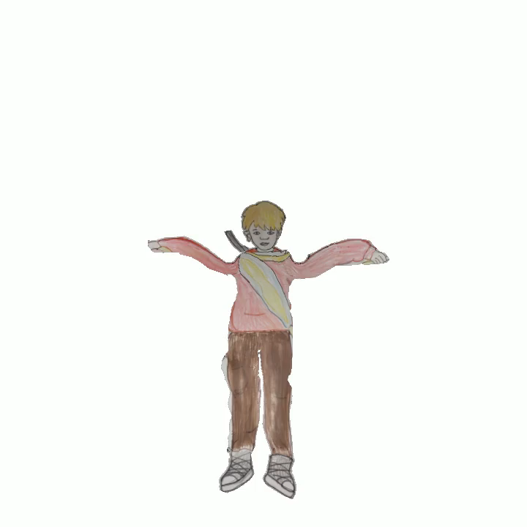
Speaking practice

Slide 12
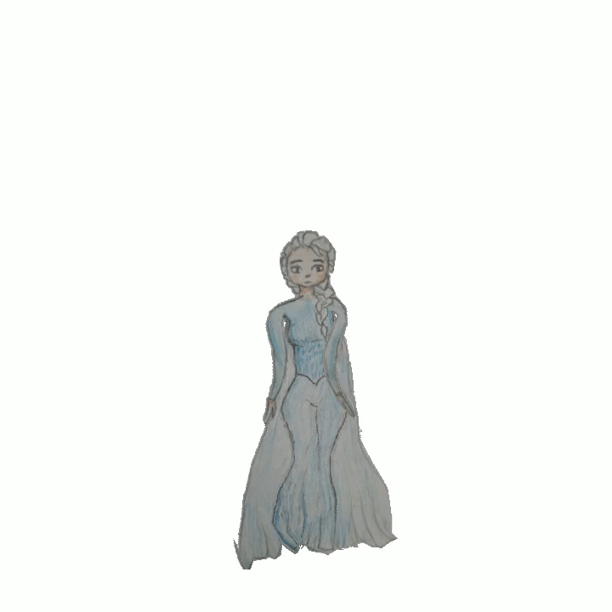
Speaking practice

Slide 13
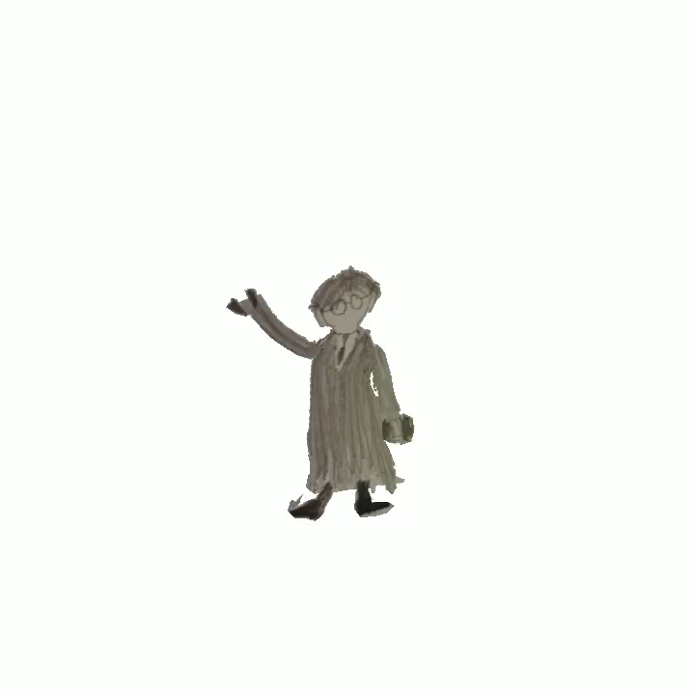
Speaking practice

Slide 14
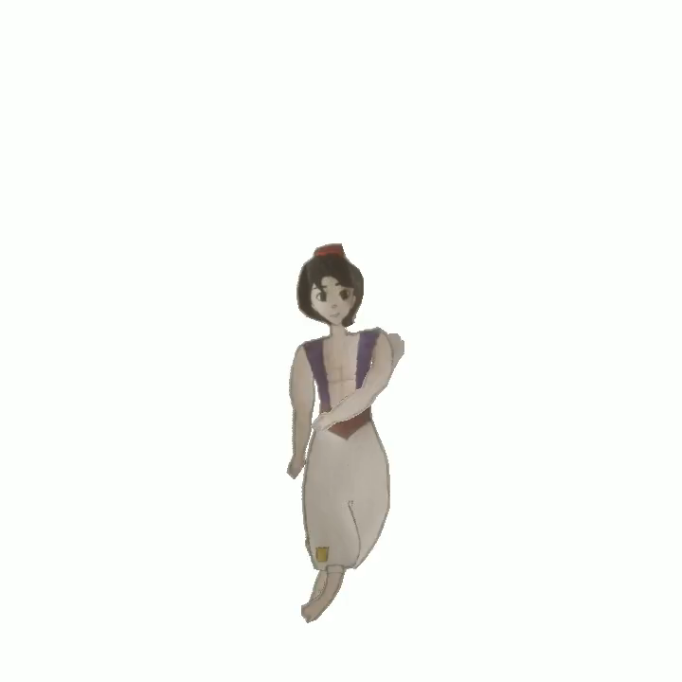
Speaking practice

Slide 15
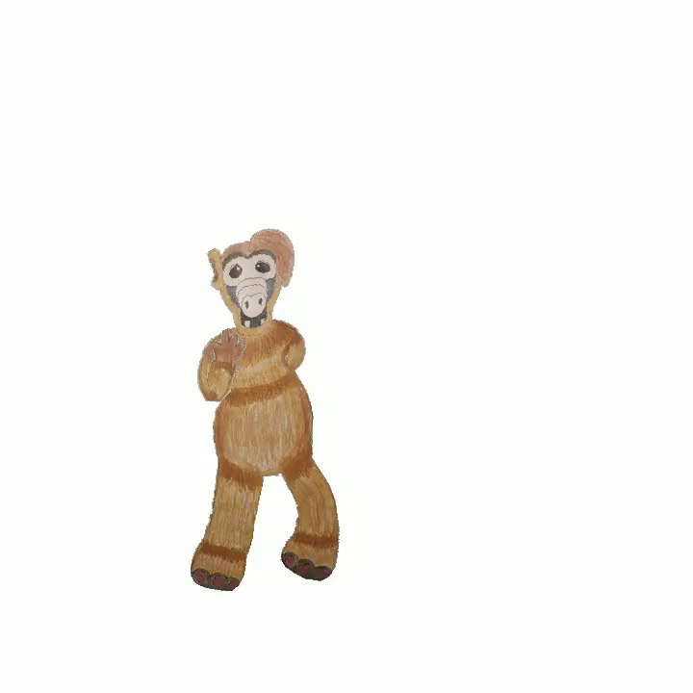
Speaking practice

Slide 16
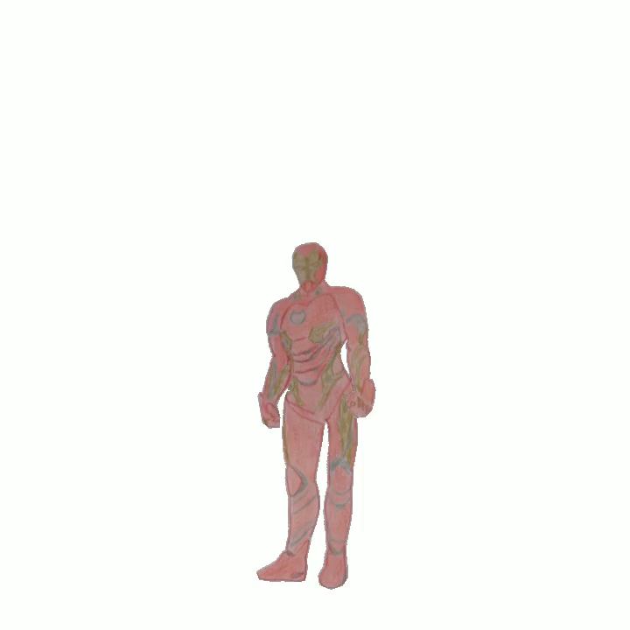
Speaking practice

Slide 17

Speaking practice

Slide 18

Speaking practice

Slide 19



Guess the name of the cartoon
WARM – UP
101 Dalmatians

Slide 20


Guess the name of the cartoon
WARM – UP
The Lion King

Slide 21



Guess the name of the cartoon
WARM – UP
The Grinch

Slide 22



Guess the name of the cartoon
WARM – UP
Snow White

Slide 23


Guess the name of the cartoon
WARM – UP
Kung Fu Panda

Slide 24
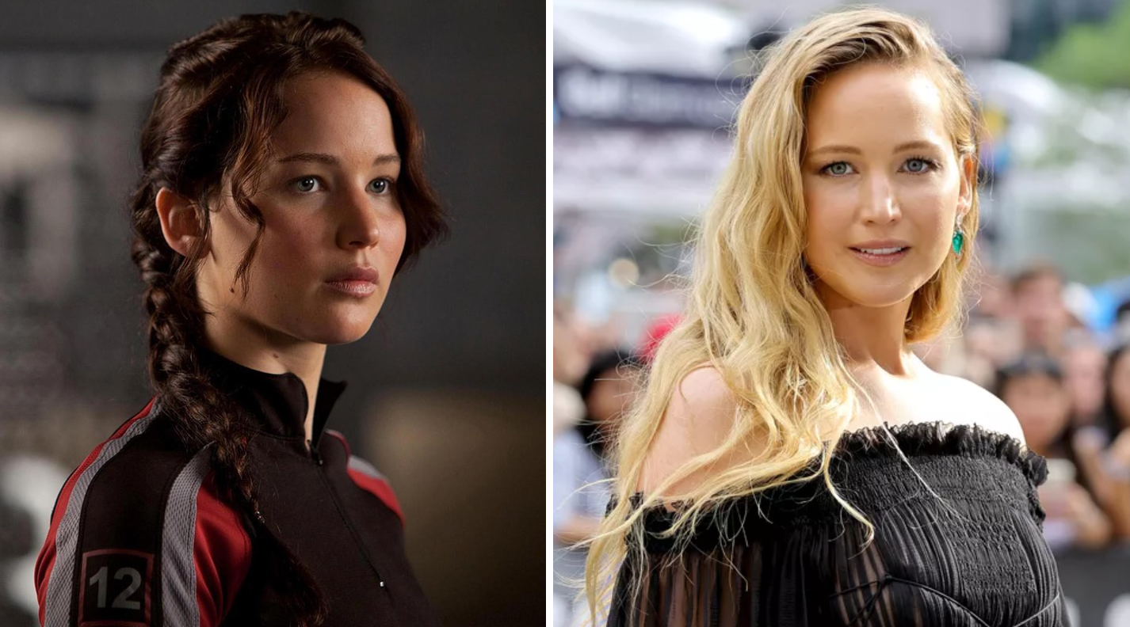
READING PRACTICE

Slide 25
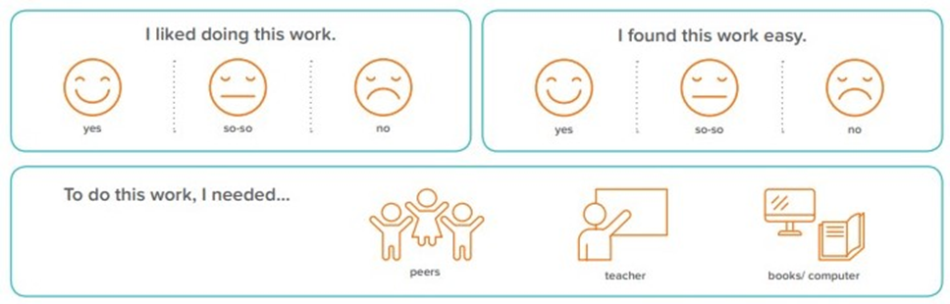
REFLECTION CARDS

