Slide 1
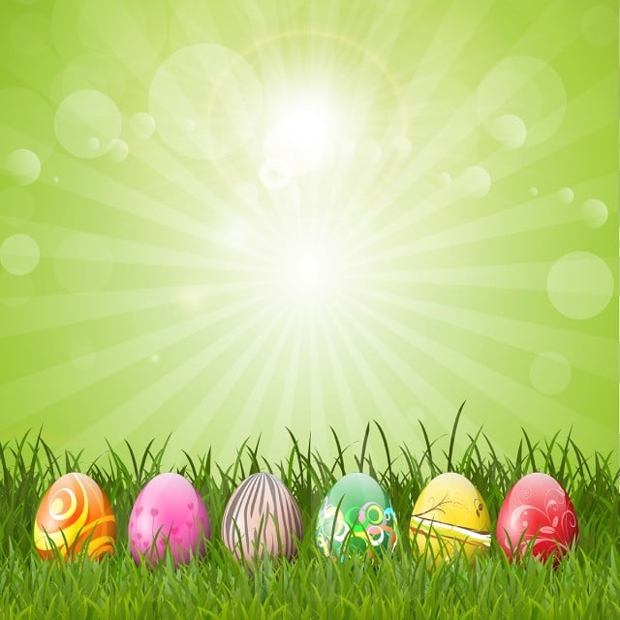
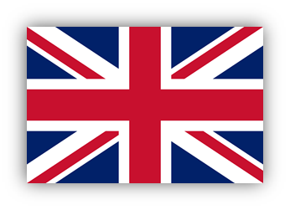
Easter in
Great Britain

Slide 2
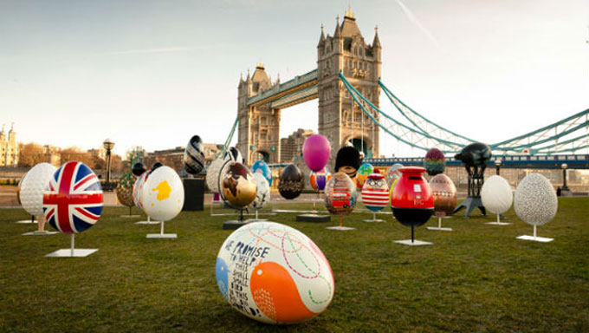
Easter is a very important festival in Great Britain.
Easter day is always on Sunday, and it is in spring.
The wish for this day is “Happy Easter”. There are many symbols and interesting traditions on this day.

Slide 3

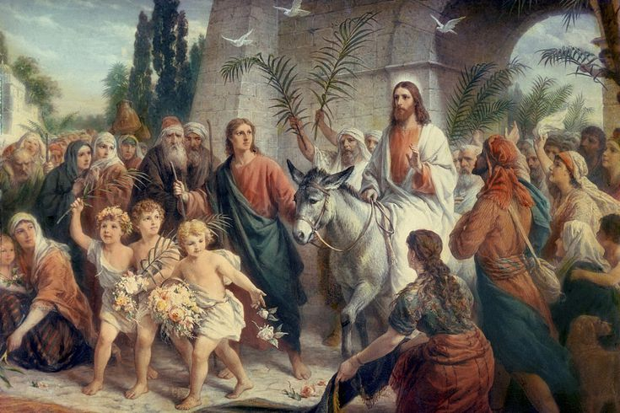
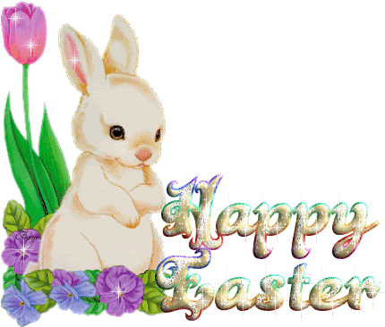
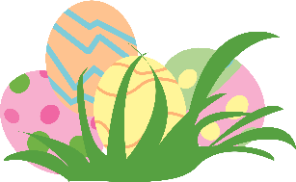
Palm Sunday
Palm Sunday is the last Sunday of Lent and first day of Holy Week in Christian churches. It falls on the Sunday before Easter and is always a movable feast. Palm Sunday is often celebrated with processions and distribution of blessed palm leaves.

Slide 4
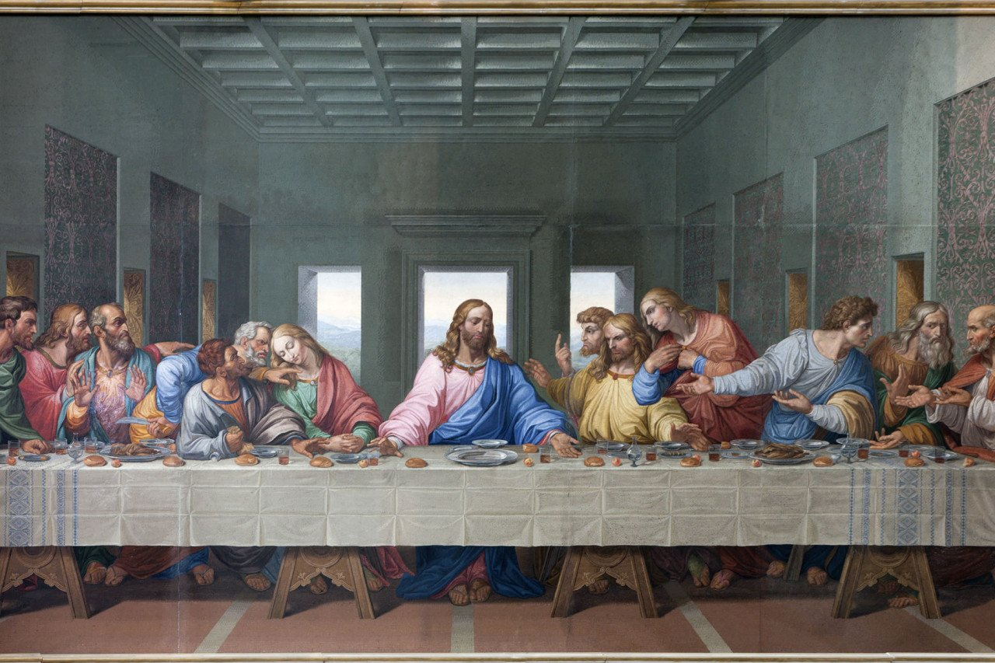

Maundy Thursday
Maundy Thursday or Holy Thursday is the day during Holy Week that commemorates the Washing of the Feet (Maundy) and Last Supper of Jesus Christ with the Apostles.

Slide 5
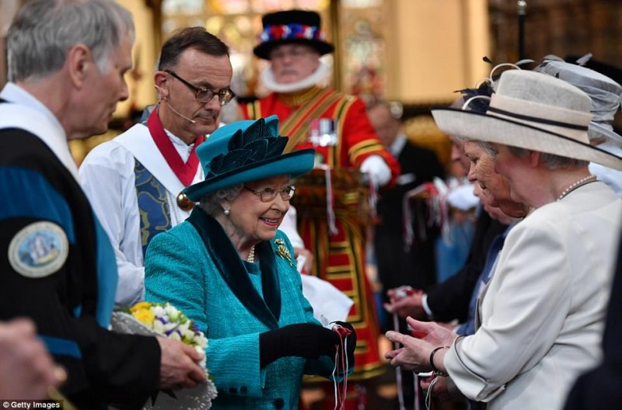
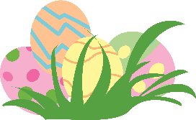
Maundy Thursday
Maundy Thursday in the United Kingdom features the monarch offering Maundy money, also known as Royal Maundy, to selected senior citizens – one man and one woman for each year of the monarch's age. The monarch presents each man and woman with a red and white purse during the service.

Slide 6
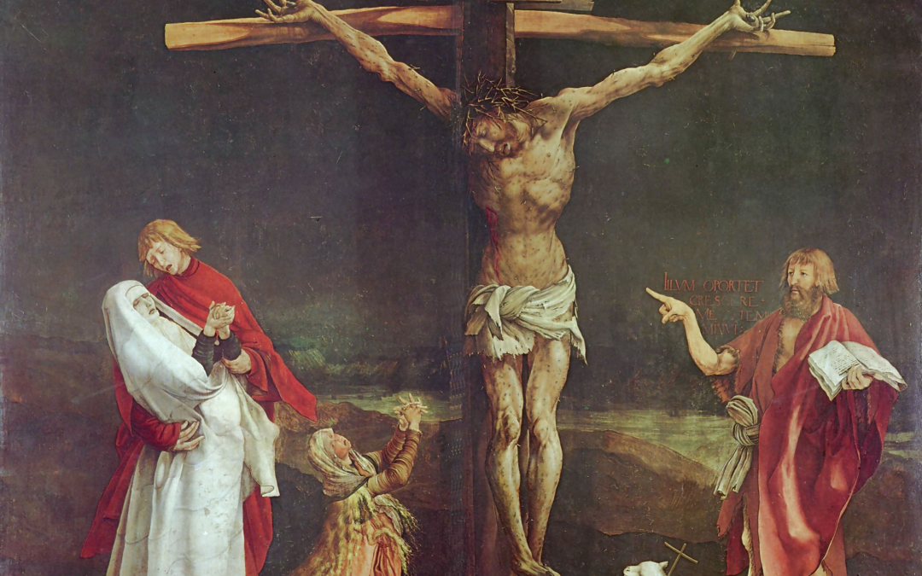
Good Friday
Good Friday is a religious public holiday in the UK.
It is the last Friday before Easter. It is the day when Christians commemorate the death of Jesus on the cross.

Slide 7
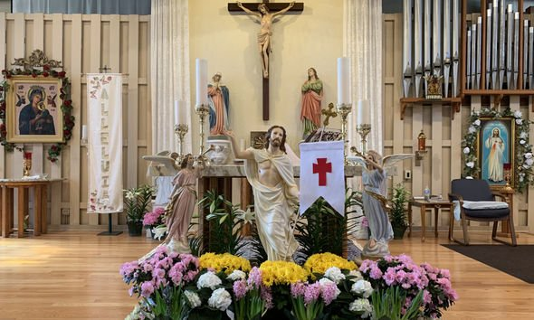
All churches in different parts of the country have special services.

Slide 8
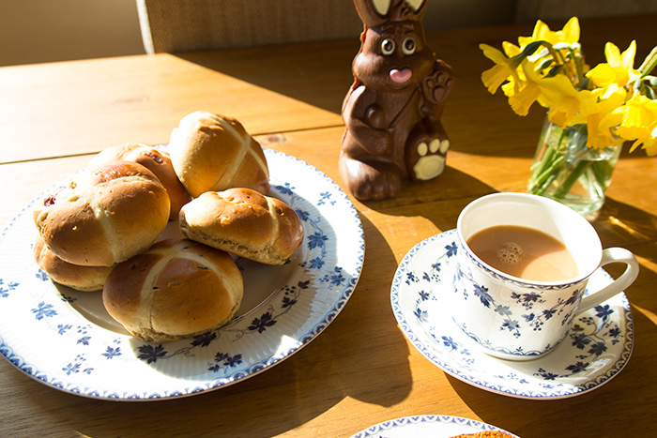
Hot Cross Buns
On Good Friday people eat hot cross buns.
These are small loaves bread of sweet bread with fruit and spices and they have a cross on top. They are best when you eat them hot.

Slide 9
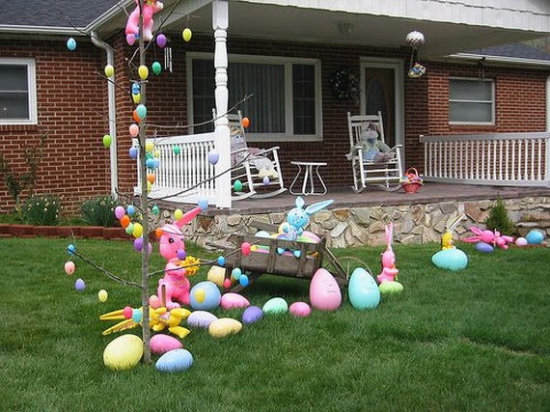
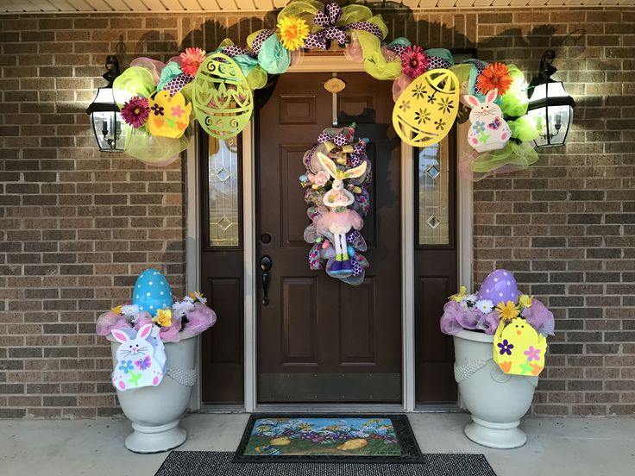
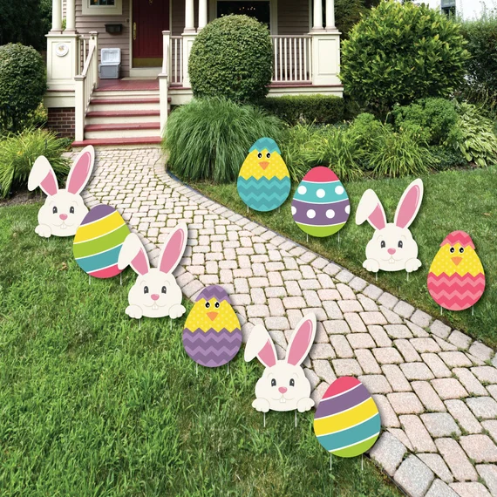
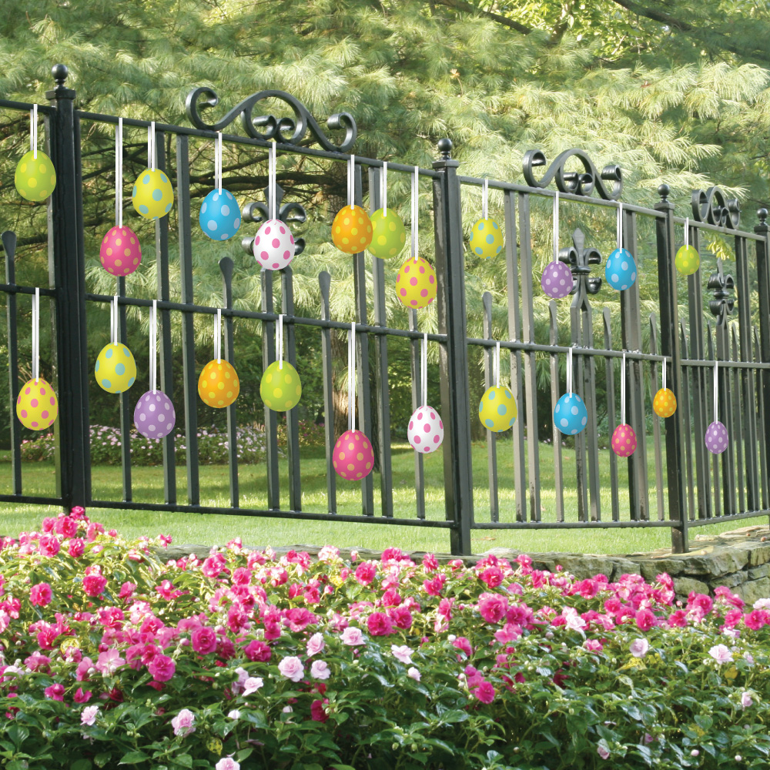
Easter decorations outside

Slide 10
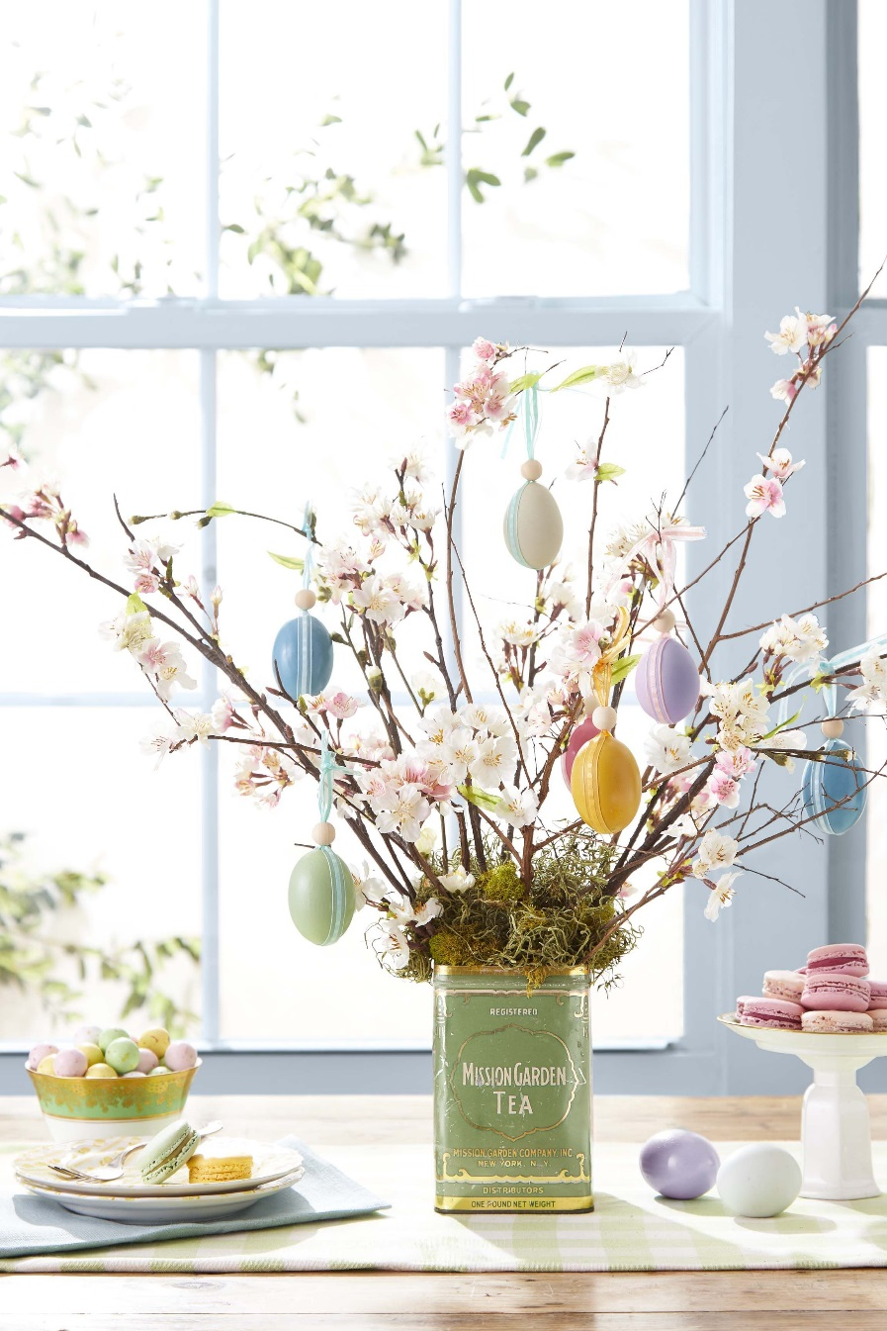
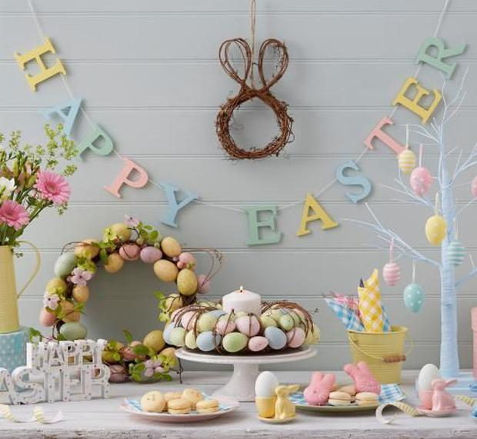
Children and parents make a very nice decoration. They put branches in a vase and hang eggs on them.

Slide 11
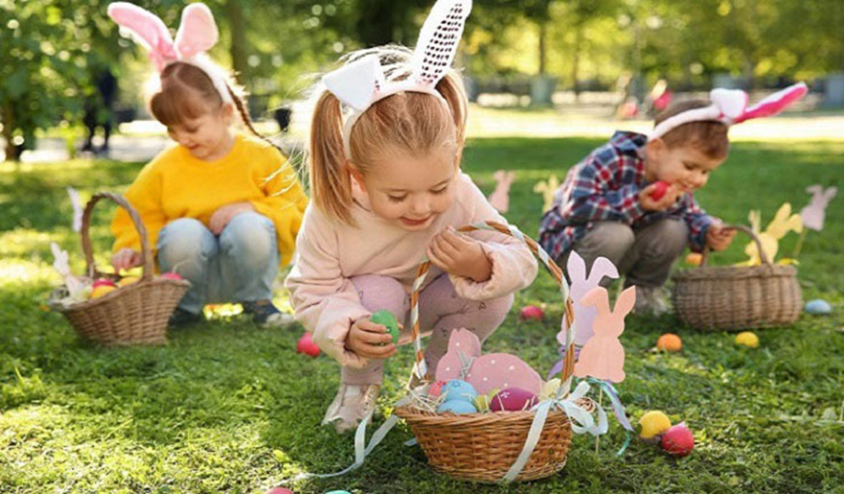
Easter Egg Hunt
On Easter Sunday morning children look for the eggs. It's a very exciting Easter egg hunt. For this reason, chocolate bunnies and Easter eggs are very popular in Great Britain. Children have a basket to collect their eggs.

Slide 12
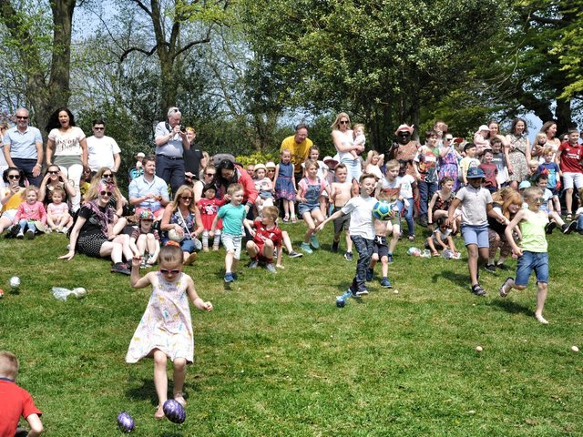
Easter Egg Rolling
Another Easter tradition is egg rolling. People decorate eggs with different colors. They take the eggs on the top of the hill and eggs roll down. The first egg to get to the bottom of the hill, is the winner.

Slide 13
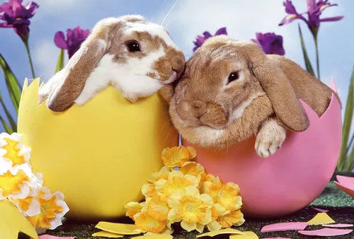
The symbols of Easter

Slide 14
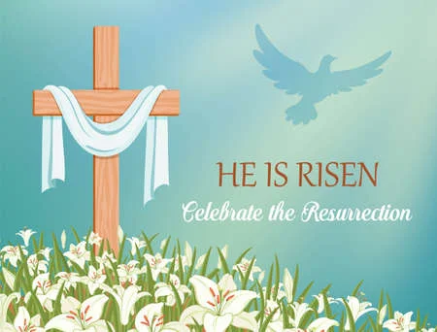
Cross

Slide 15
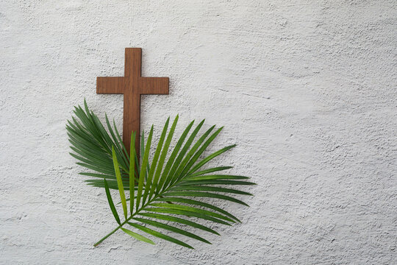
Palms

Slide 16
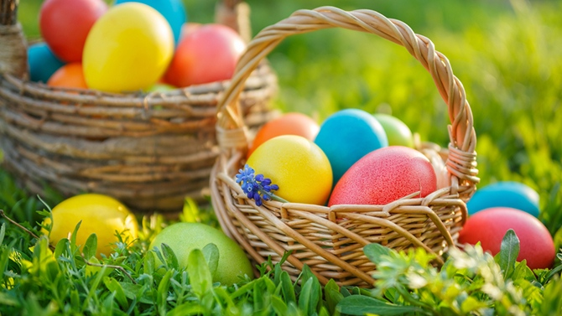
Easter Eggs
English children like coloring and decorating eggs for Easter. Eggs are very important because they mean spring and new life.

Slide 17
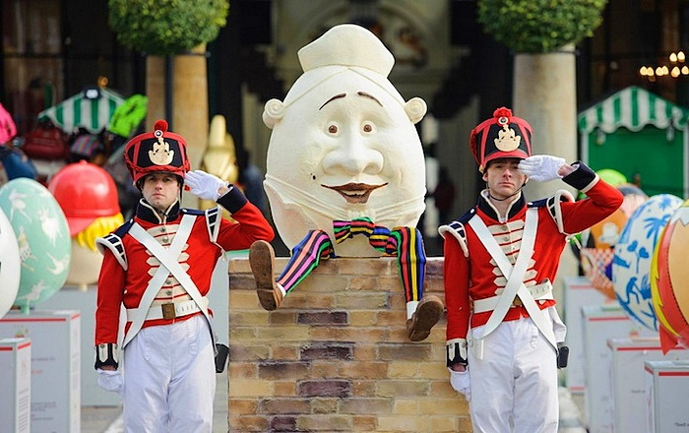
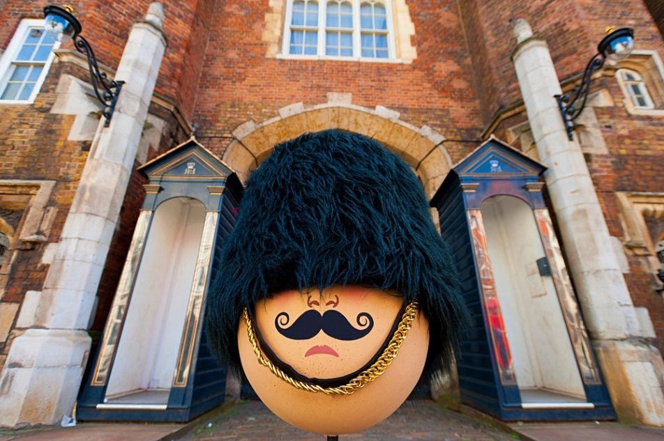
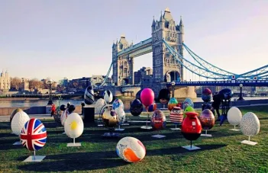
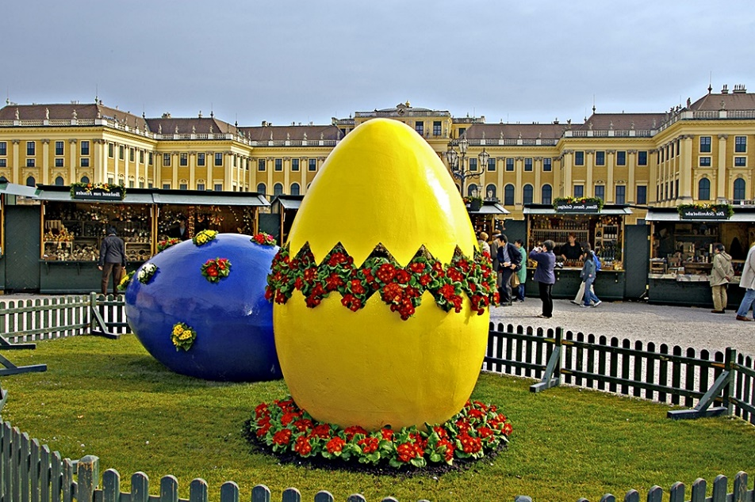

Slide 18
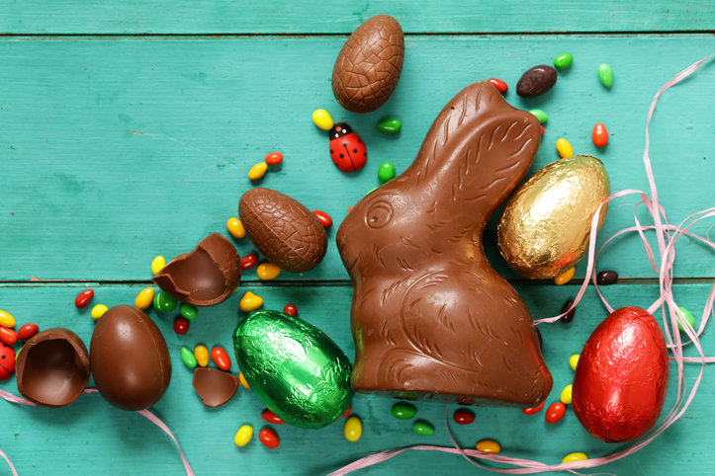
Easter Chocolate Eggs

Slide 19
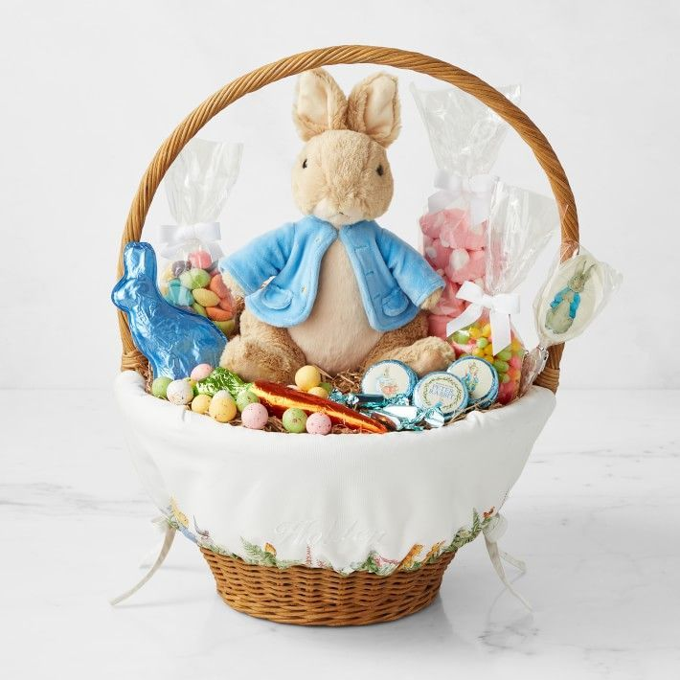
Easter Bunny
The symbol of Easter is an Easter bunny, a happy rabbit with a basket of chocolate eggs.

Slide 20
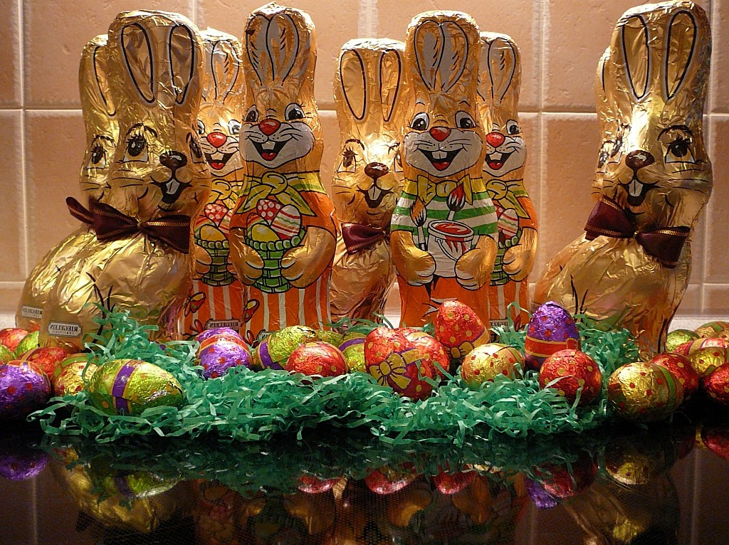
Chocolate Easter Bunny

Slide 21
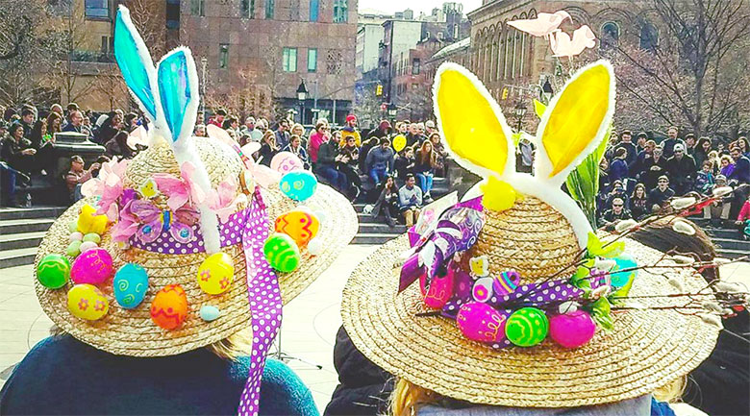
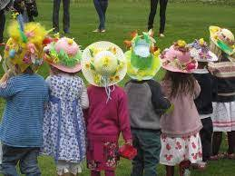
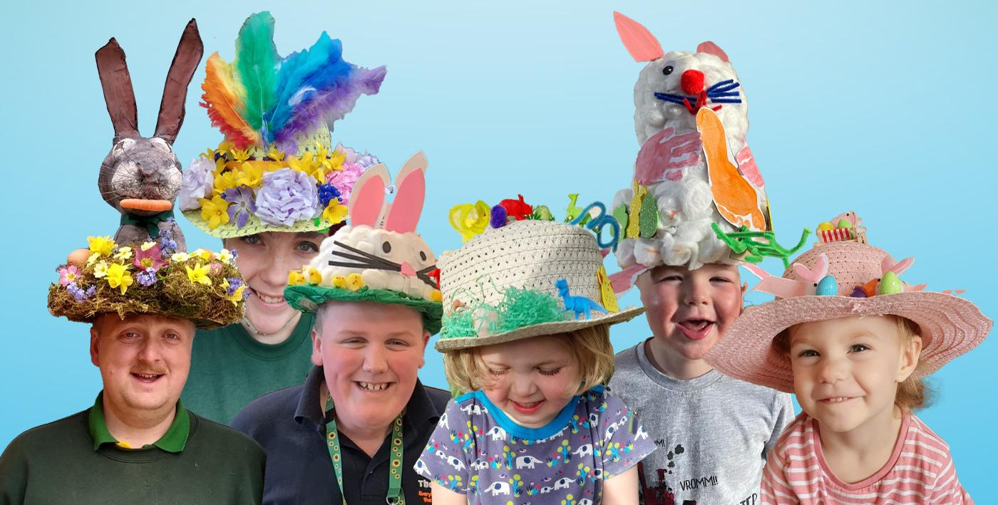
Easter Bonnet Parade
At Easter people used to wear special hats. They are called bonnets. The bonnets are always new. In some British primary schools they organize an ‘Easter bonnet parade’ where the best bonnet wins a prize.

Slide 22
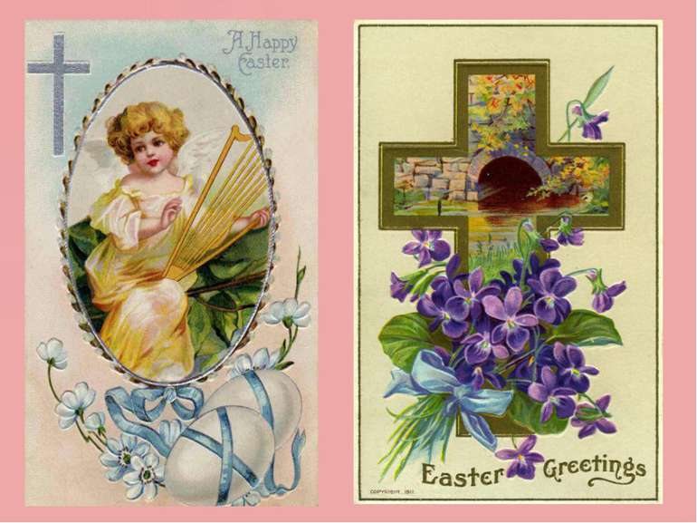
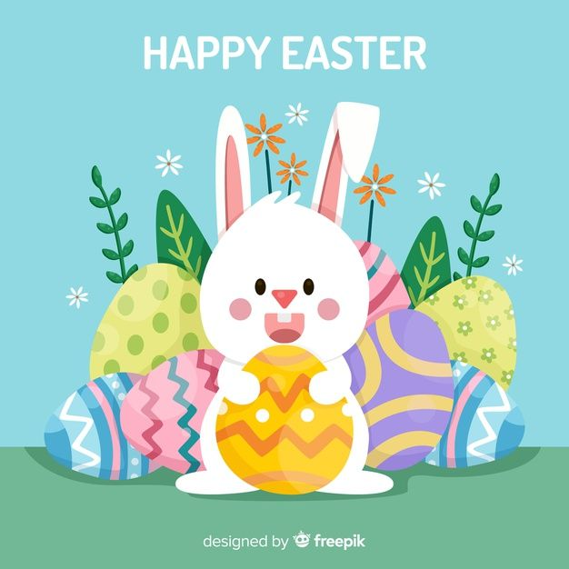
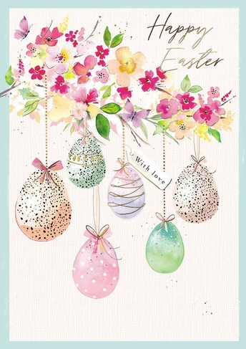
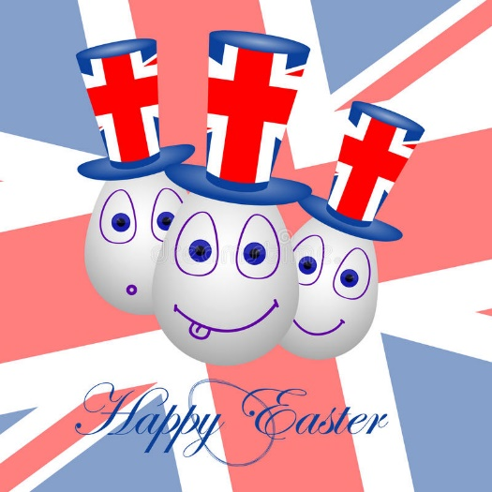
Easter Cards

Slide 23
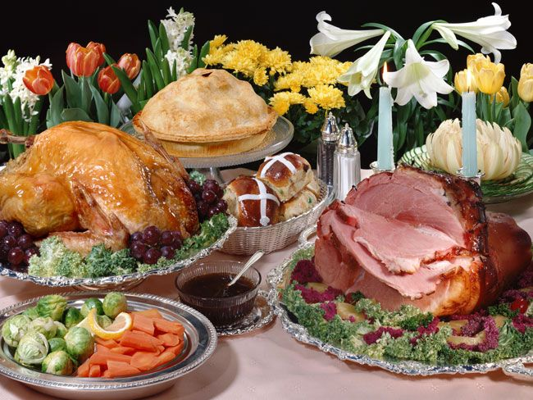
Easter dishes

Slide 24
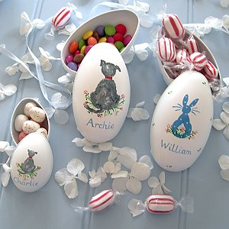
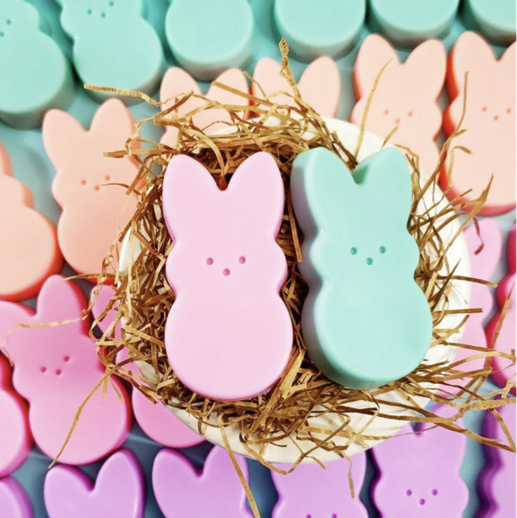
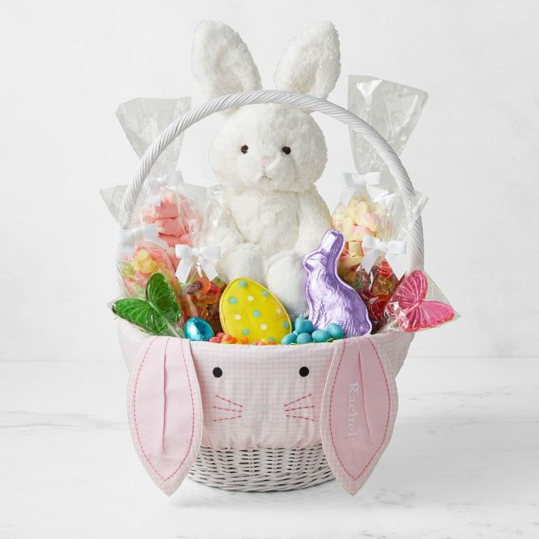
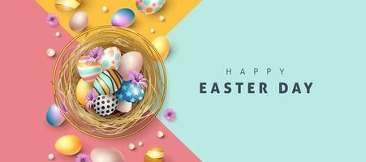
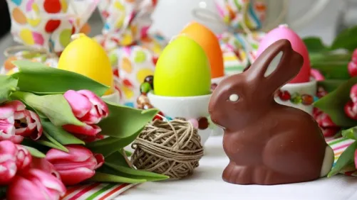
Easter souvenirs

Slide 25


