Slide 1
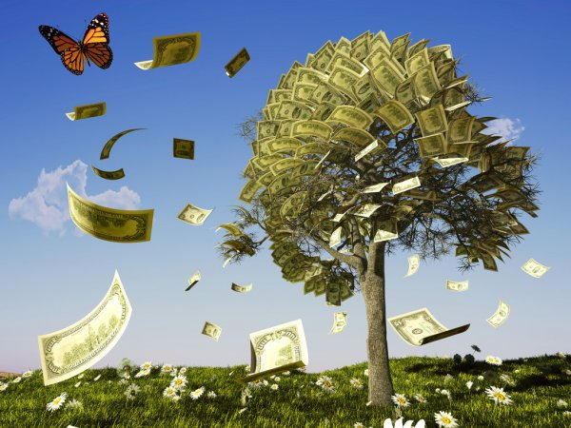
Money matters
Money matters is a play on words. The word matters means the subject (things related to money) but it can also mean to be of importance (money is important).

Slide 2
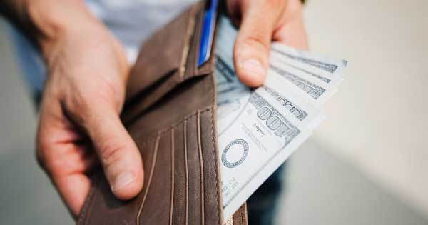
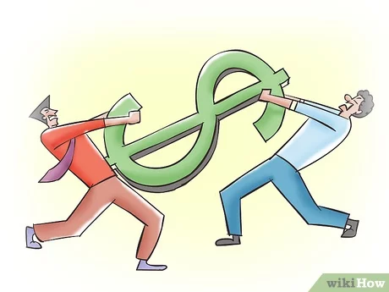
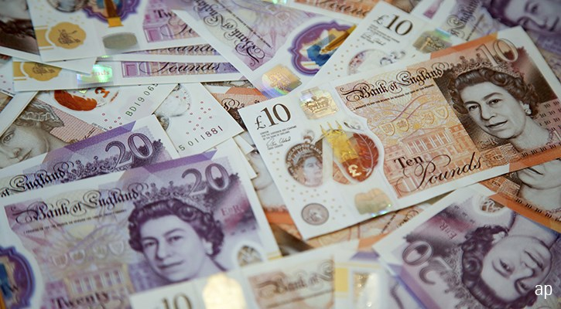

Afford- something that is not too
expensive, and you are able to buy it
Bargain- to discuss with someone
how much you are willing to pay for
something
Cash- money in the form of coins
and paper notes
Change- the money someone gives
back to you

Slide 3
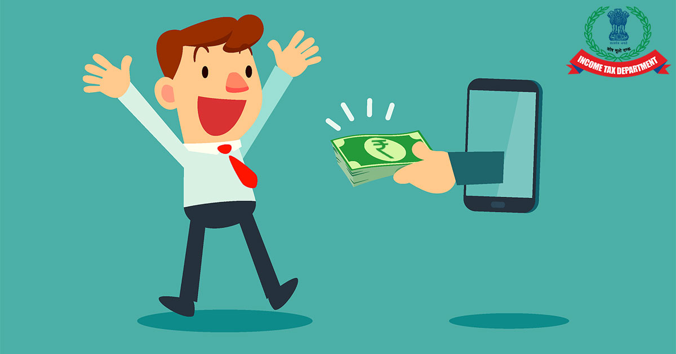


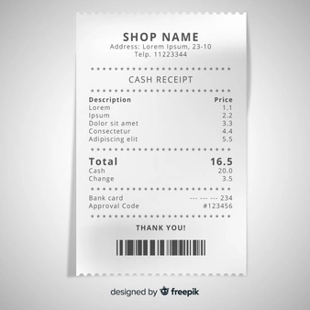
Refund – money that is given back to you
in a shop
Sale – an event when a shop sells
things for lower prices than usual
Receipt – a piece of paper which
shows how much you have paid
for something
Discount – a lower price than usual

Slide 4
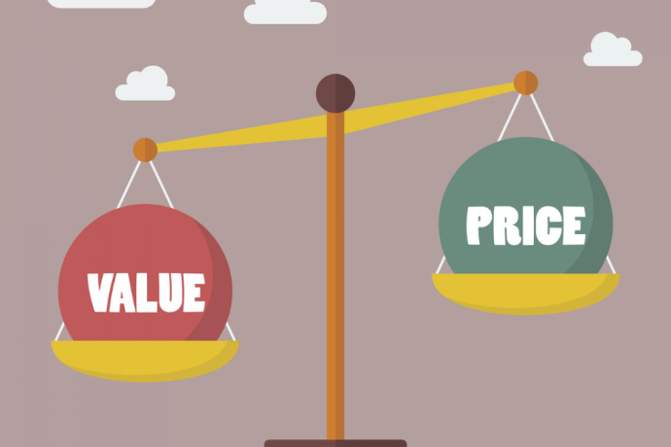
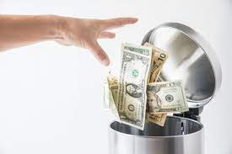
Value of money – how much
money is worth
A waste of money – when you use
more of something than you need to,
or you do not use it in a sensible way

Slide 5

Work with a partner. Ask these questions.
Do you usually carry some change in your pocket?
How do your parents usually pay in shops?
Do you or your family usually buy things in the sales? What types of things?
4. Do you usually keep the receipt when you buy something? Why/Why not?
5. Have you or your family ever asked for a refund?
6. Do students get special discounts in your country?
7. Have you ever wasted your money? When?
8. What have you bought recently that was good value for money?

Slide 6
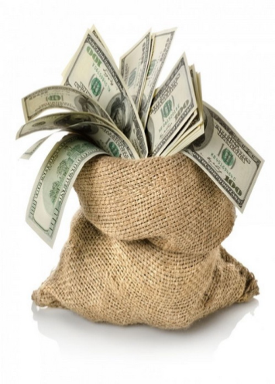
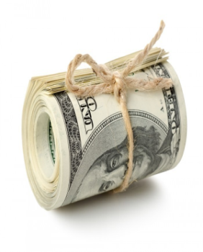
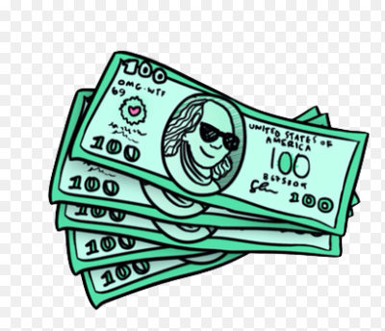
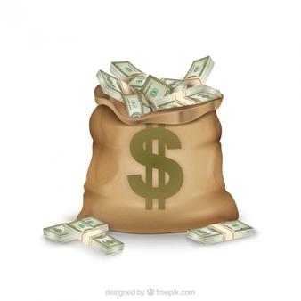
Money is any item or verifiable record that is generally accepted as payment for goods and services and settlement of debts, such as taxes, in a particular country or socio-economic context.
Money itself has no real value; it can be a shell, a metal coin, or a sheet of paper. Its meaning is symbolic; it conveys the importance that people place on it. Money derives its value from its functions: it acts as a medium of exchange, a unit of measurement and a store of wealth.

Slide 7
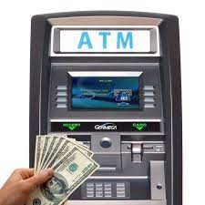
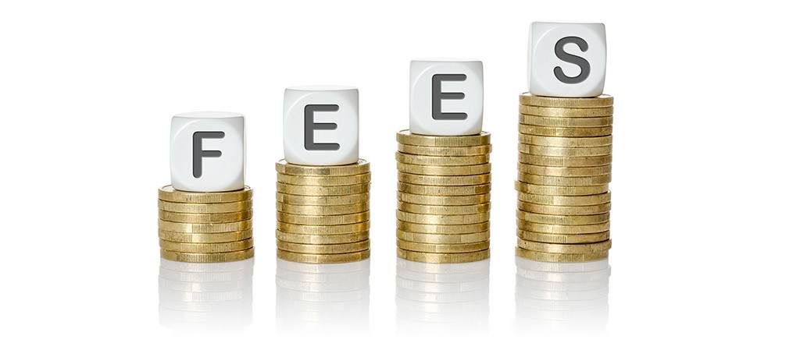
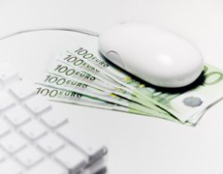
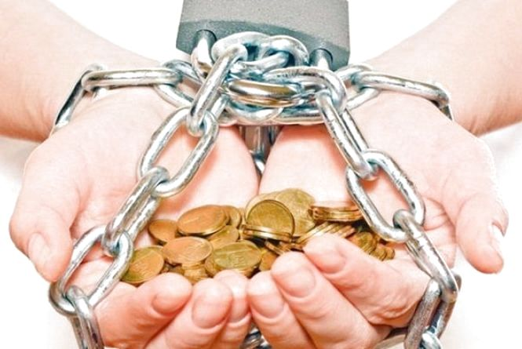
Money and banking
Cashpoint - банкомат
Fees - платежі
current account - поточний рахунок
Get into debt - потрапити в борг

Slide 8
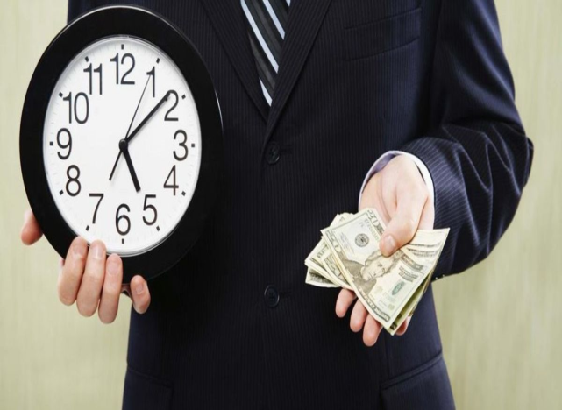
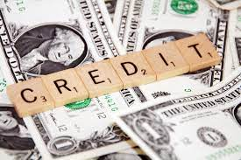
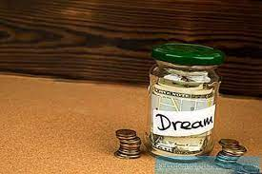
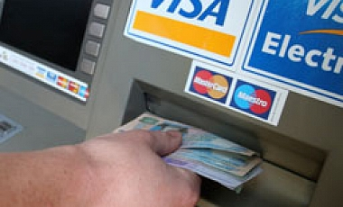
Give somebody a loan - дати комусь позику
Overdraft - перевищення
кредиту
Savings account -накопичувальний рахунок
Withdraw money - зняти гроші

Slide 9
Read the definitions and try to guess the words or phrases
An agreement with you bank that allows you to spend money when there is no money in your account.
A bank account that you use to keep and save money.
Give money to somebody for a period of time, after which they give it back.
Amount of money you have to pay a bank for the services that they give you.
A bank account that you can take money out of when you want.
Take money from a bank account.
A written statement saying how much money you owe for goods or services you have received.
Machine that gives you money when you put a bank card in it.
Start to owe money.
Answers: 1. overdraft, 2. savings account, 3. give somebody a loan, 4. fees, 5. current account, 6. withdraw money, 7. bill, 8. cashpoint, 9. get into debt.

Slide 10
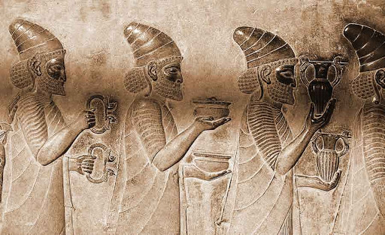
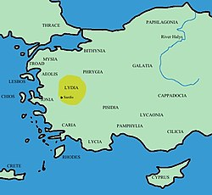
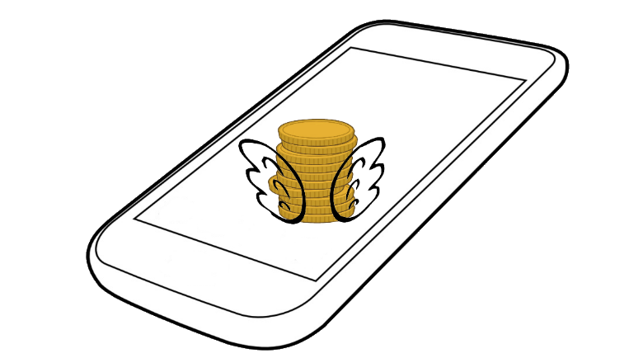
History says that money appeared in ancient times in the 7th century BC and were independently invented by the Chinese and the inhabitants of Asia Minor - the Lydians
It is unlikely that today anyone has not heard about cash or electronic money. And in the recent past, our ancestors would have taken such a thing for fantasy. Money was invented by people. People change - money changes. But no matter how their appearance changed, they always retained their most important functions: measures of value, means of circulation, accumulation, payment. If money disappears in the form in which it exists now, then its equivalent will certainly appear. History confirms this fact. But this will happen when society reaches a higher level of socio-economic and cultural development.

Slide 11
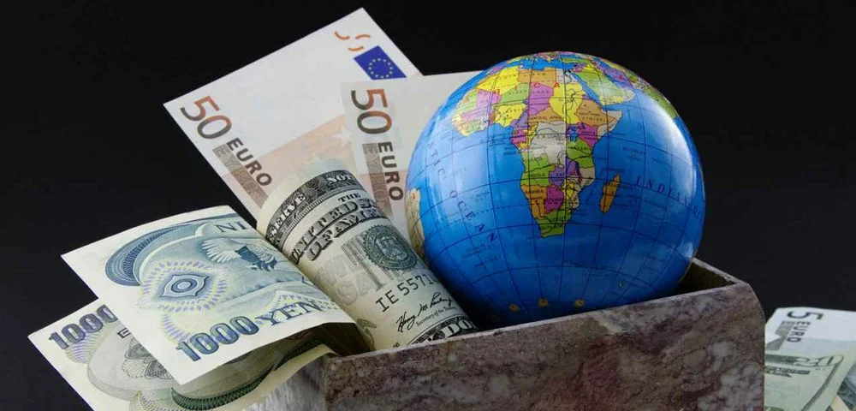
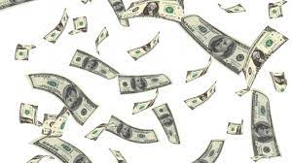
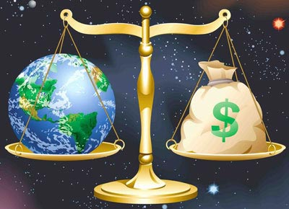
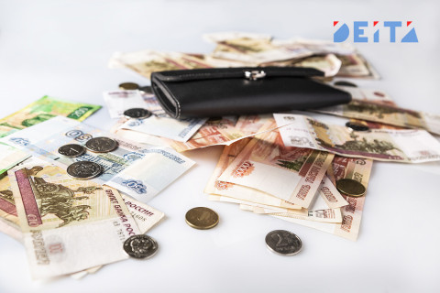
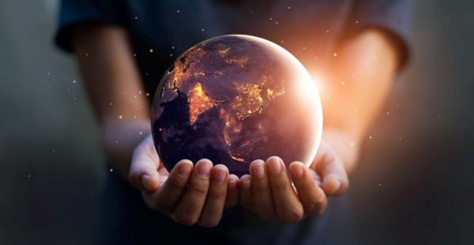
In conclusion, I want to say that even if money disappears, there will certainly not be less kind, sympathetic people. The world will not die!!!

