Slide 1
Literary game
5 Х 5

Slide 2


Slide 3

Round 1
Guess who am I

Slide 4
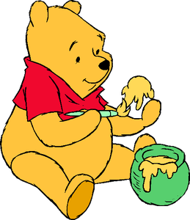
Question 1
I love honey and live in a wood. One of my best friends is called Christopher Robin. Who am I?

Slide 5
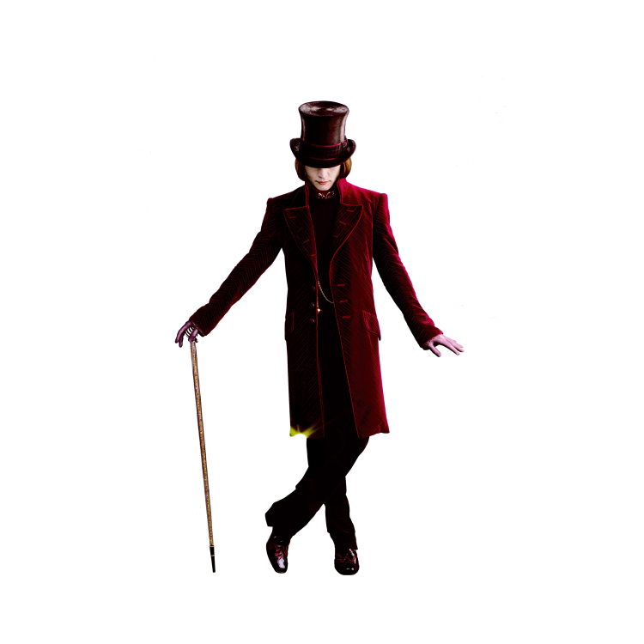
Question 2
I have a factory where we make all sorts of chocolates. I send out five special Golden Tickets that are hidden with the chocolate so that five lucky children can explore my factory. Who am I?

Slide 6
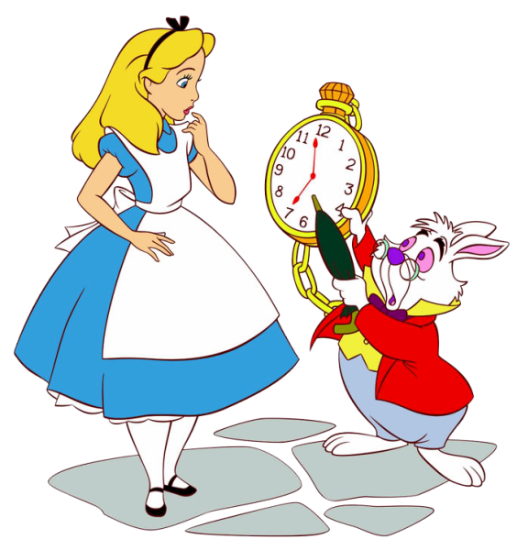
Question 3
I followed a white rabbit down a hole and met all sorts of strange creatures and a queen. Who am I?

Slide 7
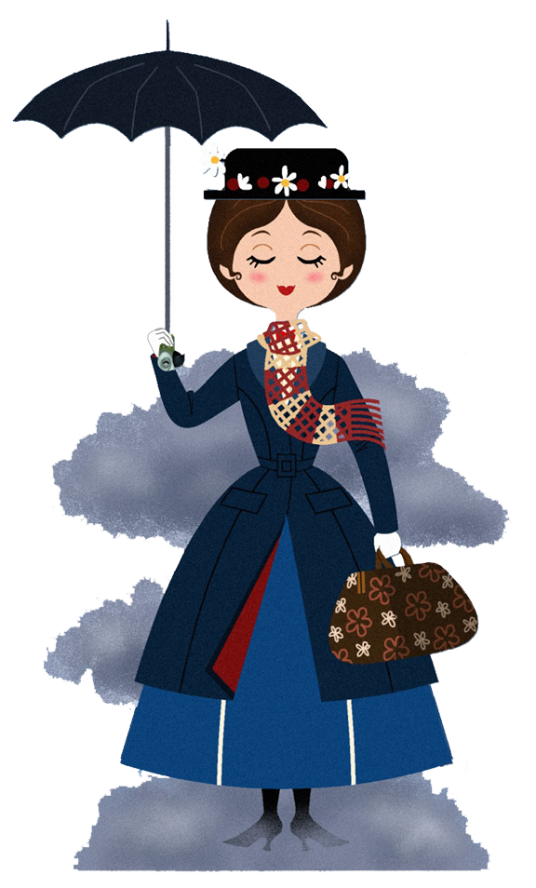
Question 4
I can fly, have special powers and magical items like an umbrella and stretchable bag. I arrived in London to help the Banks family and their two children. Who am I?

Slide 8
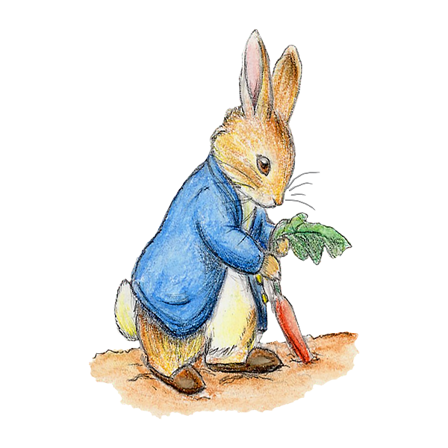
Question 5
I have a little blue jacket and love eating the vegetables from Mr McGregor’s garden. Who am I?

Slide 9

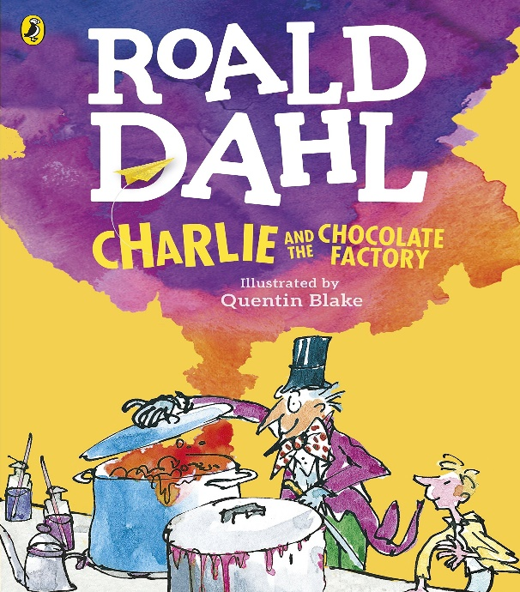
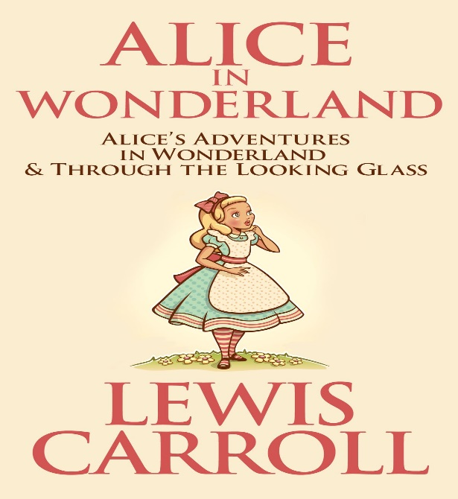
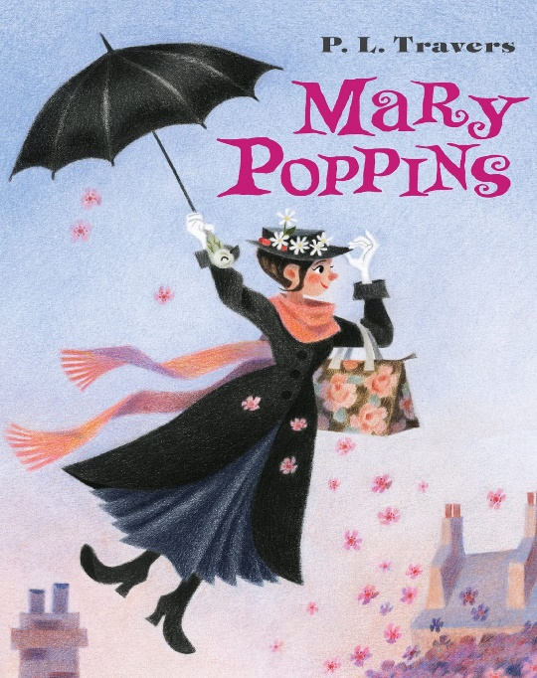
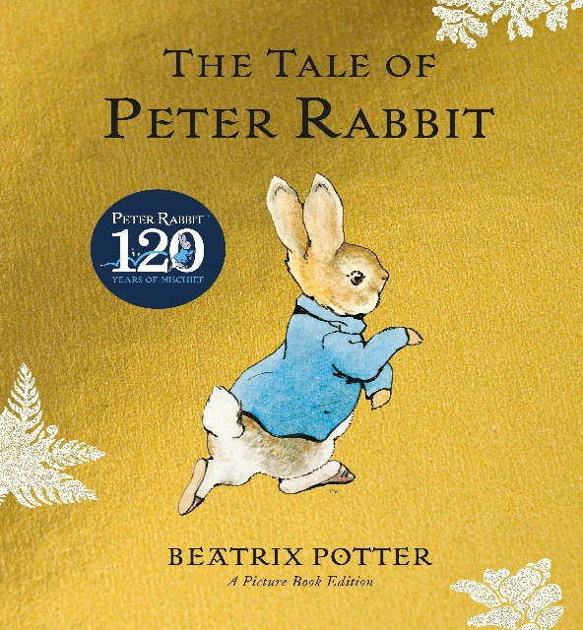
2
3
1
4
5

Slide 10
Round 2
Match the pair

Slide 11
Match the pair
Scarlett O'Hara
1.Sherlock Holms
2.Tom Sawyer
3.Robinson Crusoe
4. Romeo
5. Frodo Baggins
A. Friday
B. Juliet
C. Samwise Gamgee
D. Huckleberry Finn
E. Watson
Notes:
hh

Slide 12
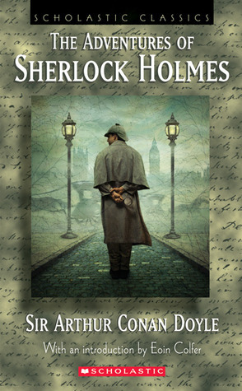
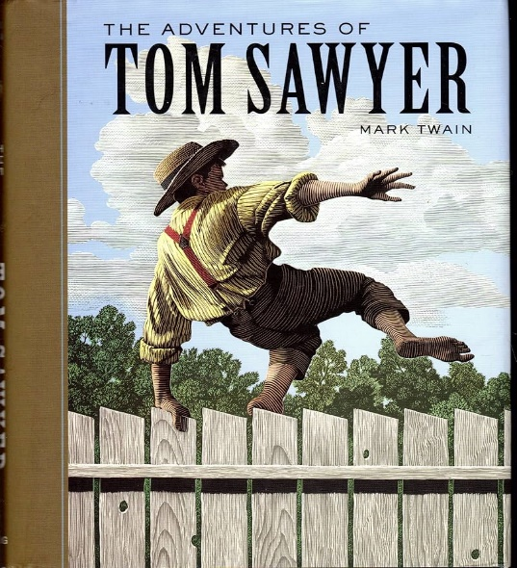
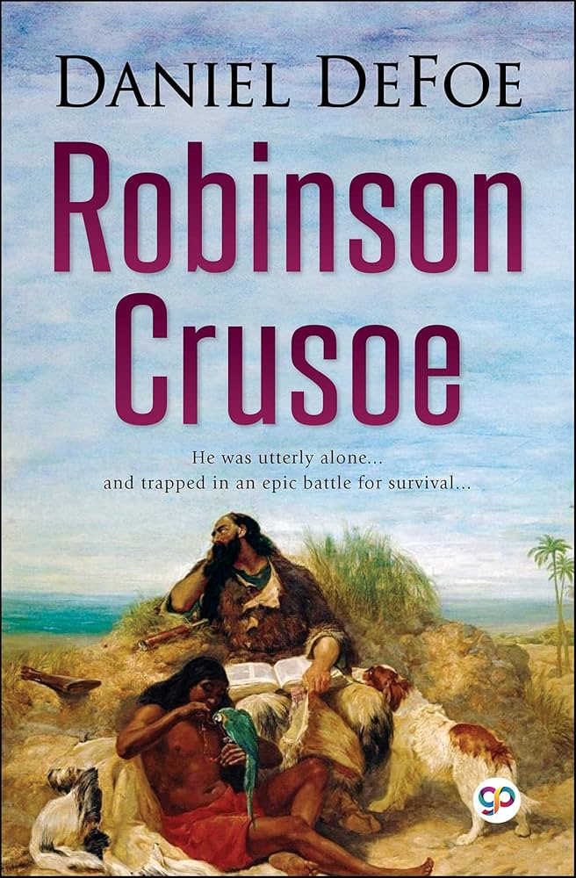
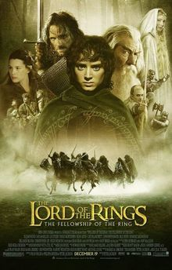


Slide 13

Round 3
Shakespeare's tour

Slide 14
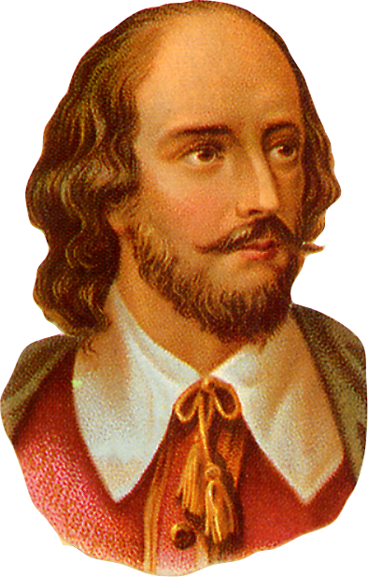
A horse, a horse!
My kingdom for a horse!
(Коня, коня! Моє королівство за коня!)

Slide 15
All the world’s a stagе
(Весь світ театр)

Slide 16
To be or
not to be
(Бути чи не бути)

Slide 17
.Much ado about nothing
(Багато галасу з нічого)

Slide 18
You too, Brutus?
(Ти також, Бруте?)

Slide 19
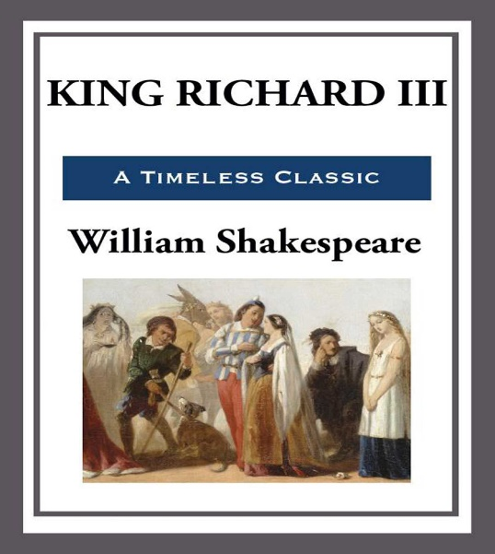
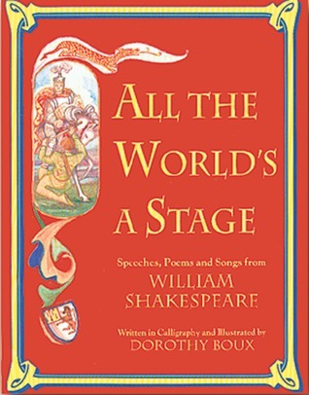
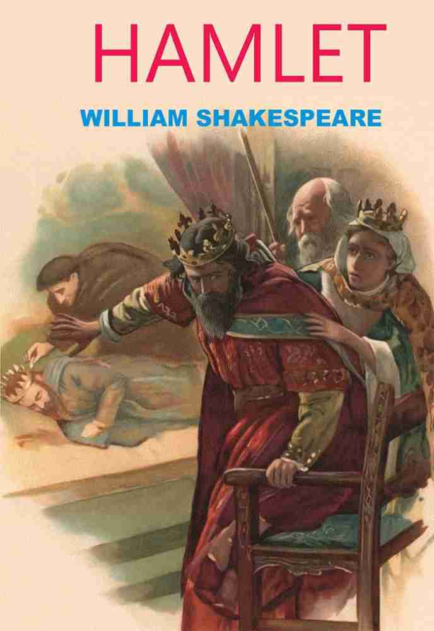
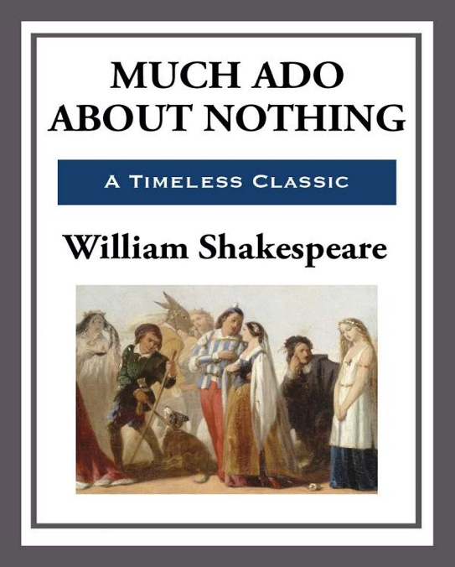
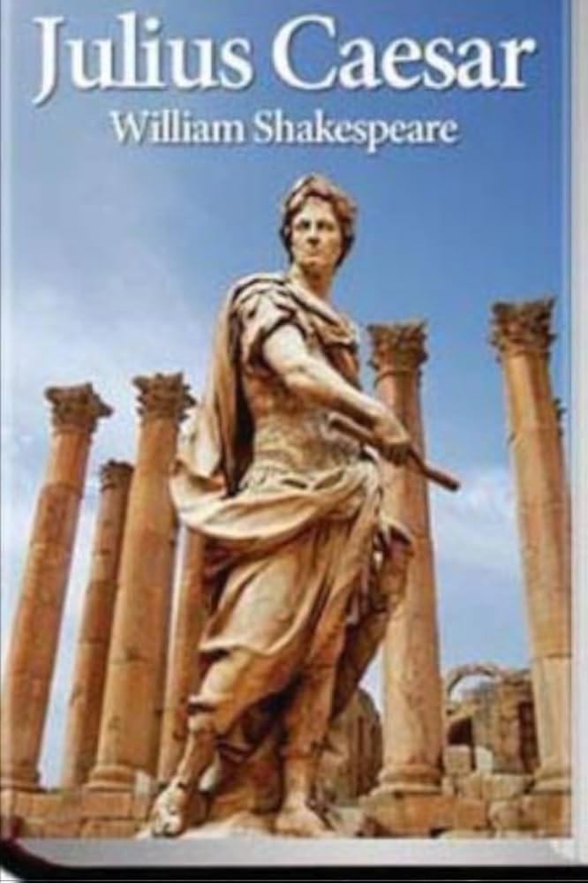
1
2
3
4
5

Slide 20
Round 4
Whose things are they?

Slide 21



Slide 22
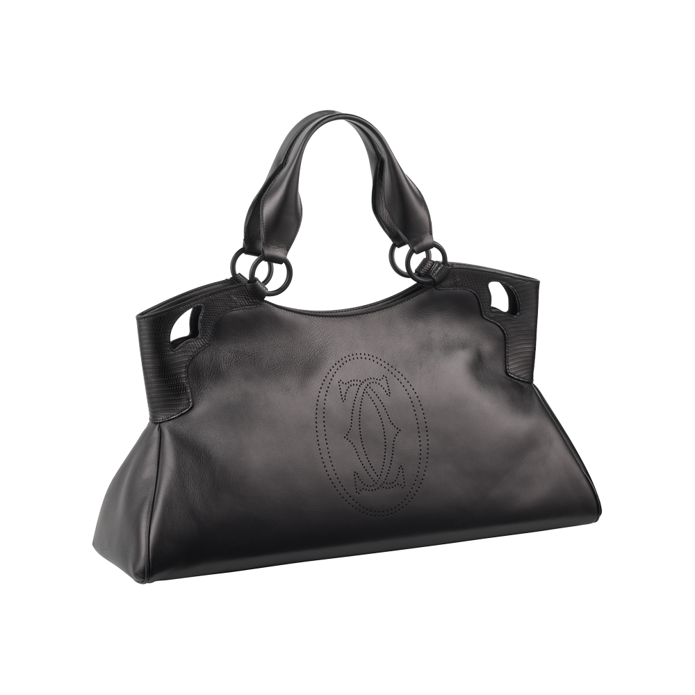


Slide 23

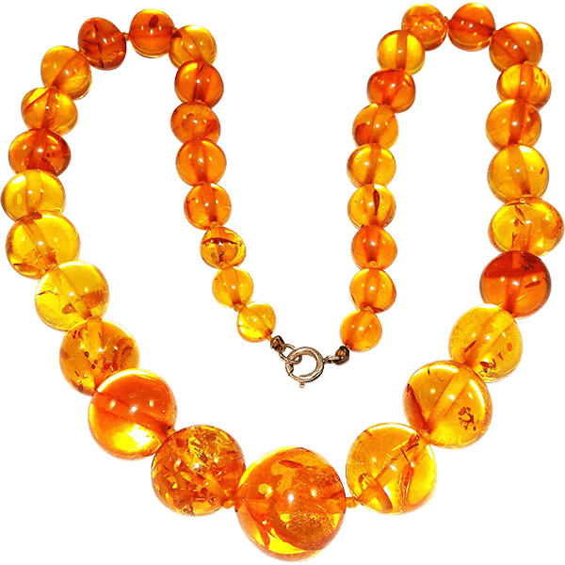

Slide 24

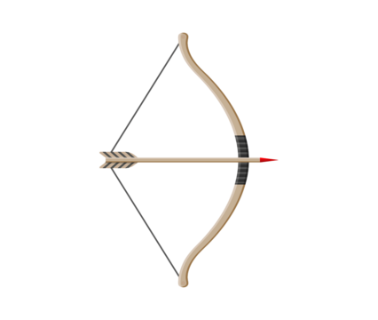

Slide 25

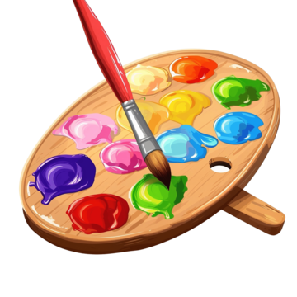

Slide 26
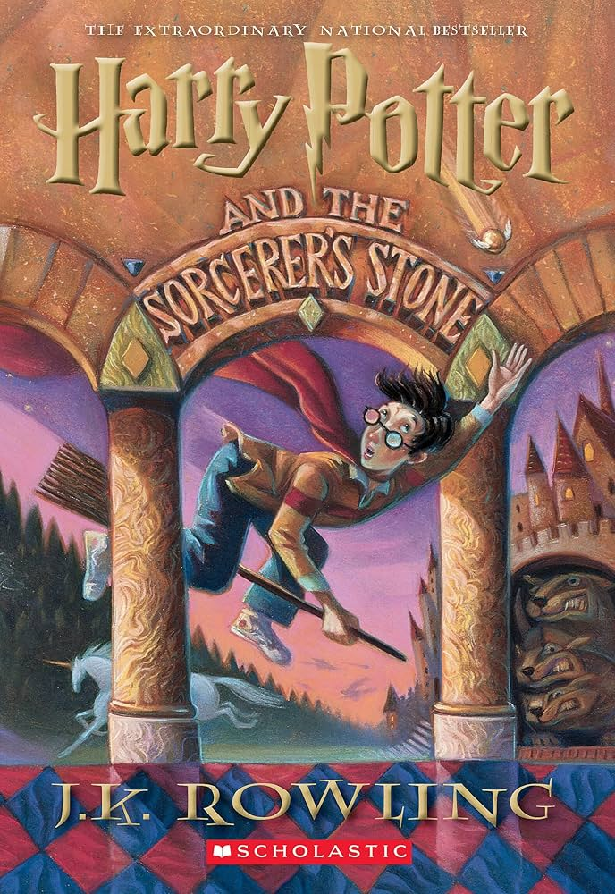
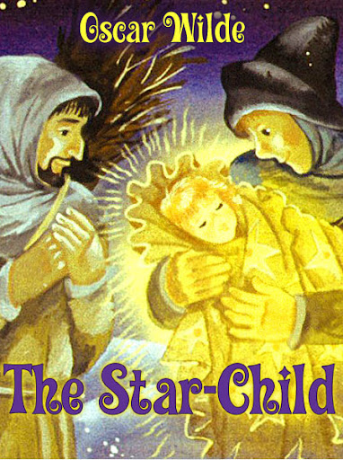
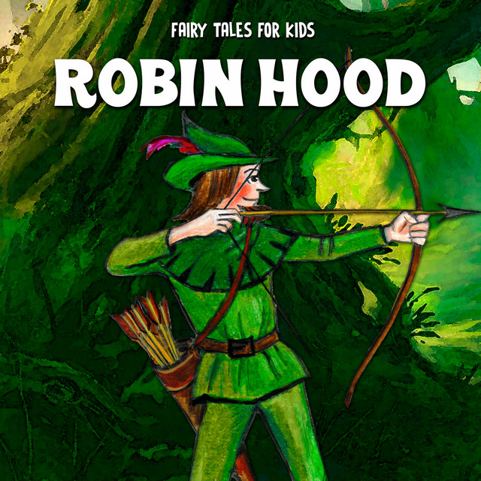
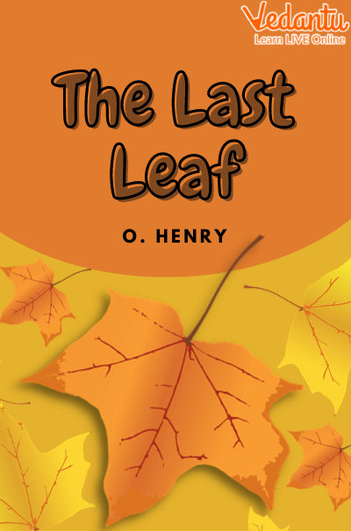
1
2
3
4
5

Slide 27

Round 5
Monuments of literary characters

Slide 28
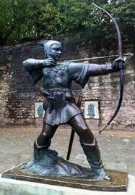

Slide 29
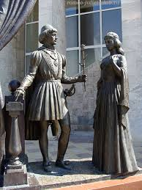

Slide 30
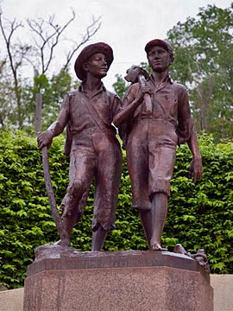

Slide 31
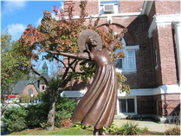

Slide 32
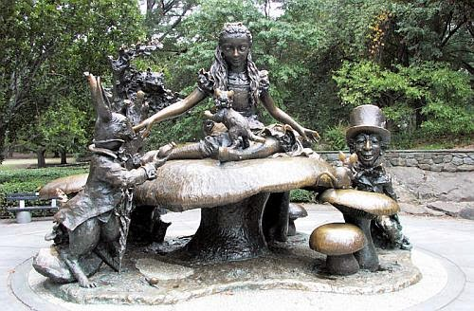

Slide 33
1. The monument to Robin Hood in
Nottingham (England)
2. The monument to Romeo and Juliet in
Verona (Italy)
3. The monument to Tom Sawyer and
Huckleberry Finn in Hannibal, Missouri (USA)
4. The monument to Pollyanna in Littleton (USA)
5. The monument to Alice in New York City (USA)
nottingham
KEYS

Slide 34

Iнтернет – ресурси:
1.https://www.gobeyond.org.uk/wp-content/uploads/2021/02/21-02-26-World-Book-Day-Quiz.pdf
2.https://vseosvita.ua/library/prezentacia-na-temu-pamatniki-literaturnim-geroam-449832.html
3. https://azbooks.com/news/happy-international-children-s-book-day/

