Slide 1
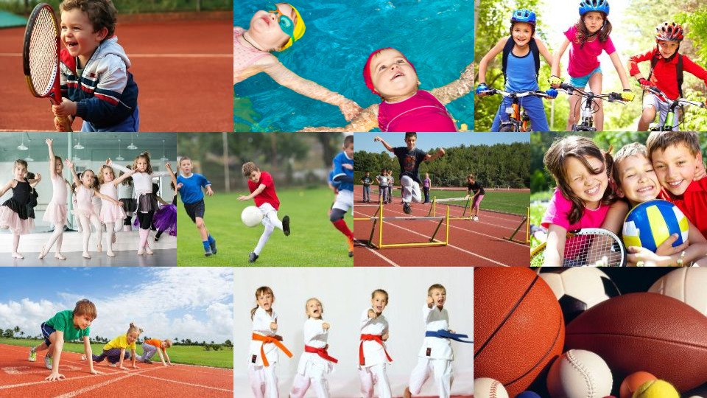
MY SPORTS

Slide 2
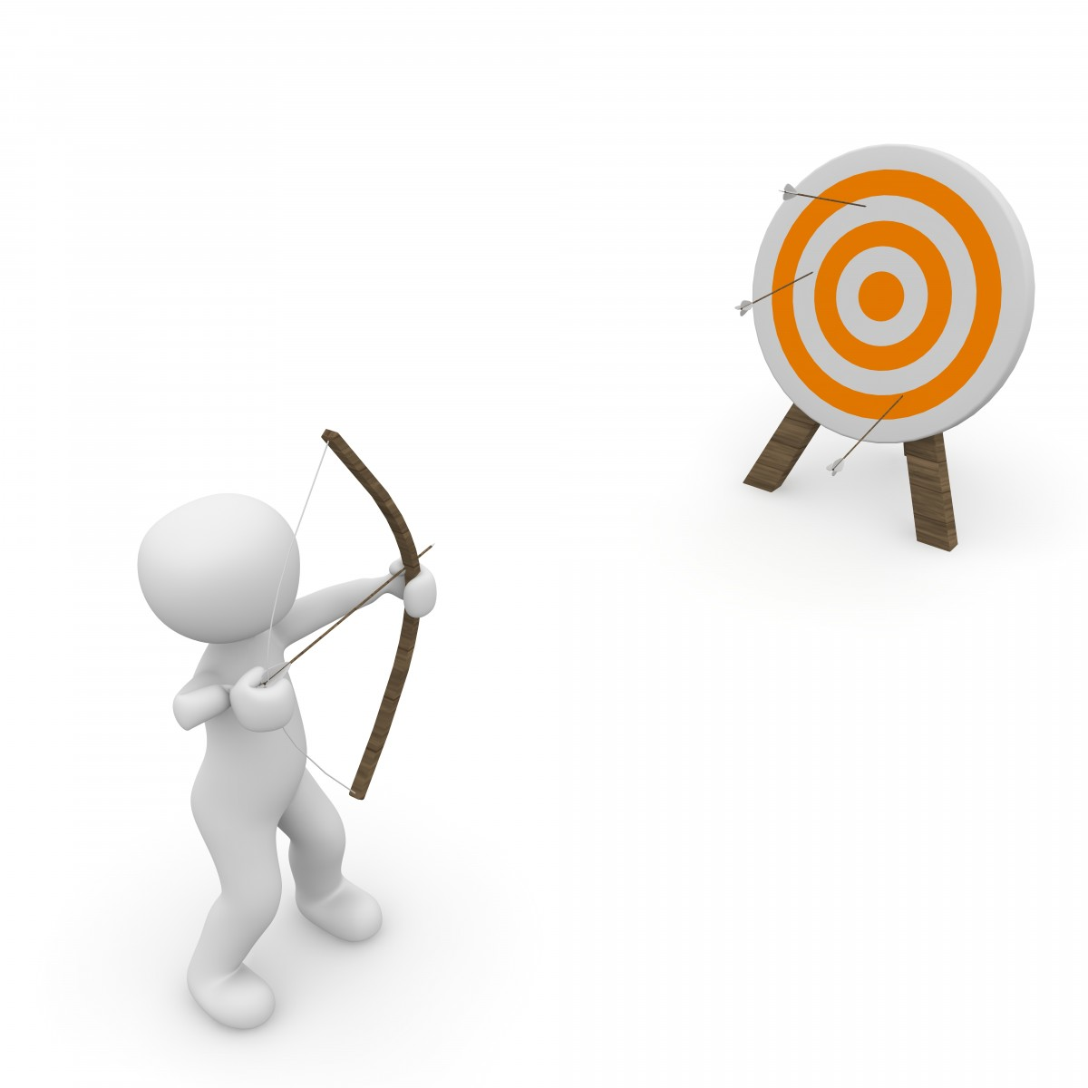
A SOUND MIND
IN A SOUND BODY

Slide 3
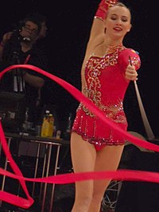
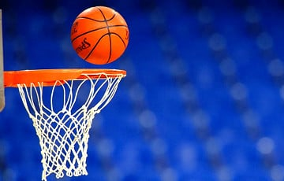

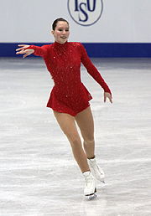
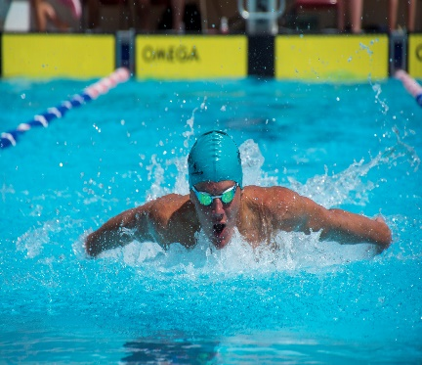
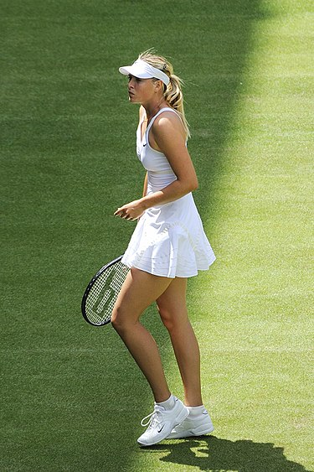
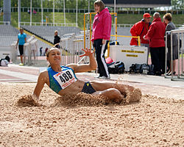
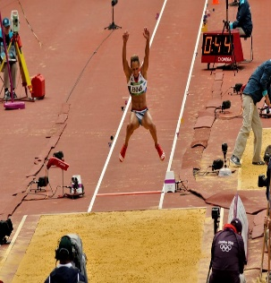
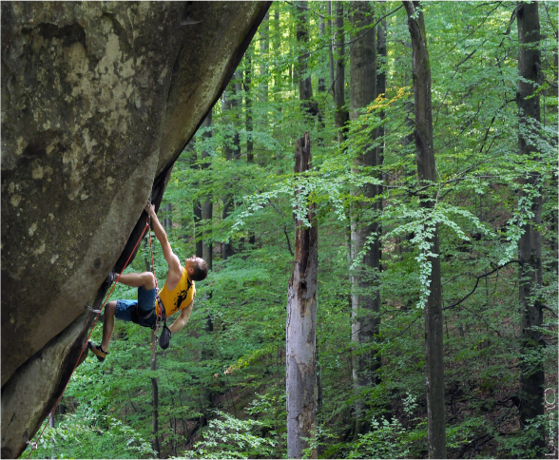
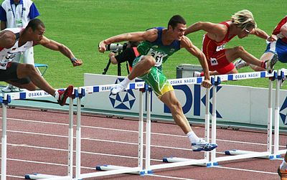
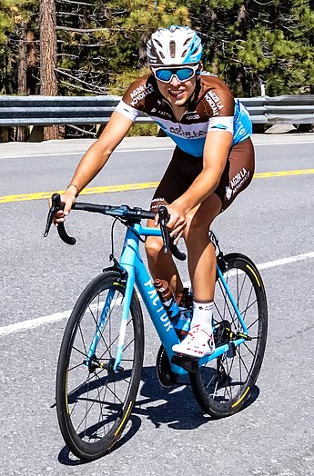
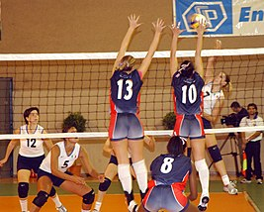
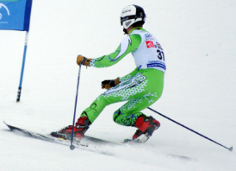
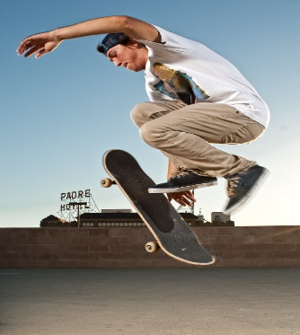
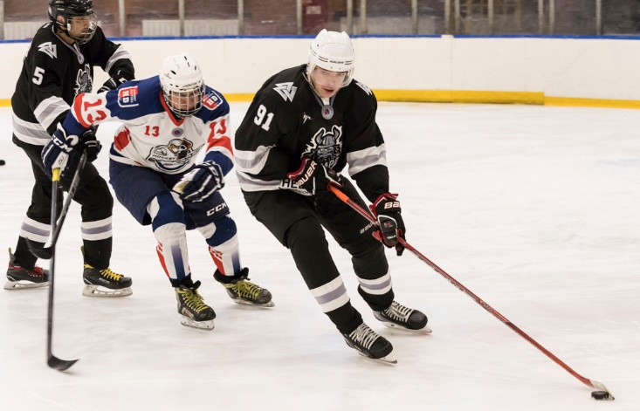
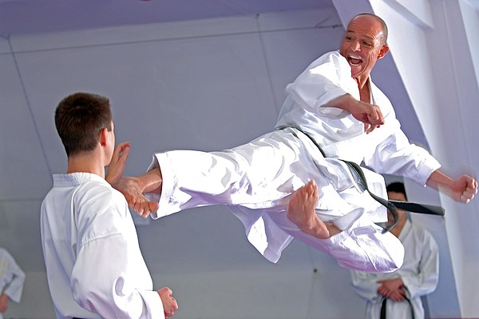
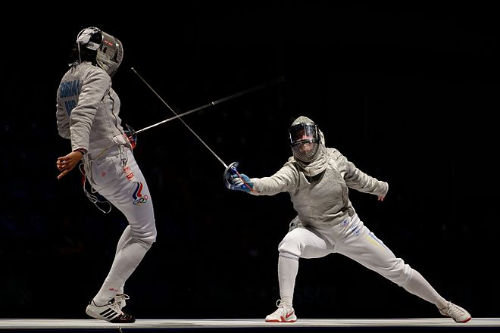
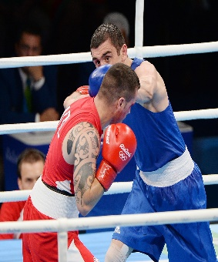
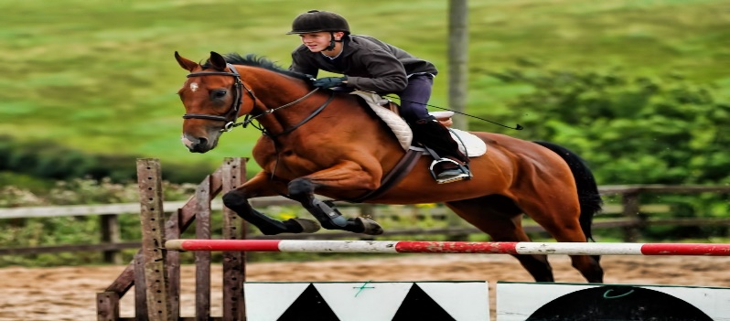
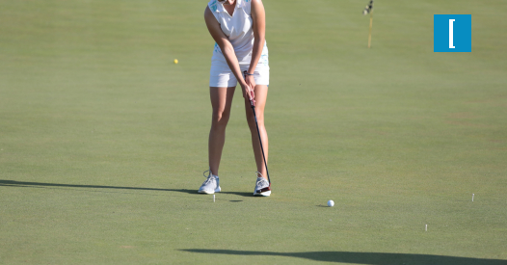

Slide 4




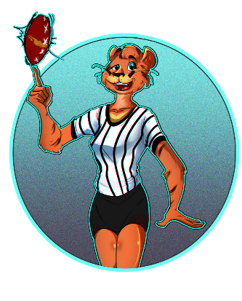
I AM FOND OF…
I AM INTERESTED IN …
I AM CRAZY ABOUT …
I AM GOOD AT…

Slide 5
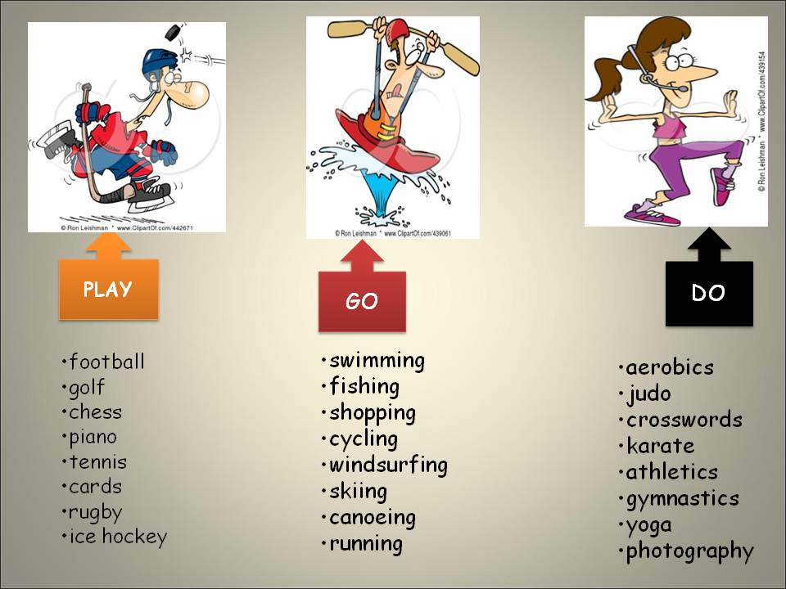

Slide 6
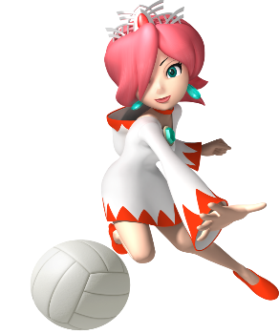
GYMNASTICS RUNNING HOCKEY FENCING KARATE CLIMBING SKATING JUMPING GOLF TENNIS
SKIING BOXING HORSE RIDING SWIMMING VOLLEYBALL BASKETBALL SKATEBOARDING
GO PLAY DO

Slide 7

GUESS THE SPORT
A table, a ball, a bat …
Ice, a stick, a puck …
Skis, a slope, goggles …
A bike, a helmet, a mountain …
A boat, a lake, oars …
WE NEED … FOR …

Slide 8
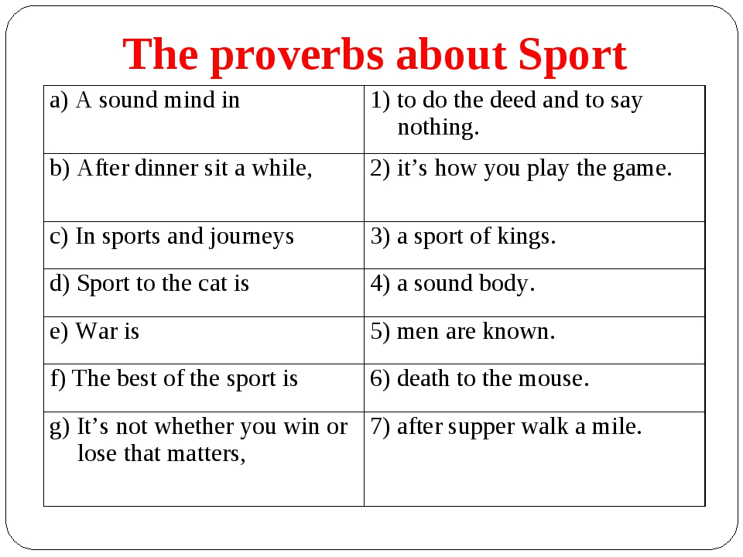

Slide 9
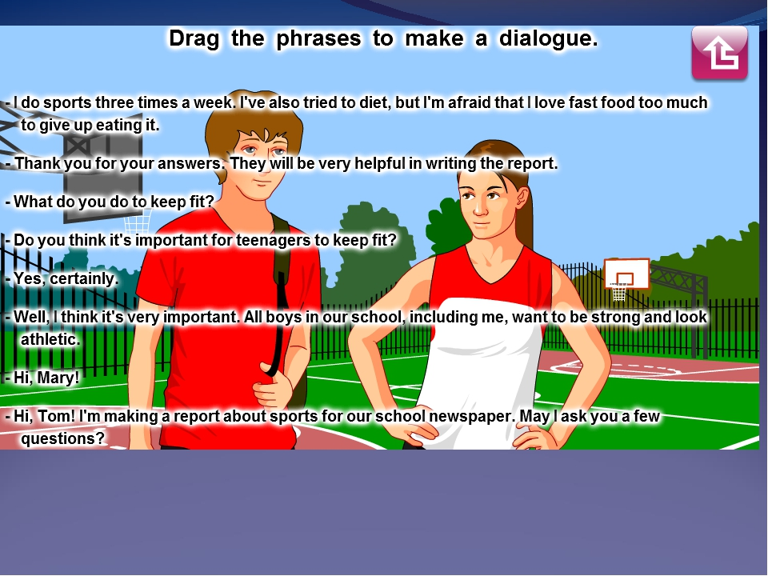
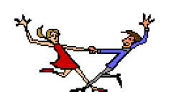

Slide 10
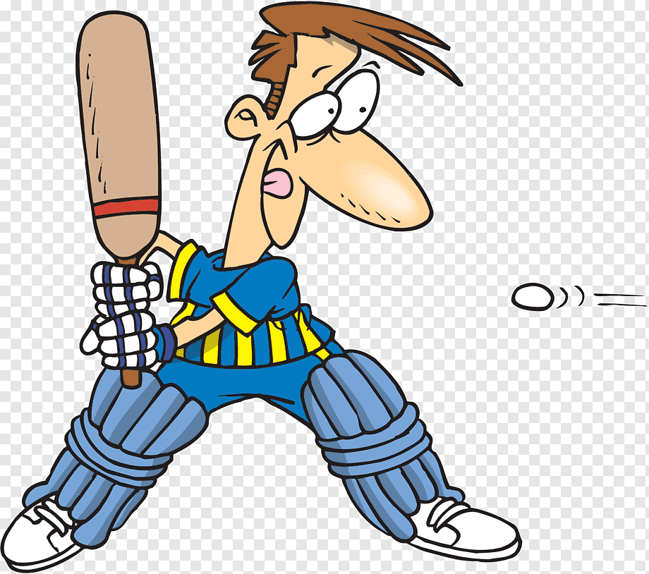
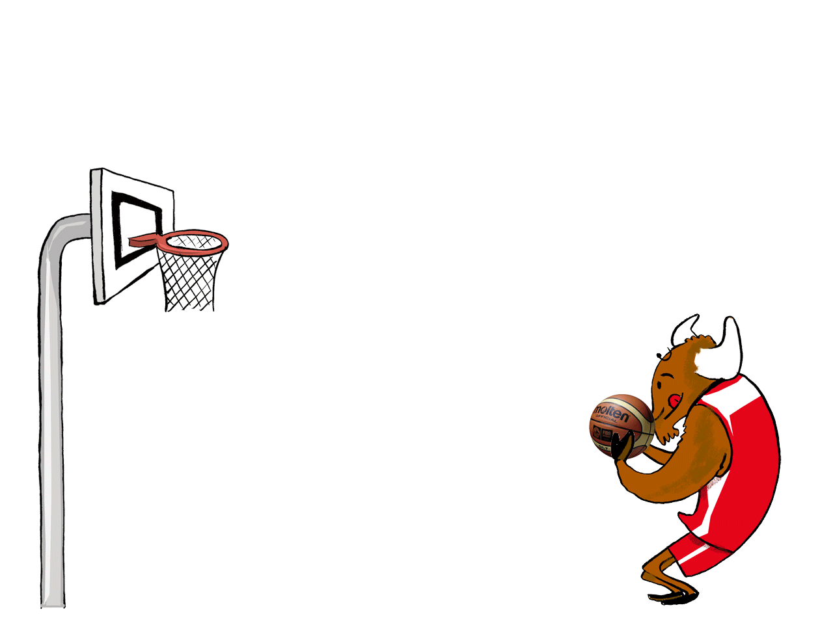
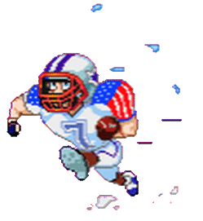
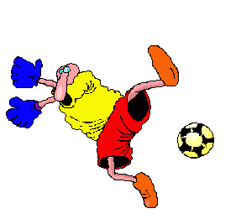
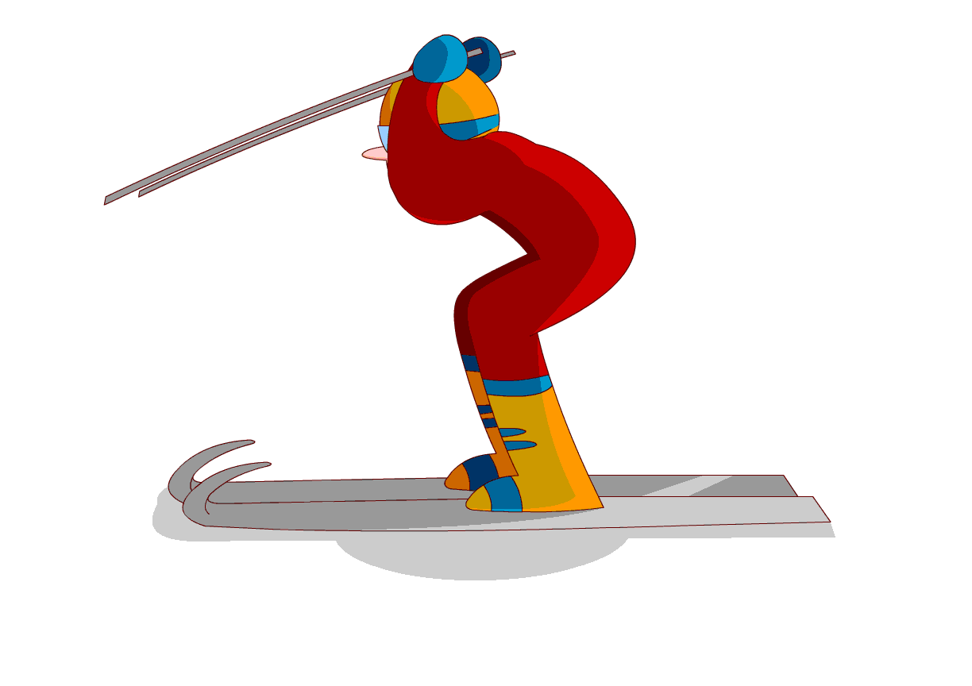
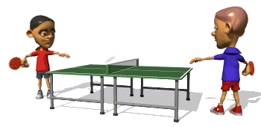
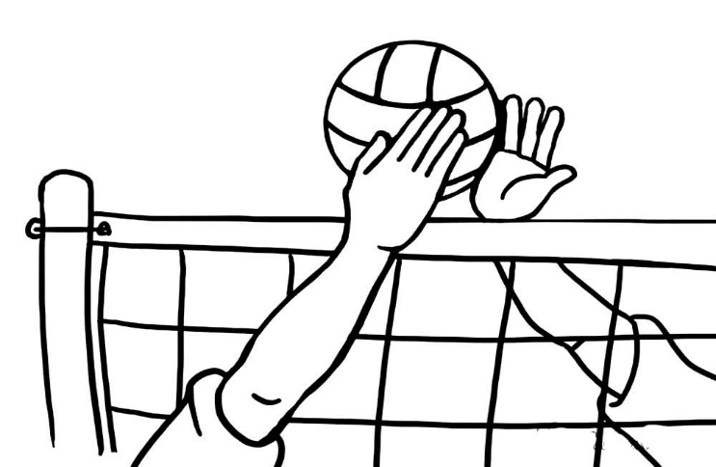

What sport is not mentioned in the text?
- What sport is typically British?

Slide 11
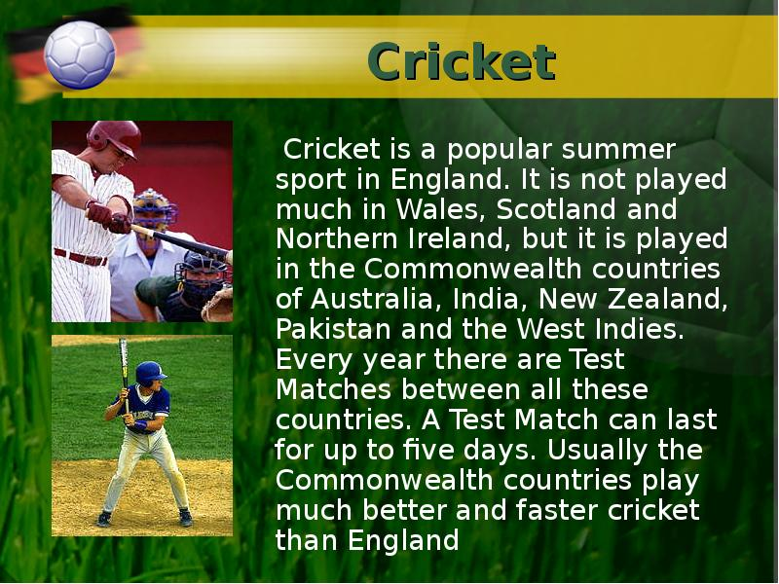

Slide 12
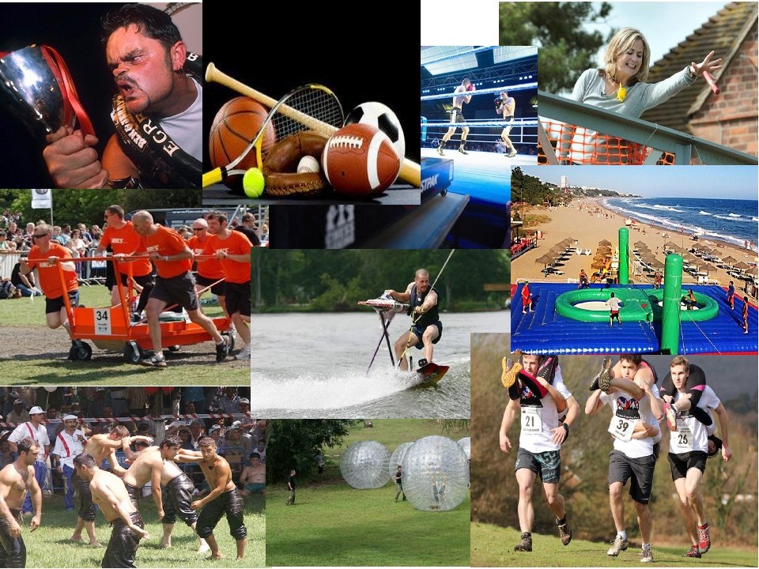
GURNING
SPORT WITH NO CLOTHES
POOHSTICKS
CHESS BOXING
BOSSABALL
BED RACING
EXTREME IRONING
OIL WRESTLING
ZORBING
WIFE CARRYING

Slide 13
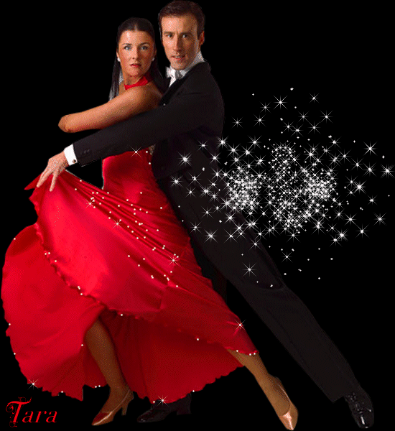
MY FAVOURITE SPORT
DANCING is my favourite sport.
It is great and funny.
I feel happy when I go in for dancing.
My coach is very patient.
I train three times a week.
I often take part in the dancing competitions.
I do sport because I want to keep fit.
Football, basketball, running, jumping, active, proud, kind, talented, dangerous, fast, every day, four times, win, look sporty, get a medal

Slide 14


