Slide 1


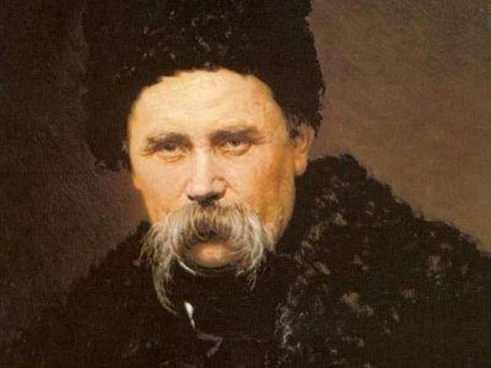

Slide 2
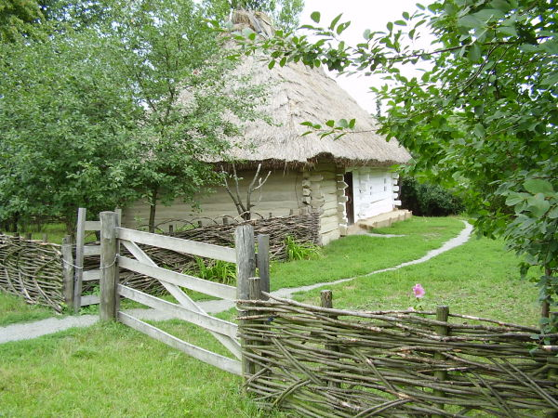
T.H. Shevchenko was born on March, 9, 1814 in the village of Moryntsi, not far from Kyiv, in the family of a serf. Taras didn't like his home. He called it the hell. His mother died because of exhausting work. Taras’s father had to marry a widow. But his life was not much longer than his wife΄s! And that was when the real hell began.

Slide 3
CHILDHOOD
To write of Shevchenko's childhood, one must contend with the fact that very little original material exists.
Amongst the peasantry, burdened by the brutal and unjust system of serfdom, tales of these folk heroes and their struggles for freedom, were commonplace, a relief from the toils of the day, as well as a hope for a better future. It was in such an environment that the young Taras and his siblings were raised.
It is not surprising that in later life so much of his poetry is devoted to the recurring themes of people’s struggle against injustice and a vengeful hatred of those who oppress.

Slide 4
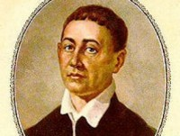
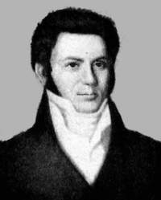
The boy was also fascinated by poetic works created by Hryhoriy Skovoroda and Ivan Kotlyarevsky. He was particularly interested in hagiographies.
Ivan Kotlyarevsky
Hryhoriy Skovoroda

Slide 5
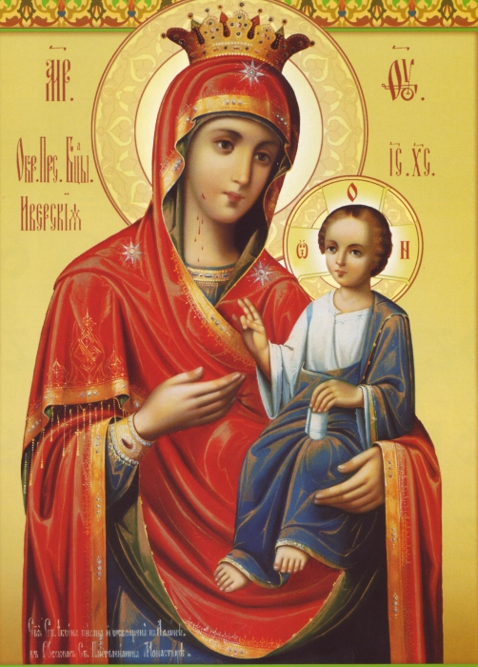
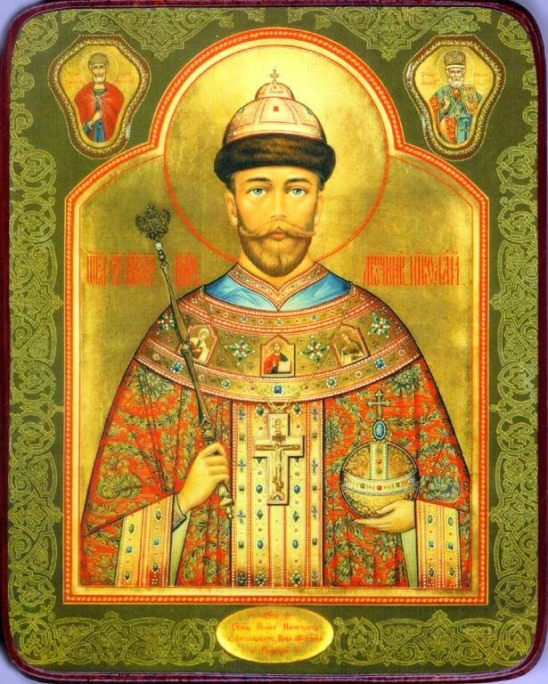
Hagiographies
It refers literally to writings on the subject of such holy people, and specifically to the biographies of saints and ecclesiastical leaders. The term hagiology, the study of hagiography, is also current in English, though less common. This, in fact, follows original Greek practice, where hagiographies refer to visual images of the saints, while their written lives or the study thereof are known as hagiographies.

Slide 6
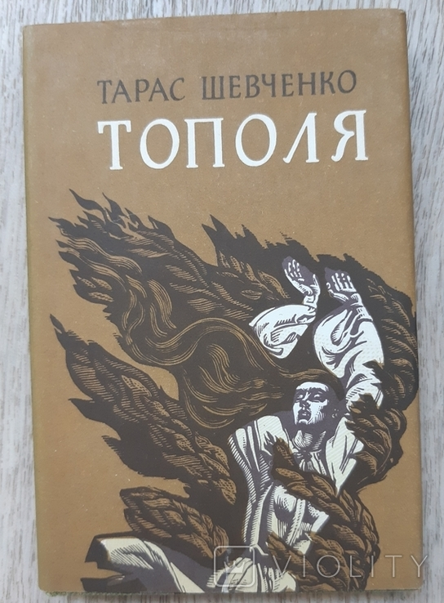
The subject of his ballads and lyro-epic poems were similar to other Ukrainian romantics depicting unusual heroes in extreme situations.
The great difference was that these unusual heroes were taken from real life. The conflict is not between real and unreal but it acquires social colouring (e. g. in Taras’s
« Topolya»).

Slide 7
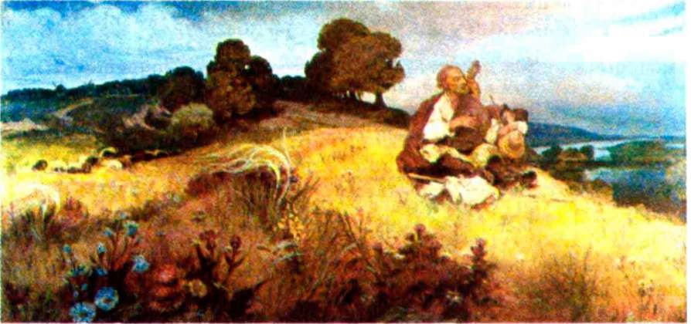
Taras’s works had folklore background. At the same time we must admit his innovations. He didn’t stylize folklore, neither he copied it. With help of it he exposed the spiritual wealth of Ukrainian people. Consider his poem «Perebendia». It’s not only of folklore character. It has literature origin.

Slide 8


Not everybody could understand the epochal significance of that small book «Kobzar». But
«Literaturna Hazeta» of those times estimated its patriotism, vividness, brightness and freshness of the stylistic devices.
His exile stimulated his poetic abilities, sharpened his patriotic and civic feelings.

Slide 9
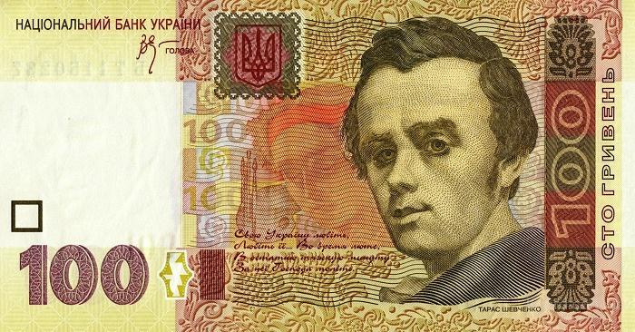
Nowadays we can see Shevchenko’s picture at 100 UAH.

Slide 10
Here is one of the most beautiful poems.
We two have never left
Our pathway rough
Have gone straight
forward, and no man can find
One grain of falsehood
That we΄ve left behind…
Let us then still go on,
My destiny,
Most humble,
Unpretentious friend to me
Let us proceed:
For there the glory lies,
And glory is my
All -consuming prize
Ми не лукавили з тобою, Ми просто йшли; у нас нема Зерна неправди за собою. Ходімо ж, доленько моя! Мій друже вбогий , нелукавий! Ходімо дальше, дальше слава, А слава – заповідь моя.

Slide 11
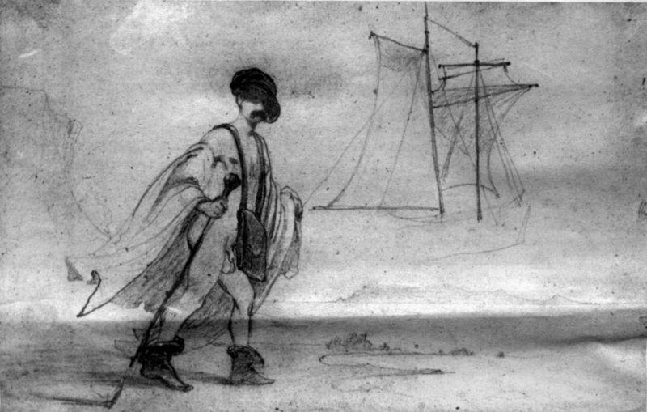
All his life he loved Ukraine, he wanted to live in Ukraine, but the great part of his life he was far from his native land - in prisons and deportation. And we can read:

Slide 12
It does not touch me, not a whit,
If I live in Ukraine, or no,
If men recall me, or forget,
Lost as I am in foreign snow,
Touches me not the slightest whit!
Captive, to manhood I have grown
In strangers homes, and by my own
Unmourned, a weeping captive still,
I’ll die… all that is mine, I will
Bear off, let not a trace remain
In our own glorious Ukraine,
Our own land – yet a stranger’s rather.
And speaking with his son, no father
Will recall, nor bid him: «Pray
Pray , son of old , for our Ukraine,
They tortured all his life away!»
It does not touch me, not a whit,
Whether that son will pray, or nor…
But it does touch me deep, if knows,
Evil rogues, lull our Ukraine
Asleep, and only in the flames
Let her, all plundered, wake again….
That touches me deepest pain!
Мені однаково, чи буду
Я жить в Україні, чи ні,
Чи хто згадає, чи забуде
Мене в снігу на чужині —
Однаковісінько мені.
В неволі виріс між чужими,
І, не оплаканий своїми,
В неволі, плачучи, умру,
І все з собою заберу,
Малого сліду не покину
На нашій славній Україні,
На нашій — не своїй землі.
І не пом’яне батько з сином,
Не скаже синові: - Молись,
Молися, сину: за Вкраїну
Його замучили колись.
Мені однаково, чи буде
Той син молитися, чи ні...
Та не однаково мені,
Як Україну злії люде
Присплять, лукаві, і в огні
її, окраденую, збудять...
Ох, не однаково мені.

Slide 13

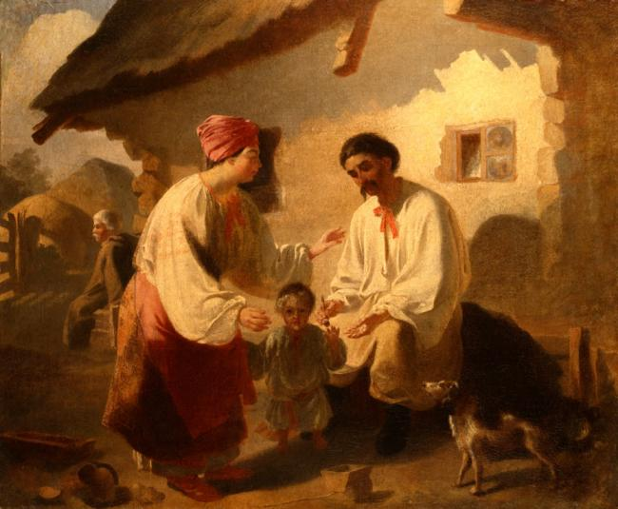
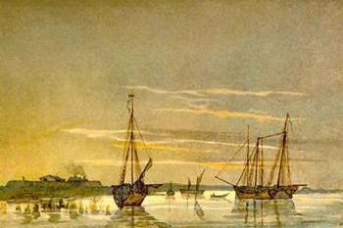
Taras Shevchenko was an outstanding poet. He opened a new epoch in the development of the Ukrainian literature and in the social and cultural life of the whole Ukrainian people.

