Slide 1
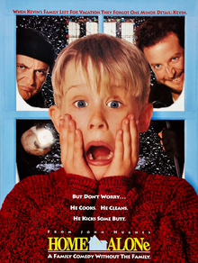
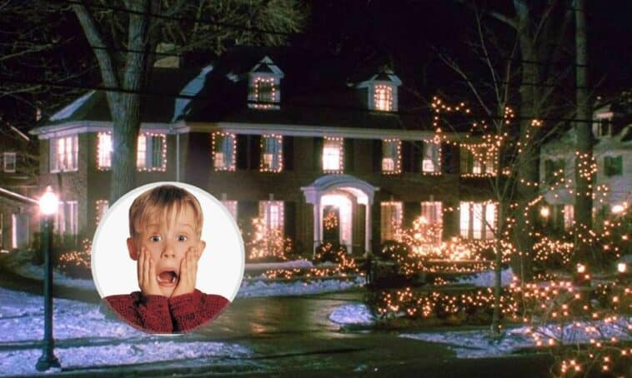
My favourite film

Slide 2
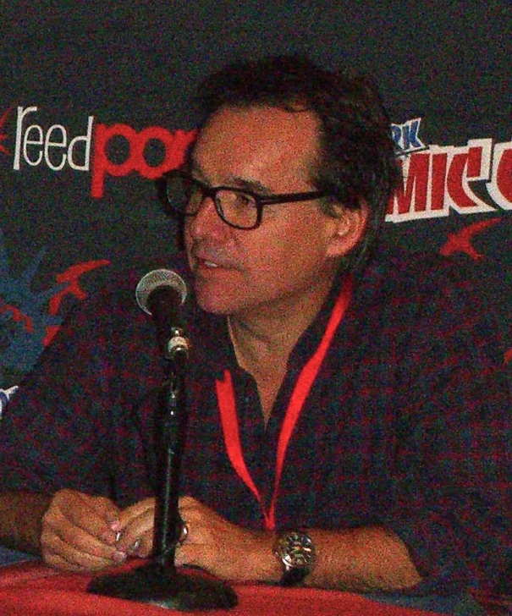
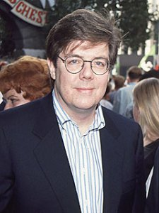
Home Alone (1990) is an American Christmas Comedy and adventure film directed by Chris Columbus and written and produced by John Hughes .
John Hughes
Chris Columbus

Slide 3

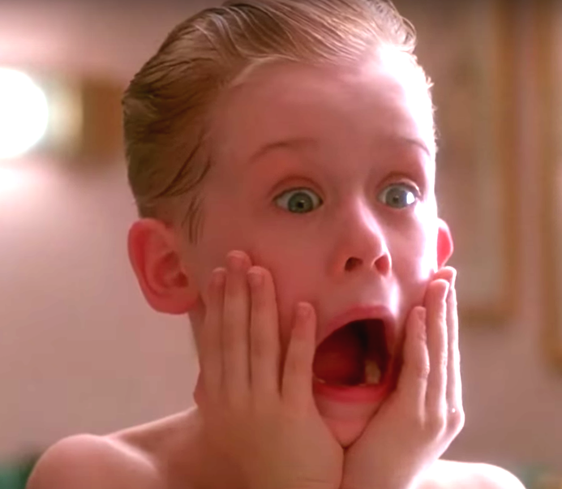
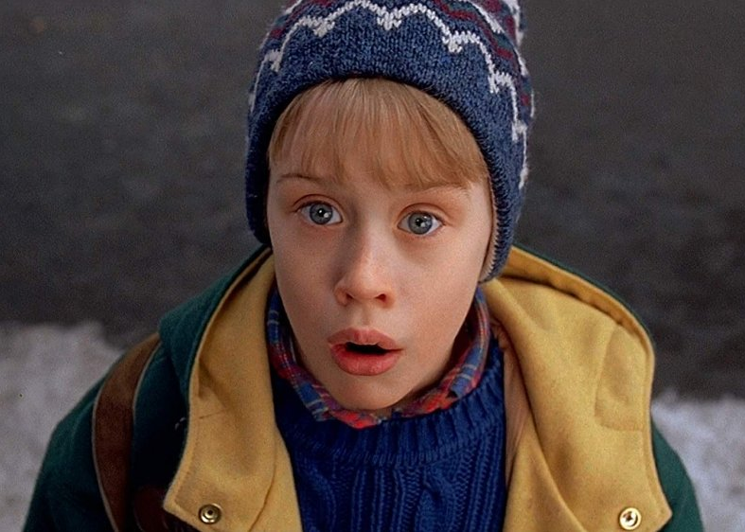
Macaulay Culkin plays Kevin McCallister, a boy who defends his suburban Chicago home from burglars after his family accidentally leaves him behind on their Christmas vacation to Paris.

Slide 4
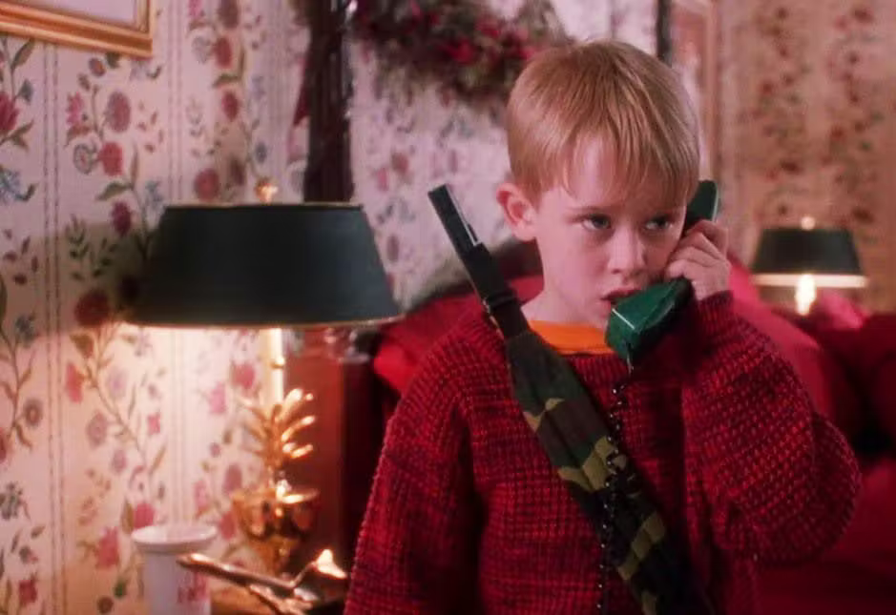
Eight-year-old Kevin McCallister is accidentally left behind when his family takes off for a vacation in Paris, France over the holiday season. Once he realizes they've left him home by himself, Kevin learns to fend for himself. He eventually has to protect his house against bumbling burglars Harry (Joe Pesci) and Marv (Daniel Stern), who are planning to rob every house in Kevin's suburban Chicago neighborhood.

Slide 5
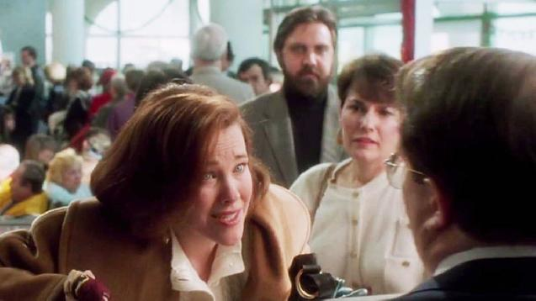
Kevin's mother Kate (Catherine O'Hara) is frantic when she realizes that she and the family have unintentionally left Kevin behind in Chicago, and she tries to make it back to Chicago as fast as she can, getting help from a poland band.

Slide 6
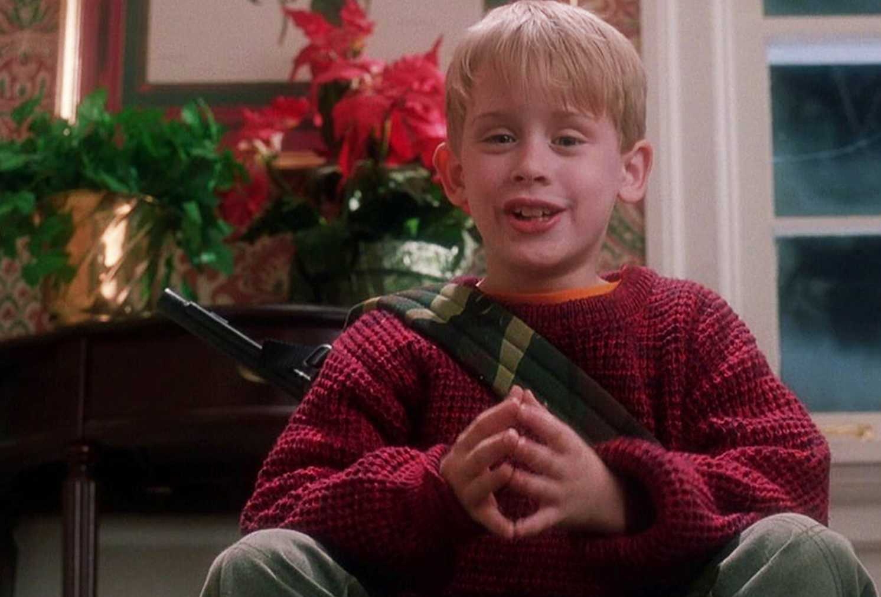
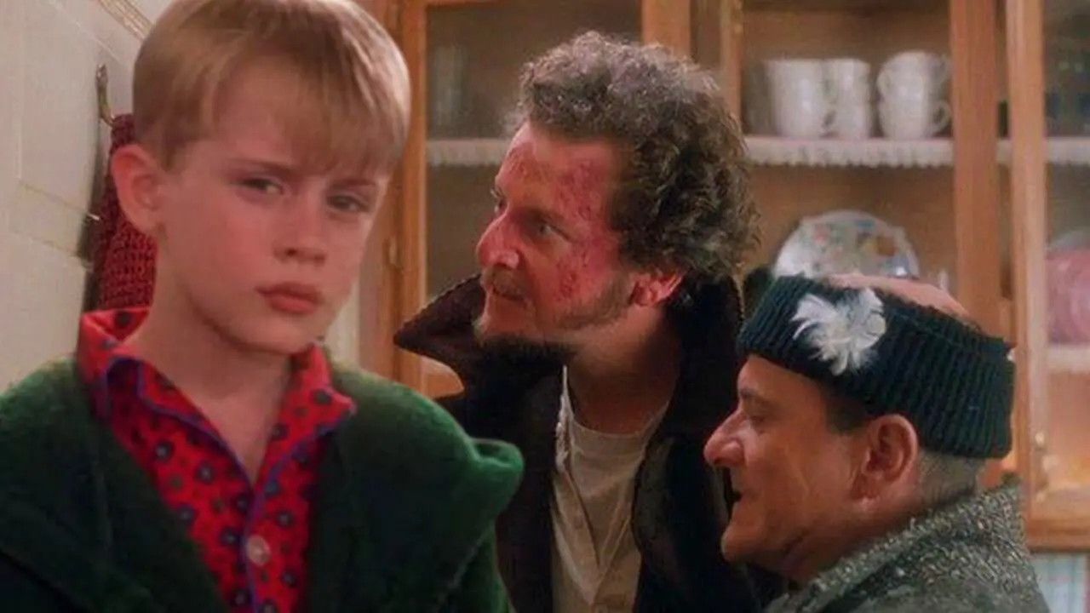
Home Alone is one of the best films I`ve seen recently.
It`s funny and action-packed, and it`s a wonderful way to spend an evening with your friends or family.

Slide 7
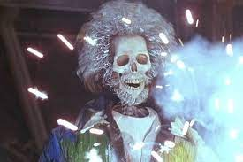
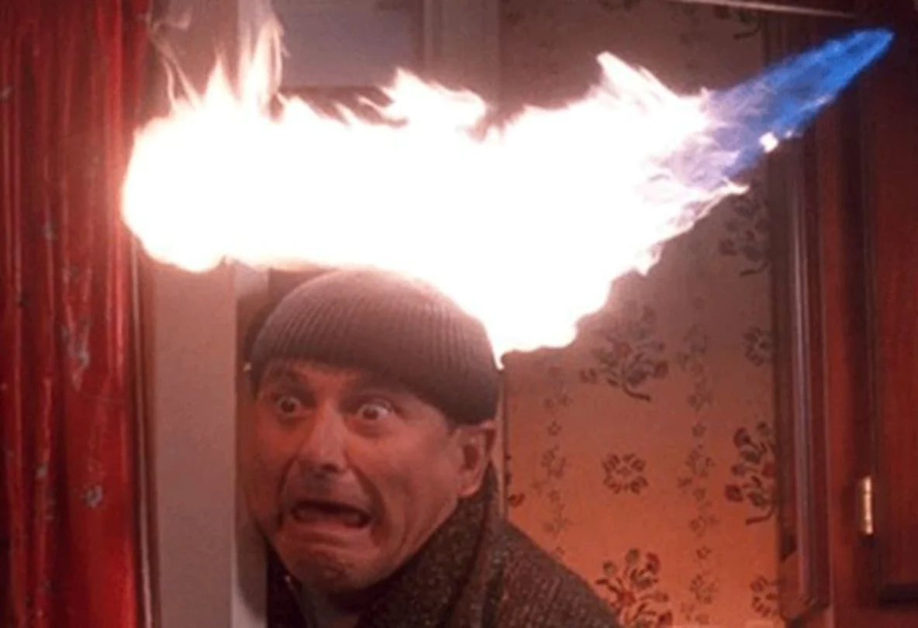
The action is excellent and the plot is exciting.
The music isn`t anything special, but the special effects are incredible.

Slide 8
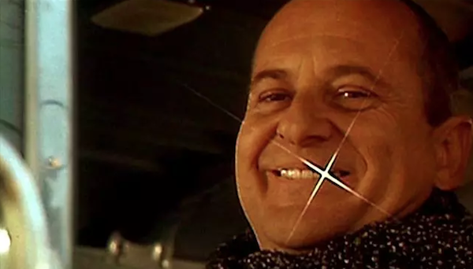
All the computer effects for the film were done by a guy (Kevin Nordine) in the basement of his parents’ Chicago home. Nordine hand drew the effects (like the BB pellet and Harry's tooth) directly onto the film, and he only charged a few hundred dollars for his services.

Slide 9



