Slide 1

THE INFLUENCE OF SOCIAL MEDIA
ON THE DEVELOPMENT OF ENGLISH AMONG TEENAGERS
The work was completed by
a student of the 11th grade
of Ovruch lyceum №4
of the Ovruch city council
Dmytro Baranovskyi

Slide 2

RELEVANCE OF THE RESEARCH
The value of social networks as an educational and communication tool is growing rapidly.
The English language, which dominates in many global platforms such as YouTube, Instagram, TikTok, has become the main means of exchanging information and cultural phenomena.
The role of digital platforms in language learning processes, especially among young people who are actively integrated into global communities through these networks is increasing.

Slide 3




YouTube, tiktok, Instagram, snapchat remain the most widely used online platforms among teens around the world
The popularity of
WhatsApp, Telegram, Viber
is increasing
The popularity of
Facebook is falling
COUNTRY | SOCIAL MEDIA | % of USERS
THE USA | TikTok, Instagram,YouTube,Snapchat | 95
THE UK | TikTok, Instagram,YouTube,Snapchat | 92
GERMANY | Instagram,YouTube, TikTok, Snapchat | 88
UKRAINE | Instagram,TikTok,YouTube, Facebook | 93

Slide 4



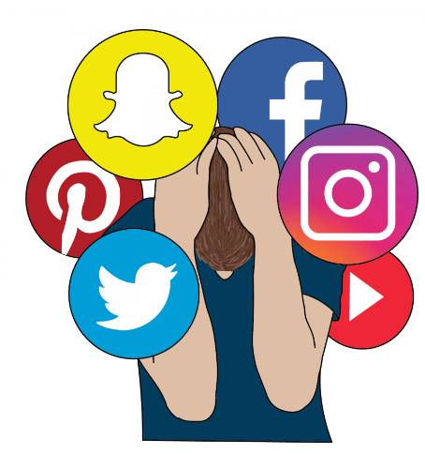
carrying out the research
FIRST
analyzing
summarizing
THEN
survey
questionnaire
NEXT
collecting the data
comparing
FINALLY
making
conclusions

Slide 5

Survey results

Slide 6

challenges and opportunities
Hashtags,emojis,internet slang,
contractions,colloquialisms,
relaxed approach to grammar
GLOBAL ENGLISH
cultural homogenization

Slide 7

Significance
Students can use social media more effectively for educational purposes.
Teachers can improve and adjust learning stratagies or techniques.
Parents can be aware of the effect of social media on the children.
Researchers will add valuable and useful information into thier research.

Slide 8

REMEMBER
Social media is a part of our life, not our life

