Slide 1
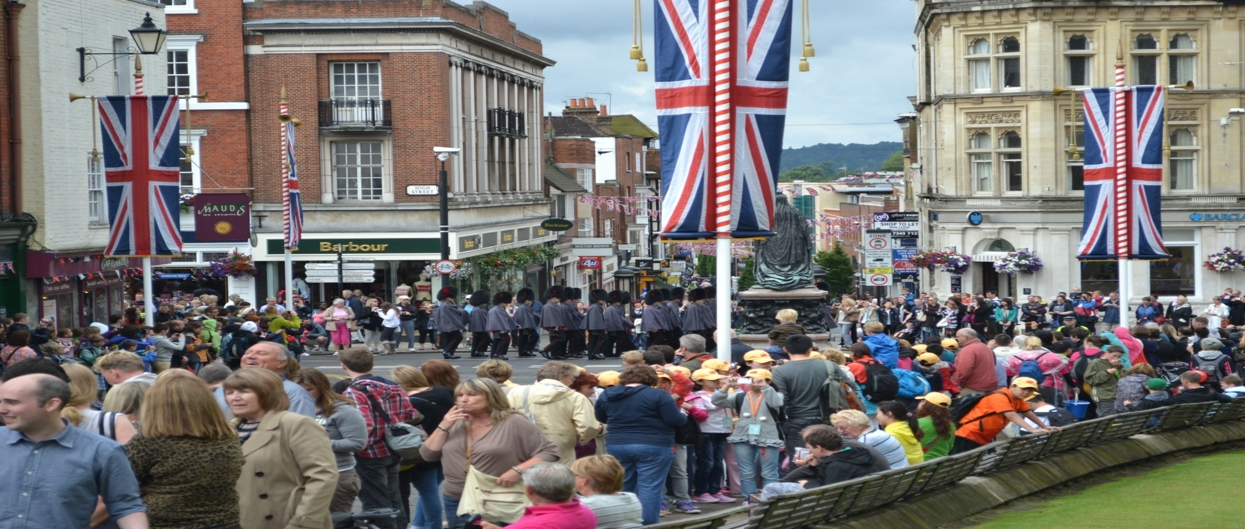
A TRIP TO ROBIN
HOOD’S COUNTRY
’
’

Slide 2


Good morning , students.
Today we are going to talk about the country the language of which we learn.
Please, take your seats , look at each other and smile.
How are you? Are you fine? Are you OK? Are you ready to start our lesson?

Slide 3

So , start our trip to Robin Hood’s country!
Watch the film and answer the questions, please.
1.Who was Robin Hood?
2.Did Robin Hood help poor people?
3.Where did he live?
4.Was Robin Hood a brave man ?
5.Did you like the film?

Slide 4
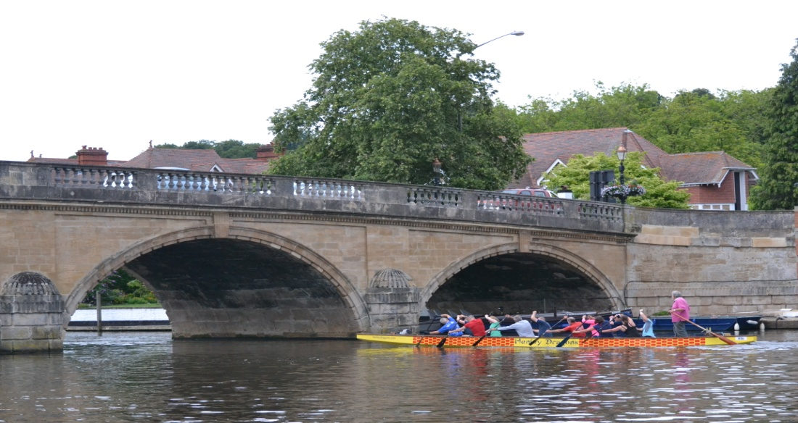
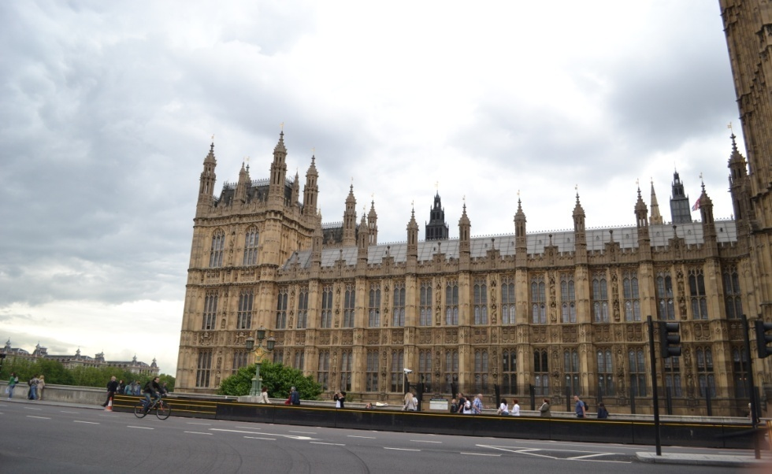
So , today we shall speak about the United Kingdom of Great Britain and Northern Ireland
You will be invited to the UK on condition you know British geography , history, culture and traditions well! Do all your best to have a wonderful trip.
Let’s start with phonetic drills.
Look at the map, listen and repeat after me the geographical names.
.

Slide 5
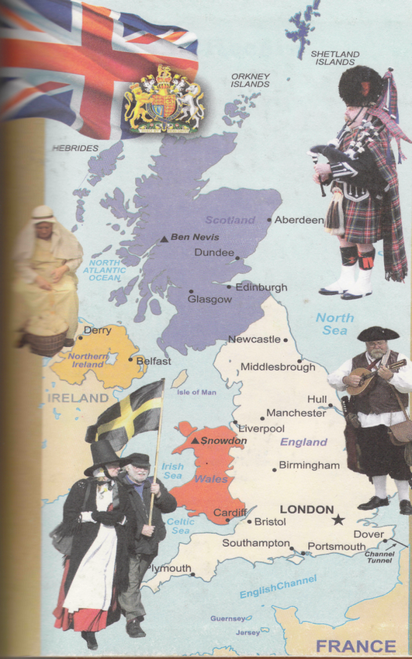
Look at the map , listen and repeat after me the geographical names
        The United Kingdom of Great Britain and Northern Ireland.
        England
        Wales
        Scotland
        • London
        The British Isles
        The English Channel
        The Thames
        The Severn
        The Atlantic Ocean
        The Irish Sea
        The North Sea

Slide 6
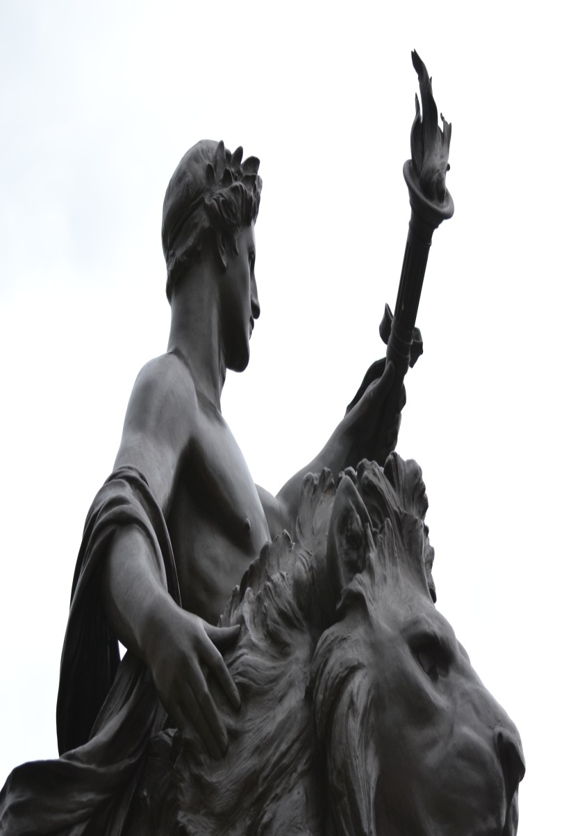
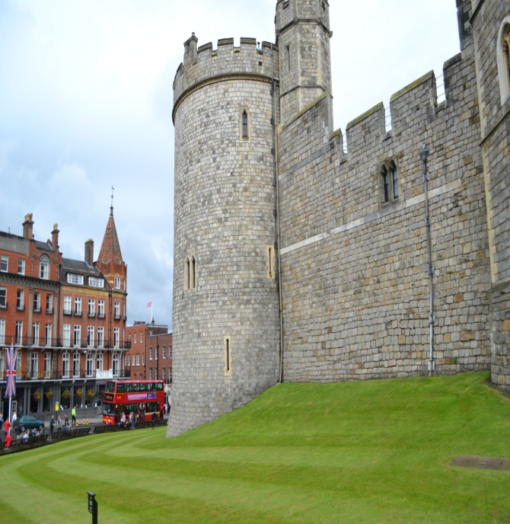
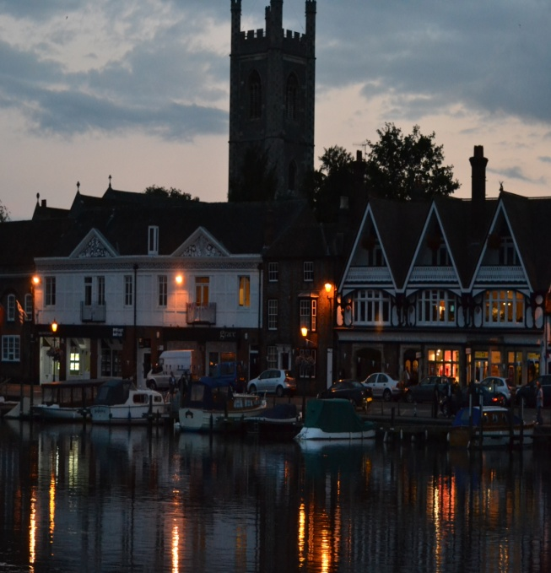
Now I want you to read and translate the text.
1.Exercise 2 page131-132
2.Answer the questions
Exercise 3 page 132

Slide 7


Work in groups. Complete the sentences. Answer one after another.
The United Kingdom occupies...
It consists of...
The British Isles are separated from Europe by...
The British Isles are washed by.. .
England is the
Scotland is the land of ...
. The British Isles have many...
The longest river is...
London stands on the river...
Great Britain is...
The largest cities of the country are.:.
The geographical position of the country is ...

Slide 8

Children, do the jumbles, please!
The, Great, is, island, in, Britain, Europe, largest.
Of, the, British, lie, northwest, Isles, in, Europe, the.
Is, Channel, the, washed, the, English, Great, in, Britain, by, south.
Scotland, the, and, surface, Wales, is, of, mountainous.
Exported, to, English, is, many, wool, countries.

Slide 9
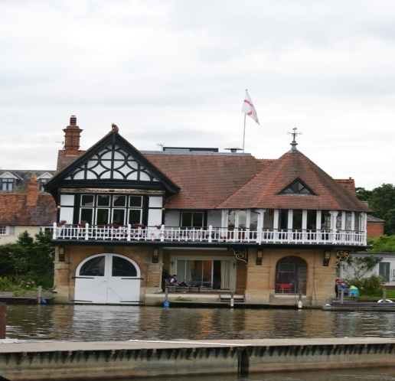
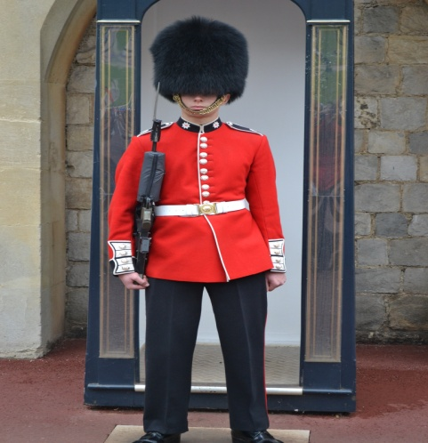
So you are welcome to the UK! What city are you going to visit? London? Why? Take a microphone and give your answers:
I want to see famous places of interests
I am going to have a look at the Queen
I want to meet my pen-friends
I am going to visit some sights
I am going to visit Tate Gallery
I want to meet with my friends and soon...
Thanks. I think that you have a lot of reasons to visit London! Look at the blackboard and read these sayings:
"I hope to see London before I die". (W. Shakespeare)
"Our England is a garden..." (R. Kipling)
"When a man is tired of London, he is tired of life".
Please, explain these sayings. Do you agree with the authors? Is London worth visiting? Take a microphone and make a conclusion.
Welcome to England

Slide 10
Before our starting abroad you have to fill in application forms. Please, write down your name, surname, age, country, home address, phone number. Thanks. You are ready to make a trip.
Activity VII. Role-playing
Be so kind as to imagine that you are on a board of a modern airplane. Listen, please, a stewardess is speaking:
Attention, please!
Ladies and gentlemen! Our plane is about to land in London, the capital of the UK! Fasten seat belts, please! No smoking! Listen to the weather forecast of a meteorologist. In Lon­don the weather is fine. It is not rainy and foggy. The temperature is about +4° C.
Our plane will arrive exactly on time. And a guide is waiting for you in the airport "Heathrow". Thanks.

Slide 11
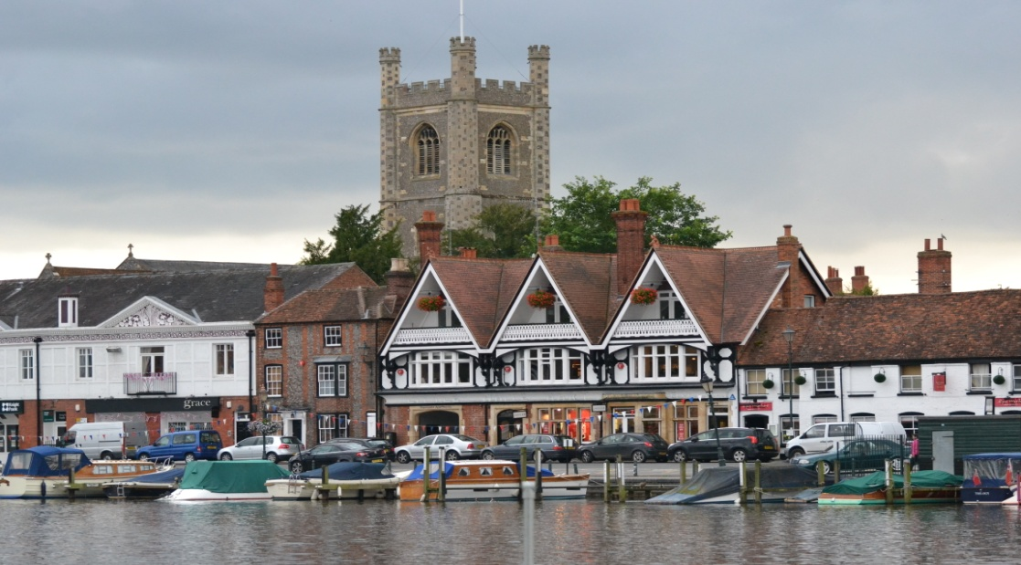

Take this microphone and answer: "What's London to your mind?" e.g.
London is the capital of England and the UK.
London stands on the river Thames.
London is a very old city.
London is a center of business and tourism.
London is a big port.
London is the most beautiful city in the world.
London is an old, beautiful, rich and interesting city of England.
London is famous for its wonderful sights.
London is famous for its historical places.
London is famous for its culture and sights.

Slide 12
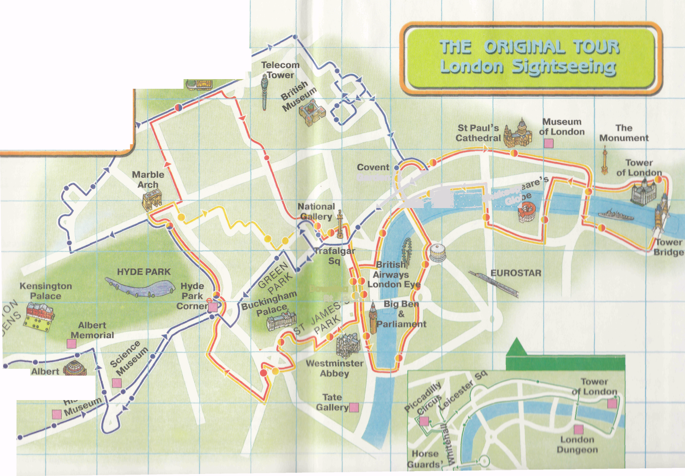

Slide 13
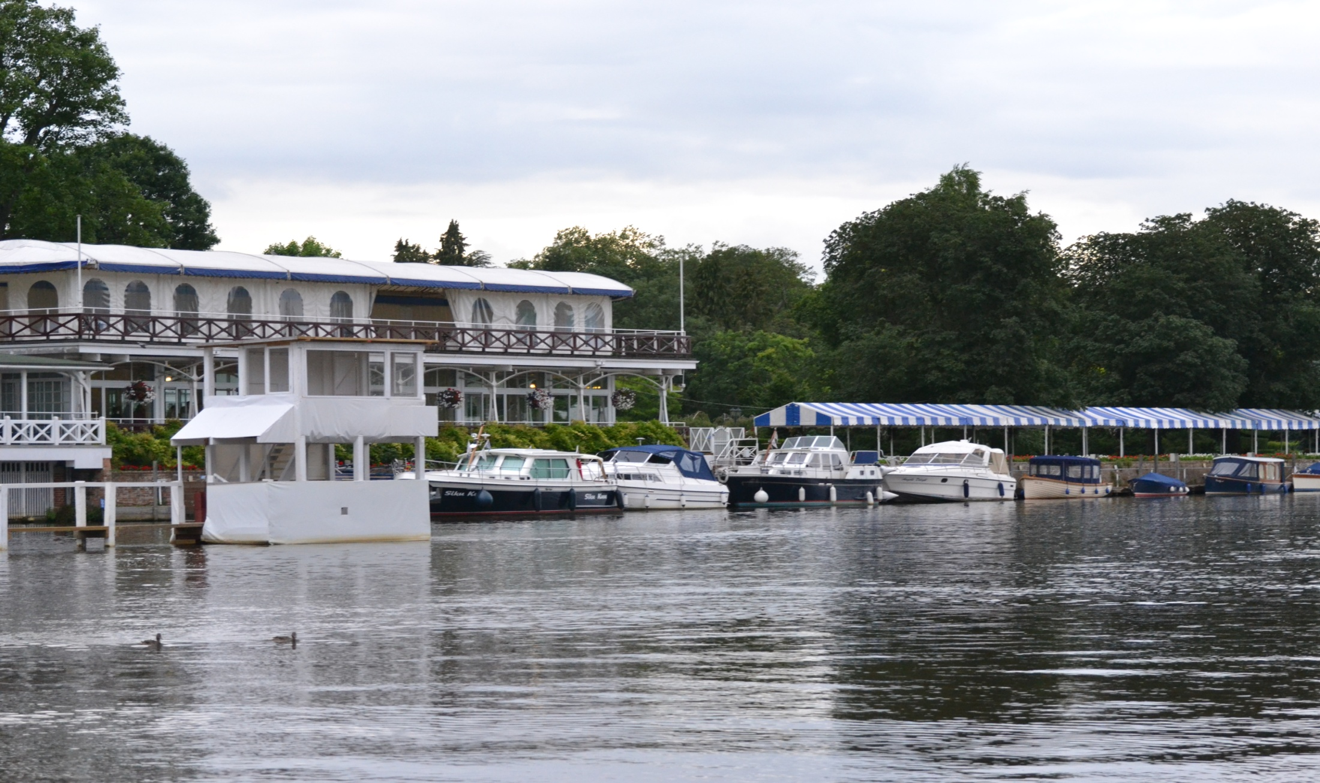
First of all we had a wonderful exursion about London by the river Thames.

Slide 14
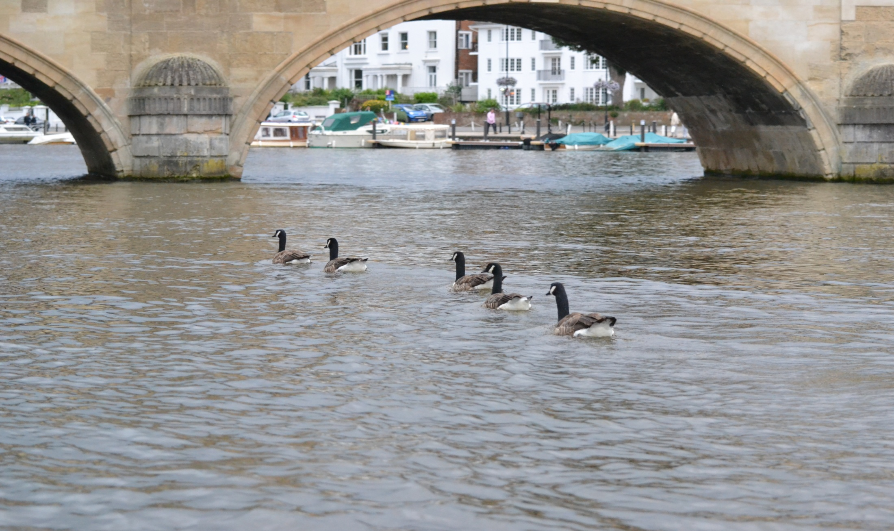
It was fantastic.

Slide 15
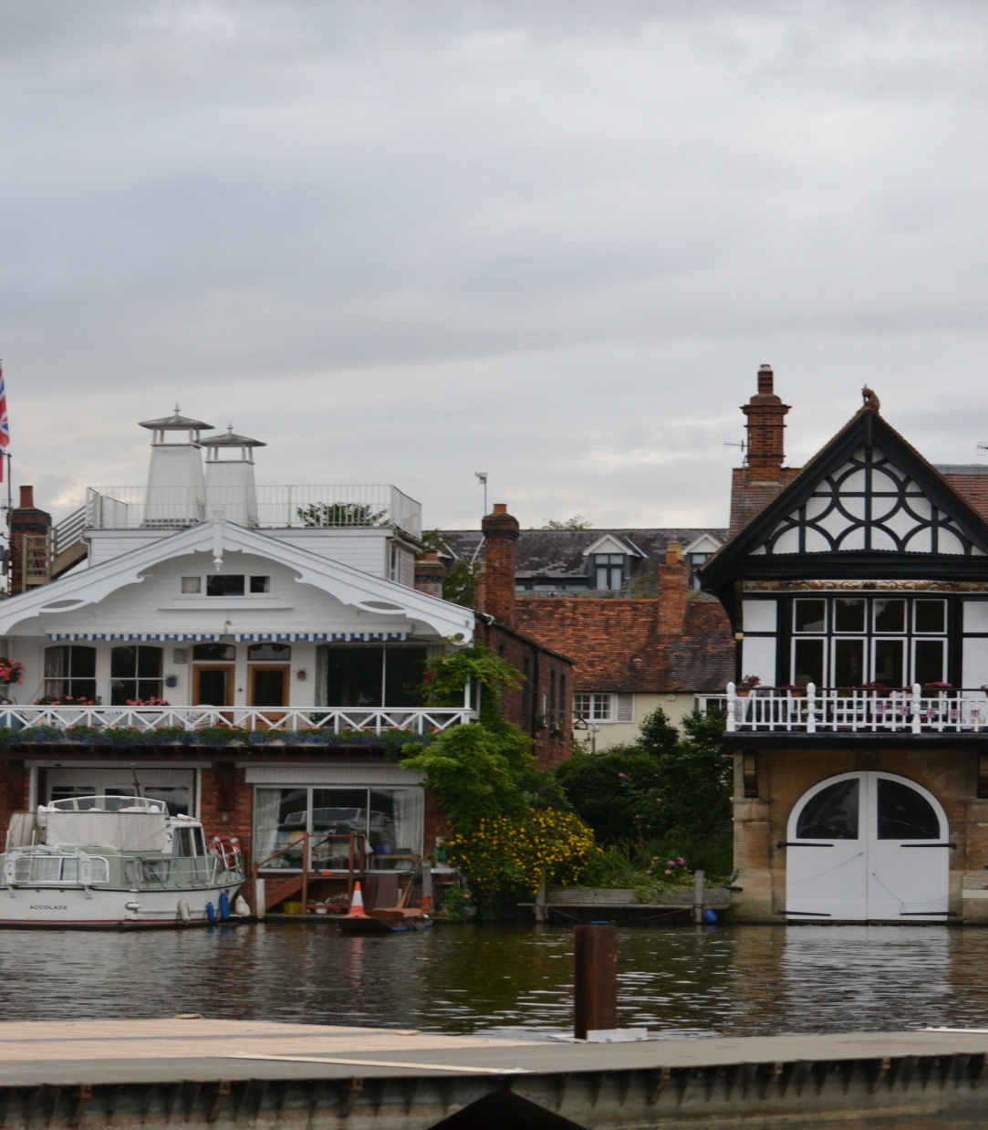

Then we came to Piccadilly Circus . Do you know that it is the meeting point of six streets.

Slide 16
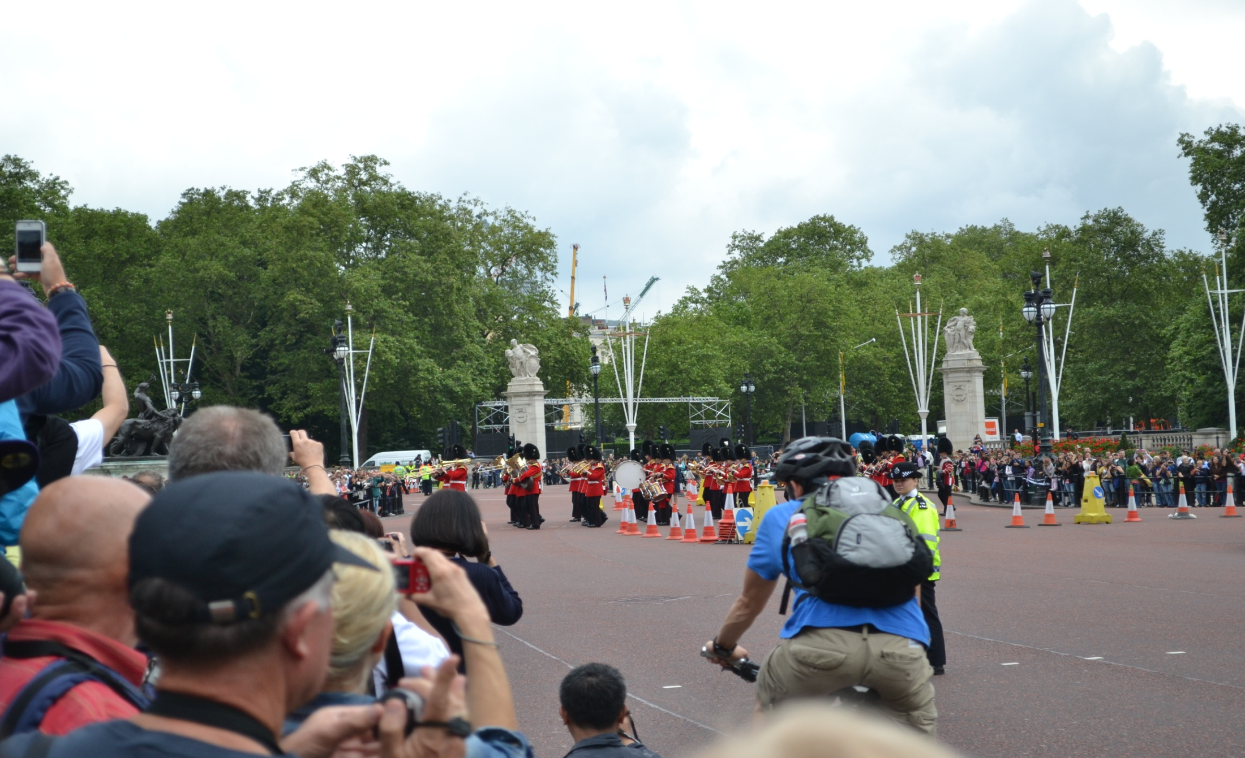
We passed Piccadilly Circus and made our way to Buckingham Palace.

Slide 17
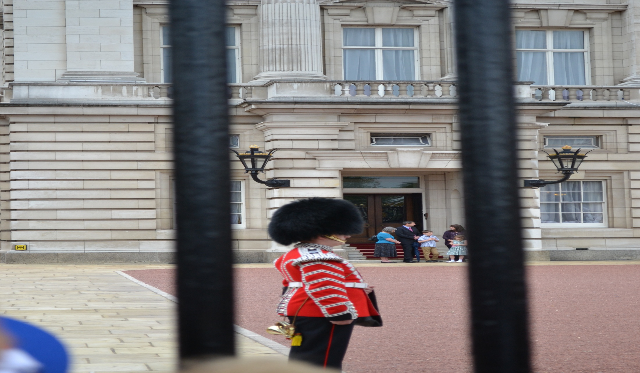
It is the London home of the Queen.

Slide 18
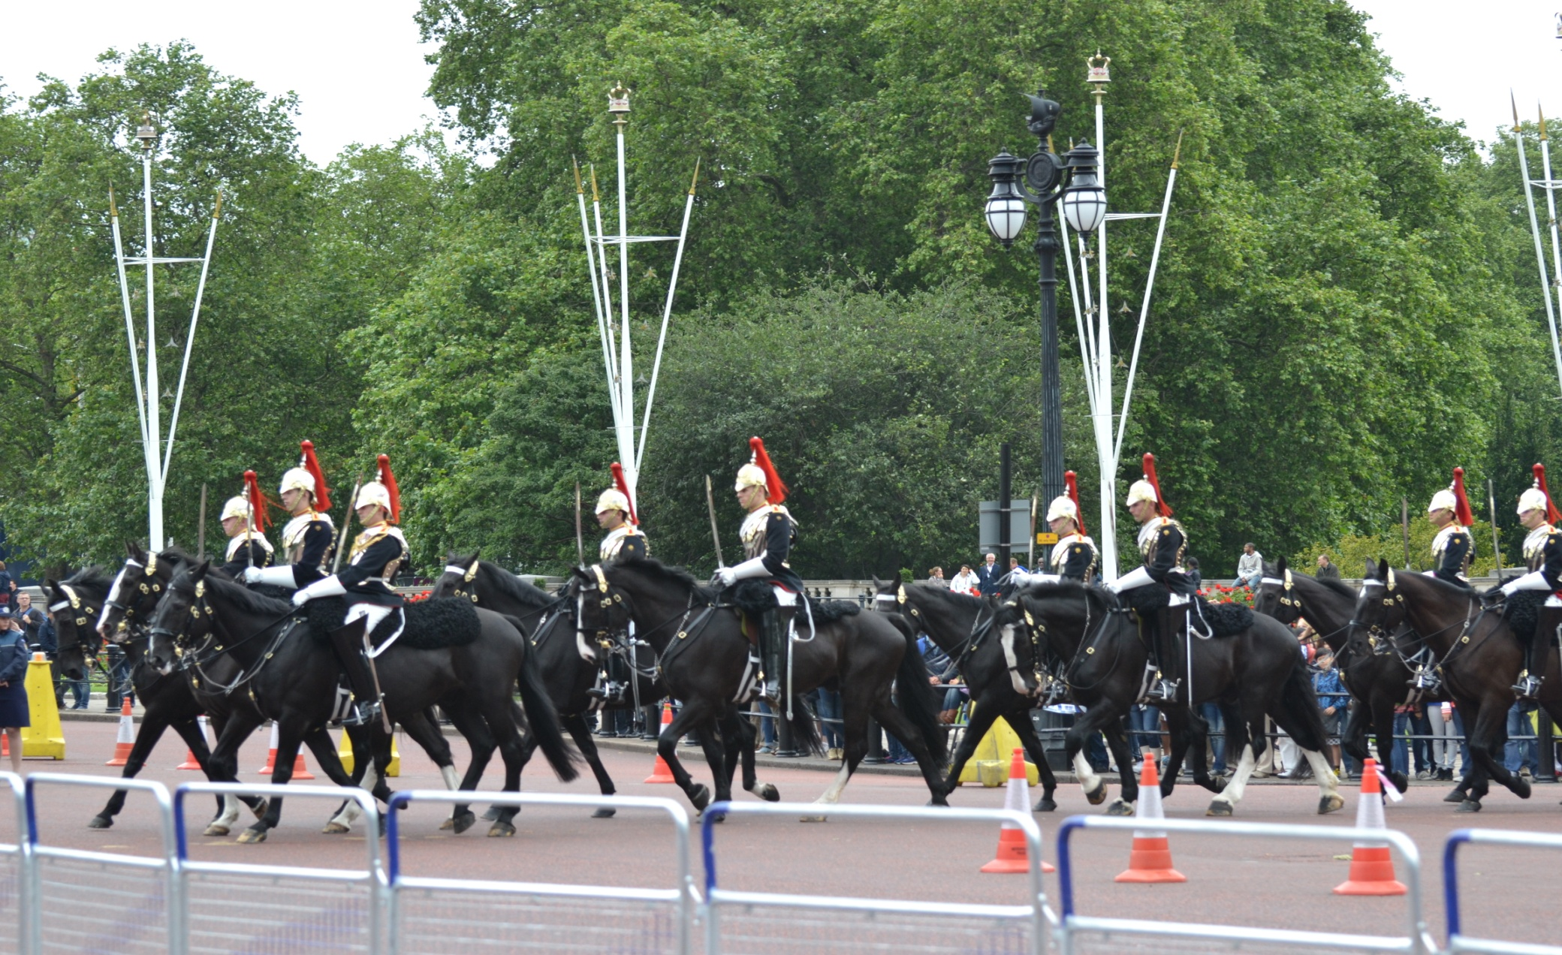
Look , they are changing the Guard . It happens every day at 11.30. a.m.

Slide 19
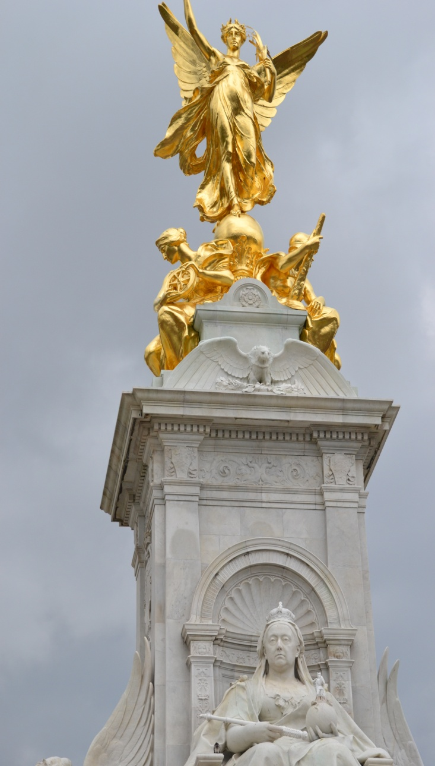
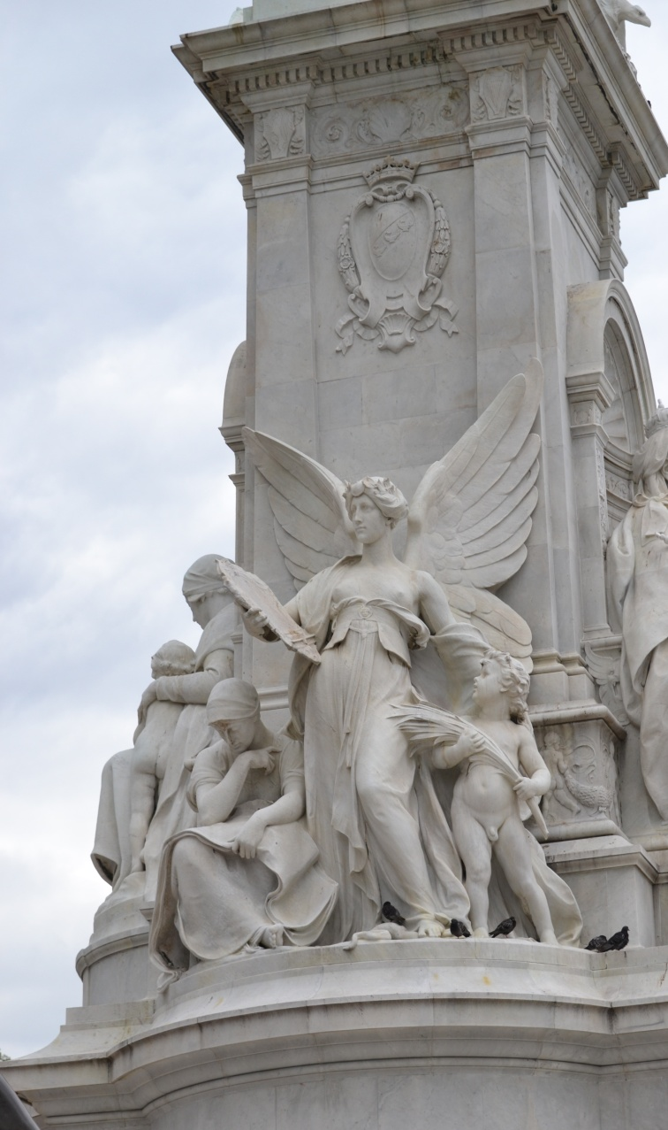
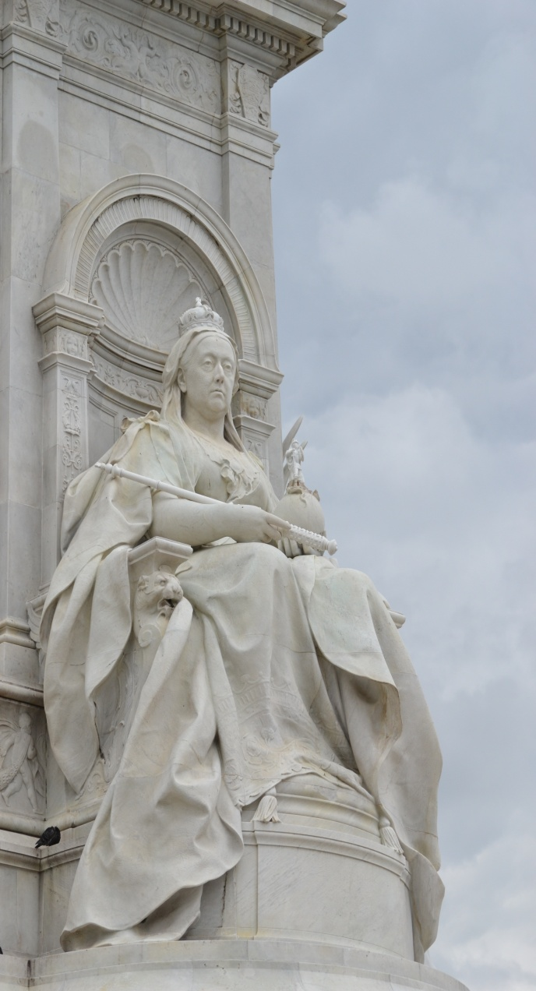
Then I saw the Houses of Parliament.

Slide 20

It is the seat of the British government.

Slide 21
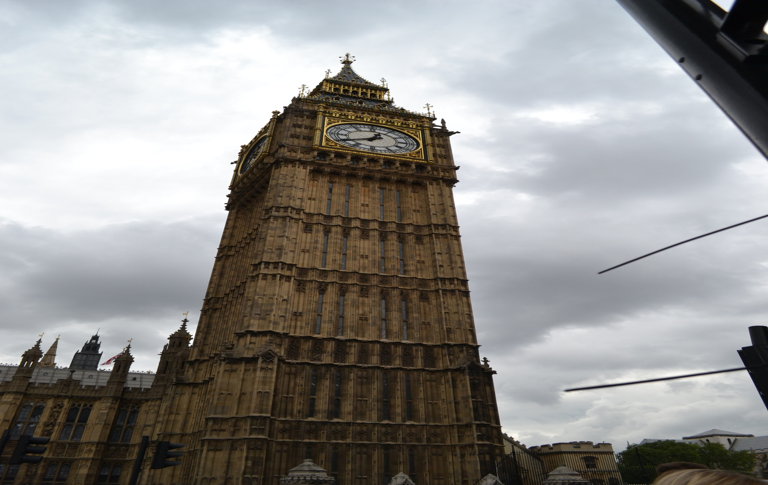
My dream was to see one of the most famous clocks in the world.

Slide 22
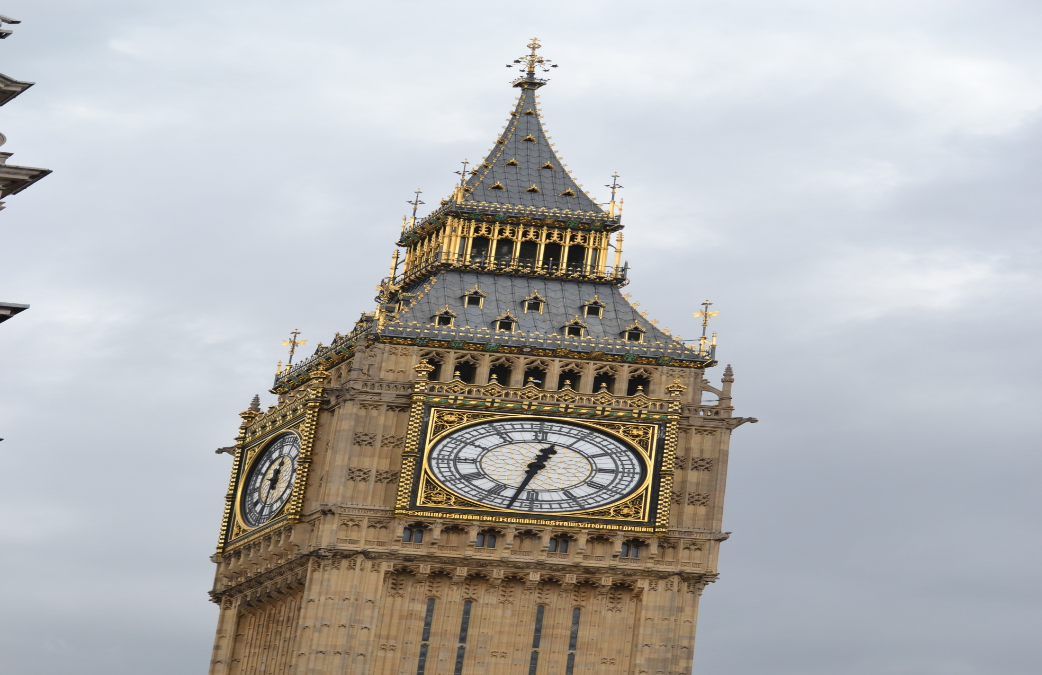
It is Big Ben.

Slide 23
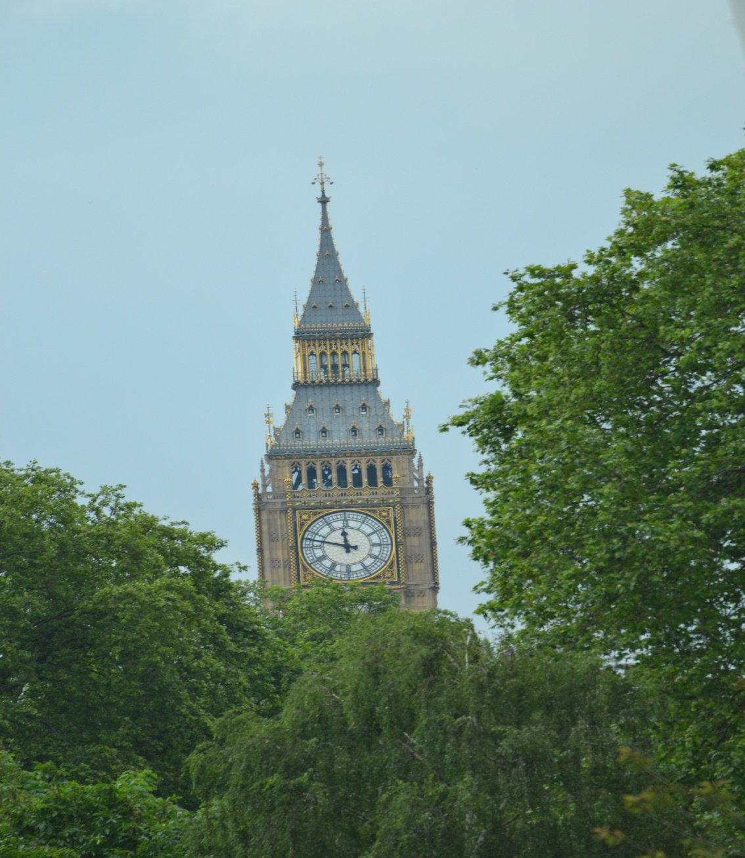
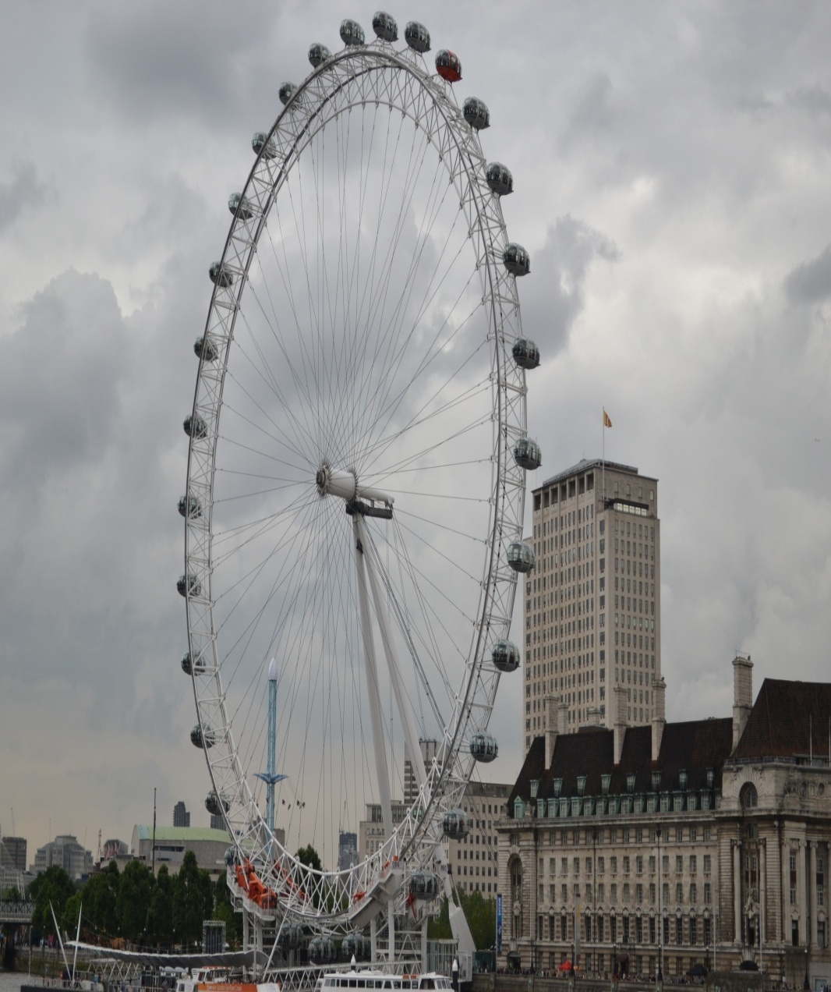
Then we saw Westminster Abbey . It is a famous royal church. The Royal Windsor Wheel is the biggest attraction for tourists

Slide 24
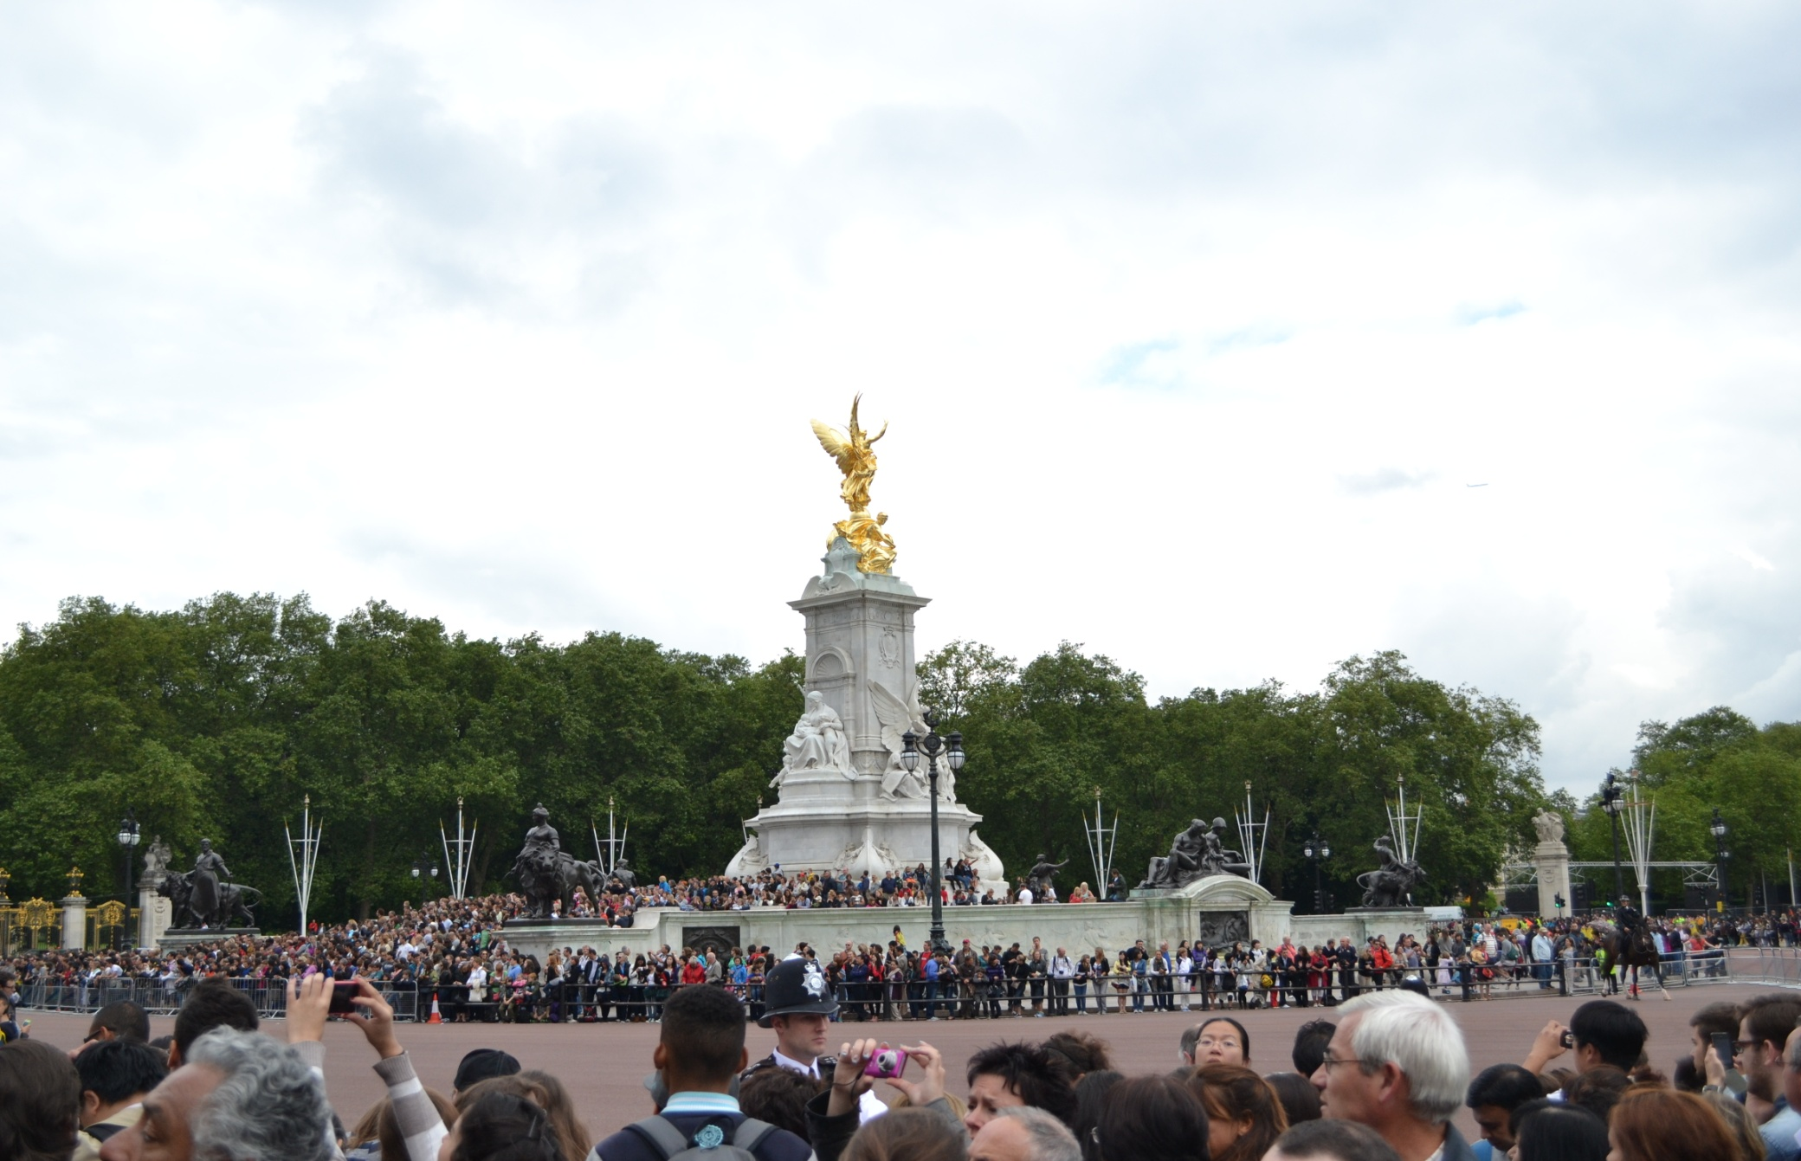
Besides that I have seen a lot of monuments, buildings and busy streets of London.

Slide 25
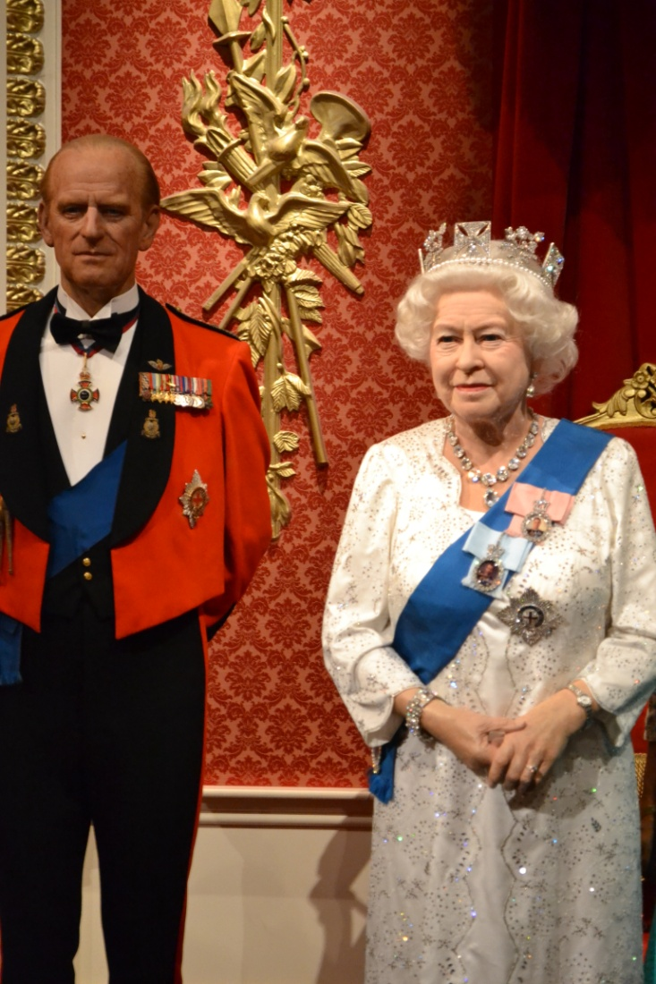
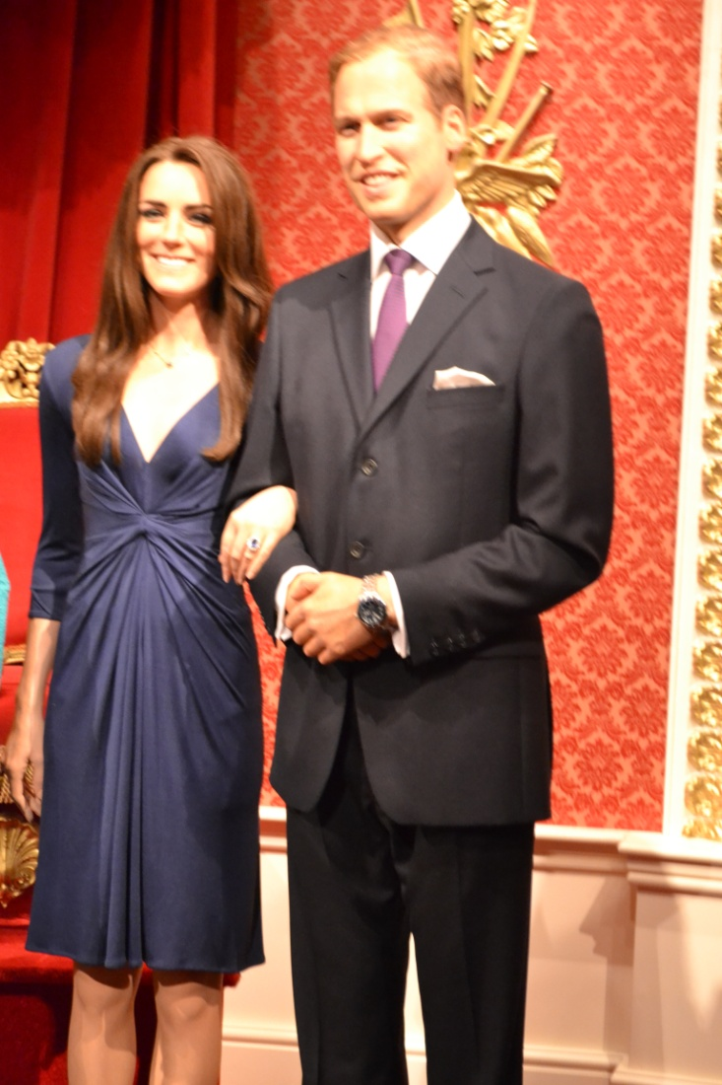
Madame Tussaud’s is the world’s most famous wax museum.
Here you can see historical characters, modern stars of stage, screen and pop music and even criminals.

Slide 26

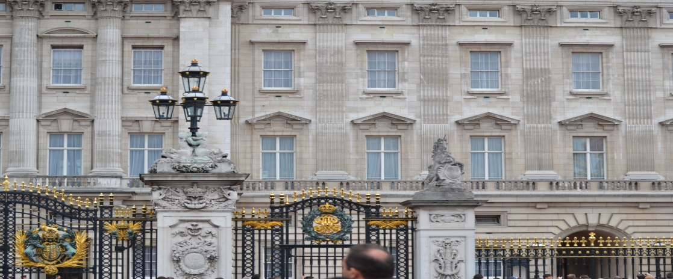
We have already made an exciting excursion about London it's high time to take of your mobile phone and ring your parents up. Say 1 -2 sentences about your visit to London,
We have visited many sights in London.
We have seen Trafalgar Square.
We have seen Tower Bridge and Hide Park!
We have visited the National Gallery.
We have seen Westminster Abbey and Buckingham Palace.
It's a pity we have not seen Elisabeth II.
We have seen Big Ben and Changing of the Guard.

Slide 27
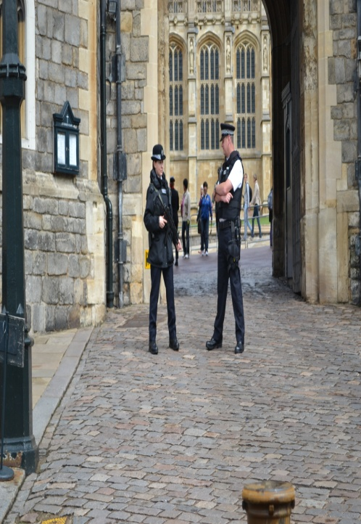
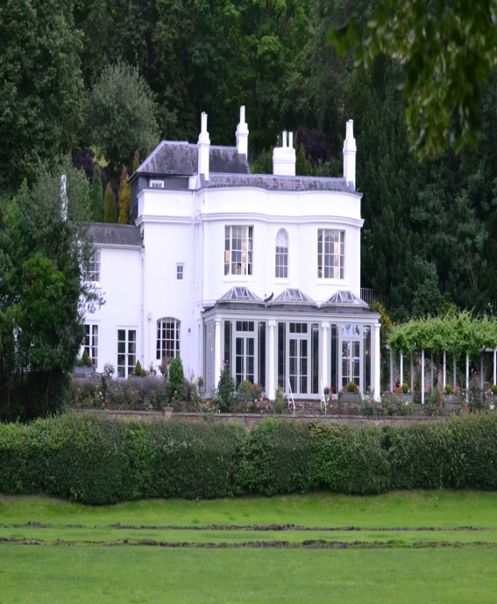
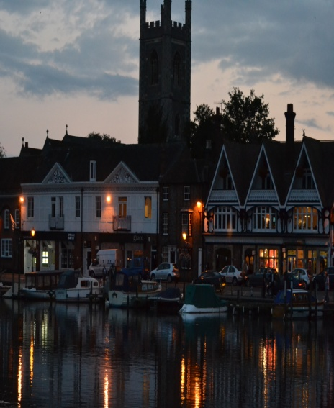
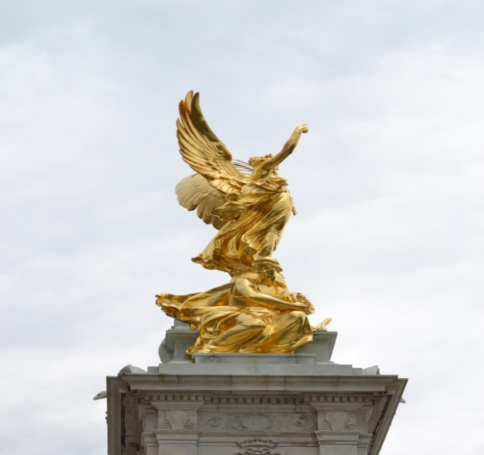
What is it? the Thames —
GB —
The UK —
Halloween —
Oxford —
Elizabeth II —
The tube —
The black cab —
A red rose —
Ben Nevis —
Loch —
London —
Irish —
West End —
Tower of London —
Westminster Abbey —
Buckingham Palace —
Football —
Wimbledon —
Double-decker —
The Globe —
Union Jack —
Big Ben —
Let’s play the game

Slide 28
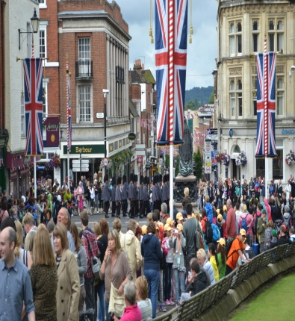
Reflection and feedback
Have you enjoyed your travelling to the UK?
Have you known any new information about London, the UK at the lesson?
Recollect it!
What activity was the best to your mind?
Your knowledge of English helped you during your visit to London , did not it?
Is it necessary for you to improve your English?

Slide 29

Well , we are coming back home.
I think our lesson- travelling was nice and useful.
You have got a lot of information about the country of Robin Hood.
Thank you very much for your answers.
I am satisfied with your work at the lesson.
You are very active and got good marks.
Our lesson is over.
Good-bye.

