Slide 1
Present Simple Tense
For: 5th Grade Students

Slide 2
What is the Present Simple Tense?
The Present Simple tense is used to talk about things that happen regularly or are always true.
Examples:
I play football every Saturday.
The Earth revolves around the Sun.

Slide 3
When Do We Use the Present Simple?
1. For habits or routines:
  Example: She goes to school every day.
2. For general truths (facts):
  Example: Water boils at 100°C.
3. For feelings, thoughts, and opinions:
  Example: I like chocolate.
4. For timetables or schedules:
  Example: The train leaves at 7:30 AM.

Slide 4
How to Form the Present Simple
For I, you, we, they (Subject + Base verb):
  Example: I eat lunch at 12 o’clock.
  Example: They study English every day.
For he, she, it (Subject + verb + s):
  Example: He plays football.
  Example: She lives in London.

Slide 5
The Negative Form
To make a negative sentence, we use do not (don’t) or does not (doesn’t).
For I, you, we, they: I don’t play football.
For he, she, it: She doesn’t like tea.

Slide 6
The Question Form
To make a question, we use do or does at the beginning of the sentence.
For I, you, we, they: Do you play football?
For he, she, it: Does she like chocolate?

Slide 7
Spelling Rules for He/She/It
Add -s to most verbs:
  He plays (play → plays)
  She studies (study → studies)
For verbs ending in -ch, -sh, -x, -o, add -es:
  He watches TV.
  She goes to school.
For verbs ending in -y, change the -y to -ies:
  She carries the books.
  He flies to Paris.

Slide 8
Let's Practice!
Fill in the blanks with the correct form of the verb:
He _____ (play) the piano every day.
They _____ (study) English at school.
I _____ (not like) to wake up early.
2. Answer the questions:
What time do you get up in the morning?
Does your sister play a sport?

Slide 9
Fun Quiz!
Choose the correct answer:
1. My brother _______ to the gym every day.
  a) go
  b) goes
  c) going
2. She _______ like ice cream.
  a) don’t
  b) doesn’t
  c) not
3. ________ you like English?
  a) Do
  b) Does
  c) Are

Slide 10
Summary
Present Simple is used for:
  Regular actions and routines.
  General truths.
  Feelings and opinions.
  Timetables and schedules.
Forming:
  Affirmative: Subject + base verb (He plays).
  Negative: Subject + do/does + not + base verb (He doesn’t play).
  Question: Do/Does + subject + base verb? (Does he play?).

Slide 11
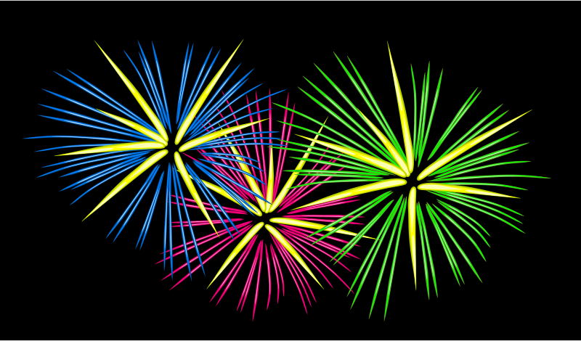
Great Job!

