Slide 1
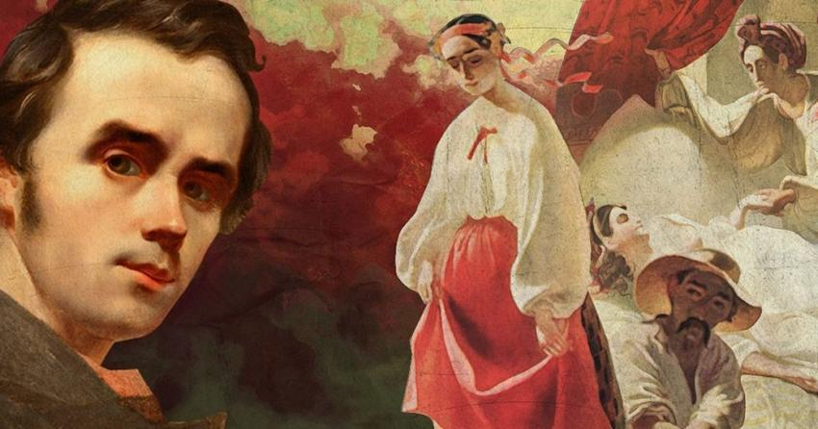
Shevchenko as an artist

Slide 2
Taras Shevchenko as an artist occupies an honorable place in Ukrainian fine art.
835 drawings and paintings of Taras Shevchenko have survived, which have come down to our time in the originals and partially in engravings on metal and wood made by Russian and foreign engravers, as well as in copies which were made by artists during Shevchenko’s lifetime. In addition, there is information about the 278 lost and still not found works of Shevchenko.

Slide 3
  Pictorial and graphic works by the time of writing date back to the years 1830–1861 and are geographically connected with Russia, Ukraine and Kazakhstan. They are portraits, compositions on mythological, historical and everyday themes, architectural and natural landscapes by genre. They are made in oil on canvas, in watercolor, sepia, ink, lead pencil and etching on separate sheets of white, colored and tinted paper of various sizes, as well as in five albums.

Slide 4
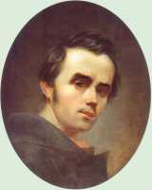
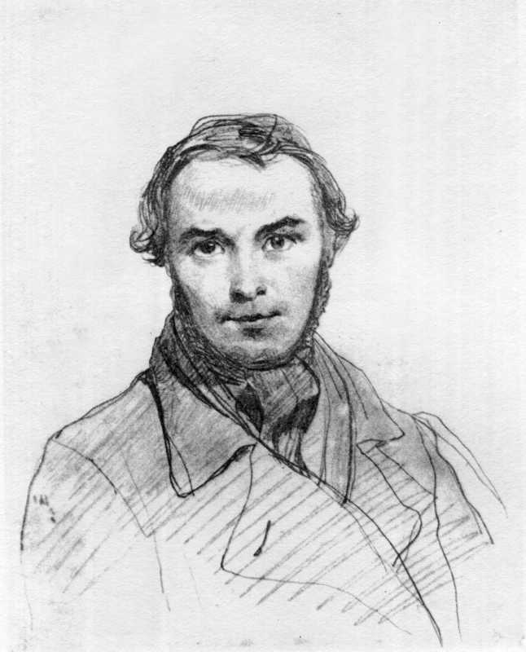
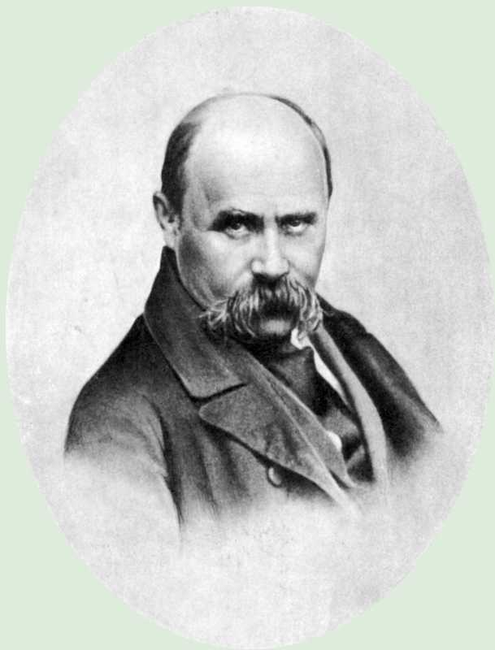
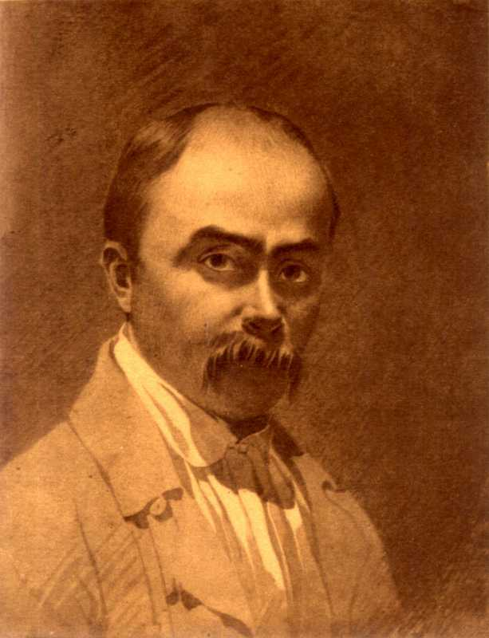
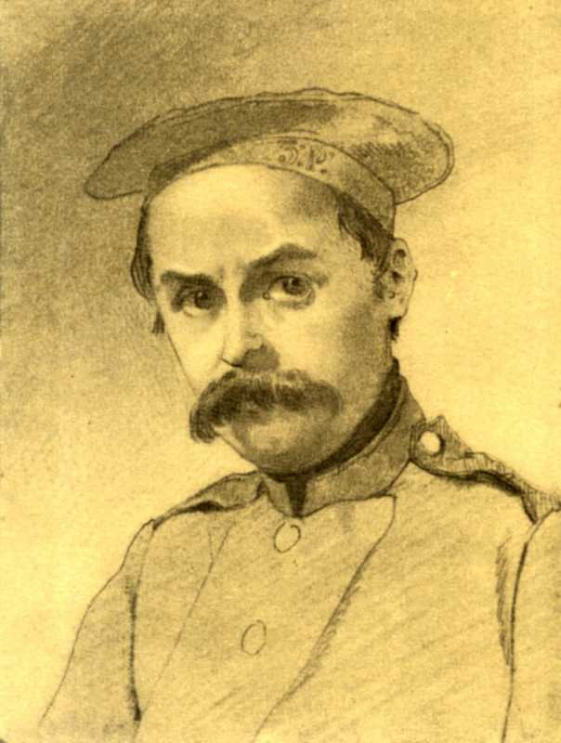
Shevchenko loved to draw self-portraits. One of his first works in oil paints, which he performed in 1840, was a self-portrait. The poet drew his last self-portrait in just a few months as he died. There were more than 30 self-portraits.

Slide 5
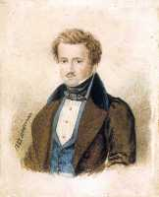
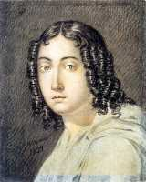
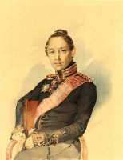
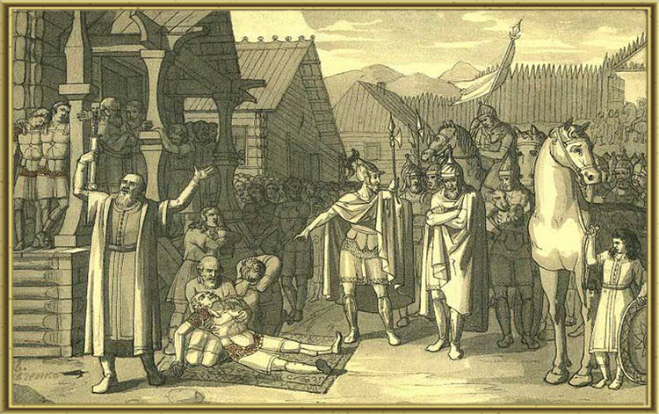
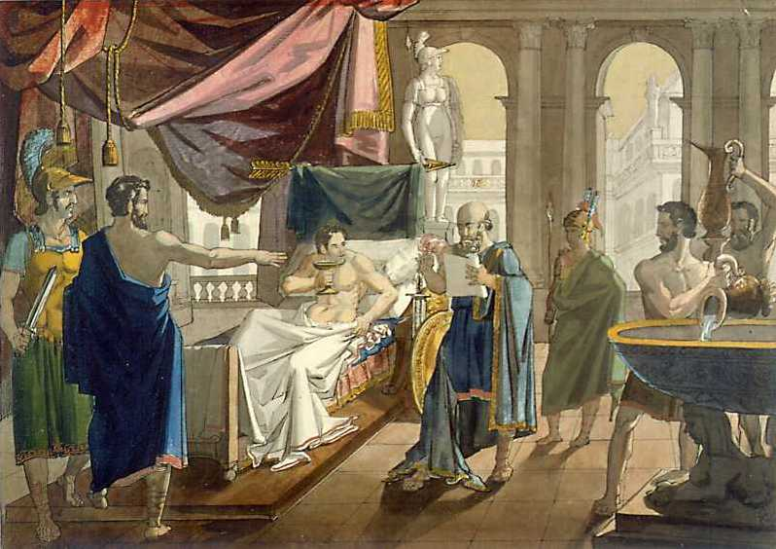
Works of 1830 - 1839

Slide 6
A portrait of P.V. Engelhardt
A portrait of an Unknown
A portrait of N.A. Lunin
The Death of Oleg, the Prince of the drevlians
Alexandr the Great shows confidence to his doctor Philipp

Slide 7
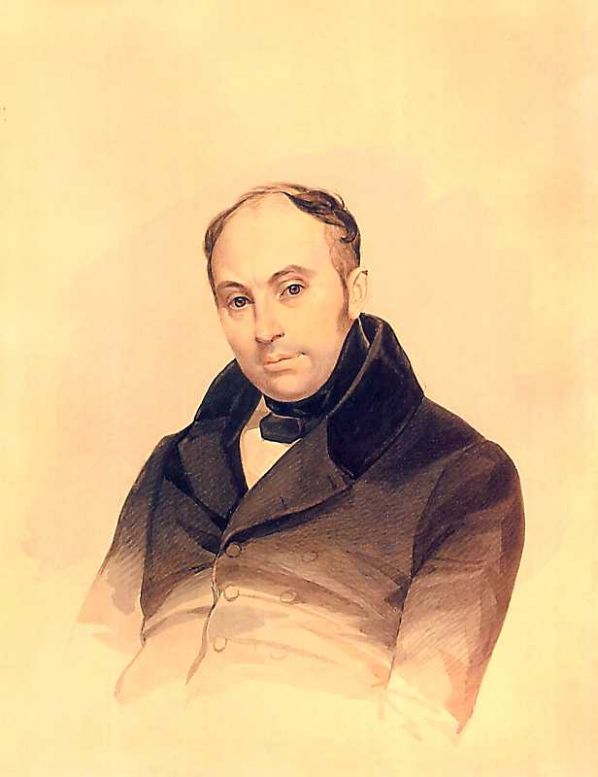
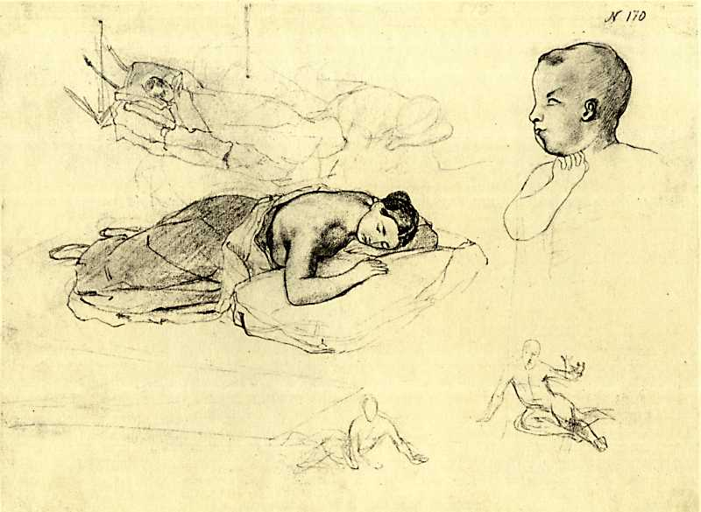
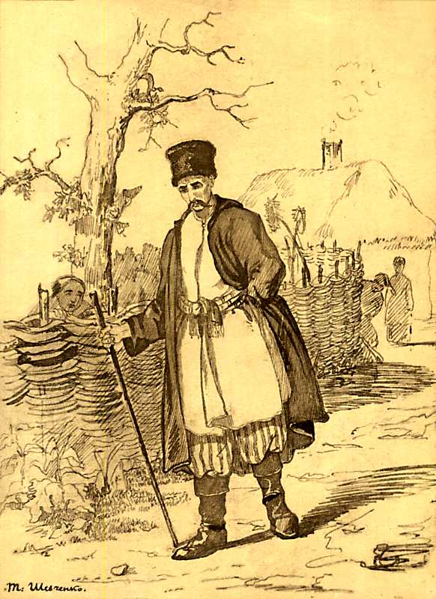
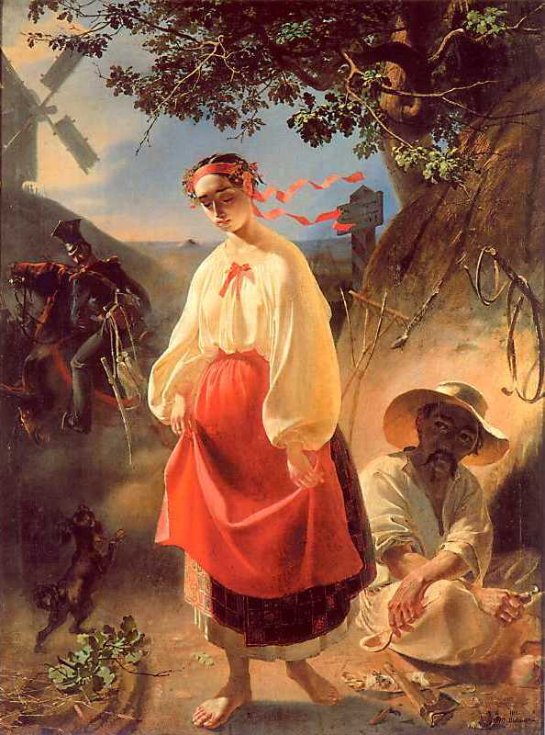
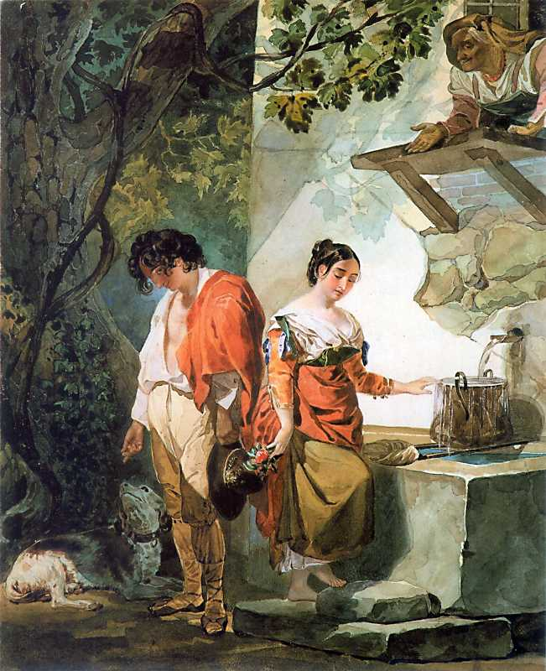
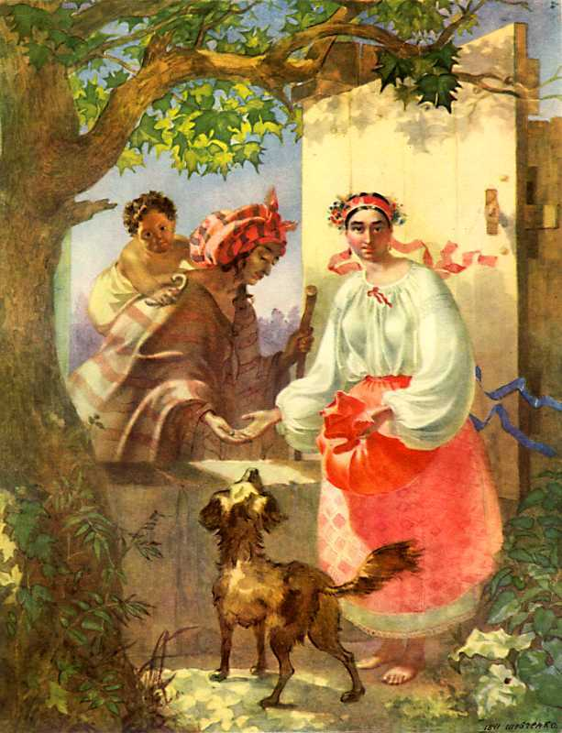
Works of 1840 – 1842

Slide 8
A Portrait of V. A. Zhukovsky
The Sleeping woman. Etude
The healer
Kateryna
The interrupted date
A Gypsy fortune teller

Slide 9
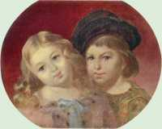
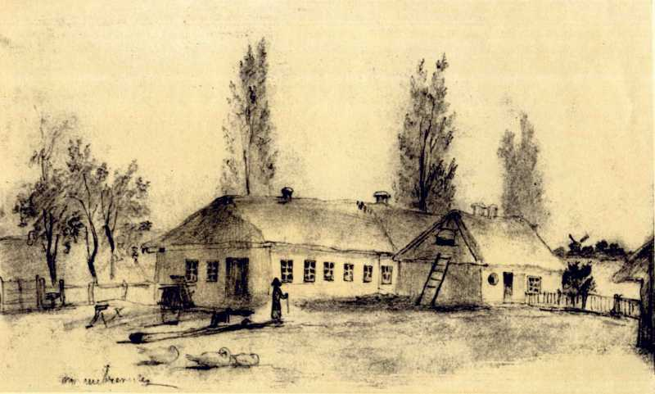
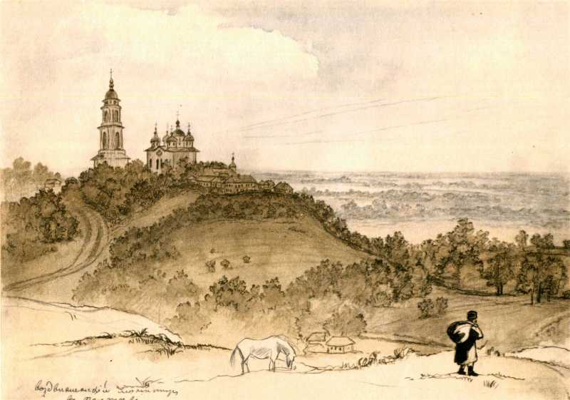
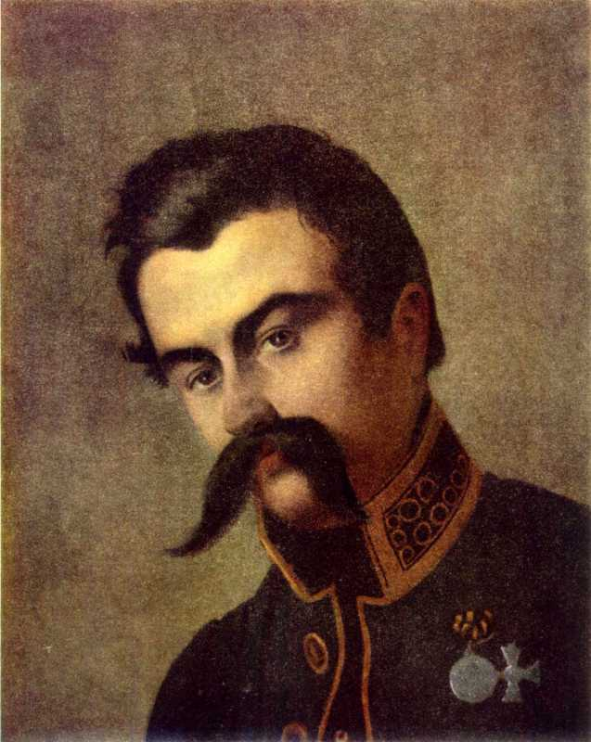
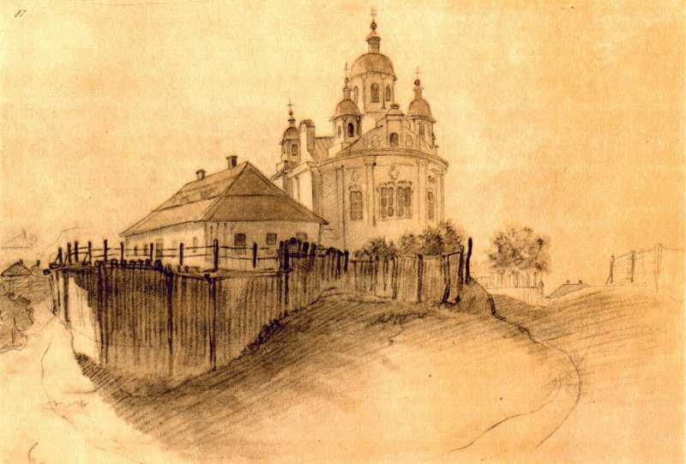
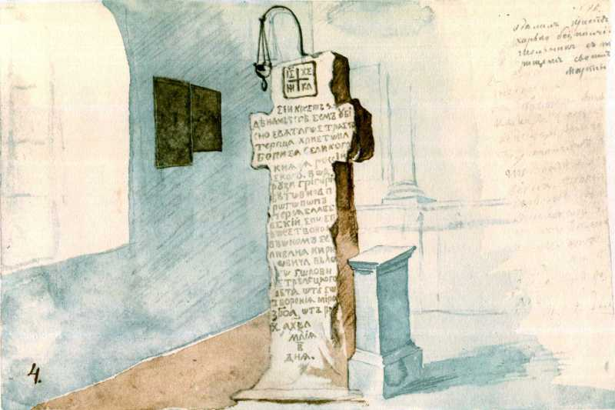
Works of 1844 – 1845

Slide 10
A Portrait of V.M. Repnin’s children
The Yard in the village
Vozdvizhensky Monastery in Poltava
A portrait of I.F. Rudzinsky
I.P. Kotlyarevsky’s house in Poltava
A stone cross to St. Boris

Slide 11
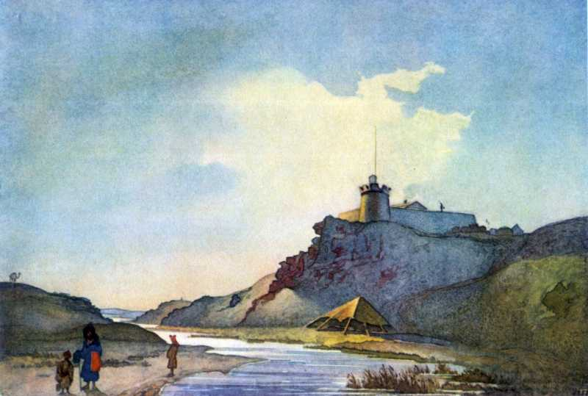
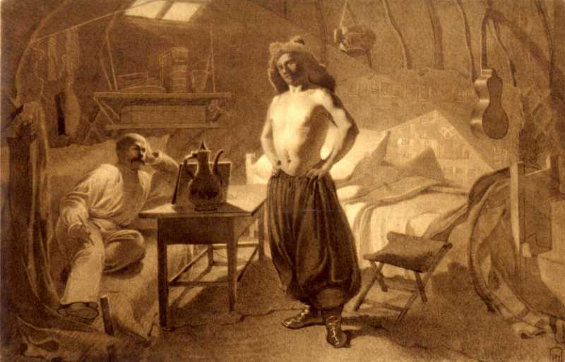
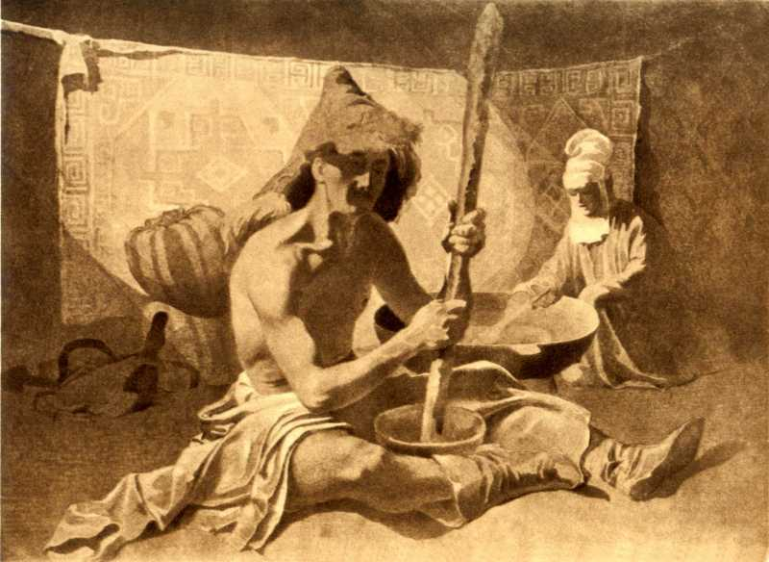
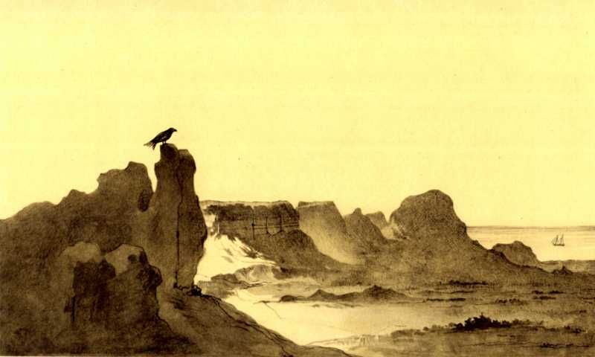
Aral expedition of 1848 – 1849

Slide 12
Fort Kara-Butak
T.G. Shevchenko is drawing a friend
Kazakhs are in a yurt
Kug-Aral Island

Slide 13
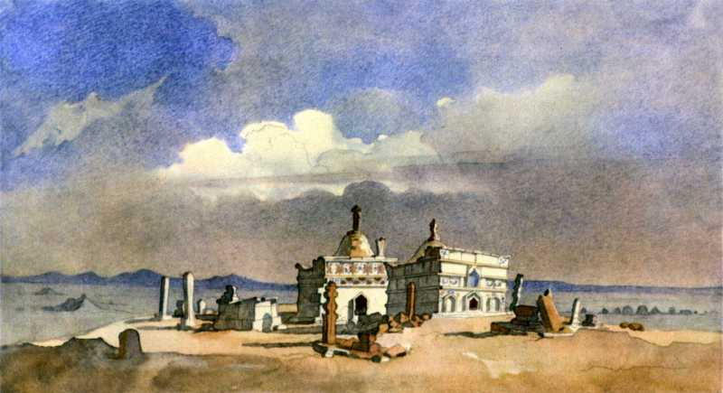
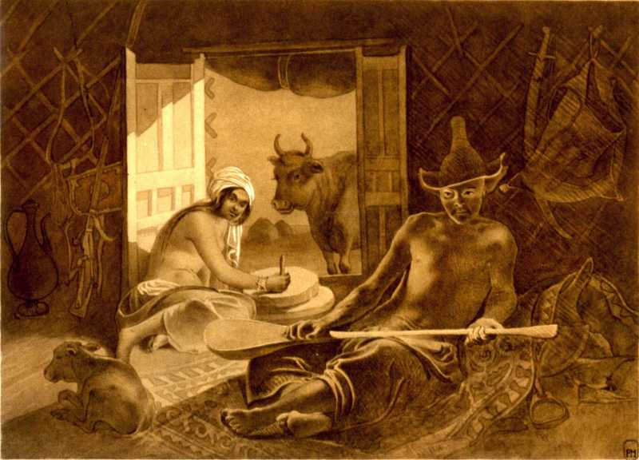
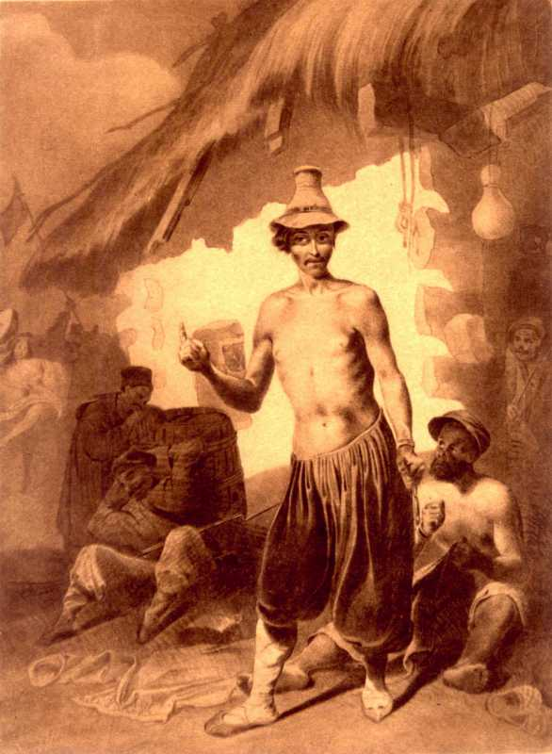
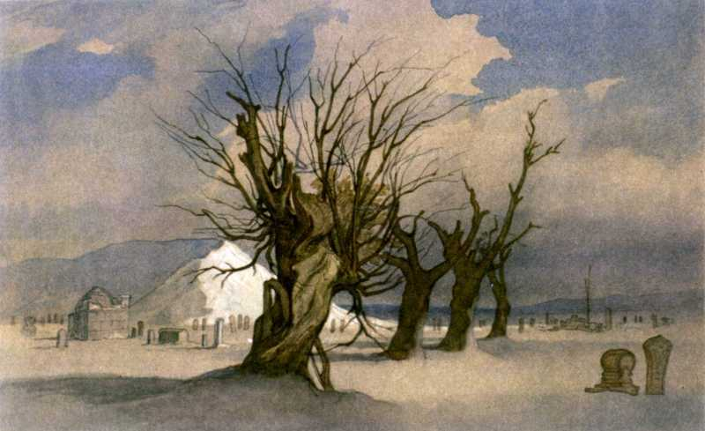
An Expedition to Kara-Tau, 1851

Slide 14
Turkmen abbies in Kara-Tau
Trio
Roma
Hanga Baba

Slide 15
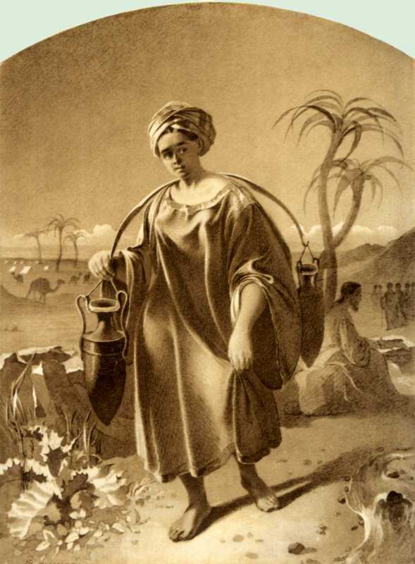
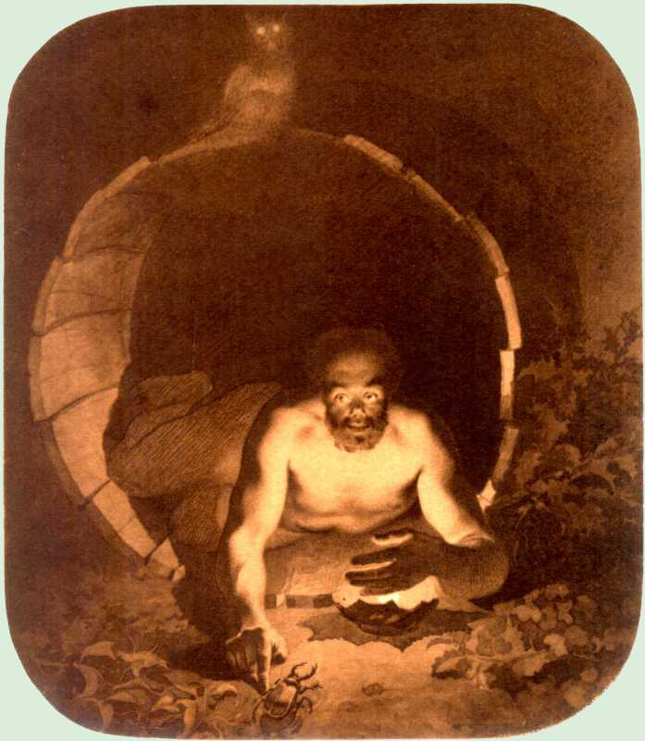
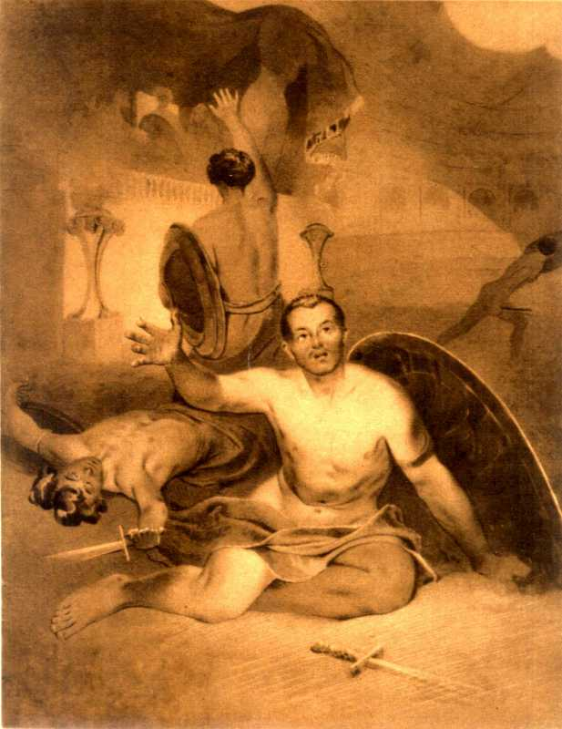
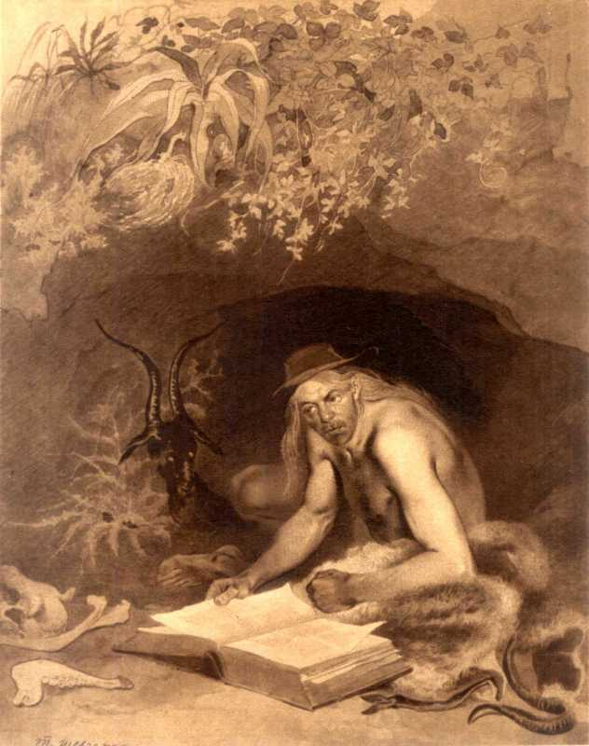
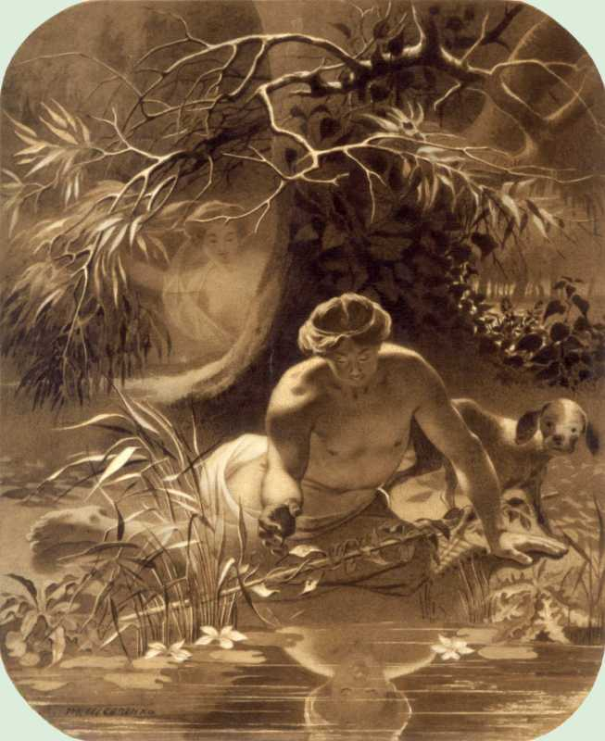
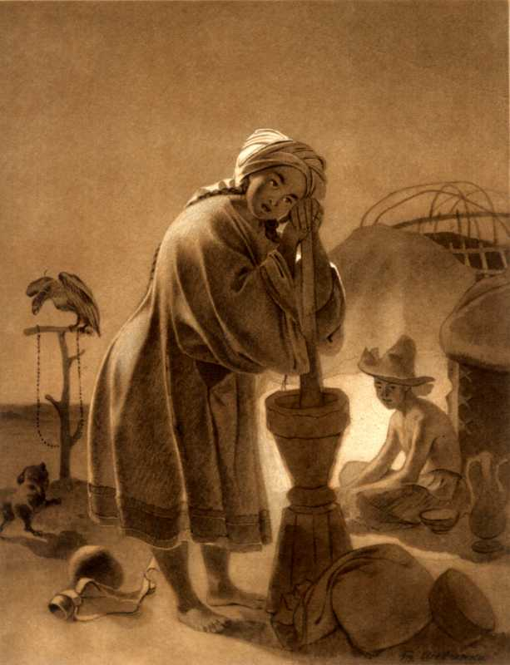
The allegorical drawings of 1856

Slide 16
The Samaritan Woman
Diogenes
Dying gladiator
Robinson Crusoe
Narcissus and Nymph Echo
Kazakh

Slide 17
Sources:
1. Leonid Ushakov. Shevchenko from A to Z. The edition "Staryi Lev", - 2017.
2. Encyclopedia of life and creativity of Taras Shevchenko. Shevchenko as an artist. Pictures http://tarasshevchenko.in.ua/shevchenko_hudognik.html

Slide 18
Thank you for your attention!

