Slide 1
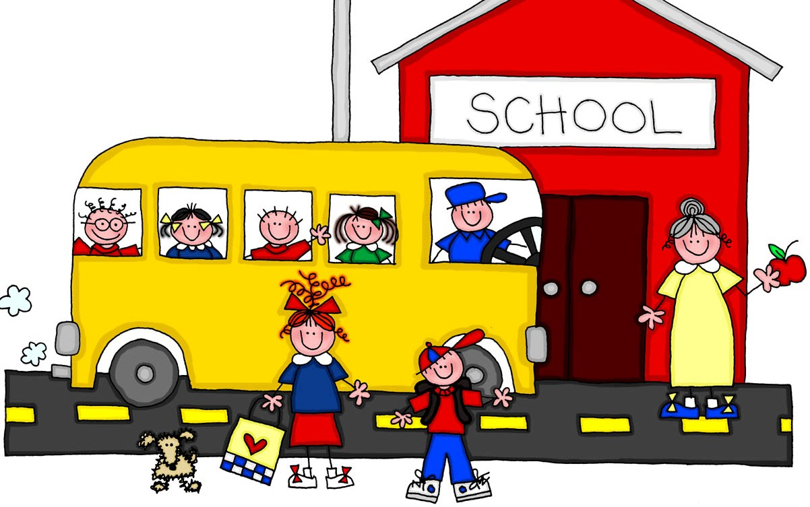
School life
Козелецький ЗОЗСО І – ІІІ ступенів №3
Form 10-B
Підготував
вчитель англійської філології Михед Р.В.

Slide 2

School is the place where we spend a lot of time…
Add 2-3 sentences of your own

Slide 3
Listen to the text and match school and activities to the age group
At the age of … pupils go to …
At … school they learn …
At the age of … pupils take … exam.
Age | School | Activities/School subjects | Exams
3 – 5
5 – 8
8 – 11
11 – 16
16 – 18

Slide 4
Read this leaflet giving advice on doing your homework. Match headings to paragraphs. There is one heading you will not need to use.
1. It is possible to get your homework done even if you have a busy schedule – if you decide in advance what you have to do. On Sunday or Monday, jot down your activities for the upcoming week in a notebook and then include a time for homework for each day.
2. Buy a folder for each of your classes. Divide it into three sections: notes, homework, and tests. Always put papers in the correct section.
3. Forget about doing your homework in front of the TV. Find a quiet place that’s well – lit, where you can concentrate without getting distracted.
4. You won’t get any work done if you’re hungry. Your brain needs energy to work effectively! Drink plenty of water, and snack on some fruit or cookies to get more strength.
5. Begin with your best subject. Your success will give you a feeling of satisfaction that will help you deal with your weaker subjects later.
6. If you’ve started your Science homework, finish it! Don’t leave one part of your homework unfinished to start another – you may not remember all those Chemistry formulas when you come back.
7. Take at least a five – minute break when you feel tired. The rest will re – energise you so you'll be able to finish your work.
8. Homework is rarely an exciting thing to do. But it’s your top priority, and you have to get it done. Accepting this fact will help you deal with homework effectively.
A Start strong D Eat for energy G Talk to an expert
B Complete each task E Just do it H Take a break
C Plan ahead F Keep things in order I Find the right place

Slide 5
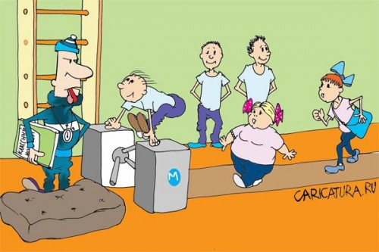
Let's make two groups. Students from the first group are great sport lovers. Students from the second group are against having too many lessons of PE at school.
Physical Education should be optional.
For | Against

Slide 6

What can you see in the picture?
What is the student doing?
What lesson is she at ?
Is she bored? Why?

Slide 7

What can you see in the picture?
What is his favourite school subject?
Does he like going to school? Why?

Slide 8

1st type of Conditional sentences
Conditional clause | Main clause
If Present Simple ( V1) | Future Simple
( am, is, are ) | Shall/will + V1

Slide 9
Complete my sentences
If I fail my exams …
If I do well at school …
If I learn English hard …
If … I will come to school in time.
If … I will get a good mark.
If … I will be excluded from school.

Slide 10
Make up as many sentences as possible in the 1st conditional using these words
homework
exam
the
help
mark
pupils
at
teacher
If
have
enter
on
of
study
some
school
be
smart
book
get
will
buy
time
a
Learn
he
I
good
do
we
come
well
you
go
English
in
pass
university
She
with
work

Slide 11

Home assignment
Be ready to speak on the topics:
School life.
My favourite school subject.
My school.

