Slide 1
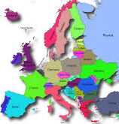
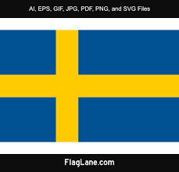
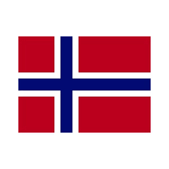

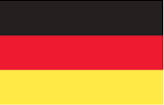
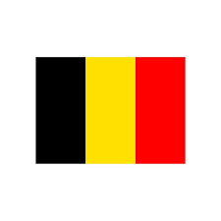
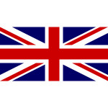
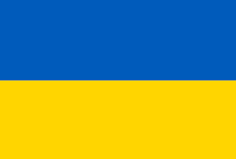
What
Do You Know About Europe?

Slide 2
I. How many words can you make up using ‘Ukraine’ ?
Use * for the only one letter you need.

Slide 3
I. How many words can you make up using ‘Ukraine’ ?
Use * for the only one letter you need
rain are
in a
run an
ran air
. . . . . .

Slide 4
II. Some European countries ends with ‘land’. What are they?
_ _ _ _ _ _ _
_ _
_ i _ l a n d
_ _ _
_ _ g

Slide 5
II. Some European countries ends with ‘land’. What are they?
S w i t z e r l a n d
P o l a n d
F i n l a n d
I r e l a n d
E n g l a n d

Slide 6
III. Complete the sentences using the first one as the example.
Ukrainians live in Ukraine.
. . . in Italy.
. . . Great Britain.
. . . Spain.
. . . France.
. . . Germany.

Slide 7
III. Complete the sentences using the first one as the example.
Ukrainians live in Ukraine.
Italians live in Italy.
British live in Great Britain.
Spaniards live in Spain.
The French live in France.
Germans live in Germany.

Slide 8
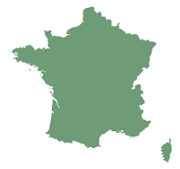
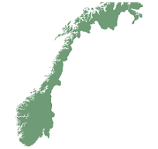
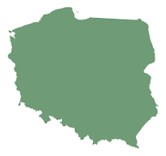
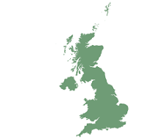
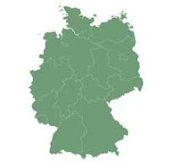
IV Can you guess the country ?
1
2
3
4
5

Slide 9
IV Can you guess the country ?
1 France
2 Norway
3 Poland
4 Great Britain
5 Germany

Slide 10
Flags of which countries have such colours?
BLUE, WHITE - . . . .
BLUE, YELLOW - . . . .
BLUE, WHITE, RED - . . . .
BLACK, YELLOW, RED - . . . .
RED, WHITE - . . . .

Slide 11
Flags of which countries have such colours?
BLUE, WHITE -- Scotland, Greece, Finland
BLUE, YELLOW – Sweden, Ukraine
BLUE, WHITE, RED – Check Republic, France, Croatia, Iceland,
Luxemburg, Netherlands
BLACK, YELLOW, RED – Belgium, Germany
RED, WHITE – England, Austria, Poland, Monako,
Denmark, Malta

Slide 12
VI. What countries’ flags have crosses?

Slide 13
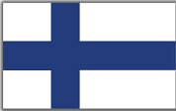

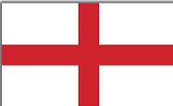
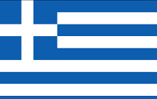
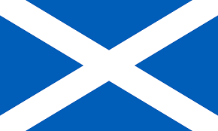
VI. What countries’ flags have crosses?
Finland United Kingdom
Sweden Switzerland
Norway England
Scotland Greece

Slide 14
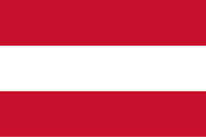
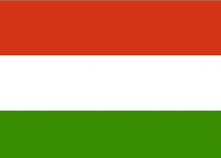
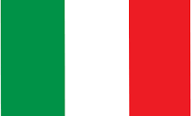
Match country’s name to its flag
a
c
1 Lithuania
2 Italy
3 Austria
4 Belgium
5 Finland
6 Hungary
b
d
f
e

Slide 15
Match country’s name to its flag
c
1 Lithuania b
2 Italy e
3 Austria a
4 Belgium f
5 Finland d
6 Hungary c
a
b
d
f
e

Slide 16
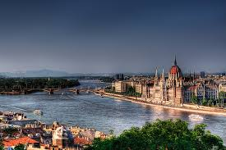
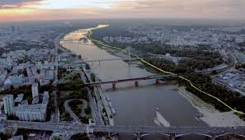
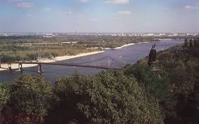
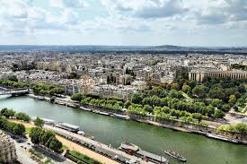
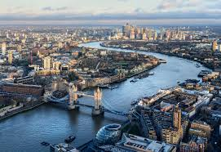
VIII. Some capital cities stand on the rivers. Can you name them?

Slide 17
VIII. Some capital cities stand on the rivers. Can you name them?
Kyiv the Dnieper
Warsaw the Vistula
London the Thames
Vienna the Danube
Budapest the Danube
Belgrade the Danube
Bratislava the Danube
Paris the Seine
Rome the Tiber

Slide 18
Thank
you
very
much

