Slide 1
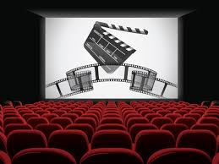
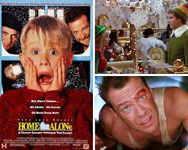
FORM 7
CINEMA. MOVIE.

Slide 2

OUR PLAN
- warm-up
speak“My favorite film”
game “guess the genres”
lexical game
game “Microphone”
grammar
game “My classmate”
listening
a quiz
game in Learning App

Slide 3
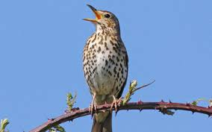
WARM-UP
sing
sinning
Interesting
convincing
fascinating
depressing
entertaining

Slide 4
What is you favourite film?
My favourite film is:

Slide 5
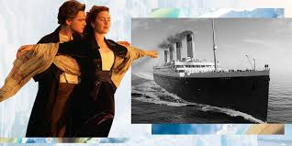
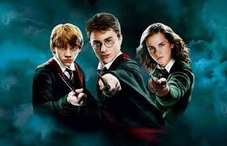
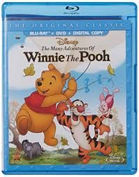
GAME «THE GENRES»

Slide 6
LEXICAL GAME
C | I | N | E | M | A | S | C | R | E | E | N
A | U | D | I | E | N | C | E | P | L | O | T
R | A | C | T | I | N | G | M | U | S | I | C
T | R | O | L | E | A | C | T | O | R | E | L
O | M | O | V | I | E | S | F | I | L | M | K
O | C | A | M | E | R | A | C | A | S | T | E
N | E | Q | U | I | P | M | E | N | T | A | T
S | D | O | C | U | M | E | N | T | A | R | Y

Slide 7
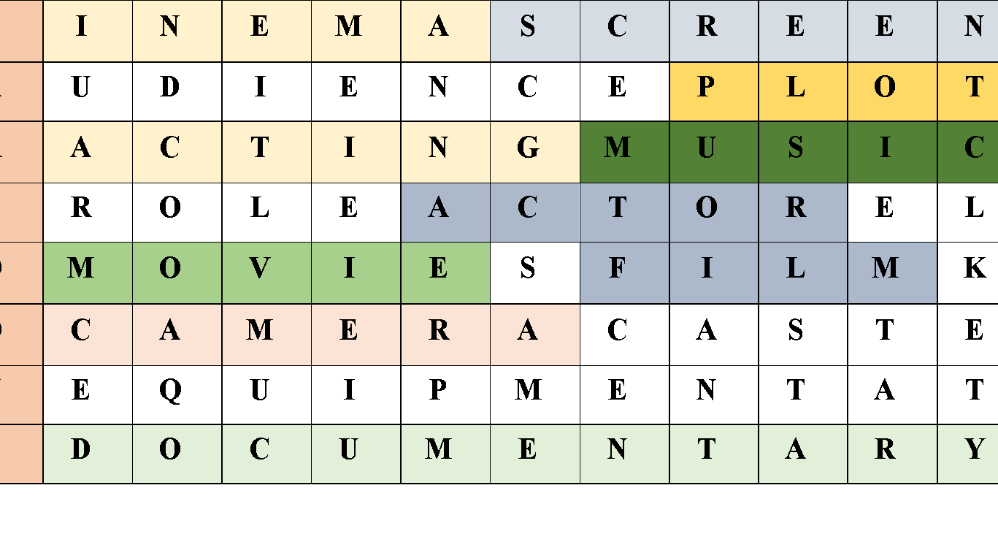
ANSWER

Slide 8
GAME “MICROPHONE”
What is your favourite kind of films?
My favourite kind of films is ……
(thriller, scenes fictions, drama, adventures, mystery, war, historical, romantic, horror, fantasy )

Slide 9
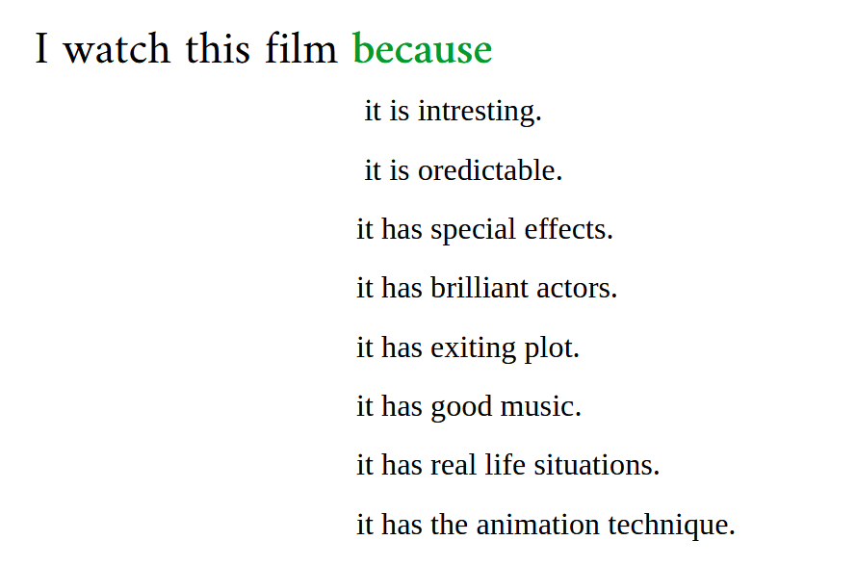
Practice vocabulary

Slide 10
GAME “MY CLASSMATE”
What is your favourite kind of films?
-I like watching cartoons and detective films.
Why do you like this film?
I like cartoons because they are funny.
I watch detectives because they have an exiting plot.

Slide 11

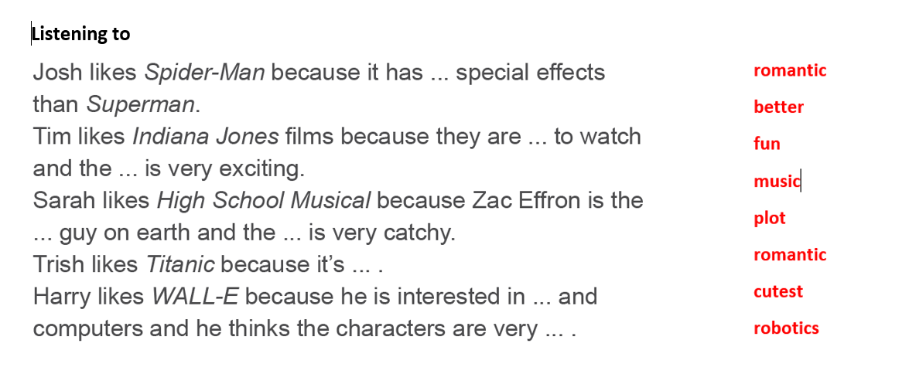

Slide 12
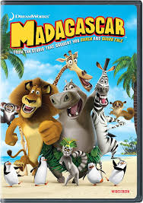
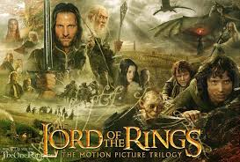
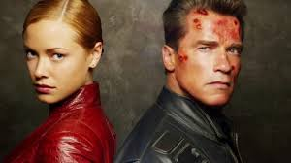
A QUIZ «GUESS THE GENRE OF THE FILM»

Slide 13
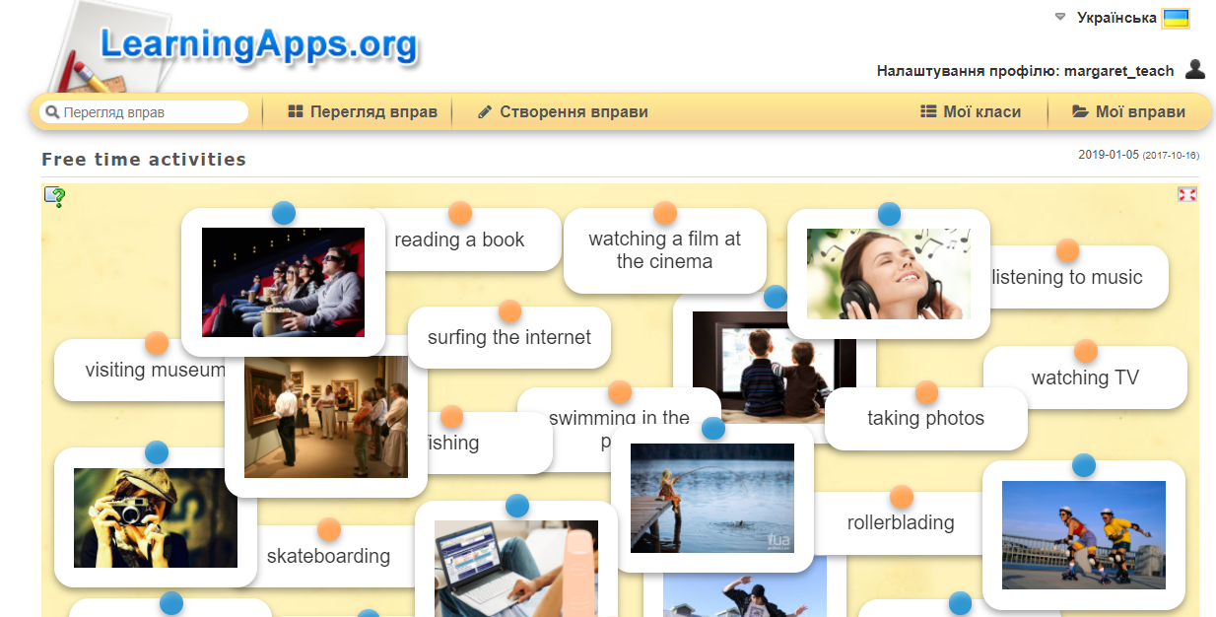
GAME
“FREE TIME ACTIVITIES”

