Slide 1
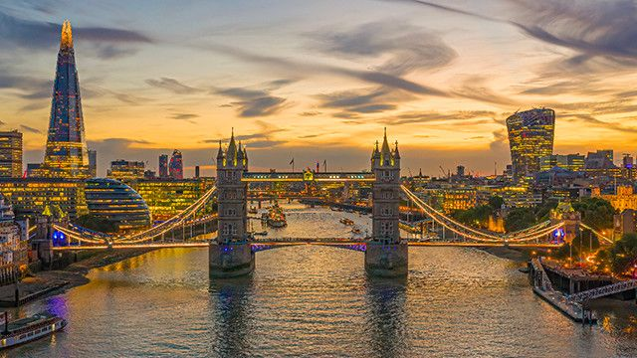
LONDON

Slide 2
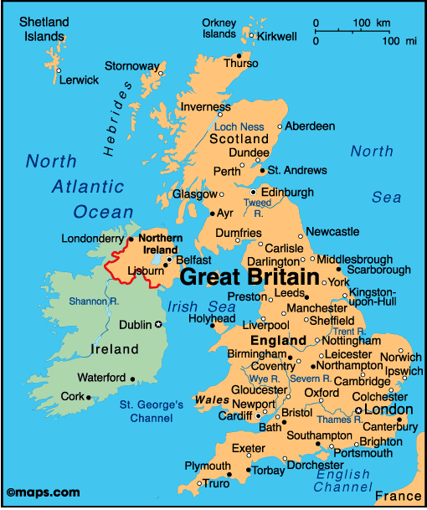

Slide 3
London is the capital of Great Britain, the city great and ancient, large industrial and cultural center. London stands on the river Thames.

Slide 4
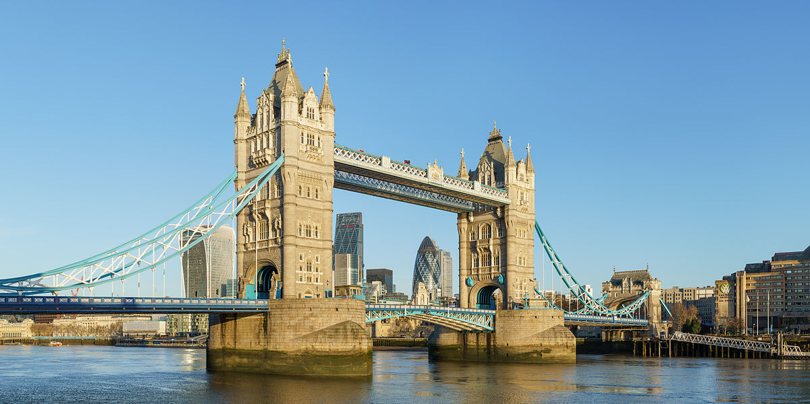
London stands on the river Thames.

Slide 5
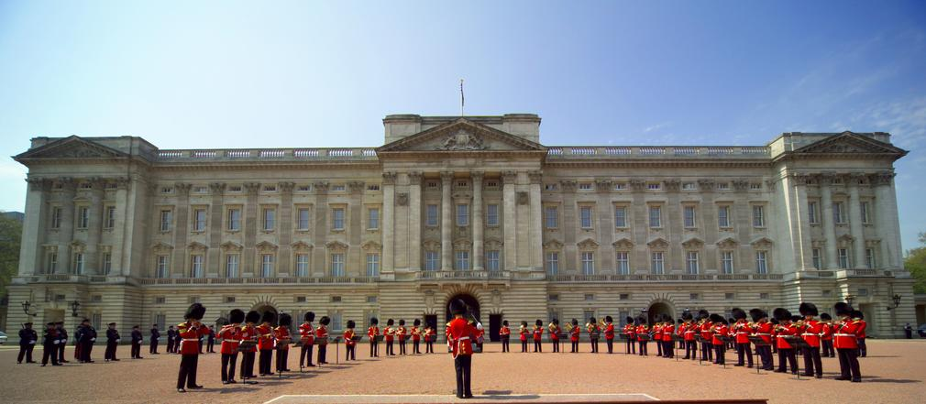
Buckingham Palace is a home and the office for the Queen.
There are 775 rooms in the palace. The palace has
got a cinema, a post office, a pool and a police station.

Slide 6
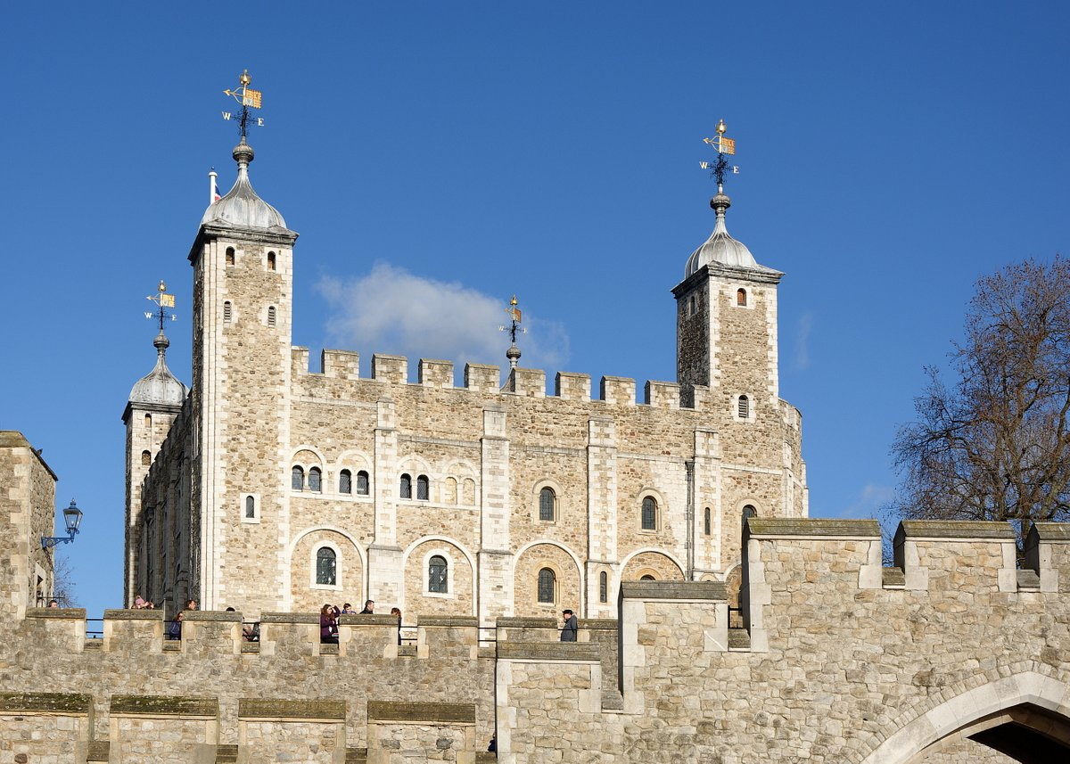
The Tower of London. It is an old castle with high walls, high towers,
small windows and large gardens. The Tower oj London was a prison,
a fortress and a palace.

Slide 7
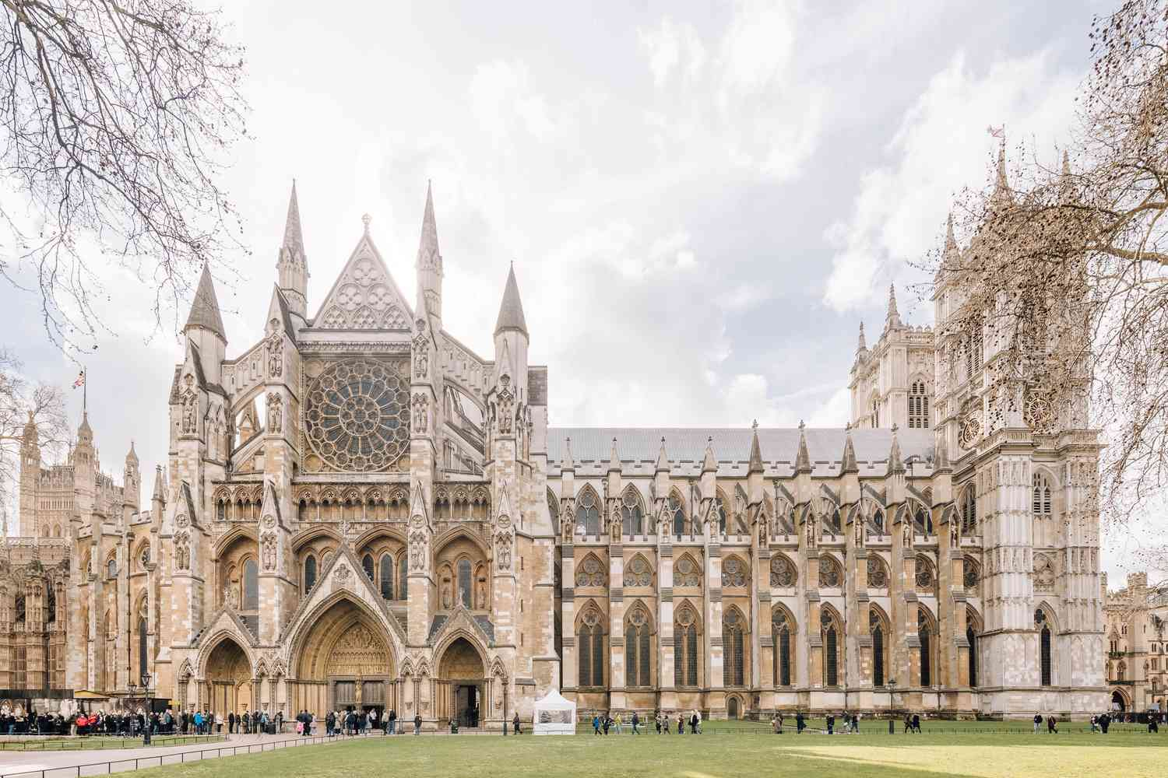
Westminster Abbey is large church. Many kings
and queens have been crowned and
many famous people were buried..

Slide 8
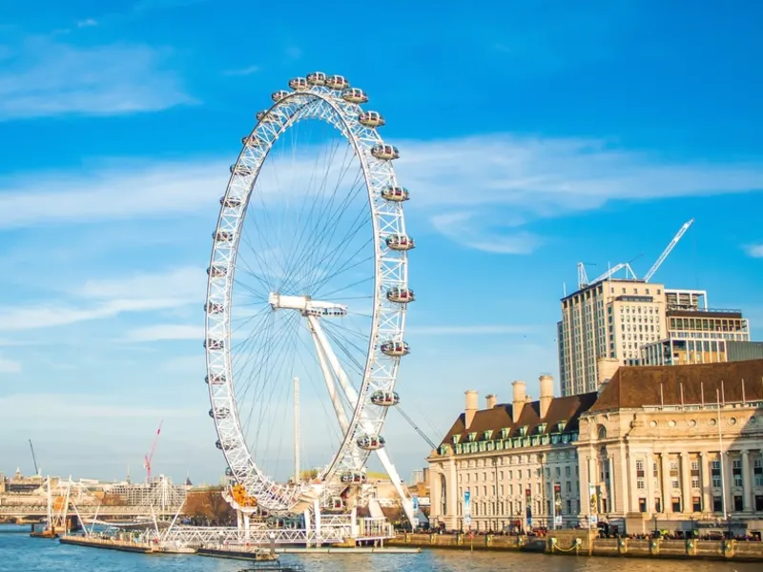
The London Eye is a big wheel.
It’s 135 high with 32 glass capsules.

Slide 9
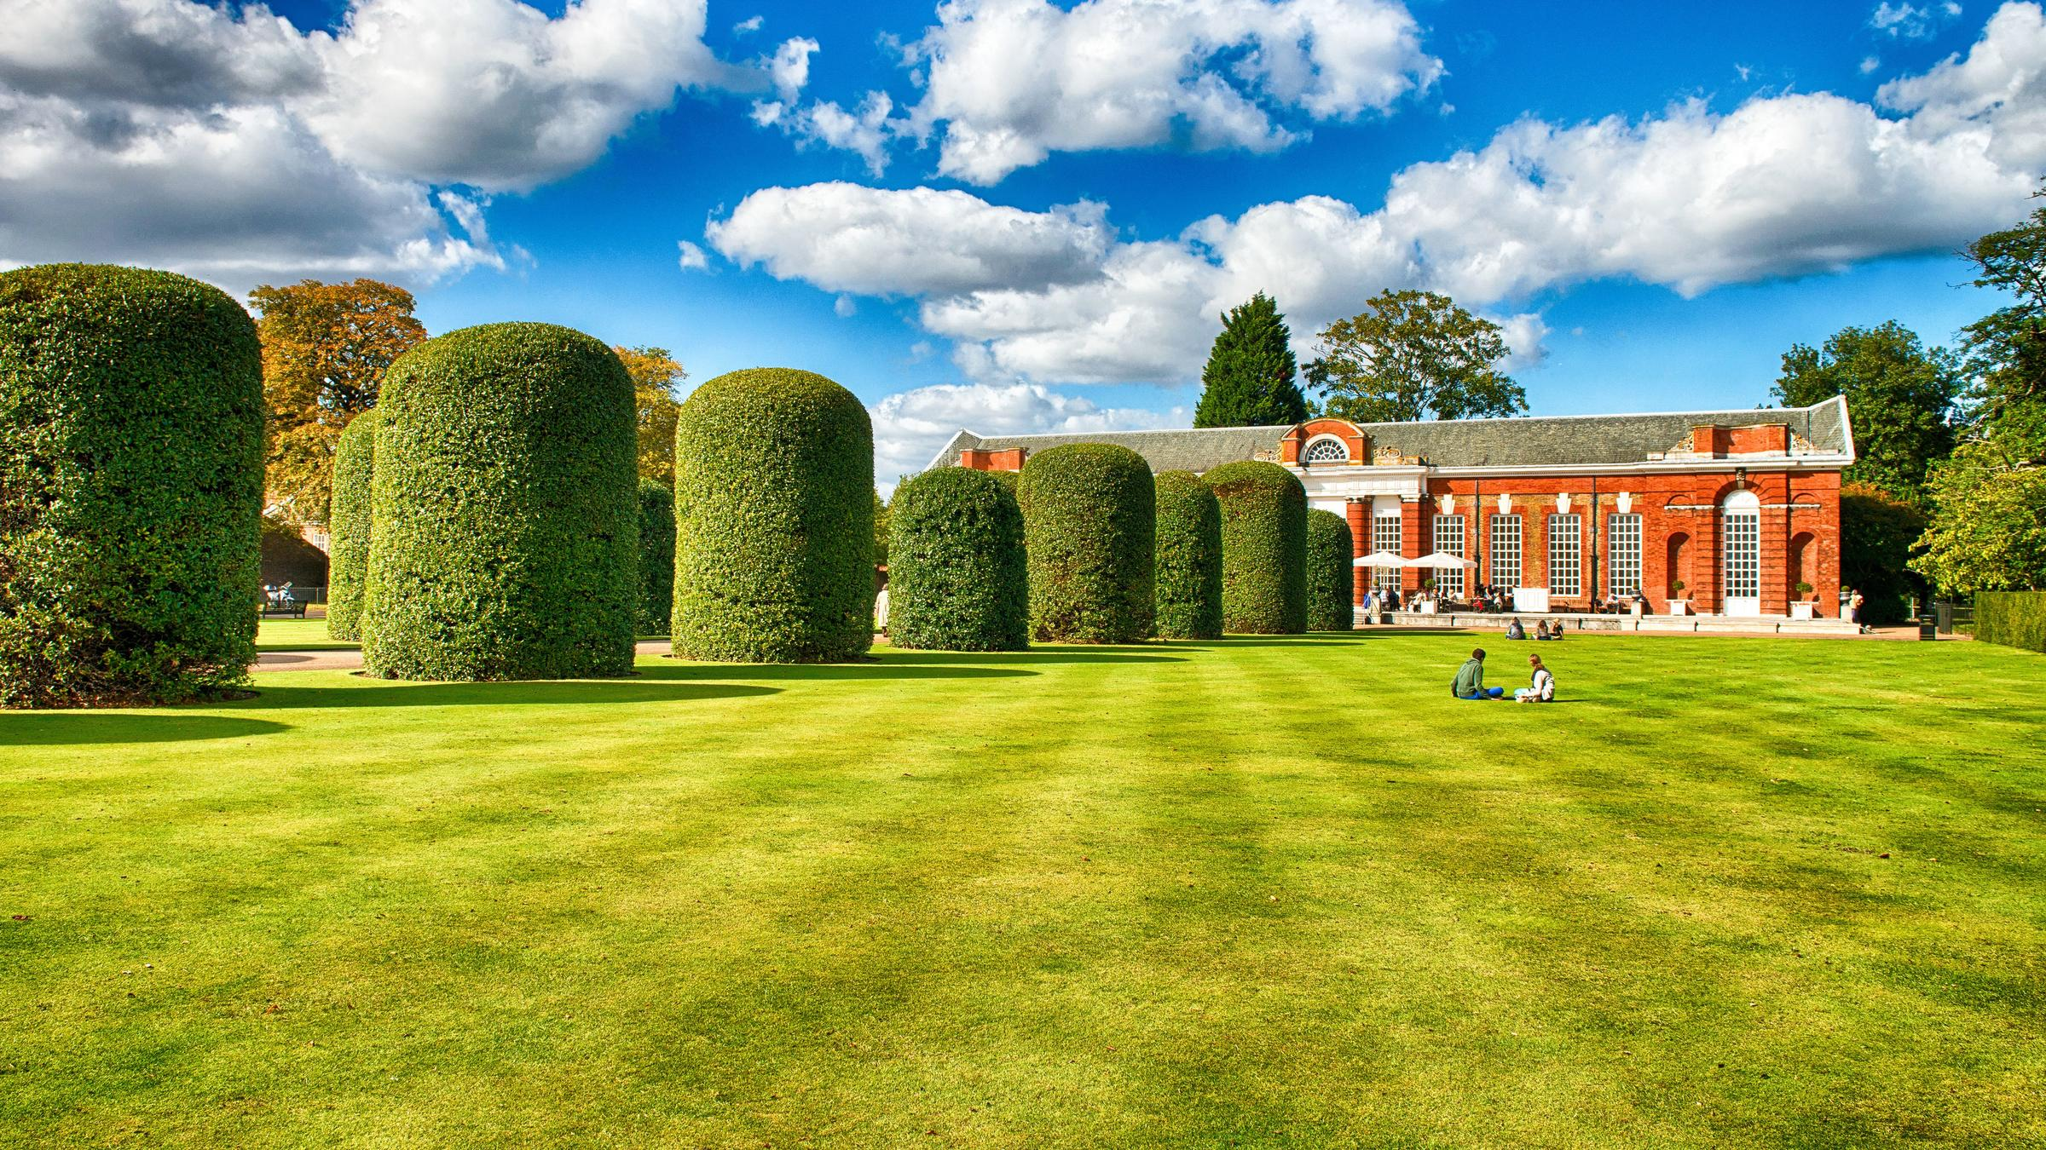
Hide Park is one of the largest park in London.
People can rest and meet with their friends.

Slide 10
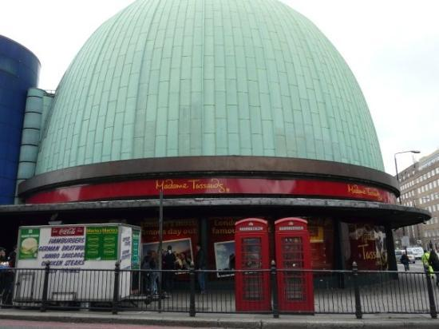
Madame Tussaud’s Museum is a wax museum in London

Slide 11
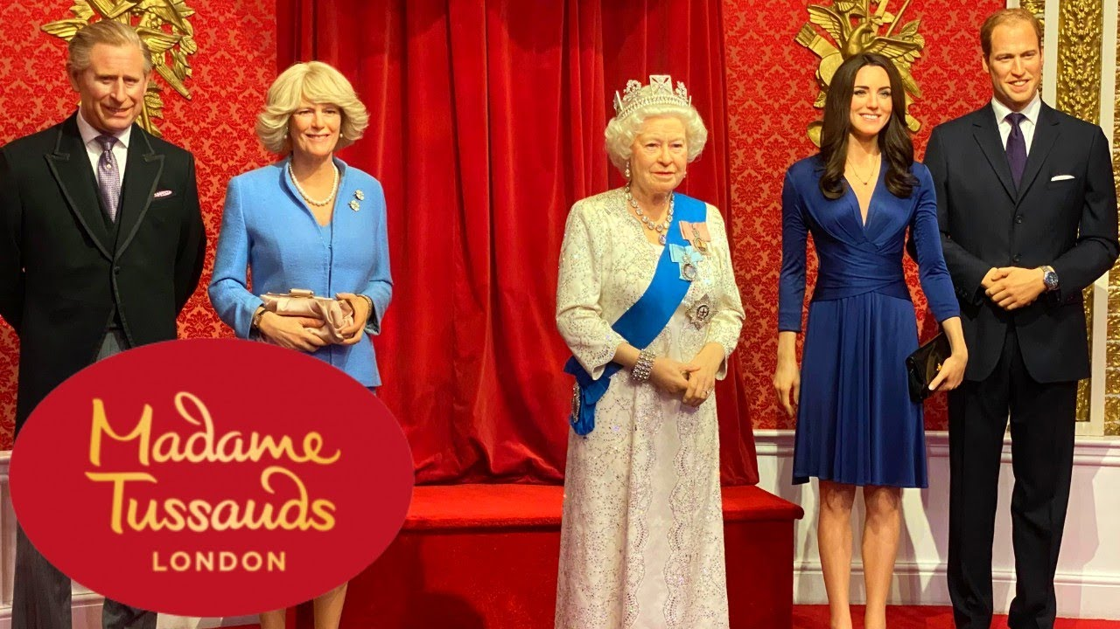

Slide 12
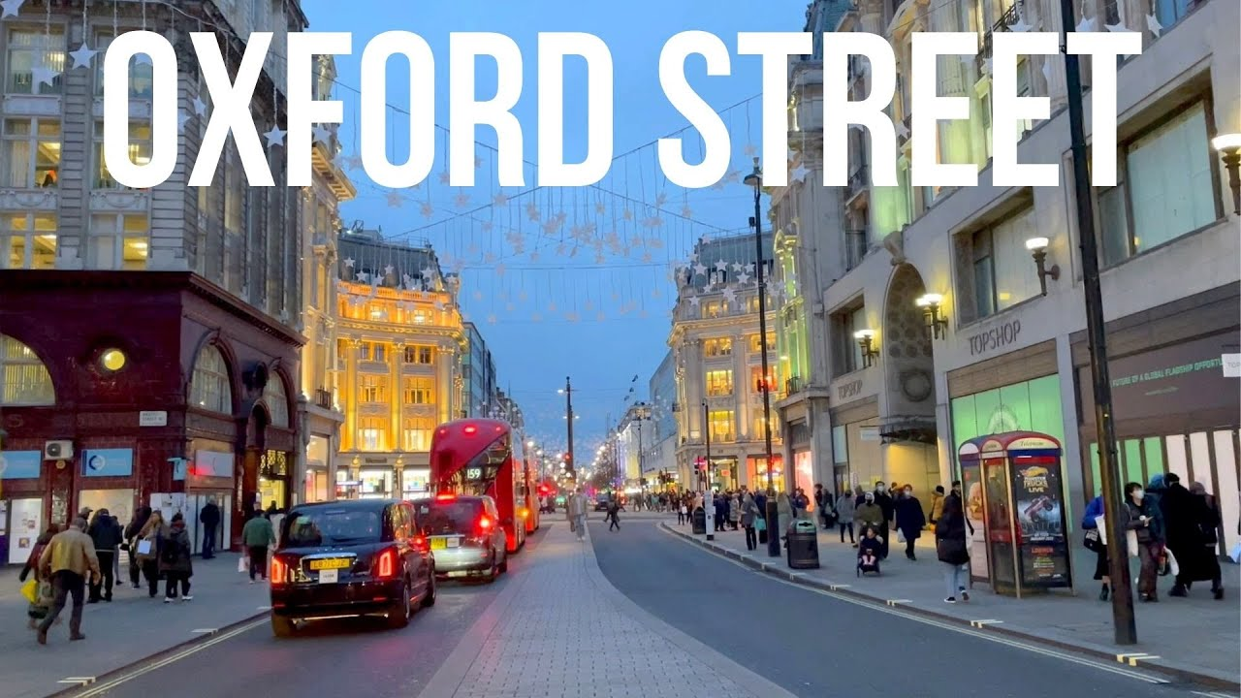
It is the famous
shopping street
in London..

Slide 13
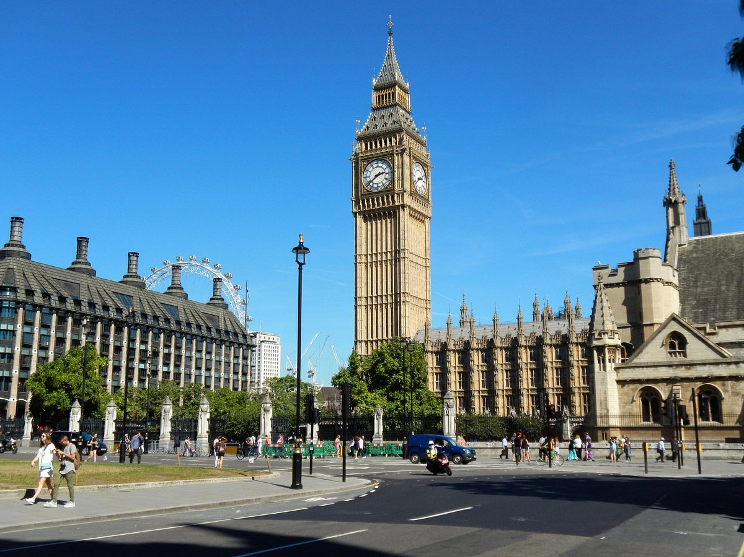
Big Ben is the famous
clock in the world.

Slide 14
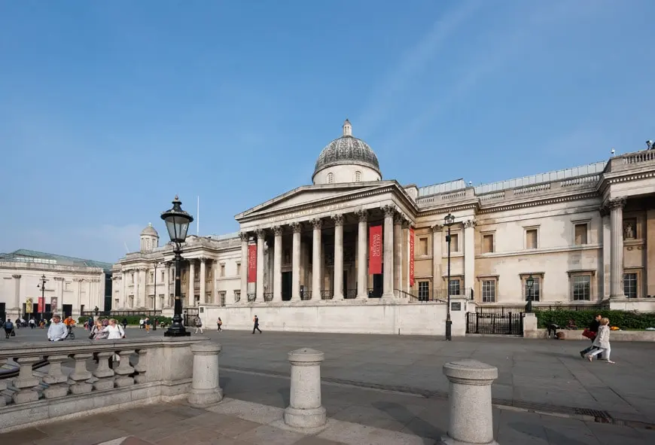
National Gallery in London. It is the Art Museum.

Slide 15
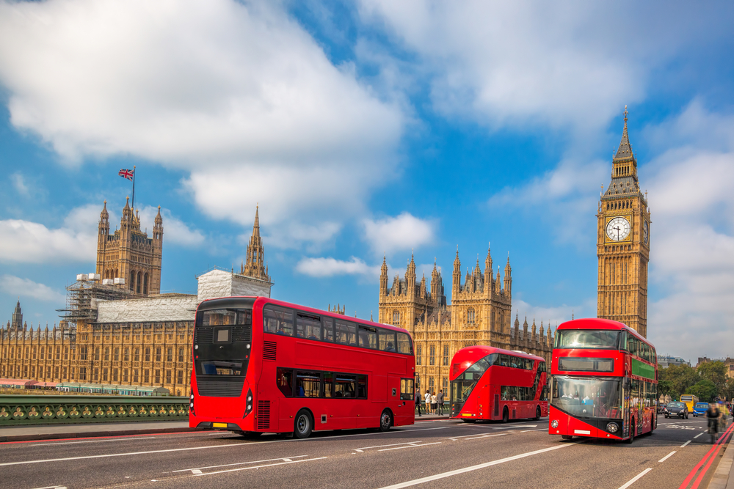
The double-decker buses.

