Slide 1

The Brainiest
Cadet

Slide 2
The 1st round
Play the Kahoot game
https://create.kahoot.it/details/d011e521-a26b-401f-9982-a6818d3e8f3c
Try to answer the questions to be
one of the five players of the next round.

Slide 3
The 2nd round
Find and circle the names of the greatest British and American poets and writers.

Slide 4
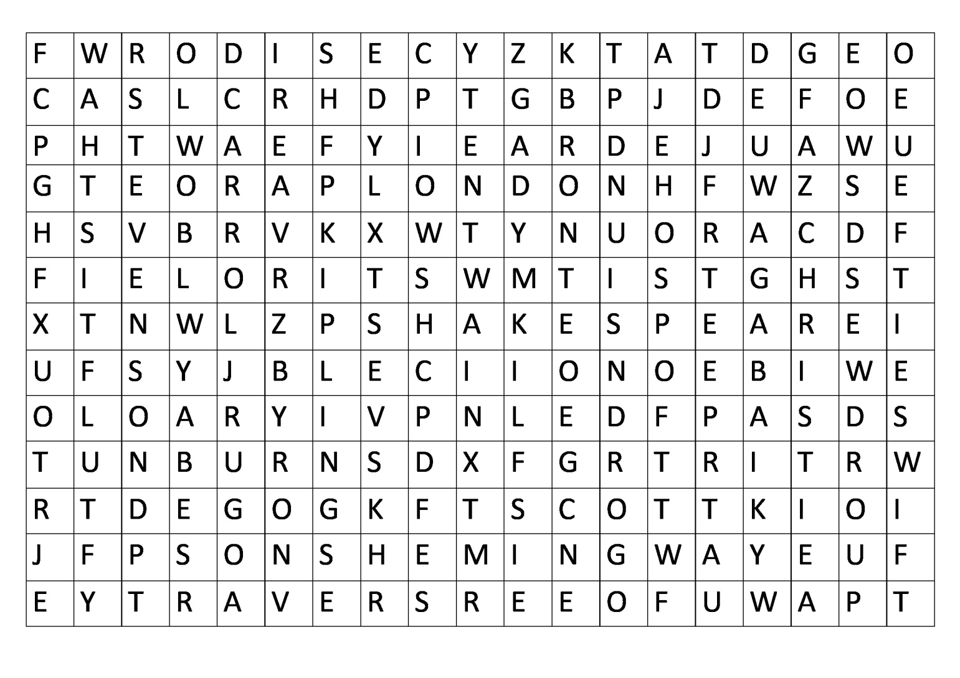

Slide 5
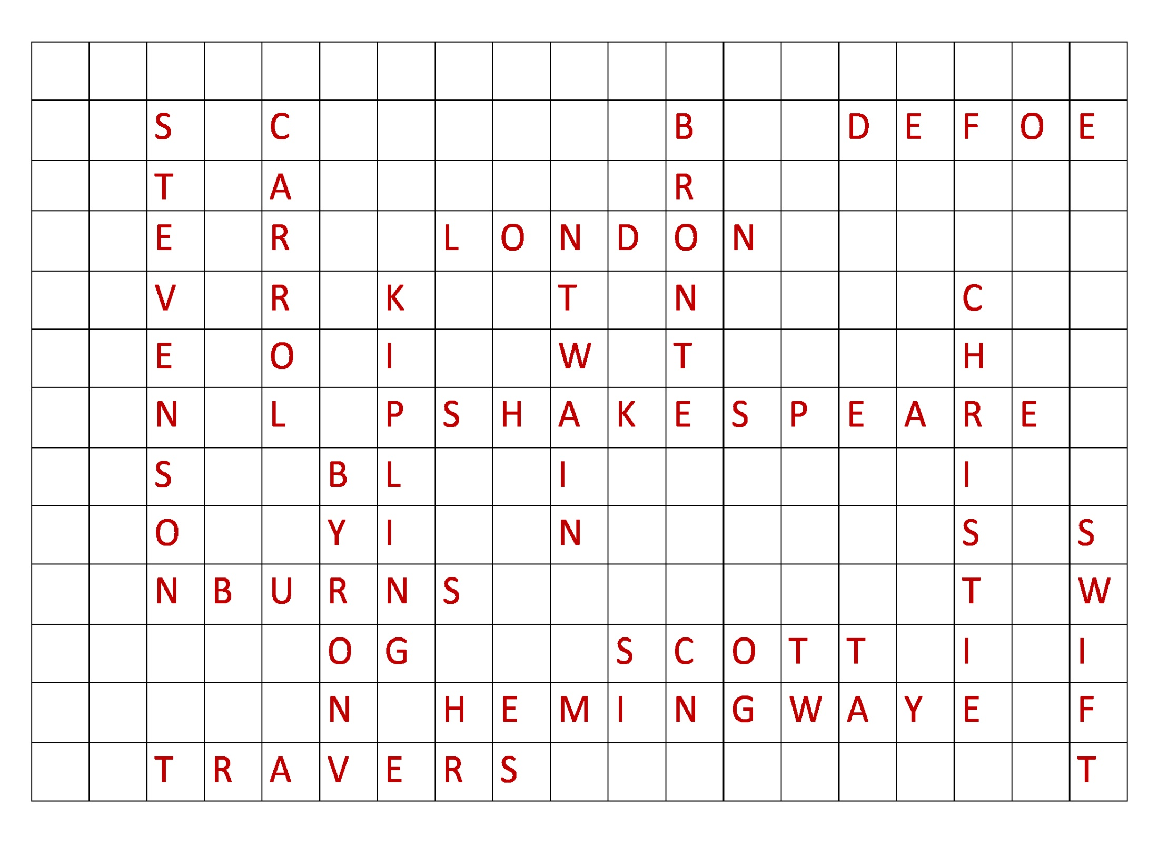

Slide 6
CODEBREAKER
You can see the numerals. Your task is to break the code and guess the word.

Slide 7
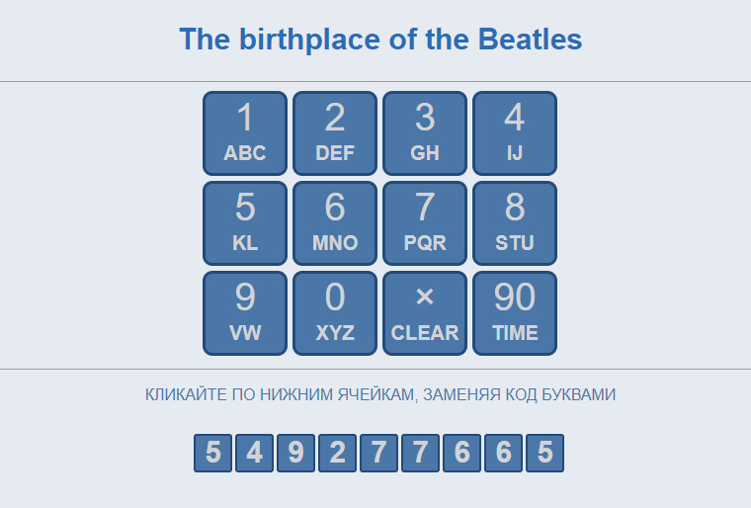
CODEBREAKER

Slide 8
The 3rd round
Choose the best category for you.
Try to remember all the cells of your category.
Blue cells are for the Geography Quiz.
Red cells are for the Traditions and Holidays Quiz.
Yellow cells are for the Culture and Literature Quiz.
Grey cells are for the General Knowledge Quiz.
You have the opportunity to open 8 cells.
Good luck!

Slide 9
1 | 2 | 3 | 4 | 5 | 6
7 | 8 | 9 | 10 | 11 | 12
13 | 14 | 15 | 16 | 17 | 18
19 | 20 | 21 | 22 | 23 | 24
25 | 26 | 27 | 28 | 29 | 30
31 | 32 | 33 | 34 | 35 | 36

Slide 10
1 | 2 | 3 | 4 | 5 | 6
7 |  | 9 | 10 | 11 | 12
13 | 14 | 15 | 16 | 17 | 18
19 | 20 | 21 | 22 | 23 | 24
25 | 26 | 27 | 28 | 29 | 30
31 | 32 | 33 | 34 | 35 | 36
8

Slide 11
Geography
1. What is the capital of Canada?
Answer: Ottawa

Slide 12
Geography
3. What is the longest river in the UK?
Answer: the Severn

Slide 13
Geography
11. What separates Scotland from England?
Answer: the Highlands

Slide 14
Geography
14. What parts does London consist of?
Answer: the City, the West End,
the East End, Westminster

Slide 15
Geography
22. What river does London stand on?
Answer: the Thames

Slide 16
Geography
30. What are the colours of Great Britain on the geographical maps?
Answer: green and brown

Slide 17
Geography
32. What is the full official name of the country we call Great Britain?
Answer: the United Kingdom of Great Britain
and Northern Ireland

Slide 18
Geography
35. What is the capital of Australia?
Answer: Canberra

Slide 19
Traditions and Holidays
2. When is Thanksgiving Day celebrated?
Answer: November

Slide 20
Traditions and Holidays
6. When do the Americans say these words “Trick or treat, give us something good to eat”?
Answer: At Halloween

Slide 21
Traditions and Holidays
10. When do Americans celebrate Independence Day?
Answer: July, 4

Slide 22
Traditions and Holidays
13. What is the emblem of England?
Answer: Red Rose

Slide 23
Traditions and Holidays
17. Complete the verse: “Roses are red, violets are blue, sugar is sweet …
Answer: so are you

Slide 24
Traditions and Holidays
27. What is the favourite hot drink in Britain?
Answer: Tea

Slide 25
Traditions and Holidays
29. When is Christmas Day celebrated in Britain?
Answer: December, 25

Slide 26
Traditions and Holidays
31. Who is the head of the United Kingdom of Great Britain and Northern Ireland?
Answer: Queen Elizabeth II

Slide 27
Culture and Literature
5. What river is associated with the name of Shakespeare?
Answer: the Avon

Slide 28
Culture and Literature
8. Name the most intelligent old lady in Agatha Christie’s detective stories?
Answer: Ms. Marple

Slide 29
Culture and Literature
16. What is the favourite musical instrument of Sherlock Holmes?
Answer: the violin

Slide 30
Culture and Literature
18. Who is the author of the book “Alice in Wonderland”?
Answer: Lewis Carrol

Slide 31
Culture and Literature
21. Whose address is 26, Baker Street, London?
Answer: Sherlock Holmes

Slide 32
Culture and Literature
25. Who was the close friend and assistant of Sherlock Holmes?
Answer: Dr. Watson

Slide 33
Culture and Literature
34. Who wrote “King Lear”, “Hamlet” and “Romeo and Juliet”?
Answer: William Shakespeare

Slide 34
Culture and Literature
36. Who is the author of “Harry Potter”?
Answer: Joanne Kathleen Rowling

Slide 35
General Knowledge
4. What is the English weather famous for?
Answer: Rain

Slide 36
General Knowledge
7. What was the first university in America?
Answer: Harvard

Slide 37
General Knowledge
9. What are the oldest and largest English universities?
Answer: Oxford and Cambridge

Slide 38
General Knowledge
12. What age do English children start going to school?
Answer: at 4-5 years old

Slide 39
General Knowledge
15. What is the famous American city district which was a base of the movie with the same name?
Answer: Beverly Hills

Slide 40
General Knowledge
19. Who is the national hero of Britain, the defender of the poor people?
Answer: Robin Hood

Slide 41
General Knowledge
20. Who were the first Americans?
Answer: Indians

Slide 42
General Knowledge
23. Who was the most famous woman Prime Minister in Britain?
Answer: Margaret Thatcher

Slide 43
General Knowledge
24. Which of the Beatles was killed?
Answer: John Lennon

Slide 44
General Knowledge
26. Which American President died a violent death in 1963?
Answer: John F. Kennedy

Slide 45
General Knowledge
28. When and where were the last Olympic Games held?
Answer: the 2018 Winter Olympics ,
Pyeongchang, South Korea

Slide 46
General Knowledge
33. How many letters are there in the English Alphabet?
Answer: 26 letters

Slide 47
The Brainiest
Cadet

