Slide 1


Slide 2
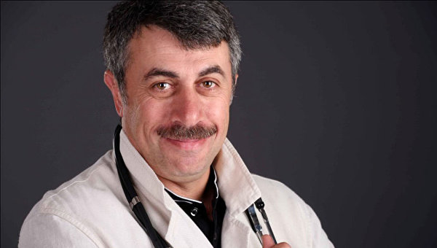

Slide 3
a doctor

Slide 4
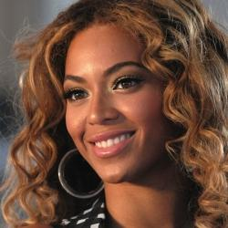

Slide 5
a singer

Slide 6
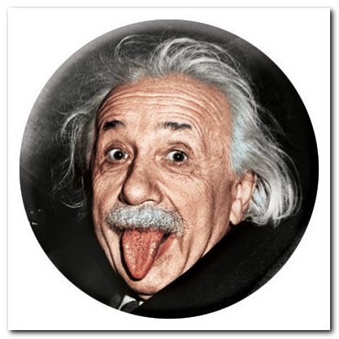

Slide 7
a scientist

Slide 8
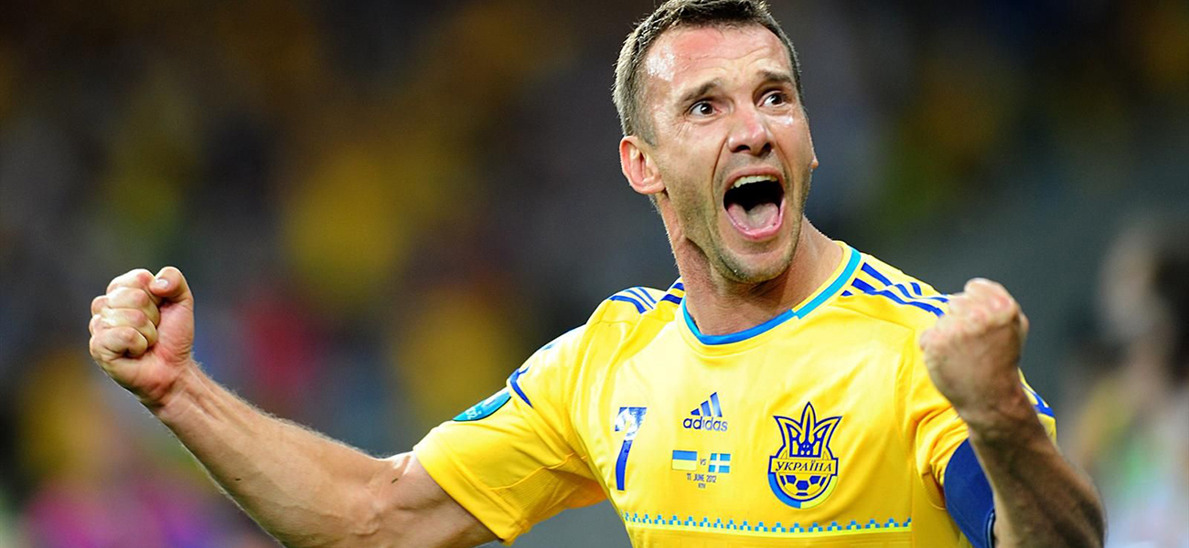

Slide 9
a footballer

Slide 10
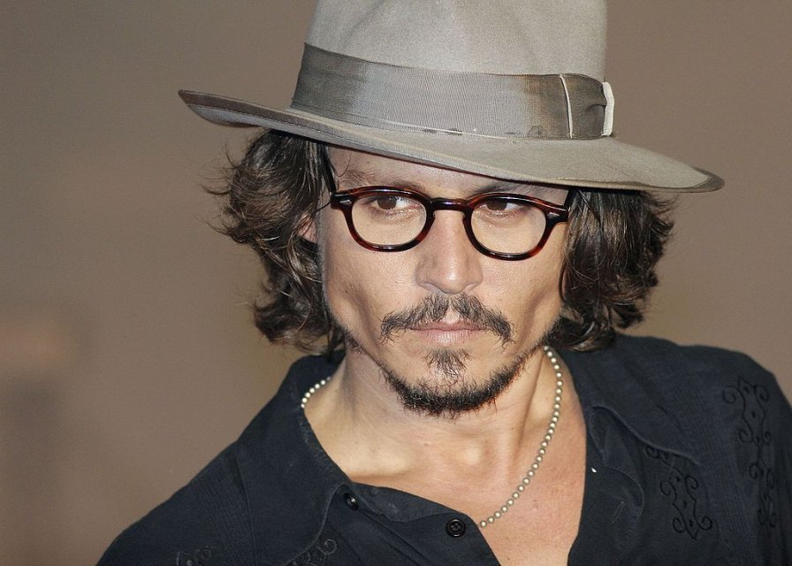

Slide 11
an actor

Slide 12
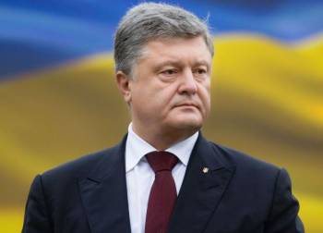

Slide 13
a politician

Slide 14
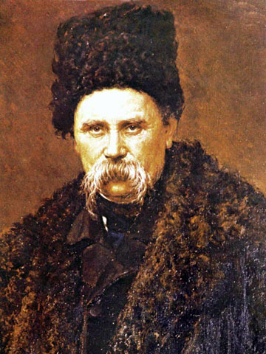

Slide 15
a poet

Slide 16
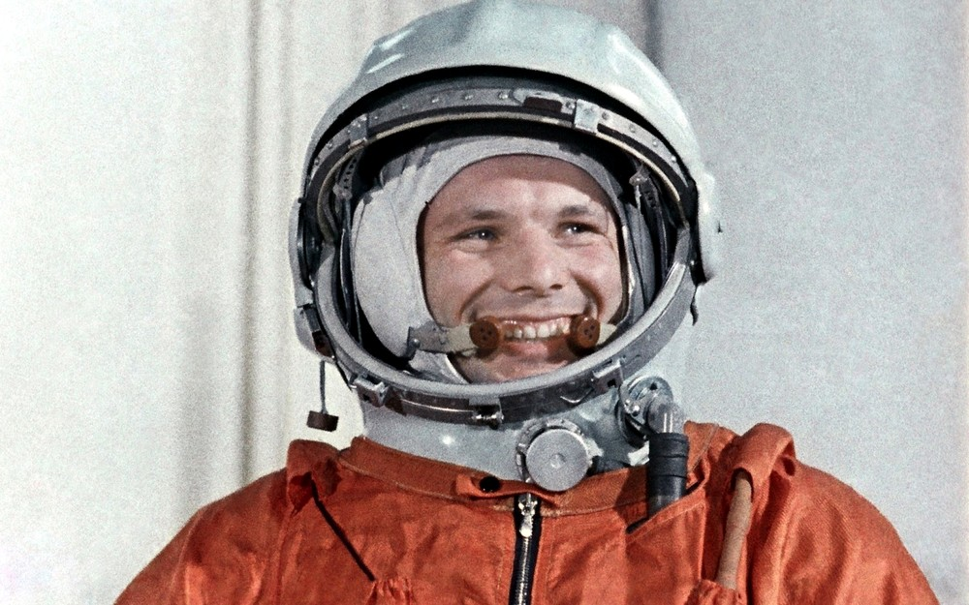

Slide 17
an astronaut

Slide 18

Jobs around us

Slide 19

a teacher

Slide 20
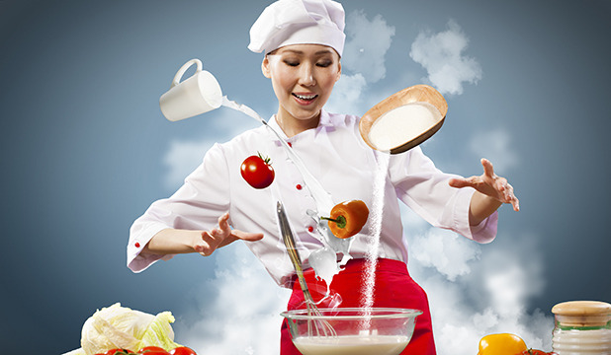
a chef

Slide 21
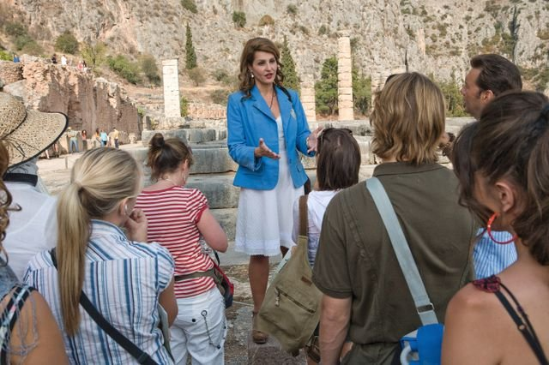
a guide

Slide 22
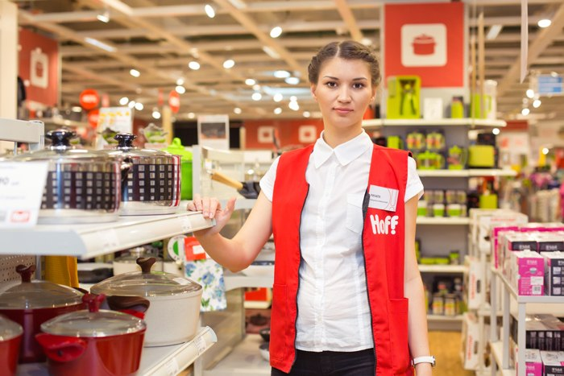
a shopassistant

Slide 23
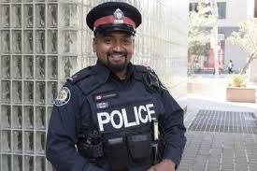
a policeman

Slide 24

a secretary

Slide 25
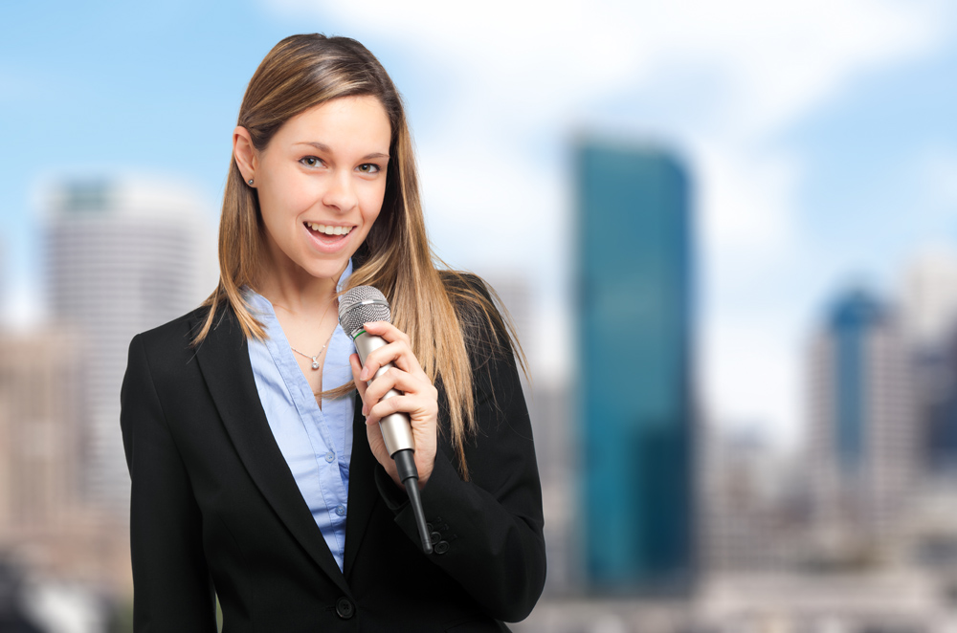
a journalist

Slide 26
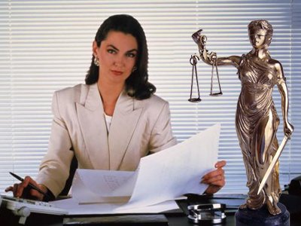
a lawyer

Slide 27
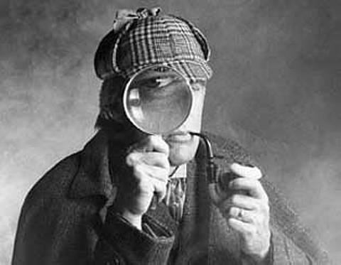
a detective

Slide 28
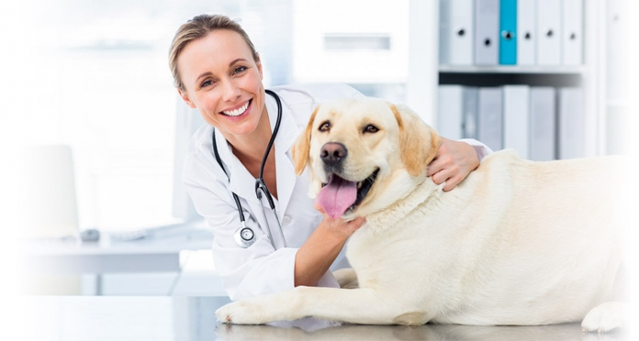
a vet

Slide 29
Listening

Slide 30
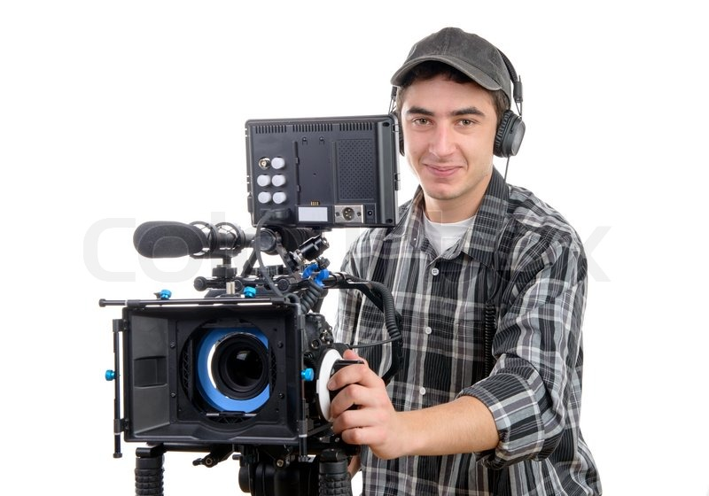
a……….has to be…….

Slide 31

a…………should be…..

Slide 32
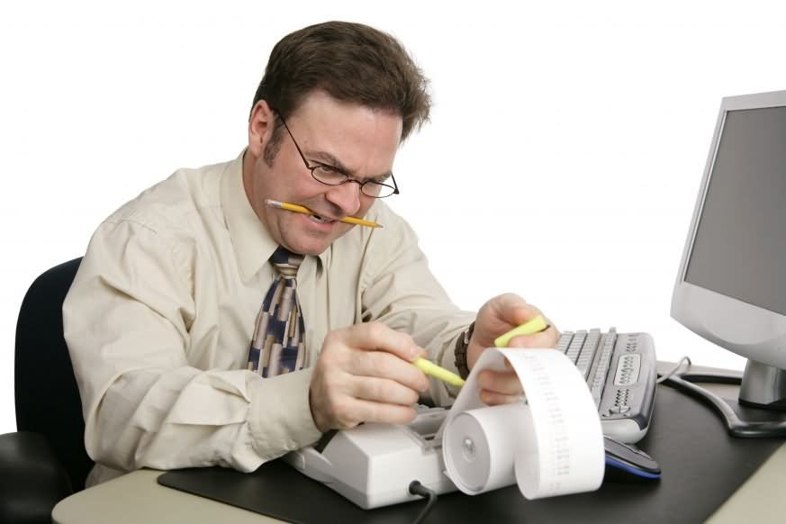
an……….has to be……

Slide 33

an……..has to be……..

Slide 34

a……….should be……..

Slide 35
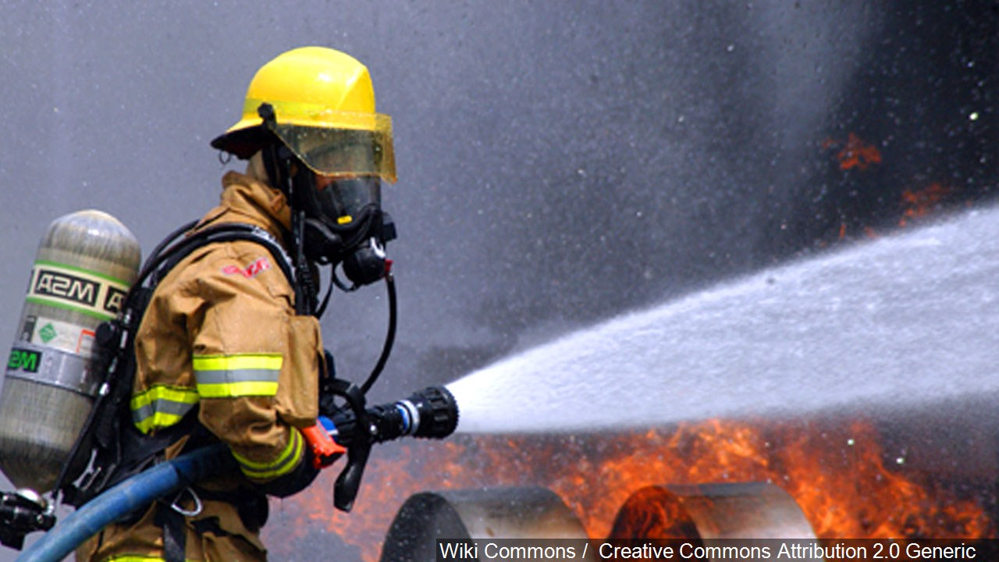
a………..has to be……

Slide 36
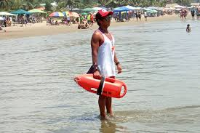
a………..has to be……..

Slide 37
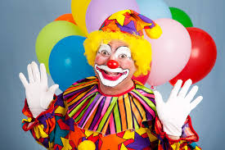
a……….should be……

Slide 38
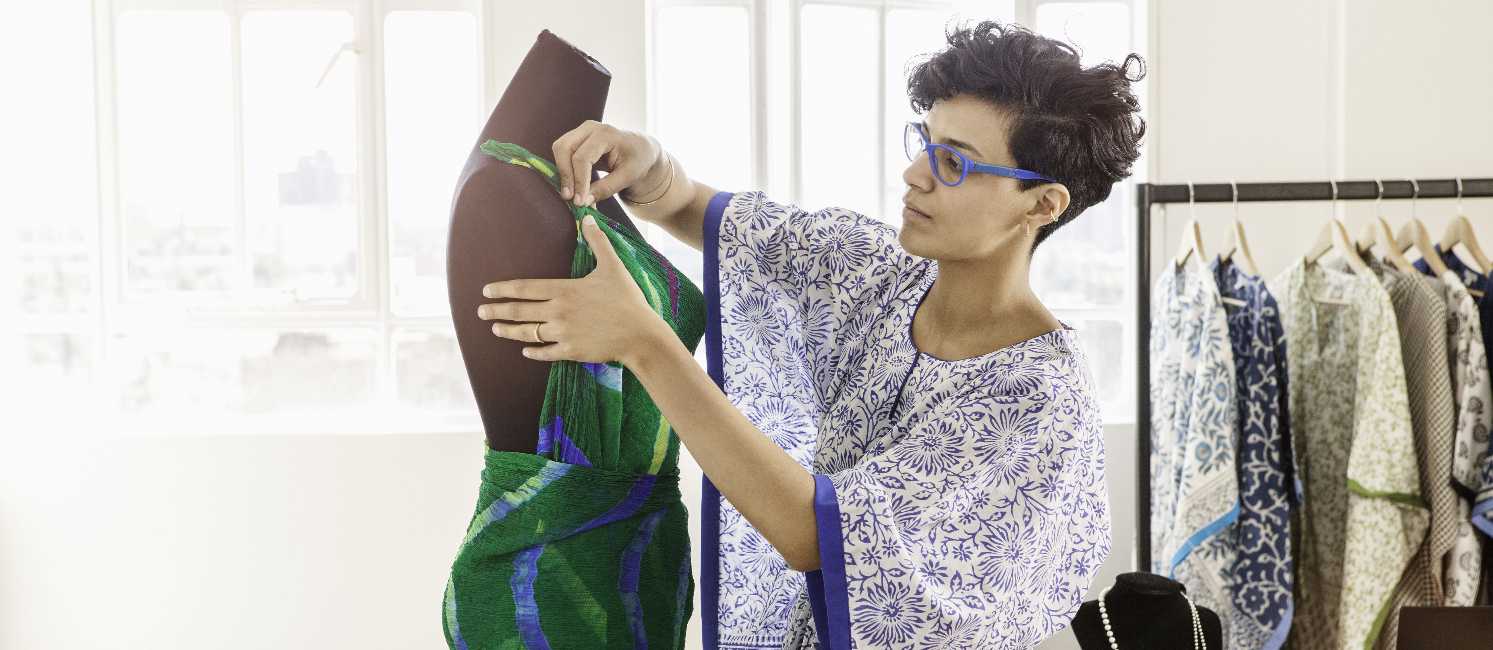
a…………should be……

Slide 39

an……..has to be…..

Slide 40
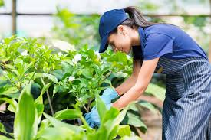
a…………….should be……….

Slide 41
Read the sentences and fill in the correct adjective: persuasive, brave, creative, patient, intelligent, polite, accurate, fair, friendly
1. Salespeople need to be …..to get people to buy their products.

Slide 42
Read the sentences and fill in the correct adjective: persuasive, brave, creative, patient, intelligent, polite, accurate, fair, friendly
2. A scientist has to be………..in order to understand complex theories.

Slide 43
Read the sentences and fill in the correct adjective: persuasive, brave, creative, patient, intelligent, polite, accurate, fair, friendly
3. Receptionists should be………..in order to make people feel welcome.

Slide 44
Read the sentences and fill in the correct adjective: persuasive, brave, creative, patient, intelligent, polite, accurate, fair, friendly
4. Surgeons must be very………..as they should not make mistakes in their work.

Slide 45
Read the sentences and fill in the correct adjective: persuasive, brave, creative, patient, intelligent, polite, accurate, fair, friendly
5. A shop assistant has to be………even when dealing with a rude customer.

Slide 46
Read the sentences and fill in the correct adjective: persuasive, brave, creative, patient, intelligent, polite, accurate, fair, friendly
6. Lifeguards have to be…………..as they often find themselves in dangerous situations.

Slide 47
Read the sentences and fill in the correct adjective: persuasive, brave, creative, patient, intelligent, polite, accurate, fair, friendly
7. Teachers need to be very………..as students sometimes take a long time to learn things.

Slide 48
Read the sentences and fill in the correct adjective: persuasive, brave, creative, patient, intelligent, polite, accurate, fair, friendly
8. Judges should be…………and give all evidence equal consideration.

Slide 49
Read the sentences and fill in the correct adjective: persuasive, brave, creative, patient, intelligent, polite, accurate, fair, friendly
9.Fashion designers should be very……….so that they can come up with new designs.

Slide 50
It seems to me that the job of a …. is suitable for… because…

Slide 51
I would like to work as a………..because……… but I wouldn`t like to be a……….because.
What about you……..?

Slide 52
Your homework:
“My future profession”

