Slide 1







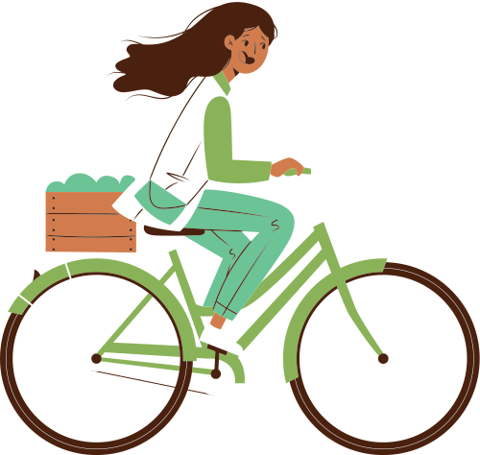
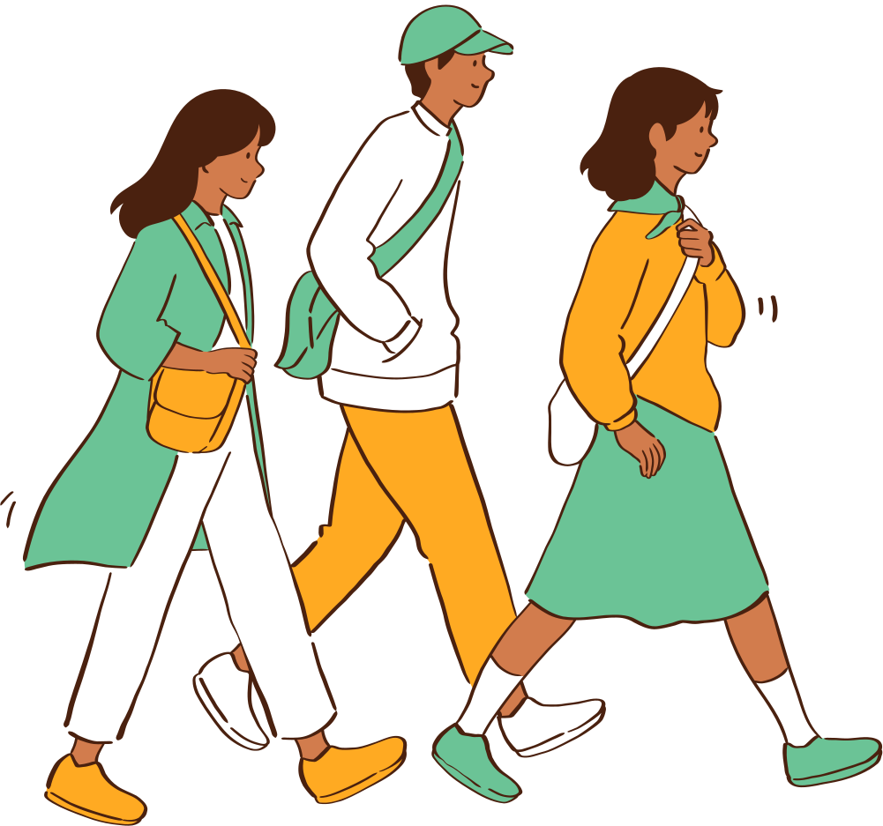

“LET`S SAVE OUR PLANET”
CONDITIONALS.

Slide 2


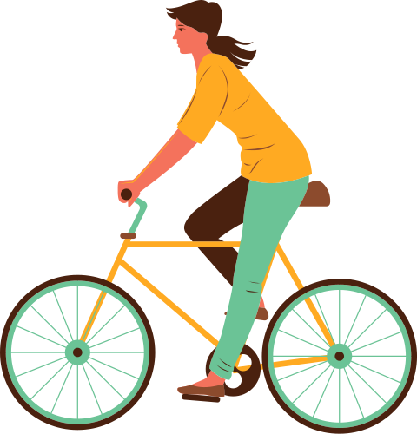
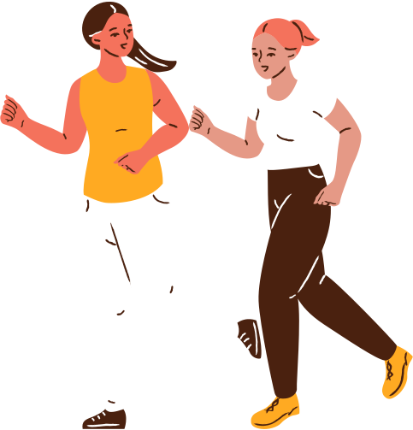
TODAY WE ARE GOING TO ...
practise and expand vocabulary
analyse and understand the situations in which 0/the 1st Conditionals are used
practise the 1st Conditionals in exercises
improve listening, reading and speaking skills
share knowledge with
each other

Slide 3

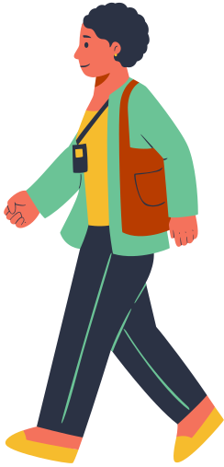
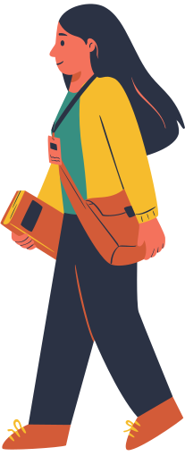

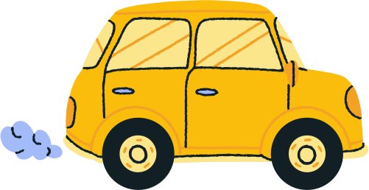
VOCABULARY REVISION
NATURE AND THE ENVIRONMENT

Slide 4


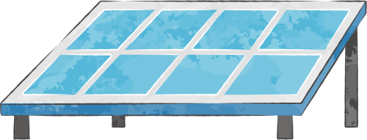
ANSWER THE QUESTIONS TO FIND OUT HOW ENVIRONMENTALLY AWARE YOU AND YOUR FAMILY ARE.
What does your family do with empty bottles?
  A Take them to a recycling bin.
  B Return them to the supermarket.
  C Throw them in the rubbish bin
When you buy one or two items at the supermarket, you…
  A take a plastic carrier bag
  B reuse an old plastic carrier bag
  C use your own bag

Slide 5
ANSWER THE QUESTIONS TO FIND OUT HOW ENVIRONMENTALLY AWARE YOU AND YOUR FAMILY ARE.
How often do you choose products which contain recycled materials?
  A Always.
  B Never.
  C Sometimes
When you clean your teeth, you… .
  A turn the tap on only when you need water
  B leave the tap running until you have finished
  C use only one glass of water

Slide 6


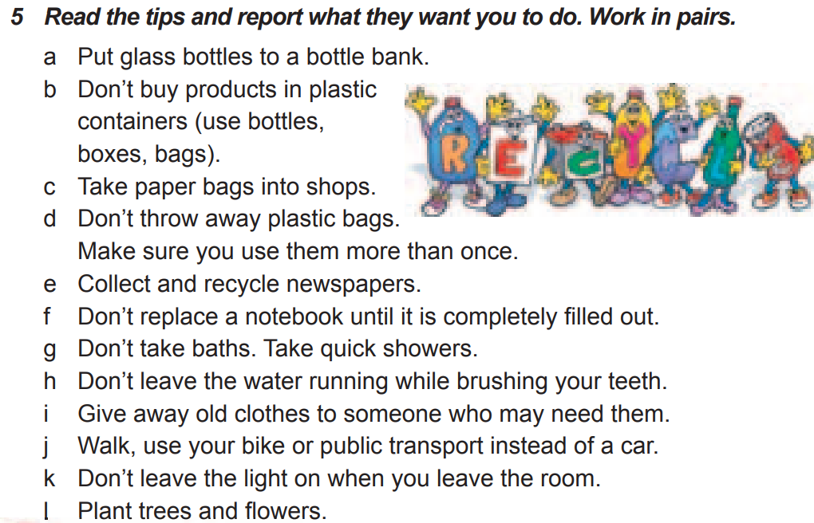

WHAT CAN WE DO TO PROTECT OUR WORLD?
Using the tips from the textbook, describe the pictures.
Start with:
I SHOULD/SHOULDN`T ...
THEY ASK ME TO.../ THEY ASK ME NOT TO...

Slide 7
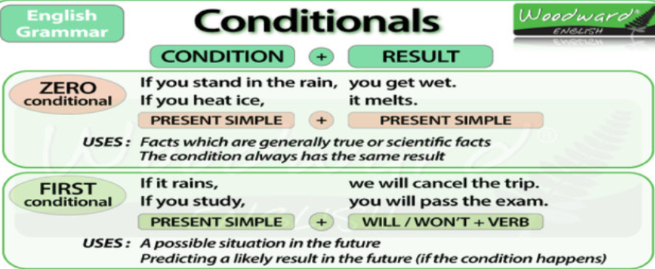

IT`S TIME TO RELAX AND LISTEN TO MUSIC.
BRUNO MARS “COUNT ON ME”
After listening, be ready to answer the questions:
  Are there any Conditionals in this song?
  Are there the 1st or 0 Conditionals?

Slide 8
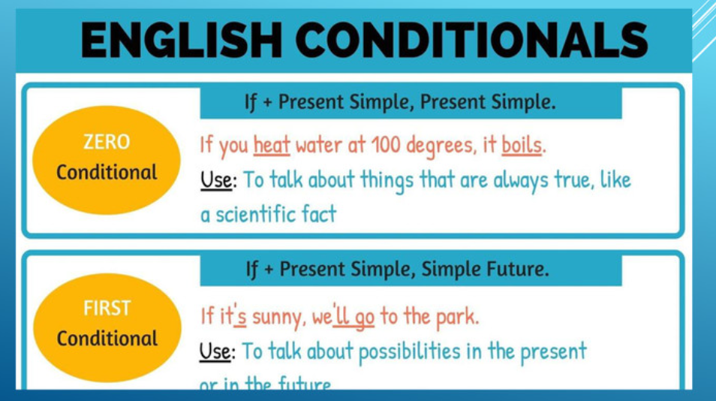
BRUNO MARS “COUNT ON ME”
If you ever find yourself stuck in the middle of the sea, I will sail the world to find you.
Якщо ти коли-небудь застрянеш посеред моря,
я перепливу весь світ, щоб знайти тебе

Slide 9
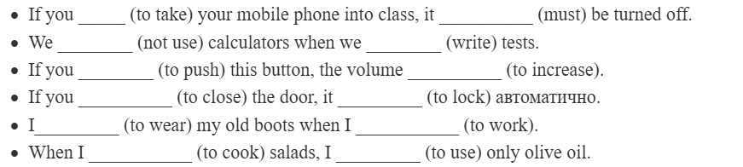
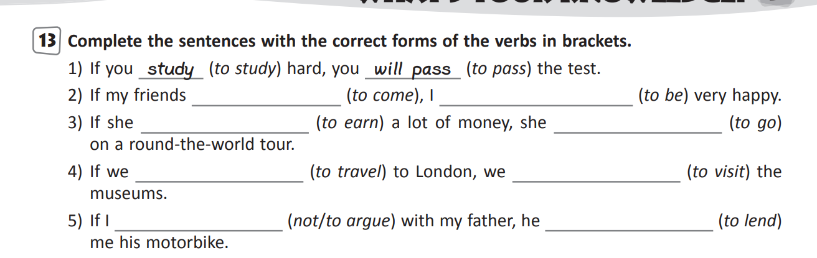
0/the 1st Conditionals practice

Slide 10
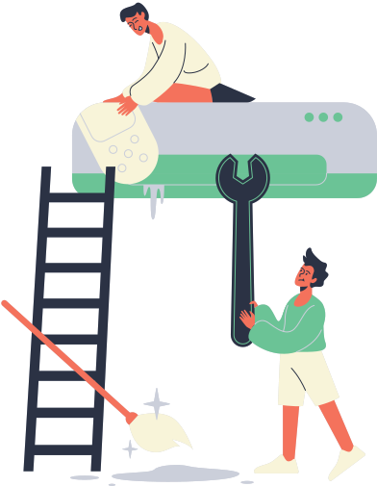
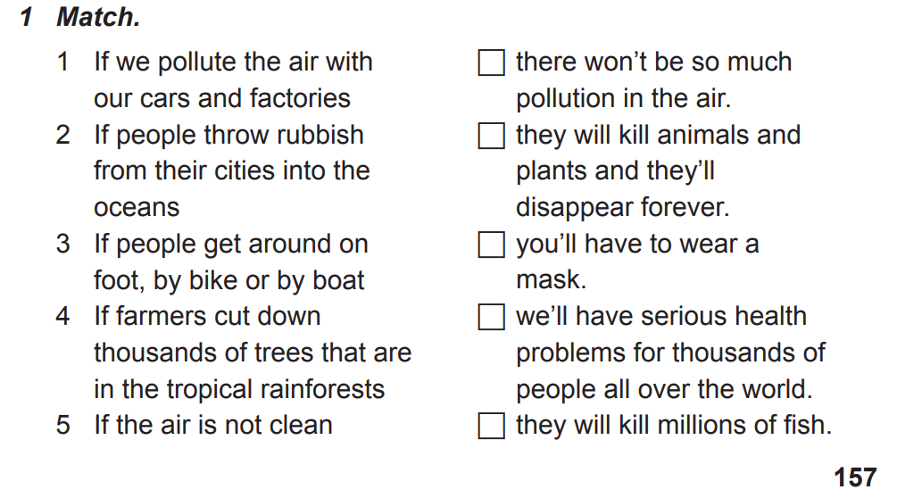
WHAT CAN WE DO TO SAVE THE PLANET?
The 1st Conditionals practice

Slide 11
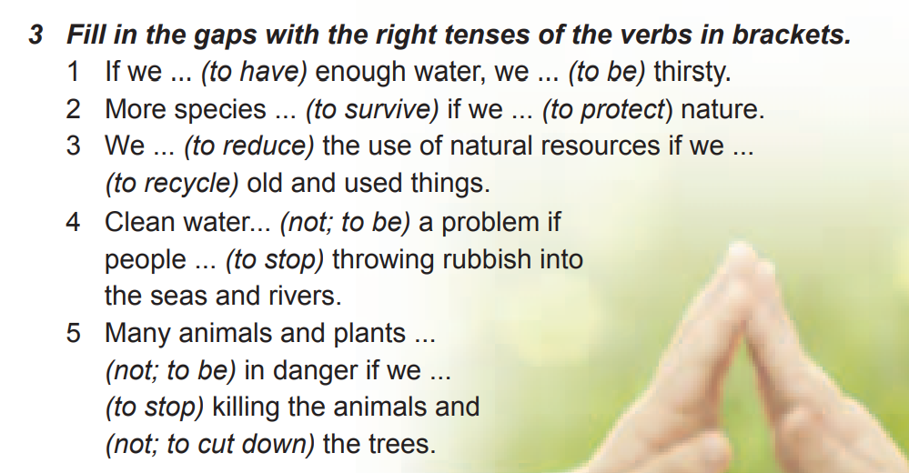
WHAT CAN WE DO TO SAVE THE PLANET?
The 1st Conditionals practice

Slide 12
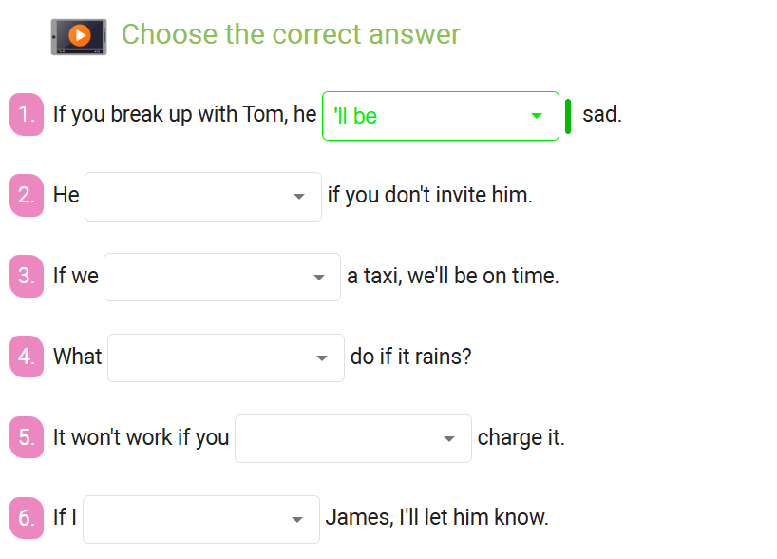
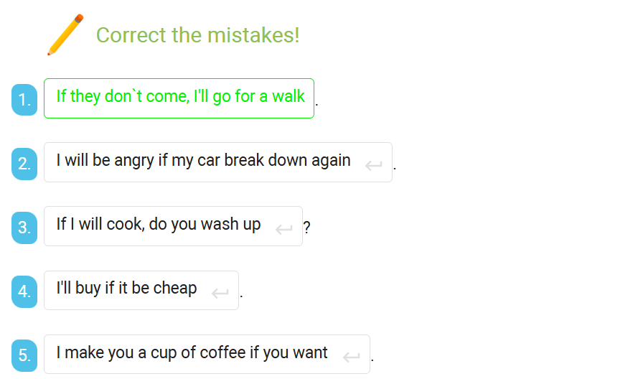
The 1st Conditionals practice

Slide 13
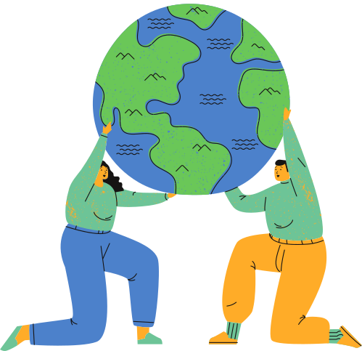
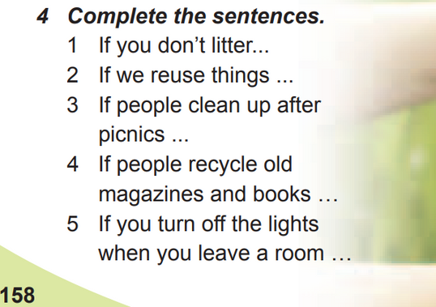
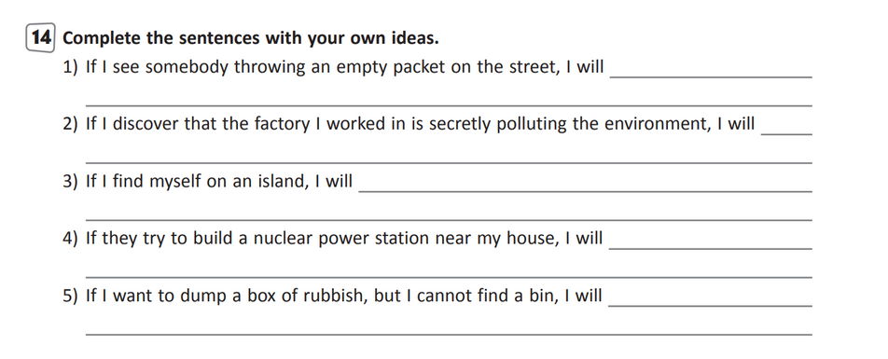
HOMEWORK
Complete the sentences
Ex. 4 p.158 (textbook)
Ex. 14 (photo)
Test https://vseosvita.ua/test/start/xze686

Slide 14



REFLECTION
I understood everything
I need more explanation
І didn't understand anything

Slide 15
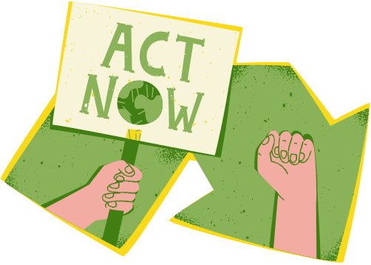
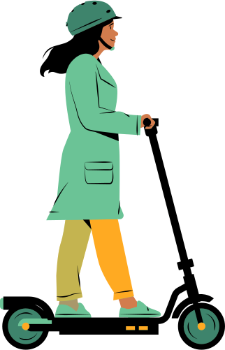
“If we protect nature,
we`ll save our planet for future generations”
THANK YOU

