Slide 1





The national symbols of Ukraine.
The Ukrainian flag.

Slide 2

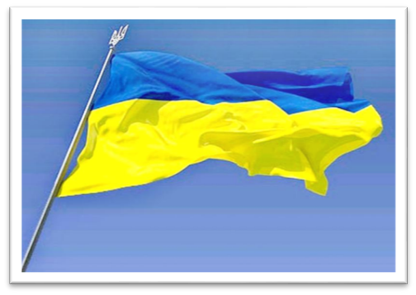
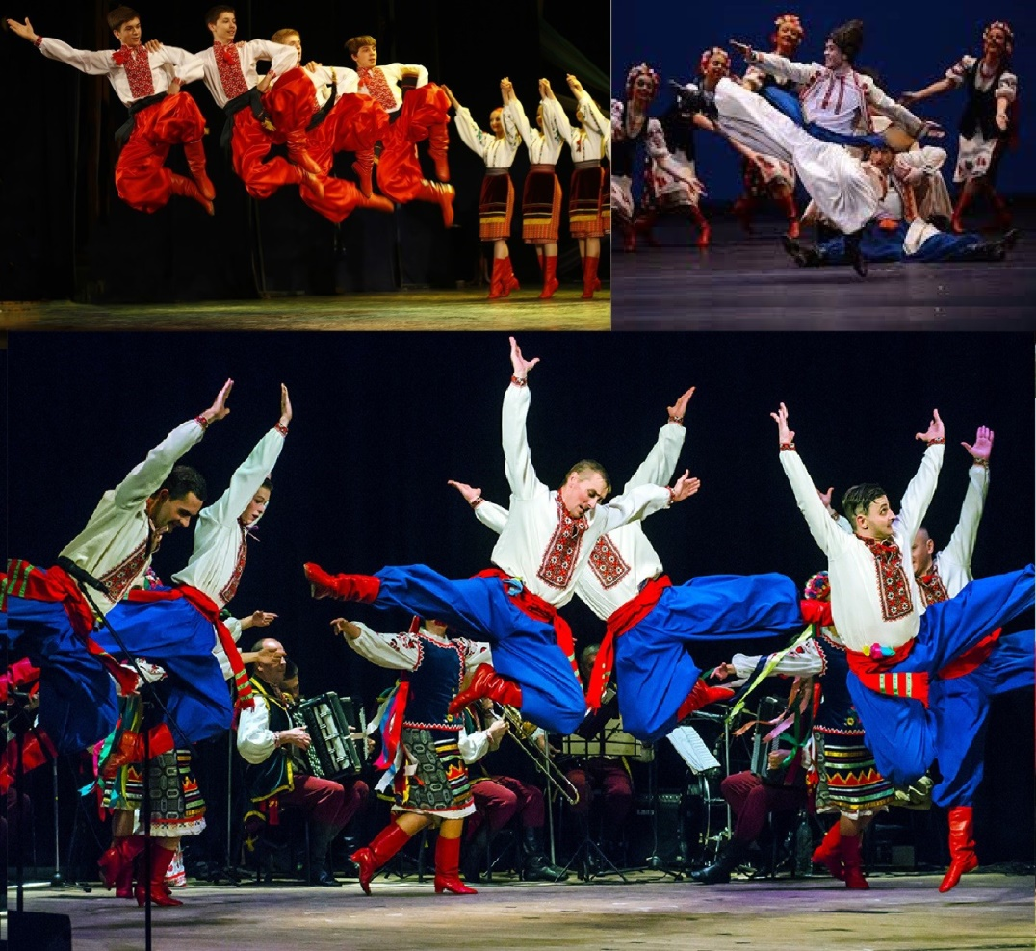
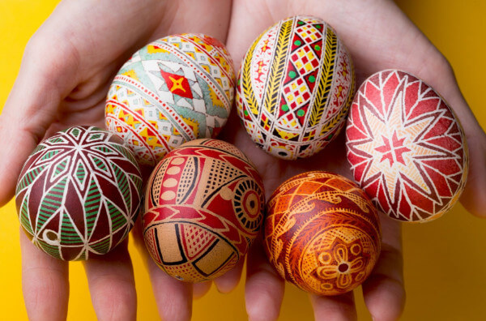




Slide 3






Raising the Ukrainian flag is a powerful statement of national identity and pride.
- Volodymyr Zelensky
The Ukrainian flag is yellow and blue. Yellow is at the top, and blue is at the bottom.
The colors of the Ukrainian flag are very important to Ukrainians. The yellow color means fields of wheat in Ukraine. The blue color means the sky above Ukraine.
The Ukrainian flag is a national symbol of Ukraine. It was officially used for the first time on 4th September 1848. But it wasn't the country's only flag until 1991. In 1991, Ukraine became an independent country. From that day, the blue and yellow flag was the country's only flag. Before that, the country had other flags. One of them was the red and black flag.
Every year on 23rd August, there is a holiday called 'Yellow-Blue Day' in Ukraine. On this day, people have parties and concerts. They wear clothes with the colors of the flag.
The Ukrainian flag is also a symbol of the Ukrainian people. During protests in Ukraine, people often wave the flag. In 2004, people protested against the government. This protest was called 'the Orange Revolution'. People waved orange flags and they wore orange clothes. In 2013 and 2014, there were more protests in Ukraine. These protests were called 'the Revolution of Dignity'. People waved the blue and yellow flag during these protests.
The Ukrainian flag is similar to the flag of Sweden. The Swedish flag is blue and yellow too, but the colors are in different places. Some people say that the Ukrainian flag is the same as the Swedish flag, but it isn't. The blue and yellow colors are important to many countries. For example, Brazil's flag is green and yellow, and Kazakhstan's flag is light blue and yellow. But only Ukraine and Sweden have flags with these two colors.

Slide 4

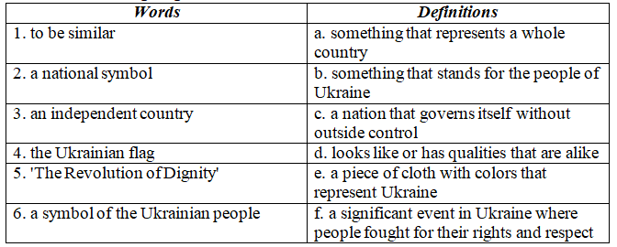


Pre-reading activities
I.Can You Match These Words to Their Definitions? Do you know them? Guess what we're going to talk about.
  Correct matches: 1.D 2.A 3.C 4.E 5.F 6.B
  Посилання на завдання: https://www.educaplay.com/learning-resources/19082017-learning_resource.html

Slide 5



While-reading activities
I. Which Title Fits Best?
  How do the colors of flags impact national identity?
  Why is the Ukrainian flag red and black?
  The Symbolism of the Ukrainian Flag
1.What are the colors of the Ukrainian flag?
A. Red and green
B. Blue and white
C. Yellow and blue
D. Black and orange
II. Choose the best answer: A, B, C, D
2. What does the yellow color on the Ukrainian flag represent?
A. The sun
B. Wheat fields
C. The sea
D. Flowers

Slide 6
While-reading activities
II. Choose the best answer: A, B, C, D
3.On what date is the "Yellow-Blue Day" holiday celebrated in Ukraine?
A. January 1st
B. March 15th
C. July 4th
D. August 23rd
4. What did people do during the "Orange Revolution" protests in Ukraine?
A. Waved the Ukrainian flag
B. Wore orange clothing
C. Held music concerts
D. Both B and C
  5. Which country's flag has the same colors as the Ukrainian flag, but in a different order?
  A. The USA
  B. Poland
  C. Sweden
  D. Brazil
Correct answers: 1.C 2.B 3.D 4.D 5.C

Slide 7


While-reading activities
III. Read the text again and choose True/False.
1. The flag of Ukraine has yellow on top and blue at the bottom. (True)
2. The yellow color on the flag represents the sun in Ukraine. (False)
3. The flag of Ukraine was first officially used in 1848. (True)
4. “Yellow-Blue Day” is a national holiday all over the world. (False)
5. The Ukrainian flag is not a symbol of the Ukrainian people. (False)
6. The Ukrainian flag is the same as the Swedish flag. (False)
Посилання на завдання (тест): https://naurok.com.ua/test/the-ukrainian-flag-history-and-meaning-2910419.html

Slide 8



Post-reading activities
I. Answer the questions:
1. Have you ever seen the Ukrainian flag before?
2. What do you think the colors of the Ukrainian flag represent?
3. Do you know any other countries that have blue and yellow flags?
4. How important do you think national flags are to a country's identity?
5. Have you ever visited Ukraine or learned about its culture?
6. Do you like the design of the Ukrainian flag?
7. What makes a flag memorable or recognizable?
8. Have you ever participated in any events celebrating Ukrainian culture?
9. How do you feel when you see the flag of a different country?
Посилання на завдання: https://wordwall.net/uk/resource/62398871

Slide 9


Post-reading activities
II. Design your own flag for a fictional country.
  Choose any colors and symbols you want.
  Describe what the colors and symbols you`ve chosen represent.
  What are the values and identity of your fictional country.

Slide 10

Thank You for attention!

