Slide 1
Sport in My Life
Form 6

Slide 2
Sport is fun for girls and boys.
It’s much better than the toys.
You can sledge and ski and skate
And play snowballs with Kate.
You can swim and play football,
Hockey, tennis, basketball.
You can jump and you can run,
You can have a lot of fun.

Slide 3


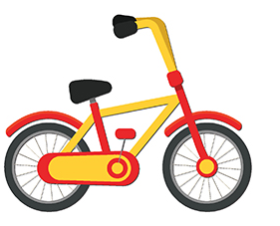
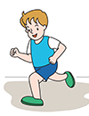
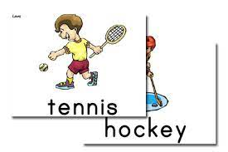
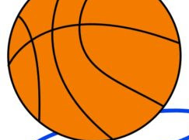
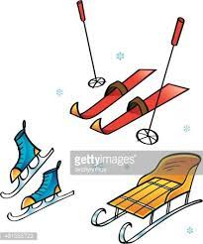
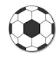
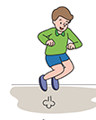
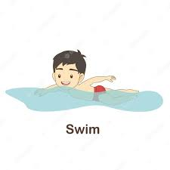
“Sport”
Sport is for girls and boys.
It’s much better than the.
You can
And with Kate.
You can and,
You can and you can ,
You can have a lot of fun.

Slide 4
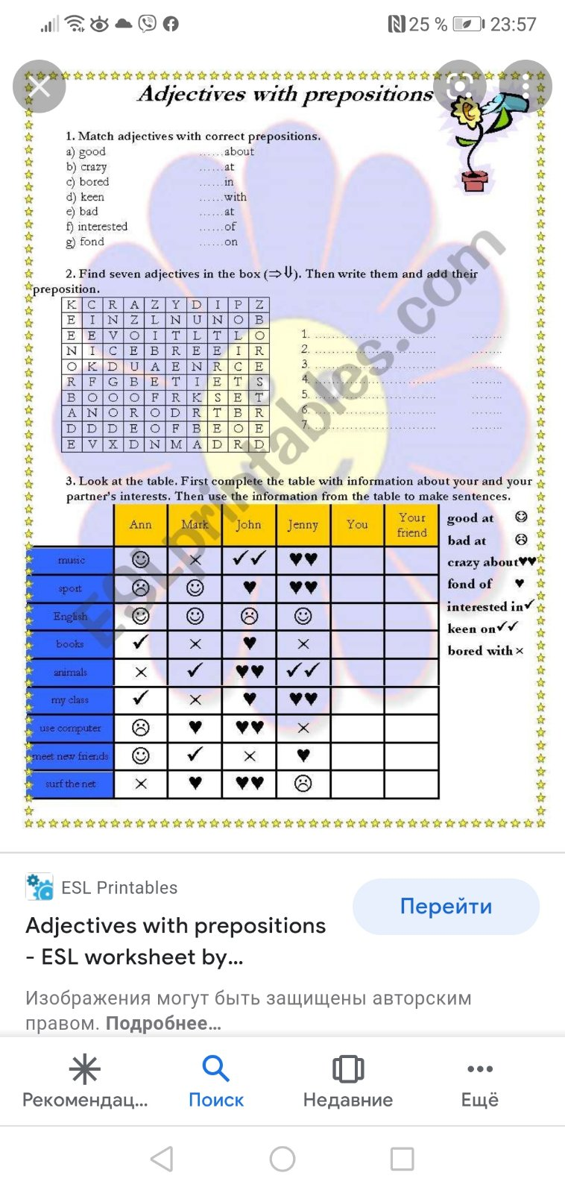

Slide 5
I like riding my bicycle AND+
I’m fond of playing chess BUT -
My friend is good at judo,SO
We are keen on sports as you can guess

Slide 6
https://wordwall.net/play/25844/496/417

Slide 7


Slide 8


Slide 9


Slide 10
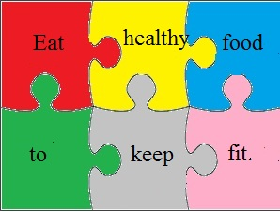
DO SPORTS

Slide 11
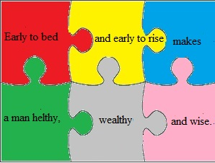

Slide 12
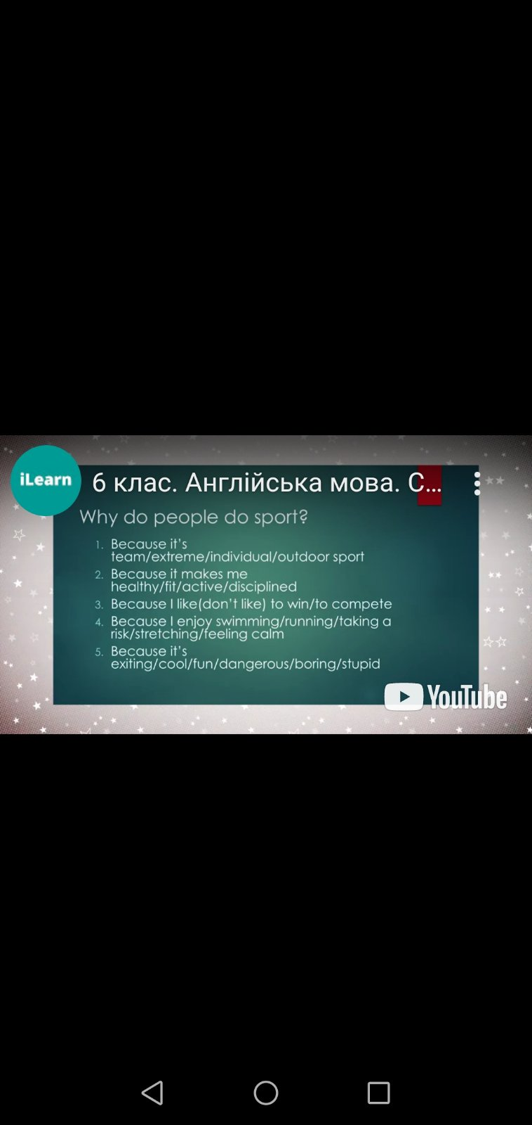

Slide 13
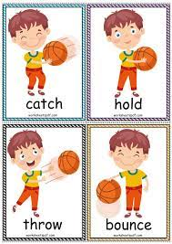

Slide 14


Slide 15


Slide 16
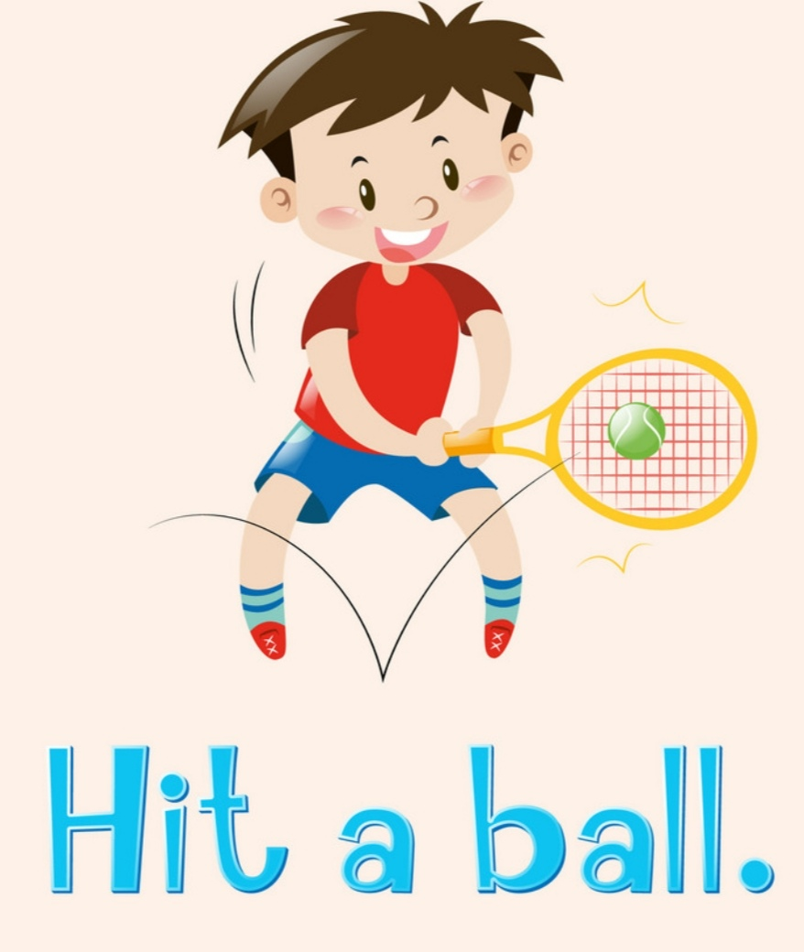

Slide 17
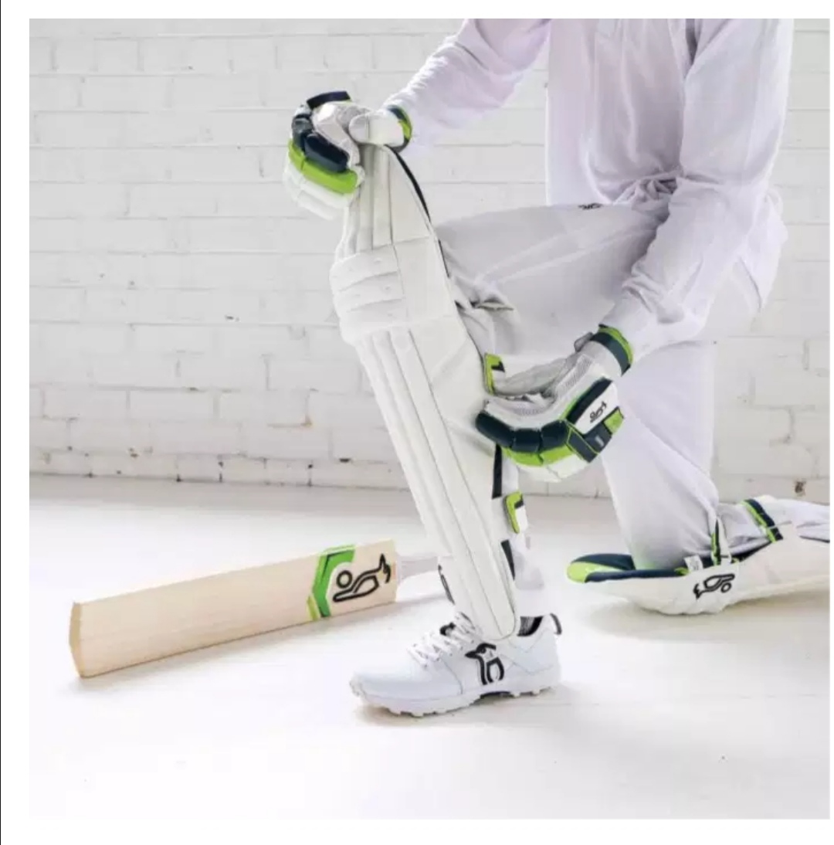
GLOVES
PAD
BAT

Slide 18
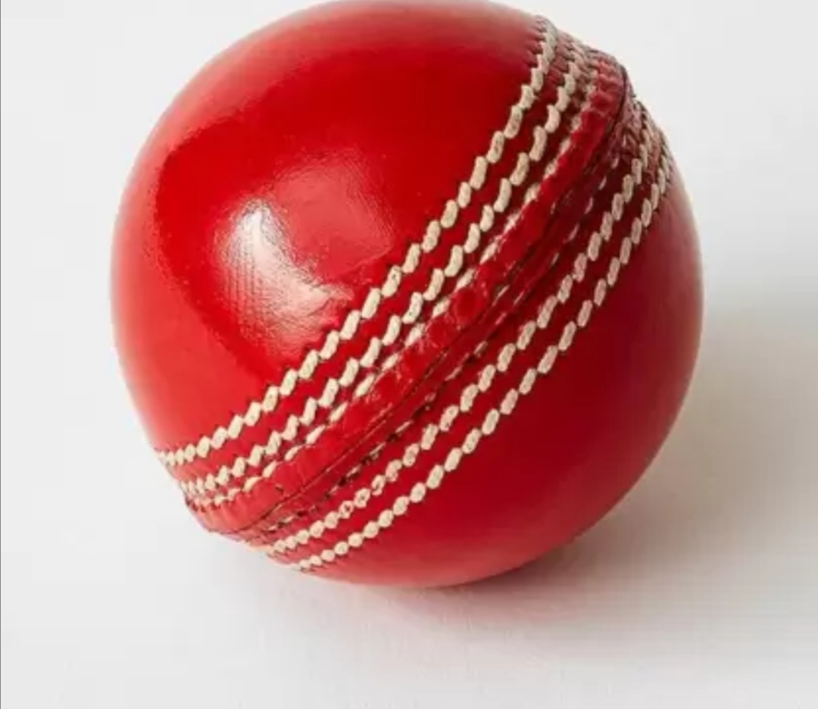
Cricket Ball

Slide 19


Slide 20
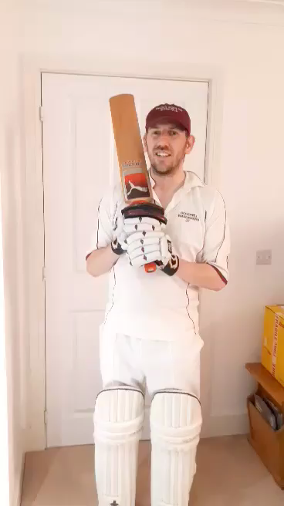

Slide 21
Answer the following questions
1.What is the name of this game?
2.How many players are there on a team?
3.Can you name some other countries apart from England where it's popular?

Slide 22
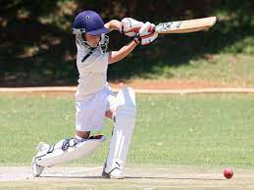
Сricket
11 Australia New Zealand

Slide 23
gloves
pads
bat

Slide 25


Slide 26
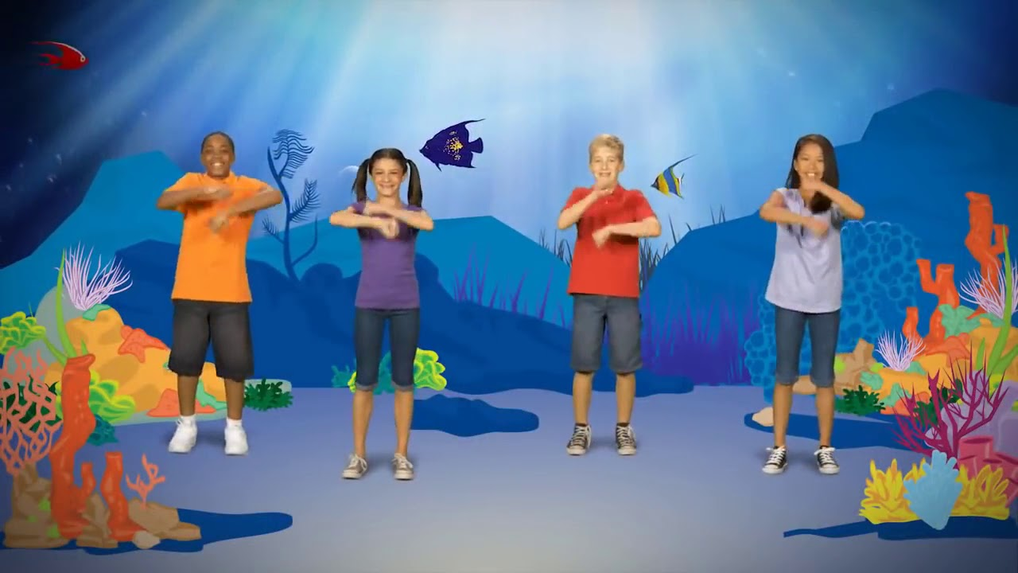
NEW ENERGIZER

Slide 27

CRAZY SPORT

Slide 28

ACT OUT AN INTERVIEW WITH A FAMOUS SPORTSMAN

Slide 29
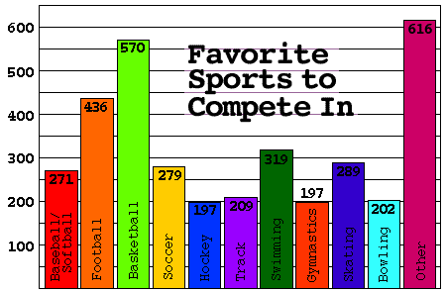
SURVEY ABOUT FAVOURITE SPORT

Slide 30


Slide 31
From; Kiril
To:Paul Hiscock
Subject :popular sport in Ukraine
Thanks for your email. It was nice to learn about a sport that is popular in England.
I'm just writing to tell you that I've become interested in basketball recently, so I play for our school basketball team now. As well as football, basketball and volleyball are quite popular indoor sports in Ukraine. I'm fond of playing it with my friends, both in our PE lessons and in the gym after school.
Do you play basketball in Britain? We would like to invite you to play basketball together during summer camp in Ukraine.
Hope you can come!
Looking forward to hearing from you!
All the best
Kiril

Slide 32



