Slide 1
Hello, dear boys and girls!

Slide 2
Crossword
1.
 |  |  | 2.
 |  |  | 3.
 |  |  |  | 4.
 |  |  |  | 5.
 |  |  | 2.
 |  |  | 3.
 |  |  |  | 4.
 |  |  |  | 5.

Slide 3
Crossword
1.D | R | E | S | S
 |  |  | 2.
 |  |  | 3.
 |  |  |  | 4.
 |  |  |  | 5.

Slide 4
Crossword
1.D | R | E | S | S
 |  |  | 2.C | H | E | E | S | E
 |  |  | 3.
 |  |  |  | 4.
 |  |  |  | 5.

Slide 5
Crossword
1.D | R | E | S | S
 |  |  | 2.C | H | E | E | S | S
 |  |  | 3.M | O | N | E | Y
 |  |  |  | 4.
 |  |  |  | 5.

Slide 6
Crossword
1.D | R | E | S | S
 |  |  | 2.C | H | E | E | S | S
 |  |  | 3.M | O | N | E | Y
 |  |  |  | 4.P | O | T | A | T | O
 |  |  |  | 5.

Slide 7
Crossword
1.D | R | E | S | S
 |  |  | 2.C | H | E | E | S | S
 |  |  | 3.M | O | N | E | Y
 |  |  |  | 4.P | O | T | A | T | O
 |  |  |  | 5.S | U | G | A | R

Slide 8
Shops and shopping

Slide 9
Aim:
to revise the words to the themes: “SHOPS”,
“FOOD”, “CLOTHES”;
to understand their meanings and use them
discussing the topic;
to watch videos for the main ideas and specific
information;
to do the tasks;
to carry on a conversation about shops and
shopping.

Slide 10
NewSAGENT

Slide 11
CHEMIST

Slide 12
The Greengrocery

Slide 13
The Baker's

Slide 14
The Butcher's

Slide 15
The TOY SHOP

Slide 16
The fishmonger’s

Slide 17
The DAIRY

Slide 18
the clothes shop

Slide 19
The GROCEr's

Slide 20
The confectioner's

Slide 21
MATCH:
newsagent’s bread
chemist’s sweets
super-market dress
confectioner's medicine
clothes shop all you need
dairy books
baker's butter

Slide 22
They sell meat at the butcher’s
They sell newspapers at _________
You can buy T-shirts at _________
They sell shampoo at ___________
When we run out of bread
we go to the __________________
You can buy trousers at _________
When we run out of sugar
we go to _____________________
They sell trainers at _____________

Slide 23
A VISIT TO THE SHOP

Slide 24
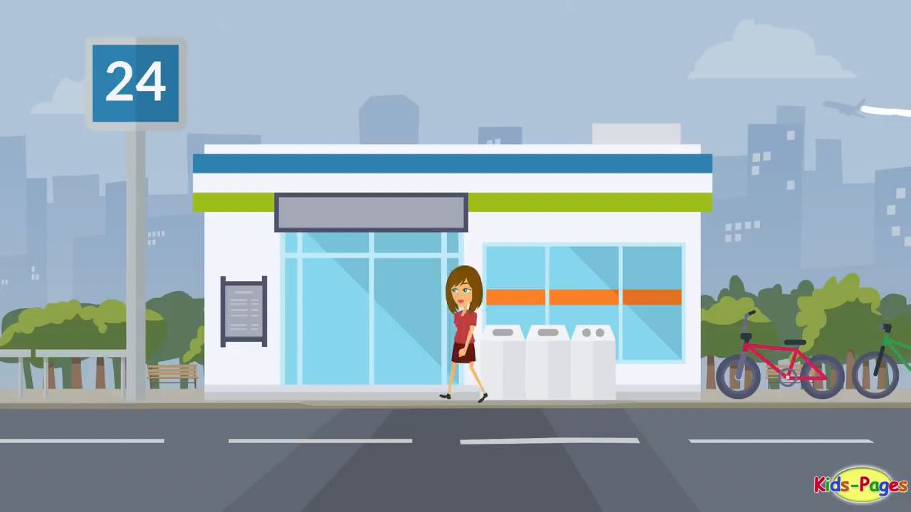

Slide 25
Answer the questions
What did a girl buy?
Did she buy white or brown bread?
How many cartons of milk did she buy?
Did she buy a big or a small bottle of oil?
How much did she pay?

Slide 26
orange juice
a bottle of
a piece of
cocoa
sugar
a jar of
bread
a carton of
jam
milk
a cup of
a jug of
chocolate
a packet of
a loaf of
tea
cheese
a bar of
a glass of
water

Slide 27
WORKOUT

Slide 28
AN ENGLISMAN IN SPAIN

Slide 30
Where was an Englishman?
Where did he go?
What did he want to buy?
What did he draw on a piece of paper?
What did the shop assistant bring him?

Slide 31
Writing and reading

Slide 32
A Shopping Day
Today is Saturday. This is the day when we do the shopping.
First we buy some milk, butter, sour cream and cheese. So we go ______________________ After that we buy meat, sausages, ham or bacon___________________. Then we buy fruit and vegetables ____________________________. I always ask my mum for a new toy or a puzzle _____________________. This shop is the best. At the end we buy some bread, cakes and pies _________________________
at the baker's , at the dairy, at the greengrocer’s, at the butcher's, in the toy shop.

Slide 33
GRAMMAR
How much is it?
How much are they?

Slide 34
Make up your own dialogues
“In The Shop”

Slide 35
DICTIONARY
OF ENGLISH IDIOMS
1. bring home the bacon - to earn a living for the family
For example:
"He felt it was his responsibility to bring home the bacon."
2 .to sell like hot cakes - to sell quickly or rapidly
For example:
"The new Spice Girls' album was sold like hot cakes."
3 .as cool as a cucumber - to remain calm under pressure
For example:
"Although he was driving at 110 mph James Bond was as cool as a cucumber."
4 .to know your onions - to know a lot about a particular subject
For example:
"When he comes to computers he really knows his onions."
5. like a fish out of water - to be uncomfortable in a particular situation
For example:
When she started talking about her personal problems, he looked like a fish out of water.

Slide 36
Your Hometask:
Ex. 5, p. 40.

Slide 37
Thank you
FOR ATTENTioN!

Slide 38
GOOD BYE!

