Slide 1
TRAVELLING
&
HOLIDAYS

Slide 2
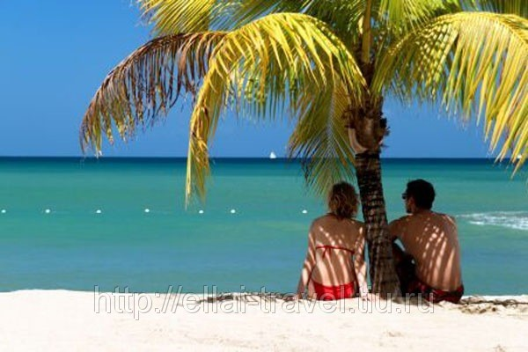
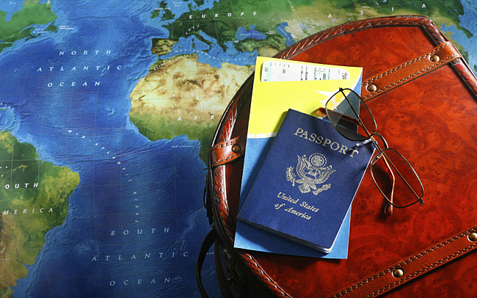
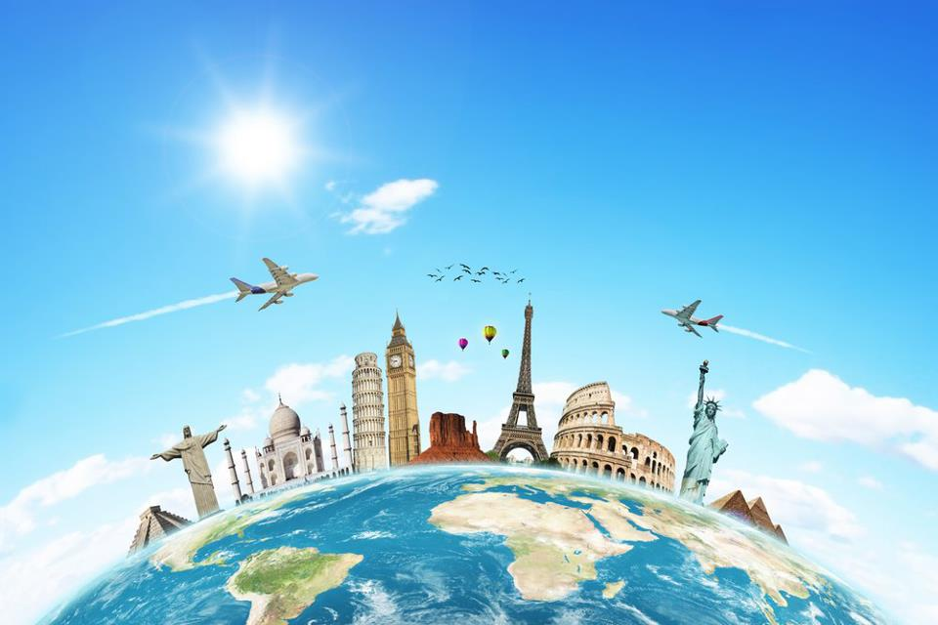
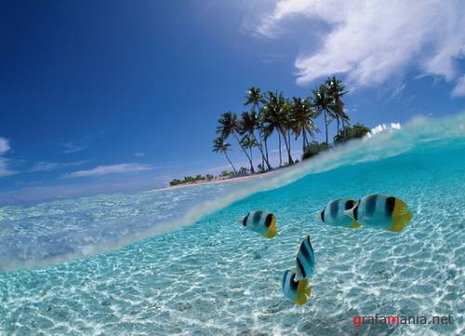
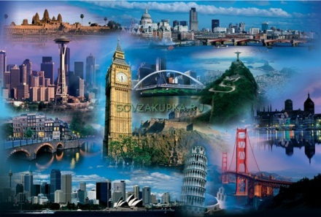

Slide 3
Explain these words:
journey
trip
voyage
travel
tour

Slide 4
Read the sentences and fill in the correct word from the list: travel,tour,voyage,trip,journey
1.It`s a two-hour train………….from York to London.
journey

Slide 5
Read the sentences and fill in the correct word from the list: travel,tour,voyage,trip,journey
2.She`s away on a business………and won`t be back until next week.
trip

Slide 6
Read the sentences and fill in the correct word from the list: travel,tour,voyage,trip,journey
3.He was a young sailor on his first sea………..
voyage

Slide 7
Read the sentences and fill in the1 correct word from the list: travel,tour,voyage,trip,journey
4.The book discusses the future of………in outer space.
travel

Slide 8
Read the sentences and fill in the correct word from the list: travel,tour,voyage,trip,journey
5. We went on a sightseeing…….of Italy.
tour

Slide 9
Read the sentences and fill in the correct word from the list: travel,tour,voyage,trip,journey
6.The Titanic sank on her maiden…….
voyage

Slide 10
Read the sentences and fill in the correct word from the list: travel,tour,voyage,trip,journey
7.They went on a driving……….of New England.
tour

Slide 11
Read the sentences and fill in the correct word from the list: travel,tour,voyage,trip,journey
8.We went on a long……..across the country.
journey

Slide 12
Read the sentences and fill in the correct word from the list: travel,tour,voyage,trip,journey
9.He wrote about his many……into the South Sea.
voyage

Slide 13
Read the sentences and fill in the correct word from the list: travel,tour,voyage,trip,journey
10.They went on a two-day…….to Greece.
trip

Slide 14
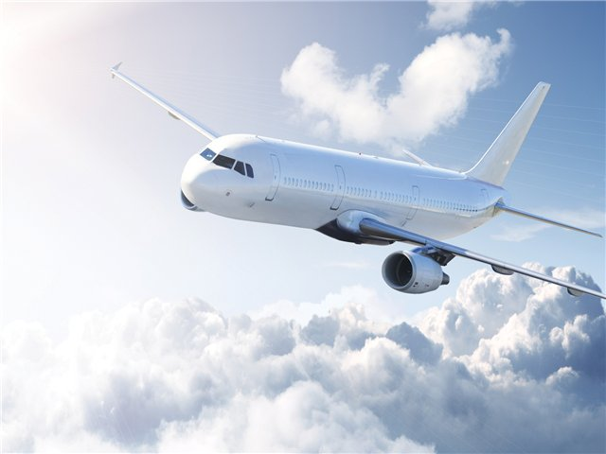
Boring
Comfortable
Economical
Fast

Slide 15
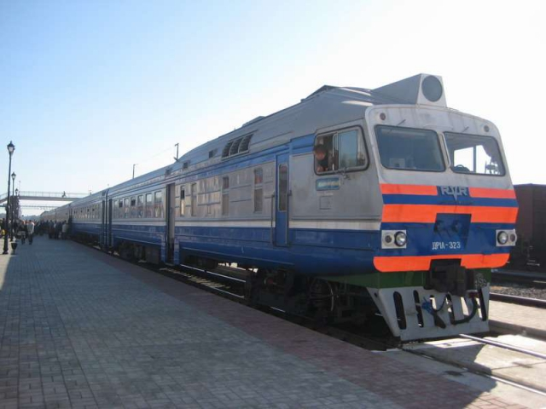
Tiring
Cheap
Reliable
Dangerous

Slide 16
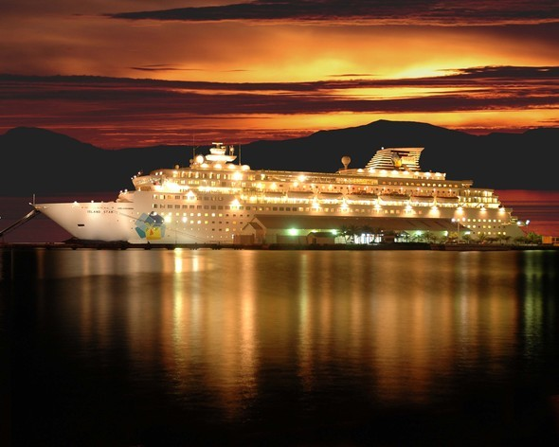
Polluting
Convenient
Exciting
slow

Slide 17
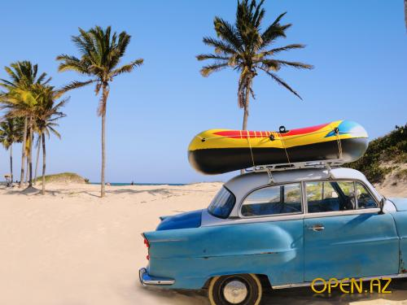
Safe
Expensive
Dangerous
Relaxing

Slide 18
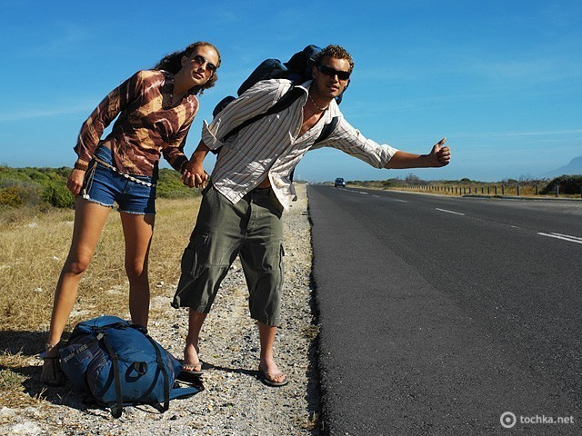
Economical
Safe
Exciting
quick

