Slide 1
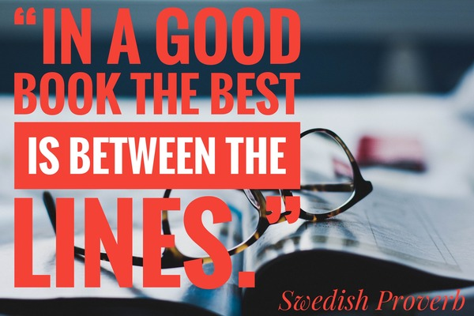

Slide 2
What is a book?
A book …
is a source of
information
is a chance to
spend time
with pleasure
is a memory of
the nation.
is full of mystery.
You always don’t know
what will be in the end.
is always different
contains new ideas

Slide 3
Reading…
Improves our memory
introduces us to new ideas and invites us to solve problems
makes us better
improves our conversational skills
improves our self-discipline
increases our knowledge of history
increases cultural knowledge
challenges our imagination
inspires us
reduces stress
fills our heads with new bits of information, and you never know when it might come in handy
expands vocabulary

Slide 4
THE PLOT IS….
Positive
Thrilling – pахоплюючий,гостросюжетний
Gripping - захоплюючий
Brilliant - блискучий, видатний
Breathtaking – захоплюючий подих
Emotional - емоційний
Unpredictable – непередбачуваний
thought-provoking – що заохочує до дукми
moving , touching – хвилюючий, зворушливий
amazing – приголомшливий
stunning – приголомшуючий
hilarious – веселий,смішний
fabulous – разючий, неймовірний
magnificent – чудовий
terrific – надзвичайний, приголомшливий
https://quizlet.com/_ahusv8?x=1qqt&i=2qraod
Negative
Predictable - передбачуваниний
Boring - нудний
Silly - безглуздий
https://quizlet.com/_ahusv8?x=1qqt&i=2qraod

Slide 5

^{The genres of literature}
All literature is divided into: fiction and science-fiction (non-fiction)
Detective stories
Adventures
Thrillers
Horror stories
Historical novels
Fantasy
Fairy tale
Short stories
Novels
Modern plays
Love stories
Essay
Poetry
Romances
Poems
Sonnets
Ballads
Tragedy
Drama
Biography
Encyclopedias
Atlases
Reference books
Dictionaries
Report
Articles
https://learningapps.org/display?v=pcj1n3cg222

Slide 6
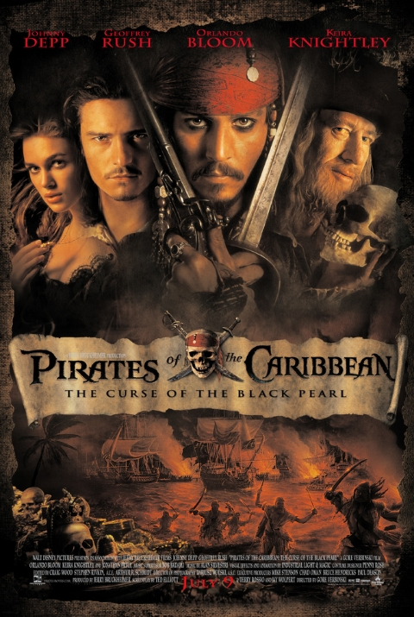
Genre Plot

Slide 7
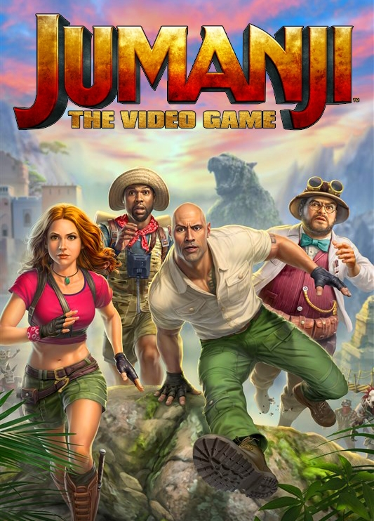
Genre Plot

Slide 8
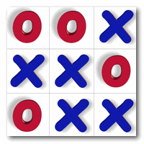
Tick tack toe

Slide 9
Tick tack toe
What kind of books do you prefer reading?
Where is the best place for reading?
What do you think about e-books?
Can be people intelligent if they don’t read a lot?
How reading impacts on personality?
Imagine your life without books. Describe it.
Have you ever read the book after watching the film?
Imagine you are a writer. What are you writing right now?

Slide 10
How am I successful today?
S=
active + no mistakes +team work
3

Slide 11


