Slide 1
Amazing architecture

Slide 2
The Tasks Of The Lesson:
Vocabulary: Describing buildings
Reading: Unusual homes around the world
Grammar: Comparative and superlative adjectives
Vocabulary: Prepositional phrases for location
Listening: Moving to another city
Speaking: Describing a picture

Slide 3
brand new - different and not ordinary
classic - comfortable and warm
cosy - new and different and therefore interesting
fresh - existing since the beginning
modern - following the customs or ways of behaving
original - happening or starting from a short time ago
recent - extremely good, exciting, or surprising
spectacular - using the newest ideas
traditional - completely new
unusual - a classic example of something

Slide 4
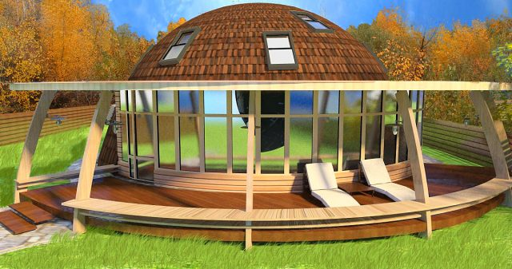

Slide 5
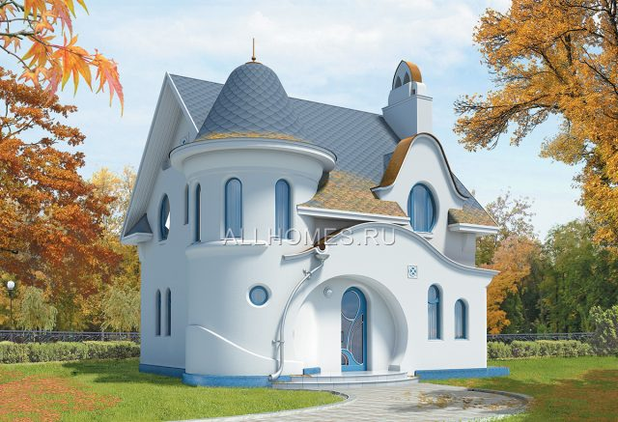

Slide 6
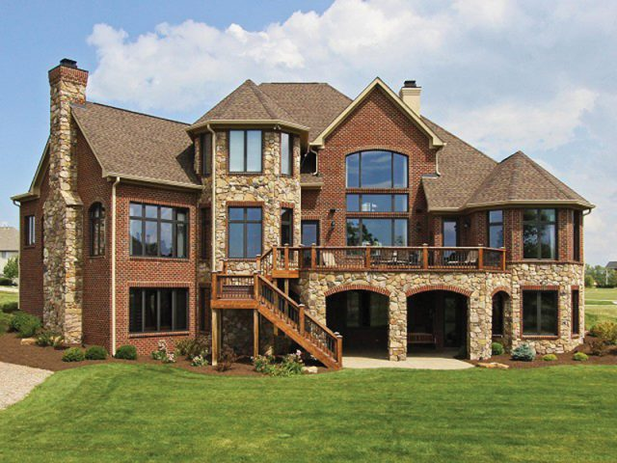

Slide 7
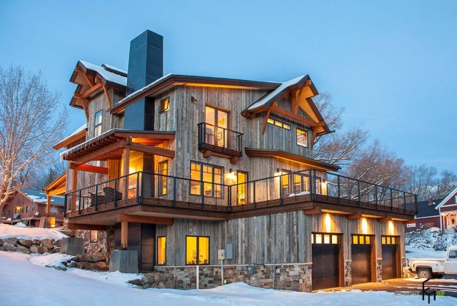

Slide 8
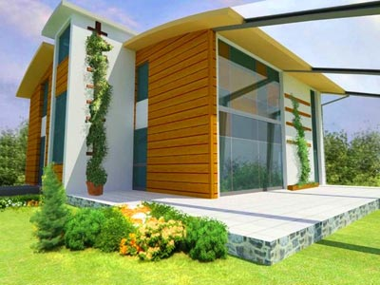

Slide 9
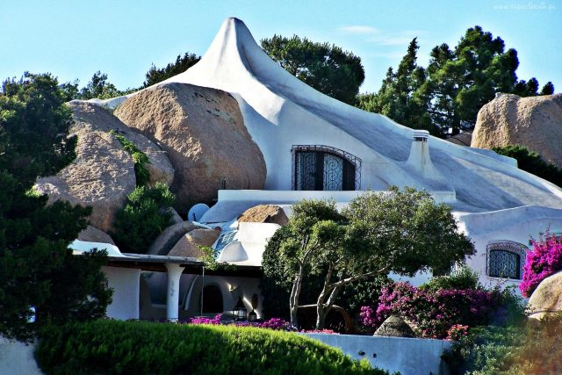

Slide 10
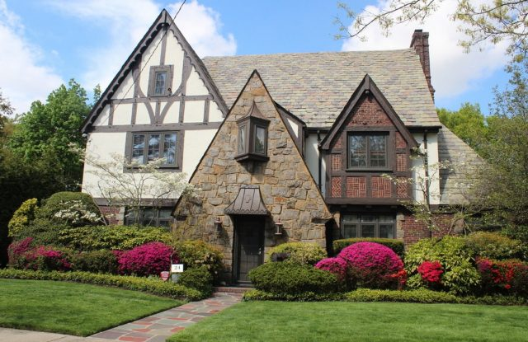

Slide 11
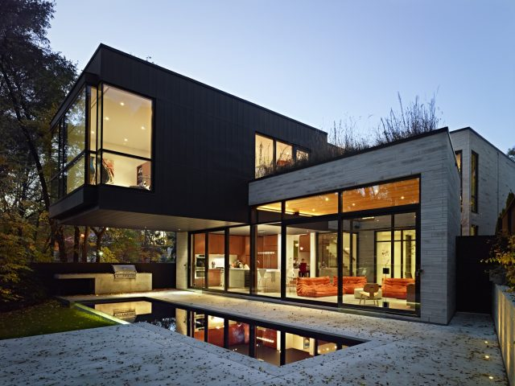

Slide 12
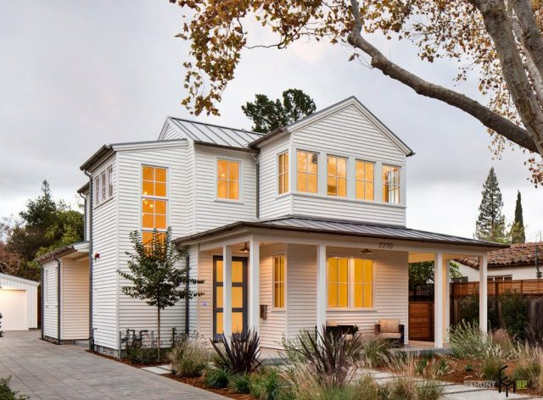

Slide 13
I am (the good/the best) chess player in our class.
His tablet is (cheaper/the cheapest) than mine.
She is (the most beautiful/beautiest) girl in the class.
Hollywood actor Arnold Schwarzenegger is one of (more famous/the most famous) person in the world.
Did she fell (best/better) today?
I don’t think this is (the best/better) idea than mine.
Last week was (hotter/the hottest) ever!
For me mathematics was (harder/more hard) than Chemistry in school.
Mike is (more tall/taller) than my brother.
This is (the funnier/the funniest) joke I’ve ever heard!

Slide 14
The House Where I’d Like To Live

