Slide 1
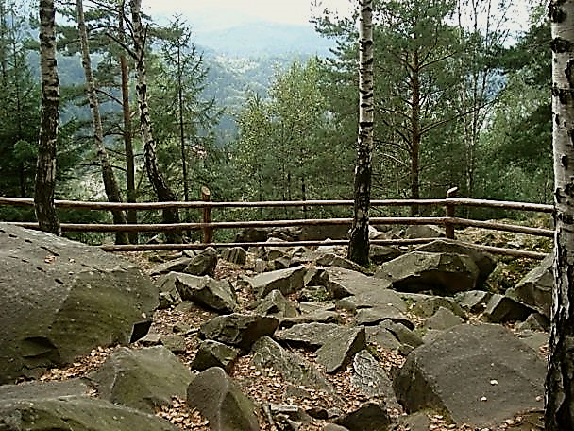
Famous Ukrainian National Nature Parks and Reserves
-to revise previously taught vocabulary;
-to broaden and improve students’ vocabulary;
-to develop students' skills in writing, speaking, reading and listening;
-to test students' grammar skills;
to motivate linguistic guess
Objectives :

Slide 2
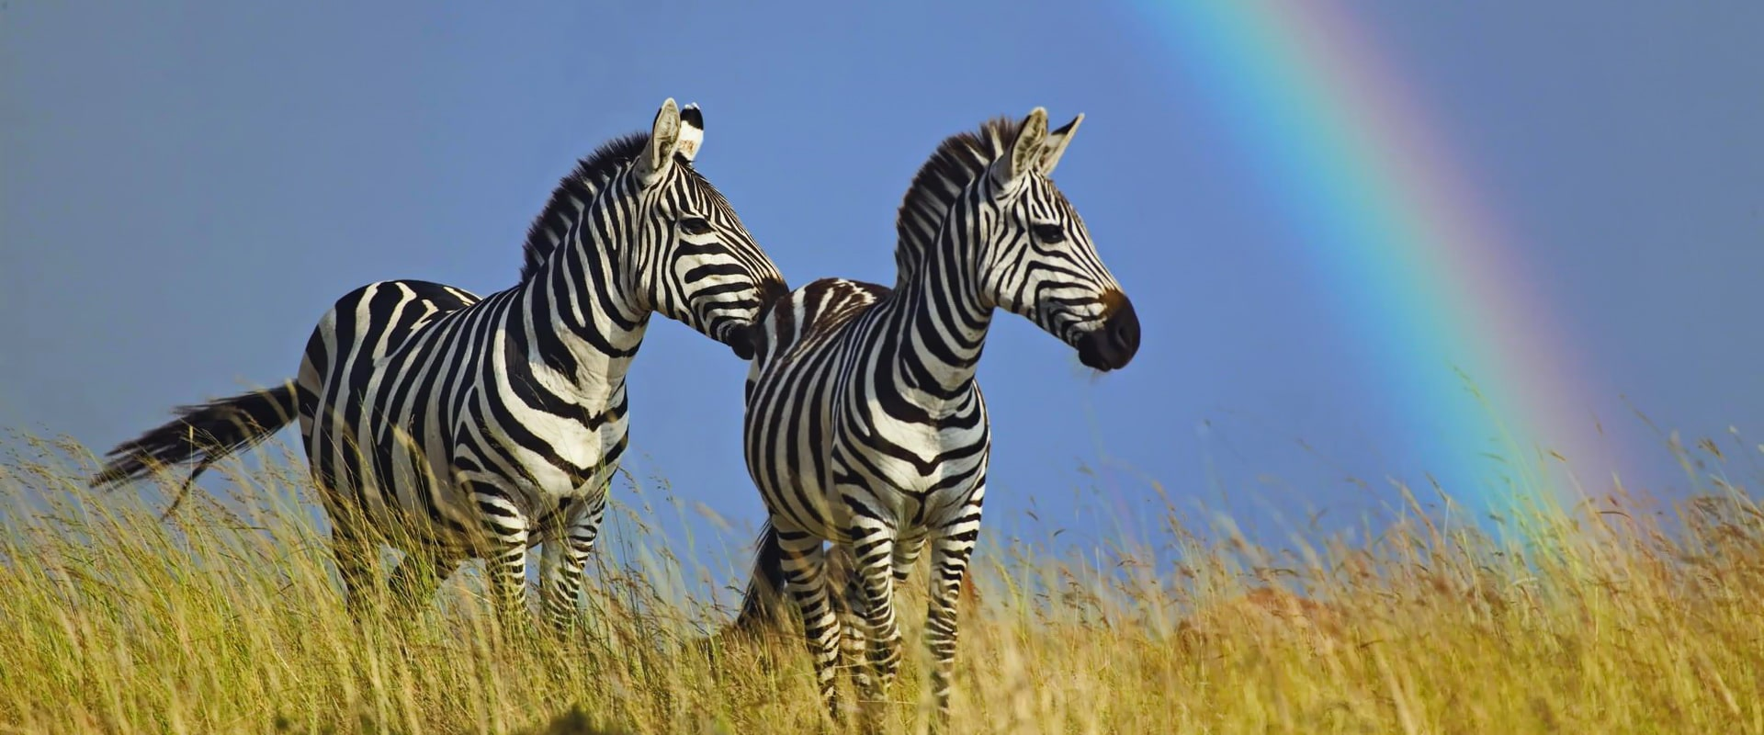
Askania Nova Reserve
https://www.youtube.com/watch?v=otU72kT_6_4

Slide 3
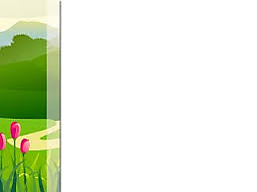
  Answer the questions:
1. Why is Askania-Nova often reffered to as a place where continents meet?
2. Who founded this nature reserve?
3.How many endangered species of animals and birds are there in the reserve?
4. Do the animals like when people talk to them ? Why ?
5. Are zebras afraid of people?
6. Who dares approaching the most dangerous beasts?
7. Is Victor Havrylenko familiar with the animals in their behavior?
8. How many bisons do they have in the reserve?
9. Do they all feel great in our Ukrainian steppes?

Slide 4

Finish the sentences:
Finish the sentences:
1. All the tourists are armed with … .
2. The bisons are from… .
3. Even the animals from… can be found here.
4. There is also a big …. garden and a zoological… .
5. Askania-Nova is one of the largest the oldest reserves in… .
6. This year is the … anniversary.

Slide 5
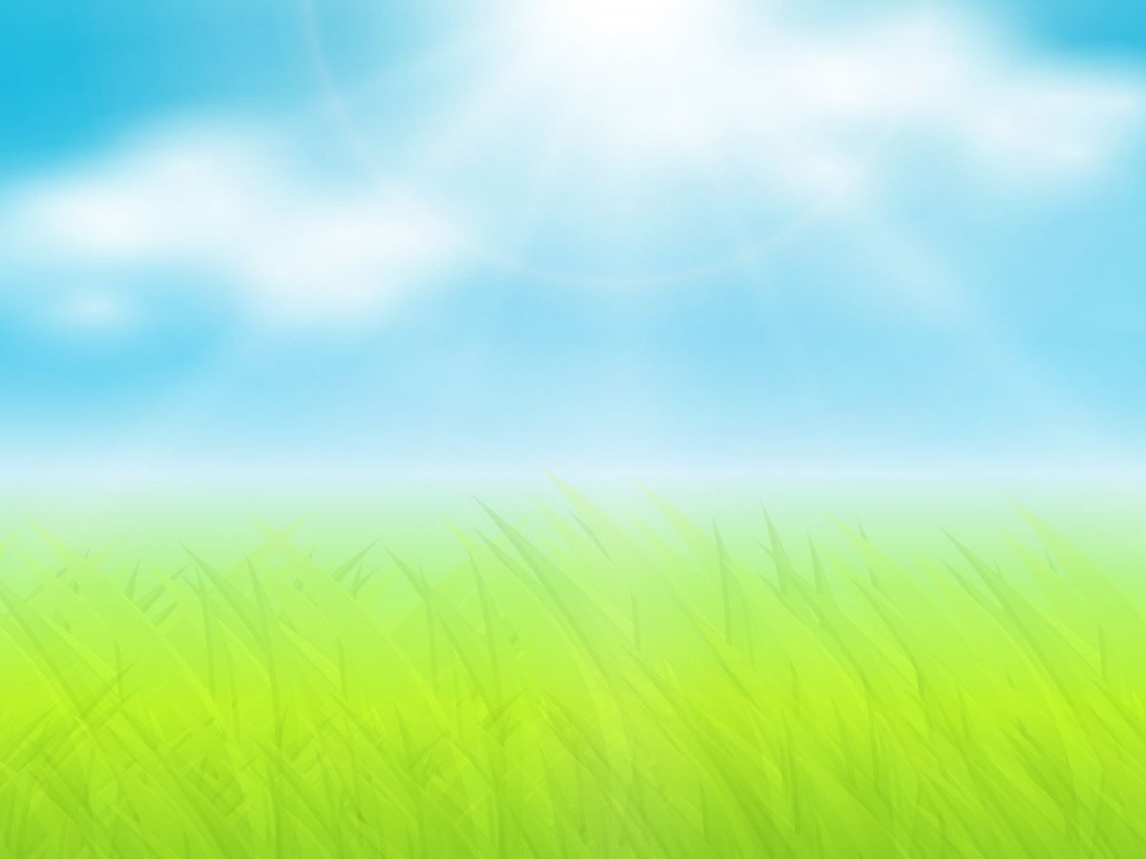
Writing
. Fill in the words:
Fill in the words: Reproduction, value, reserve, precious, virgin, constitute, admire, conservation, various, recreation, heritage.
1. There is a need for the …. of trees, or there will soon be no trees.
2. Scientists studied the…, diet and health of the wildebeests.
3. Environmental groups are asking the government to stop the destruction of … rainforest.
4. Experts hold …opinions as to causes of the pollution.
5. The land is to be left undisturbed as a nature … .
6. The land for the … area was expropriated from local farmers.
7. We must all take care to preserve our national ....
8. We never know the… of water till the well is dry.
9. Oceans ...the majority of the Earth’s whole surface, making its name a little odd.
10. Clean water is very…. commodity in many parts of the world.
11. We stopped at the top of the mountain to … the view of the peninsula.

Slide 6
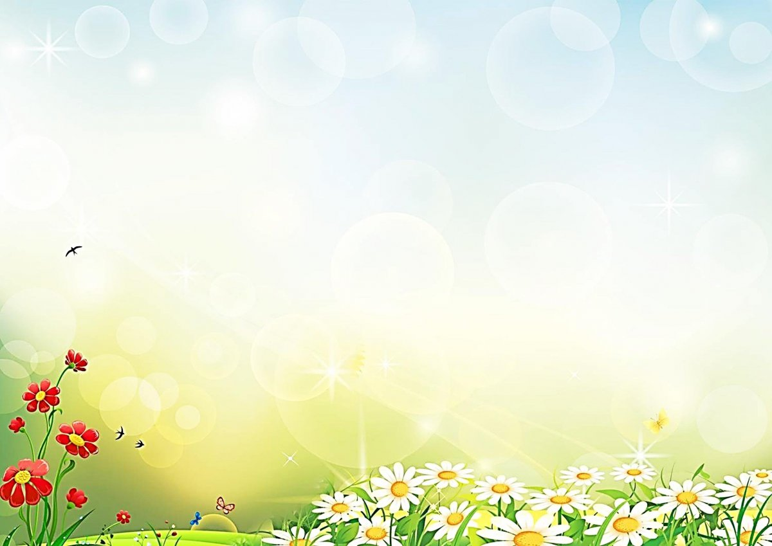
Look at our screen and try to read these scrambled words
a w k l n g i;
l y c n c g i n;
c p i g m n a;
s i h f n i g;
l i d w i f l e g c a w n i t h;
f r a n i g m d a n n r g n d e a i g;
m g i b i c n l;
i l o n t u r e g v n e;
r e w t a t s r p o s;
s e r o h d i r i g n;

Slide 7
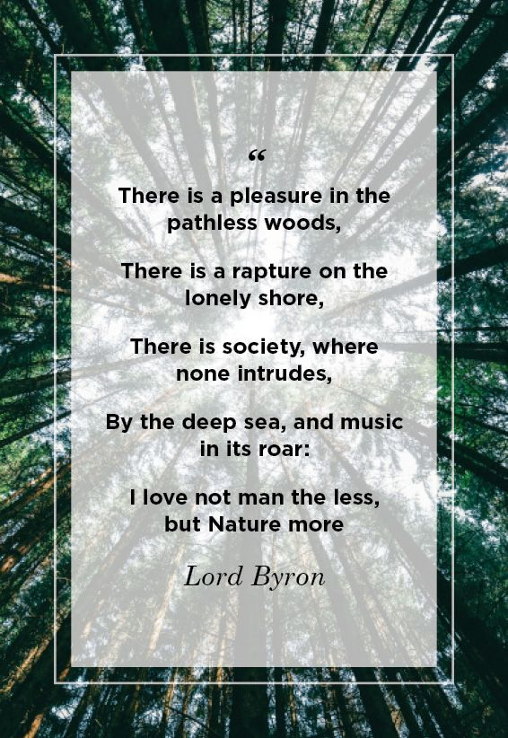
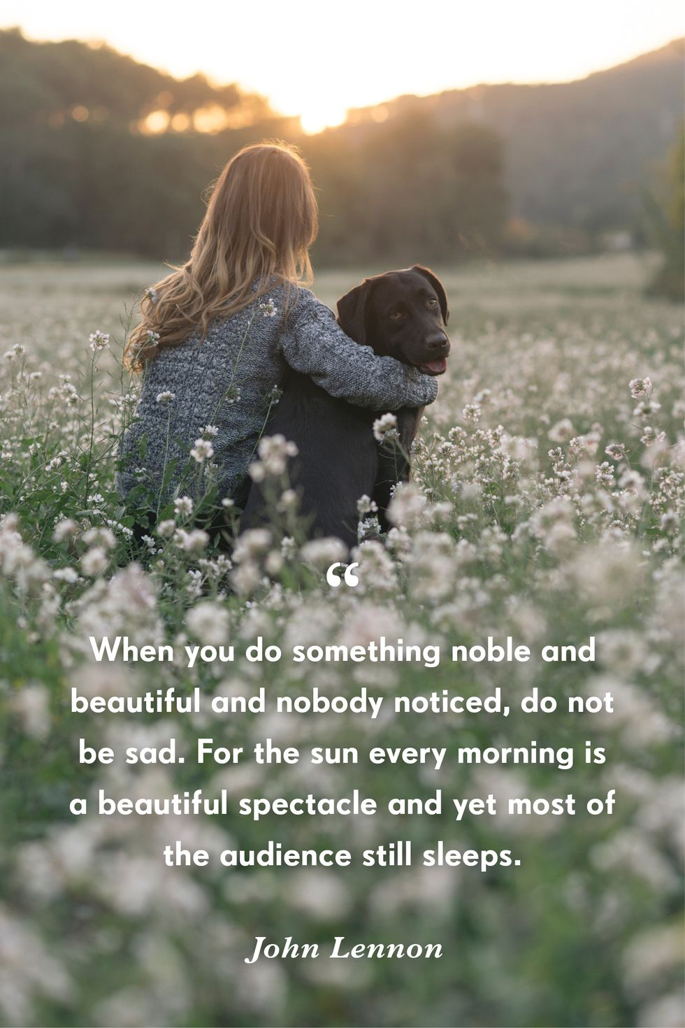

Slide 8
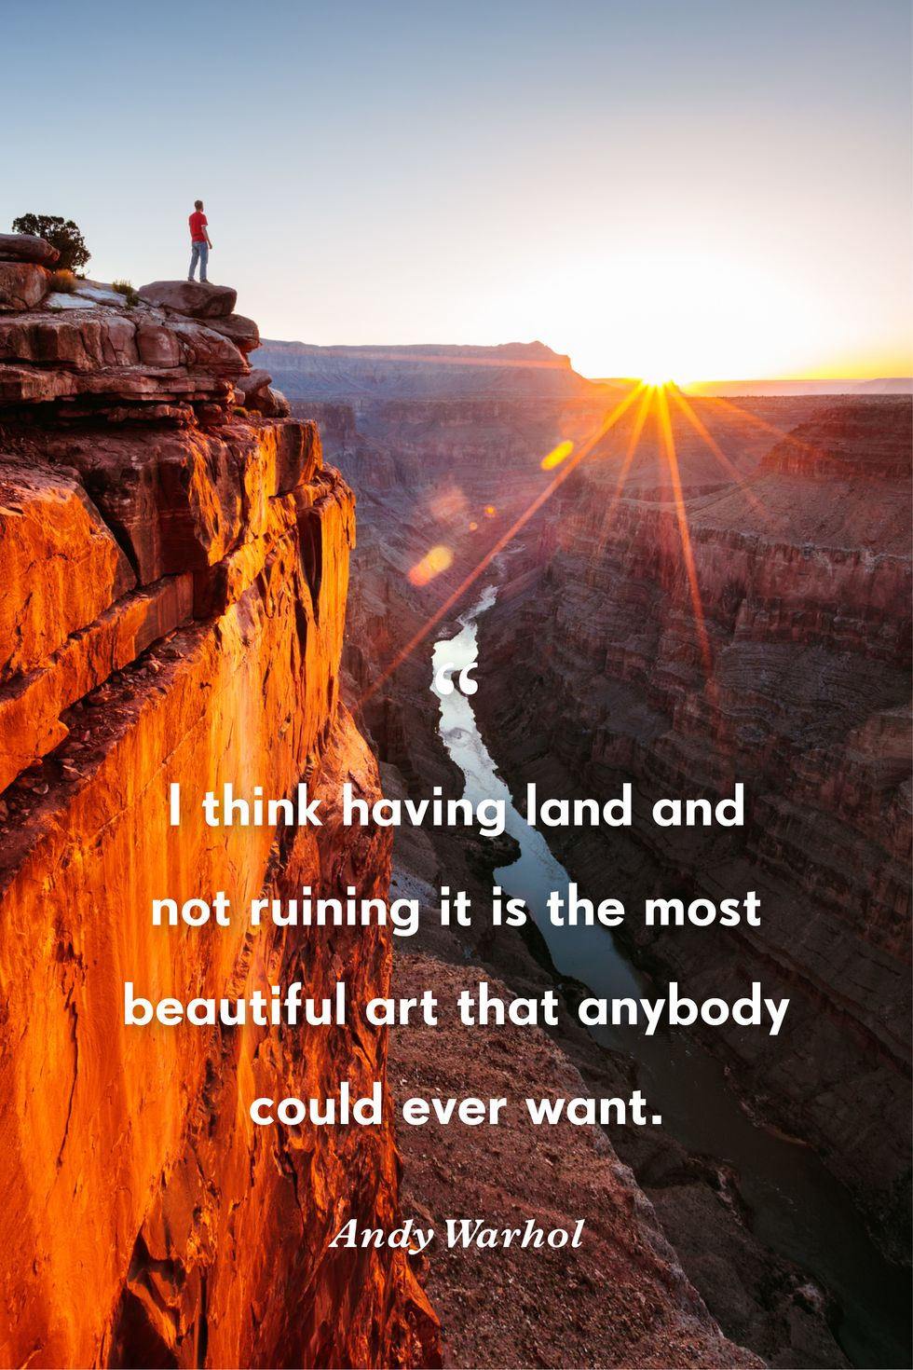
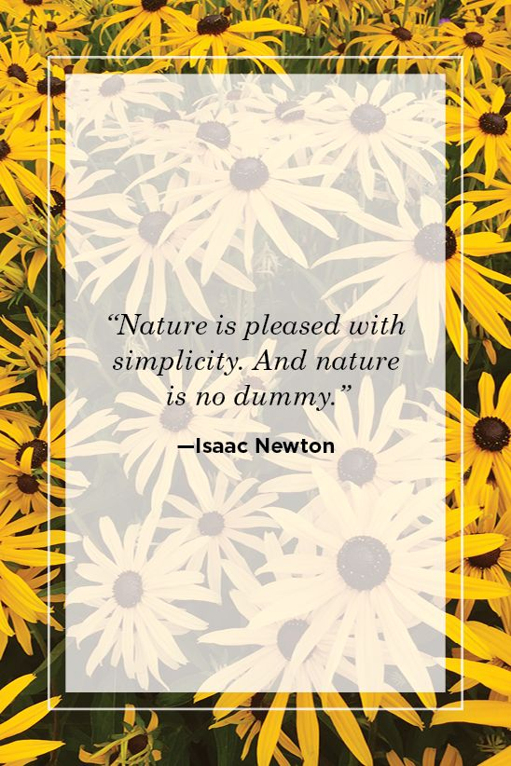

Slide 9


