Slide 1
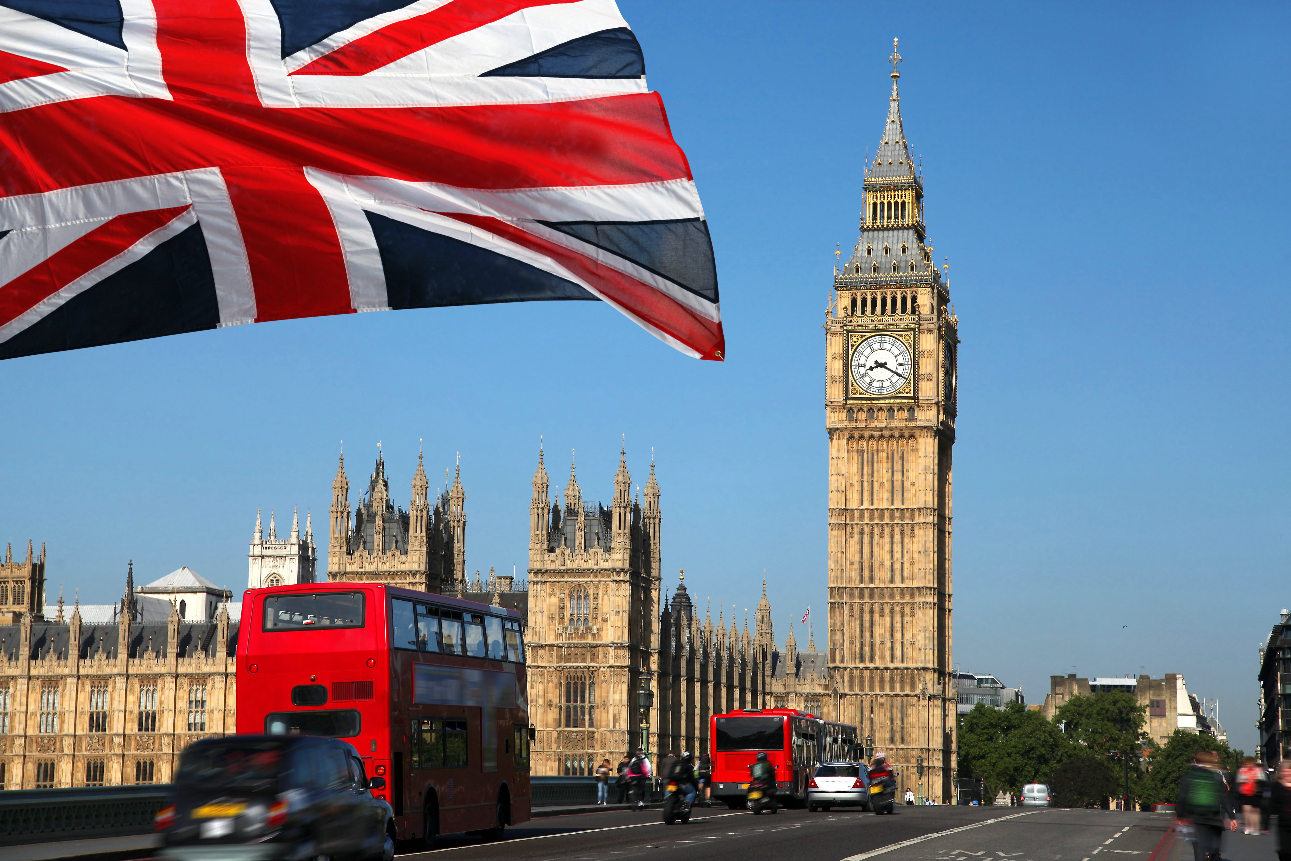
Great Britain

Slide 2
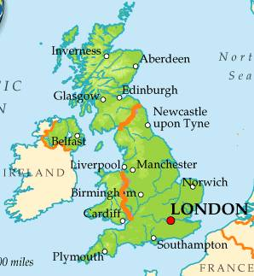
1. The United Kingdom of Great Britain and Northern Ireland is in..
A- Africa
B-America
C-Asia
D-Europe

Slide 3
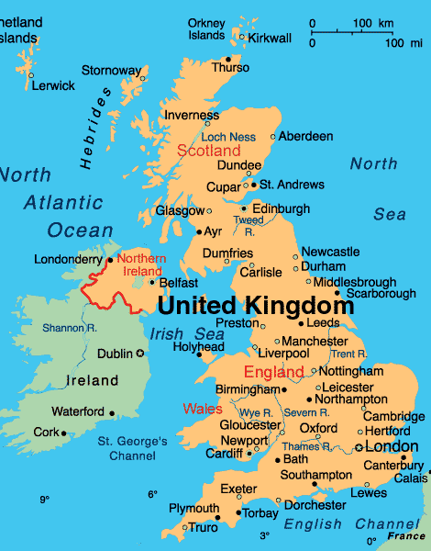
D- Europe

Slide 4
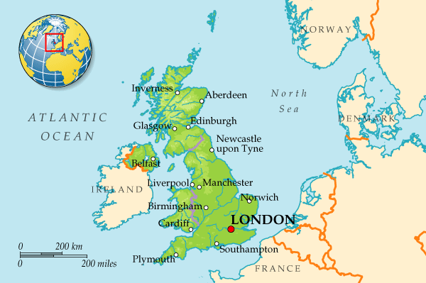
2.The UK consists of… countries.
A-three
B-two
C-five
D-four

Slide 5
D-four

Slide 6
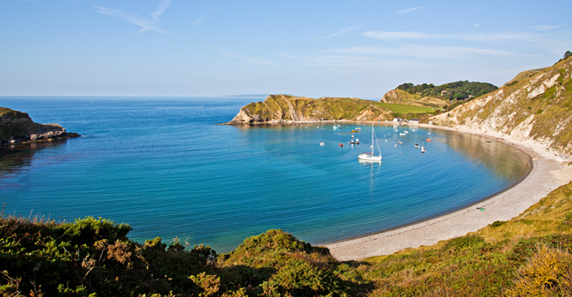
3.The country is not washed by the…
A-Atlantic Ocean
B-North Sea
C-Indian Ocean
D-Irish Sea

Slide 7
C-Indian Ocean

Slide 8
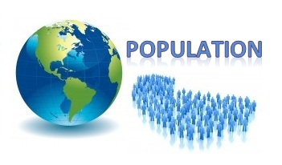
4.The population of the UK is… million people.
A-10
B-62
C-114
D-55

Slide 9
B-62

Slide 10
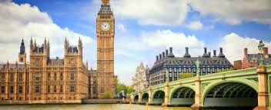
5.The largest country of the UK is…
A-England
B-Scotland
C-Wales
D-Northen Ireland

Slide 11
A-England

Slide 12
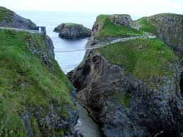
6.The smallest country of the UK is…
A-England
B-Scotland
C-Wales
D-Northen Ireland

Slide 13
D-Northen Ireland

Slide 14
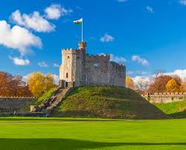
7.The capital of Wales is…
A-Belfast
B-Cardiff
C-London
D-Edinburgh

Slide 15
B-Cardiff

Slide 16
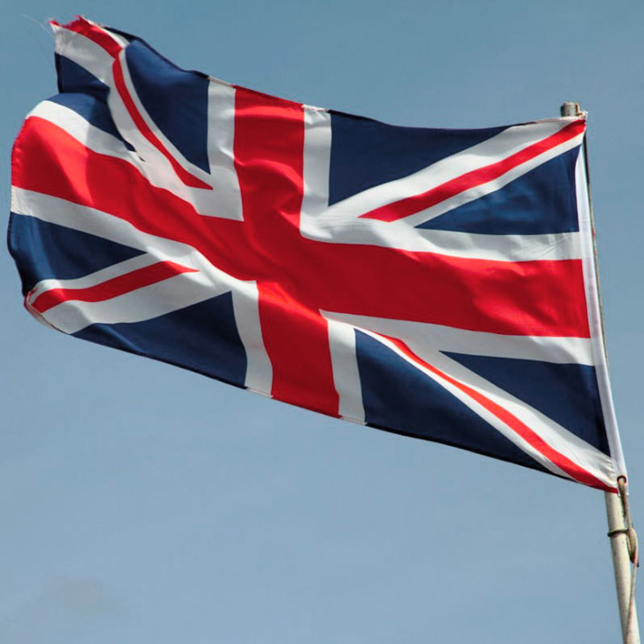
8.The official flag of the UK is called the ..
A-United Jack
B-Unified Jack
C-Unity Jack
D-Union Jack

Slide 17
D-Union Jack

Slide 18
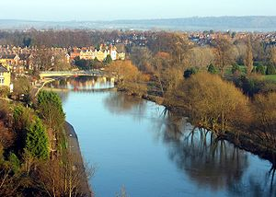
9.The longest river of the UK is the…
A-Thames
B-Avon
C-Severn
D-Tweed

Slide 19
C-Severn

Slide 20
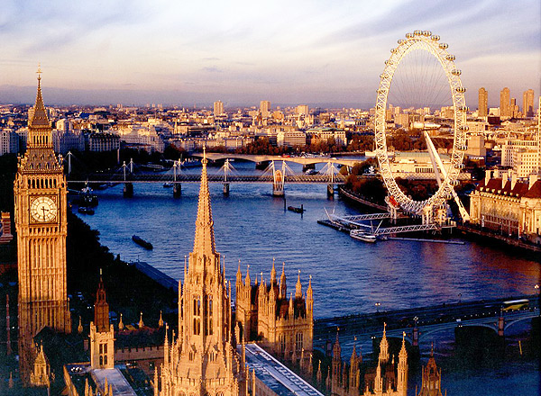
10.The largest city of the UK stands on the river …
A-Mersey
B-Severn
C-Thames
D-Avon

Slide 21
C-Thames

