Slide 1
Appearance. Clothes.
Features of character

Slide 2
‘ skini
slim
‘stɔki
streit
dres
ska:f
gla:siz
sli:v
‘swetǝ
sma:t
sɔks
su:t
‘sændǝlz

Slide 3
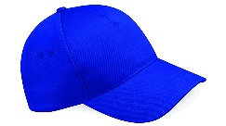
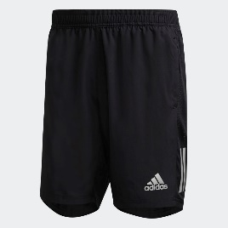
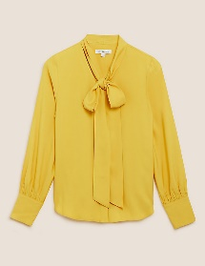
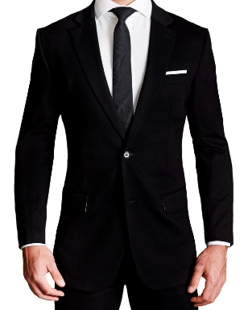
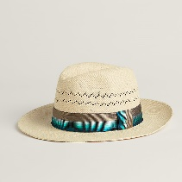
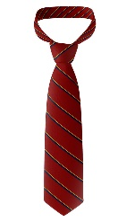
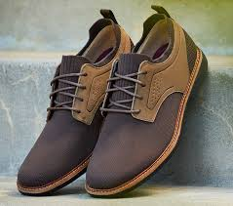
crossword
 | 1
 | 3
 |  |  | 1
 |  | 2
 | 3
 | 4
 |  | 5
 | 6
 |  |  | 7
 | 2
 | 4
 | 5
 | 7
 |  | 6

Slide 4
Positive | Negative
aggressive; hard-working; brave; bossy; nasty; reliable; careless; clever; friendly; careful; lazy; nice; helpful; open; tidy; big-headed; cheerful; mean; cowardly; serious; responsible; ambitious; shy; messy; rude; moody

Slide 5
Appearance | Clothes | Features of character
fat, muscular, dress, clever, energetic, fringe, ballgown, skirt, polite, lanky, stocky, jacket, shoes, nasty, curly, red, trousers, mean, responsible, hard-working, hoodie, suit, coat, slim, ugly, socks, boots, friendly, gentle, honest, pretty, scar, trainers, tidy, selfish, scarf, cap, plump, shy, serious, skinny, straight

Slide 6
cheekbones | receding | loose | shaven | clear | parting | piercing | auburn | high | distinguishing
HAVE YOU SEEN THEM?
The police are looking for a couple who stole money from a pensioner in the High Street yesterday. The man is stocky with fine, blond hair and a (1)[ ] hairline. He' s clean- (2)[ ] and has a small, red birthmark on his cheek. A notable feature is his (3)[ ]blue eyes. His female partner is quite nondescript with no(4) [ ]features. But she is tall and lanky with thick (5)[ ] hair that she wears (6)[ ] or up in a ponytail. She has a centre (7)[ ] and a long fringe that covers a (8)[ ] forehead. She has (9)[ ] skin and high (10)[ ] . Any information should be sent to...

Slide 7

What kind of people does Anna dislike the most?

Slide 8
Say if the statements are true or false to the dialogue:
1. Anna doesn’t mind people who lie.
2. Anna is quite untidy.
3. Anna would like to be more imaginative .

Slide 9
Answers
1. F
2. F
3. T

Slide 10
Guess who they are

