Slide 1
РОЗВИТОК ПСИХОЛОГІЧНОЇ СТІЙКОСТІ ТА РЕЗИЛЬЄНТНОСТІ В УМОВАХ ВОЄННИХ ДІЙ
Development of Psychological Stability and Resilience in the Context of Armed Conflict

Slide 2
План / Outline
1. Психологічне благополуччя учасників освітнього процесу: суть, умови, наслідки.
2. Психологічна резильєнтність та її складові.
3. Формування та розвиток резильєнтності у дітей і дорослих.
4. Особливості підтримки дітей, котрі переживають травматичний досвід.
Psychological Well-being of Educational Process Participants: Essence, Conditions, and Consequences.
Psychological Resilience and Its Components.
Formation and Development of Resilience in Children and Adults.
Features of Supporting Children who Have Experienced Trauma.

Slide 3
Ключові слова / Key terms
Резильєнтність (психологічна стійкість)
Психологічне / фізичне благополуччя
Психологічна рівновага
Стратегії подолання
Зміна світогляду
Адаптивність
Навчання стійкості
Негативні життєві обставини
Навички подолання
Стресостійкість
Resilience (Psychological Stability)
Psychological /Physical Well-being
Psychological Balance
Coping Strategies
Mindset Shifts
Adaptability
Resilience Training
Adversity
Coping Skills
Stress Resilience

Slide 4
Objectives
Understanding the Psychological Well-being in Armed Conflict
Exploring its Essence, Conditions, and Consequences
Highlighting Comprehensive Approaches
Defining Resilience
Understanding Key Aspects of Resilience
Highlighting the Interactivity of Resilience
Exploring the Counterbalance of Resilience
Understanding the Role of Adults in Building Resilience
Providing Practical Strategies for Building Resilience
Applying Resilience to Challenging Times

Slide 5
Psychological Well-being of Educational Process Participants:
Essence
Conditions
Consequences

Slide 6
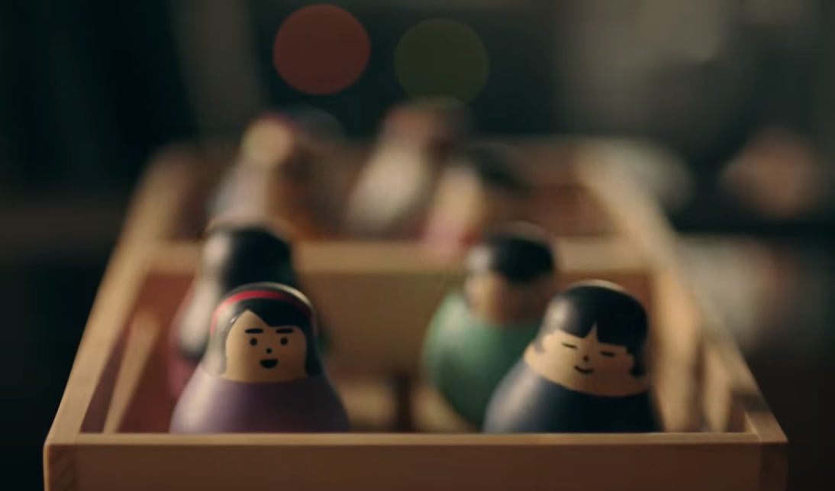
“A Lesson On Resilience”
https://www.youtube.com/watch?v=sKpBJjsZ7EE
Do you agree that learning through play is more effective than traditional classroom methods?

Slide 7
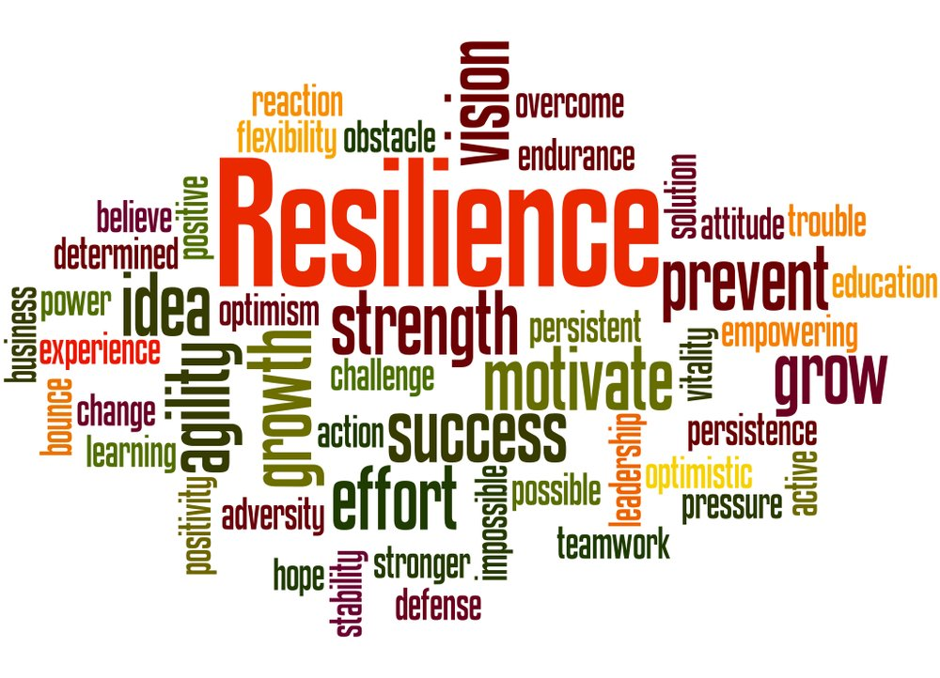
So, what IS RESILIENCE ?

Slide 8
Key aspects of resilience include:
Emotional Resilience
Problem-Solving
Adaptability
Social Support
Positive Outlook
Coping Skills
Self-Efficacy
Емоційна стійкість
Вирішення проблем
Адаптивність
Соціальна підтримка
Позитивний світогляд
Навички подолання
Самоефективність

Slide 9
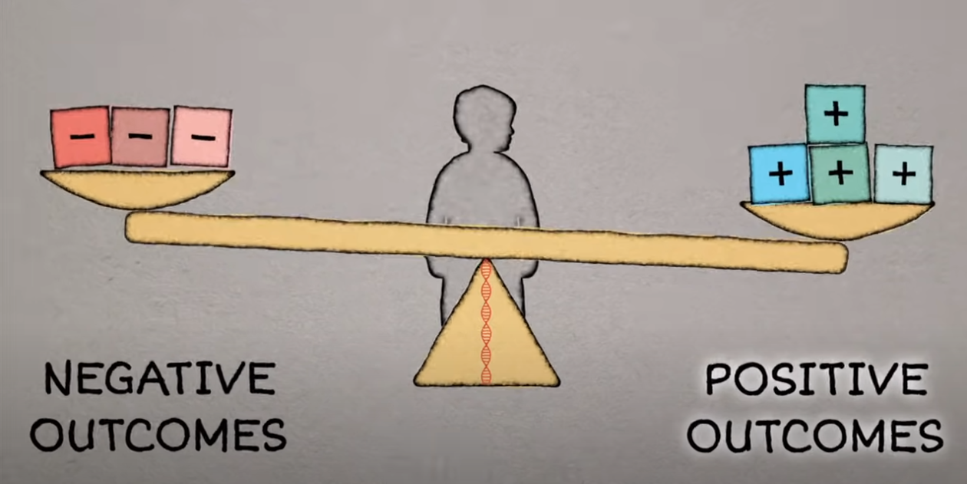

Slide 10
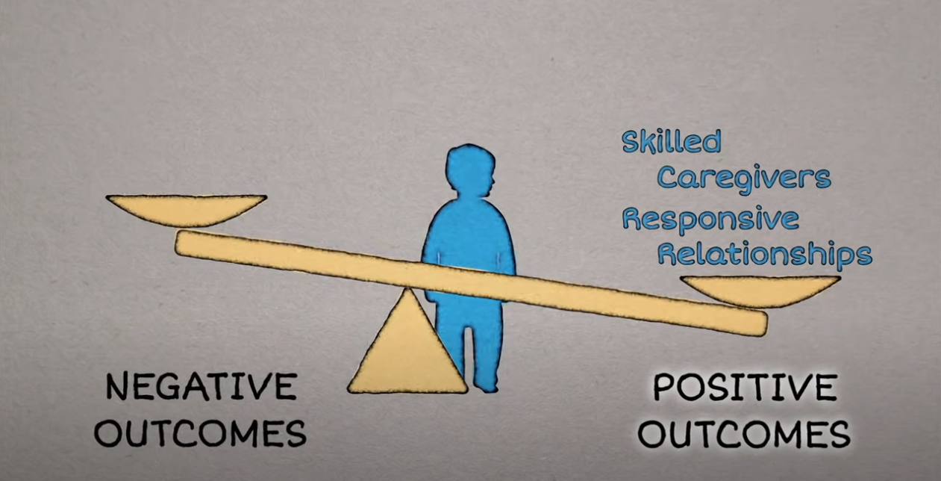

Slide 11
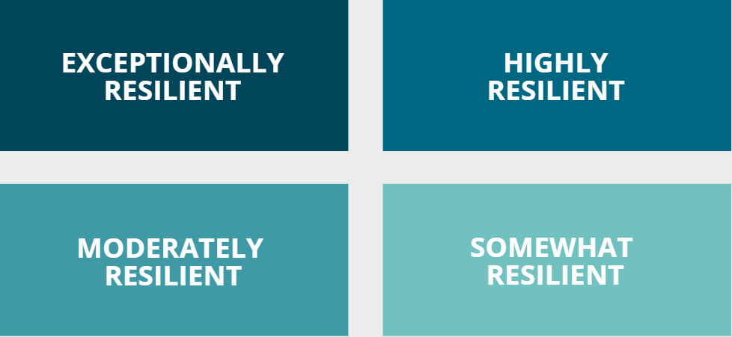
How would you rate the level of your resilience?
1
2
3
4

Slide 12
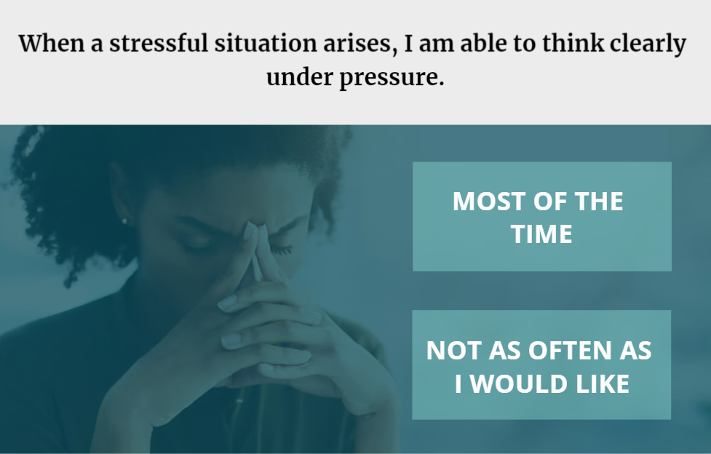
9 skills/attributes that make you resilient
#1

Slide 13
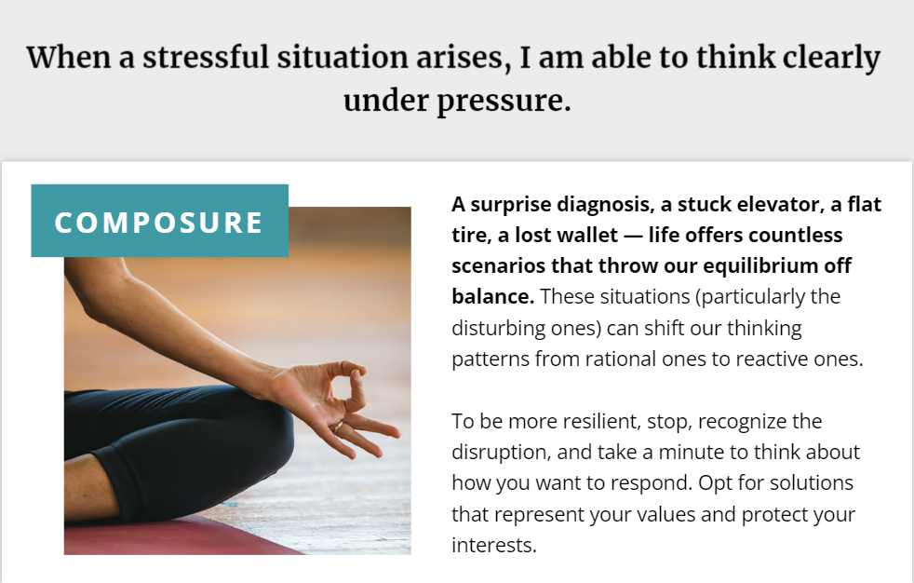
9 skills/attributes that make you resilient
#1

Slide 14
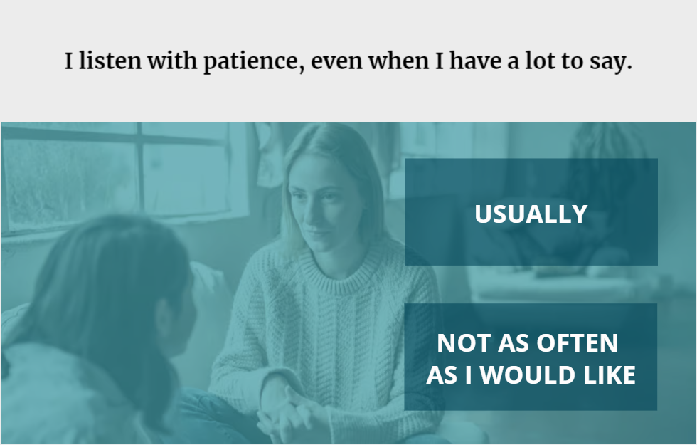
9 skills/attributes that make you resilient
#2

Slide 15
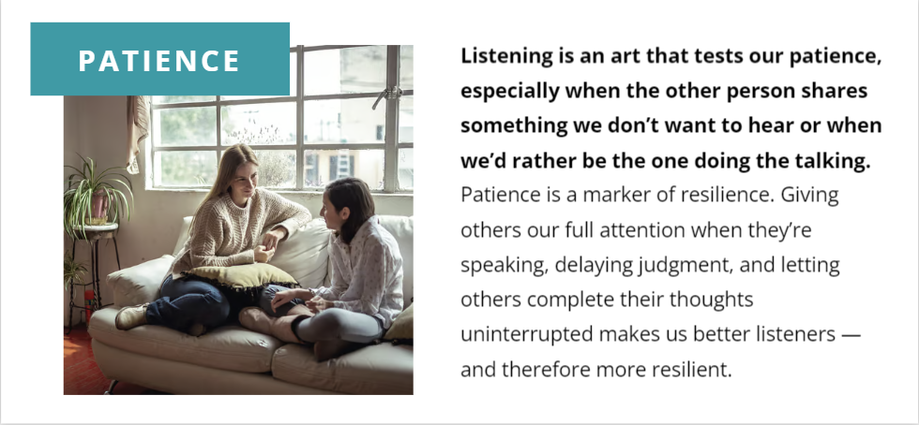
9 skills/attributes that make you resilient
#2

Slide 16
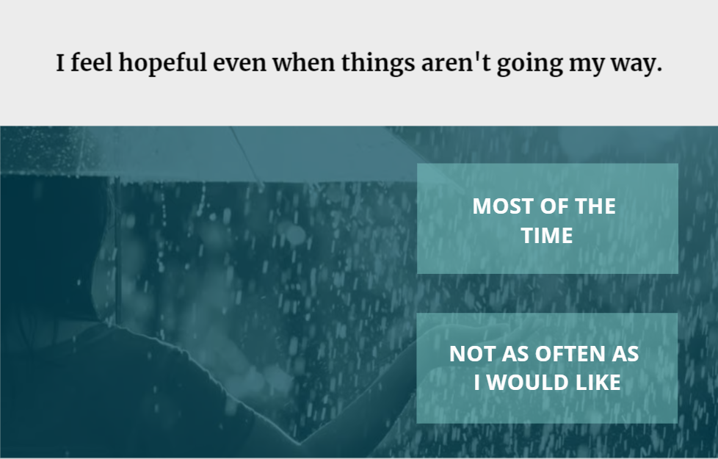
9 skills/attributes that make you resilient
#3

Slide 17

9 skills/attributes that make you resilient
#3

Slide 18
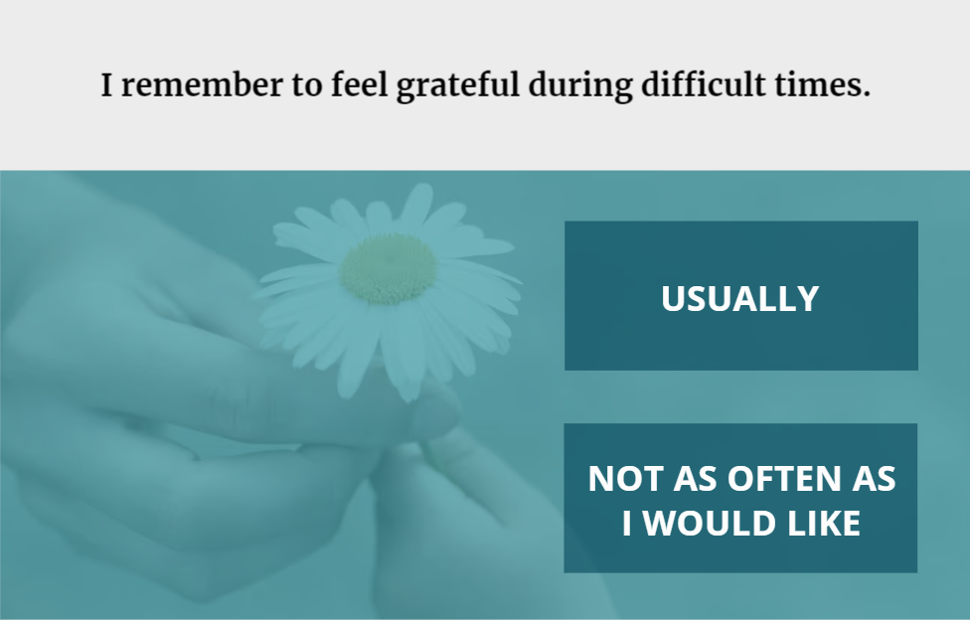
9 skills/attributes that make you resilient
#4

Slide 19
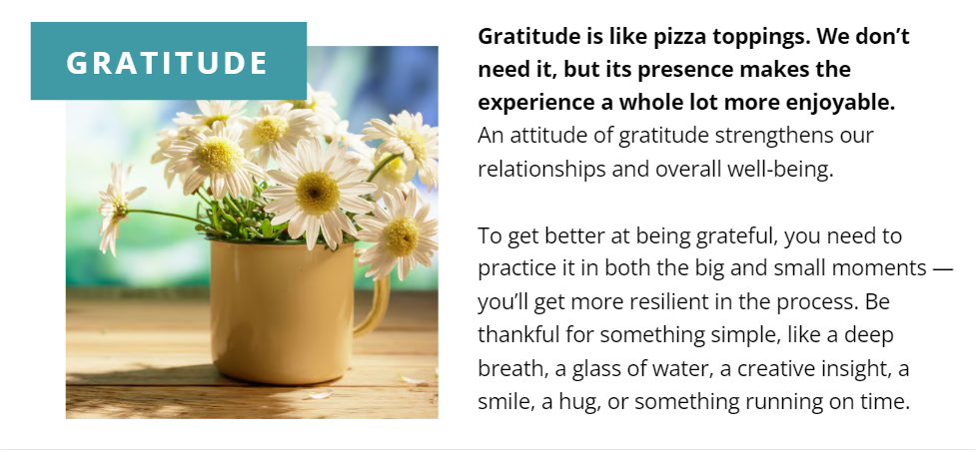
9 skills/attributes that make you resilient
#4

Slide 20
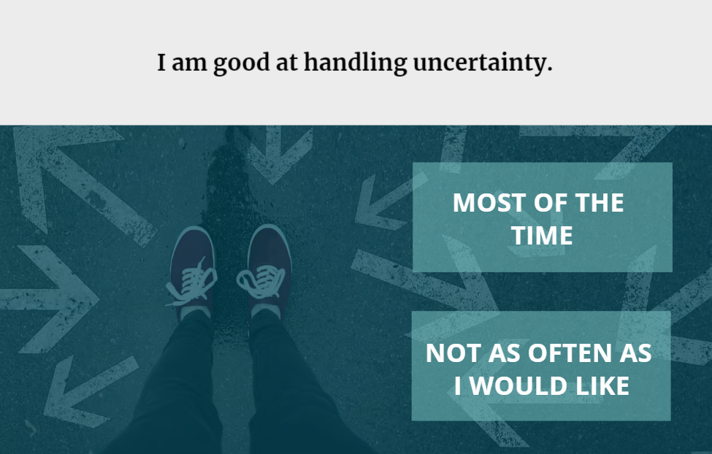
9 skills/attributes that make you resilient
#5

Slide 21
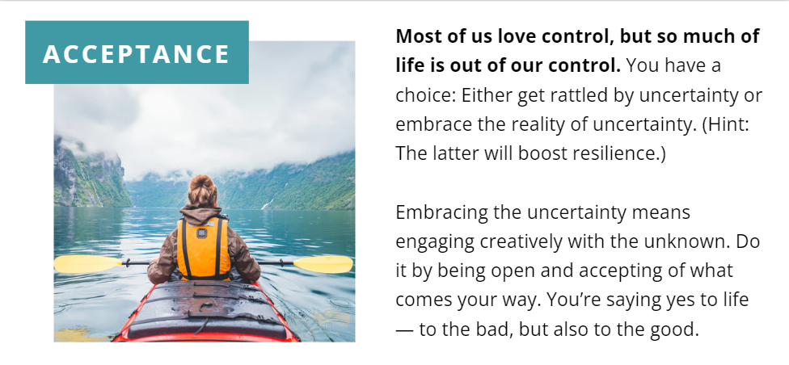
9 skills/attributes that make you resilient
#5

Slide 22
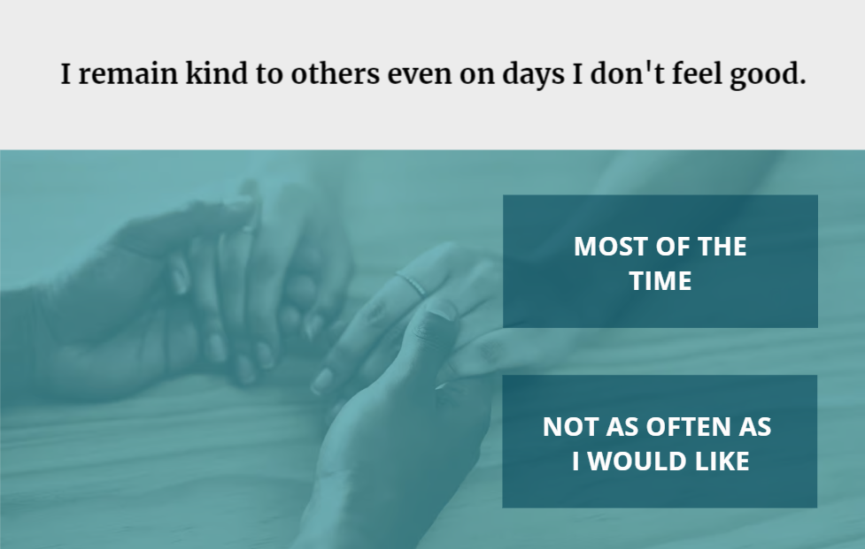
9 skills/attributes that make you resilient
#6

Slide 23
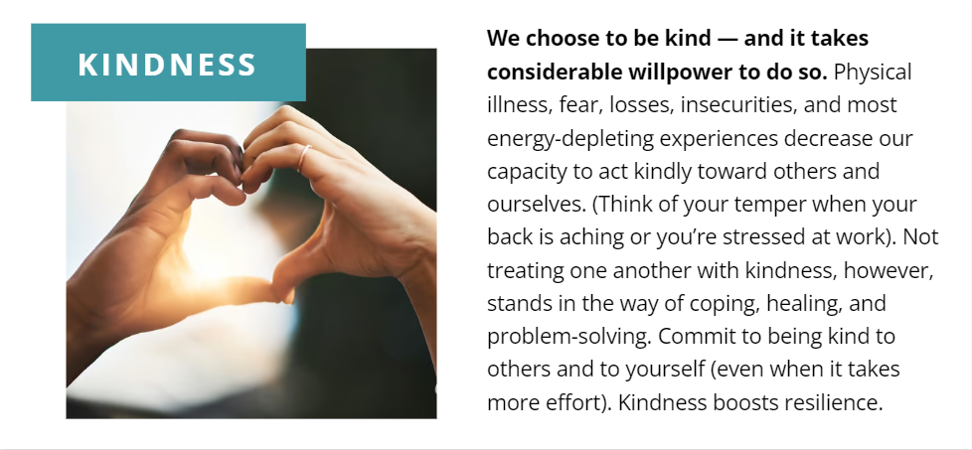
9 skills/attributes that make you resilient
#6

Slide 24
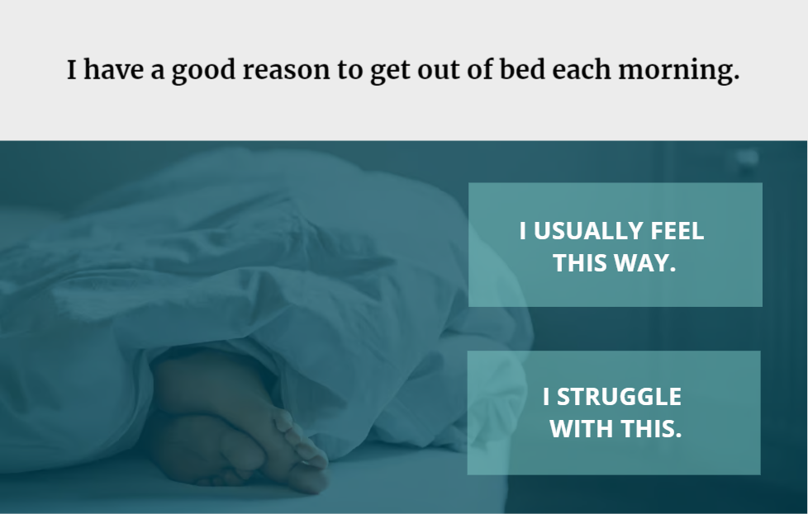
9 skills/attributes that make you resilient
#7

Slide 25

9 skills/attributes that make you resilient
#7

Slide 26
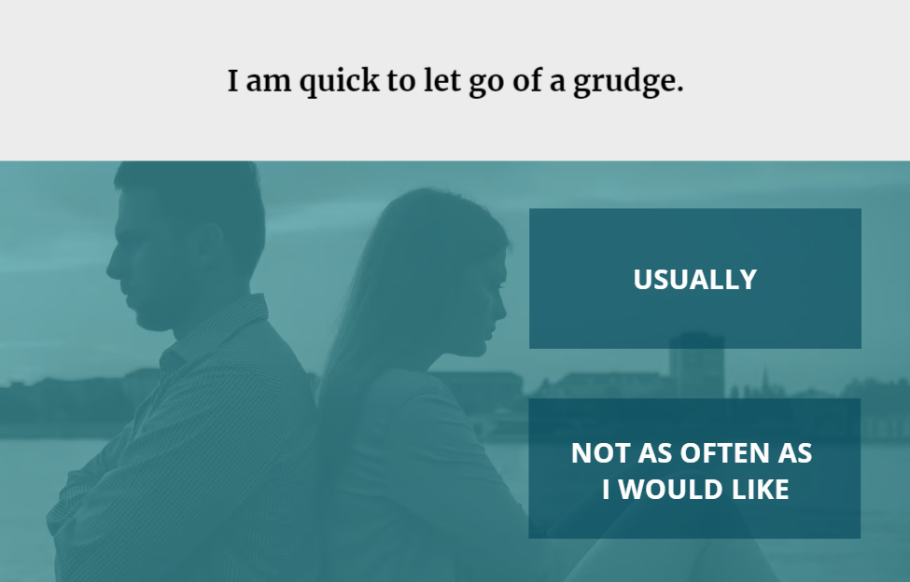
9 skills/attributes that make you resilient
#8

Slide 27

9 skills/attributes that make you resilient
#8

Slide 28
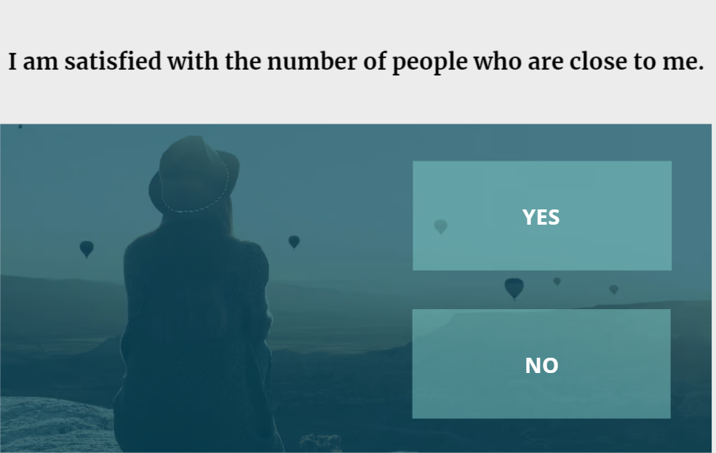
9 skills/attributes that make you resilient
#9

Slide 29
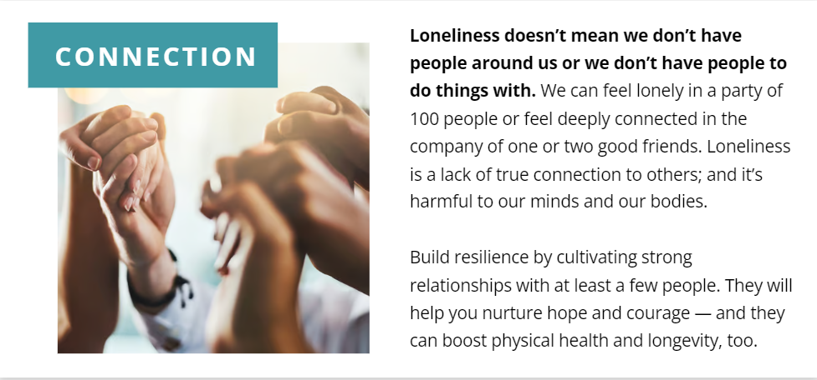
9 skills/attributes that make you resilient
#9

Slide 30
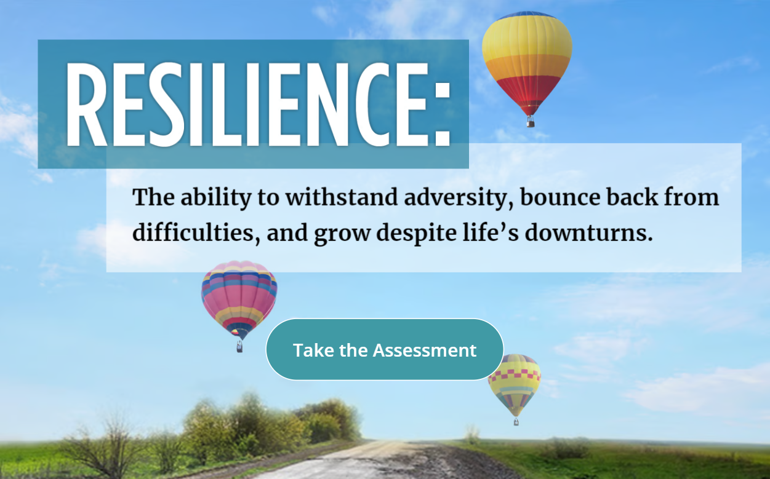
https://www.everydayhealth.com/wellness/resilience/get-your-resilience-score/

Slide 31
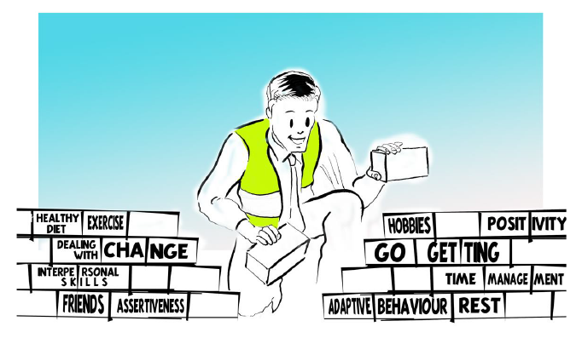
Is resilience an innate ability?
What are the ways to build your resilience?

Slide 32
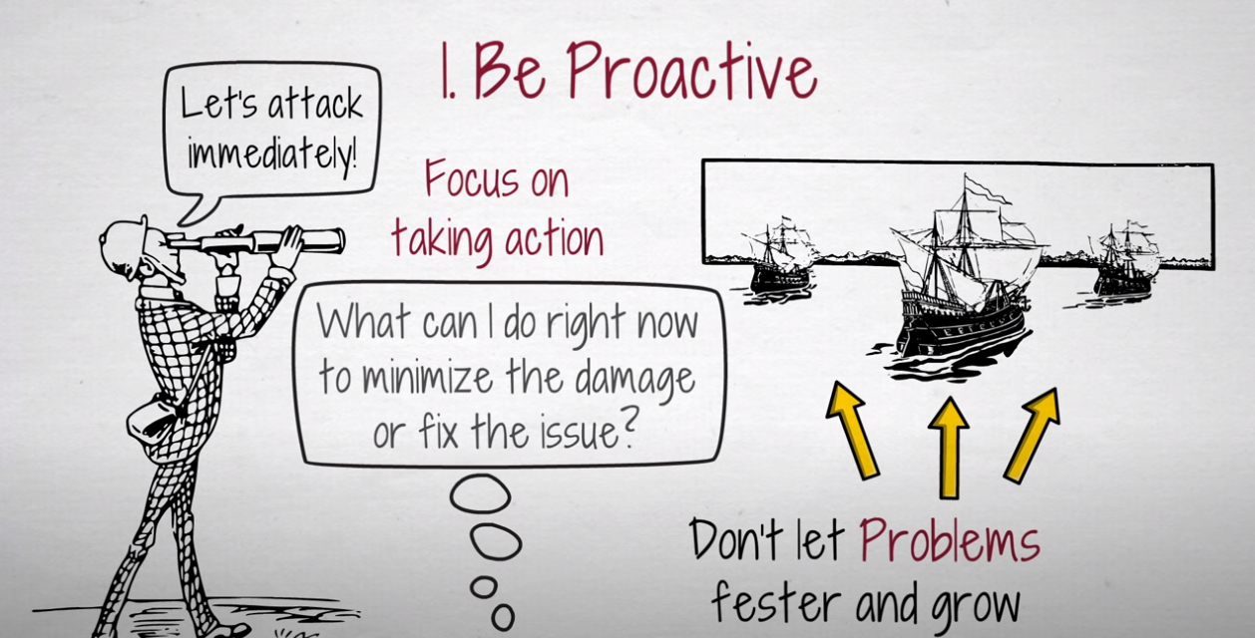

Slide 33
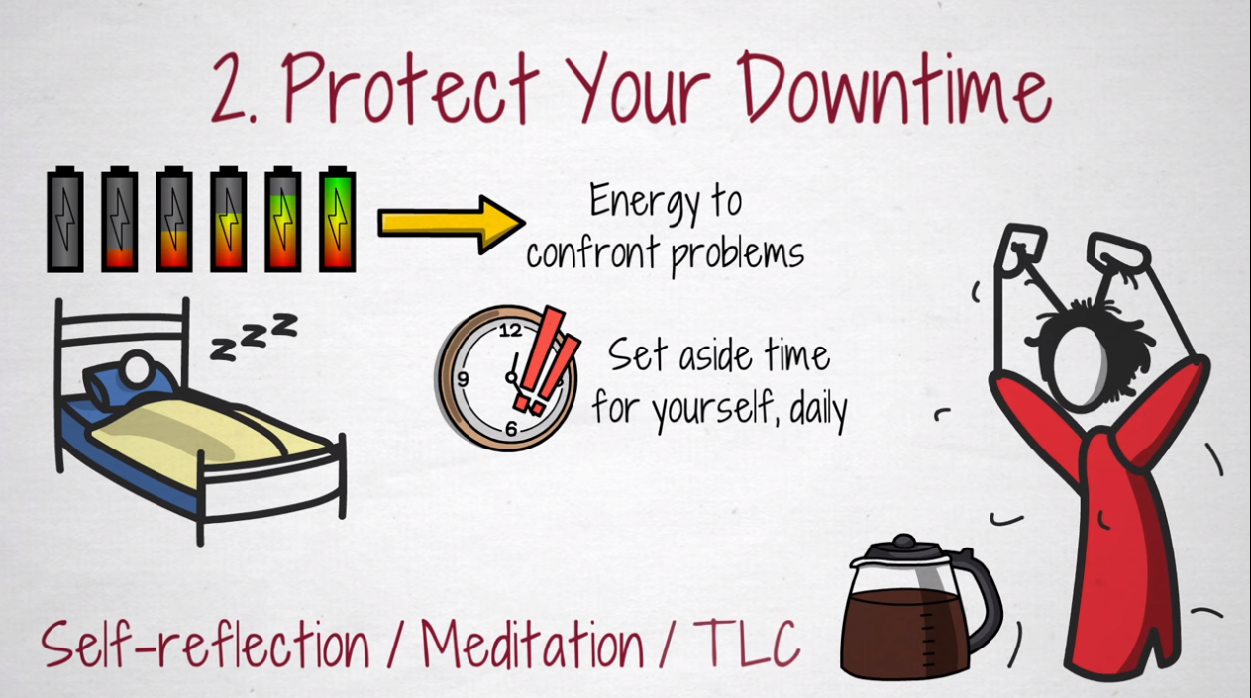

Slide 34
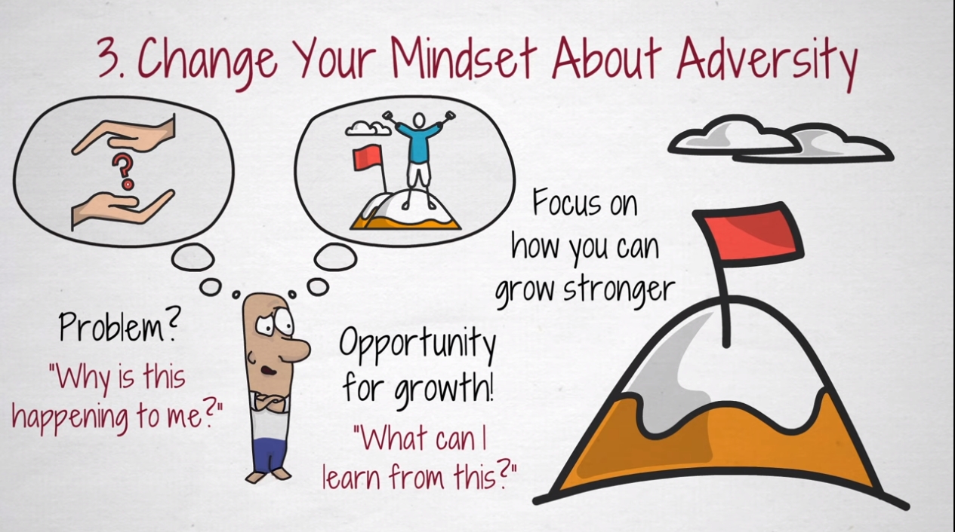

Slide 35
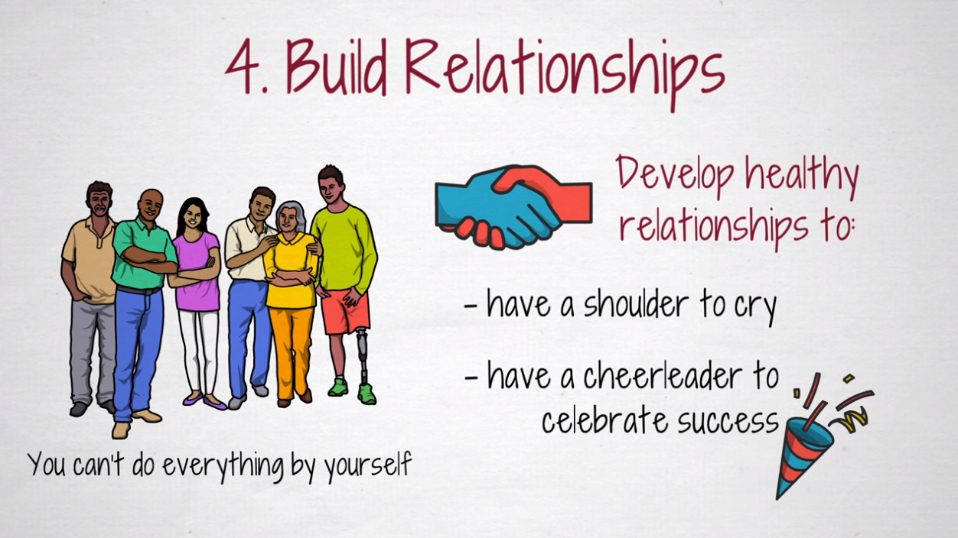

Slide 36
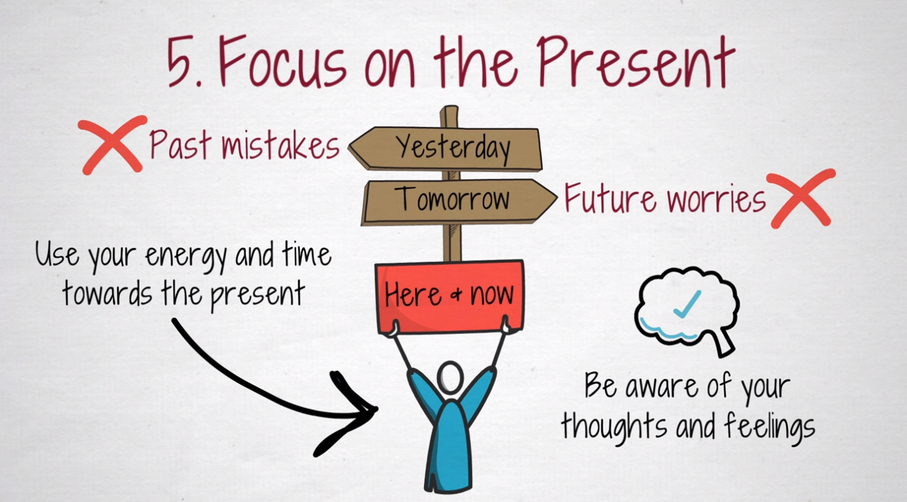

Slide 37
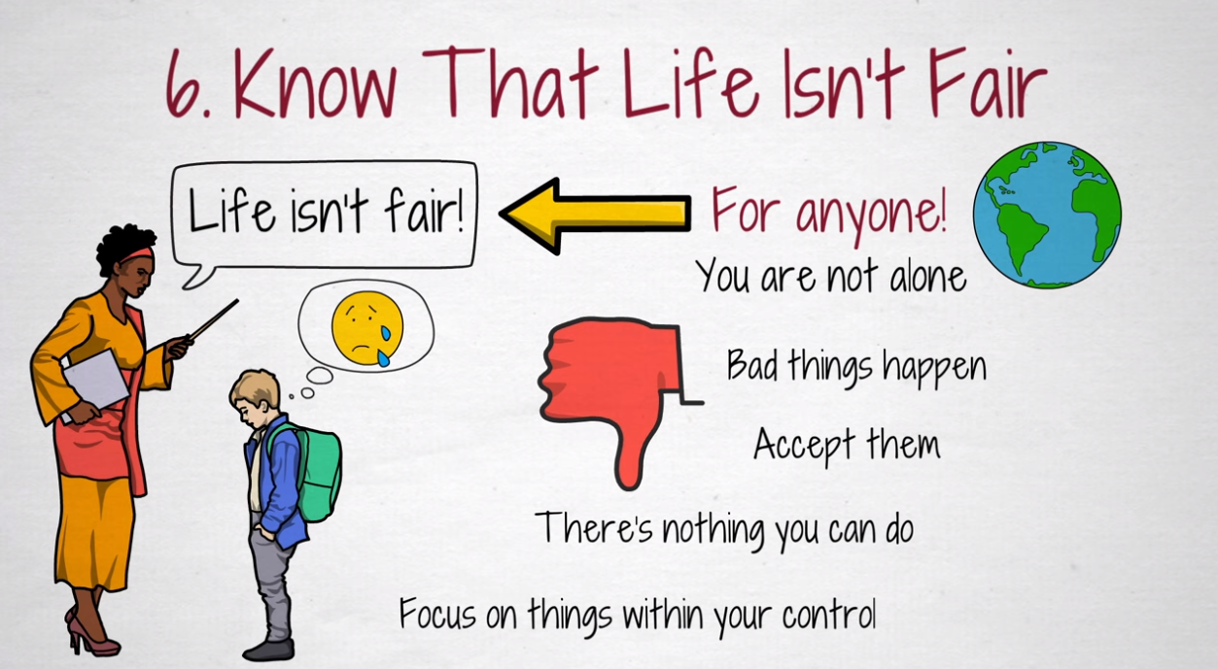

Slide 38
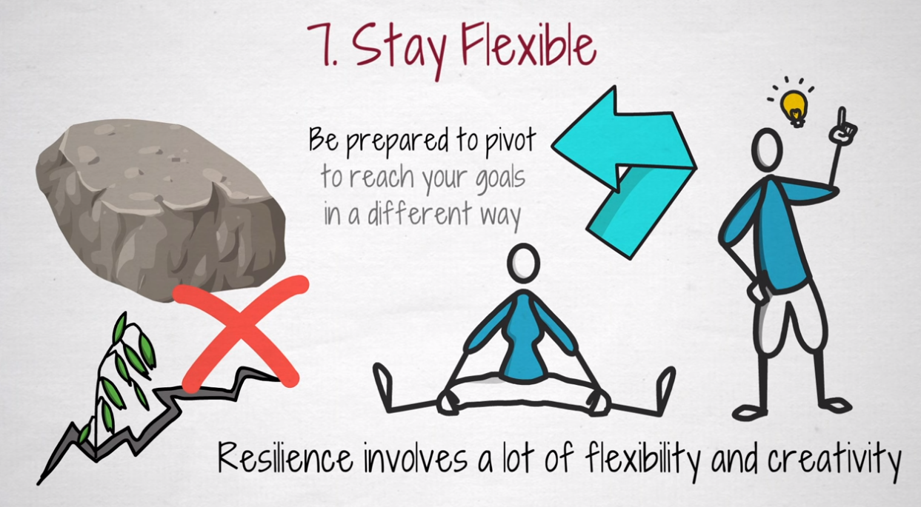

Slide 39
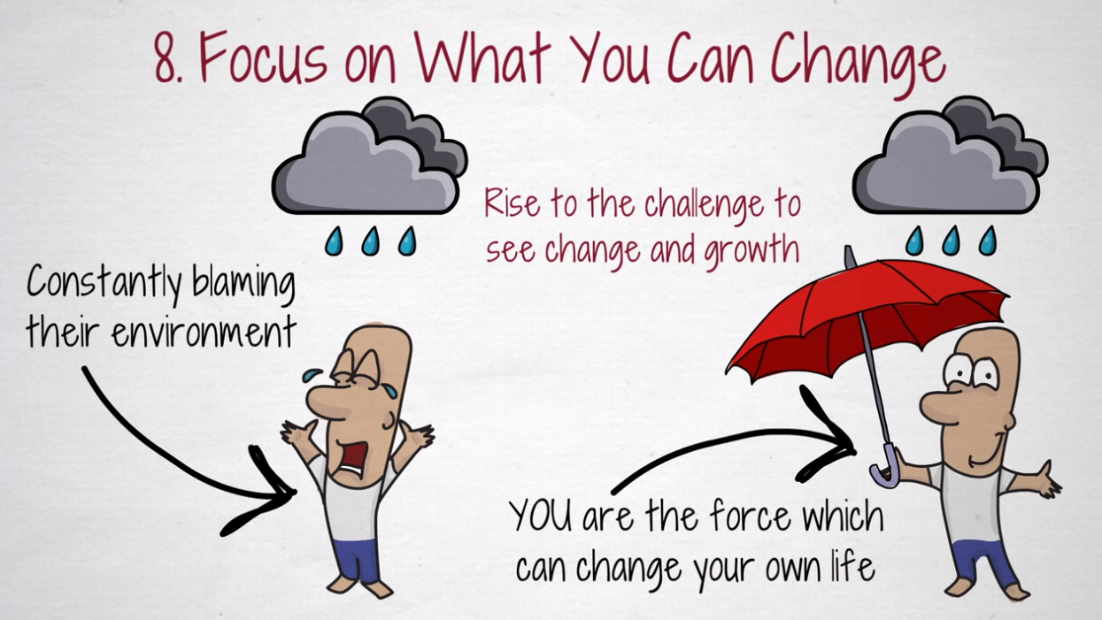

Slide 40
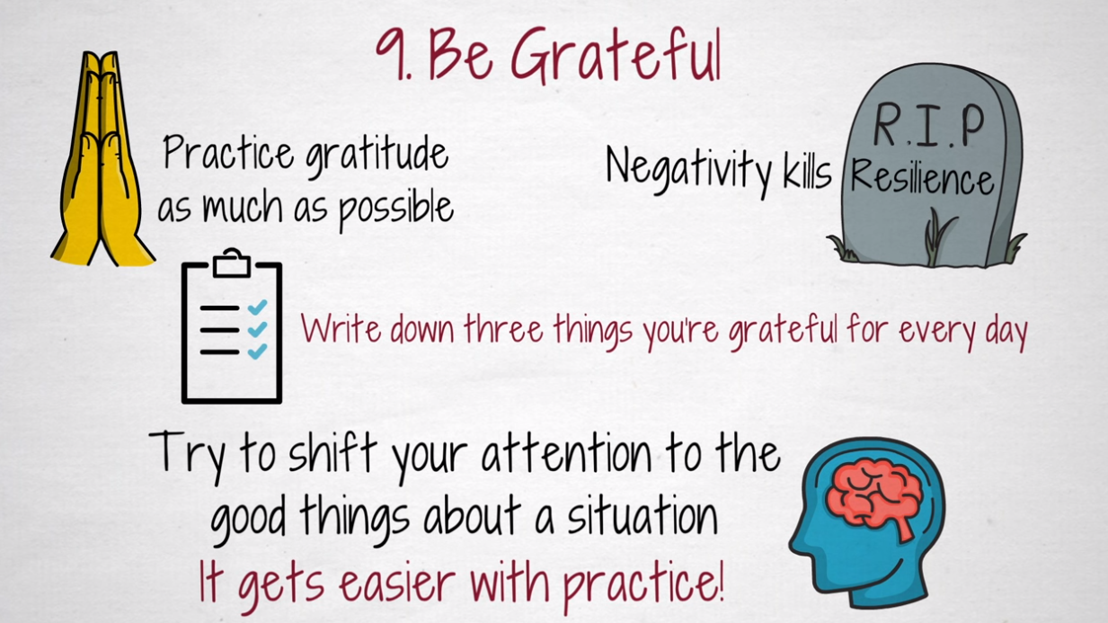

Slide 41
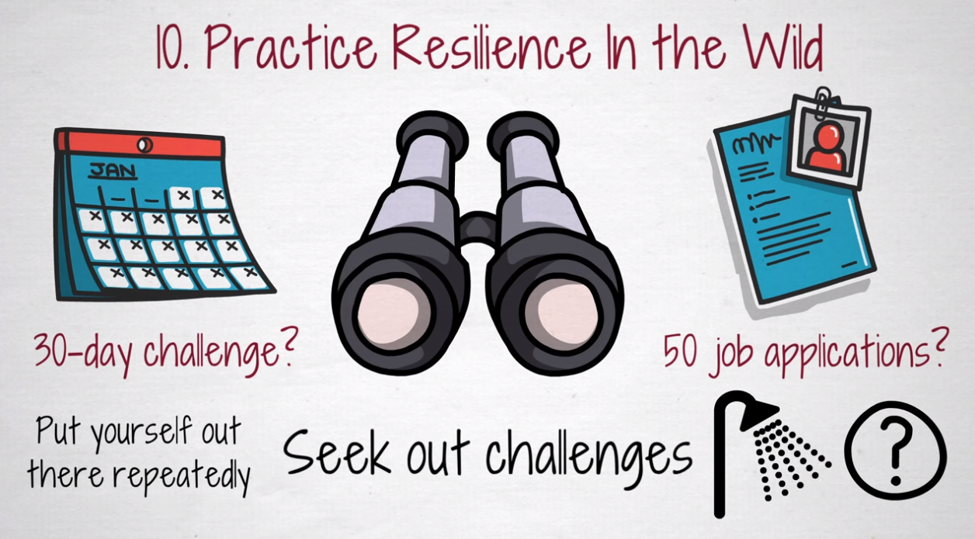

Slide 42
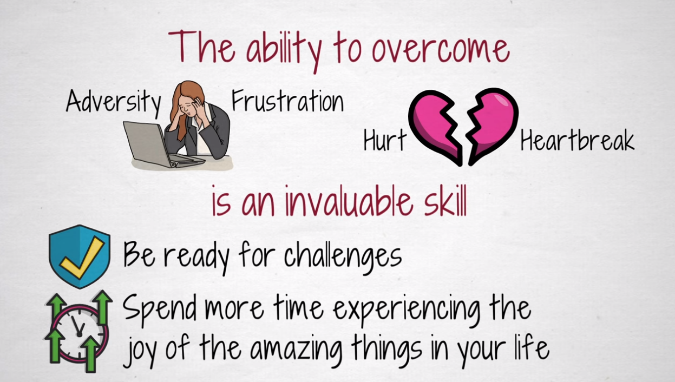

Slide 43

Resilience in a time of war: Tips for parents and teachers of teens
Write your own tips or ideas in the chat box

Slide 44
Resilience in a time of war: Tips for parents and teachers of teens
1. Talk with your teen whenever you can, even if it seems they don’t want to talk to you.
2. Make your home a safe place emotionally for your teen.
3. Encourage your teen to take “news breaks.”
4. Be understanding but firm.
5. Watch your teen for signs of fear and anxiety they may not be able to put into words.
6. Put things into a positive perspective for your teen.

Slide 45
Ways to Build Resilience at School
Relationships
Cognitive development
Self-regulation

Slide 46
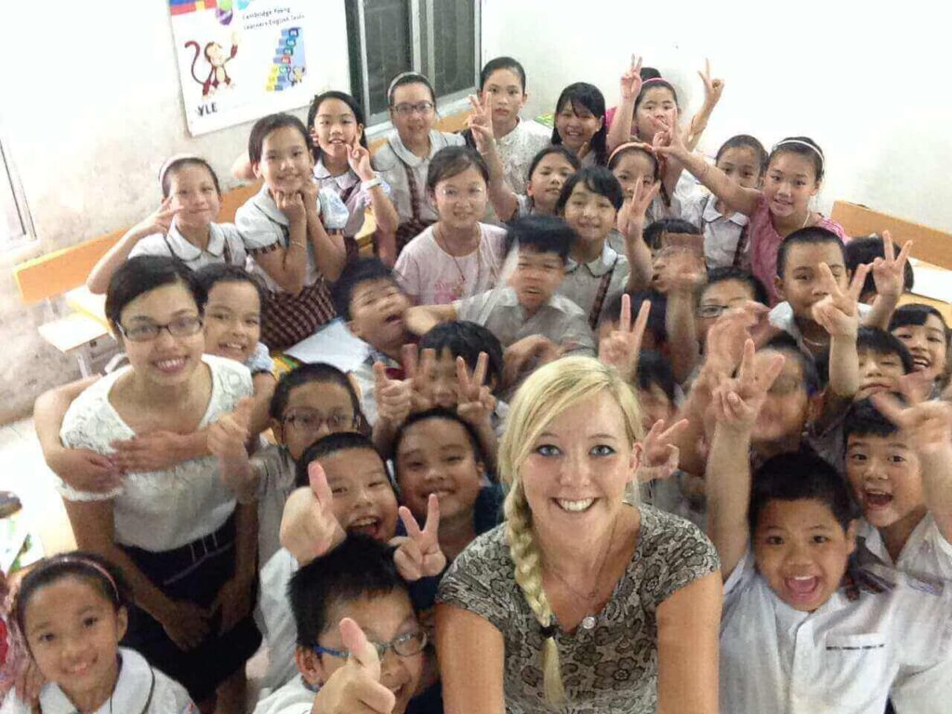
Relationships
Build strong, stable, and supportive relationship with students:
Show students you care
Consider your students’ perspectives
Develop mutual trust
Practise constructive discipline

Slide 47
Relationships to Foster Resilience:
Class identity
Classroom positive affirmations
Ground rules
Team-building activities
“Circle time” or brief at the beginning of a lesson
Collaborative activities

Slide 48
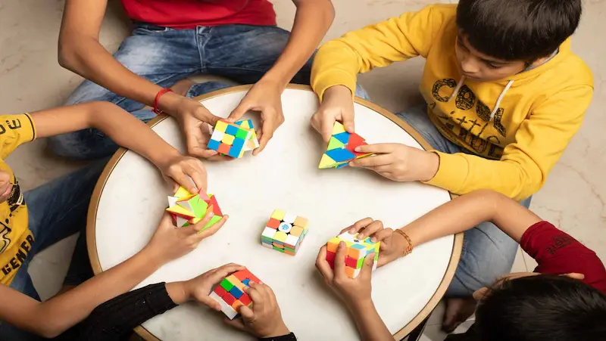
Cognitive Development and Problem-Solving Skills
Help children think through problems
and work to identify solutions

Slide 49
Ideas to booster resilience through cognitive development and problem-solving
Neurobics
Brain teasers or brain breaks
Challenging games like scavenger hunts, board games
Learning from mistakes approach
Problem-solving sequence such as ‘3 before me’, SWOT, SODAS

Slide 50

Self-regulation
Allows the child to manage thoughts, feelings, and behaviors in a way that enables goal-directed action

Slide 51
How to promote self-regulation
Teach and provide opportunities for children to identify their feelings
Help them learn to manage their emotions
Teach strategies to calm themselves
Model positive self-regulation in stressful situations

Slide 52
Self-regulation techniques for the ESL classroom
Breathing exercises
Grounding techniques
Mindfulness activities
Art therapy elements
Reappraisal/reframing
Positive self-talk
Quiet corners
Emotional literacy

Slide 53
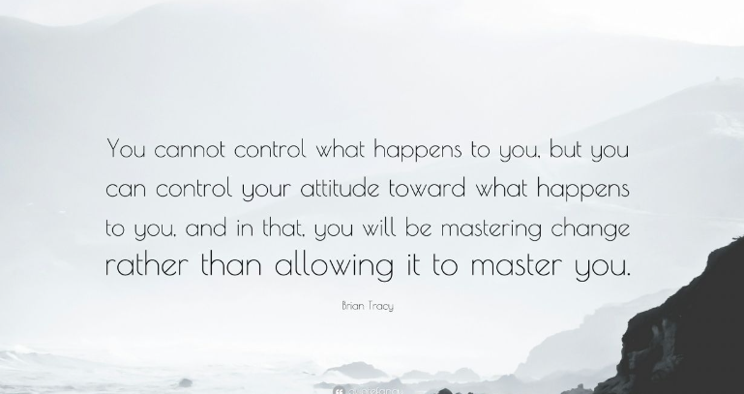
THANK YOU

