Slide 1
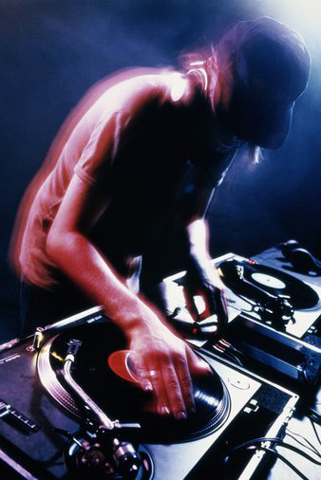
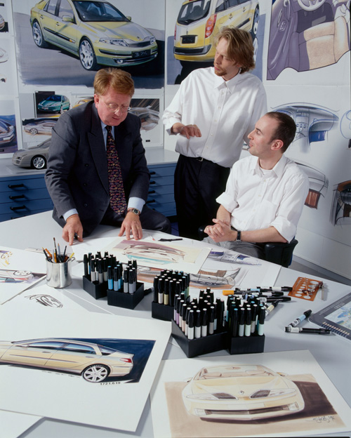
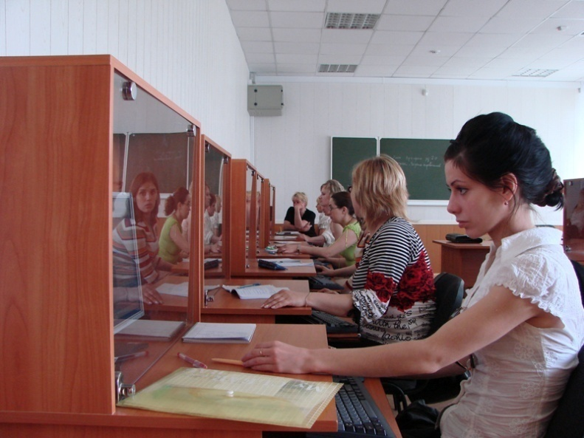
“My future job”
Objectives:
- to revise the topic-related vocabulary;
- to develop students’ speaking and listening skills;
- to practice reading for detailed information;
- to broaden students’ knowledge about different professions and job qualities;
- to encourage students to communicate in English.

Slide 2

MOTTO OF LESSON:
Find something you love to do and you'll never have to work a day in your life. For many people a job is more than an income — it's an important part of who we are.
Steve Jobs

Slide 3
Warm-up:
Match the occupation with daily activity
Occupation Mechanic Teacher Dentist Doctor/Nurse Journalist Fisherman Gardener Chef/Cook Fire fighter Photographer |  | Activity catch fish take pictures fix cars cook meals pull teeth plant flowers put out fires take care of patients teach classes write news stories

Slide 4

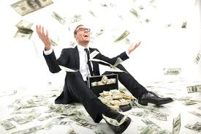
Speaking:
Which is more
important – a high salary
or satisfaction?
What profession
you will never choose?

Slide 5
To my opinion…
I don’t think so…
I fully agree with you…
In some way you are right, but …etc.

Slide 6
look at the advice for job interviews and make a list of things to do and not to do during the interview
Put on (одягати) casual clothes for the interview.
Go out (піти) for a walk before the interview to relax.
Find out (знайти) information about the company.
Turn up (з’явитися) at the interview a couple of minutes early.
Take down (робити нотатки) notes during the interview.
Make up (скласти) information about yourself.
Make out (робити вигляд) you understand something when you don’t.
Go into (вдаватися) a lot of detail about your personal life.
Speak up (розмовляти) and express yourself clearly.
Sit up straight and maintain eye contact(Сідайте прямо і підтримуйте зоровий контакт)

Slide 7

Reading:
Pre-reading activity.
read through the whole text quickly to get a general idea of the meaning

Slide 8

Complete the text with these verbs:
speak up-говорити, повторити; went into-вникати в; find out-з’ясувати; wrote down-записати; put on-одягати; turned up-з’явилася; went out-вийшла;
sat down-сідати; make out- зрозуміти; made up-вигадала; got up-встала .

Slide 9
Mandy was at the interview.
“Yesterday, I had an interview for a holiday job at summer camp for children. Unfortunately, I didn’t have much time to (1) find out about the organization, but I (2) wrote down all the things I’m good at! In the morning I woke up late quickly (3) put on some jeans and a T-shirt. I (4) turned up at the office five minutes late, so I walked straight in and (5) sat down. I couldn’t (6) make out what the interviewer was saying and I had to ask her to (7) speak up. She asked about my experience with children, so I (8) went into a lot of detail about my younger brother. Then she asked me to tell her about my work experience and I (9) made up a story about some voluntary work(волонтерська робота) with a youth club. She stopped asking questions, so I (10) got up and (11) went out of the room. I think I’ve got a good chance of getting the job. What do you think?

Slide 10
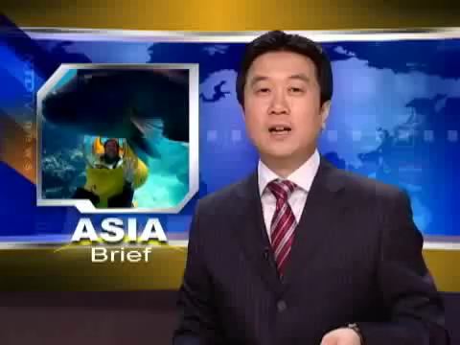
Audition

Slide 11
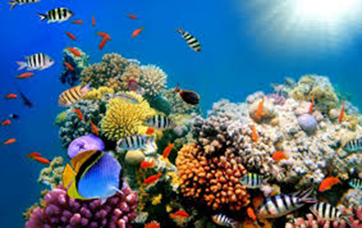
Do the test
How long do you have to work?
A. six months
B. twelve months
C. forever

Slide 12
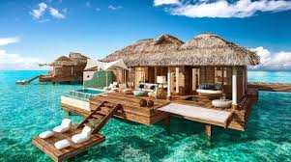
2. Where will the employee live?
A. in a bungalow near the sea
B. in a big beautiful house on an island
C. in a tourist center

Slide 13
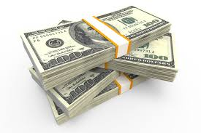
3. How much do they pay?
A. 75,000 Australian dollars
B. 75,000 Euros
C. 150,000 Euros

Slide 14

4. What must applicants submit?
A. experience papers
B. reference letters
C. video about the Great Barrier Reef

Slide 15
5. Which is NOT true according to the video?
A. Applicants are required to be 20-40 years old.
B. One of the employee's duties is to feed fish.
C. The job is advertised in 18 countries.

Slide 16
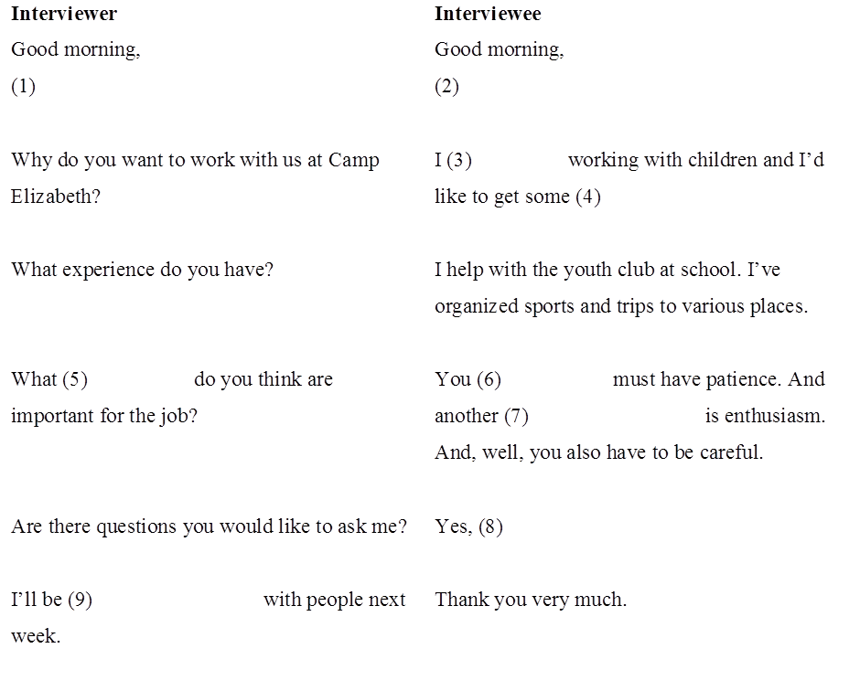
Complete the gaps with the most suitable words and phrases.
Take a seat
Thank you
Just one thing
Enjoy
Qualities
Work experience
Important things
Certainly
Getting in touch
you

Slide 17










Complete the gaps with the most suitable words and phrases.
you

Slide 18

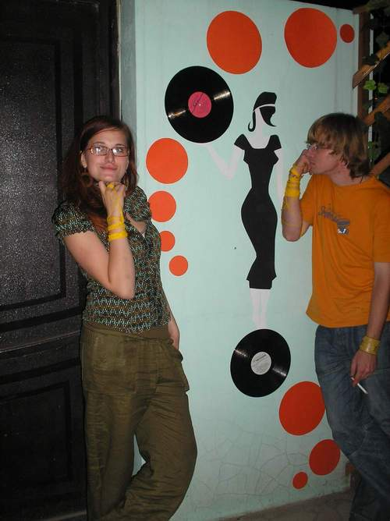
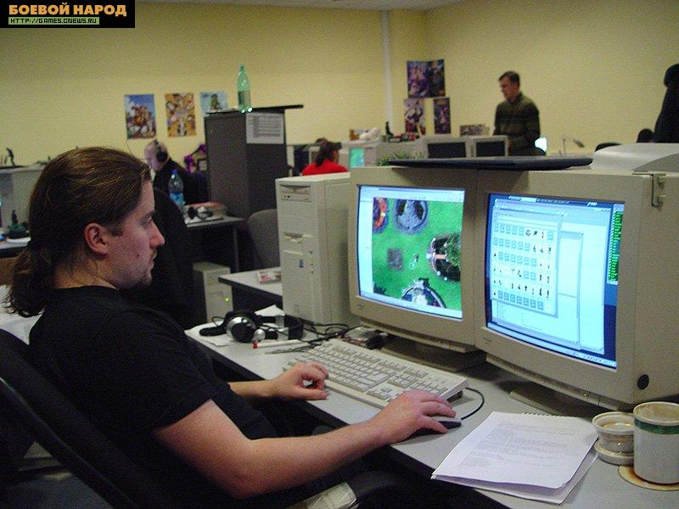
Today’s world of jobs

Slide 19


HOMETASK
Write a short composition about your plans for the future.

Slide 20
THANK YOU FOR ATTENTION !

