Slide 1
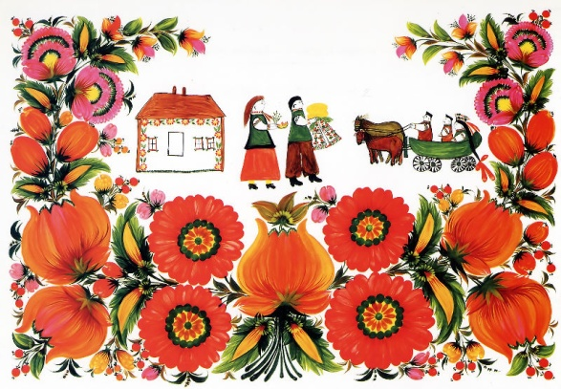
UKRAINE
my motherland

Slide 2
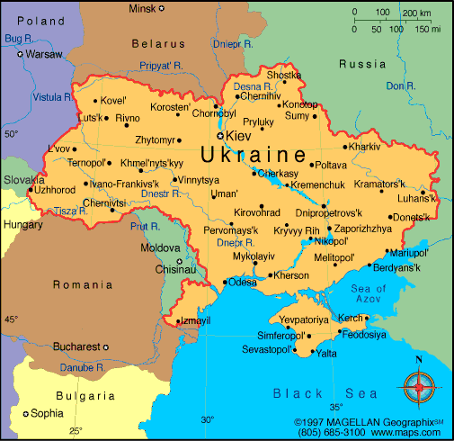

Slide 3
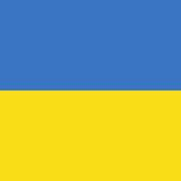
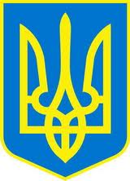
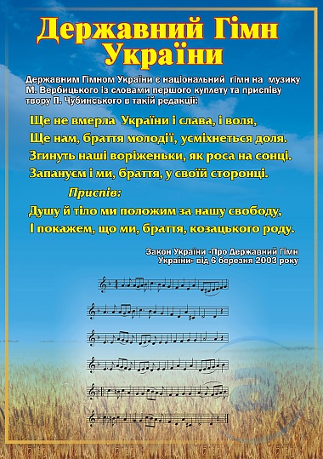
Symbols of Ukraine
The National Flag
The National Coat or Arms/The Trident
The Ukrainian Anthem

Slide 4
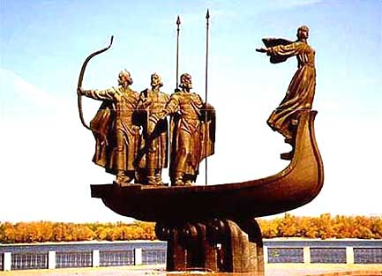
Kyiv is the capital of Ukraine

Slide 5
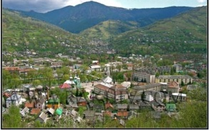
The geographical centre of Europe is situated not far from Rakhiv

Slide 6
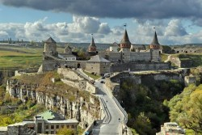
Seven Wonders of Ukraine
Kamyanets-Podilsky - a famous fortress, to cover the area of 121 hectars

Slide 7
The Old Town

Slide 8
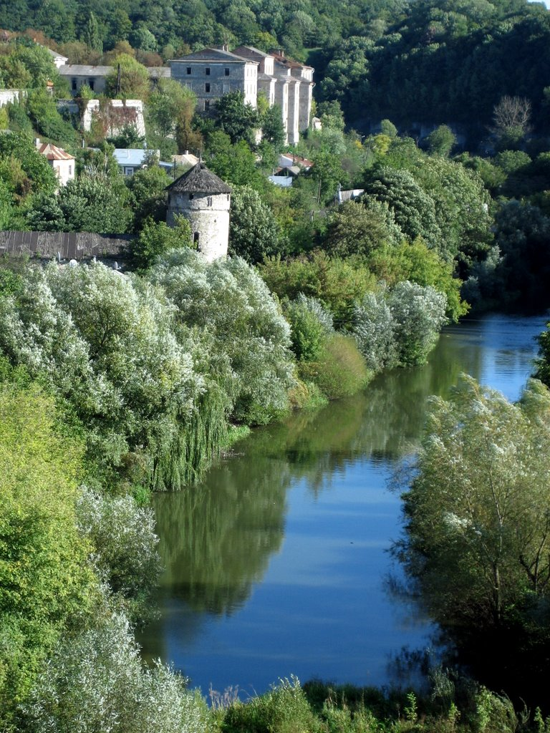
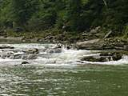
The Smotrych River

Slide 9
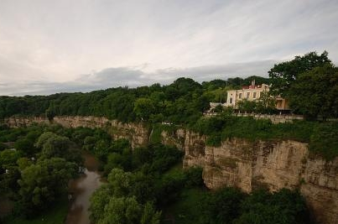
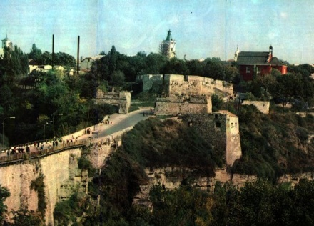
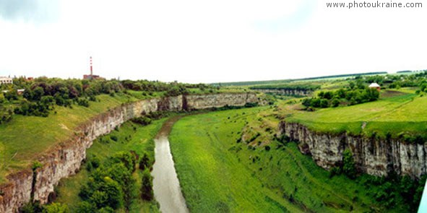
The Smotrych Canyon

Slide 10
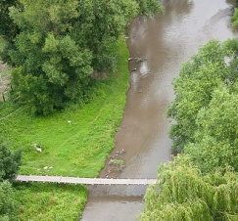
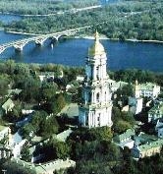
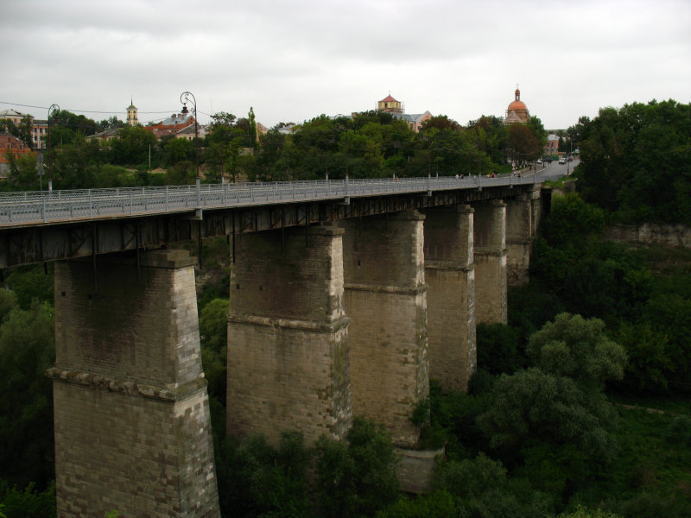
Castle Bridge

Slide 11
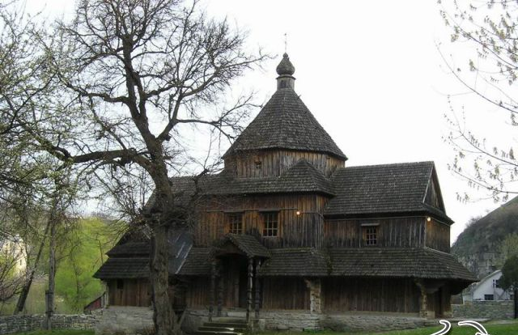
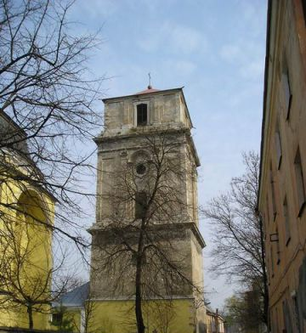
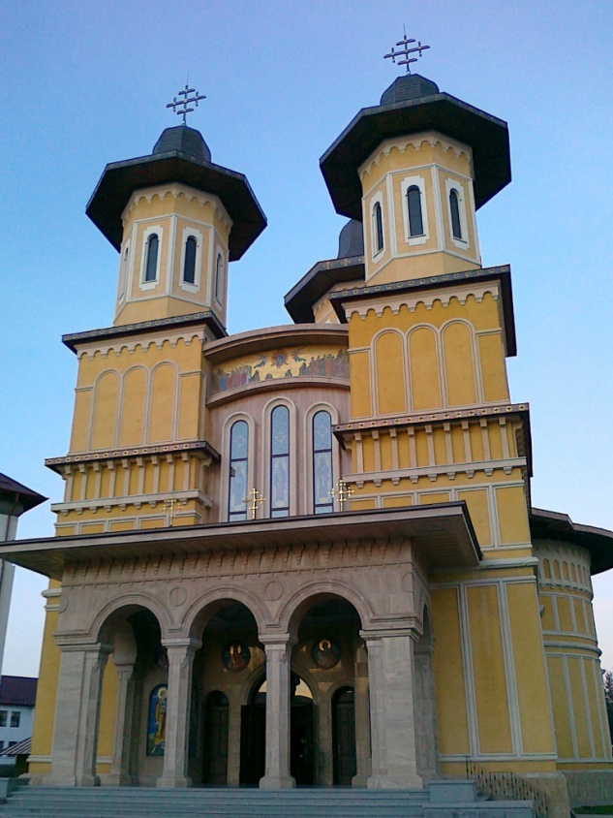
The Old and New Castle

Slide 12
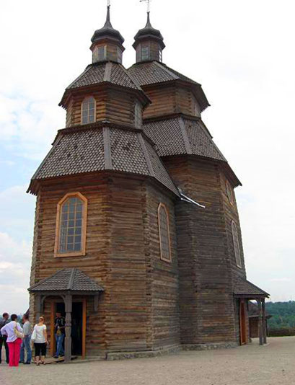
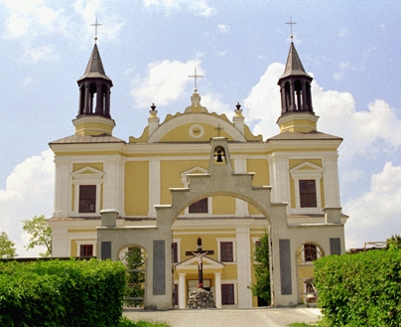
The Old and New Castle

Slide 13
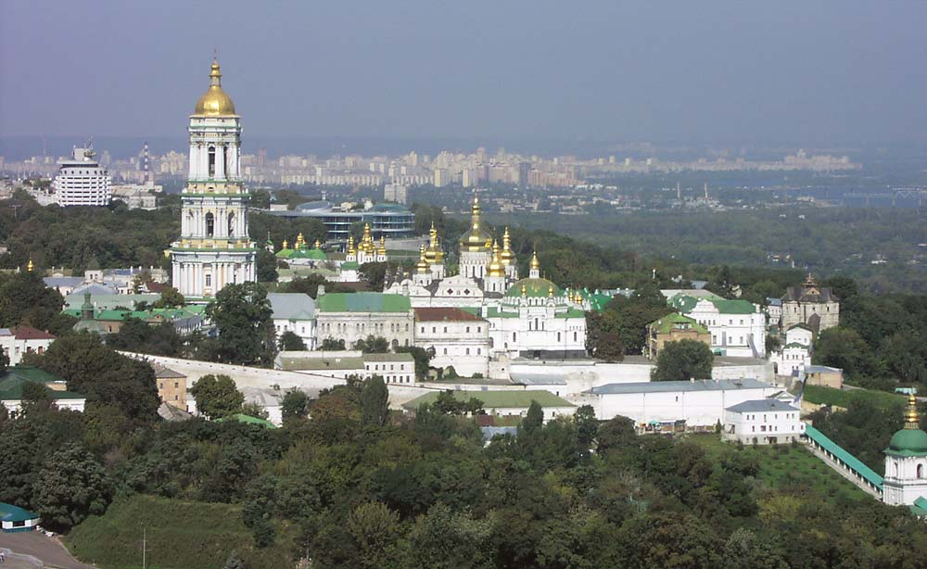
Kyiv-Pechersk Lavra
to be founded in 1051 by the monks Antonia and Feodosiy
the centre of Christiany in the 11th century
to become famous as the Lavra monastery in the 12th century
to have good collections of ancient manuscripts, cloth, embroider, jewellery, ancient icons and the works of modern artists

Slide 14
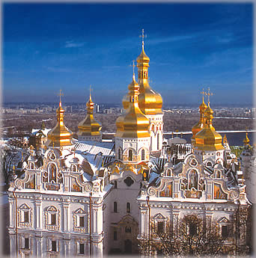
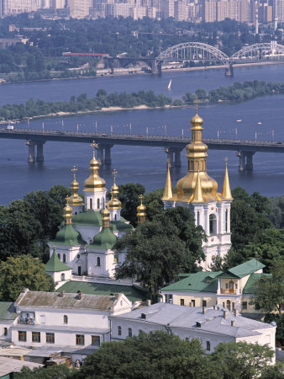
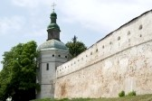

Slide 15
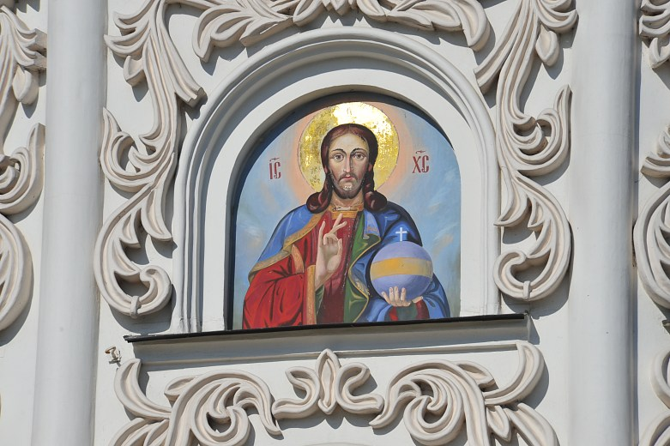
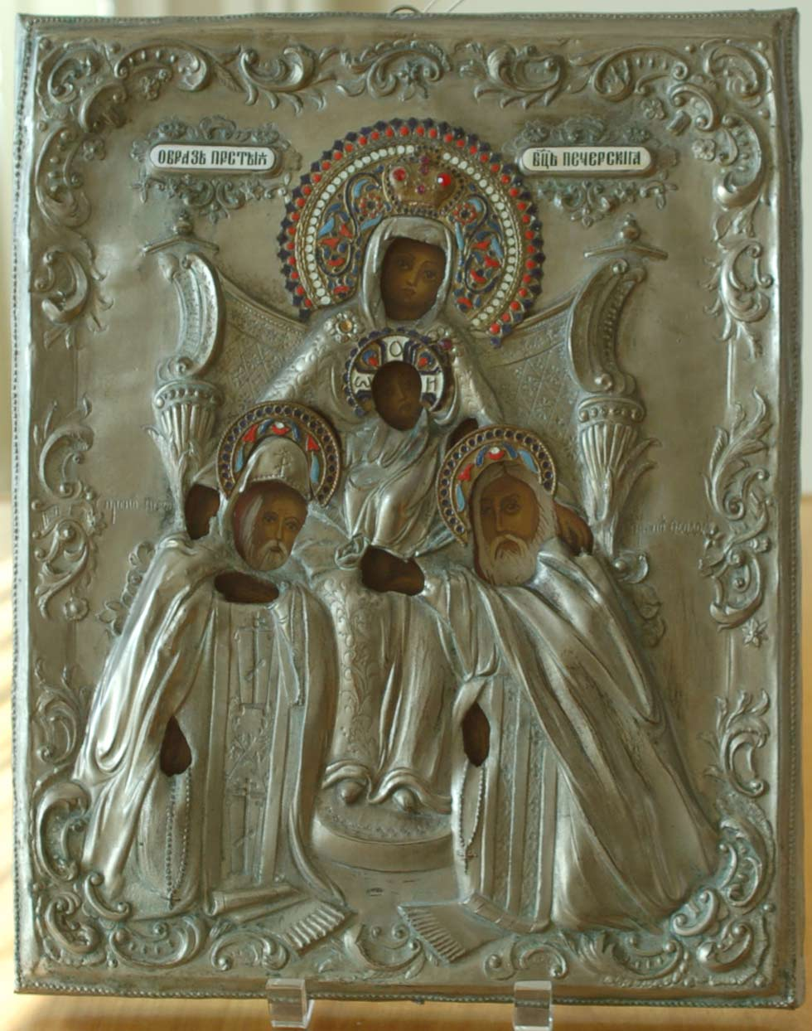
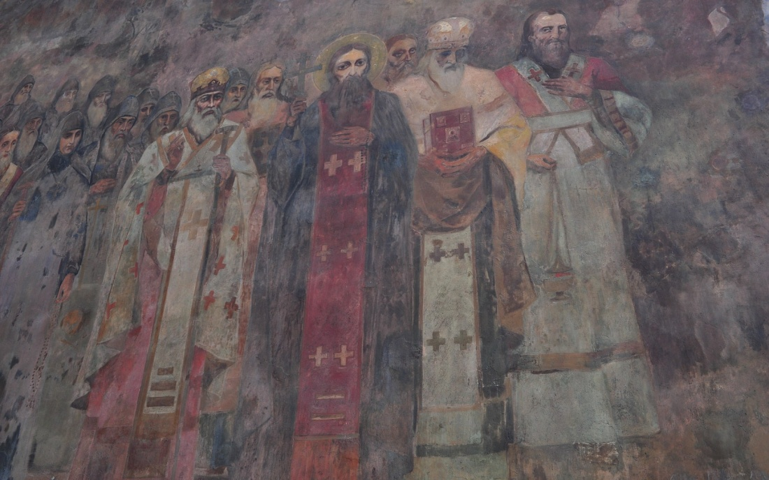

Slide 16
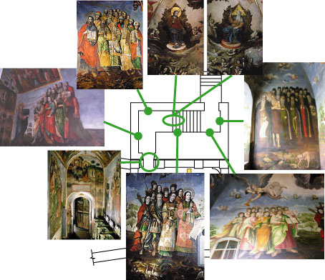

Slide 17
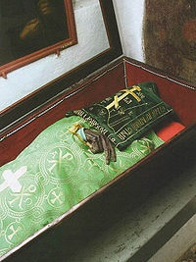
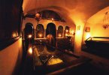

Slide 18
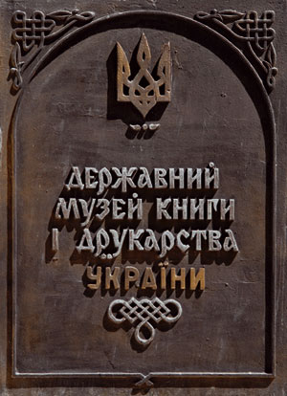
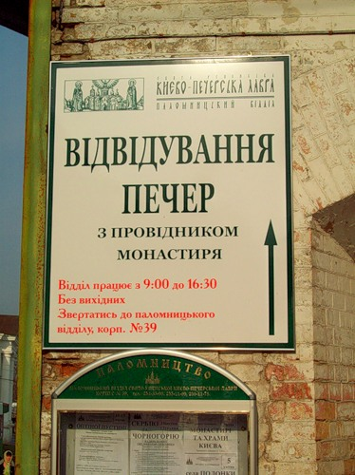

Slide 19
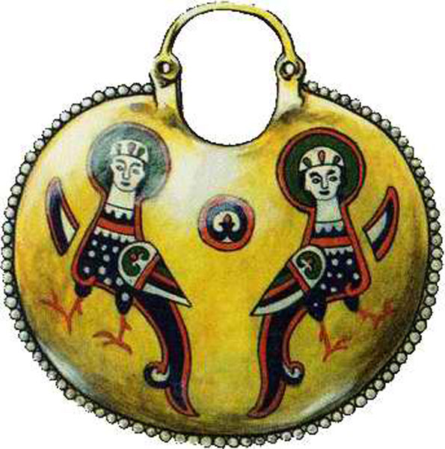
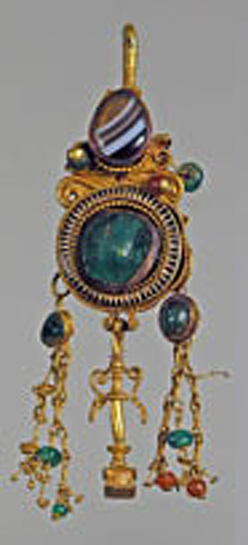
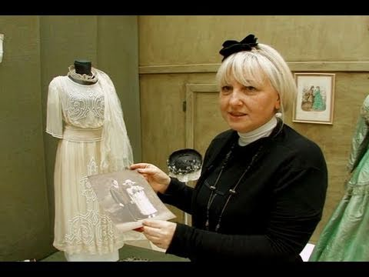



Slide 20
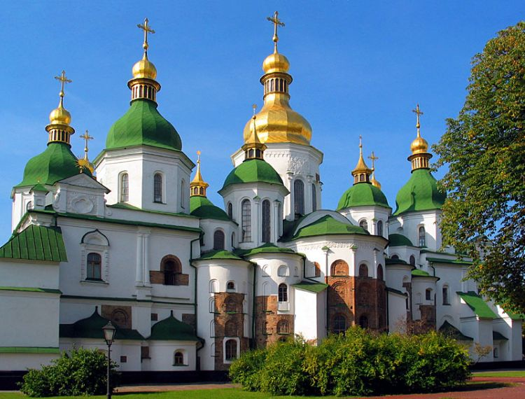
St. Sophia‘s Cathedral
to date back to the 11th-18th centuries, one of the main cathedrals in Central Europe
to be ruined by the enemies many times, to survive till nowadays, beautiful frescoes and mosaics

Slide 21
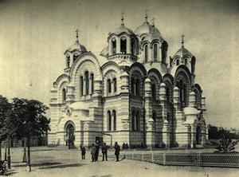
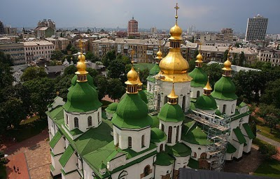

Slide 22
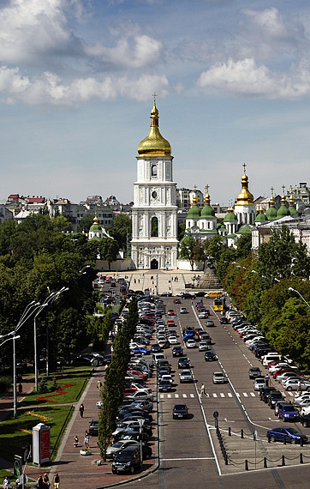
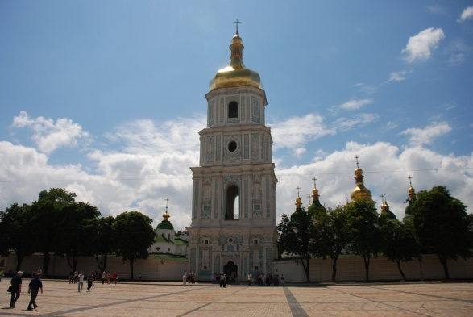

Slide 23
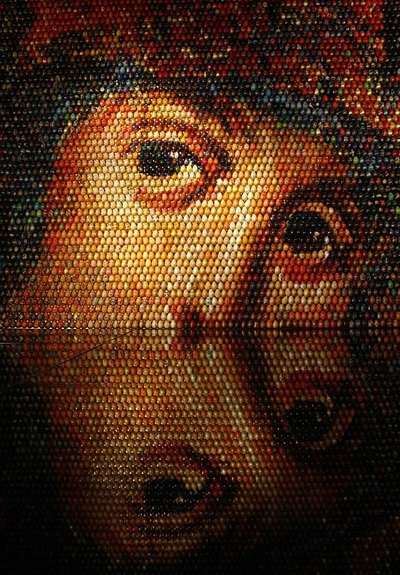
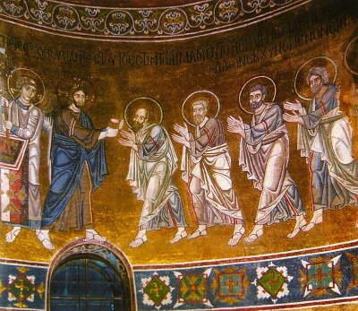
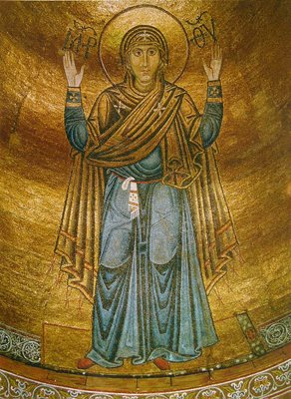
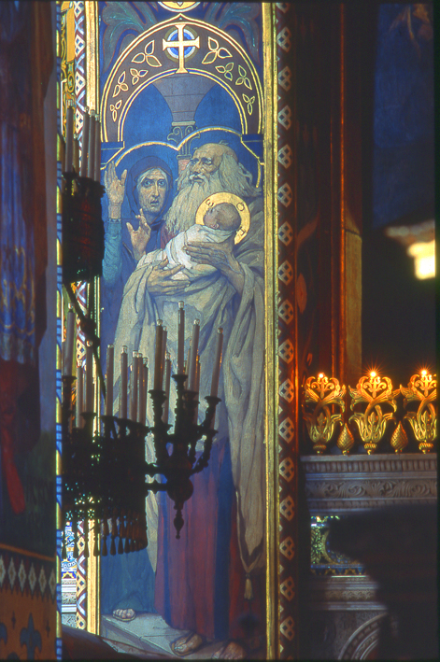
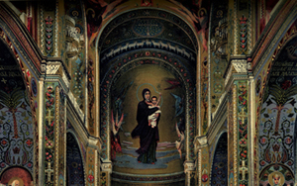

Slide 24
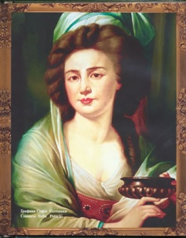
Sofiyivka, Uman
to cover of 546 hectars
the fabulous collection of 546 types of trees
1557 types of bushes
115 types of lianas
1212 types of herbs

Slide 25
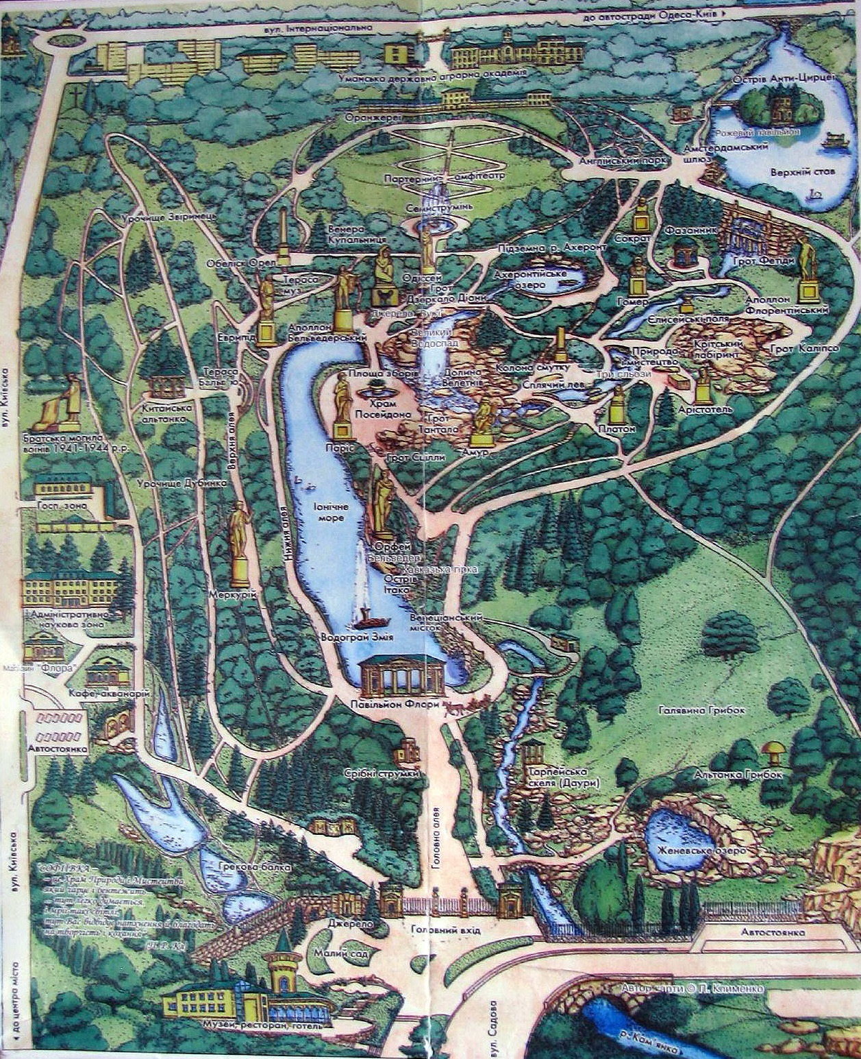

Slide 26
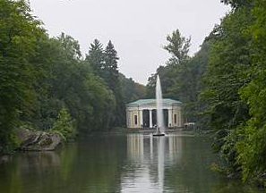
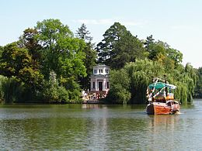




Slide 27






Slide 28

Chersonesus, Sevastopol
the ancient Greek town state
to be founded in 422 - 421 B.C. as a Greek town on the southern coast the Black Sea

Slide 29




Slide 30



Slide 31

Khotyn Fortress
the fortress of the 13th – 18th centuries
to be situated on the important trade crossroads

Slide 32


Slide 33




Slide 34

Khortytsia Island, Zaporizhzhia
the biggest island on the Dnipro River, the unique natural and historical complex
to cover the area of 3,000 hectars
to be covered with thick forests, rare types of plants and herbs

Slide 35



Slide 36



Slide 37
Task
Where is Ukraine situated ?
What countries does it border on ?
What is the capital of Ukraine ?
Where is the centr of Europe situated ?
How many wonders of Ukraine do you know ?

Slide 38
What is it?

Slide 39


Slide 40


Slide 42


Slide 43


Slide 44


Slide 45


Slide 46


Slide 47


Slide 48


Slide 49
My Motherland is beautiful !

Slide 50


Slide 51


Slide 52


Slide 53


Slide 54


Slide 55


Slide 56


Slide 57


Slide 58


Slide 59


Slide 60


Slide 61


Slide 62


Slide 63


Slide 64


Slide 65


