Slide 1
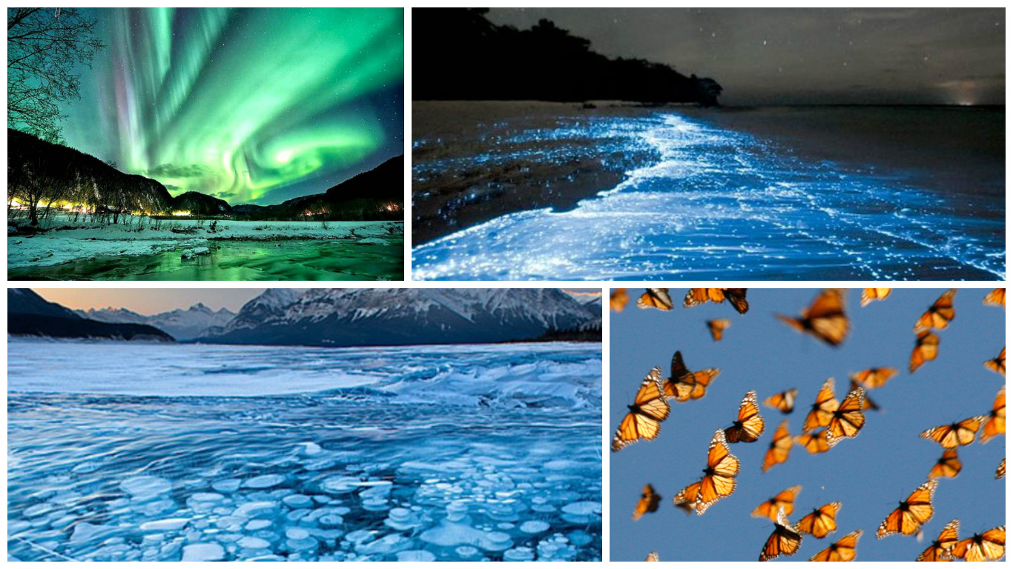
Unusual natural phenomena 10 A

Slide 2
Blue bench
Solar eclipse
Ice flowers
Typhoon
Halo
Diamond dust
Raining fish
Dried salt lake
Moon rainbow
Blue Moon
Sparkling glow
Solar eclipse
Shooting stars
Blood falls
Tsunami
Northern lights
Ball lightning
Lenticular clouds
Lunar eclipse
Aurora borealis

Slide 3
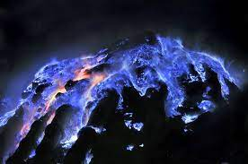
Blue bench

Slide 4
Blue bench
In Indonesia, the Kawa Izen crater on the island of Java spews blue lava instead of the traditional yellow and red it should be (although few have seen it live).
Such a bright and unusual color ensures the combustion of a high concentration of sulfur in the volcano zone. When sulfur burns, it burns with a blue flame. Therefore, when concentrated sulfur comes into contact with lava, it turns blue.
Anastasia Dolishna

Slide 5
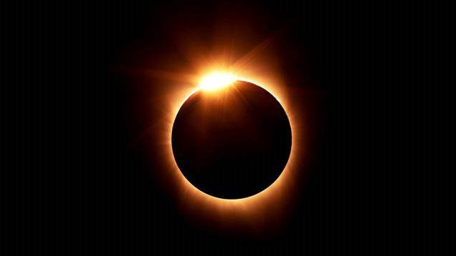
Solar eclipse

Slide 6
Solar eclipse
A solar eclipse is an astronomical phenomenon in which the Moon completely or partially covers the Sun from an observer on Earth. It occurs when the Moon is located between the Sun and the Earth, and thus blocks the flow of sunlight to the Earth. There are several types of solar eclipses: partial eclipse, total eclipse, annular eclipse, annular-total eclipse. During the year there are at least two eclipses of the Sun, but no more than five.
Khrystyna Hrytsak

Slide 7
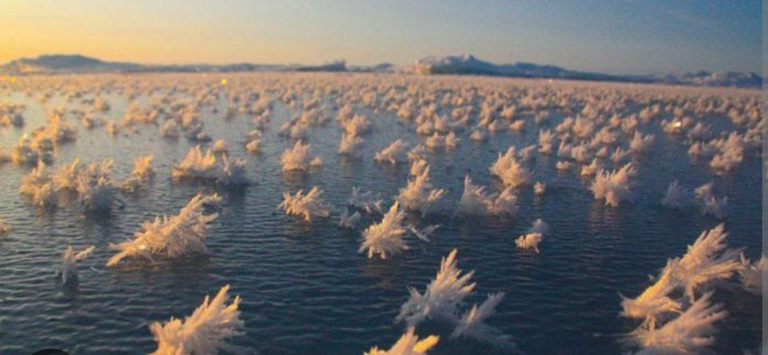
Ice flowers

Slide 8
Ice flowers
The formation of this phenomenon requires specific conditions - late autumn or early winter, when the ground is not yet frozen and plants extract water from it.
The air temperature drops sharply and the juice of some plants - for example, Verbesina virginica - bursts out, instantly freezing in an amazing configuration.
Kateryna Basarab

Slide 9
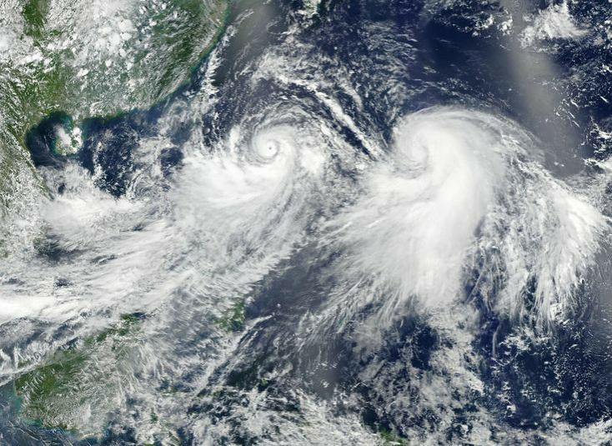
Typhoon

Slide 10
Typhoon
A typhoon is a type of tropical cyclone that is typical of the northwestern part of the Pacific Ocean. In the central part of typhoons, the greatest decrease in air pressure at the surface of the sea is observed, reaching 650 mm Hg. The typhoon zone, which accounts for a third of Earth's total tropical cyclones, is sandwiched between the coast of East Asia in the west, the equator in the south, and the date line in the east. Although most typhoons form between May and November, other months are not free from them either.
Kateryna Safiian

Slide 11
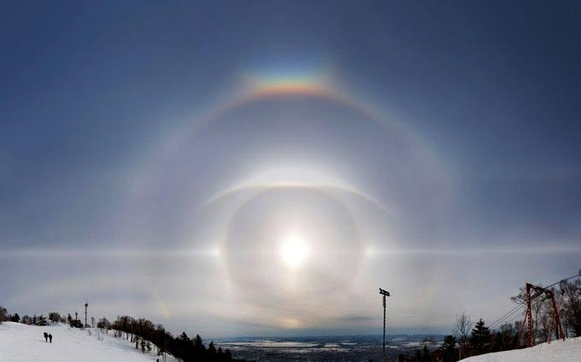
Halo

Slide 12
Halo
A halo is an optical phenomenon produced by light (typically from the Sun or Moon) interacting with ice crystals suspended in the atmosphere.
Halos can have many forms, ranging from colored or white rings to arcs and spots in the sky. Many of these appear near the Sun or Moon, but others occur elsewhere or even in the opposite part of the sky.
Volodymyra Maslii

Slide 13
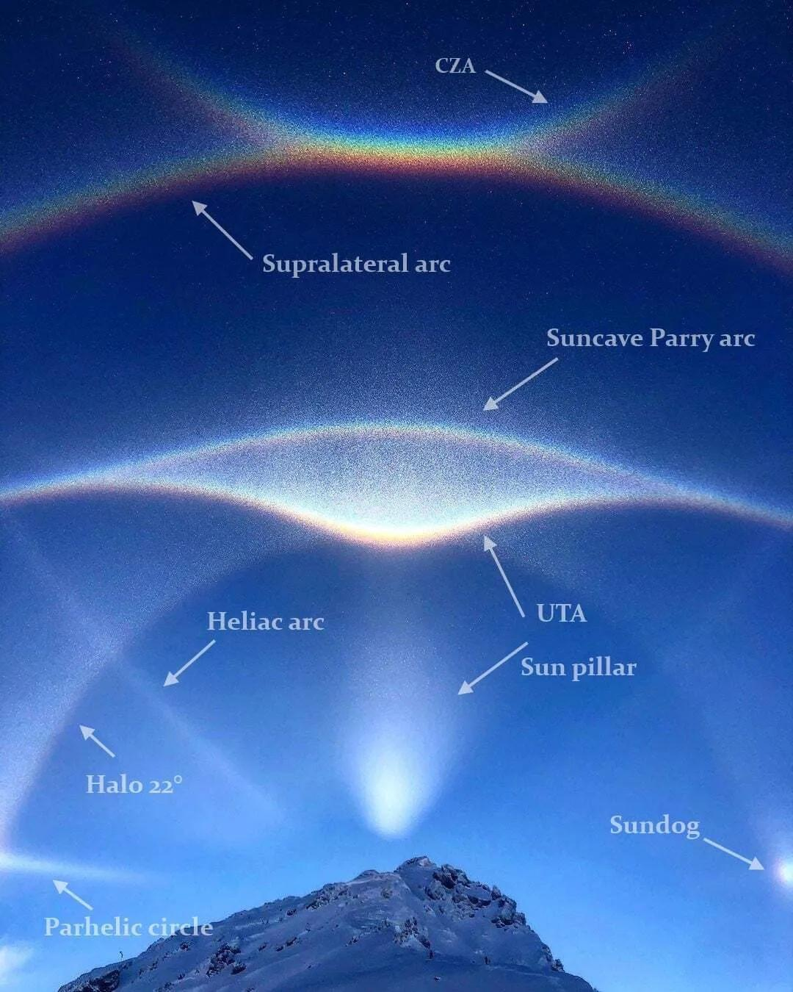
Diamond dust

Slide 14
Diamond dust
Astronomers photographed the unique star J005311, which was formed as a result of the merger of two "dead" stars - white dwarfs. According to them, such celestial bodies are very rare. The images also show very rare forms of halos: the arc of Hastings, Wegener, Moilanen, solar and subsolar loops. Thanks to the different shape and orientation of crystals (plates, prisms), the pictures show many arcs and loops, among which there are very rare ones, such as the Hastings, Wegener, Moilanen (M-arc), solar and subsolar loops.
Viktoria Postolovska

Slide 15
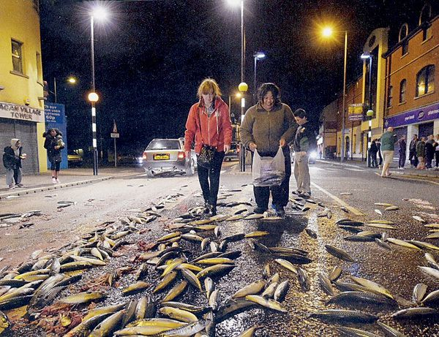
Raining fish

Slide 16
Raining fish
Raining fish is a phenomenon named "animal rain" that happens when small water animals such as frogs, crabs or small fish are swept into waterspouts. А black cloud appears in the sky, thunder begins, flashes of lightning are visible, a strong wind blows, and then the rain begins. Mainly such rains fall in Honduras, after the fish rain people leave their homes and start collecting fish, after which they cook and eat with pleasure.
Uliana Krasii

Slide 17
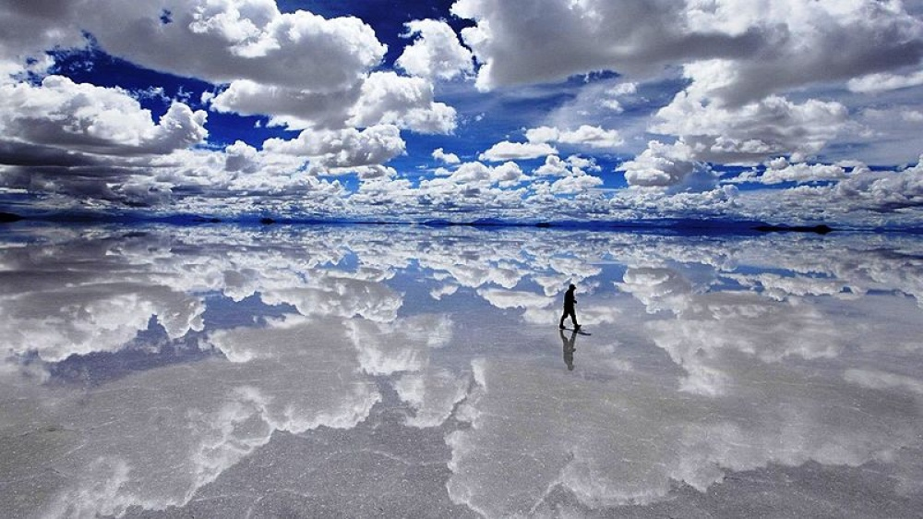
Dried salt lake

Slide 18
Dried salt lake
A dried salt lake, which during the rainy season is covered with a thin layer of water and turns into the world's largest mirror surface.
About 40 thousand years ago, a part of Lake Minchin was discovered. After its drying, two species remained today: Poopo and Uru-Uru, as well as two large salt marshes: Salar de Coipasa and Uyuni. The area of Uyuni is approximately 25 times the area of the dry Lake Bonneville in the United States.
Pavlo Yalovyi

Slide 19
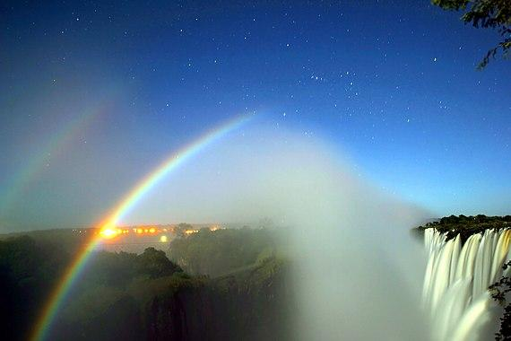
Moon rainbow

Slide 20
Moon rainbow
Moon rainbow is a rainbow formed by moonlight.
It is caused by the refraction of light in many drops of water, such as rain.
A moon rainbow can only appear in places with high humidity and only when the Moon is almost full.
Veronika Oleksyn

Slide 21
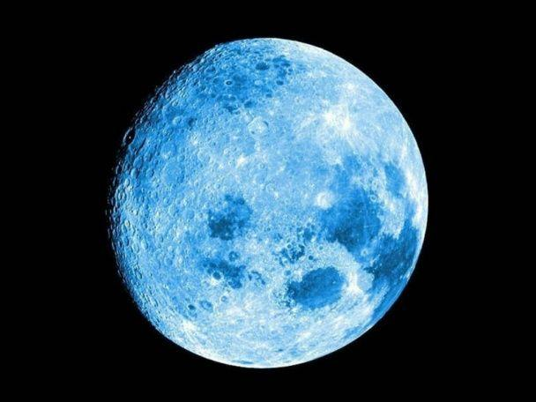
Blue Moon

Slide 22
Blue Moon
The moon can take on a blue color when there is a lot of dust or soot in the air, such as from volcanic eruptions or fires. There is evidence that after the eruption of the Krakatoa volcano in Indonesia in 1883, the moon for some time had a blue color for observers. Also, residents of the northeastern regions of the United States and Canada saw a blue moon in 1951 after severe forest fires in western Canada, they saw it for a week.
Bohdana Kepeshchuk

Slide 23
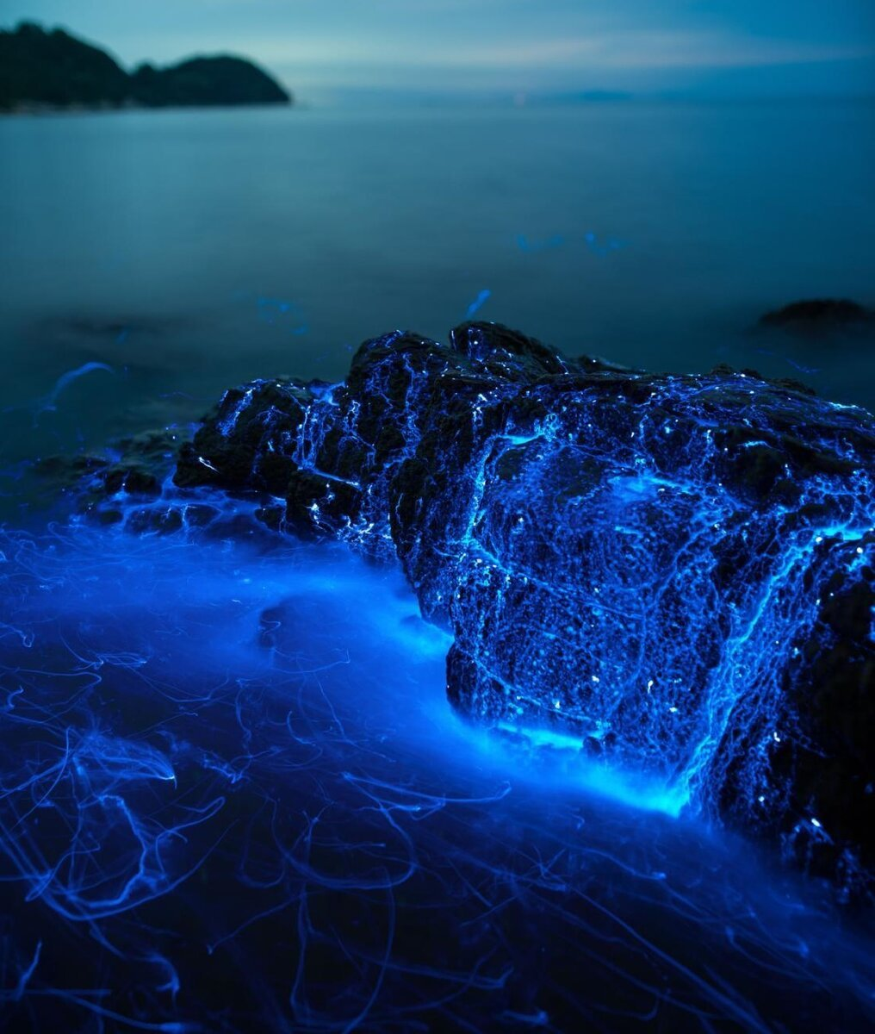
Sparkling glow

Slide 24
Sparkling glow
The glow of the sea is a natural phenomenon of biological origin that occurs when the surface of the sea or ocean is filled with microorganisms capable of luminescence as a result, it looks as if the sea is glowing from within. Sparkling glow emitted by plankton. These creatures emit light usually under the influence of external stimuli - the movement of water in currents or near the surf. There is also a uniform glow caused by the vital activity of bacteria capable of glow. It is most often observed in the Bays of Biscay and Aden near the shores of India, South America, in the Black and Okhotsk seas.
Marta Ivasiv

Slide 25
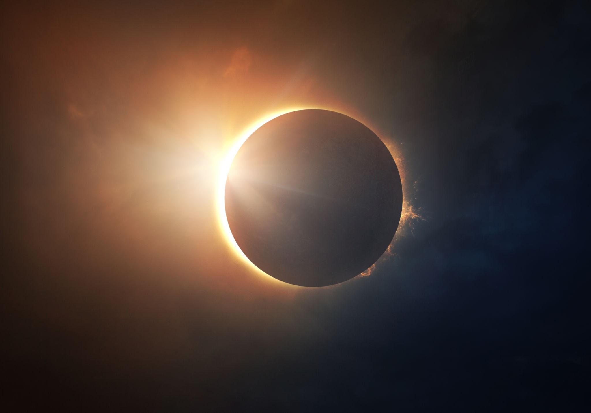
Solar eclipse

Slide 26
Solar eclipse
A solar eclipse is an astronomical phenomenon in which the Moon completely or partially covers the Sun from an observer on Earth. It occurs when the Moon is located between the Sun and the Earth, and thus blocks the flow of sunlight to the Earth. Astrologers say that the time of solar and lunar eclipses is dangerous, as it has a negative effect on a person.
Vitalina Dmytriv

Slide 27
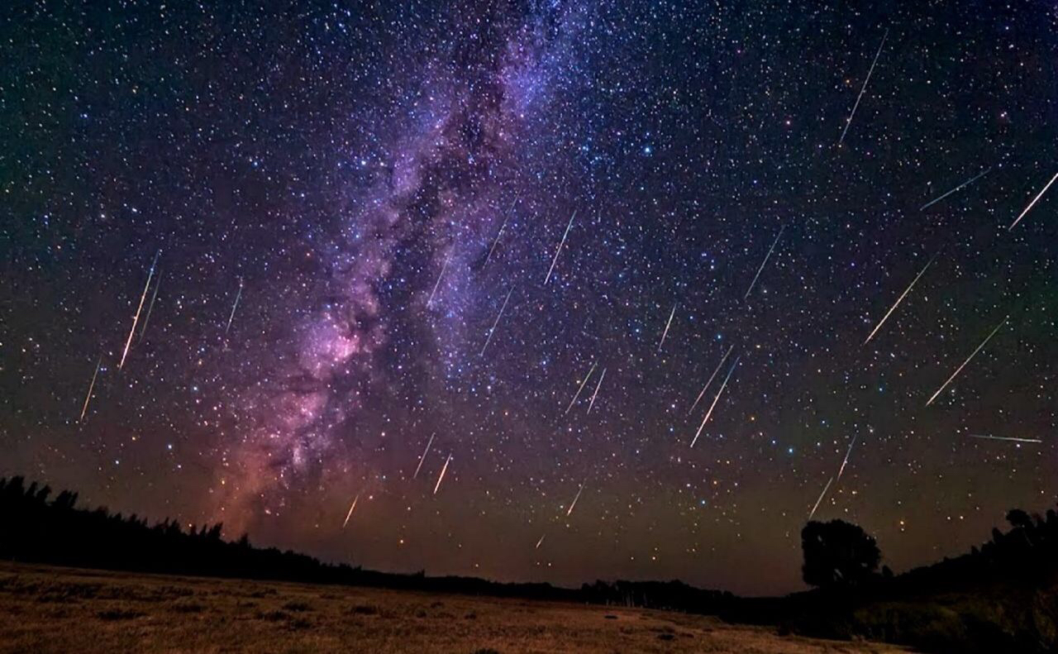
Shooting stars

Slide 28
Shooting stars
Shooting stars look like stars that quickly shoot across the sky, but they are not stars. A shooting star is really a small piece of rock or dust that hits Earth's atmosphere from space. It moves so fast that it heats up and glows as it moves through the atmosphere. Shooting stars are actually what astronomers call meteors. Most meteors burn up in the atmosphere before they reach the ground. However, once in a while a meteor is large enough than some of it survives and reaches Earth's surface. Then it is called a meteorite.
Solomia Hrynyshyn

Slide 29
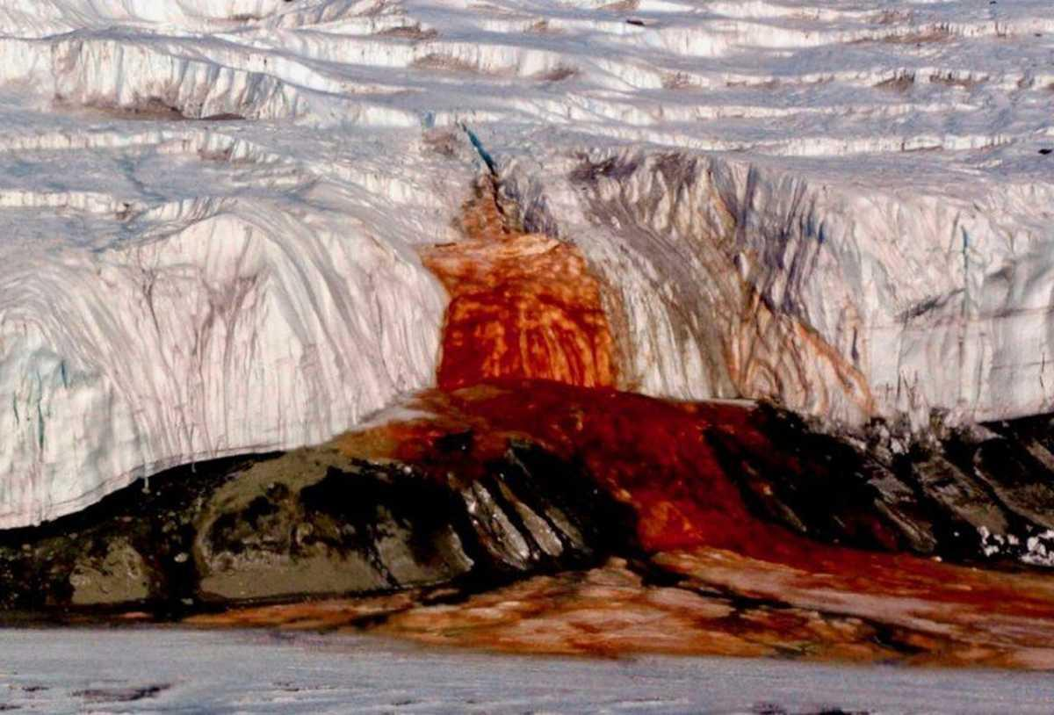
Blood falls

Slide 30
Blood falls
As the name suggests, Blood Falls is a waterfall which shoots blood-red water into a river. It was first seen in the year 1911 in Eastern part of Antarctica – in the McMurdo Dry Valley. The sight is a perfect backdrop for a horror film: creepy, mysterious and of course bloody. Previously, it was believed that red algae were causing the water to change its colour and turn blood-red. Though this hypothesis was never proved.
Illia Khmelivskyi

Slide 31
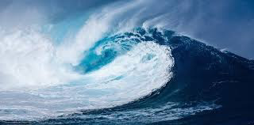
Tsunami

Slide 32
Tsunami
Tsunamis are waves longer than 500 m, which are formed in the sea or in the ocean, usually as a result of earthquakes or volcanic eruptions at the bottom of the World Ocean (or the fall of an asteroid, etc.) and cover the entire water column.
In the sea, at a great depth, tsunamis do not pose a threat to shipping, they can even go unnoticed. However, near the coast, when the depth gradually decreases, the tsunami slows down and the height of the wave increases, it turns into a moving wall of water. When running aground near the shore, its height can reach tens of meters.
Pavlo Kapushchak

Slide 33
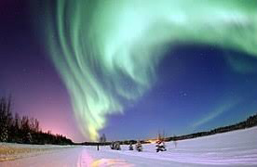
Northern lights

Slide 34
Northern lights
The northern lights are an optical phenomenon of the glow of certain areas of the night sky in the polar regions, which changes rapidly. It arises in the upper layers of the planet's atmosphere under the influence of streams of charged particles that the planet's magnetic field directs towards the poles.
The northern lights are distinguished by their forms: diffuse glow with arcs from one point of the horizon to another, as well as rays, ribbons, crowns, spots. The duration of the aurora borealis is from several minutes to several days.
Ostap Krakhovskyi

Slide 35
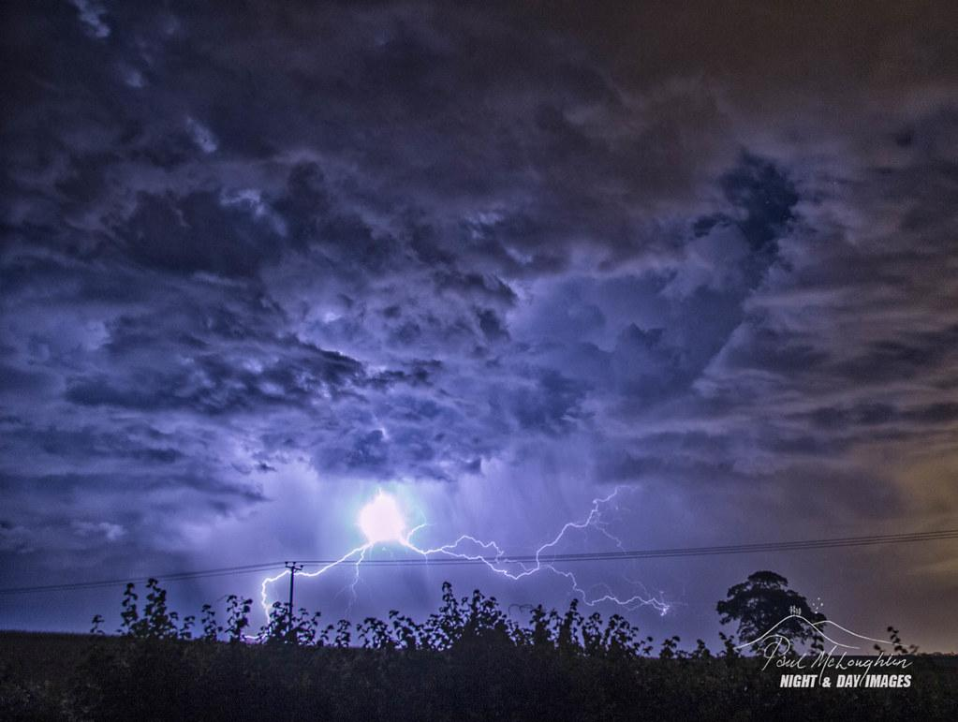
Ball lightning

Slide 36
Ball lightning
Ball lightning is a rare and unexplained phenomenon described as luminescent, spherical objects that vary from pea-sized to several meters in diameter. Though usually associated with thunderstorms, the observed phenomenon is reported to last considerably longer than the split-second flash of a lightning bolt, and is a phenomenon distinct from St. Elmo's fire.
Laboratory experiments have produced effects that are visually similar to reports of ball lightning, but how these relate to the supposed phenomenon remains unclear.
Vitalii Shtertsel

Slide 37
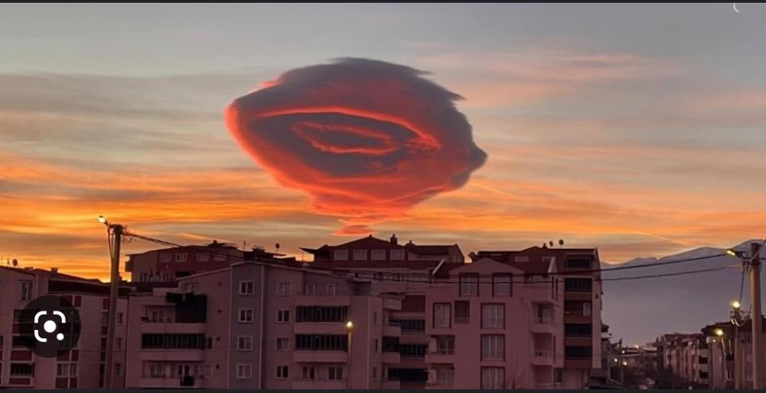
Lenticular clouds

Slide 38
Lenticular clouds
Lenticular (lens-shaped) clouds are a unique natural phenomenon, which, unfortunately, is quite rare. Although, maybe that is why it is so attractive.
These clouds are amazing not only for their unusual lenticular shape, but also for their main distinguishing feature – they are motionless.
Bohdana Dmytrash

Slide 39
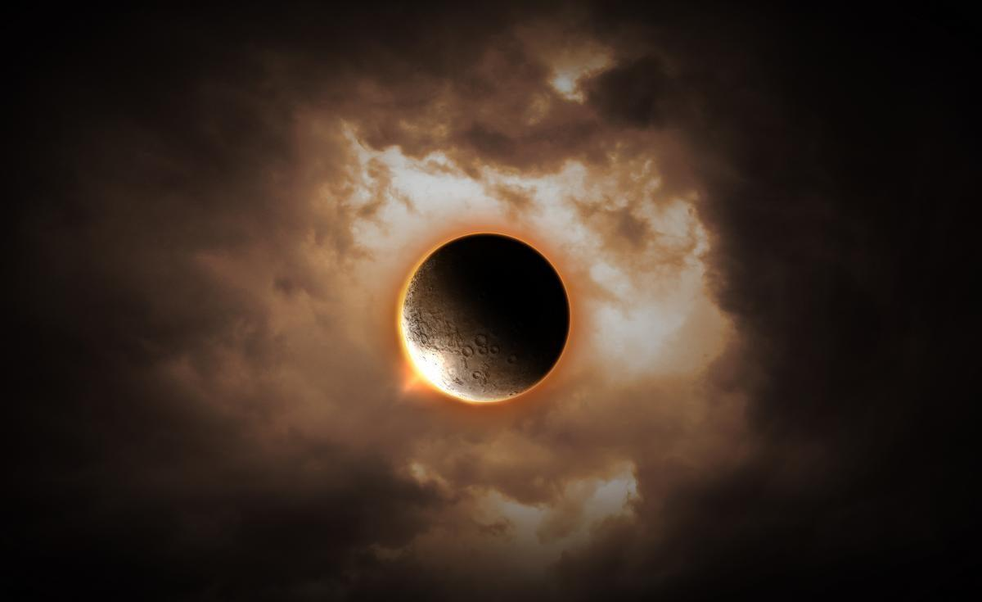
Lunar eclipse

Slide 40
Lunar eclipse
A lunar eclipse occurs when the Earth comes between the sun and the moon, casting a shadow on the moon.
The moon during a lunar eclipse looks like a reddish-orange color
Lunar eclipses can only occur during a full moon when the sun, Earth, and moon are in alignment.
Unlike solar eclipses, lunar eclipses can be seen from anywhere on Earth where the moon is visible.
Lunar eclipses can last for several hours, with the total phase, when the moon is completely within Earth's shadow, typically lasting for around an hour.
Andrii Babinskyi

Slide 41
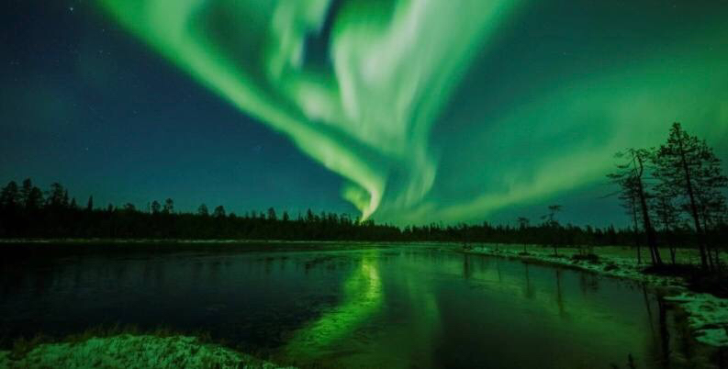
Aurora borealis

Slide 42
Aurora borealis
The aurora borealis is an optical phenomenon of the glow of individual areas of the night sky in the polar regions, which changes rapidly.
It arises in the upper layers of the planet's atmosphere under the influence of streams of charged particles that the planet's magnetic field directs towards the poles.
Yulianna Popoilyk

