Slide 1
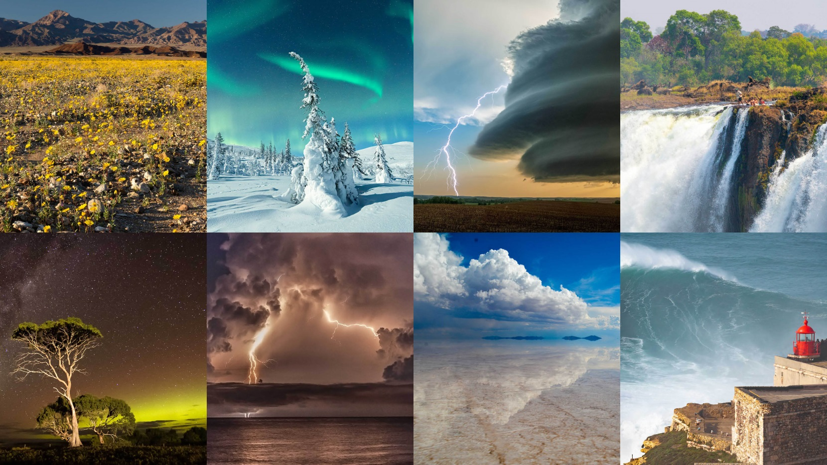
Rare natural phenomena
10 B

Slide 2
Nacreous clouds
Icy hair
Light pillars
Northern lights
Celestial communication
Showers of fish
Brainicle
Frozen bubbles of methane
Volcanic lightning
Fire tornado
Tornado
Ball lightning
Sea of stars
Eclipse of the Sun
Moving stones
Penitentes

Slide 3
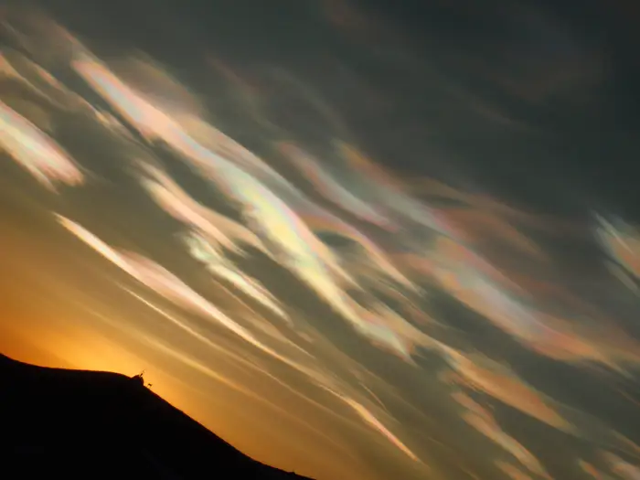
Nacreous clouds

Slide 4
Nacreous clouds
Usually spotted only near the poles, nacreous clouds form very high in the atmosphere (twice as high as commercial airplanes fly), where the air is particularly cold and dry.
The colorful shine actually comes from the setting sun being lower in the sky than the clouds, so they reflect sunbeams back toward Earth.
Unfortunately, while they're beautiful, nacreous clouds also destroy ozone the compound that protects us from the sun's most dangerous rays.
Marian Serediuk

Slide 5
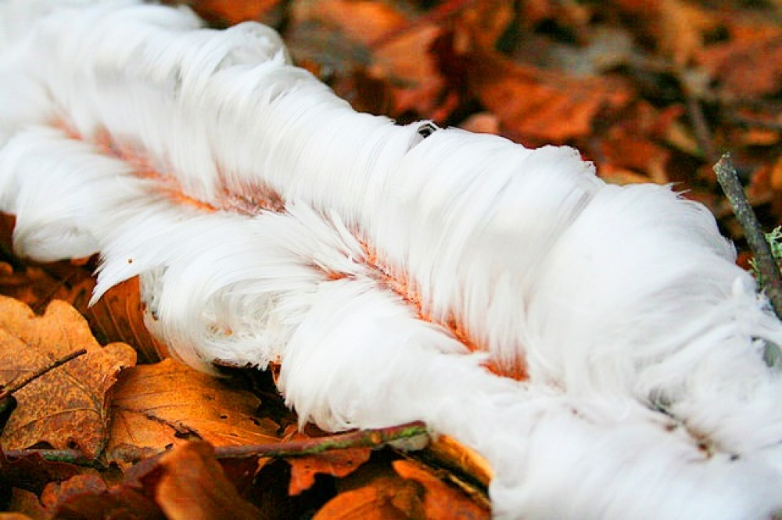
Icy hair

Slide 6
Icy hair
Ice, which is more like silky hair, is a very unusual natural phenomenon. The bacterium Pseudomonas syringe raises the freezing point of water inside plants, and when the water leaves the plant and meets cold air, this icy hair forms. If the miracle falls under the sun's rays or if you touch it with your hand, the snow-white strands immediately melt. Crystals form on rotting wood on wet winter nights when the temperature is just below freezing. Scientists discovered that due to the fungus, the ice takes the form of thin hairs with a diameter of about 0.01 mm.
Diana Peklych

Slide 7
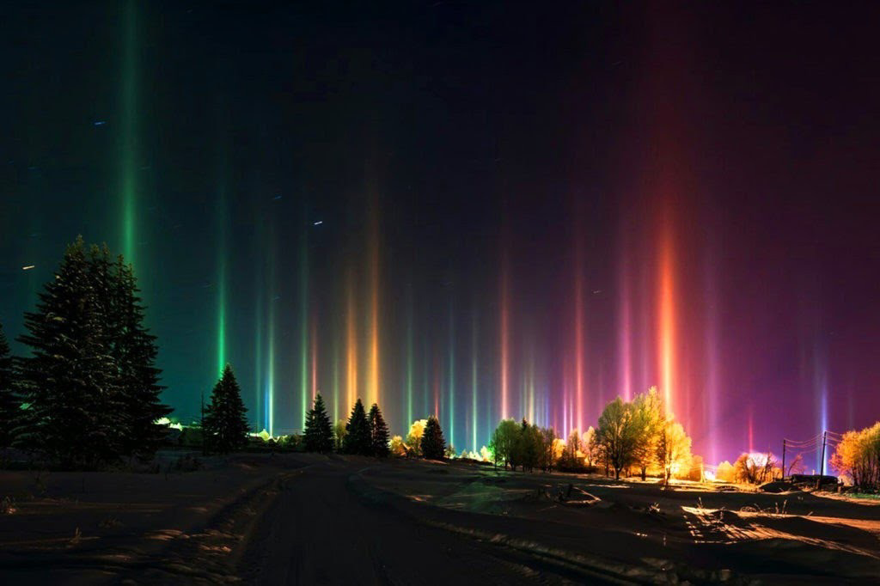
Light pillars

Slide 8
Light pillars
Light Pillars created by the Sun are often mistaken for mystical manifestations of divine light. Legends about the fiery swords of heavenly inhabitants arose. Most likely, thanks to a wonderful natural phenomenon - when the west or rising Light illuminates the cirrus clouds. The pillar of the sun binds them, as it were to the ground.
Anastasia Kapushchak

Slide 9
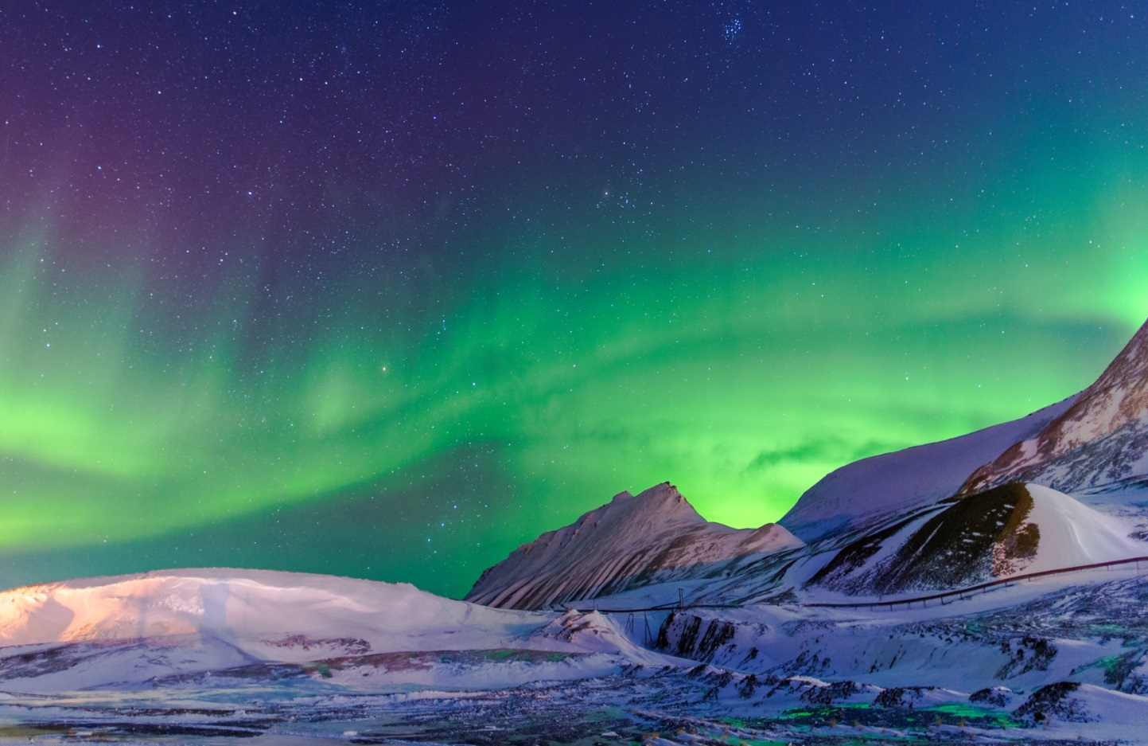
Northern lights

Slide 10
Northern lights
The northern lights are caused by the fact that charged particles of the universe are sent to Earth. On their way, they meet the atmosphere. The interaction of these charged particles with the Earth's atmosphere creates the glow. The light that we can see on Earth takes on different colors. Each color in that glow can be explained by the predominance of certain substances in the composition of the atmosphere. Green and red shades are oxygen, which is the basis of air. Blue colors mean that there is a lot of nitrogen in the atmosphere, which is also an important component of it.
Artur Rozenchuk

Slide 11
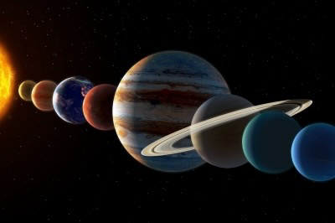
Celestial communication

Slide 12
Celestial communication
June offers star lovers a rare opportunity to see the celestial spectacle when five planets and the moon line up. In the northern hemisphere, Mercury, Venus, the Moon, Mars, Jupiter and Saturn will go to the pre-dawn "parade", forming a curved line. This formation will be most perfect from June 23 to 24.
This phenomenon is called celestial communication, and you can see it with the naked eye. The last time such a phenomenon occurred was in 2004.
Denys Humeniuk

Slide 13
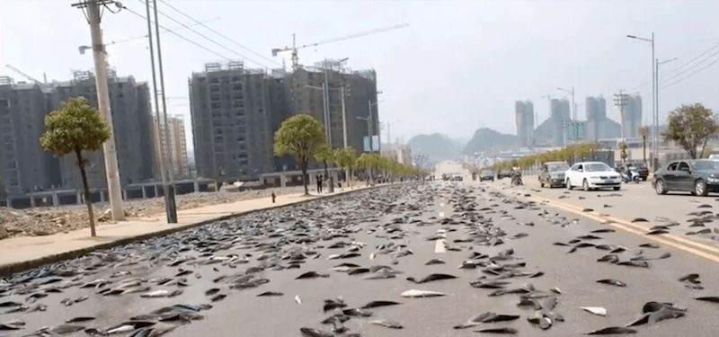
Showers of fish

Slide 14
Showers of fish
A relatively rare meteorological phenomenon, although such cases have been recorded in many countries throughout human history. But for Honduras, this phenomenon is regular. Every year between May and July, a dark cloud appears in the sky, there is lightning everywhere, thunder rolls, a strong wind blows and it rains heavily for 2-3 hours. As soon as it stops, hundreds of live fish remain on the ground.
One hypothesis for the phenomenon is that strong winds lift the fish several kilometers into the air from the water, as the Caribbean waters off the northern coast of Honduras are abundant with fish and other seafood.
Oksana Stasiuk

Slide 15
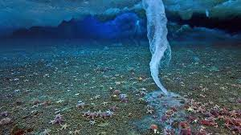
Brinicle

Slide 16
Brinicle
Growing from the bottom layer of sea ice, this underwater stalactite is a tube of ice with water reaching the bottom that is much saltier than what flows around it. Brinicle forms quickly and continues to grow even after reaching the bottom, freezing small marine life like starfish to death.
Arina Zhurakovska

Slide 17
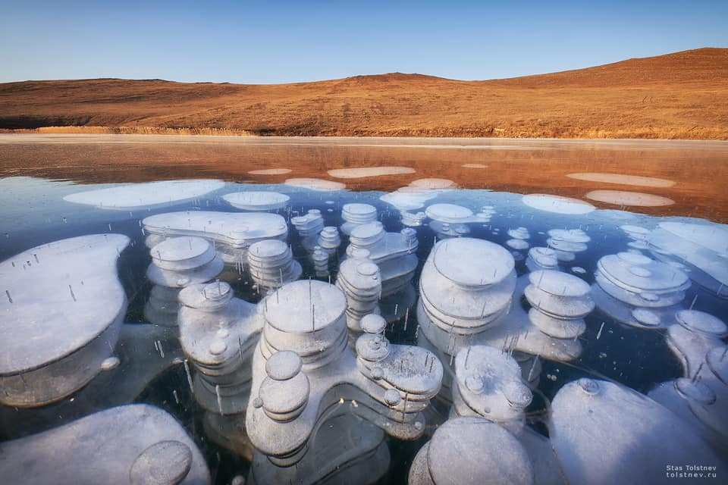
Frozen bubbles of methane

Slide 18
Frozen bubbles of methane
An amazing sight - frozen gas bubbles under the surface of the water. They freeze at different depths and create an unusual visual effect. And although it is quite beautiful, but in fact this phenomenon is a wake-up call for all of us. Scientists say that methane rising from the bottom is an indicator of global warming. The higher the average temperature, the more actively decomposes organic matter at the bottom of the lake, releasing gas.
Martyn Dotsiak

Slide 19
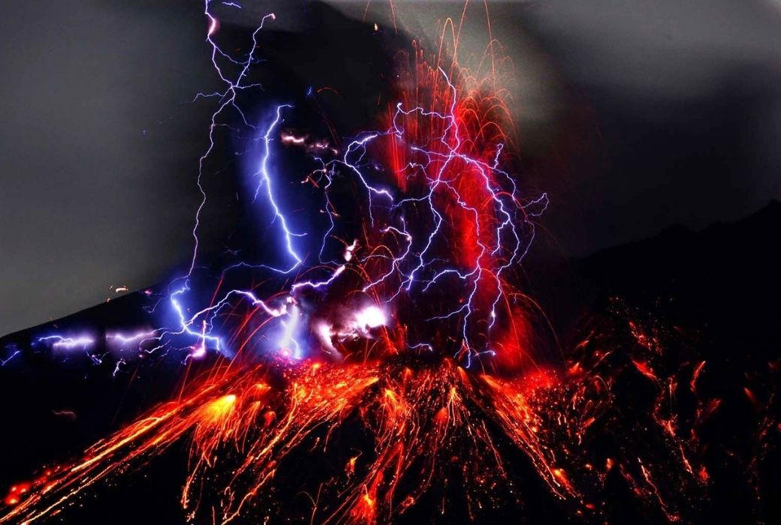
Volcanic lightning

Slide 20
Volcanic lightning
'Dirty thunderstorms’ are known as volcanic lightning. That's right, volcanoes can produce lightning. They occur when material ejected from a volcano has a positive charge. The result is a spectacular display of volcanic lightning and lava.
Generally, they’re a rare occurrence but they happen regularly at Sakurajima volcano, Japan.
Yevhenia Kravchenko

Slide 21
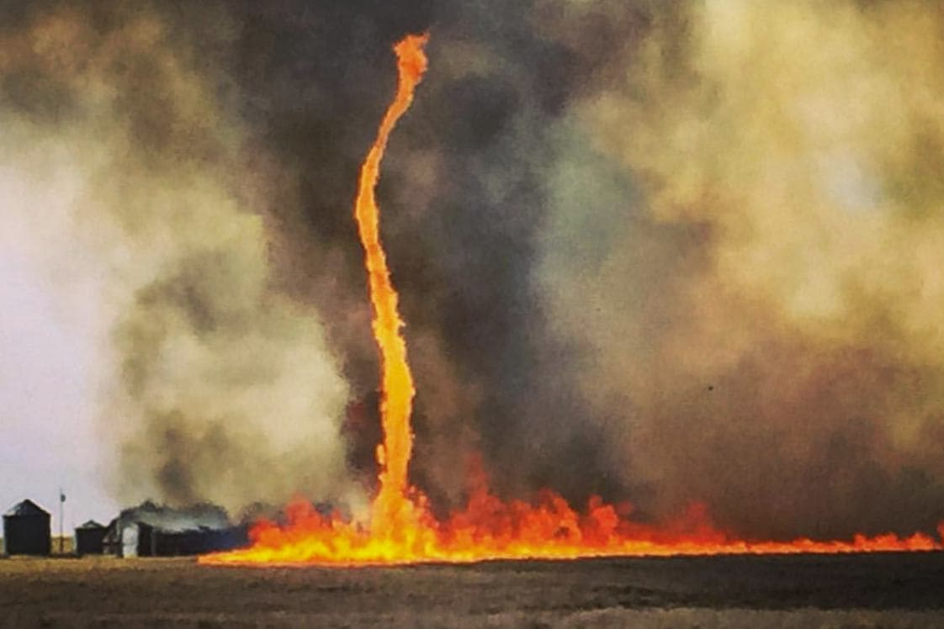
Fire tornado

Slide 22
Fire tornado
A fire tornado is an atmospheric phenomenon, which is formed when scattered centers of fires merge into one huge bonfire. The air above it heats up, its density decreases and the fire rises. From below, cold masses of air from the periphery arrive in its place, which also heats up. There is a smokestack effect. The pressure of hot air reaches hurricane speeds, and the temperature rises to 1000˚С.
Artem Zamryka

Slide 23
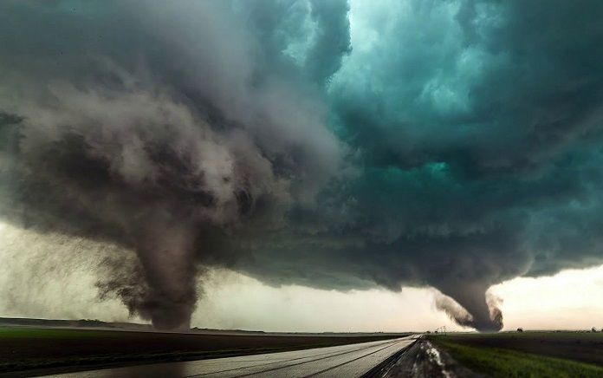
Tornado

Slide 24
Tornado
A tornado is a giant air funnel that has arisen due to a pressure difference. It rotates at a frantic speed and draws in more or less large objects. In America, this destructive atmospheric phenomenon is called a tornado.
Lilia Henyk

Slide 25
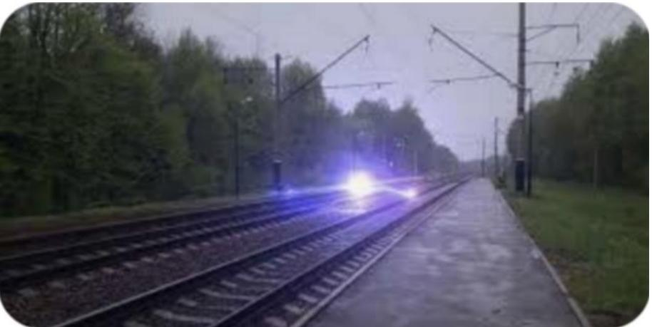
Ball lightning

Slide 26
Ball lightning
Ball lightning is a rare atmospheric phenomenon that has the appearance of a moving clump of plasma from a few to several tens of centimeters in size, sometimes making a hissing sound. The size of lightning usually ranges from 3 to 20 cm in diameter, but it happened that lightning reached two meters in size. The behavior of ball lightning is unpredictable. They refer to phenomena that appear when they want, where they want and do what they want.
Sofia Platko

Slide 27
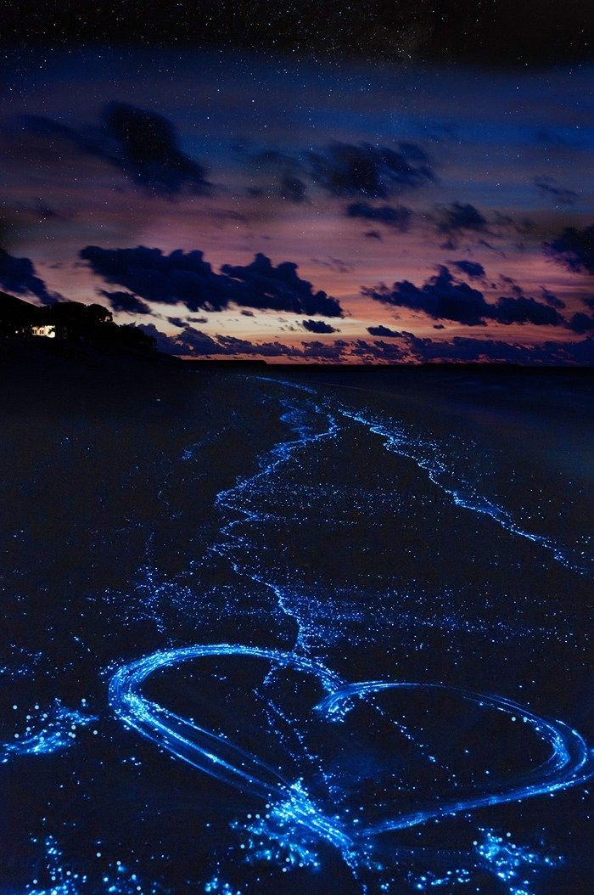
Sea of stars

Slide 28
Sea of stars
The “Sea of Stars” is a beautiful phenomenon that occurs during late summer in the reefs of the Maldives, caused by bioluminescent phytoplankton called Lingulodinium polyedrum. The water here is filled with this plankton, and the movement of the waves causes it to glow, creating an incredible shimmering effect that looks like the sea is full of stars.
Ilona Petryshyn

Slide 29
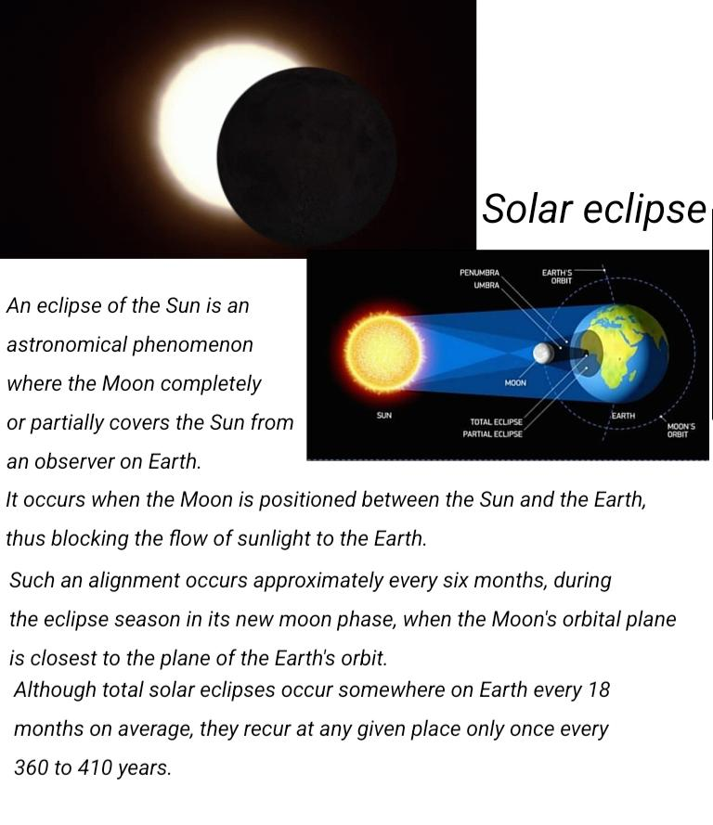
Eclipse of the Sun

Slide 30
Eclipse of the Sun
An eclipse of the Sun is an astronomical phenomenon where the Moon completely or partially covers the Sun from an observer on Earth. It occurs when the Moon is positioned between the Sun and the Earth, thus blocking the flow of sunlight to the Earth. Such an alignment occurs approximately every six months, during the eclipse season in its new moon phase, when the Moon's orbital plane is closest to the plane of the Earth's orbit.
Ivanna Levko

Slide 31
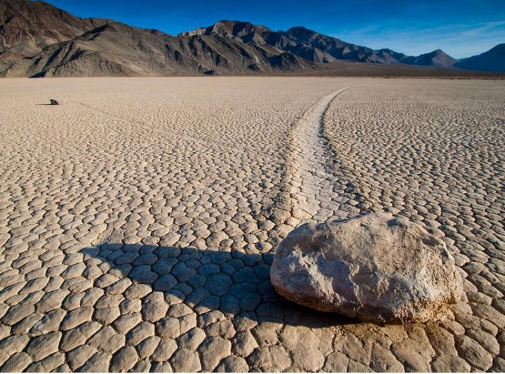
Moving stones

Slide 32
Moving stones
Moving stones — a geological phenomenon discovered on the surface of the high lake Racewreck Playa in Death Valley, USA. The stones move slowly across the clay bottom of the high lake, as evidenced by the long tracks left behind. Stones move on their own without the help of living creatures, but no one has ever seen or recorded the movement on camera.
Andrii Kostrabii

Slide 33
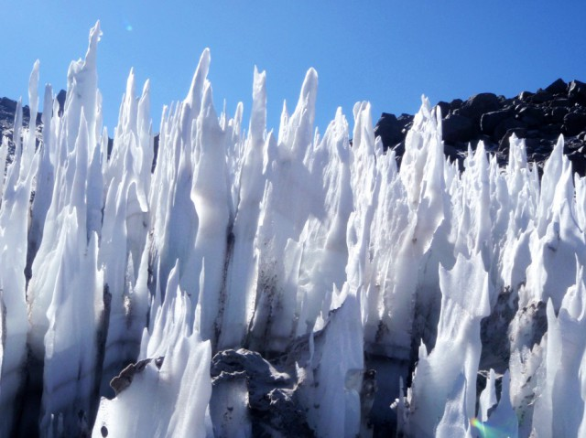
Penitentes

Slide 34
Penitentes
Penitentes are formations of ice and snow, which are tall pillars ranging in height from a few tens of centimeters to more than 2 meters. These formations take the form of tall thin blades of very hard snow or ice pointing towards the sun. Penitentes are usually found in large groups, ranging in size from a few centimeters to two meters, but recently a formation as high as 5 meters has been discovered.
Nazar Romanysyn

