Slide 1
3. Science Department The game “Guess”
(Slide 1).
Look at this table and guess the meaning
of the given words and put the words into categories
of your choice: press, radio, television, the Internet).
Article | 5.Advertisement | 9.Satellite | 13.Comedies
2.Channel | 6.Commercial | 10.Facebook | 14.A live match
3.Edition | 7.Documentary | 11.Radio programme | 15.Mail.ru
4.Tabloid | 8.Prime time | 12.V kontakte | 16.Website

Slide 2
Short debate glossary (Slide 2)
In my opinion…
I believe…
It is quite obvious that…
I would like to say…
Speaking/talking of…
It should be mentioned…
It seems to me that…
Besides, …
I want to add…
I agree/disagree with…
As I see it…
As I understand…
Despite…
I can’t accept…
For example/instance,…
I am sure/certain…
It means…
In summary…
Summing this up…
In support of the fact…
The point is…
I wonder if…
I am convinced ..
I doubt if…

Slide 3
Slide # 3
1- реклама
2- комерційний канал
3-збагачувати
4-канал
5-для того, щоб
6-транслювати
7-наявний
8-фінансований державою
9-мульфільм
10-розповсюджувати
11- бути забороненим
12-кращий ефірний час
13-досягти удачі
14- марнувати час
15- бути залежним від…
1-advertising
2-commercial TV channel
3-enrich
4- channel
5- in order to
6-televise
7-available
8-state – financed
9-animated cartoon
10-spread
11-to be forbidden
12-prime time
13-gain a fortune
14-waste of time
15- be addicted to….

Slide 4












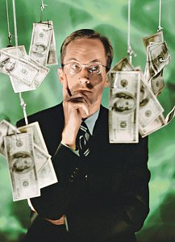

POPULAR TV PROGRAMMES

Slide 5

A GAME SHOW

Slide 6
A CHAT SHOW

Slide 7

REALITY SHOW

Slide 8
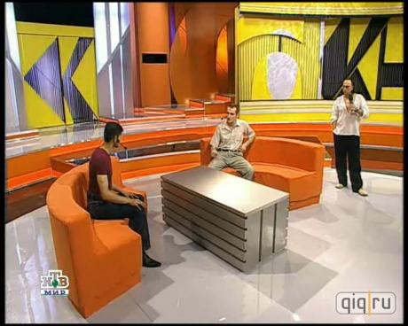
TALK SHOWS

Slide 9

A LIVE MATCH

Slide 10

A SITCOM

Slide 11
SERIAL

Slide 12

A NEWS PROGRAMME

Slide 13

CHILDREN’S PROGRAMME

Slide 14

CARTOONS

Slide 15

THRILLERS

Slide 16

TV DRAMA

Slide 17

HISTORIC EPIC FILMS

Slide 18
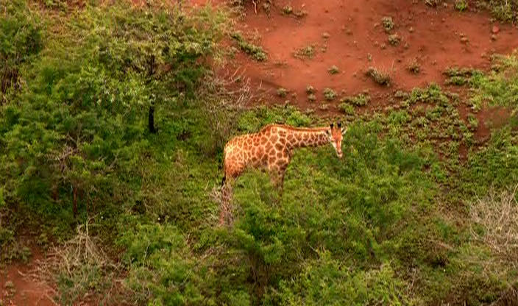
WILD LIFE FILMS

