Slide 1


Slide 2
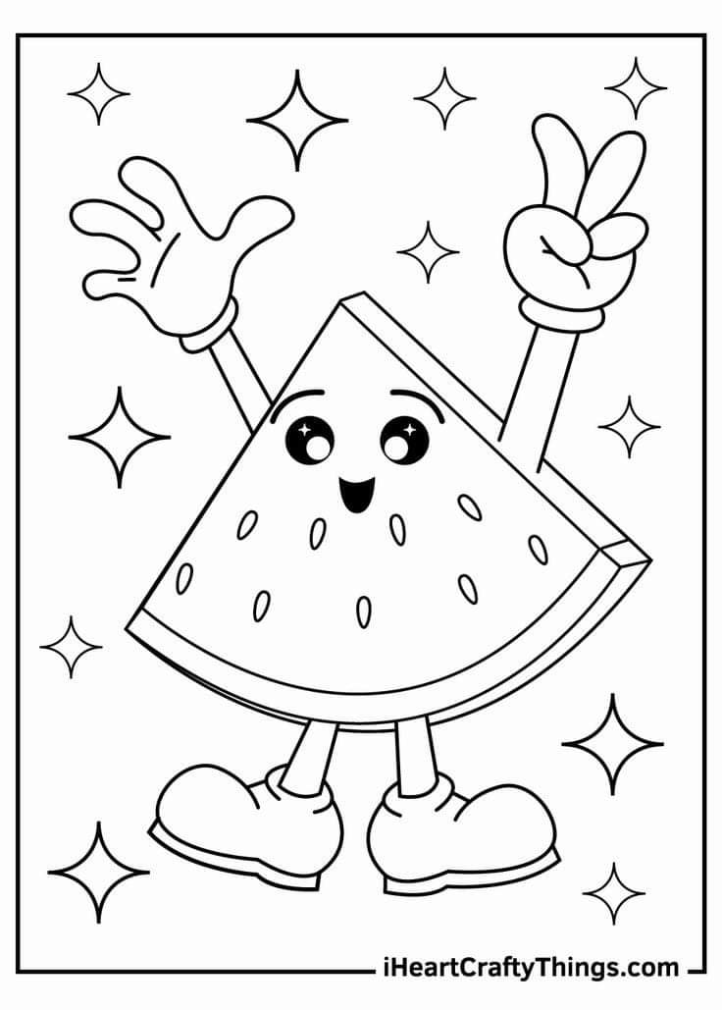
TODAY WE WILL
Play
Sing
Read
Draw
Listen

Slide 3
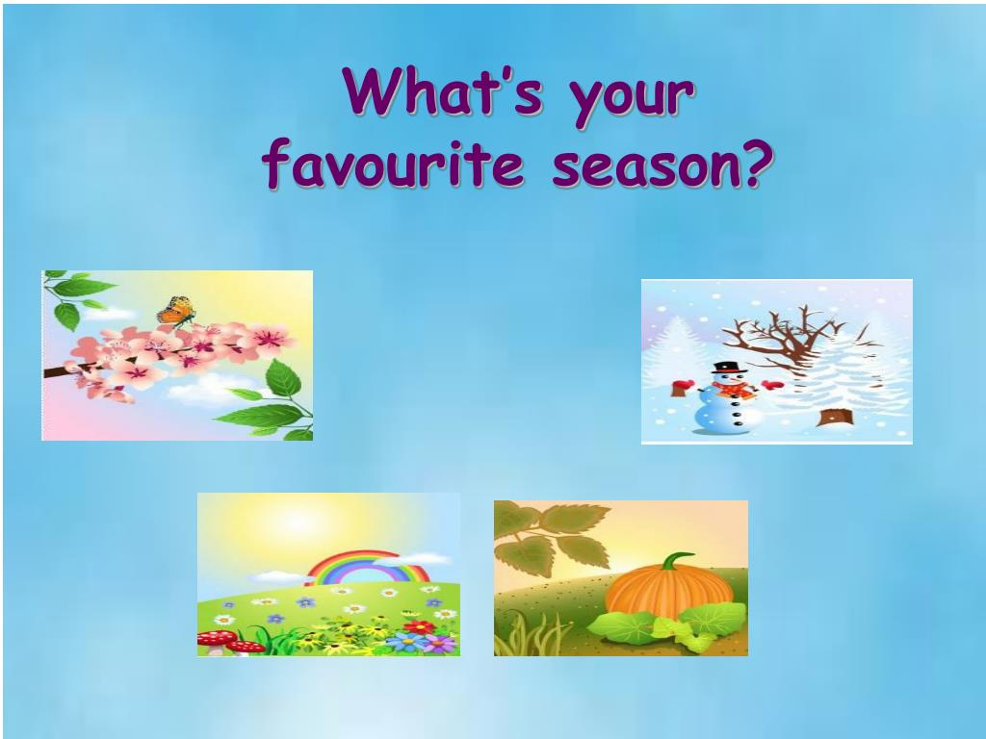

Slide 4
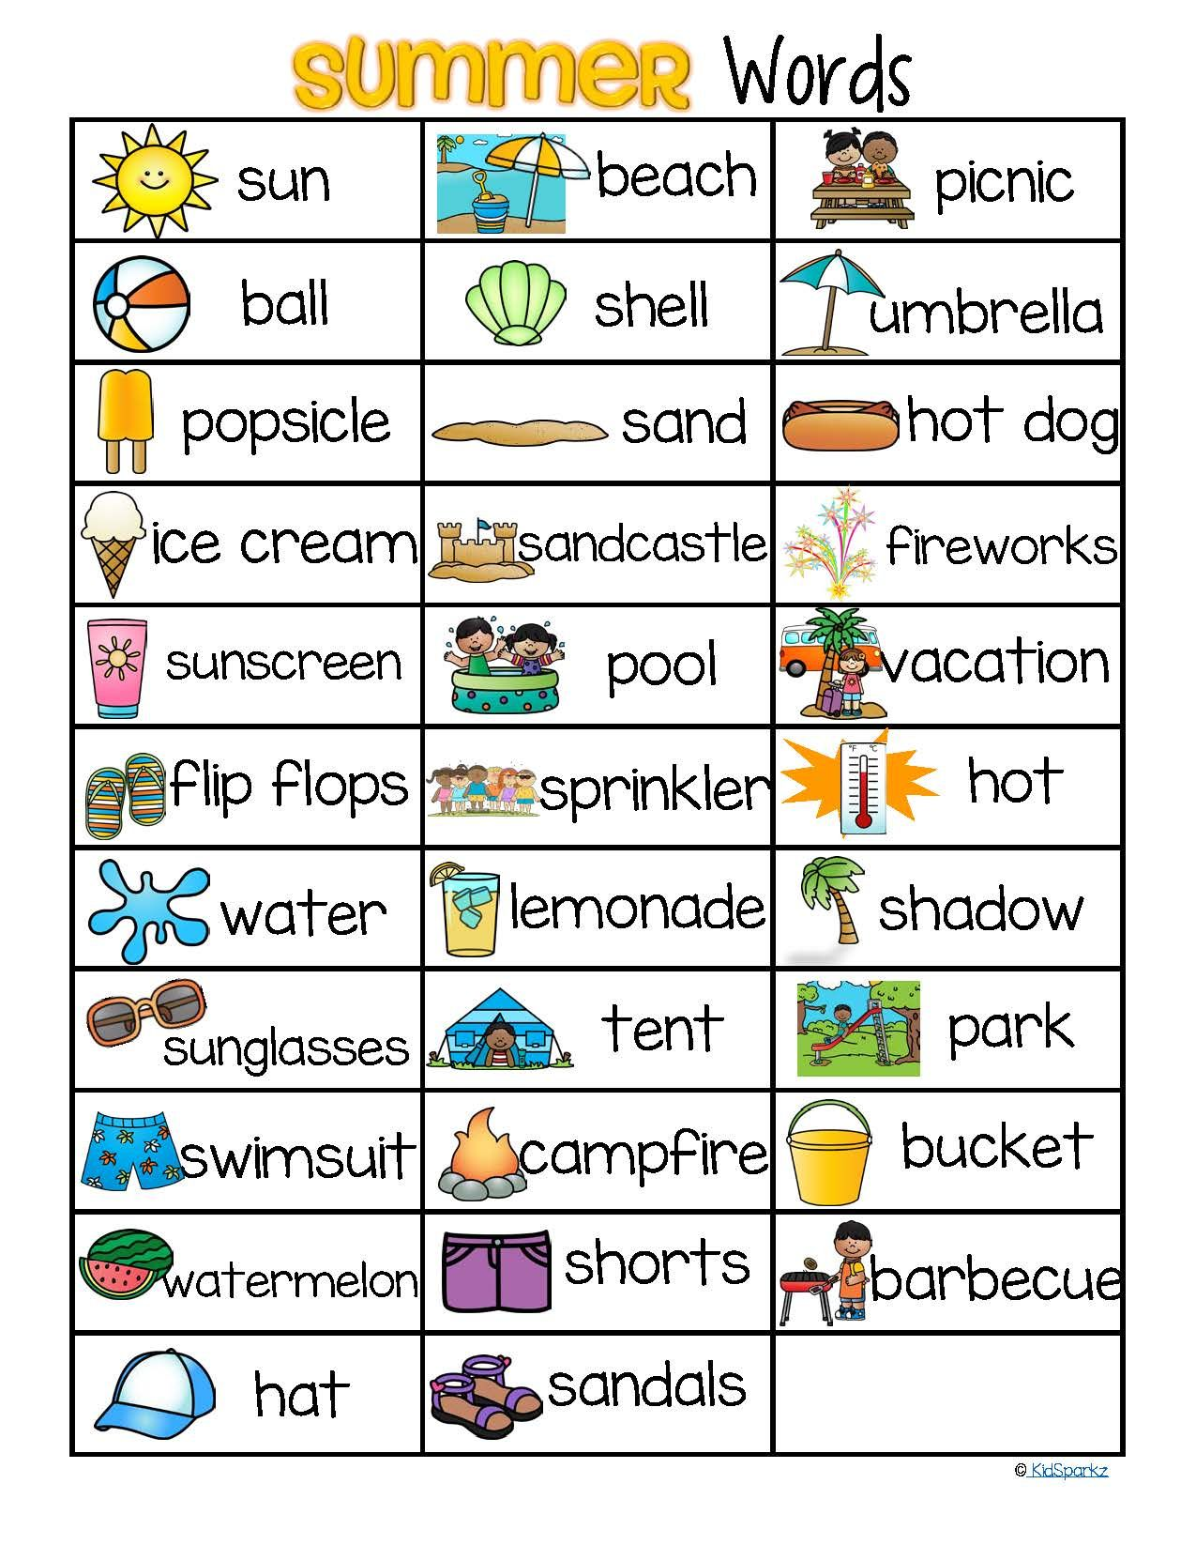
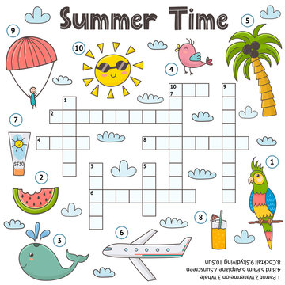

Slide 5
LET’S SING!

Slide 6
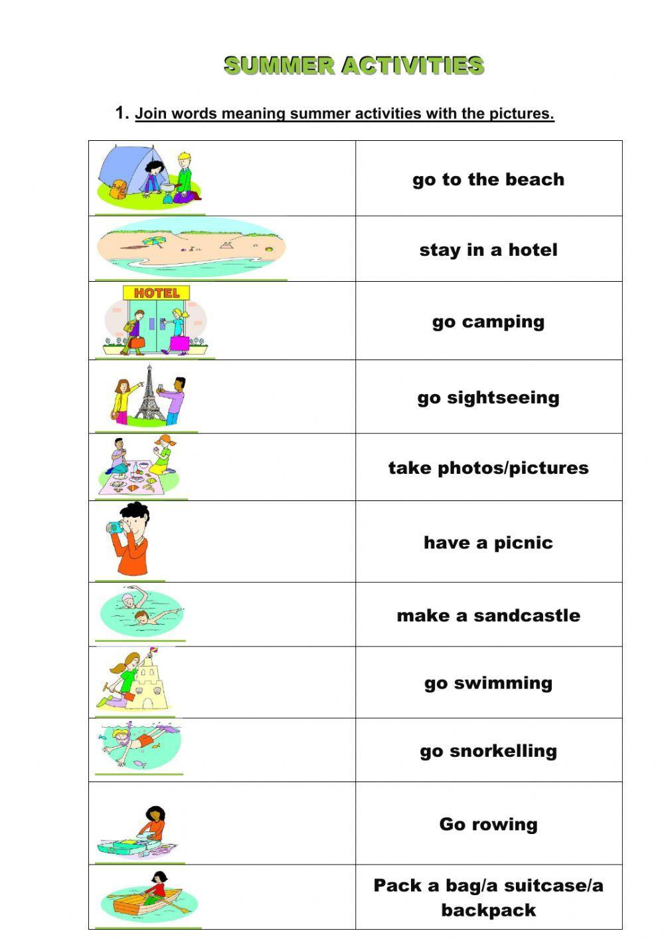
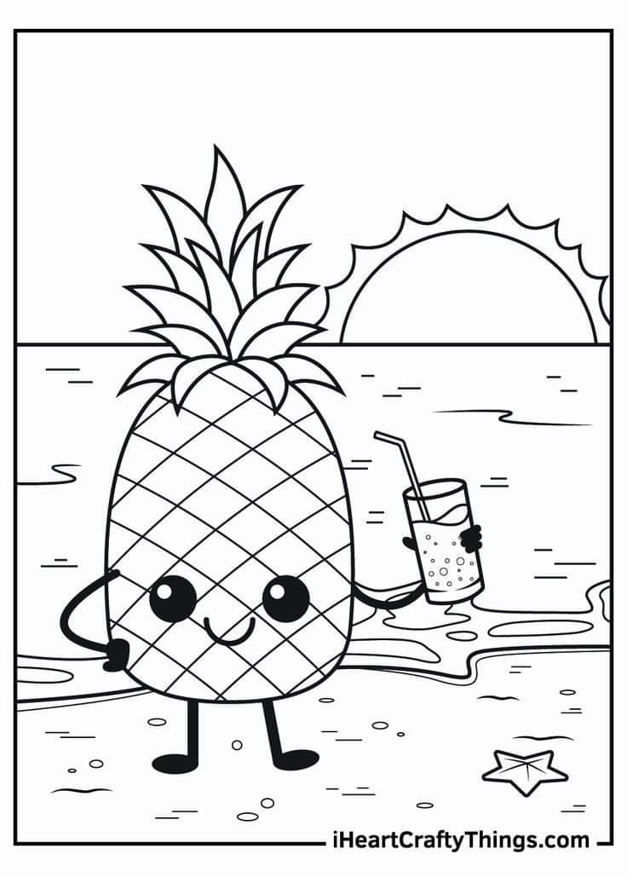
Summer activities

Slide 7
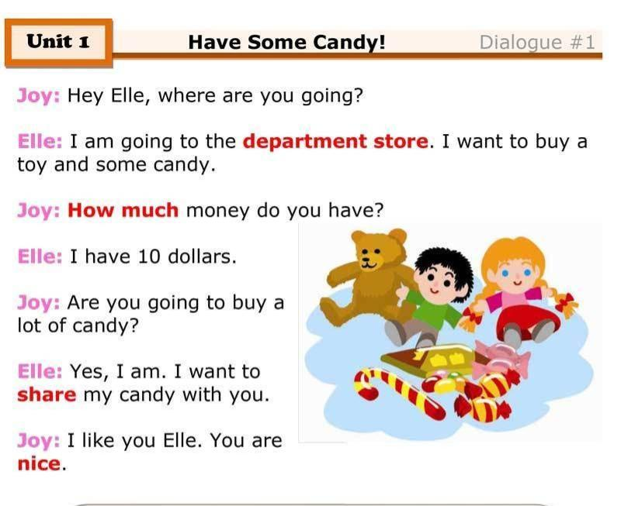

Slide 8
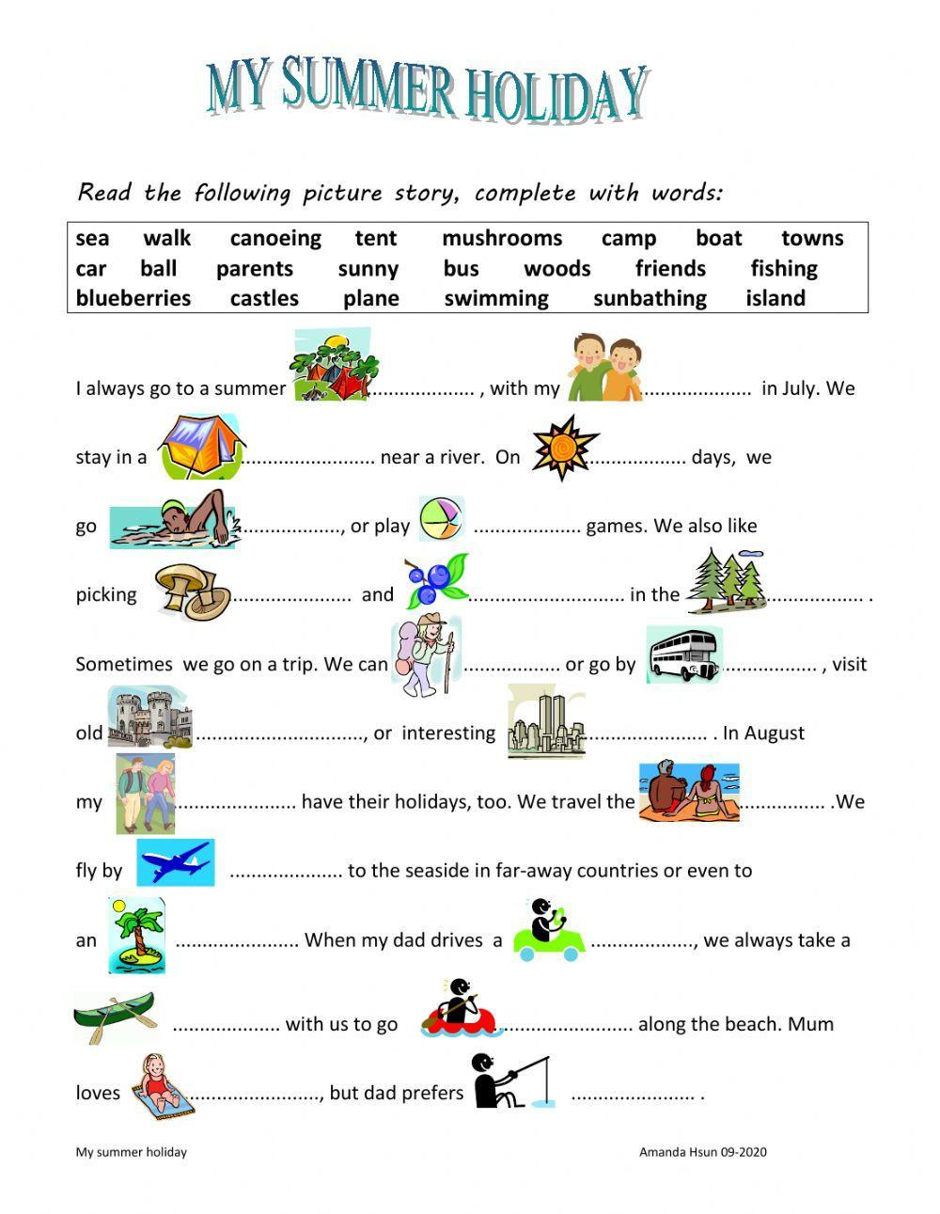

Slide 9
LET’S PLAY!

Slide 10
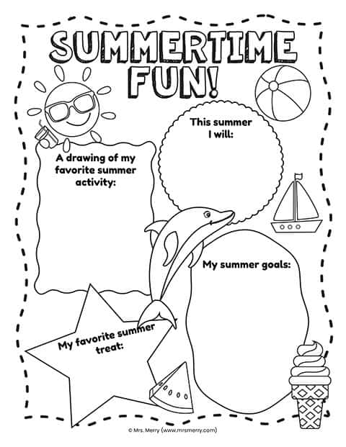
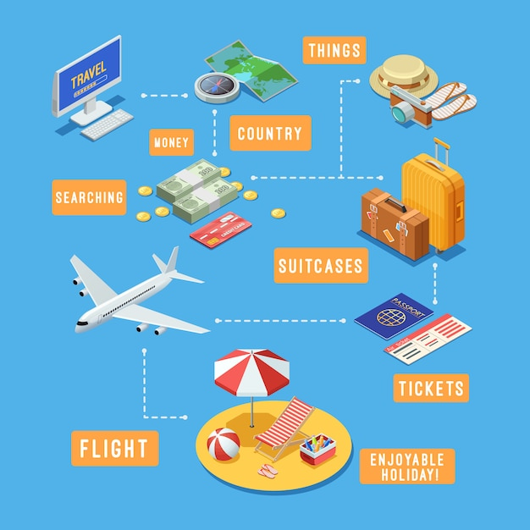
MY SUMMER PLANS

Slide 11

HAPPY HOLIDAYS!

