Slide 1

Colours

Slide 2

Blue

Slide 3

Red

Slide 4

Yellow

Slide 5

Green

Slide 6
Black

Slide 7
Brown

Slide 8
Pink

Slide 9
Orange

Slide 10

Blue

Slide 11


Red

Slide 12


Yellow

Slide 13


Green

Slide 14


Black

Slide 15


Brown

Slide 16

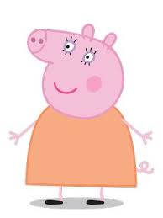
Pink

Slide 17


Orange

Slide 18

Numbers
https://www.youtube.com/watch?v=vn7bx2_XIiw

Slide 19


Five
Four
Three
Two
One

Slide 20
1
2
3
4

