Slide 1


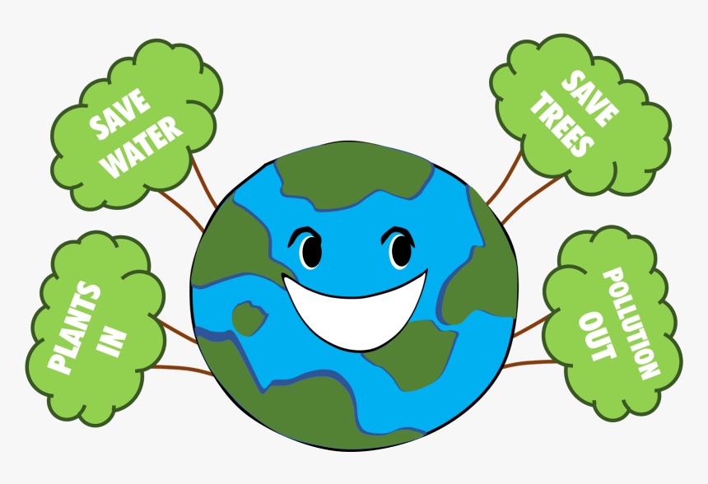
Be clean and be green!
The motto of the lesson:

Slide 2

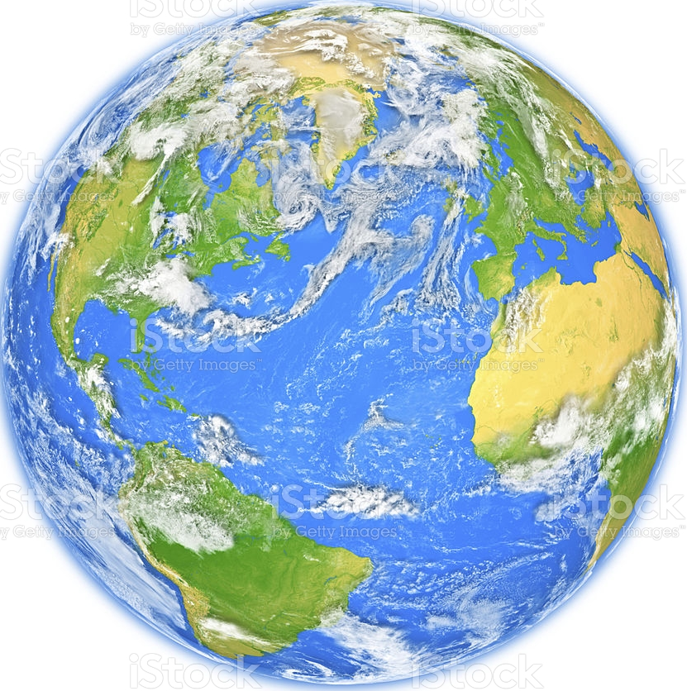
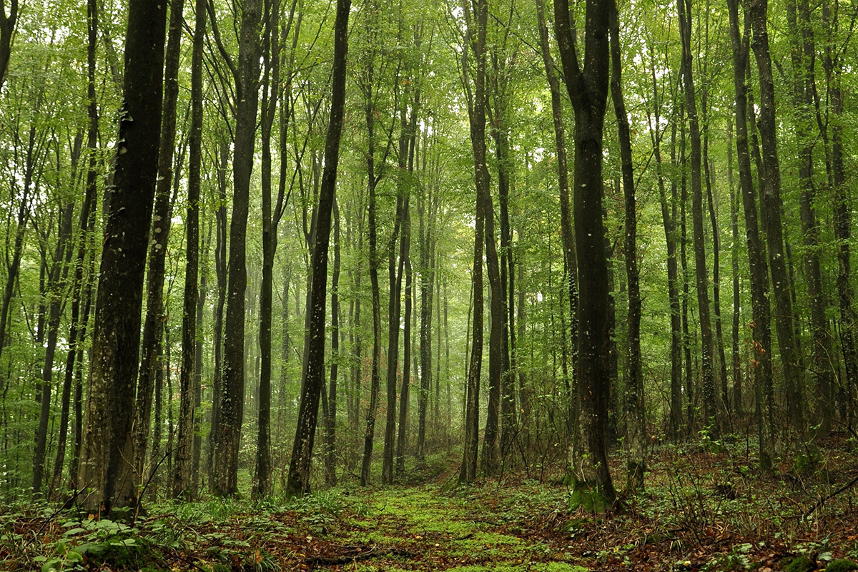
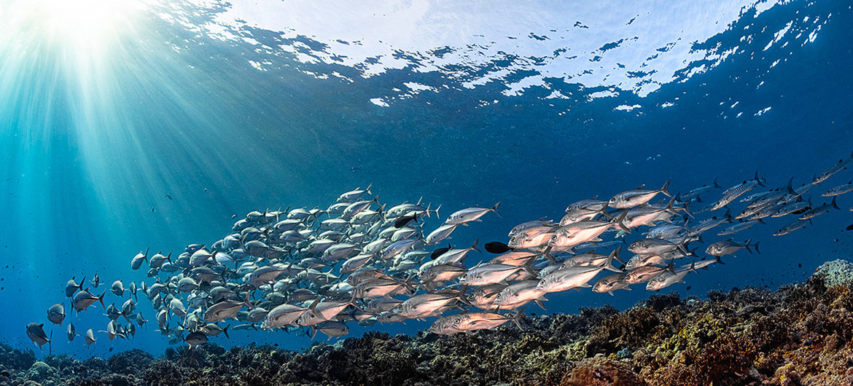
Forests are green,
Oceans are blue.
Keep the Earth clean
For me and you!

Slide 3


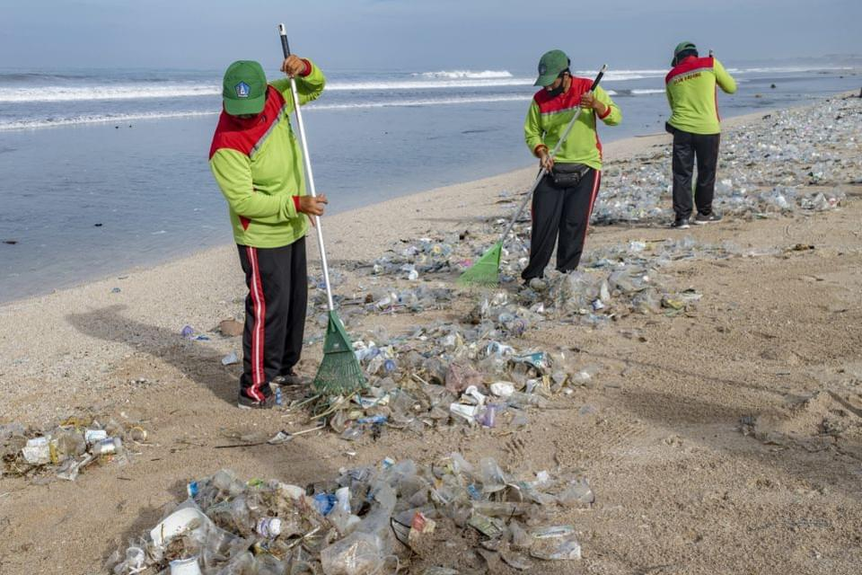

They are________.Yes, they are./No, they aren’t. working having a picnic cooking planting trees sleeping

Slide 4
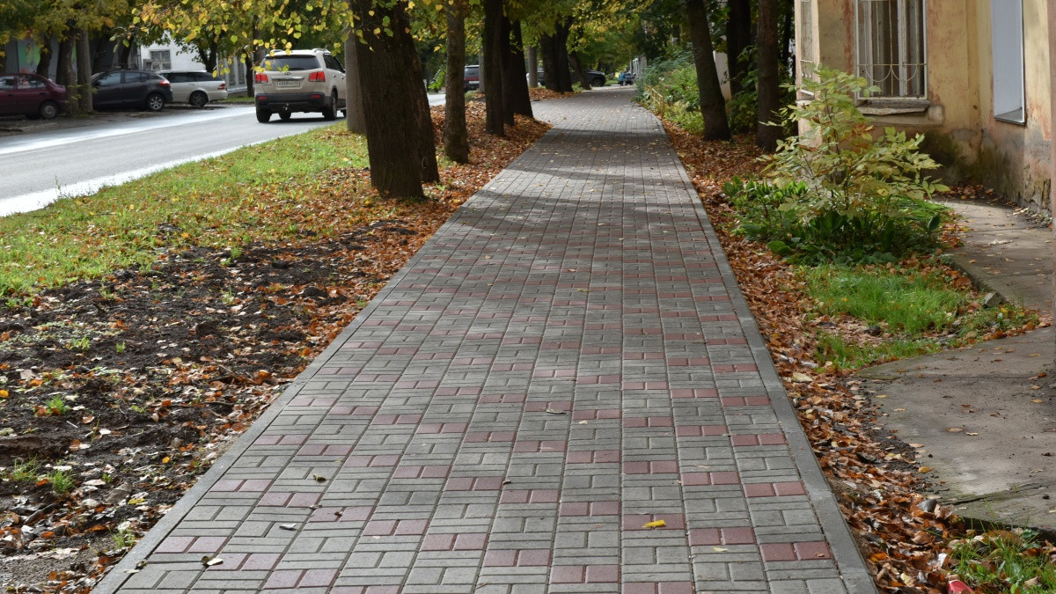
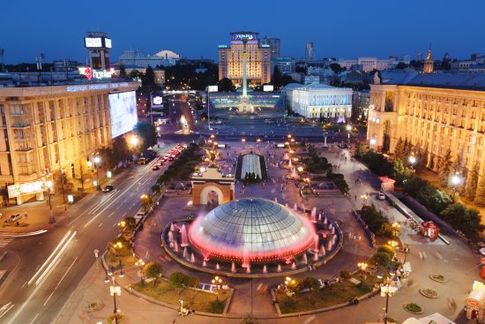
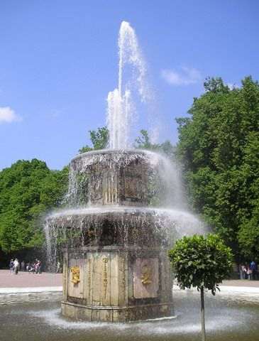
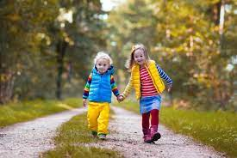
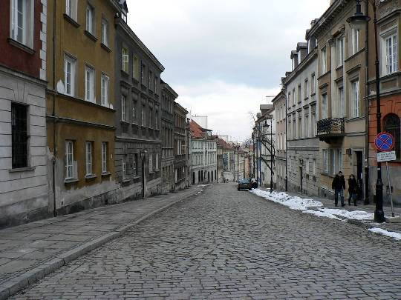



Listen, repeat and learn
bin
fountain
sign
street
town centre
walk
pavement

Slide 5
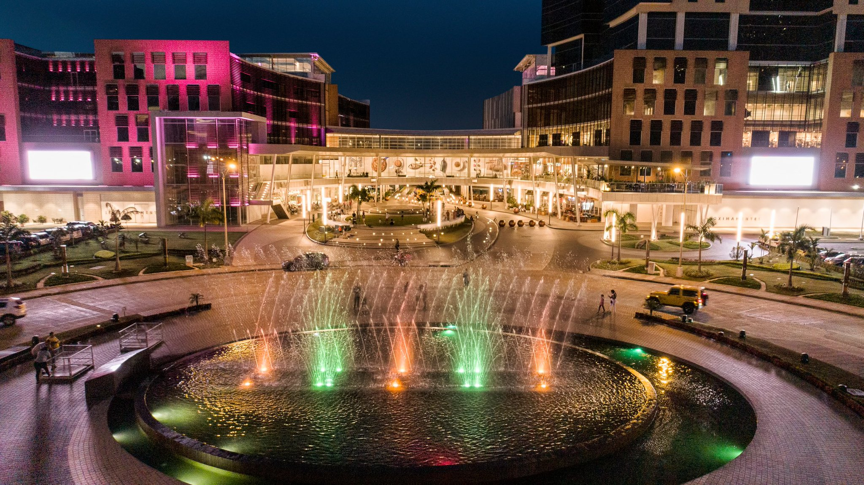
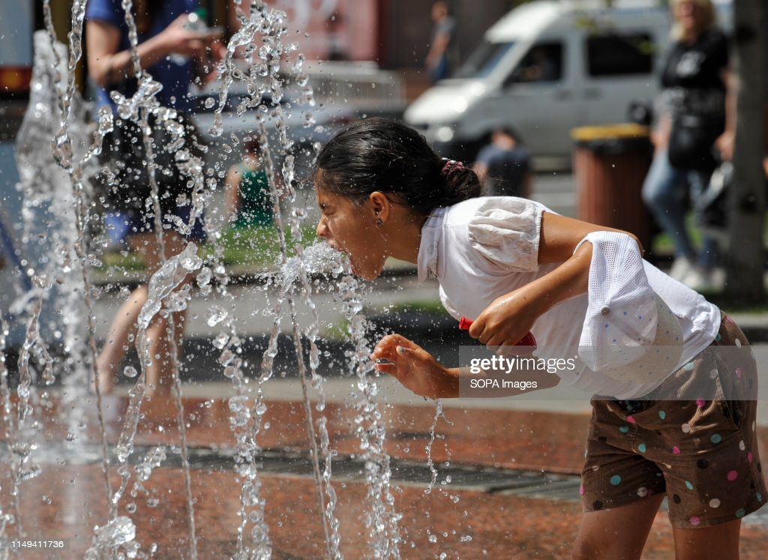

SB Exercise 2 page 120
Listen and read.11.2
We went to the town centre yesterday.
It was sunny. We played in the fountain.
We had lots of fun.

