Slide 1
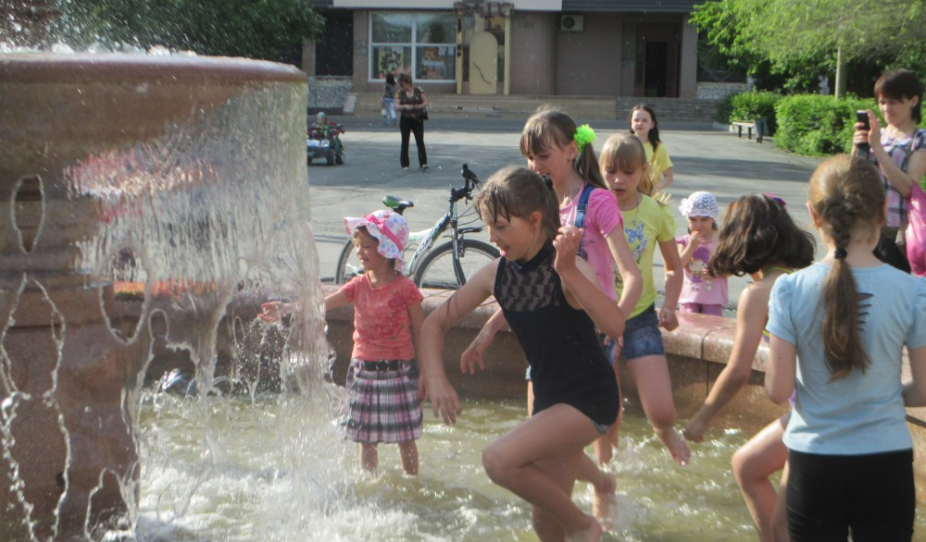
SB Exercise 3, page 120
Look and read. Write Yes or No.
The children are playing in a fountain.
There’s a sign in the photo. It says, “No Jumping”.
They’re walking in the street.
They’re wet.
Yes.
No.
No.
Yes.

Slide 2
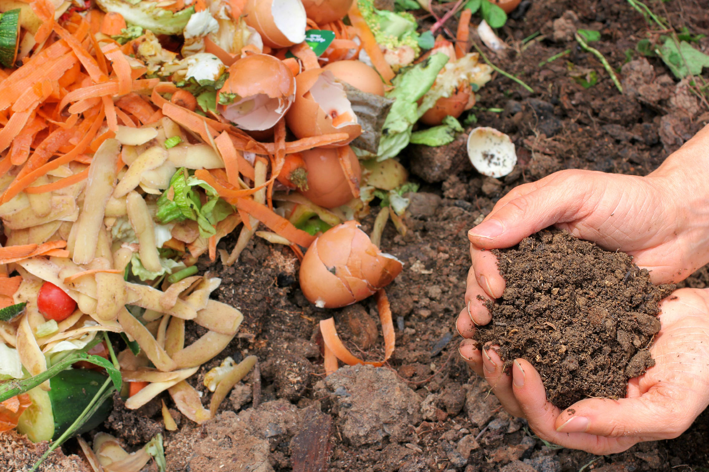
Compost-це багаті поживними речовинами «ЗЕЛЕНІ» відходи.

Slide 3
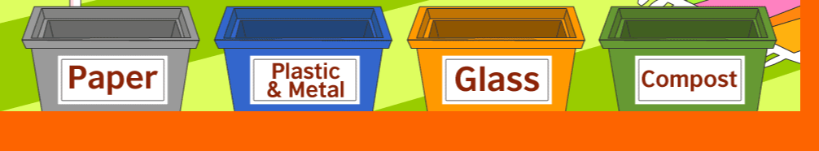
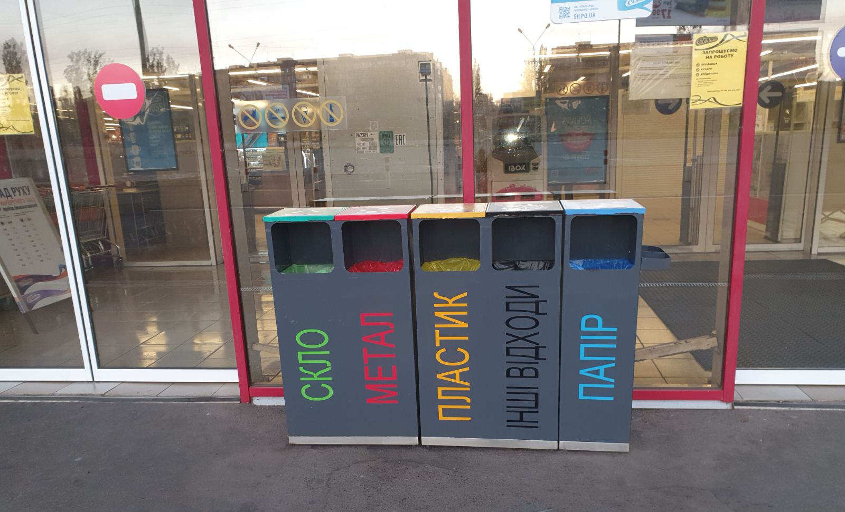

Slide 4
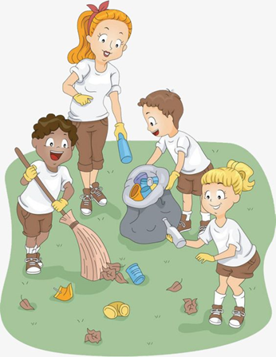


Slide 5
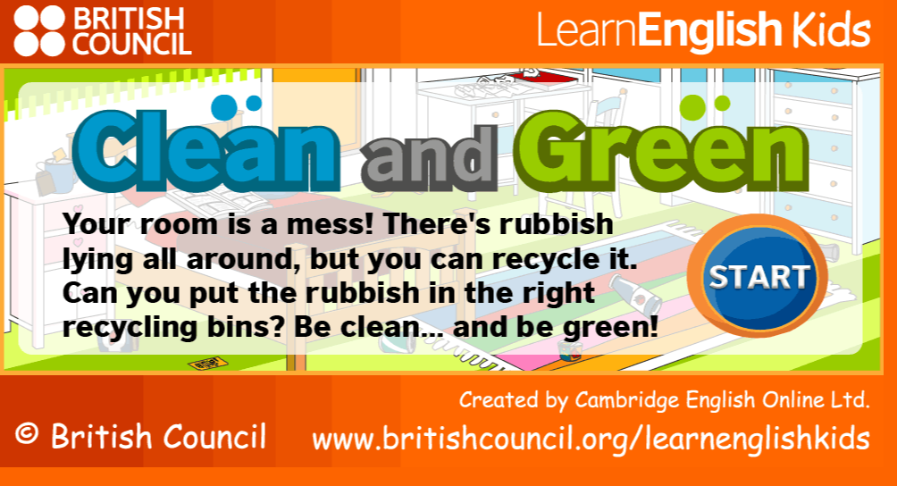
Homework
SB page 120
WB Ex 1, 2 p 84
Game
Wordwall
Test
https://1c7951e0f713f82c10d3-9c5e6fbd2c9d828eb37b6bf0399bddd6.ssl.cf1.rackcdn.com/clean-green/index.html
https://wordwall.net/uk/resource/25143551/keep-it-clean-wonderful-world-2-sb-p-120

